Slide 1
Virtual Threads in Java - A Primer
Notes:
In this workshop, we will explore the intricacies of Java virtual threads, a revolutionary feature in modern Java development aimed at simplifying concurrency and improving performance. Unlike typical discussions that focus on how to use virtual threads, this session will take a deep dive into the internals of the Java runtime, shedding light on what happens under the hood when you work with virtual threads.
We will start by examining the traditional thread model in Java and its limitations, setting the stage for understanding the motivations behind the introduction of virtual threads. We will dissect the core design decisions that the Java development team made to enable virtual threads to scale effortlessly, providing lightweight concurrency while maintaining the familiar Java threading model. Netflix Zuul (API Gateway), Netflix Eureka (for service discovery), Netflix Ribbon (for load balancing), and Netflix Hystrix (fault tolerance) Performance overhead, security concerns, testing complexity, latency, error handling

Slide 2
Rules of Engagement
Every information is public
https://github.com/openjdk/jdk
https://dev.java/
https://inside.java/
https://jdk.java.net/loom/
No question is stupid
... but could be early or out of syllabus
Download JDK - https://jdk.java.net/archive/
Source - https://github.com/ram-bgl/virtualthread

Slide 3
JDK 1.0 Green Threads
User-level threads
Allowed for portability
Independent scheduling
Cannot utilize multi-core processors
Blocking I/O
Notes:
OS sees only one thread

Slide 4
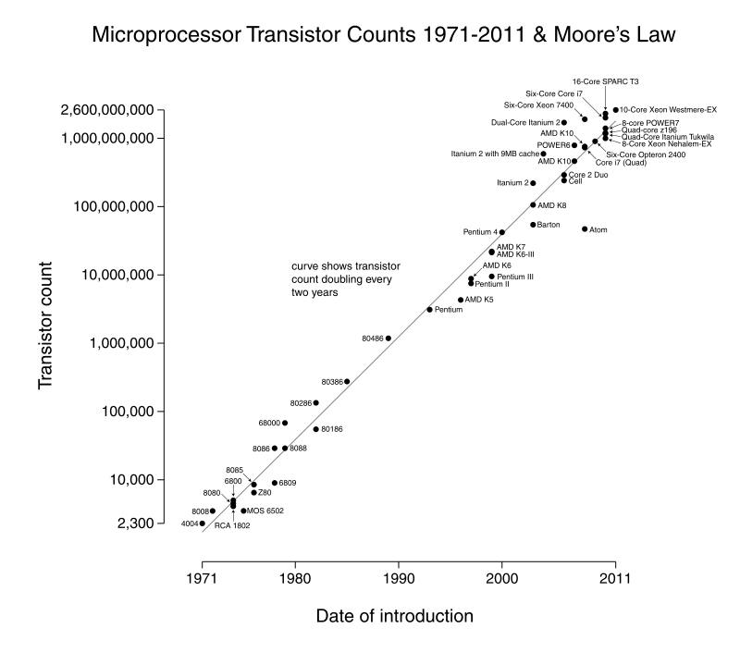
Moore’s Law
By Max Roser, Hannah Ritchie - https://ourworldindata.org/uploads/2020/11/Transistor-Count-over-time.png, CC BY 4.0, https://commons.wikimedia.org/w/index.php?curid=98219918
Notes:
The proliferation of multi-core processors made Java to drop green threads

Slide 5
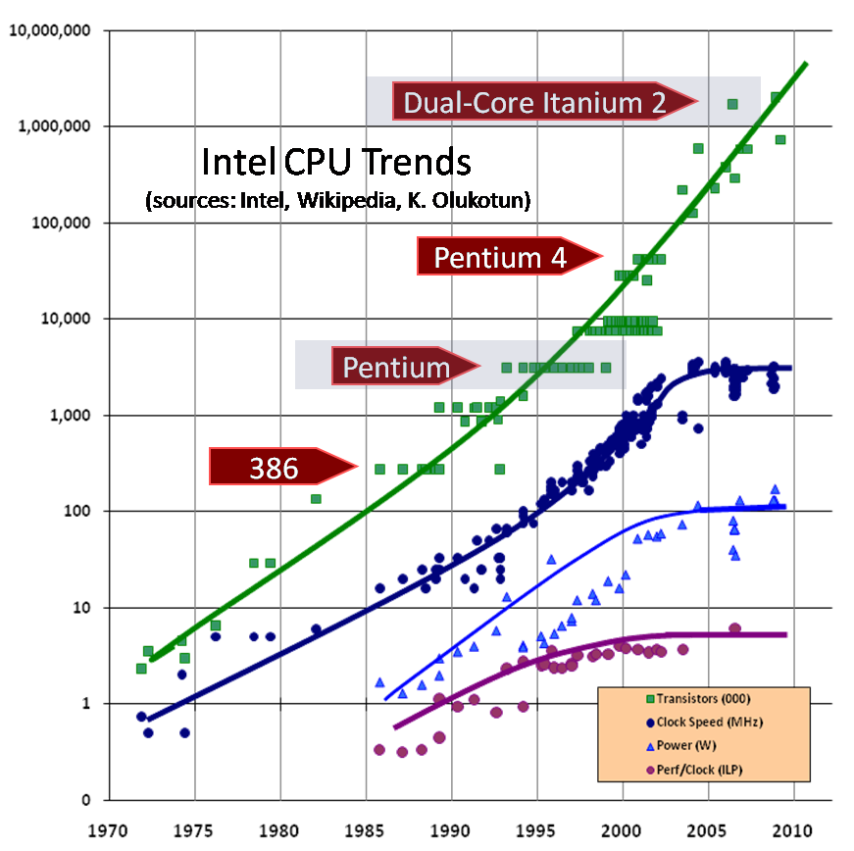
Free Lunch is over (H. Stutter)
By Herb Stutter, The Free Lunch Is Over A Fundamental Turn Toward Concurrency in Software
Notes:
Moore’s law - Doubles every 18 months

Slide 6
JDK 1.2 (Java Thread <-> OS Thread
Move from n:1 to 1:1 mapping
Simpler code
Leveraging multi-core processors

Slide 7
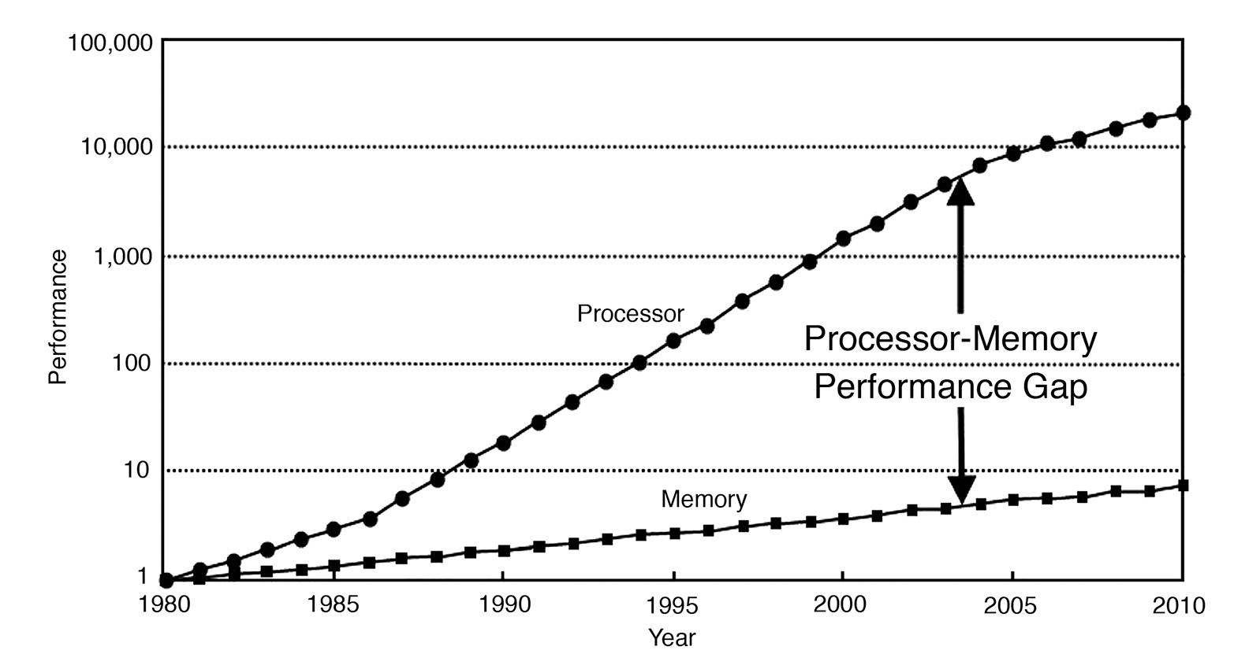
Processor - Memory
By Hennessey and Patterson
Notes:
Main memory is accessed over the Northbridge component, and it is traversing this bus that causes the large drop-off in access time to main memory.
cat /sys/devices/system/cpu/cpu0/cache/index0/coherency_line_size
sysctl -a | grep cacheline
REST API, DB, Files

Slide 8
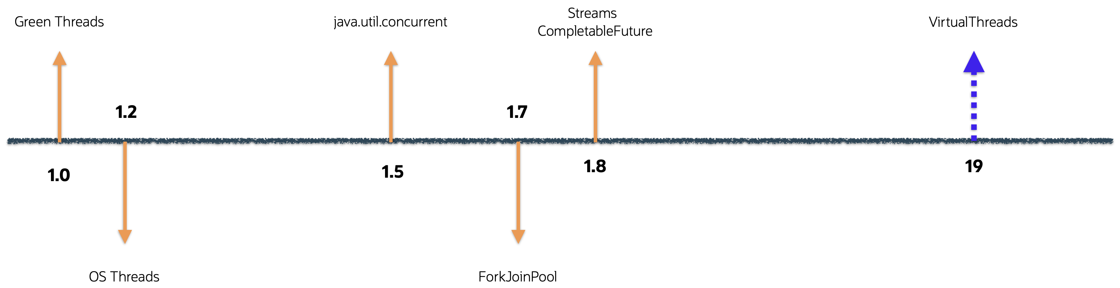
Evolution of JDK
Notes:
1.0 - 1996
1.5 - 2004
1.8 - 2014
21 - 2023

Slide 9
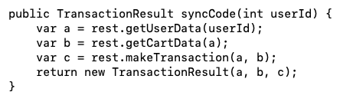
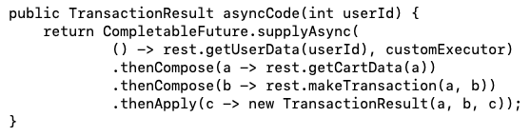

Evolution of Programming Style
SYNC
ASYNC
simple
harmonious w/ the platform
less scalable
scalable,
viral/non-interoperable,
hard to debug/profile
Programmer 😄 Hardware 😤
Programmer 😤 Hardware 😄
Notes:
There are 2 popular styles – sync n async
synchronous code follows thread per task model. It is simple to write and debug which makes developers happy. however it does not scale well. Whenever we create java.lang.Thread, JVM creates a corresponding new kernel thread. Due to various reasons, OS doesn’t allow creation of large number of kernel threads. So, concurrent programs hit scalability limitations due to threads much before other resources such as CPU, memory, n/w connections do so.
On a side note, JVM specification never mandates that thread be implemented with this 1to1 model.
Coming to asynchronous code..
It scales very well as the tasks are severed to bare minimum in order to exploit cpu as much as possible. However, this code doesn't compose well and is hard to write and debug.
So we end up in a situation where either programmer or the hardware is happy.
Demo: Show OOM when platform thread scales
~/Tools/jdk/openjdk-21.0.2/Contents/Home/bin/java -cp /Users/rsunderb/Tools/IdeaProjects/TestCode/out/production/TestCode javafest.MaxThreads 1000

Slide 10
Parallelism/Concurrency
Independent tasks Compete
Split sub-tasks
Co-operate
Latency
Throughput
Notes:
Latency – time unit
Throughput – tasks per time unit

Slide 11

Little’ Law
L = λW
W — latency
λ — throughput
L — concurrency
Notes:
Theoretical motivation behind this effort.

Slide 12
Project Loom
Virtual Thread
Enables high-scalable server applications
Adopt Virtual Thread with minimal code change
Easy troubleshooting
JEP 425,436,444
Structured Concurrency
Eliminate thread leaks
Reduce cancellation delays
Improve observability
JEP 428,437,453
Notes:
Project Loom was created to address these concerns. It is intended
to significantly reduce the difficulty of writing efficient concurrent applications,
to eliminate the tradeoff between simplicity and efficiency.
Loom consists of 2 major parts, VT n SC.
With VT, the goal is
to enable high scalable server applications
to do so without much change to the existing code
or without making it difficult to troubleshoot problems
With SC, we are trying to promote a programming style that
eliminates thread leaks
reduces cancellation delays
improve observability

Slide 13
Virtual Threads
Property | Platform Thread | Virtual Thread
Stack Size | 1MB | Pay as you go stack
Meta Data | >2KB | 200-300B
Switching Time | >1µs | ~200ns
Platform
Virtual
Green
Mount
UnMount
Notes:
so, what is virtual thread? As the name suggests, it is very similar to virtual memory. With vm we are able to conceptually use more memory than might be physically available, using the technique of paging or segmentation. In the same way, with vt, we are able to conceptually create more threads aka user mode threads than might be possible with kernel threads. VTs are light-weight. They have considerably less meta data and pay as you go stack. There is significant improvement with context switching times also.
When VT needs to run, it is mounted on a carrier thread or platform thread. When the task in the VT is suspended or blocked, VT is unmounted and the carrier thread is now free to carry other VTs.

Slide 14
Virtual Thread
Virtual Thread Tasks
3
4
5
6
7
8
mount
ForkJoinPool Queue
unmount
1
Platform Thread
OS Thread
Carrier Thread
mount
2

Slide 15
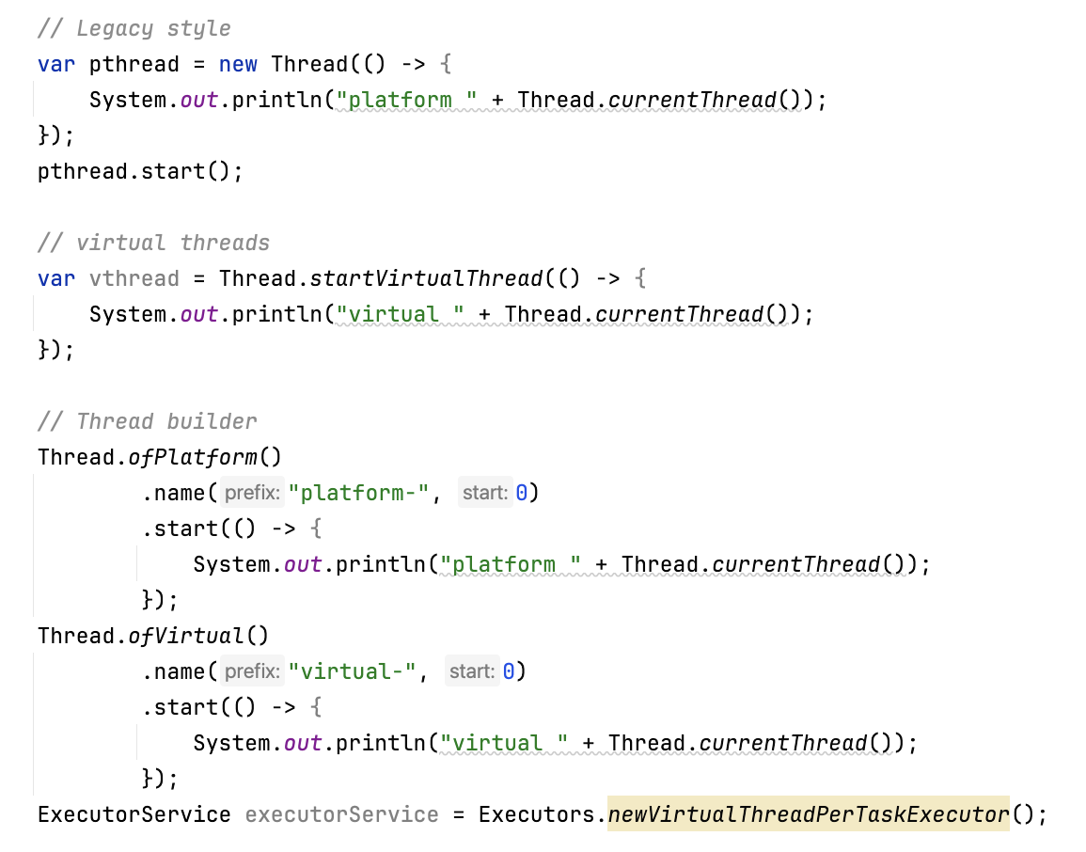
API
Notes:
VT is also a Thread, API will little change. https://openjdk.org/jeps/444 Goals
Demo: Show VT can scale
Show the memory allocation difference
~/Tools/jdk/openjdk-21.0.2/Contents/Home/bin/java -cp /Users/rsunderb/Tools/IdeaProjects/TestCode/out/production/TestCode -XX:NativeMemoryTracking=summary javafest.MaxThreads
Game of life
The application that I am showing you is written by Elliot Barlas to demonstrate the power of VT. This application is a java implementation of "Game of Life", a zero player game invented by Conway. We will have a pattern to start with and based on the game's rule, evolution of patterns happens. In the implementation we have one virtual thread spawned per cell.
cd /Users/rsunderb/repo/game-of-life-csp
export PATH=/Users/rsunderb/Tools/jdk/jdk-21.0.2b13/Contents/Home/bin:$PATH
java -cp build/ gameoflife.Main patterns/puffer_train.txt 1600 800 0 235 91 10 91 true true
export PATH=/Users/rsunderb/Tools/jdk/jdk-21.0.2b13/Contents/Home/bin:$PATH
jcmd 32003 Thread.dump_to_file -format=json -overwrite ~/Downloads/dump.json
grep "Cell\.run" ~/Downloads/dump.json| wc -l
grep "VirtualThread\.park" ~/Downloads/dump.json| wc -l

Slide 16
Jacking up the JDK
1,133 changed files with 95,870 additions and 8,270 deletions.
Java 13
JEP 353 Reimplement the Legacy Socket API
Java 15
JEP 373 Reimplement the Legacy DatagramSocket API
JEP 374 Deprecate and Disable Biased Locking
Java 18
JEP 416 Reimplement Core Reflection with Method Handles
Notes:
https://bugs.openjdk.org/browse/JDK-8284161
https://github.com/openjdk/jdk/commit/9583e3657e43cc1c6f2101a64534564db2a9bd84
1,133 changed files with 95,870 additions and 8,270 deletions.
Authored by who's who

Slide 17
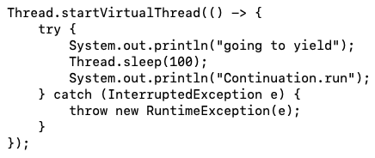
Under the hood - Continuation
More specifically delimited continuation
Continuation.yield
Continuation.run
https://github.com/openjdk/jdk/blob/master/src/java.base/share/classes/java/lang/Thread.java
Notes:
a continuation is an abstract representation of the control state of a computer program. A continuation implements (reifies) the program control state, i.e. the continuation is a data structure that represents the computational process at a given point in the process's execution; the created data structure can be accessed by the programming language, instead of being hidden in the runtime environment.
a delimited continuation, composable continuation or partial continuation, is a "slice" of a continuation frame that has been reified into a function.
~/Tools/jdk/openjdk-21.0.2/Contents/Home/bin/java --add-exports java.base/jdk.internal.vm=ALL-UNNAMED /Users/rsunderb/Tools/IdeaProjects/TestCode/src/javafest/ContinuationYield.java

Slide 18
Continuation contd…
HEAP
HEAP
HEAP
PT1
PT2
PT1
PT2
PT1
PT2
Continuation.run
Continuation.yield

Slide 19
Hands-on
Let’s see how VTs respond to I/O bound and CPU bound tasks.
Notes:
i/o
cpu
locks

Slide 20
Virtual Thread pinning
VT cannot be unmounted during blocking operations because it is pinned to its carrier:
When it executes code inside a synchronized block or method, or
When it executes a native method or a foreign function.
Detection
-Djdk.tracePinnedThreads=full/short
JFR event - jdk.VirtualThreadPinned
Notes:
Foreign function - https://openjdk.java.net/jeps/424

Slide 21

Deadlock
VT1 blocks while fetching data
VT2 waits for data arrival notification from VT1
VT2 is inside synchronized block, so VT2 is pinned
VT1 gets the data, but cannot mount because VT2 is pinned
PT
VT2
VT1
Notes:
Let’s write a deadlock
ReentrantLockDeadLock
VT will pin even when carrier thread is trying to get the monitor held by another carrier thread
Run experiment with locks() and try to fix it
~/Tools/jdk/openjdk-21.0.2/Contents/Home/bin/java -cp /Users/rsunderb/Tools/IdeaProjects/TestCode/out/production/TestCode -XX:StartFlightRecording javafest.ReentrantLockDeadLock false
Java serviceability component cannot report the deadlock, need to use jcmd <pid> Thread.dump_to_file -format=json -overwrite ~/Downloads/dump.json

Slide 22
Migration Challenges - Old Habits die hard
Forget thread is a resource
Thread pool => thread per task
Find(platform).replace(virtual) ❌ - Virtual threads are not faster than platform threads
Rate limiting using semaphores
Simple blocking I/O
Don’t cache in ThreadLocals
Avoid pinning (synchronized ❌ ReentrantLock ✅)
Lack of fairness
Prepare of extra memory
Notes:
We need a mental model shift for the adoption. While implementing concurrent tasks, we need to stop thinking in terms of threads and start thinking in terms of domain tasks.
Since VT is cheap, there is no point in pooling them. Just create a new thread per task.
We need to be careful in adoption though, don't go about replacing all the threads in the projects with VTs. In the end, VTs are not inherently faster in execution than PTs, as we saw VT is carried by PT .
Thread limits used to act as a natural rate limiter when it comes to accessing scarce resources like database connections. With VT we are unhinged in terms of thread creation, which means we have to explicitly do rate limiting, possibly with semaphores.
All the multi-threading dos and don’ts still apply - prefer immutable objects, avoid sharing objects among threads, avoid mutating states. - all the lessons are still relevant.
ThreadLocals need memory created per thread. If we use thread locals in conjunction with VTs, we would end up utilising lot of memory. There is a new feature called ScopedValue introduced in project loom that will serve as an alternate to ThreadLocal.
There are situations when JVM is unable to unmount VT from its career thread despite the code gets blocking, this is called pinning. For example, while running native code.
ForkJoinPool scheduler is the one that takes care of scheduling VTs. We must understand that it is not as powerful as a kernel scheduler. It cannot preempt a computation intensive task and hence lack fairness.
Now I would defer to Jayashree to show how SC is getting introduced in java.

Slide 23
My Thread pins… 😩
Avoid pinning by using ReentrantLock instead of synchronized
OLD code and library code are difficult to fix
https://quarkus.io/guides/virtual-threads
<dependency> <groupId>io.quarkus.junit5</groupId> <artifactId>junit5-virtual-threads</artifactId> <scope>test</scope> </dependency>
Junit5 extension - https://github.com/cescoffier/loom-unit/tree/main
@ShouldNotPin @ShouldPin
War story – NetFlix, Dude Where’s my lock
JEP 491: Synchronize Virtual Threads without Pinning
Notes:
@ShouldNotPin annotation
https://netflixtechblog.com/java-21-virtual-threads-dude-wheres-my-lock-3052540e231d

Slide 24
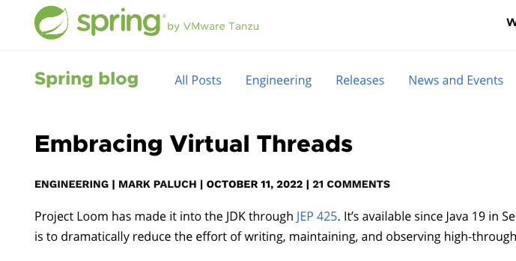
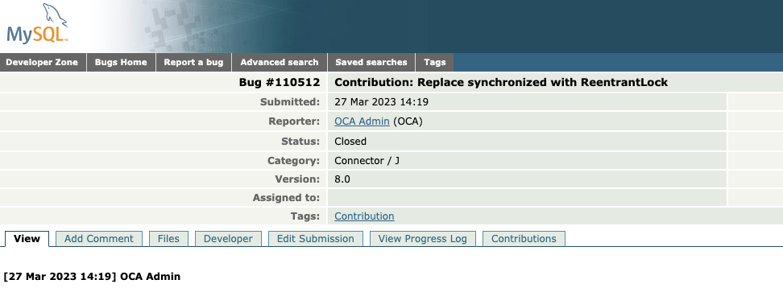
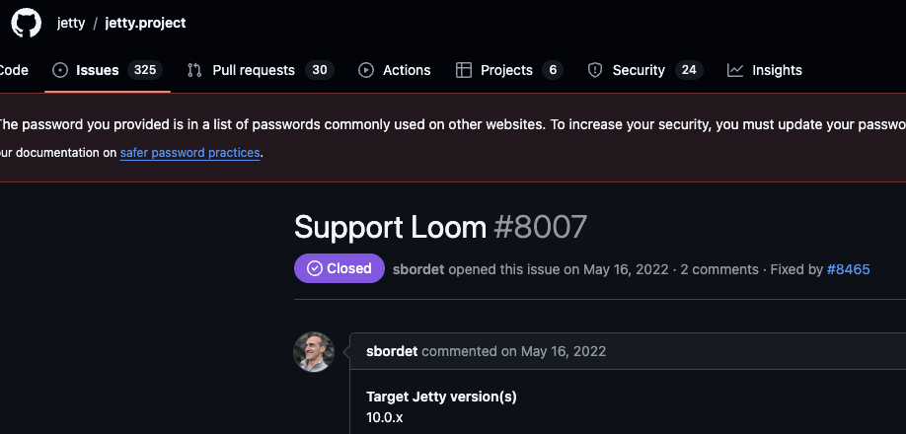
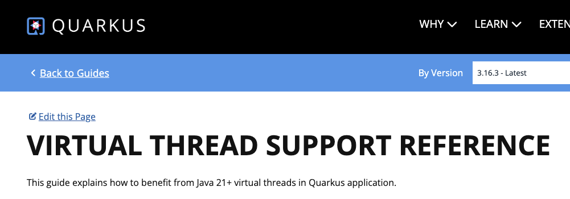

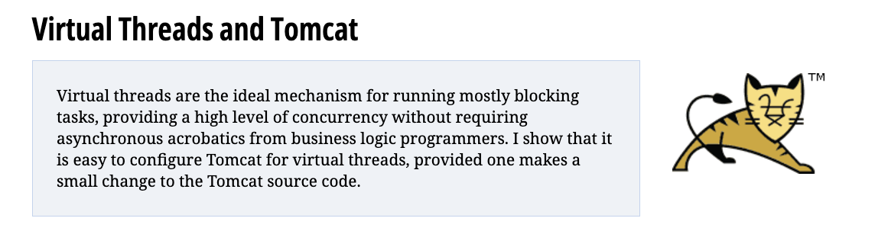
Adoption underway
Notes:
https://github.com/jetty/jetty.project/issues/8007
https://bugs.mysql.com/bug.php?id=110512
https://helidon.io/nima
https://spring.io/blog/2022/10/11/embracing-virtual-threads
https://horstmann.com/unblog/2022-04-15/index.html
https://quarkus.io/guides/virtual-threads

Slide 25
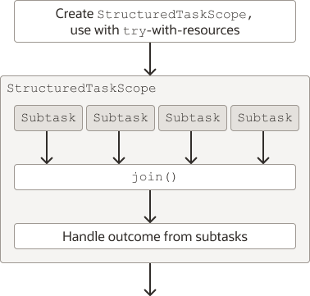
Structured Concurrency
Write code again in imperative style
Virtual Thread under the hood

Slide 26
ಧನ್ಯವಾದಗಳು 🙏
Notes:
Doubts
Will JEP 491 be backported to JDK 21?
Will reactive programming disappear?

