Slide 1
Punnya Task Management System
Windows-Native Task Assignment & Background Activity Telemetry for Technical & Content Teams
Notes:
Good day and welcome. Today we are presenting the architecture and design specification for the Punnya Task Management System. This is a lightweight, high-performance, windows-native desktop application custom-engineered for our technical and content creation teams. Our primary goals are automating work hours calculation, facilitating active task assignments, and capturing background desktop application logs with zero complex system administration. This system delivers critical metrics to our administrators without relying on expensive enterprise subscription tools.

Slide 2
Background Activity Telemetry Maps Seamlessly to Active Projects
TECHNICAL & CREATIVE TASK DESK
Direct Task Assignment: Allows admins to dispatch discrete creative and technical cards directly to staff terminals.
Content Pipelines Supported: Clean boards tailored for video editing, newsletter drafting, graphic asset creation, website deployments, and database script writing.
Two-Click Control: Simple, high-adoption status toggles (Assigned -> In Progress -> Completed) with integrated text comment updates.
WINDOWS BACKGROUND ACTIVITY LOGGER
Win32 Session Monitoring: Polling daemon silently logs active foreground window handles (e.g., Premiere Pro, Photoshop, VS Code) to track software usage.
OS Session Logs Ingested: Captures critical operating system events like Logon, Lock, Unlock, and Shutdown to automatically audit working boundaries.
Zero Manual Logging: Completely removes the manual burden of writing timesheets. Employees focus purely on creative content and developer pipelines.
Notes:
On this slide, we review our software philosophy: matching active task workflows directly with passive Windows background telemetry. Rather than forcing employees to manually write out how they spent every 15 minutes, our custom client monitors active window focuses in the background, pairing them automatically to assigned tasks. For instance, if an employee is assigned to edit a video, the desktop background daemon verifies that their active foreground application is indeed Premiere Pro or Photoshop. This approach eliminates the heavy project management overhead and ensures high data accuracy.

Slide 3
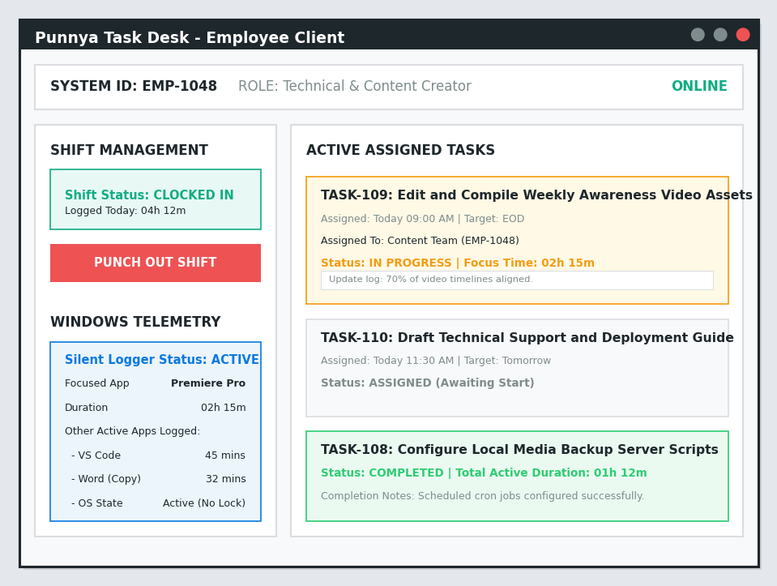
Employee Client Interface Combines Direct Tasks with Window Logs
CLIENT SCREEN WIDGETS EXPLAINED
1. Shift Management Desk: Features a prominent Crimson/Teal button for employees to punch in or out of their shifts. It records absolute clock-in and out times, dynamically calculating the active duration.
2. Live Active Tasks Feed: Displays cards of creative and technical tasks assigned by admins. Integrates keyboard hotkeys (F2/F3) allowing staff to change task states or append log notes instantly.
3. Windows Telemetry Status Monitor: A visual box notifying the user that their active window session is actively monitored. It lists current active apps (Premiere Pro, VS Code, Word) and local buffering status.
Notes:
This slide displays the native Windows Employee Client user interface. On the left, we can see the visual wireframe layout, and on the right, we explain the main widgets. Let's walk through them: First, the top bar displays their secure System ID, EMP-1048, and their technical role, establishing their permissions. Second, on the bottom-left sidebar, the employee has a clear visual toggle to punch in or punch out, and a dedicated blue telemetry container that displays what application is currently tracked. Finally, the main right-hand panel hosts their active task cards. We can see Task-109, focused on video asset compilation, in progress with local log notes updated by the creator.

Slide 4
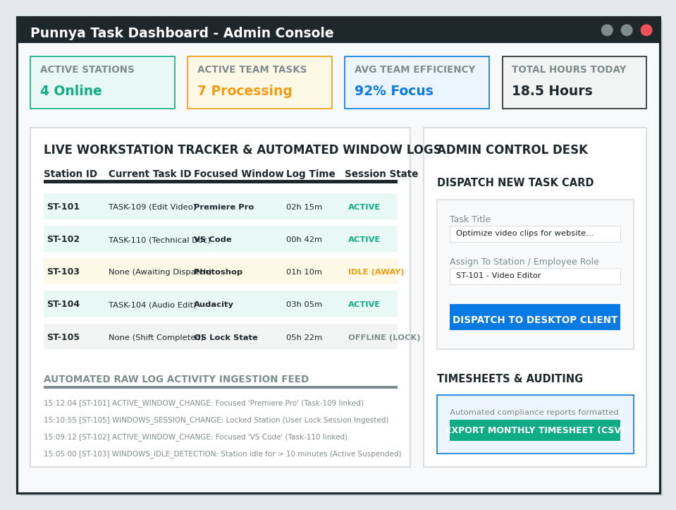
Admin Control Console Automates Team Activity Aggregation
ADMIN SCREEN WIDGETS EXPLAINED
1. Workstation Telemetry Tracker: A real-time, auto-refreshing table displaying active stations (ST-101, ST-102), active task assignments, live focused window names (Premiere Pro, VS Code, Photoshop), and OS statuses (Active/Away/Locked).
2. Live Performance Feed: Located beneath the station grid, a running event stream captures raw ingest signals, showing exactly when window changes occur or when OS locking is detected.
3. Desktop Task Dispatcher Form: A clean widget enabling admins to input task titles, select target stations, and dispatch task cards directly into the employee's active desktop client in one click.
4. Timesheet Exporter Utility: A fast database button that extracts, structures, and exports monthly employee shift hours as a standard CSV format ready for administrative auditing.
Notes:
This slide demonstrates the Administrative Control Console. Let's explore the key regions: At the top, admins have live metric cards illustrating active stations online, total processing tasks, average active team focus, and total shift hours aggregated today. Below these metrics is the core Workstation Tracker table, displaying station IDs ST-101 through 105, alongside their focused windows and live durations. On the right sidebar, admins can quickly dispatch new tasks—filling in details and targeting role categories. Crucially, the green button at the bottom allows downloading the complete monthly timesheet compiled from the backend database as an Excel-ready CSV, enabling zero-friction operational audits.

Slide 5
Native C# Client Combined with Supabase Delivers \$0 Hosting Cost
NATIVE WINDOWS CLIENT
WPF UI Engine: High performance WPF and .NET 8, providing extremely low RAM overhead.
Win32 Interop Hooks: Silently interrogates user32.dll for focused window handles and wtsapi32.dll for OS lock/logon session states.
No Admin Rights Required: Operates strictly within user-space context—safe for easy desktop deployment.
LOCAL SQLITE ENGINE
Offline Caching: Built-in SQLite local database cache ensures that logged sessions are never lost during internet outages.
Dynamic Synchronization: Once an active internet connection is recovered, cached logs automatically sync to the server.
Anti-Surveillance Lock: Data is securely packaged and verified, preventing raw local tampering by end users.
ASSISTIVE DESIGN SYSTEM
Narrator Integration: Native Windows UI Automation (UIA) tags expose all UI buttons to Windows Narrator and NVDA.
Contrast Compliance: Accessible color palettes compliant with WCAG 2.1 AA text legibility standards.
Keyboard Control: Full keyboard tab indexes mapped across all forms, ensuring 100% accessible navigation.
Notes:
On this technical slide, we detail our system architecture. To ensure high speed, accessibility, and zero maintenance fees, we use a Native Windows WPF client paired with Supabase PostgreSQL hosting. First, on the left, we outline the native C# client which uses standard Win32 Interop hooks to monitor active applications and locks without requiring administrator privileges on local machines. Second, the center column explains our offline data safety: if the internet connection is disrupted, data buffers into a local SQLite database and automatically synchronizes when connection is restored. Finally, on the right, we detail our compliance with assistive technologies: native Narrator automation tags and keyboard-only tab indexes are integrated directly into our WPF layouts, ensuring maximum accessibility.

Slide 6
Structured Five-Week Timeline Guides the App to Production
WEEK 1
Database Setup
• Deploy PostgreSQL schemas on Supabase.
• Implement JWT secure user authentication protocols.
• Configure active task directory.
WEEK 2
WPF UI Build
• Design Employee UI grids in WPF / XAML.
• Program tab-key tab index and Narrator tags.
• Build Admin dashboard frames.
WEEK 3
Telemetry Hooks
• Code Win32 foreground handle polling hooks.
• Integrate Windows session lock listener signals.
• Link app focuses to task records.
WEEK 4
SQLite & Sync
• Program local SQLite transaction database.
• Configure automatic delta sync pipelines.
• Perform testing for offline data resilience.
WEEK 5
UAT & Deployment
• Conduct User Acceptance Testing with team staff.
• Perform contrast visual verification passes.
• Package and deploy MSI installers to office systems.
Notes:
Finally, this roadmap outlines a structured, 5-week schedule to execute our development plan. Week 1 establishes our database schemas and secure access logs on Supabase. Week 2 focuses on front-end layouts in WPF and screen reader compliance. Week 3 implements low-level Win32 foreground polling hooks. Week 4 configures local SQLite databases to safeguard data during offline periods. In Week 5, we wrap up with live testing sessions with our technical and content staff, ensuring all accessibility guidelines are met, before deploying installer packages across office terminals. Thank you, and I look forward to your questions.

