Slide 1
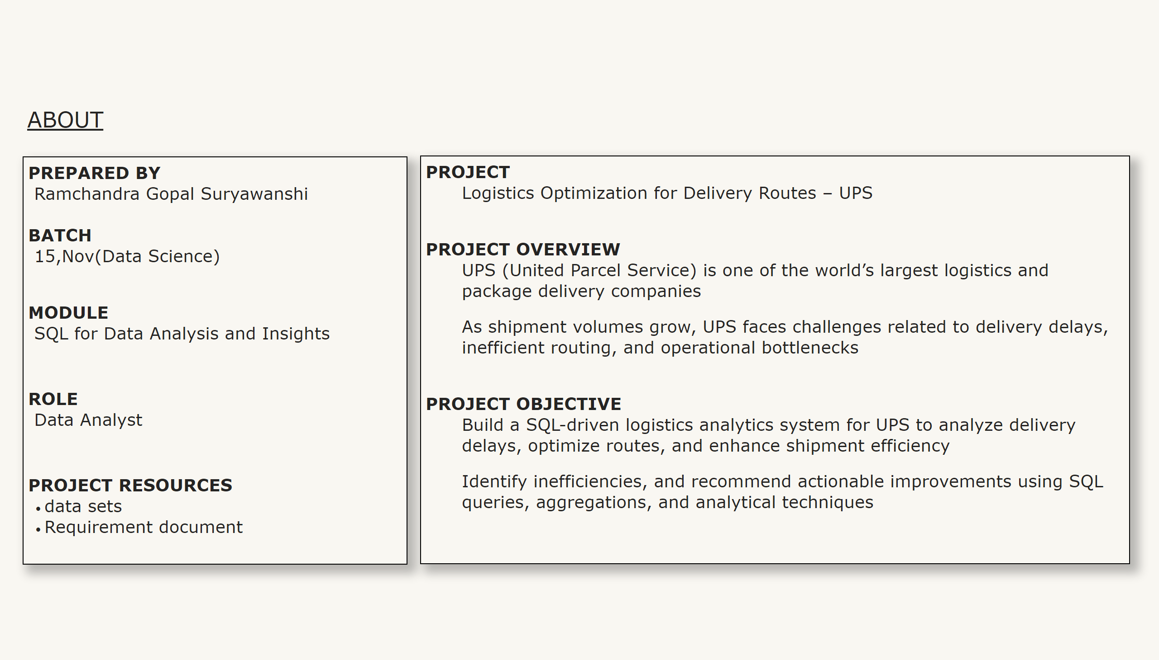
ABOUT
Notes:
textbox
No alt text provided
textbox
No alt text provided
textbox
No alt text provided

Slide 2
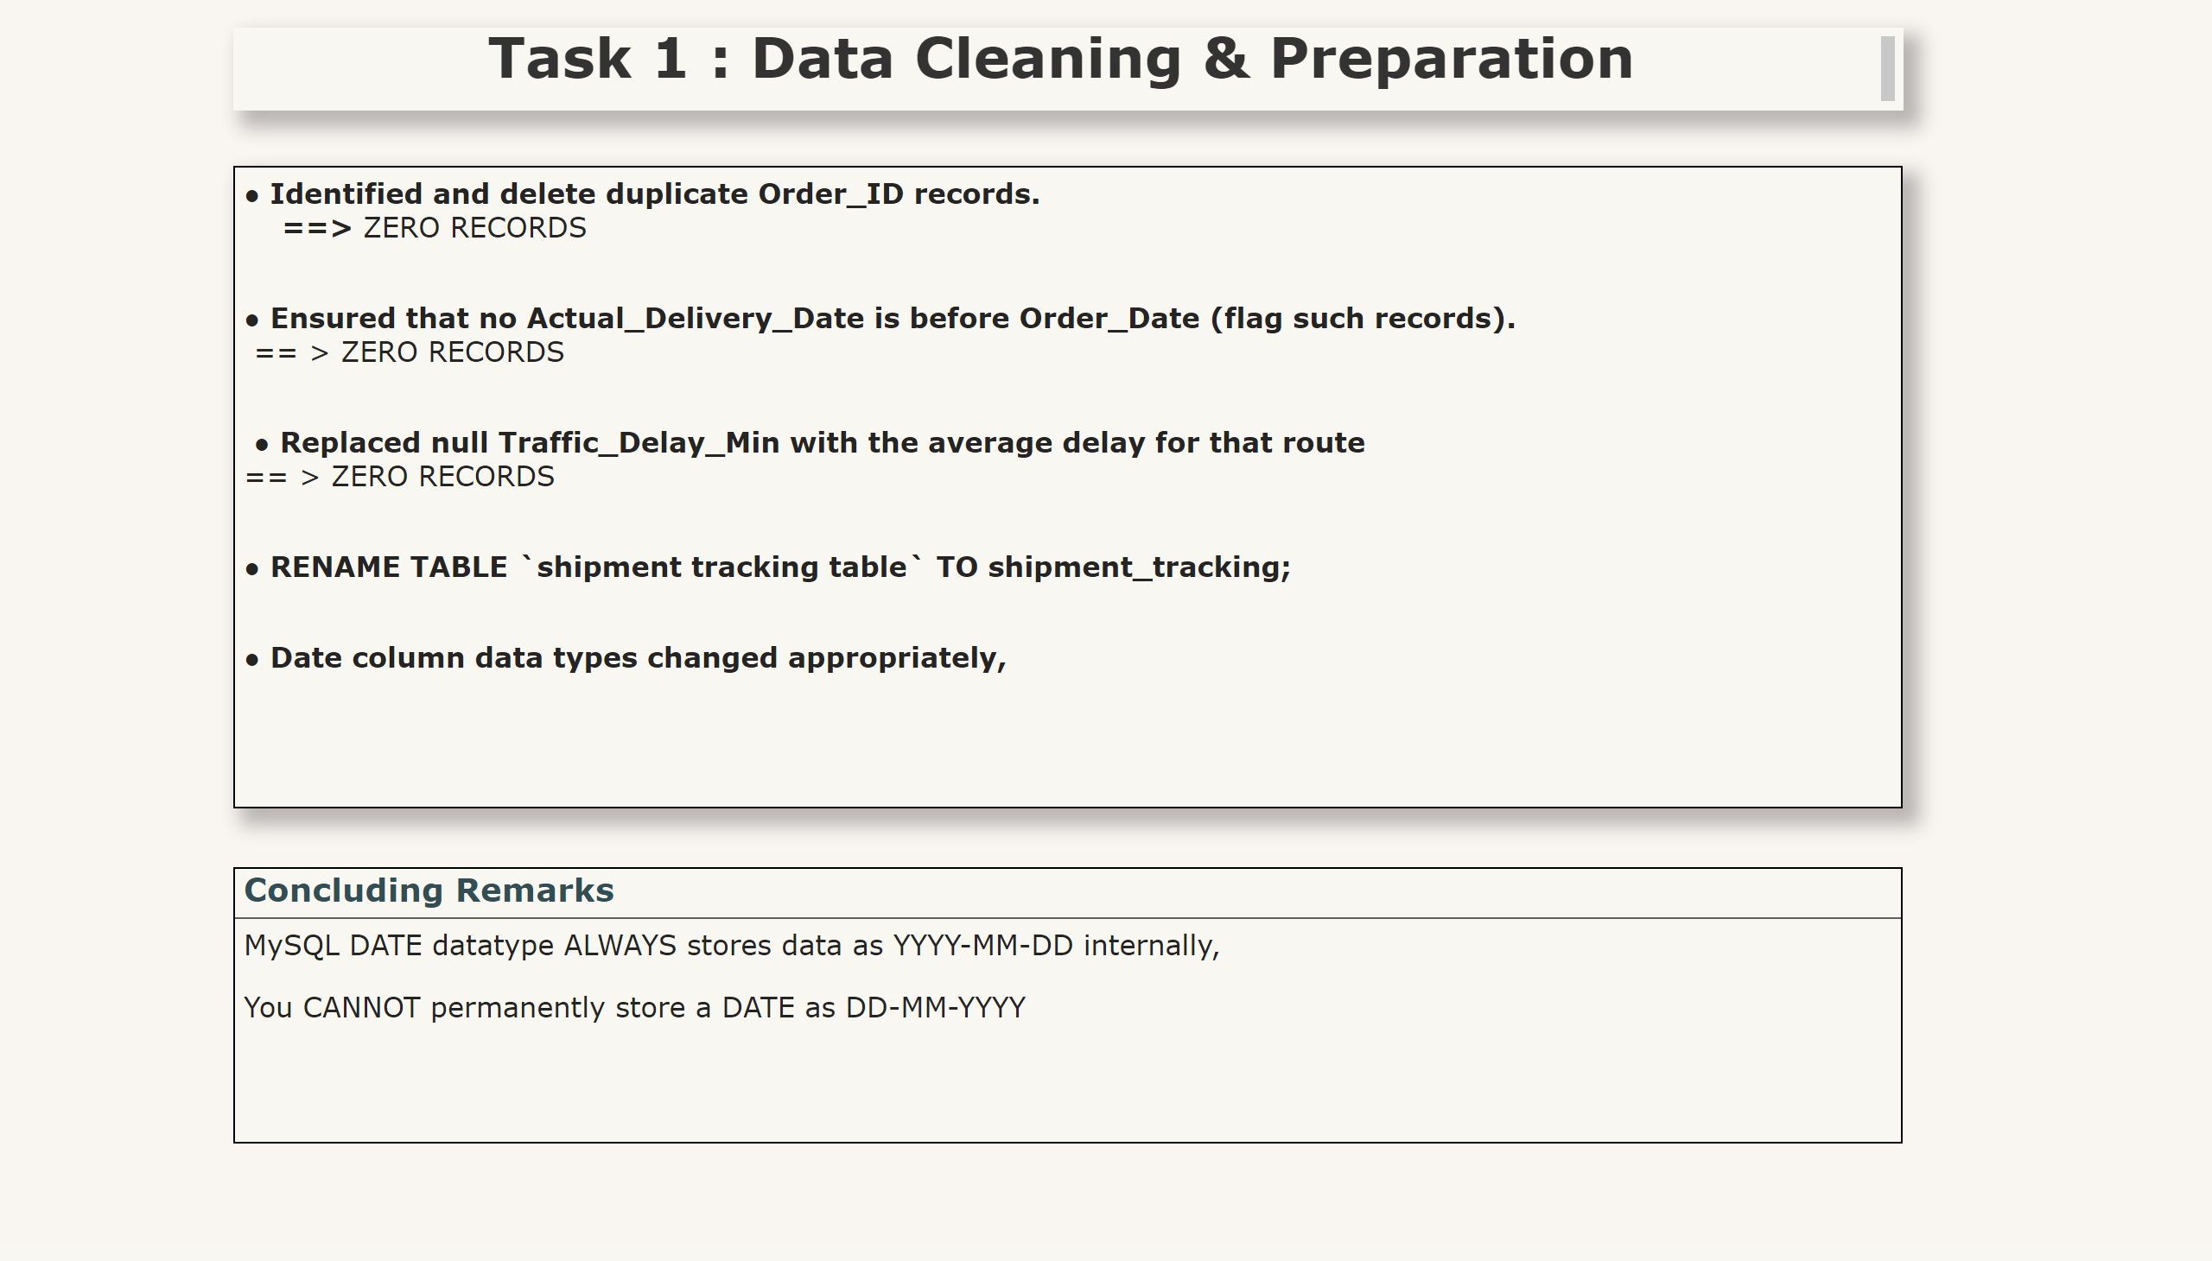
1
Notes:
textbox
No alt text provided
textbox
No alt text provided
Concluding Remarks
No alt text provided

Slide 3
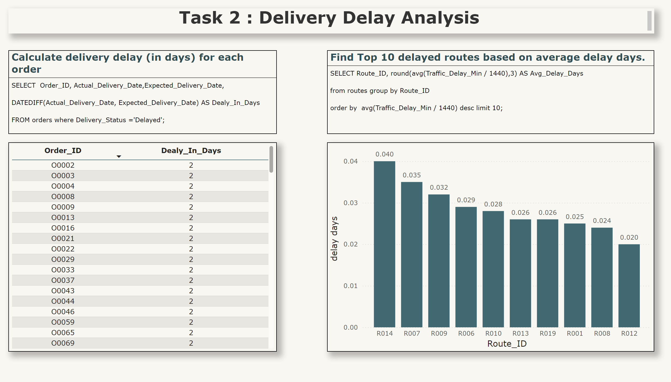
2.1
Notes:
textbox
No alt text provided
Calculate delivery delay (in days) for each order
No alt text provided
tableEx
No alt text provided
Find Top 10 delayed routes based on average delay days.
No alt text provided
clusteredColumnChart
No alt text provided

Slide 4
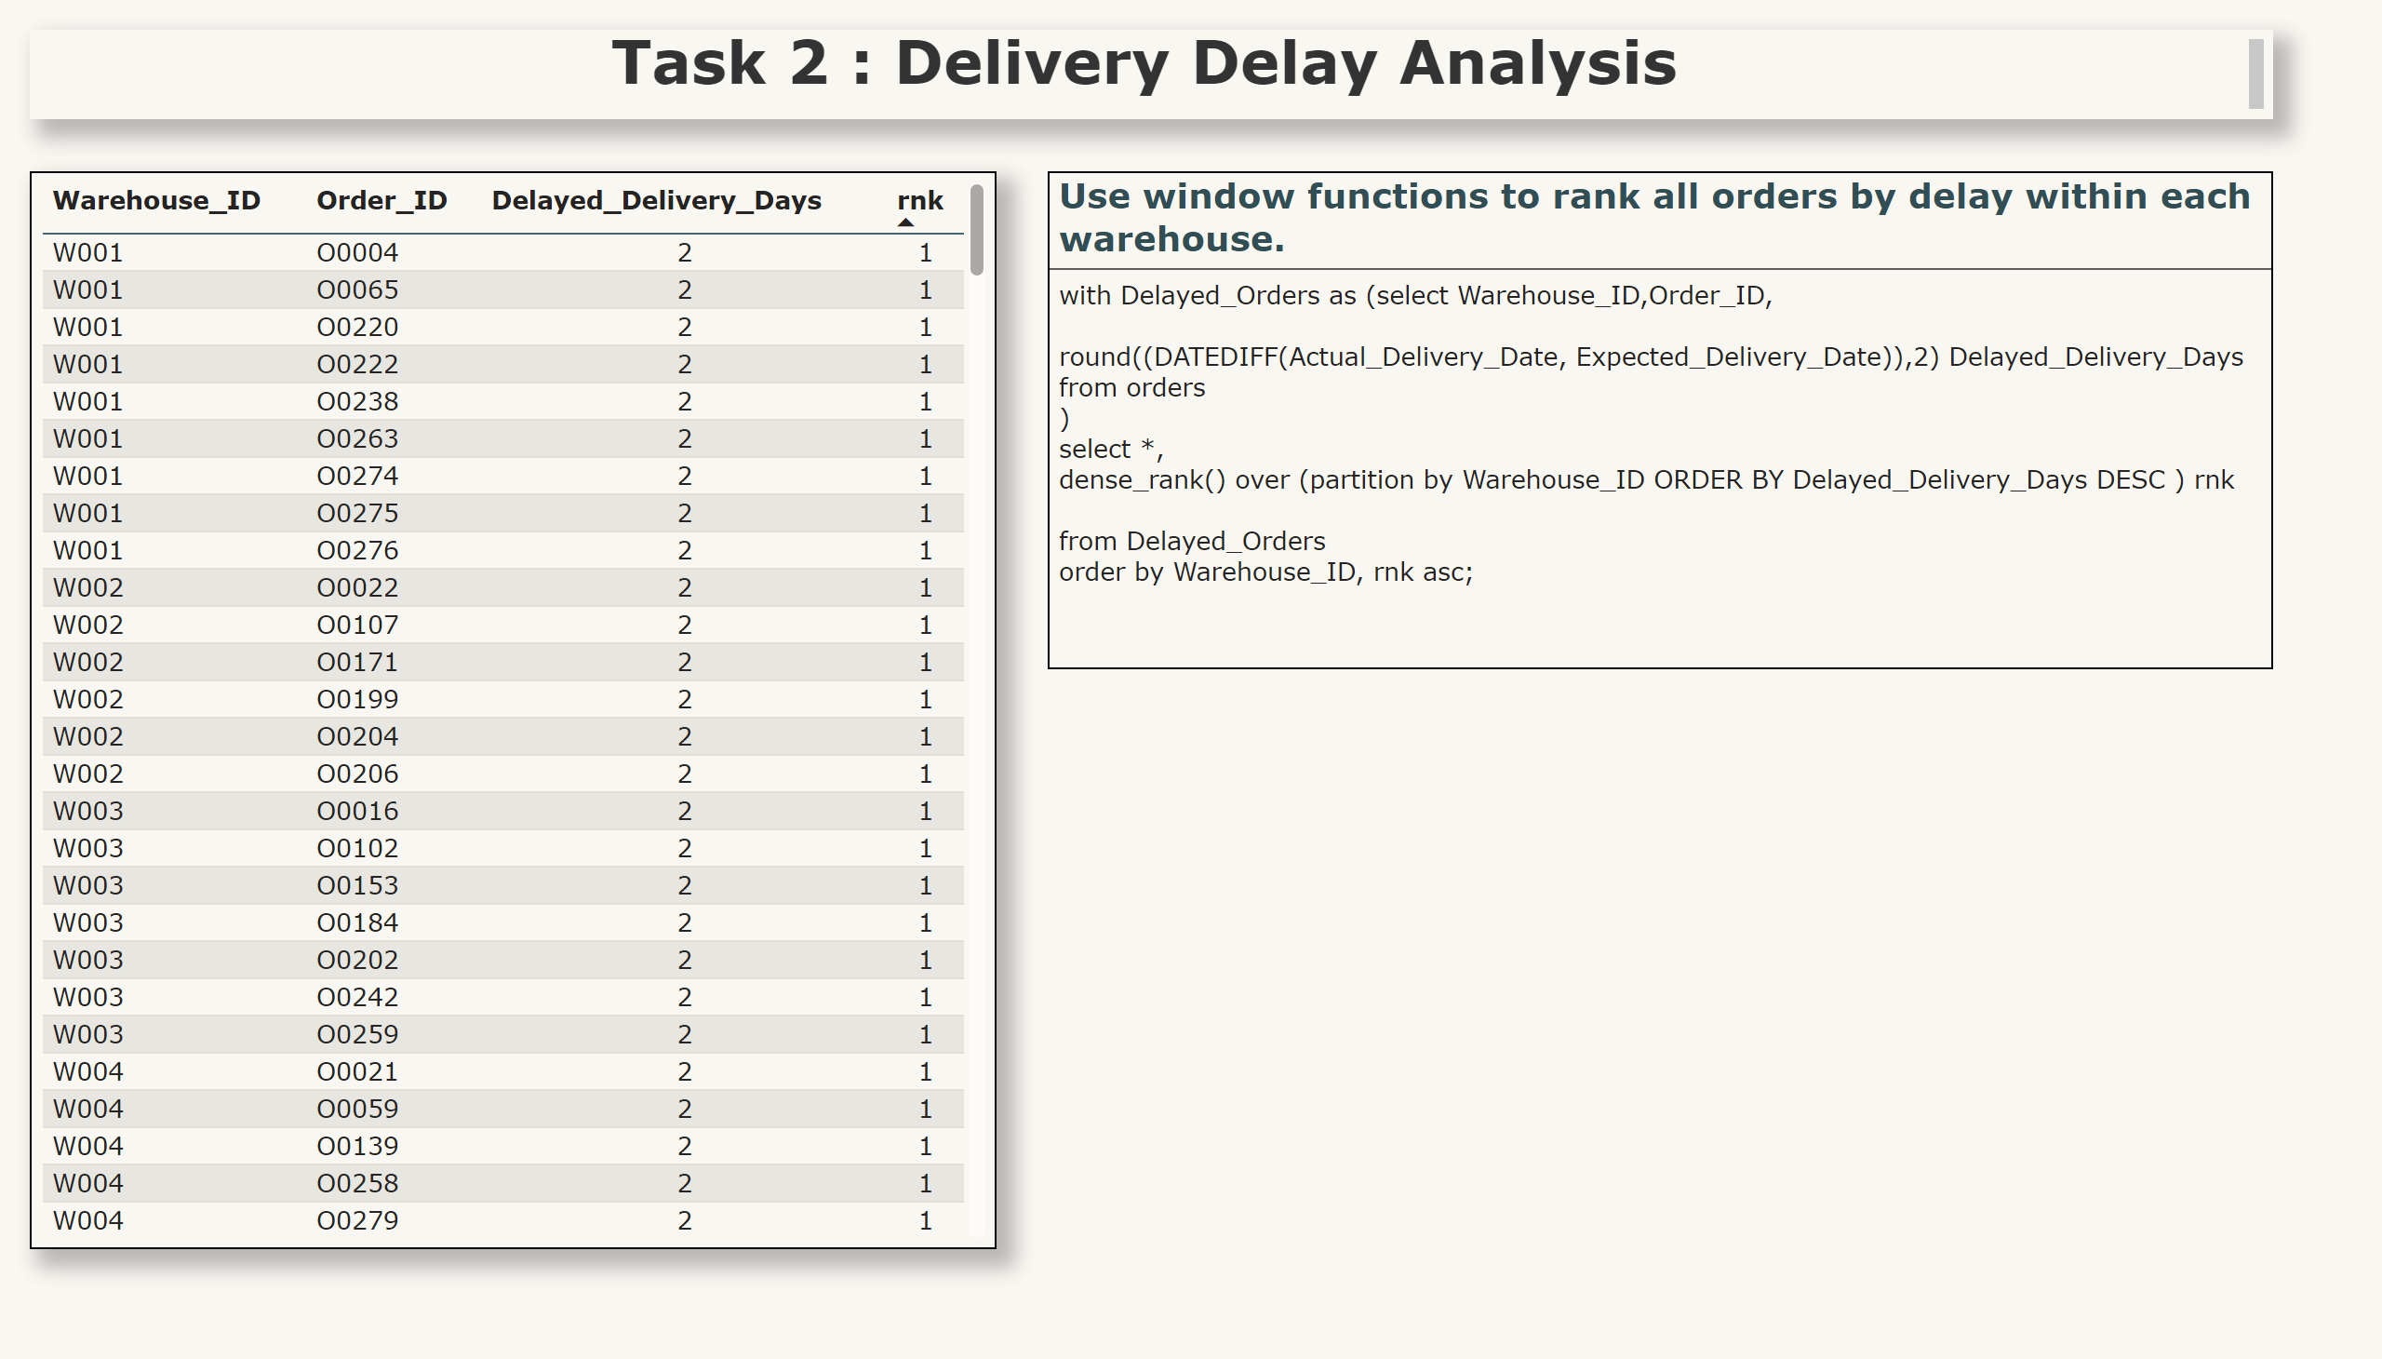
2.2
Notes:
textbox
No alt text provided
Use window functions to rank all orders by delay within each warehouse.
No alt text provided
tableEx
No alt text provided

Slide 5
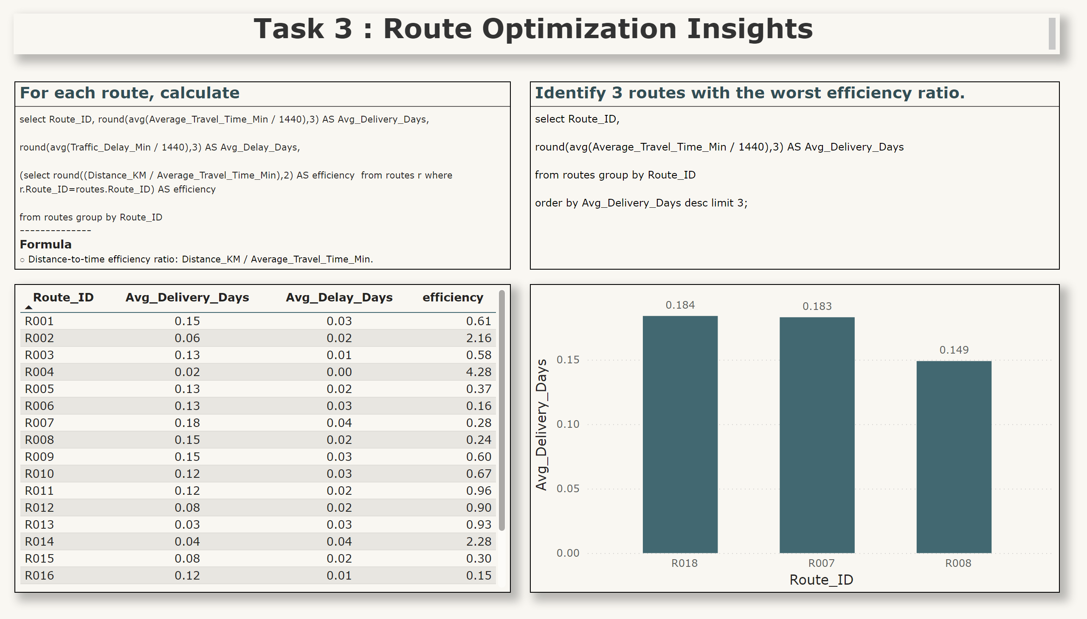
3.1
Notes:
textbox
No alt text provided
For each route, calculate
No alt text provided
tableEx
No alt text provided
Identify 3 routes with the worst efficiency ratio.
No alt text provided
clusteredColumnChart
No alt text provided

Slide 6
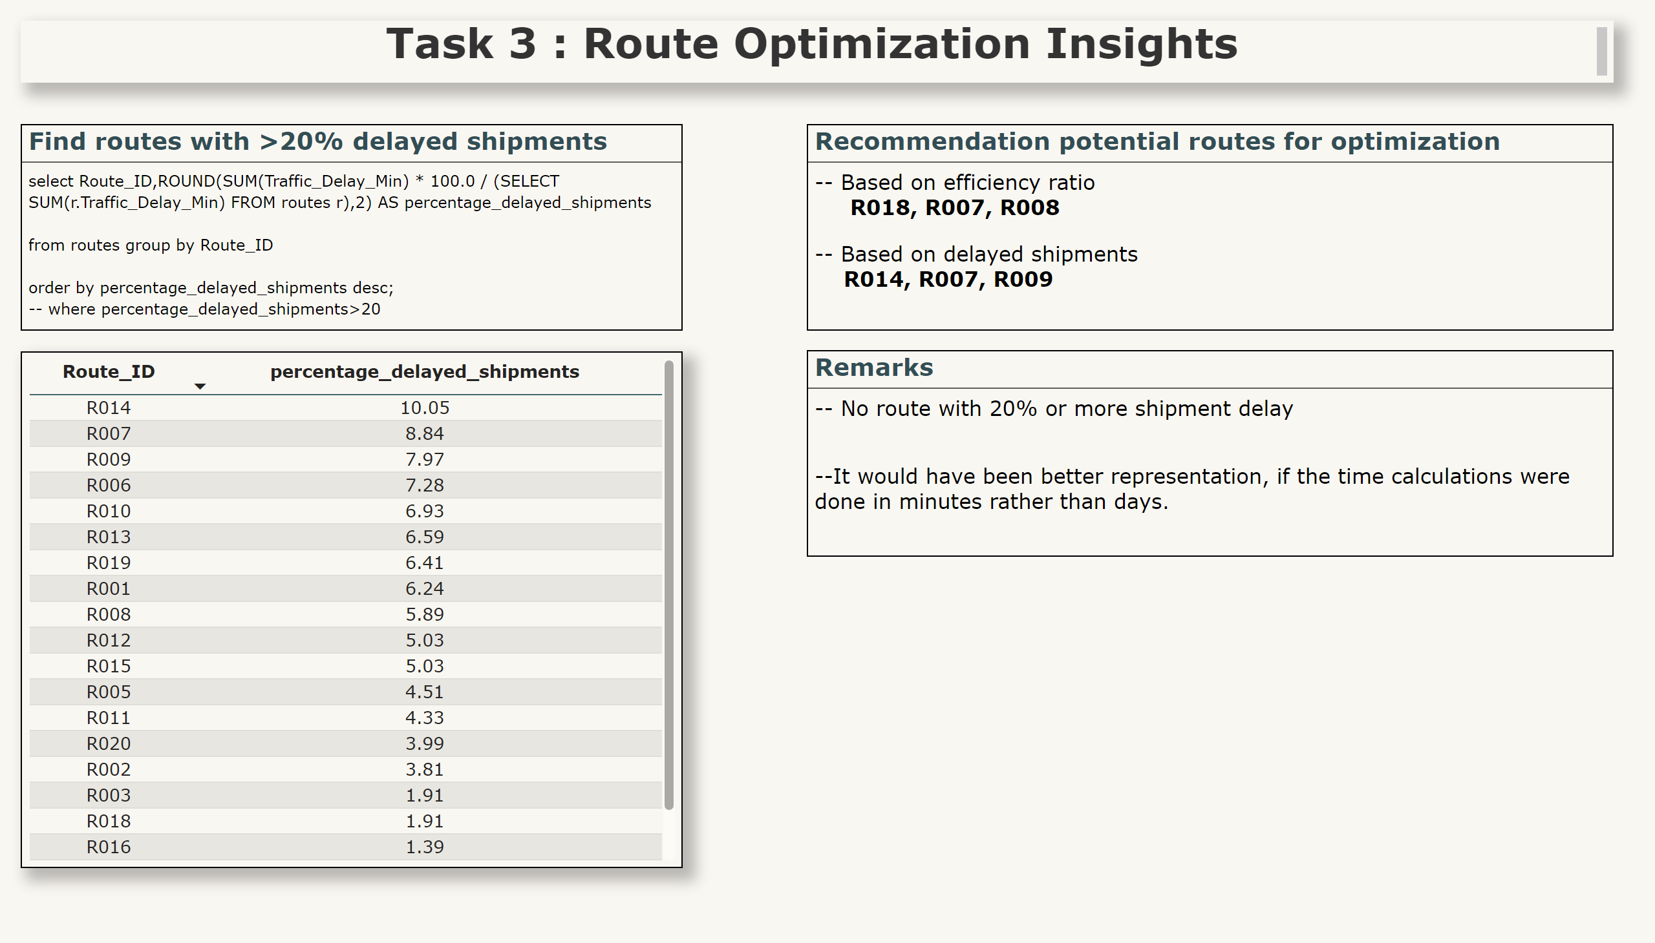
3.2
Notes:
textbox
No alt text provided
Find routes with >20% delayed shipments
No alt text provided
tableEx
No alt text provided
Recommendation potential routes for optimization
No alt text provided
Remarks
No alt text provided

Slide 7
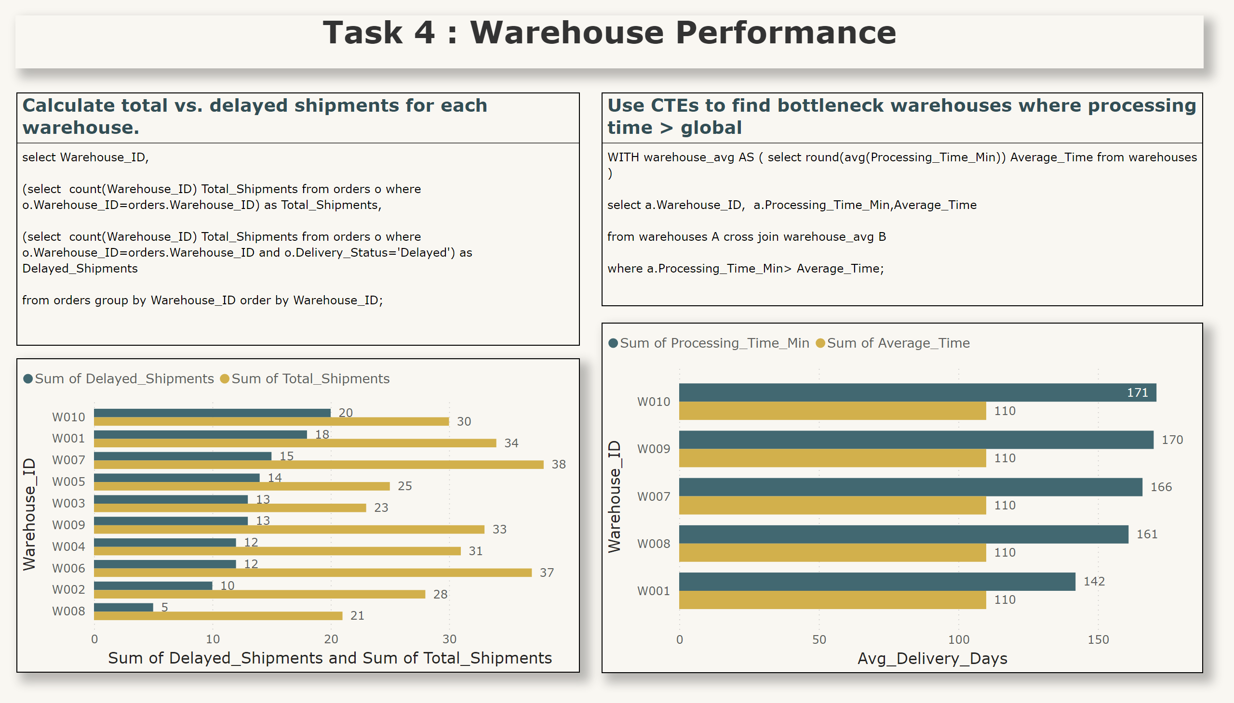
4.1
Notes:
textbox
No alt text provided
Calculate total vs. delayed shipments for each warehouse.
No alt text provided
clusteredBarChart
No alt text provided
Use CTEs to find bottleneck warehouses where processing time > global
No alt text provided
clusteredBarChart
No alt text provided

Slide 8
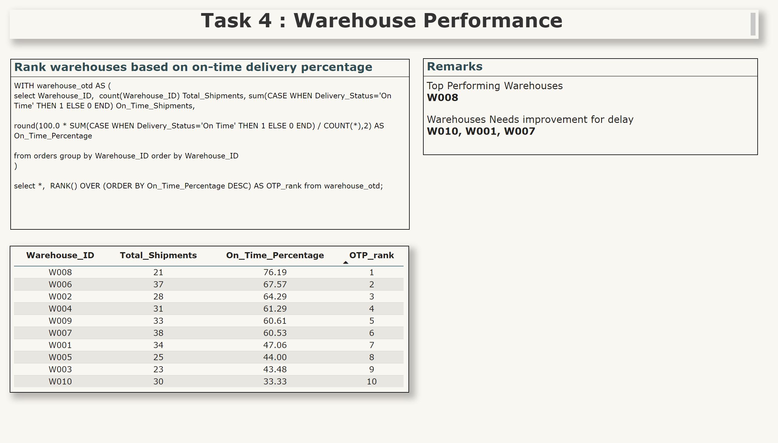
4.2
Notes:
textbox
No alt text provided
Rank warehouses based on on-time delivery percentage
No alt text provided
tableEx
No alt text provided
Remarks
No alt text provided

Slide 9
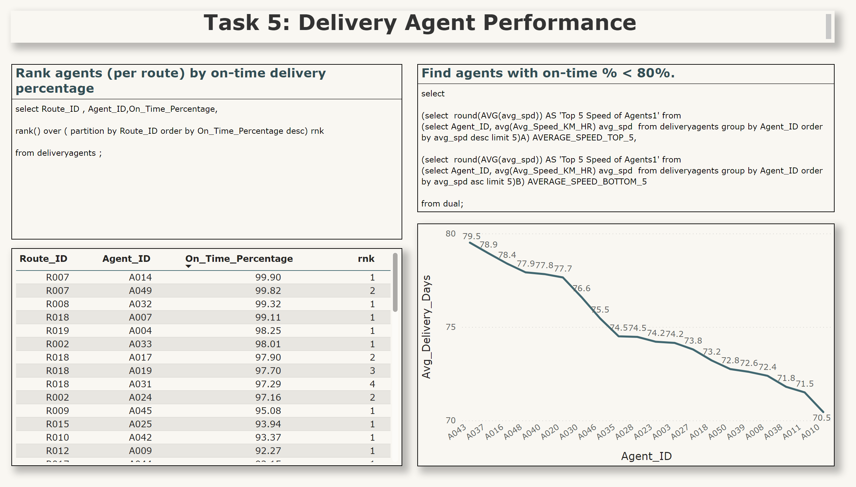
5.1
Notes:
textbox
No alt text provided
Rank agents (per route) by on-time delivery percentage
No alt text provided
tableEx
No alt text provided
Find agents with on-time % < 80%.
No alt text provided
lineChart
No alt text provided

Slide 10
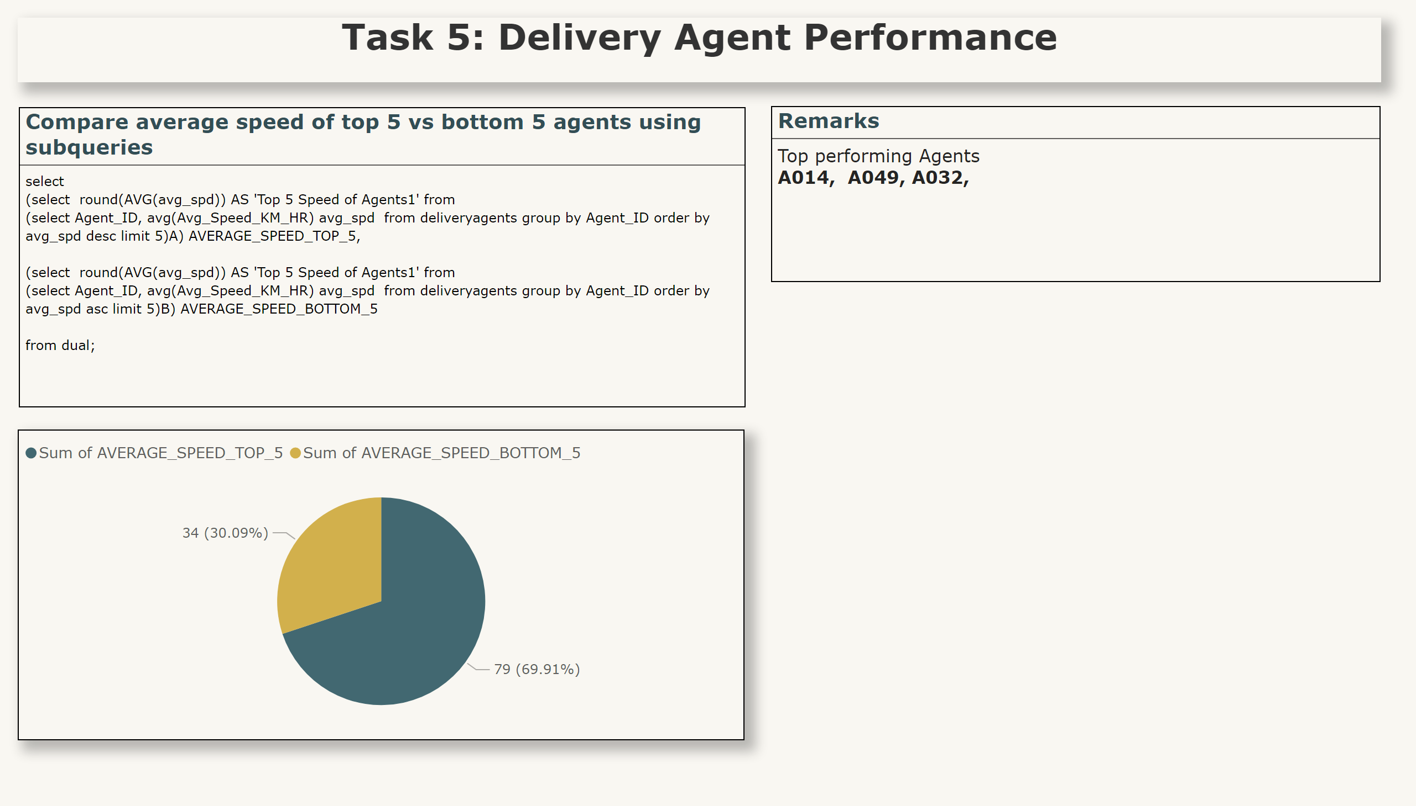
5.2
Notes:
textbox
No alt text provided
Compare average speed of top 5 vs bottom 5 agents using subqueries
No alt text provided
pieChart
No alt text provided
Remarks
No alt text provided

Slide 11
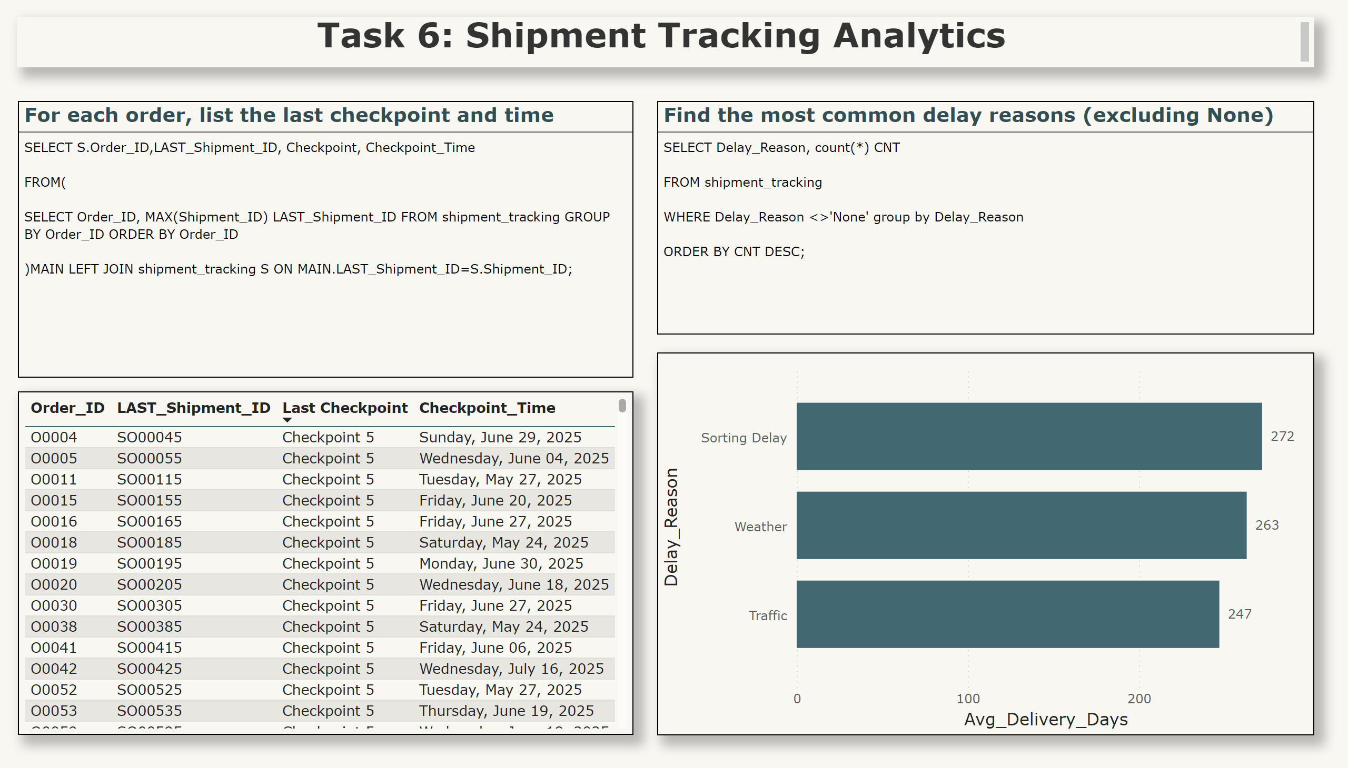
6.1
Notes:
textbox
No alt text provided
For each order, list the last checkpoint and time
No alt text provided
tableEx
No alt text provided
Find the most common delay reasons (excluding None)
No alt text provided
clusteredBarChart
No alt text provided

Slide 12
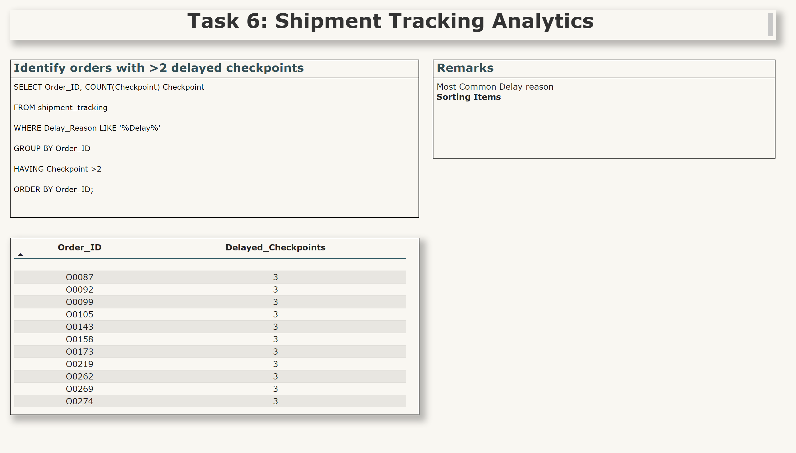
6.2
Notes:
textbox
No alt text provided
Identify orders with >2 delayed checkpoints
No alt text provided
tableEx
No alt text provided
Remarks
No alt text provided

Slide 13
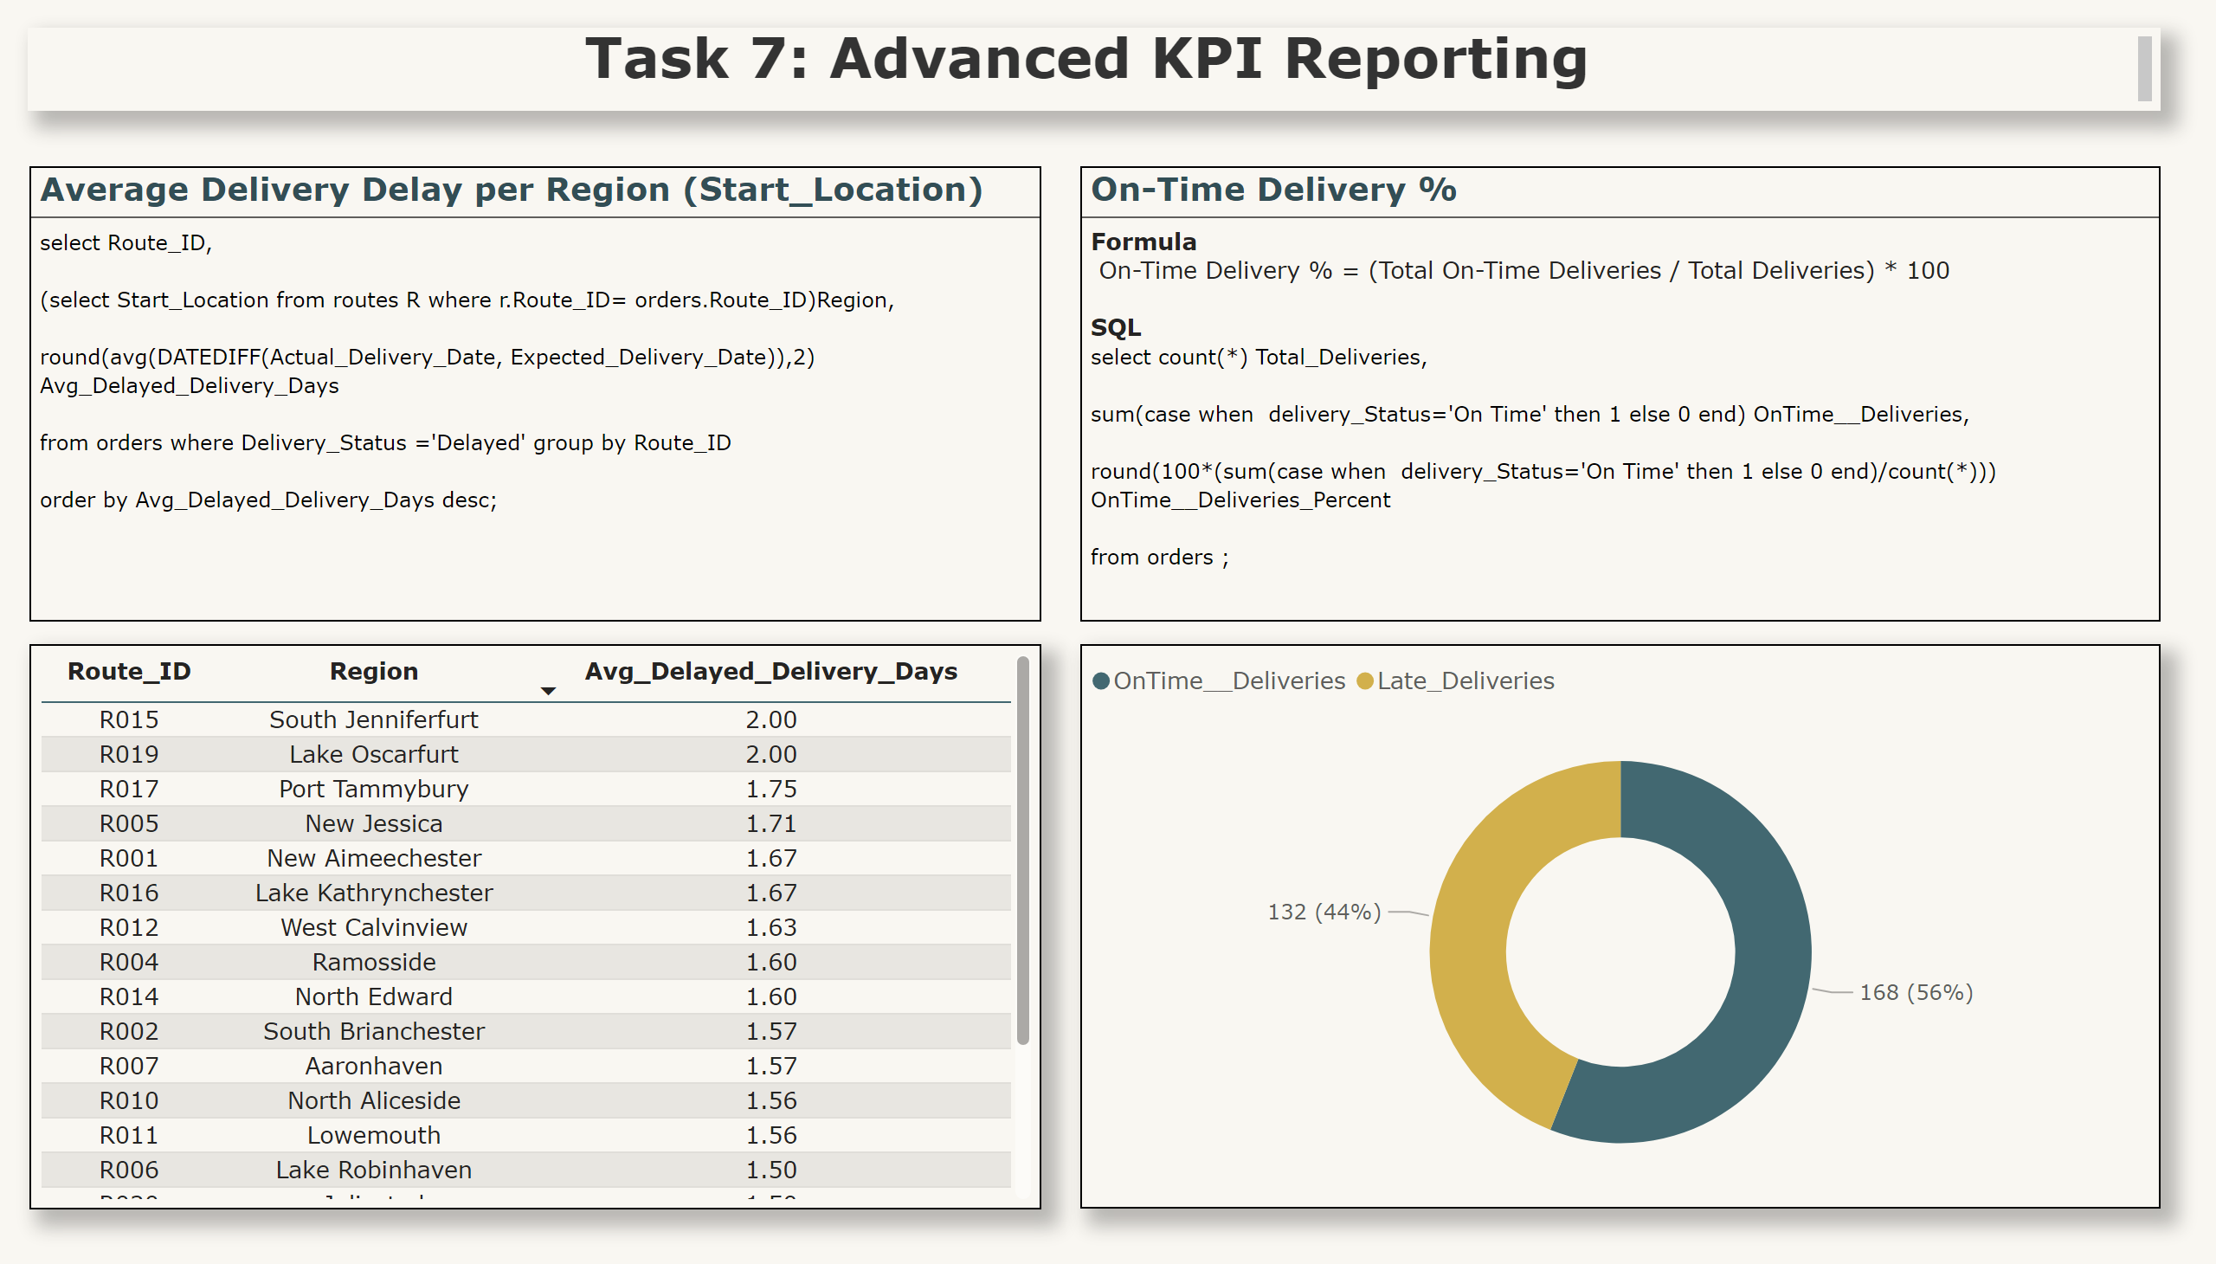
7.1
Notes:
textbox
No alt text provided
Average Delivery Delay per Region (Start_Location)
No alt text provided
tableEx
No alt text provided
On-Time Delivery %
No alt text provided
donutChart
No alt text provided

Slide 14
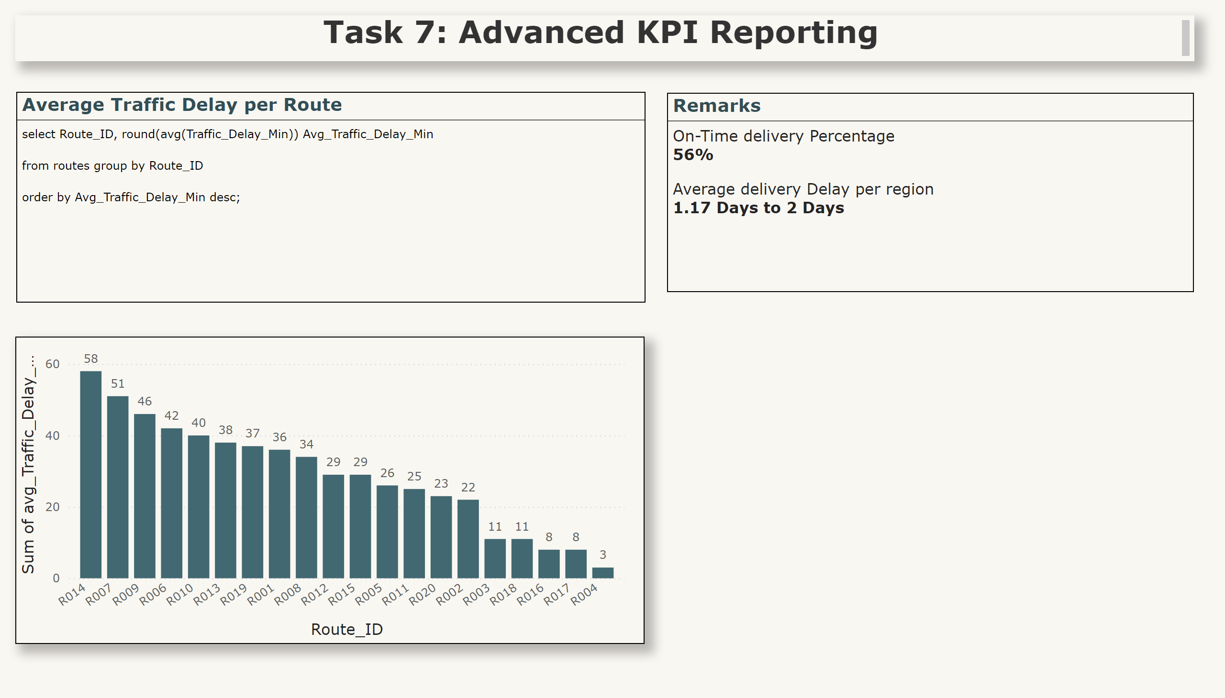
7.2
Notes:
textbox
No alt text provided
Average Traffic Delay per Route
No alt text provided
clusteredColumnChart
No alt text provided
Remarks
No alt text provided

Slide 15
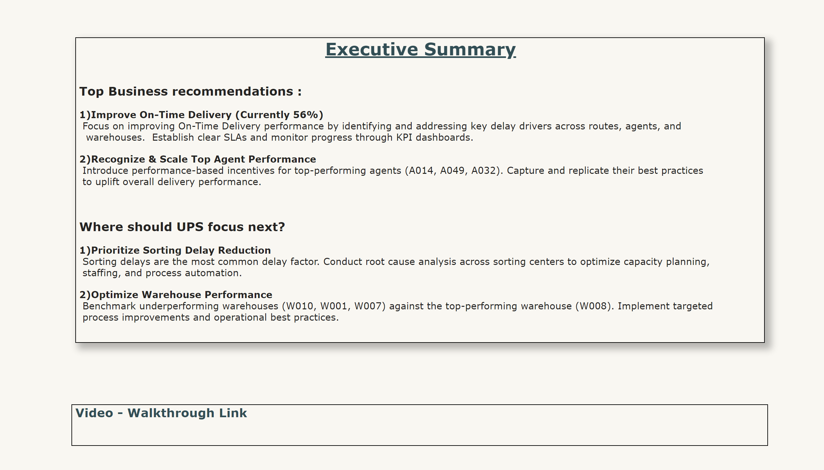
EXECUTIVE SUMMARY
https://drive.google.com/file/d/181JET1XtCqahq2JzguvRyijCVqUtYz2A/view?usp=sharing
Notes:
Executive Summary
No alt text provided
Video - Walkthrough Link
No alt text provided

