Slide 1
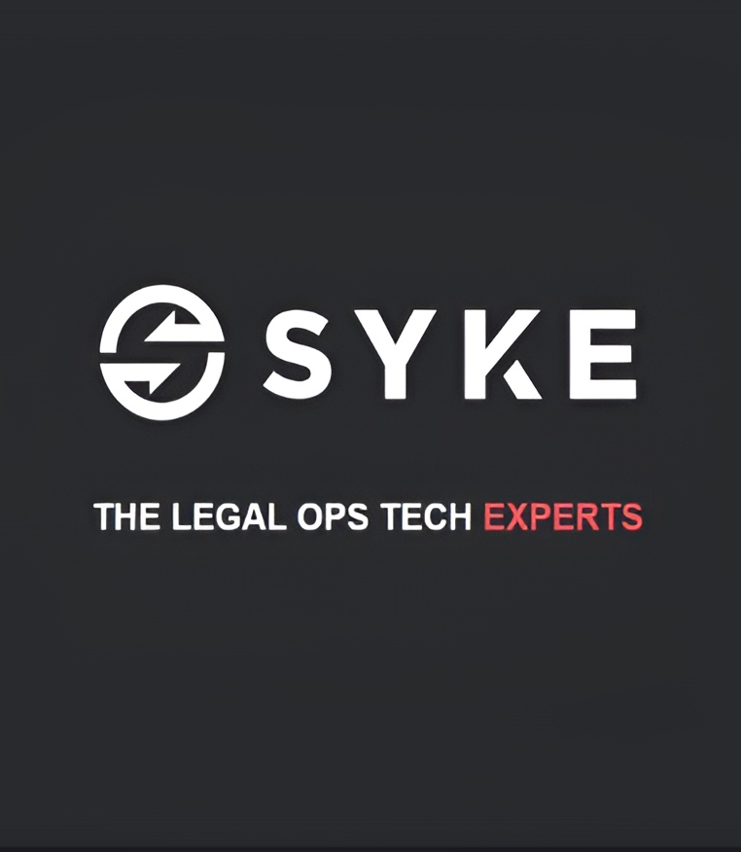
Syke India
Kunal Tyagi
12013195
Analyst Intern
(August 23 – Present)

Slide 2
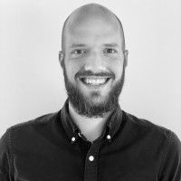
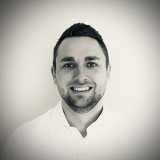
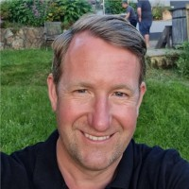
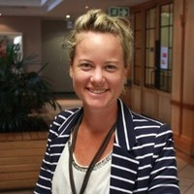
Meet our Leadership team
Tom Mellor
Jonny Badrock
Chief Operations Officer
Senior VP – Chief Legal Engineer
Alistair Maiden
Claire Mcmullin
Global Advisory Lead – Consilio and SYKE
VP – People and Talent

Slide 3
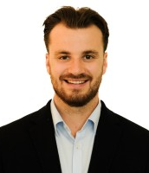
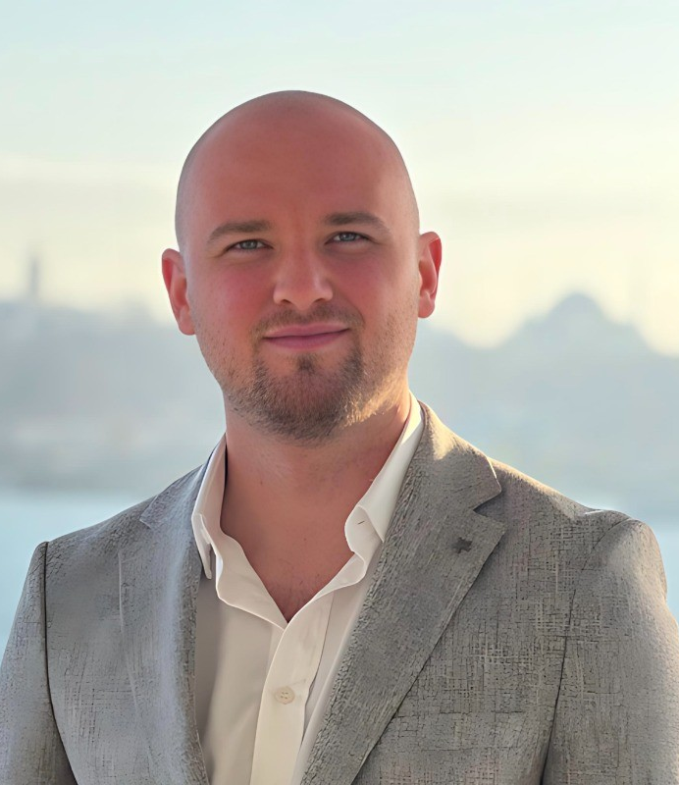
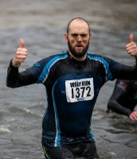
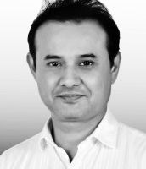
Meet our Leaders
Alistair Maiden
Jamie Goldrich
Global Advisory Lead – Consilio and SYKE
VP Legal Operations Technology
Tom Mellor
Bartu Gundogdu
Chief Operations Officer
Senior Associate – BRYTER - Legal Operations Technology
Claire Mcmullin
Scott Quinlivan
VP – People and Talent
Delivery Director - Legal Operations Technology
Atul Arora
Jonny Badrock
MD and Country Head - India
Senior VP – Chief Legal Engineer

