Slide 1

Aggregate production planning

Slide 2
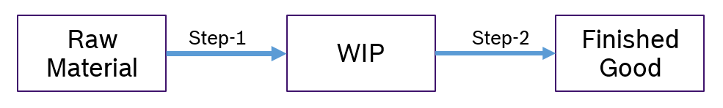
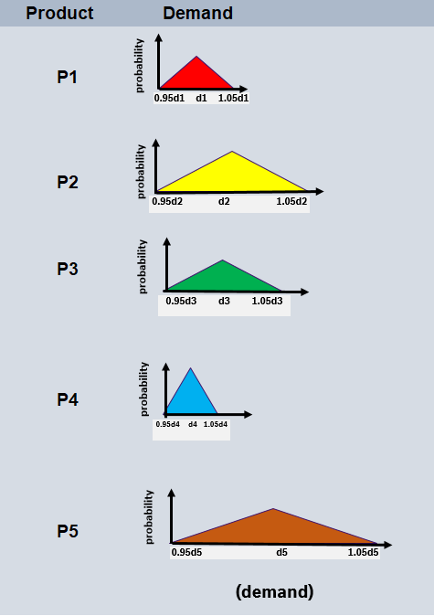
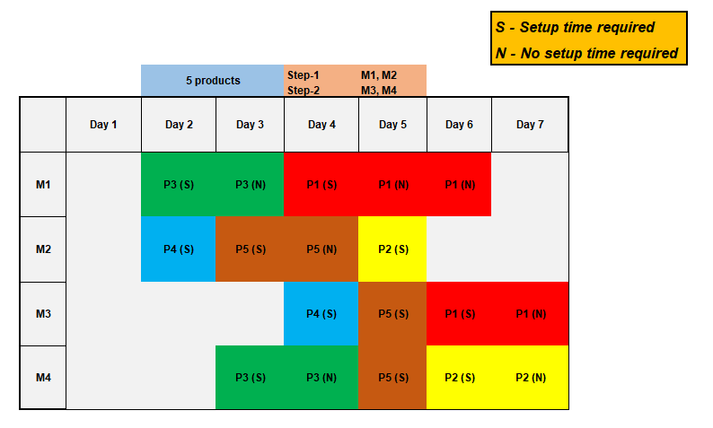
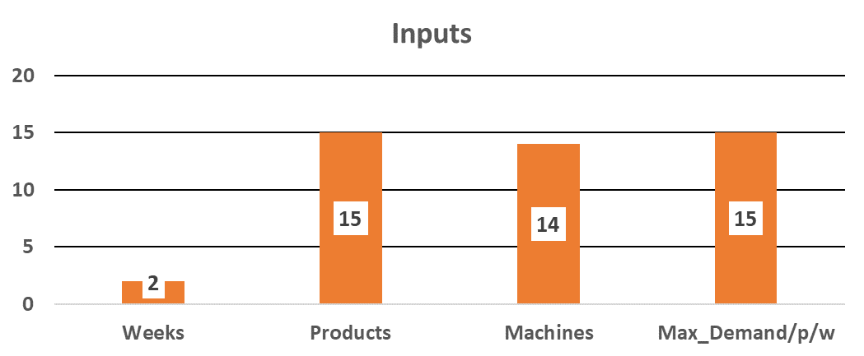
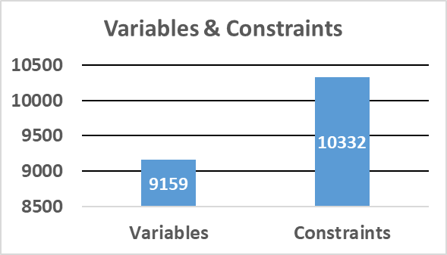
Aggregate Production Planning
Machine-product allocation (sample):
Problem complexity:

Slide 3
Problem Statement:
Inventory cost
Overtime cost
Production planning
Excess work hours penalty cost
Cost optimization
Excess production penalty cost
Lost sales penalty cost
Resource
limitations
Demand uncertainty
Excess machine time penalty cost
Max. workers’ time per day
Max. machine time per day
Probability
0.95d
d
1.05d
Demand
4
Internal | RBEI/BE-II | 2019-07-25
© Robert Bosch Engineering and Business Solutions Private Limited 2018. All rights reserved, also regarding any disposal, exploitation, reproduction, editing, distribution, as well as in the event of applications for industrial property rights.

Slide 4
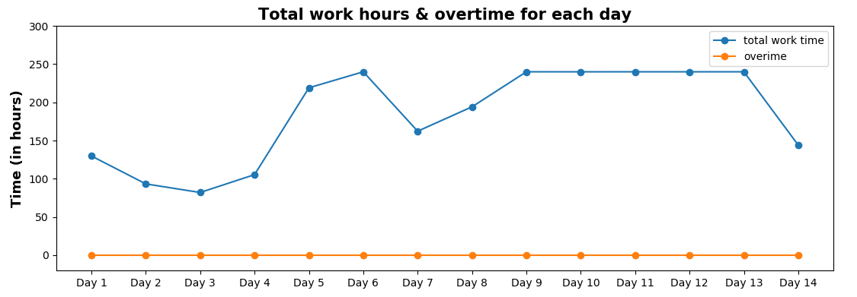
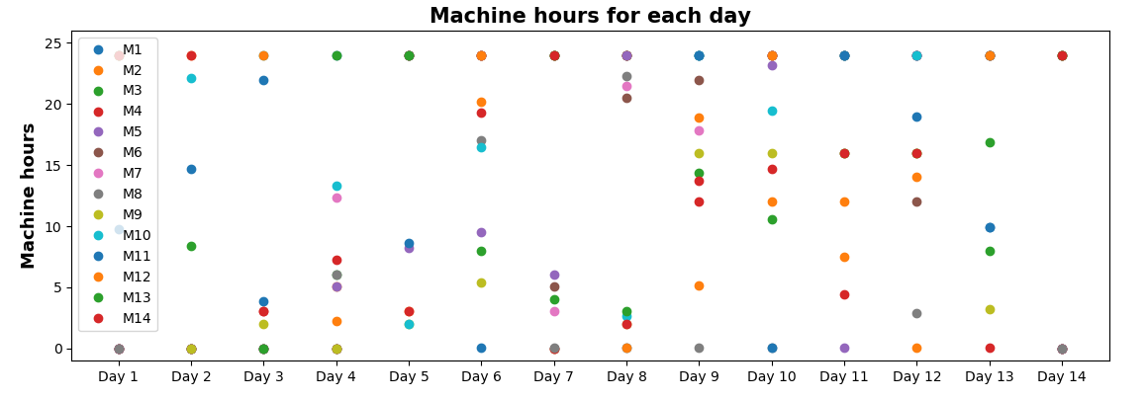
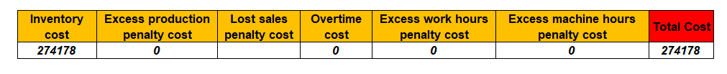
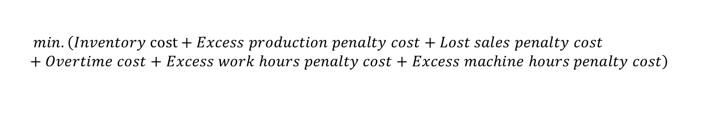
Aggregate Production Planning
Opt. production
cost
Solution approach:
High Level Design
Input data
(demands, costs, resource limitations)
Problem formulation
(PULP)
Optimization
(gurobi / CBC Solver)
Outputs
(prod_vars, alloc_vars, setup_vars, lost_sales_vars)
Optimization model
Objective function :
$$min. \left(Inventory cost+Excess production penalty cost+Lost sales penalty cost+Overtime cost+Excess work hours penalty cost+Excess machine hours penalty cost\right)$$
Constraints :

Slide 5
Gurobi solver:
Pulp Modeler:
Python
expressions
Mathematical
functions/constraints
PuLP
Matrix / vector representations
CBC / Gurobi Solver
Simplex method
CBC solver:
Branch and bound algorithm
4
Internal | RBEI/BE-II | 2019-07-25
© Robert Bosch Engineering and Business Solutions Private Limited 2018. All rights reserved, also regarding any disposal, exploitation, reproduction, editing, distribution, as well as in the event of applications for industrial property rights.

Slide 6
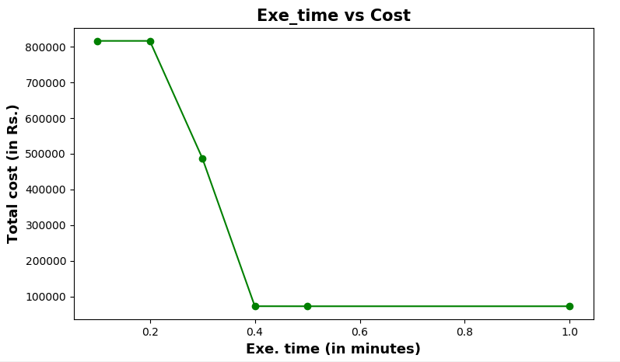















Key points of solution approach:
Aggregate Production Planning
Demand uncertainty:
$$d_{7}$$
$$d_{8}$$
$$d_{9}$$
$$d_{6}$$
$$d_{10}$$
$$d_{11}$$
$$d_{4}$$
$$d_{5}$$
Probability
$$d_{3}$$
$$d_{12}$$
$$d_{13}$$
$$d_{14}$$
$$d_{2}$$
$$d_{1}$$
$$d_{15}$$
950
1000
1050
Non-linear to linear formulation
Demand
Model performance:

Slide 7
Case1: Simple optimization problem:
1 product, demand of 2 consecutive days : D1 (100), D2(320)
Min. 2*(X1 + L1 – D1) + 2*(X2 + L2 – D2) + 50*(L1 + L2)
s.t.
X1 + L1 >=D1
Opt. solution: Cost = 0
X1 = 100, X2 = 320
X2 + L2 >=D2
Case2: Optimization problem with stochasticity:
1 product, demand of 2 consecutive days :
Day1 [(100, 0.4), (150, 0.6)]
Day2 [(300, 0.3), (320, 0.7)]
Min. 2*[p11*(X1 + L11 – D11) + p12*(X1 + L12 – D12)]
+ 2*[p21*(Inv11 + X2 + L21 – D21) + p22*(Inv12 + X2 + L22 – D22)]
+ 50*(L11 + L12+ L21 + L22)
s.t.
X1 + L11>= D11
X1 + L12>= D12
Opt. solution: Cost = 92
X1 = 150, X2 = 320
Inv1 + X2 + L21>= D21
Inv1 + X2 + L22>= D22
Inv2 + X2 + L21>= D21
Inv2 + X2 + L22>= D22
4
Internal | RBEI/BE-II | 2019-07-25
© Robert Bosch Engineering and Business Solutions Private Limited 2018. All rights reserved, also regarding any disposal, exploitation, reproduction, editing, distribution, as well as in the event of applications for industrial property rights.

Slide 8
Performance comparison
Opt. solution: Cost = 0
X1 = 100, X2 = 320
Opt. solution: Cost = 92
X1 = 150, X2 = 320
Demands of 2 consecutive days | Total cost (Case 1) | Total cost (Case 2)
(100, 300) | 20 | 120
(100, 320) | 0 | 100
(150, 300) | 1020 | 20
(150, 320) | 1000 | 0

Slide 9
THANK YOU!!

