Slide 1

Curriculum based Continual Learning on Gpt2 and T5.
Ramki R

Slide 2
While some data may differ significantly in difficulty from the rest, most current approaches to language model fine-tuning treat all fine-tuning data equally. As a result, rather than representing the data in a random order, the data is arranged according to their difficulty level and fed into the model. We call this method "curriculum learning”. I have taken the tiny Stories Dataset generated by Gpt3.5 and Gpt4 - A dataset for training tiny models to produce coherent English text with small vocabulary. I have taken first 2 lakhs record and split the data into 10 equivalent parts and found the perplexity by training 10 different models on these subsets and took average perplexity of each data. Finally, I have arranged the data based on the average perplexity order. This data is fed into the Gpt 2 model for fine-tuning language modeling purpose to better understand abstract categories like grammar and reasoning capabilities.

Slide 3

When Language Models are sequentially fine-tuned specific to a task on a dataset and subjected to fine tuning for another task later the network will forget the task learned before. This behavior is said to be reported as catastrophic forgetting. To overcome this limitation by remembering old tasks some of the weights are subjected to slow down on the learning process based on their importance for the tasks. This approach is called as Elastic Weight Consolidation(EWC). The Gpt2 model is subjected to Language modelling task on the tiny Stories dataset generated based on curriculum learning with additional ewc loss training and then it is further trained with a summarization task on cnn-dailymail dataset of first 10000 data. Again, it is trained with an additional ewc loss and evaluated on both the language modelling and summarization capabilities. Ewc Loss.

Slide 4

Based on the Memory Aware Synapses(MAS) paper, In contrast to computing the importance of weights based on the diagonal of Fisher information matrix, the importance is calculated based on the sensitivity of the learned function, rather than the loss. Unlike the loss, the learned function is not in local minimum and complications like gradients going close to minimum are avoided. For a given input x the network outputs F(x, θ). The learned function is changed based on the perturbations ie. Changes in the parameters δ = {δij}. This can be approximated by: where g_i,j is the gradient of the learned function with respect to parameter θ_ij evaluated at the data point x_k and δ_ij is the change in parameter θ_ij .

Slide 5
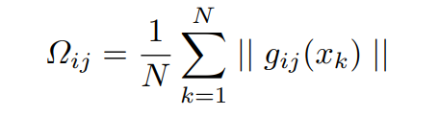
A parameter's significance is determined by the gradient's magnitude, or how much a small adjustment to a parameter alters the learned function's output for a given data point (xk). The gradients over the provided data points are then added up to get the importance weight Ωij for the parameter θij: The importance weights of the parameters are updated in this fashion instead of using diagonal of the fisher information matrix. I have taken the T5 encoder-decoder transformer framework and trying to work on implementing the MAS sequence learning task loss for the following finetuning tasks.

Slide 6
I have chosen the T5 encoder decoder architecture with three finetuning tasks ie. Translation, summarization and paraphrasing and trying to implement MAS optimization to learn all the three tasks sequentially without forgetting the other tasks learned previously. For the translation task, I have taken the WMT-16 dataset first 10000 examples with English to German translation task and finetuned the t5-small model from the hugging face repository and evaluated with validation dataset of 2000 examples. For the paraphrasing task, I have taken the para-nmt-processed 5m token dataset with back –translation and fine –tune the t5-small model from the hugging face repository and evaluated the model with validation dataset of 1128 examples. Similarly, for the summarization task, I have taken the Cnn-dailymail dataset of first 40000 examples and finetuned the t5-small model from the hugging face repository and evaluated the model with 2000 examples.

Slide 7

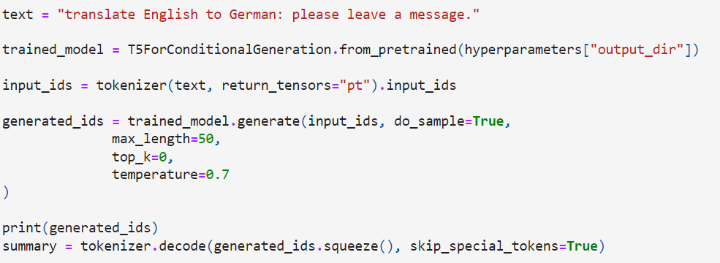

Results so Far:

Slide 8
Next Steps: 1. so far, I have trained Gpt2 model with tiny Stories dataset evaluated on avg perplexity by curriculum learning and cnn-dailymail dataset. I have implemented ewc loss and trained the model with this loss in addition to fine tuning loss. I’m working on to get better results. 2. for the MAS based training iam trying to implement the MAS optimization along with the T5 transformer fine-tuning. So far, I have fine tuned the model on the different tasks separately. From now on, I will try to fine tune the model on the three different tasks trained based on the MAS loss and get the evaluation on the three tasks at the same time.

Slide 9
Conclusion:
In this research project, I have tried to develop my research skills by focusing on studying the research papers and their approach in solving the problems in producing innovative solutions. I have tried to replicate the research on continual learning to fine tune smaller language models like gpt2 and t5 to better improve their language modelling performance and reasoning capabilities in contrast to large language models and the naïve law of scaling a language model by increasing the number of parameters leads to a better performance in a wide range of linguistic tasks.

