Slide 1
JavaScript

Slide 2
What is JavaScript?
Lightweight programming language – scripting language.
Used to make web page interactive
Insert dynamic text into HTML
React to events
Get information about a user’s computer
Perform calculation on user’s computer
A web standard
NOT related to Java other than by name and some syntactic similarities

Slide 3
Linking HTML to a JavaScipt file
<script src=“where/you/saved/your/file.js” type=“text/javascript”></script> HTML
script tag can be placed in HTML page's head or body
JS code can be placed directly in the HTML file's body or head (like CSS) – bad practice

Slide 4
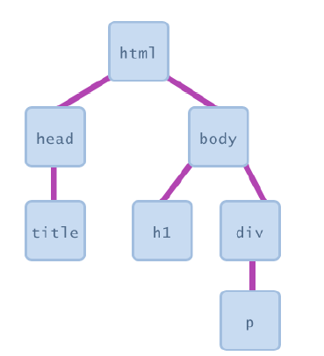
Document Object Model (DOM)
Most JS code manipulates elements on an HTML page
Examine elements
Change state
Change style

Slide 5
Accessing Elements document.getElementById
var name = document.getElementById("id");
JS
<button onclick="changeText();">Click me!</button>
<span id="output">replace me</span>
<input id="textbox" type="text" /> HTML
function changeText() {
var span = document.getElementById("output");
var textBox = document.getElementById("textbox");
textbox.style.color = "red";
} JS

Slide 6
Accessing Elements document.getElementById
document.getElementById returns DOM object for an element with a given id

Slide 7
Variables
It is where we store data temporarily
“Loosely typed”
Dynamic type
Declaration: var, let, const
Rules: - cannot be a reserved keyword (if, function)
- should be meaningful
- cannot start with a number (1name)
- case sensitive
- cannot contain a white space or hyphen
- camel notation: thisIsMyVariable
- pascal notation: ThisIsMyVariable
- snake notation: this_is_my_variable

Slide 8
Variables: Categories of Types
Primitive/Value types
String: var name = ‘Jose’
Number: var age = ’50’
Boolean: var isApproved = true
Undefined: var lastName = undefined
NULL: var selectedCourse = null
Reference Types
Object
Array
Function

Slide 9
Objects
Like object in real life: has properties
//instead of
var name = ‘Jose’;
var age = ‘30’;
//We use
var person = {
name: ‘Jose’,
age: 30
};
//We group variables that are highly related
JS

Slide 10
Accessing properties of an object
var person = {name: ‘Jose’, age: 30};
JS
Dot notation
Bracket notation
Console.log(person.name); //returns Jose in DOM
JS
Console.log(person[“age”]); //returns 30 in DOM
JS

Slide 11
Arrays
Data structure that we use to represent a list of items
Data type and length is dynamic
Array is also typed object in javaScript
var colorList = [‘orange’, ‘green’, ’blue’]
JS

Slide 12
Funtions
Fundamental building blocks in javaScript
Set of statements that performs a task or calculates a value
function greetings(){ //body starts here
console.log(“Hello World”);
} //ends here
JS

