Slide 1


Russia v/s Ukraine
By :
Sanjana Veesam
Shailaja Muchintala
Srinand Andey
Ram Manohar chundi
Ram Chandra Bhavirisetty

Slide 2


Introduction
The Russo-Ukrainian War is an ongoing war between Russia (together with pro-Russian separatist forces) and Ukraine. It began in February 2014 following the Ukrainian Revolution of Dignity, and initially focused on the status of Crimea and the Donbas, internationally recognised as part of Ukraine.

Slide 3
Goal
1. Extract data from twitter with discussions on the topic of Russia Ukraine war.
2. Clean data and create a pre - processed document.
3. LDA applied on the cleaned data for training.
4. Segregated the data into topics.
5. Explore the words in a topic and their relative weight.
6. Applied overall graph metrics for twitter data on the topic of Russia Ukraine War.

Slide 4
Data
Analyzing data on Russian invasion on Ukraine
Collecting tweets and performed topic modelling algorithm
Calculated all group metrics and derived the insights

Slide 5
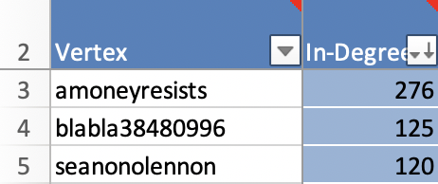
In-degree Analysis
1. amoneyresists, blabla38480996, senonolennon are the highest indegree vertices.

Slide 6
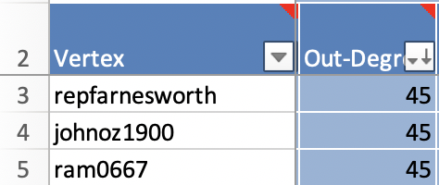
Out degree analysis
Repfarnesworth, johnoz1900, ram0667are the highest out-degree vertices

Slide 7
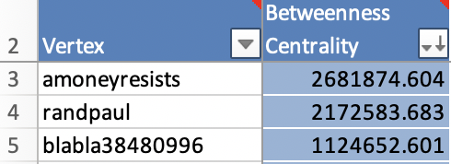
Betweenness Centrality
randpaul
randpaul
The account with Amoneyresists, randpaul, blabla38480996 have the highest betweenness centrality.

Slide 8
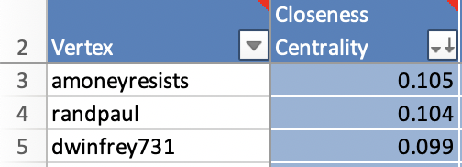
Closeness Centrality
Amoneyresists, randapaul, dwinfrey731 have the highest closeness centrality.

Slide 9
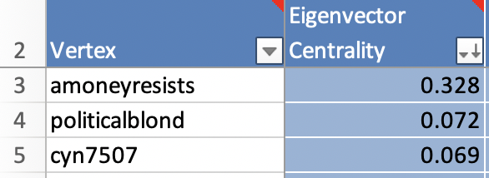
Eigen Vector Centrality
1. amoneyresists, politicalblond, cyn7507 have the highest eigen vector centrality.

Slide 10
Topic Modelling
1 Data : Twitter data.
2. 7918 tweets analyzed.
3. Cleaned data.
4. Created a data that can be an input for LDA.
5. Computed coherence score.
6. We could identify 19 topics with the use of LDA we would be analyzing highest frequent topics ahead.

Slide 11
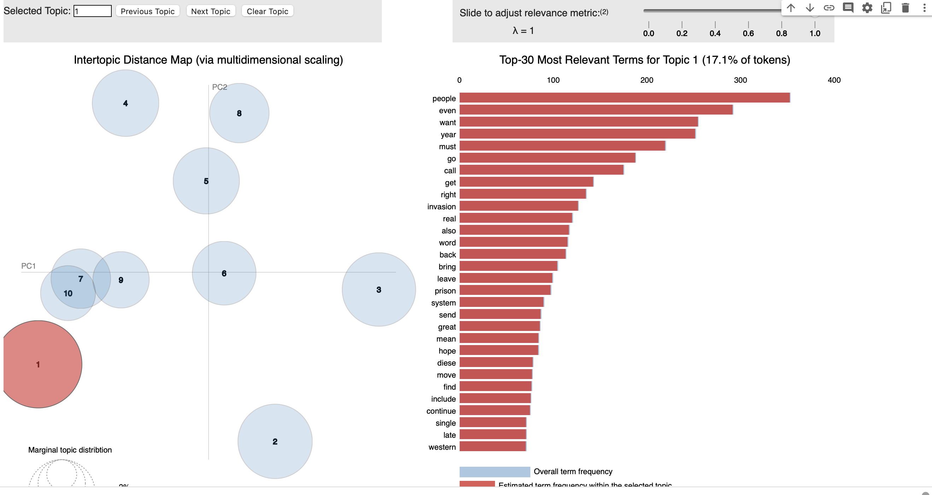
Topic 1
17.1% tokens were used in topic 1
People, even, want, year, must , go, call, get, right, invasion.
These are the highest used words in topic 1.

Slide 12
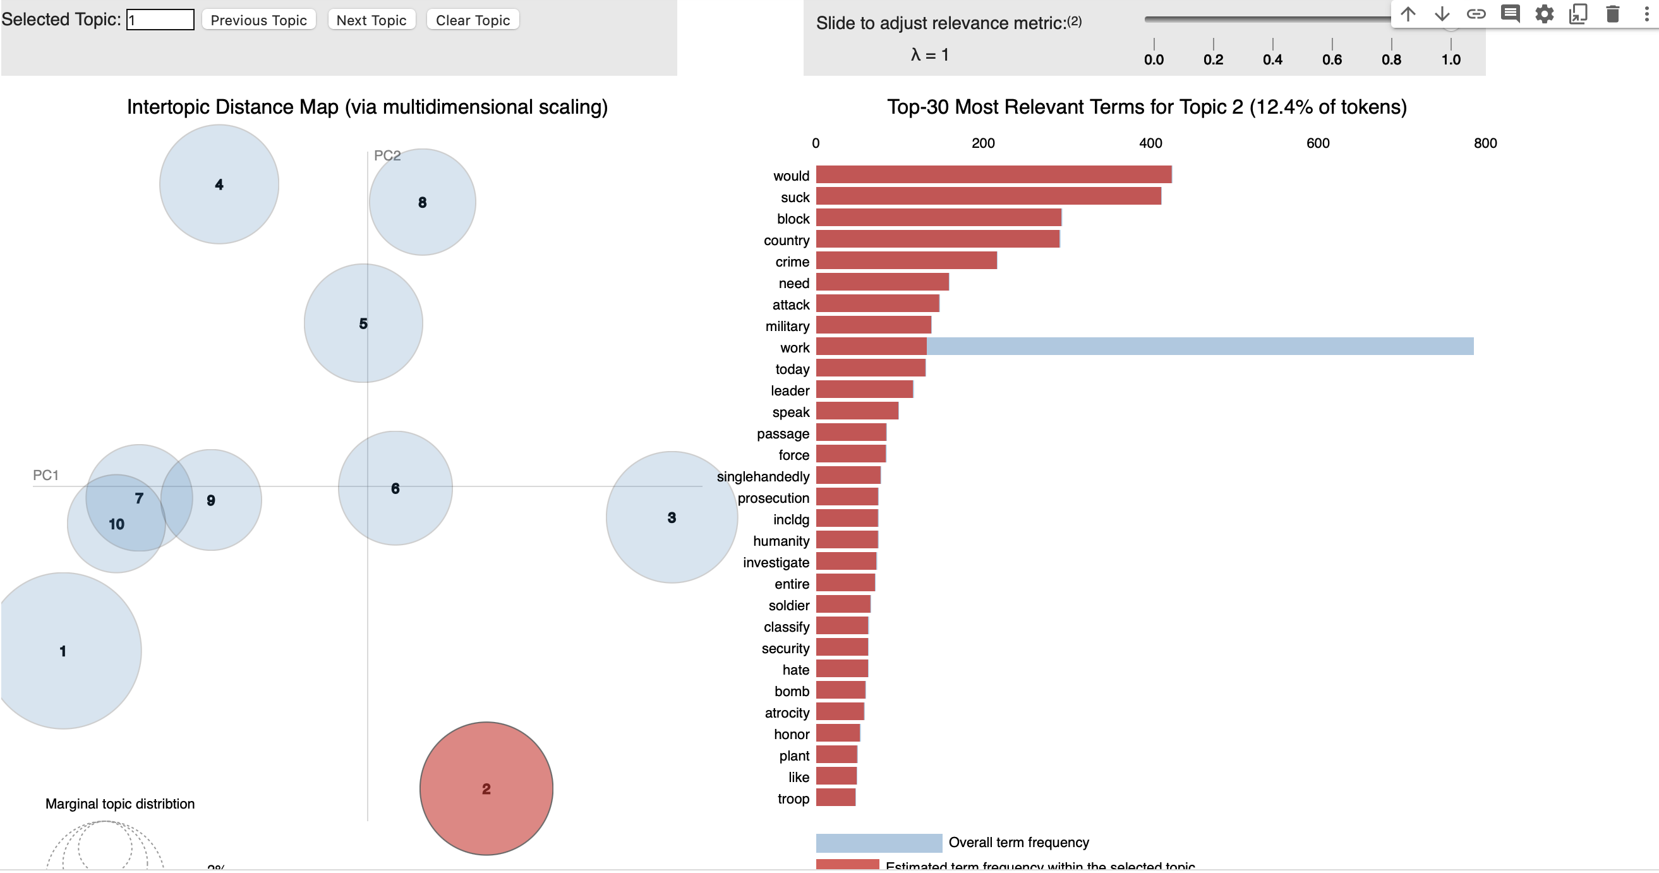
Topic 2
12.4% tokens used in topic 2.
Would, suck, block, country, crime, need, attack, military, work, today.
These were the words used in topic 3.

Slide 13
Coherence score
1. Coherence Score: 0.4668966371767018
2. Perplexity: -6.868672672789927
3. here we can observe that perplexity is less which is a good sign.

Slide 14
Topic 3
12.1% of tokens were used in topic 3.
Work, say, Ukraine, last, know, package, pass, join, critical, actual.
These were the words used in topic3.

Slide 15
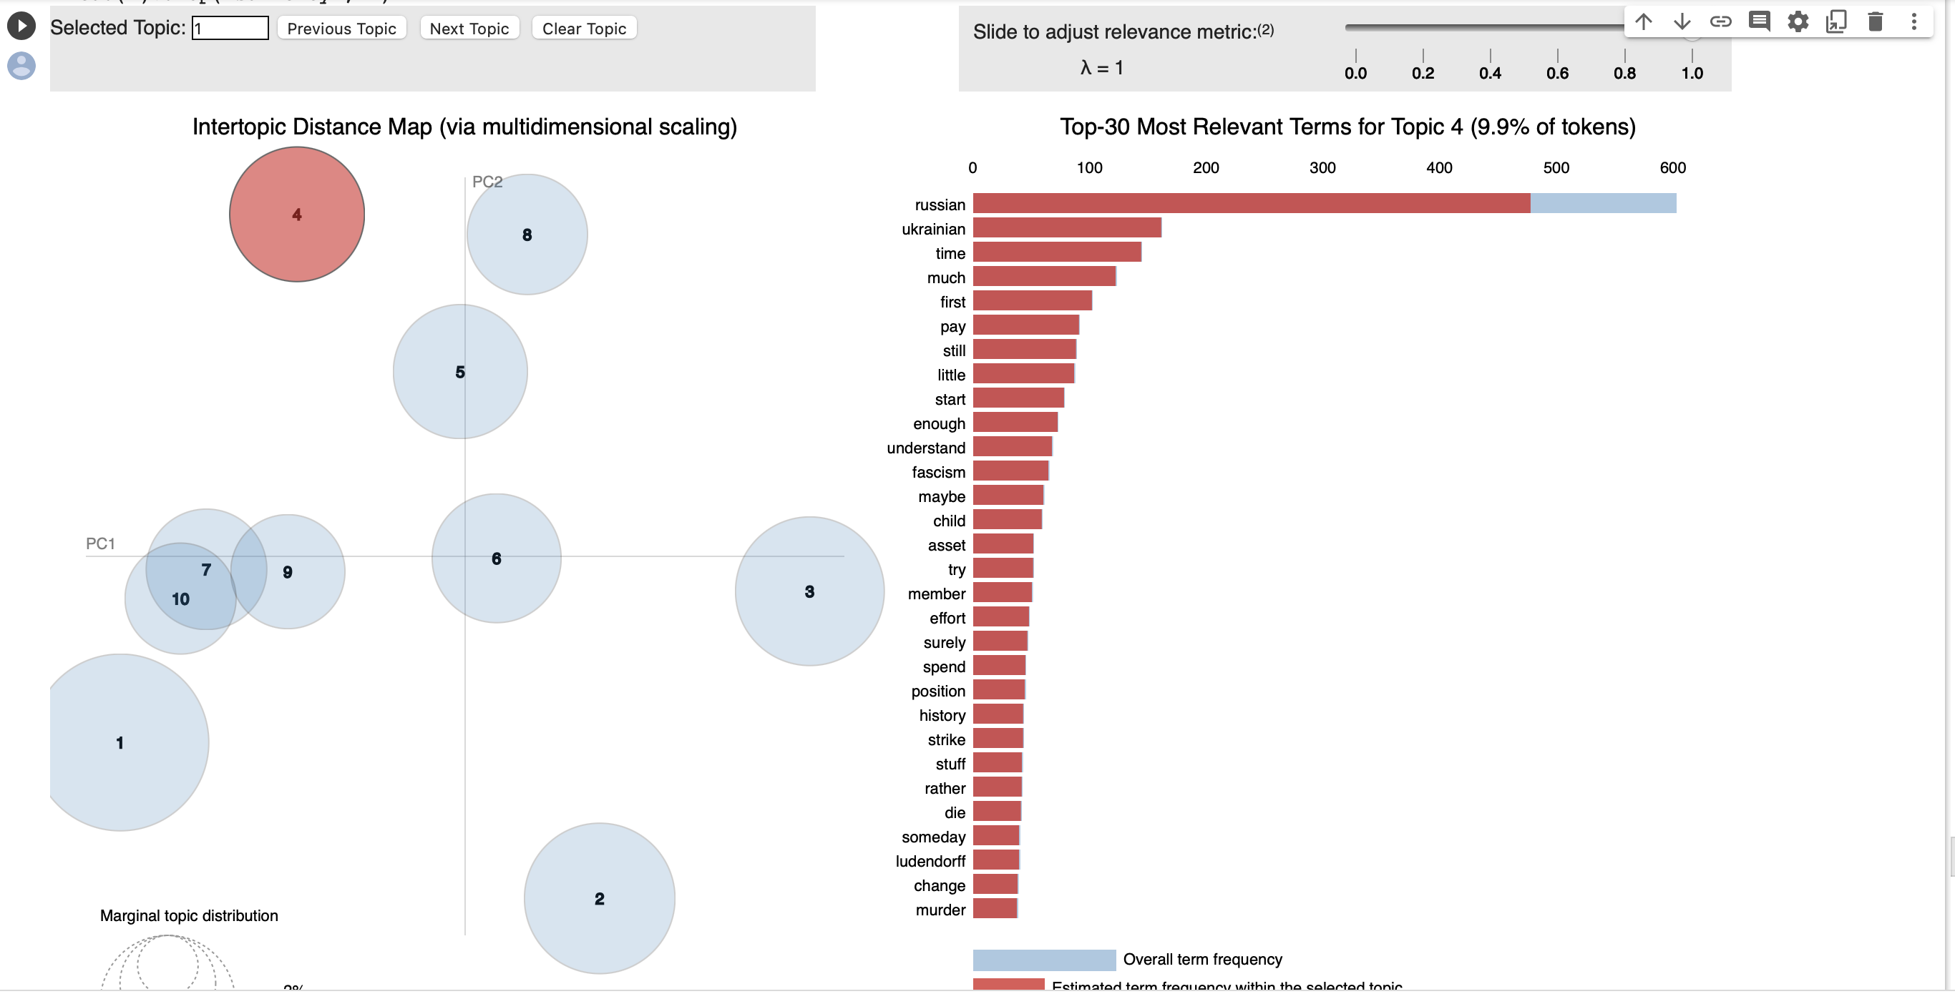
Topic 4
9.9% of tokens were used in topic 4.
Russian, ukranian, time, much, first, pay, still, little, start, enough.
These were the most used words in topic 4.

Slide 16
Limitations
Less number of understandable tweets.
Constrained coding skills.
Limited availability of relevant data.

Slide 17
Conclusions
Among all the topics created, topic 17 has the highest coherence score with 58
After Processing the data, the coherence score is 47.

Slide 18
Thank you

