Slide 1
PlanIT!
Plan your way ahead

Slide 2
What is PlanIT?
It is always better to plan you journey before you go out, courtesy Delhi- A city of mishappenings
Notes:
The issue of safety is of crucial importance in Delhi with the ever so escalating crime rates. Putting the same crime related data to good use, we have come up with an app that suggests alternative routes between any two places in Delhi, giving information about not only the time duaration and distance of travel, but also a certain 'Danger Index' of each route. We evaluate this 'Danger Index' by applying Unsupersvised Machine Learning on crime data/records of the past. We hope to extend this app's utility by including more detailed and transparent data which is not currently available.

Slide 3
Technical Complexity
We have applied Unsupervised Machine Learning Algorithm to find danger index of multiple routes between two places.
Notes:
We have applied Unsupervised Machine Learning Algorithm to find danger index of multiple routes between two places.
We have used a Clustering algorithm : K-Means , to rate criminal activities in 166 places on the map of Delhi on a scale of 0 to 4. K-means clustering is unsupervised machine learning, which is used when you have unlabeled data (i.e., data without defined categories or groups). The goal of this algorithm is to find groups in the data, with the number of groups represented by the variable K. The algorithm works iteratively to assign each data point to one of K groups based on the features that are provided. Data points are clustered based on feature similarity. The results of the K-means clustering algorithm are: 1.The centroids of the K clusters, which can be used to label new data 2.Labels for the training data (each data point is assigned to a single cluster)
The k-means algorithm assigns 0-4 values to 166 locations in Delhi. An index of 0 indicates that the place is relatively safe with less crime rates in past while an index of 4 means that the place has high crime records in the past. We used various legends to display safety index of various locations in Delhi.

Slide 4
Other Features
Report Crimes in different areas
Find the nearest Police Station and its contact number near you in a single tap
Send SOS Messages during Emergency to your caring ones

Slide 5
Future Prospects
Expand the reach
Improving the accuracy….

Slide 6
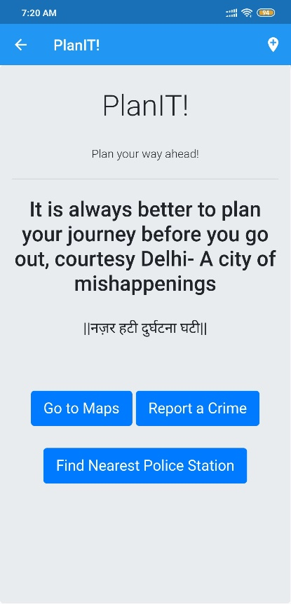
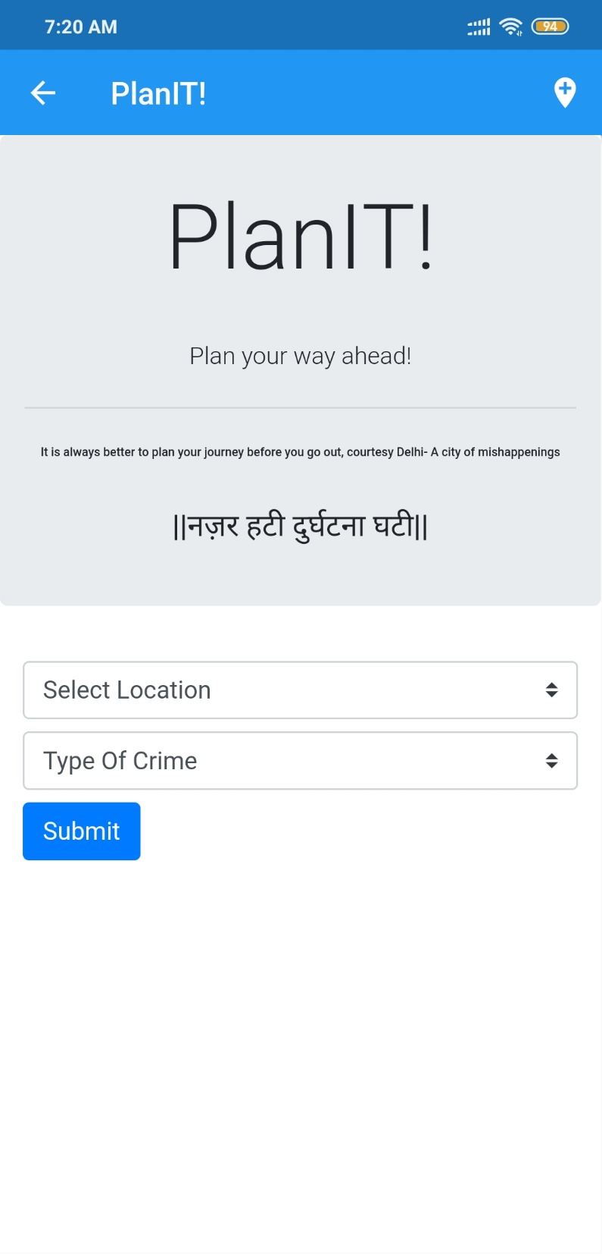
Snapshots

Slide 7
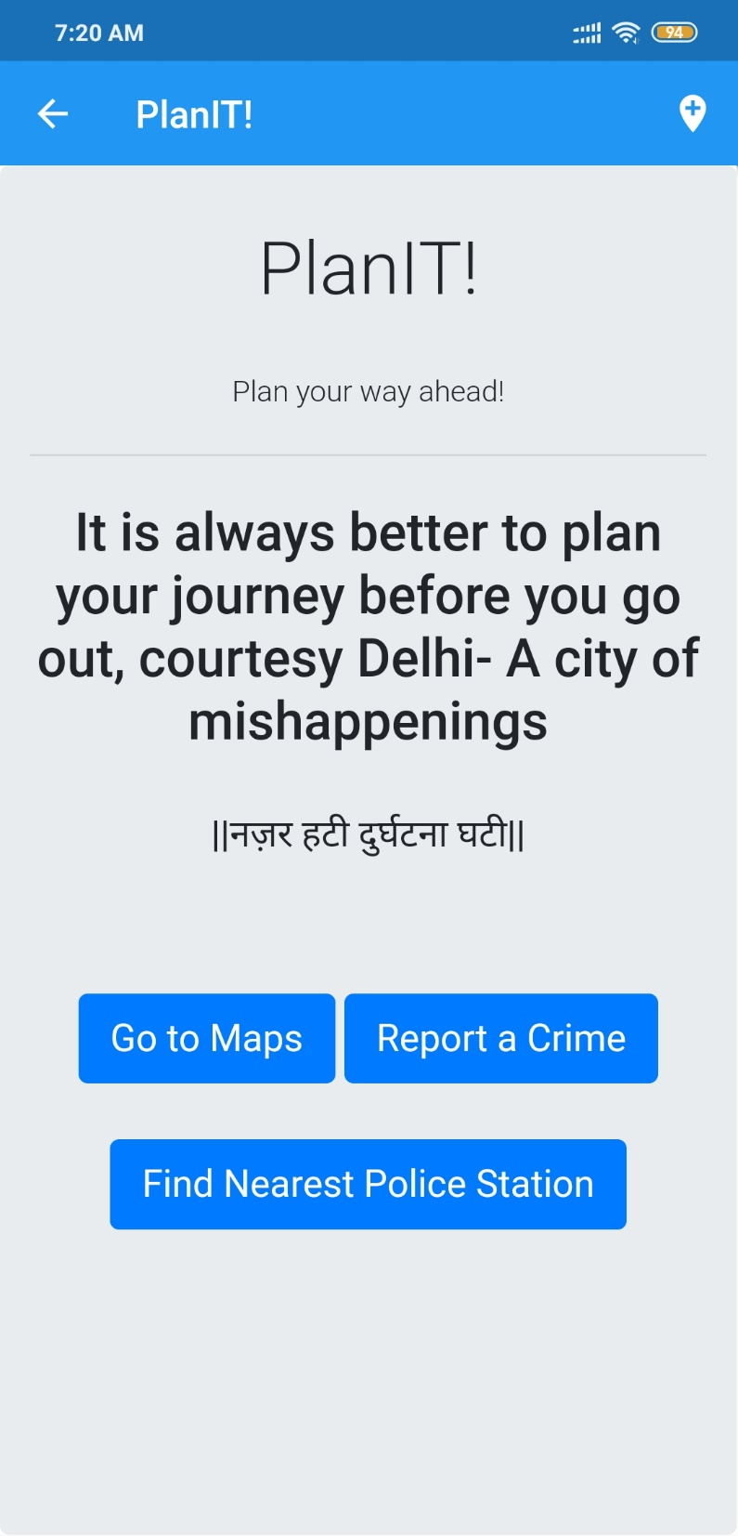
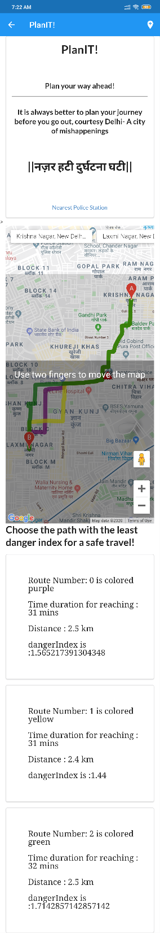

Slide 8
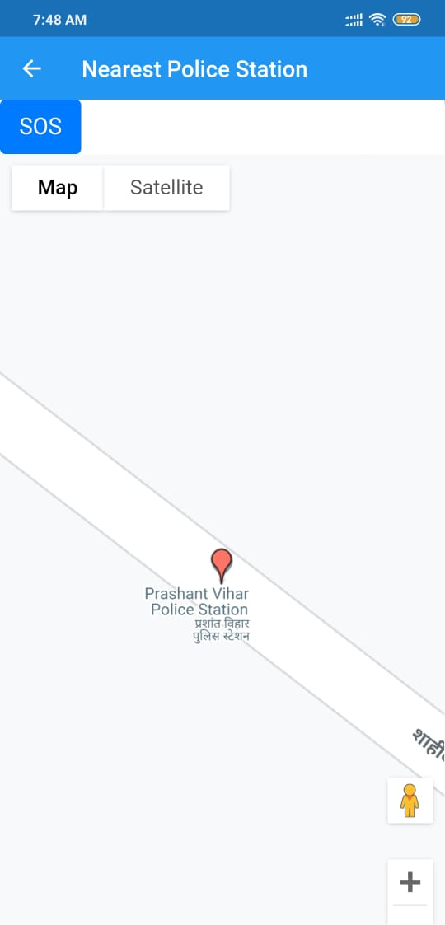
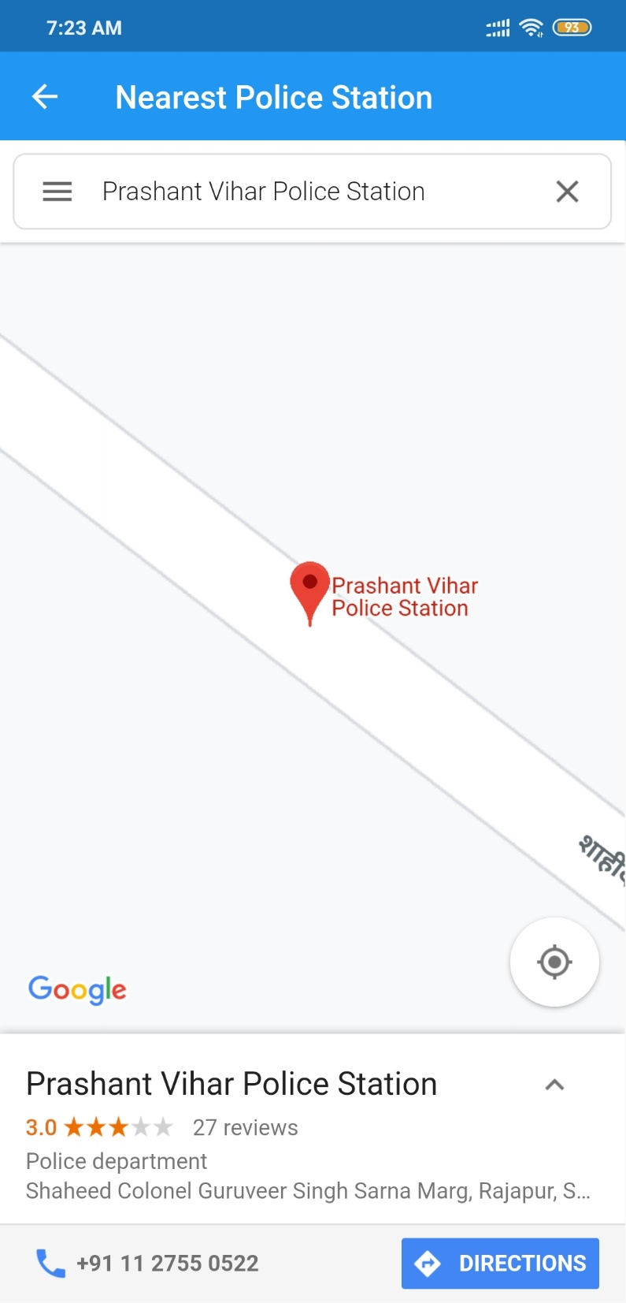
THE SOS Button

Slide 9
Thank You

