Slide 1
When Kubeflow Fights Cilium:
Debugging 60% Idle GPUs in Kubernetes
Ramkumar Nagaraj | Sr. Computer Scientist, Adobe
Bingi Narasimha Karthik | Computer Scientist II, Adobe

Slide 2
Agenda
1. The Problem — 60% idle GPUs, no obvious cause
2. Root Cause — Cilium network policy meets topology blindness
3. Live Demo — Reproduce the conflict, watch the alert fire
4. The Fix — 3 YAML additions, no CNI or Kubeflow changes
5. Takeaways — General patterns for CNI-aware ML scheduling

Slide 3
Part 1: The Problem
60% idle GPUs. Pods scheduled. Training stalled.

Slide 4
The Setup: Two Zones, One Problem
zone-a (GPU Zone)
2 worker nodes
GPU taint: gpu=present:NoSchedule
Label: topology.kubernetes.io/zone=zone-a
Cilium policy: intra-zone-a ALLOW
Cross-zone GPU traffic: DENY
zone-b (CPU Zone)
2 worker nodes
No GPU taint — any pod can land here
Label: topology.kubernetes.io/zone=zone-b
Cilium policy: intra-zone-b ALLOW
No GPU workers — coordinator ends up here

Slide 5
Default Kubeflow Scheduling: No Topology Awareness
What Kubeflow does by default
Coordinator pod: no affinity, no nodeSelector — lands anywhere
GPU workers: nodeSelector gpu=true — always land in zone-a
Result: coordinator in zone-b, workers in zone-a — different network zones
Observed symptoms
gpu_demo_utilization_pct: ~40% (resources allocated, nothing computing)
Workers retry connection to coordinator — all fail with timeout
No kernel errors, no OOM — pods Running, training never starts

Slide 6
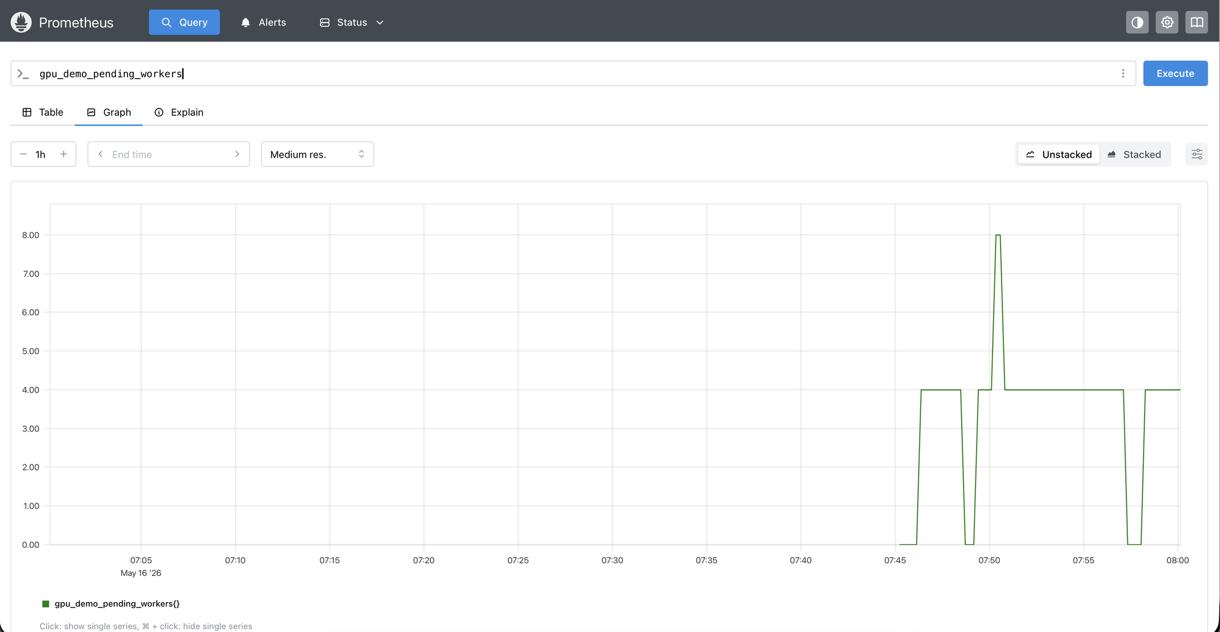

Slide 7
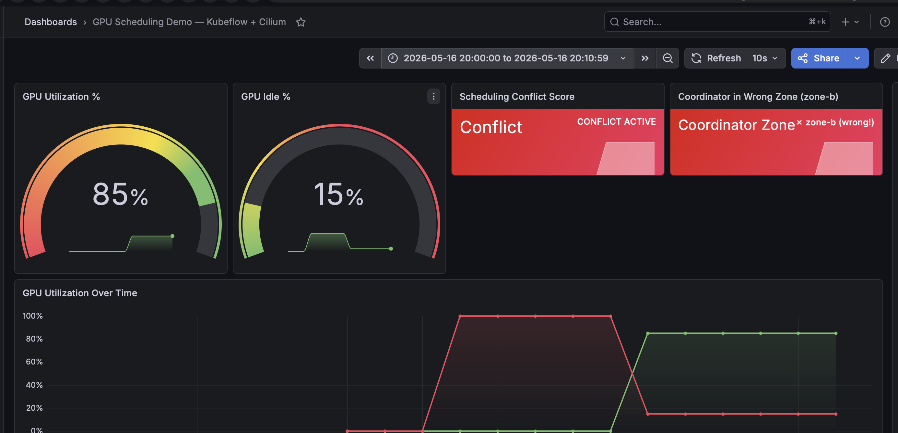
Live Demo: Reproducing the Conflict
bash scripts/demo-before.sh
Watch: coordinator lands zone-b — workers retry — GPU at 40%
Grafana: http://localhost:3000 | Prometheus: http://localhost:9090

Slide 8
Part 2: Root Cause
Cilium network policy meets topology blindness

Slide 9
Cilium’s Topology-Aware Network Policy
How it works
CiliumNetworkPolicy uses pod label selectors
allow-intra-zone-a: pods in zone-a can talk to each other
deny-cross-zone-gpu-traffic: gpu-worker pods CANNOT egress to zone-b pods
The policy is correct security design —
the scheduler didn’t know about it
The policy snippet
kind: CiliumNetworkPolicy
name: deny-cross-zone-gpu-traffic
spec:
endpointSelector:
matchLabels: {role: gpu-worker}
egressDeny:
- toEndpoints:
matchLabels: {zone: zone-b}

Slide 10
The Smoking Gun: GPUWorkersCantReachCoordinator
Prometheus alert fires within 30 seconds of BEFORE state
Alert condition: coordinator_zone > 0 AND workers_running > 0 for 30s
gpu_demo_coordinator_zone returns 1 — “coordinator is in the wrong zone”
gpu_demo_utilization_pct returns 40 — allocated but idle
gpu_demo_zones_occupied returns 2 — workers and coordinator split across zones
Debugging path
1. Alert fires → check pod placement → coordinator in zone-b
2. Check Cilium policies → deny-cross-zone-gpu-traffic matches exactly
3. Root cause: no topology awareness in workload spec

Slide 11
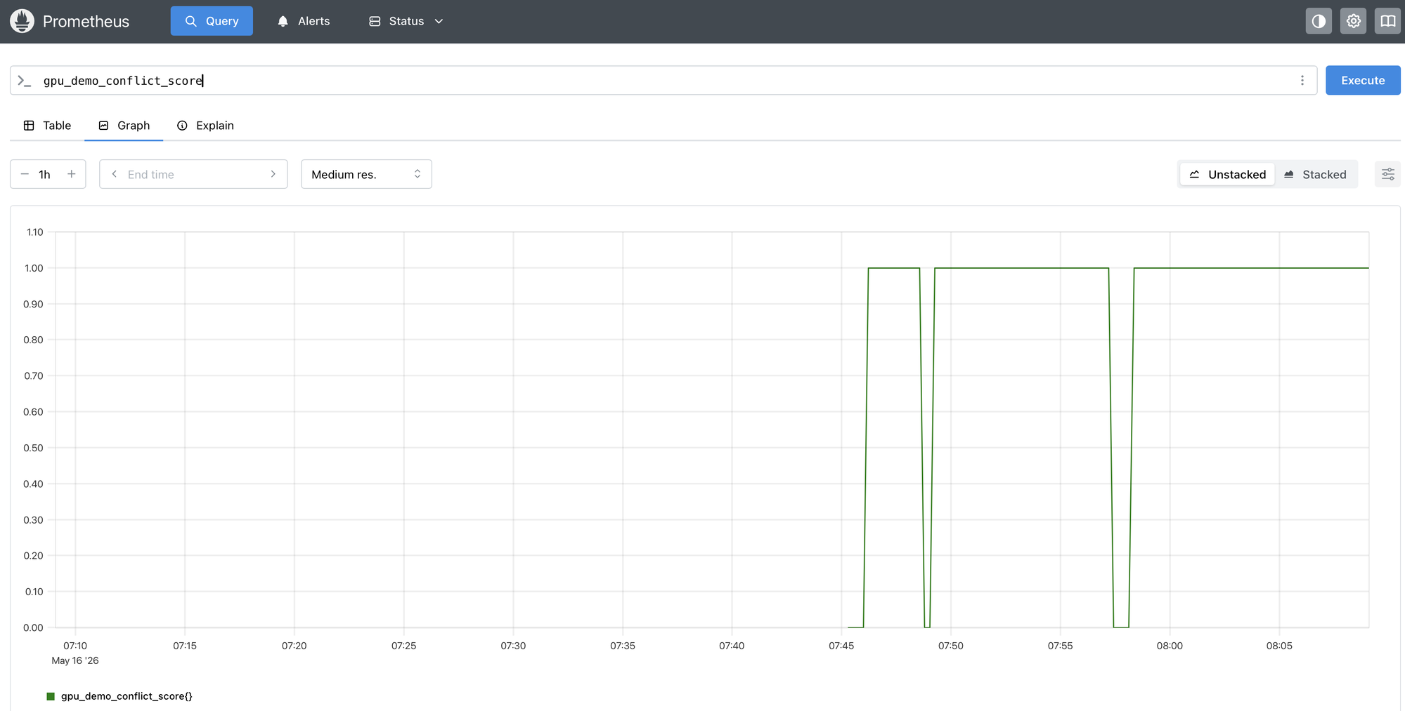

Slide 12
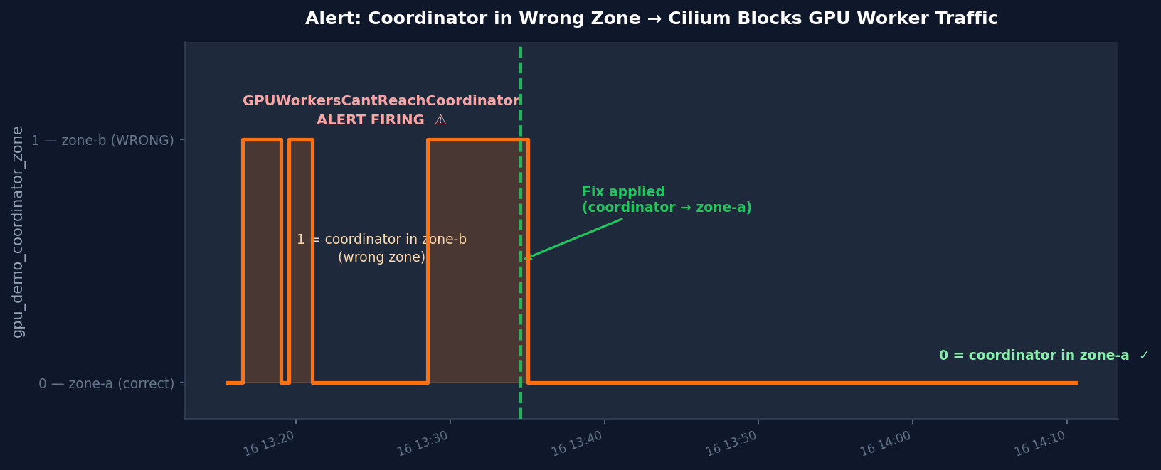

Slide 13
Part 3: The Fix
3 YAML additions. No Kubeflow changes. No Cilium changes.

Slide 14
The Fix: 3 YAML Additions
1. nodeAffinity on coordinator — pin to zone-a
requiredDuringScheduling: zone IN [zone-a]
2. topologySpreadConstraints on coordinator
maxSkew: 1 | topologyKey: zone | DoNotSchedule | selector: ml-training
Forces all ml-training pods into the same zone as the coordinator
3. topologySpreadConstraints on GPU workers
Zone-level spread (DoNotSchedule) + hostname spread (ScheduleAnyway)
Result: coordinator → zone-a | workers → zone-a | Cilium allows all traffic

Slide 15
Live Demo: Applying the Fix
bash scripts/demo-after.sh
Watch: all pods move to zone-a — workers connect — training runs — GPU at 85%
Grafana: http://localhost:3000 | Conflict score drops to 0

Slide 16
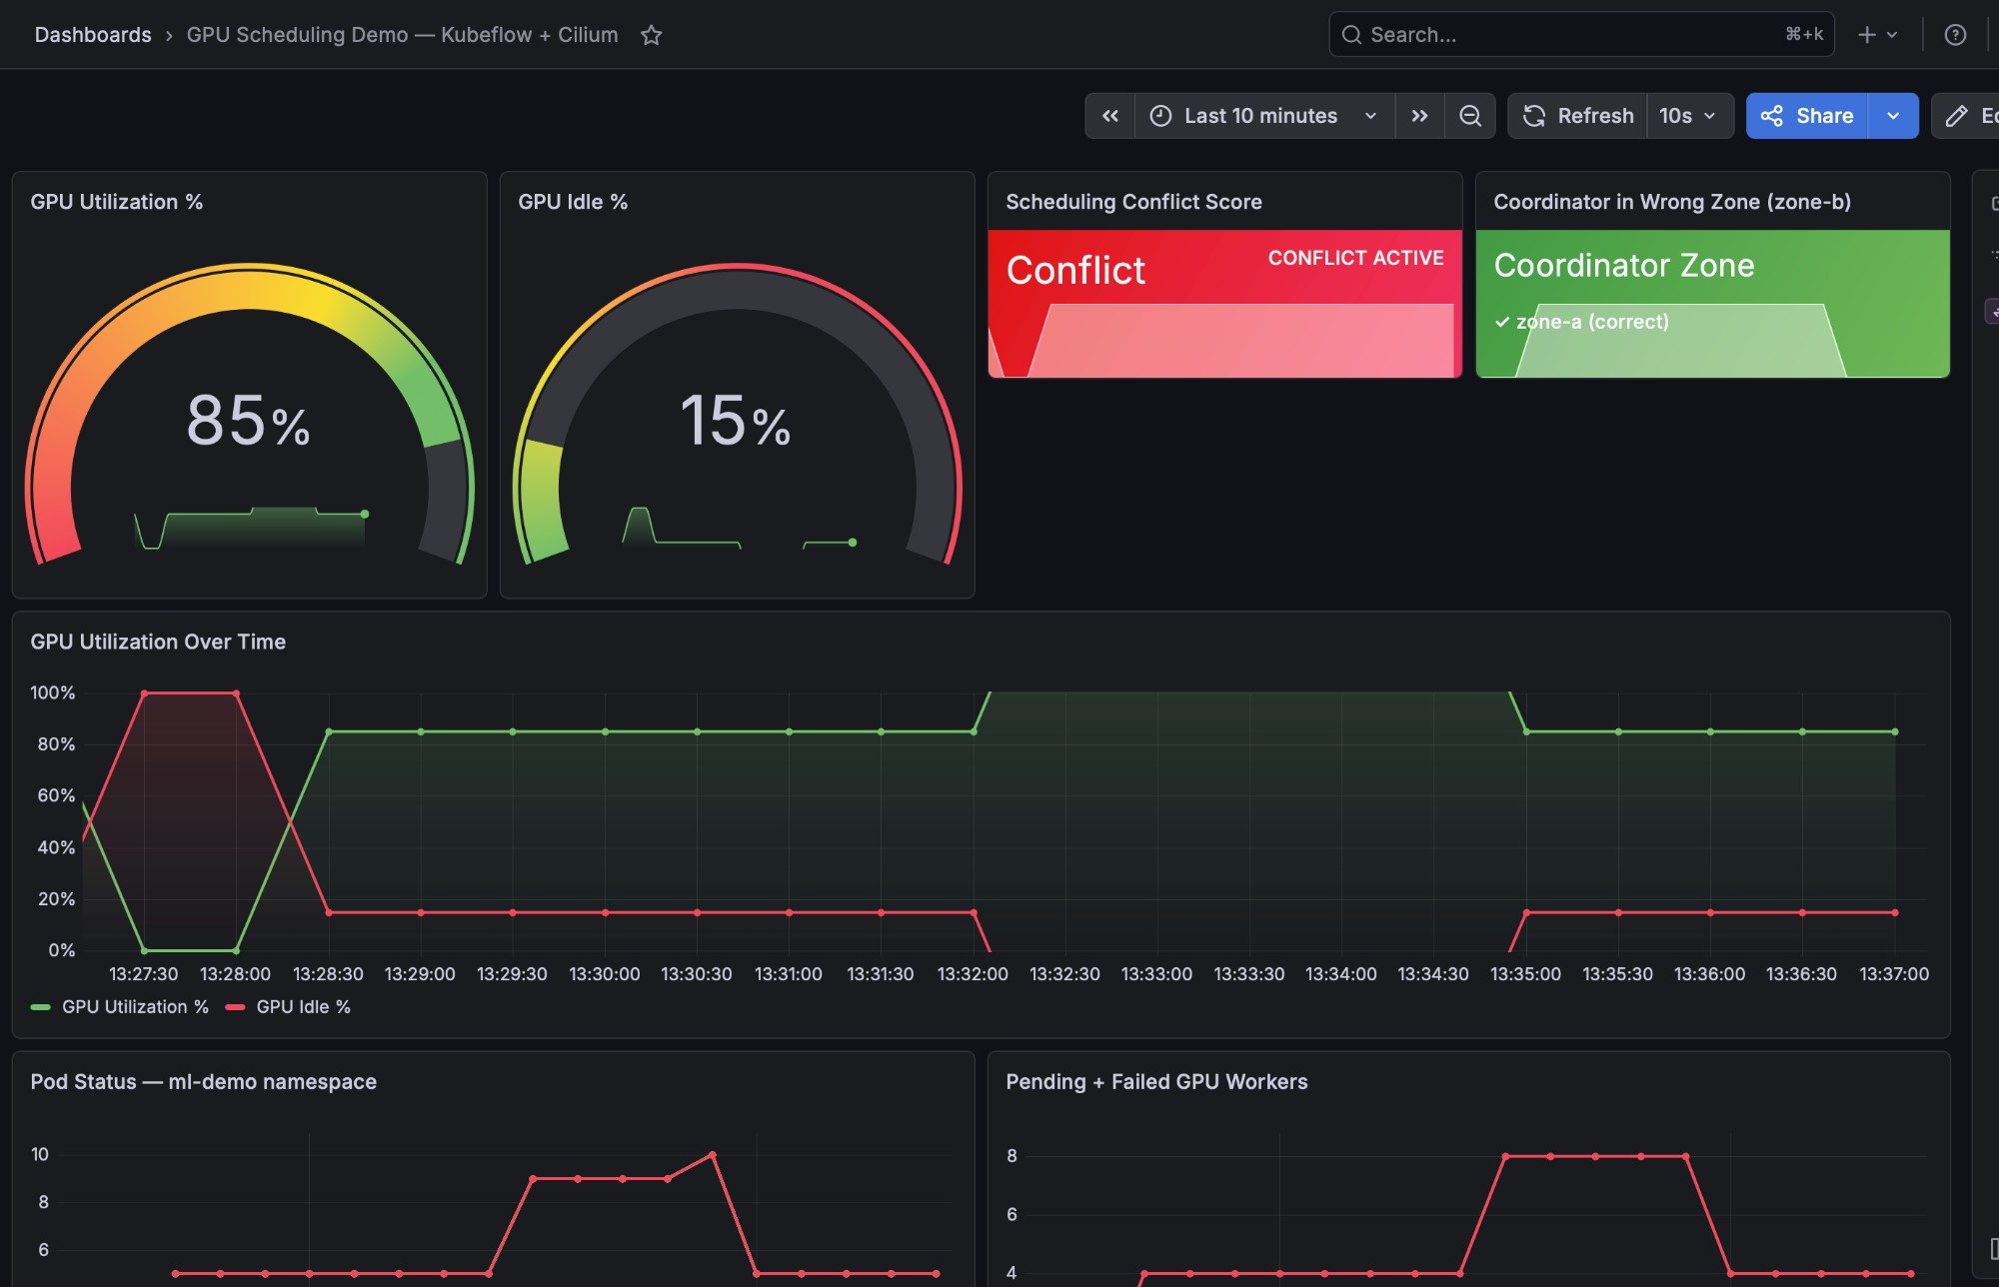

Slide 17
Before vs After: The Numbers
BEFORE (broken)
GPU utilization: ~40%
Coordinator zone: zone-b (wrong)
Cross-zone Cilium blocks: ACTIVE
Training progress: STALLED
Prometheus alert: FIRING
Conflict score: 1.0
AFTER (fixed)
GPU utilization: ~85%
Coordinator zone: zone-a (correct)
Cross-zone Cilium blocks: NONE
Training progress: RUNNING (30/30 steps)
Prometheus alert: RESOLVED
Conflict score: 0.0

Slide 18
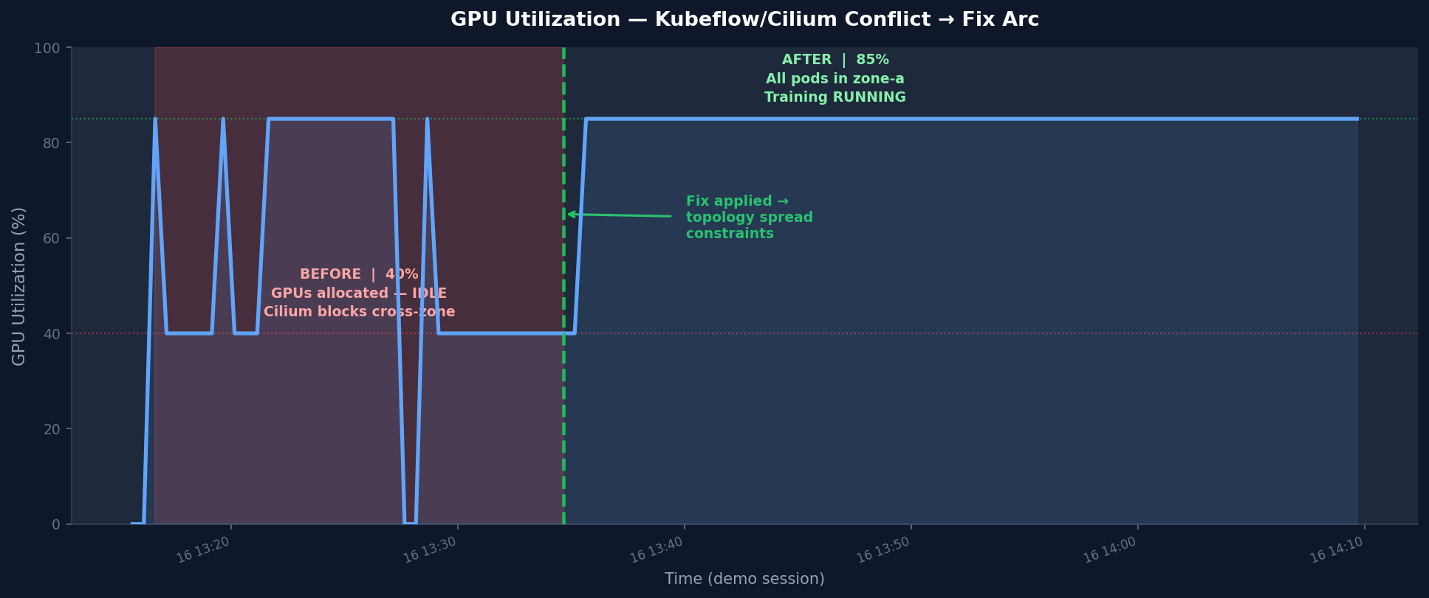

Slide 19
Beyond the Hard Block: The Production Spectrum
1. Hard CiliumNetworkPolicy block — what this demo shows
Workers can’t reach coordinator; training never starts. Detected in seconds.
2. Cross-zone NCCL latency — no hard block, just distance
Training runs 30–60% slower; AllReduce pays cross-zone RTT. No error — detected in hours.
3. Cross-AZ egress cost — invisible to Kubernetes
Surfaces only in cloud billing; significant at scale. Detected in days.
One fix resolves all three
Topology spread constraints pin the coordinator to the GPU zone — same YAML, every scenario.

Slide 20
Key Takeaways
1. Your CNI has opinions about topology — your scheduler doesn’t know
Cilium topology-aware policies are silent to the Kubernetes scheduler
2. Topology spread constraints = Kubernetes-native fix
No Kubeflow patch, no Cilium change — 3 YAML stanzas in your workload spec
3. Instrument before you need it: GPU utilization + pod zone metrics
Prometheus + Grafana dashboards exposed this in seconds, not days
4. Pattern applies beyond Kubeflow/Cilium
Same root cause, 3 faces in prod: hard Cilium block, cross-zone NCCL latency, cross-AZ egress cost

Slide 21


Questions? | https://github.com/ram2valar/kubeflow-cilium-lab

