Slide 1
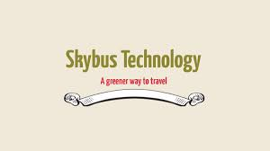

Slide 2
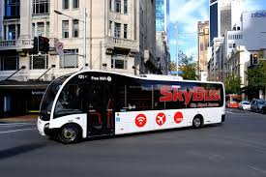
CONTENTS
INTRODUCTION
COMPONENTS
WORKING PRINCIPLE
ADVANTAGES

Slide 3
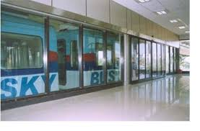
PIC PETLAND

Slide 4
WHAT IS SKY BUS ?
The Skybus Metro was a prototype suspended railway system by Indian technologist B. Rajaram with the Konkan Railway.
The system consisted of an elevated track with the cars suspended below, similar to the Wuppertal Schwebebahn or H-Bahn systems in Germany.
SkyBus is a greener way to travel. When delegates choose to travel on SkyBus
between the Airport and the city they all leave a smaller carbon footprint. SkyBus ...

Slide 5
COMPONENTS
SKY WAY
SKY BOGIE
SKY COACH
SKY STATION

Slide 6
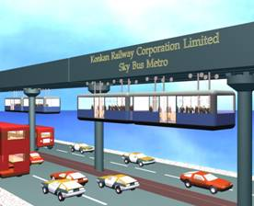

Slide 7
SKY BOGIE
STANDARD TWO AXLE BOGIES
SPEED 100 KMPH (MAX 160 KMPH)
LINEAR INDUCTION MOTOR – TO BE DRIVEN
DISC OF EMERGENCY BRAKES

