Slide 1
Predicting sample size required for classification performance
AI-2, Roman Prokopchuk

Slide 2
Motivation
Why is this important?
Human-annotated data is a scarce resource, and its creation is expensive in terms of both money and time(e.g. clinical notes);
In research, sample size decisions are often made based on ad hoc budget constraints rather than the expected performance of the classifier;
Predicting performance allows researchers to evaluate whether paying for additional annotations is actually worth the investment before committing resources

Slide 3
Previous and related work(Mukherjee’s approach): Learning curve fitting
Learning curve - a collection of data points showing how classifier performance relates to training sample size
Curve consists of three stages:
Rapid performance increase
A turning point with slower growth
An efficiency threshold (plateau) with marginal improvement.

Slide 4
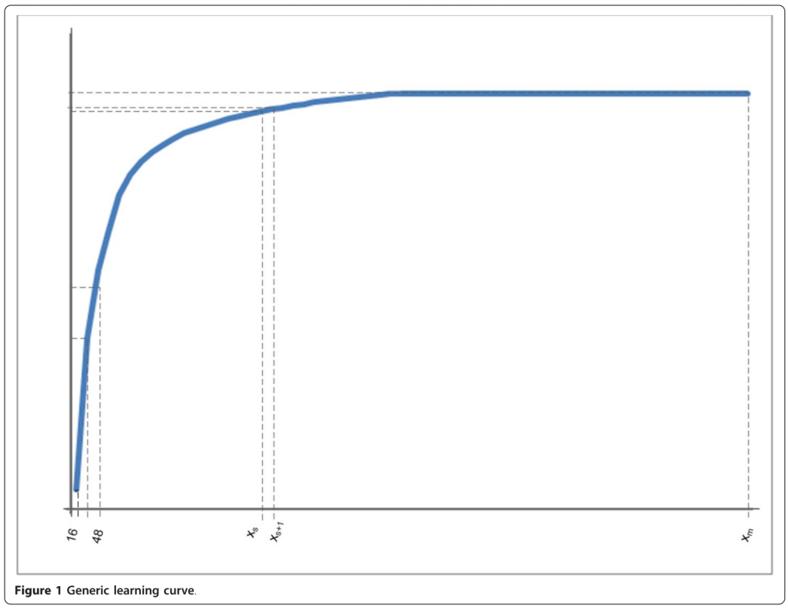
Learning curve example

Slide 5
Previous and related work (Mukherjee’s approach):
Mukherjee’s approach results:
Mukherjee et al. fitted inverse power laws to empirical learning curves to forecast performance at larger sample sizes. A permutation test procedure was used to assess the statistical significance of the classification performance for a given dataset size;
Evaluated on relatively small microarray datasets (n=53 to 280);
The differences between predicted and actual classification errors were in the range of 1%–7%;
Limitations:
The Mukherjee algorithm treats all empirical data points on the learning curve with equal importance. However, performance at larger sample sizes is more indicative of the classifier's true future behaviour
Solution: weighted fitting method, proposed by authors

Slide 6
Proposed algorithm
Proposed algorithm consists of three steps:
Learning curve creation
Model fitting and parameter identification
Sample size prediction

Slide 7

Step 1: Learning curve creation
The objective: create a learning curve that characterizes classification accuracy ($Y_{acc})$ as a function of the training set size ($X$);
The process: Classifiers are created and tested at increasing training set sizes:
Training sample size increases by a constant batch size $k$ (e.g. $k$, $2k$, $3k$, …)
Accuracy is calculated at each step using an independent test set or through n-fold cross validation

Slide 8

Step 2: Model fitting and parameter identification
The objective: find the function, used to model learning curve:
$Y_{acc}\left(x\right)=f\left(X, a, b, c\right)=\left(1−a\right)−b∗x^{c}$
$a$ much smaller than 1;
$c$ within the range $[−1, 0]$;
Parameter identification was found using nonlinear weighted least squares optimization together with the nl2sol routine
Each point $\left(x_{i}, y_{i}\right)$ has assigned weight $\frac{i}{m}$, where $m$ – total number of initial points

Slide 9
Evaluation(datasets)
Used datasets:
D1: Smoking-related sentences from patient discharge summaries
7016 sentences, target classes: smoker, no smoker
Test dataset size: 1000
D2: Smoking-related sentences from patient discharge summaries
8449 sentences, target classes: past smoker, current smoker
Test dataset size: 1000
D3: Waveform-5000
21 features, 5000 samples, 3 classes(wave 1, wave 2, wave 3). Target classes: wave 1, wave 2 or wave 3
Test dataset size: 2500

Slide 10

Evaluation(parameters)
Used model: SVM with a linear kernel (WEKA implementation):
Complexity constant =1, epsilon = ${10}^{−12}$, tolerance = ${10}^{−3}$, without normalization and standardization;
Used sampling strategies:
Random;
Distance(DIST): selection based on their proximity to the SVM hyperplane;
Diversity(DIV): selection based on dissimilarity (cosine distance) to reduce information redundancy;
Combined(CMB): hybrid approach utilizing DIST, DIV;
Batch size($k$): 16;
Each experiment was repeated 100 times, and results were averaged to ensure smooth learning curves

Slide 11

Evaluation(goodness metrics)
Used goodness metrics for approximated function:
Mean absolute error(MAE)
$$MAE=\frac{1}{|D_{v}|}\sum_{(x_{i}, y_{i})∈D_{v}}^{|D_{v}|}{|y_{i}−\hat{y_{i}}|}$$
$D_{v}$ - points, used for validation
Root mean squared error(RMSE)
$$RMSE=\sqrt{\frac{\sum_{(x_{i}, y_{i})∈D_{v}}^{|D_{v}|}{{\left(y_{i}−\hat{y_{i}}\right)}^{2}}}{|D_{v}|}}$$

Slide 12
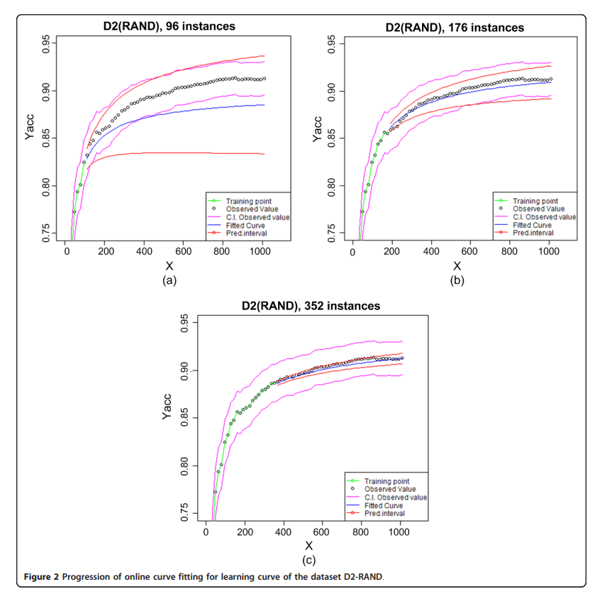
Results (learning curves)

Slide 13
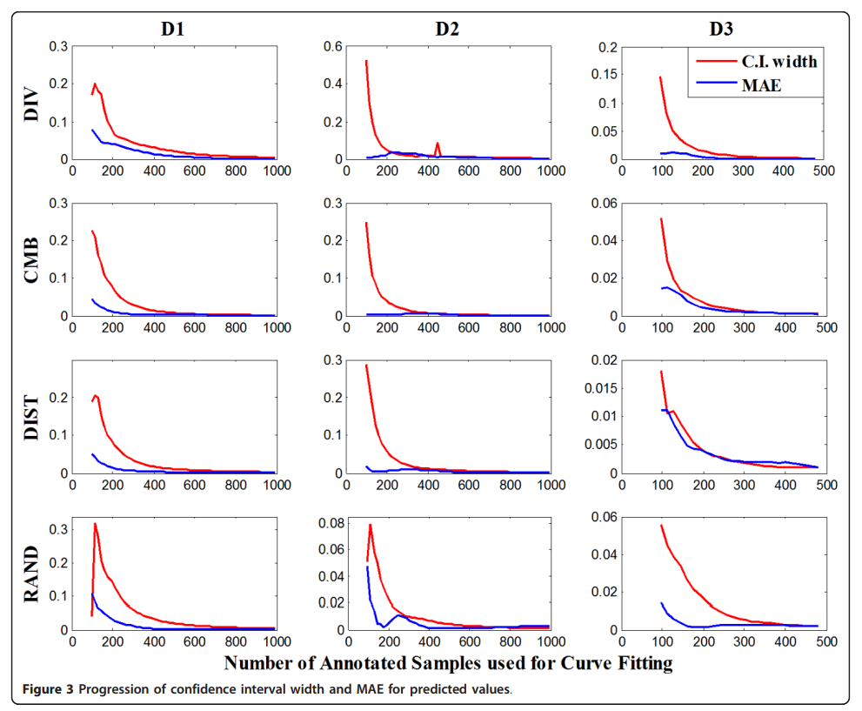
Results(MAE and confidence interval width)

Slide 14
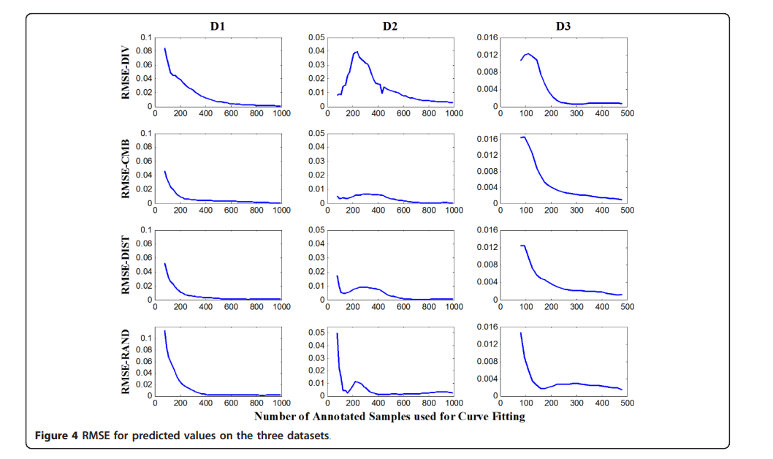
Results(RMSE)

Slide 15
Results
Proposed method significantly outperformed(error <1%) the unweighted baseline (Mukherjee et al.) across all datasets;
Improvements in forecasting accuracy were statistically significant with p-value < 0.05;
Stable predictions were achieved with as few as 80 to 560 initial training instances, depending on the dataset;
The method proved effective for both clinical text classification (D1, D2) and numeric waveform data (D3), showing its versatility across different AI domains;

Slide 16

Thank you for attention!

