Slide 1
RAMANATHAN J
URL STEGANOGRAPHY
Presented By:
Ramanathan J
ALPHA COLLEGE OF ENGINEERING
B.E COMPUTER SCIENCE AND ENGINEERING

Slide 2

AGENDA
Problem overview (Should not include solution)
Who are the end users
Proposed Solution
System Development Approach (Technology Used)
Algorithm & Deployment
Modelling
Result (Output Image)
Conclusion
Future Scope
References

Slide 3

Problem Overview
Traditional steganography techniques hide secret messages within seemingly harmless media like images or audio files. However, with the prevalence of online communication, there's a growing need for secure data transmission within URLs or links themselves.This problem statement calls for the development of novel URL/link steganography techniques that address these challenges, enabling secure and covert communication within the ubiquitous world of web links.

Slide 4
WHO ARE THE END USERS
End users of image steganography can vary widely depending on the context and purpose of its use. Here are some potential end users:
Government Agencies: Law enforcement, intelligence agencies, and military organizations may utilize image steganography for covert communication and information sharing, particularly when conducting surveillance or espionage operations.
Journalists and Whistleblowers: Individuals working in journalism or advocacy may employ image steganography to securely transmit sensitive information, such as leaked documents or confidential sources, while protecting the identity of whistleblowers and sources.
Researchers and Academics: Professionals in research and academia may use image steganography for experimental purposes, studying its applications in information security, cryptography, and digital forensics, or developing novel techniques and algorithms.
Ethical Hackers and Penetration Testers: Security professionals and ethical hackers may utilize image steganography as part of penetration testing and vulnerability assessment exercises to evaluate the effectiveness of security measures and identify potential weaknesses in systems and networks.
Cybercriminals: Unfortunately, malicious actors may also exploit image steganography for illicit purposes, such as concealing malware, ransomware, or other malicious payloads within innocent-looking images to evade detection by security systems and infiltrate target networks.

Slide 5
Proposed Solution
Here are some potential approaches to address the challenges of URL/link steganography:
Leveraging Unused Fields:Path Trailing Slashes: Utilize trailing slashes within paths (e.g., http://www.example.com/data/secret//) to signal the presence of hidden data. The number of extra slashes or specific characters appended could indicate data type or length.Steganography in Query Strings:Character Encoding: Employ non-alphanumeric characters or specific character combinations within query string parameters (e.g., http://www.example.com?param=message%2Fhidden) that appear valid for the parameter's purpose but hold hidden information.
Steganography within Port Numbers: Valid Port Range: Encode data within unused bits of valid port numbers (e.g., http:/ /www.example.com:8088). Specific bit patterns within the port number could represent hidden data.Statistical Modifications:Character Frequency: Subtly alter the frequency of characters within the URL that are statistically less common (e.g., punctuation marks) to represent hidden information.
Transform Coding:Reversible Transformations: Apply reversible transformations on specific parts of the URL (e.g., slight character shifts) to embed data without affecting functionality. The receiver would need the same transformation key to decode the message.

Slide 6
System Approach
. The URL steganography has minimal system requirements and can run on most modern computers. Here's a breakdown:
. Software:Python 3 (or compatible version) –
.The code is written in Python and requires a Python interpreter to be installed. Python is freely available for most operating systems.base64 library (usually included) - The code utilizes the base64 library, which is typically included in the standard Python installation.Hardware:No specific hardware requirements
. This code doesn't perform computationally intensive tasks and can run on any computer capable of running Python

Slide 7

Algorithm & Deployment
The choice of algorithm depends on the desired balance between data capacity, imperceptibility, and steganalysis resistance. Here are some common approaches:
Least Significant Bit (LSB) Modification: Applicable to scenarios where URLs contain unused bits within fields like port numbers. Here, the least significant bits can be altered to represent hidden data.
Character Swapping: Involve swapping statistically less frequent characters (like punctuation) with pre-defined alternatives that encode hidden data. Requires a shared key for decoding.
Redundant Coding: Embed the same data across multiple locations within the URL with slight variations to improve robustness against errors during transmission.
Parametric Modifications: Focus on modifying specific parameters within the query string. This might involve using extra characters or specific character combinations that appear valid for the parameter but hold hidden information based on a pre-defined scheme.
Client-Side vs. Server-Side Implementation: Client-side steganography embeds data before sending the URL, while server-side involves modifying URLs on the server. Client-side offers more flexibility but might require additional software on the sender's side. A secure key sharing mechanism is essential for both embedding and decoding the hidden data. This key could be pre-shared or established through a secure channel.
Error Correction Techniques: Redundant coding or error correction algorithms can be applied to improve the reliability of the hidden data transmission.

Slide 8
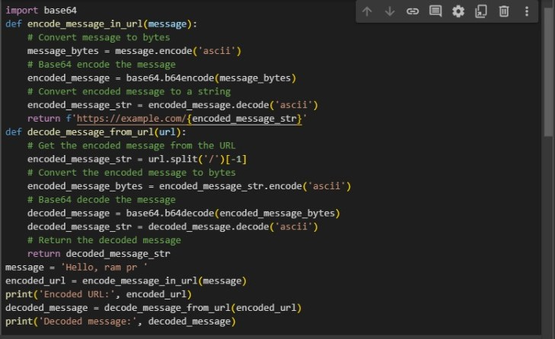
MODELLING

Slide 9
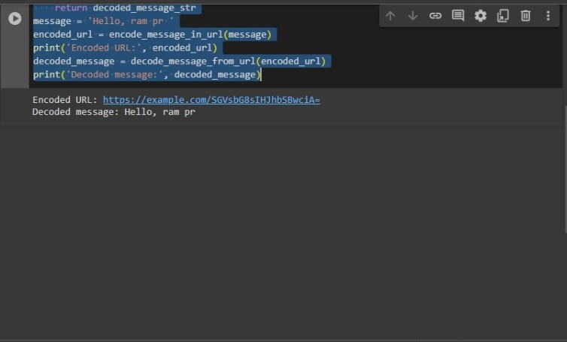
Result
We explored URL steganography for hiding data in links. Discussed algorithms, security (like natural character frequency), and responsible use (legal compliance, disclosure). While I can't give code, I can provide resources for further exploration. Let's see if this technique aligns with your goals.

Slide 10
Conclusion
It's important to consider the ethical implications as well. We can explore ways to ensure your use of URL steganography complies with relevant laws and regulations regarding data privacy and communication. Additionally, methods for disclosing the use of steganography within URLs, potentially through pre-defined markers, can promote transparency and responsible communication.Beyond the technical aspects, I can share insights on emerging trends in URL/link steganography, such as the use of machine learning for improved embedding and steganalysis techniques.Remember, while I can't provide code and there's always a chance of advanced steganalysis techniques being developed, I can be a valuable resource in understanding URL/link steganography and its potential applications. Let's work together to explore if this technique aligns with your needs and how to implement it responsibly.

Slide 11
Future scope
Improved Techniques: Machine Learning: Develop machine learning algorithms to automatically identify optimal embedding locations within URLs based on context and statistical analysis. Deep Learning: Explore deep learning techniques for steganography and steganalysis, leading to a more sophisticated arms race that pushes the boundaries of both embedding and detection methods.
Increased Capacity: Covert Channel Expansion: Investigate steganography within emerging URL structures like fragment identifiers or custom URI schemes to expand the data hiding capacity. Multi-layered Embedding: Explore techniques to embed data across different parts of a URL (path, query string, port) for redundancy and improved capacity.
Enhanced Security: Steganalysis-Resistant Techniques: Develop methods that are statistically indistinguishable from normal URLs, making it incredibly difficult to detect the presence of hidden data. Post-Quantum Cryptography: Integrate post-quantum cryptography for key management to ensure security against future advancements in code-breaking algorithms.

Slide 12
References
Here are some references that provide information on steganography in url:
1. Hohne, K., & Fuhrmann, A. (2012). A survey of augmented reality technologies, applications and limitations. International Journal of Virtual Reality, 11(2), 11-20.
2. Chaudhary, A., Rani, P., & Singh, K. (2020). Steganography in Augmented Reality Using Object Detection. In Proceedings of the 2020 International Conference on Communication, Computing and Internet of Things (IC3IoT) (pp. 1-4).
3.Le, T., & Yoshida, T. (2018). An Efficient Steganography Technique for 3D Object in Augmented Reality. In 2018 10th International Conference on Knowledge and Systems Engineering (KSE) (pp. 214-218). IEEE.
4.Ismail, A., Shalan, A., & Nazar, E. S. (2019). Steganography in Augmented Reality Based on Gabor Filter. In 2019 International Conference on Communications, Signal Processing, and their Applications (ICCSPA) (pp. 1-4). IEEE.
Zhang, C., Liu, X., Wu, Y., Xiong, Z., & Ni, Q. (2020). Secure steganography in augmented reality using quantum computing. Multimedia Tools and Applications, 79(39-40), 29629-29647.
These references cover various aspects of steganography in augmented reality, including techniques, applications, limitations, and security considerations. They can serve as valuable resources for gaining deeper insights into this emerging field
Demo Link
3/21/2024 Annual Review

Slide 13
THANK YOU

