Slide 1
Dynamic Underground Strippers
(Team DUS)

Slide 2
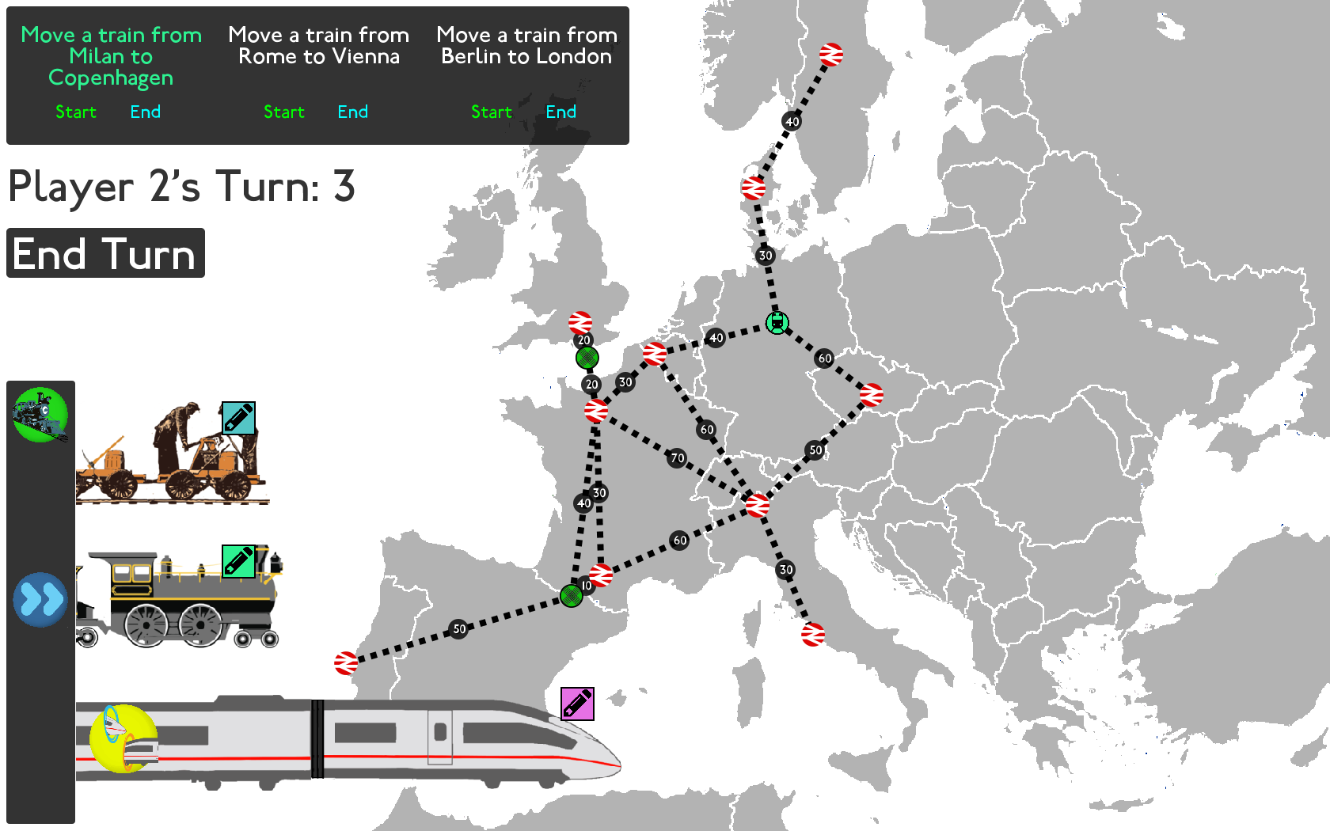
What is our game
Notes:
Explain mechanics

Slide 3

Why Pick Us?
Notes:
So the question is, why would you want to pick our game?
What makes our game different from all the other game’s you’ve seen/going to see this morning.
Here a few things we think makes our game that little bit special.

Slide 4
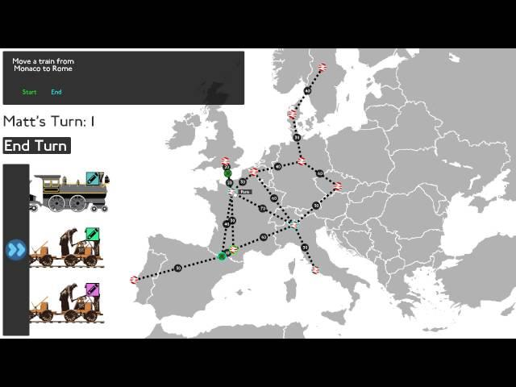
Our Game Works!

Slide 5

Our Game is Simple
Lightweight
No game engine
Portable
Only 2319 lines of code:
24 classes
Maximum 325 lines in a class
Easy to extend
Not very stylised
Notes:
Not just small, also well encapsulated

Slide 6
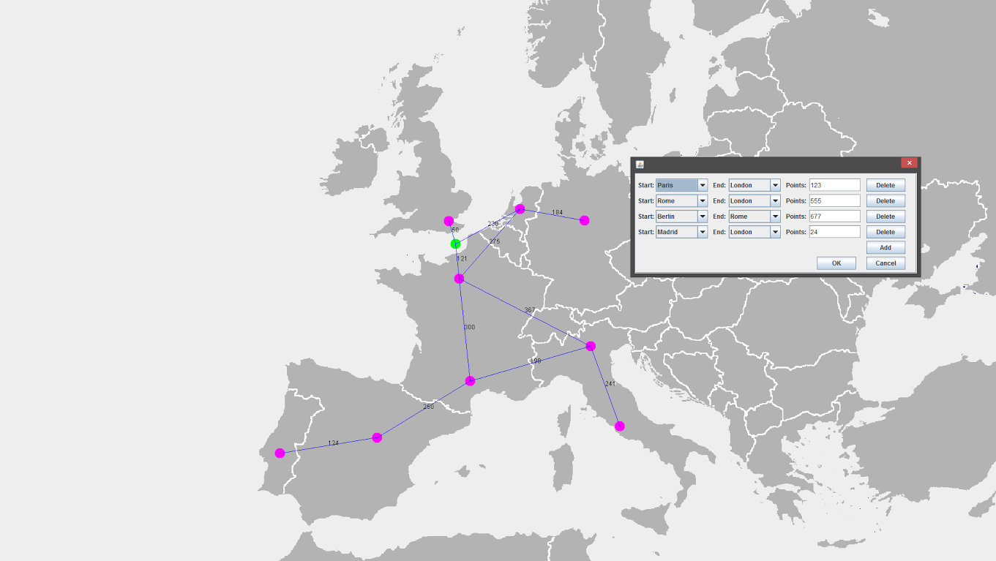
Game Designed to be Balanced
Map Editor tool
Easy to adjust game mechanics
Notes:
Whole point of a game is that it’s supposed to be fun
How do you know what fun will be when you’re sitting there coding the game.
Our game’s architecture and tools allow the developers heavy control of game mechanics in a simple and fuss-free way.
The first of these is our custom developed map editor tool, which allows you to create and edit maps for the game.
Being able to easily change the map is a very powerful tool as if a particular map begins to get boring then a new one can quickly and easily be created, then iteratively edited until it is a fun map to play.
This also adds an element of randomisation to game, offering potential for the user to have new experiences every time they play.
The game is already built to support multiple maps, junctions and scoring

Slide 7
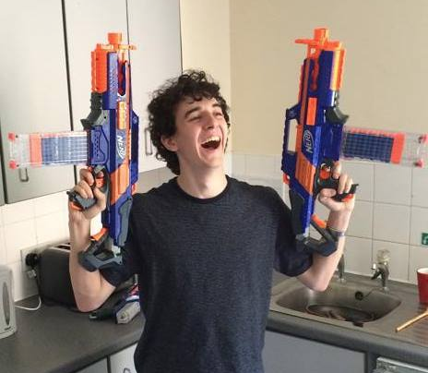
What Else do we Offer?
Dan, Dan the graphics man

Slide 8
