Slide 1


Slide 2
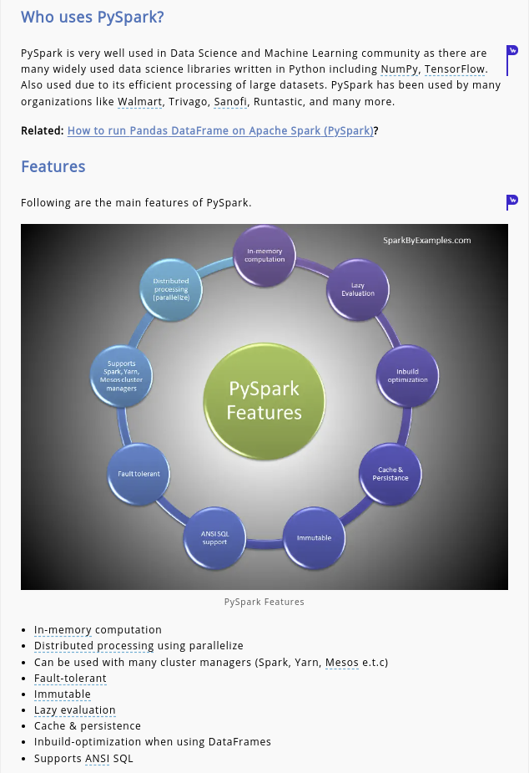

Slide 3
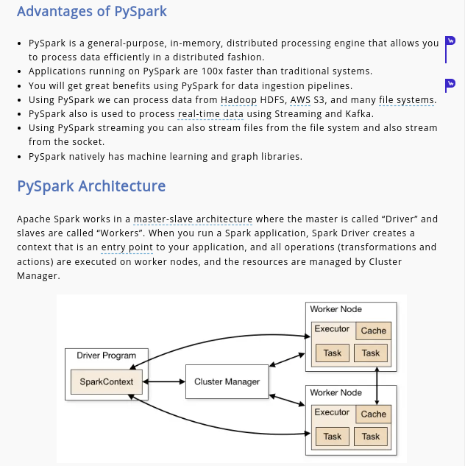

Slide 4
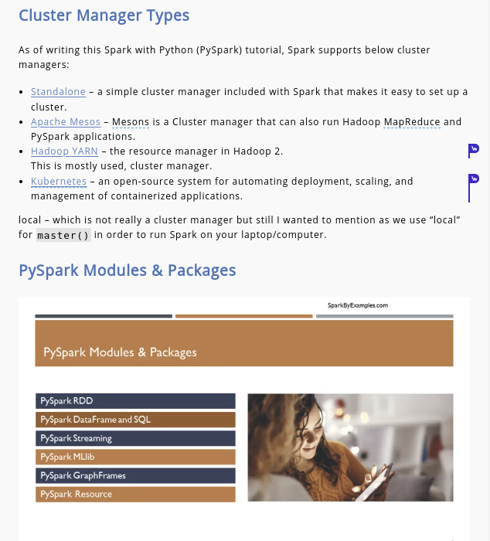

Slide 5
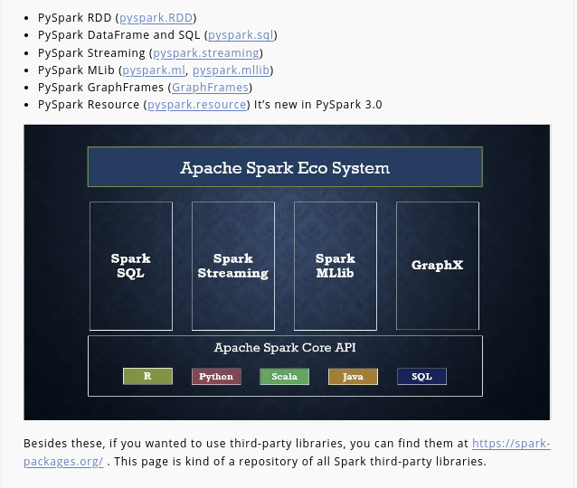

Slide 6
Spark Installation
Anaconda Environment
Pip install pyspark
Ubuntu Linux
Download the spark folder from below link
click here: Spark
Installing Java and set the java Path
sudo apt install default-jdk
sudo nano .bashrc
# Java Path Setting
JAVA_HOME="/usr/lib/jvm/jdk-20"
export JAVA_HOME
export PATH=$PATH:$JAVA_HOME/bin
Installing the python
sudo apt-get install python3
Extract the Apache Spark zip folder and set the path to run pyspark
JAVA_HOME = C:\Program Files\Java\jdk1.8.0_201
PATH = %PATH%;C:\Program Files\Java\jdk1.8.0_201\bin
Spark got installed. Now run spark-shell

Slide 7
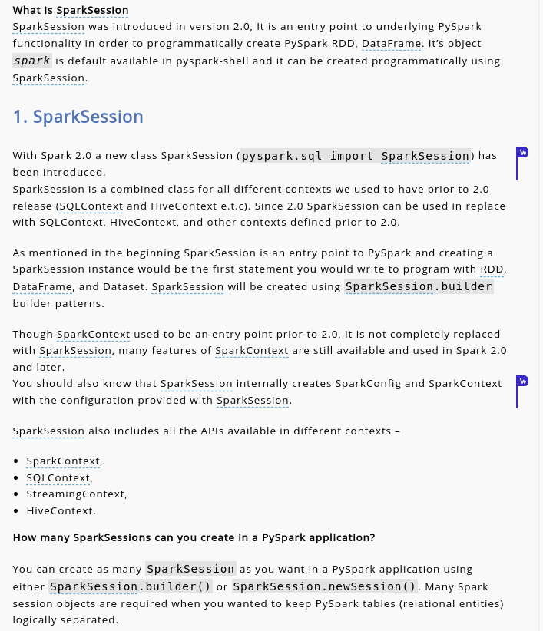
PySpark sessions

Slide 8
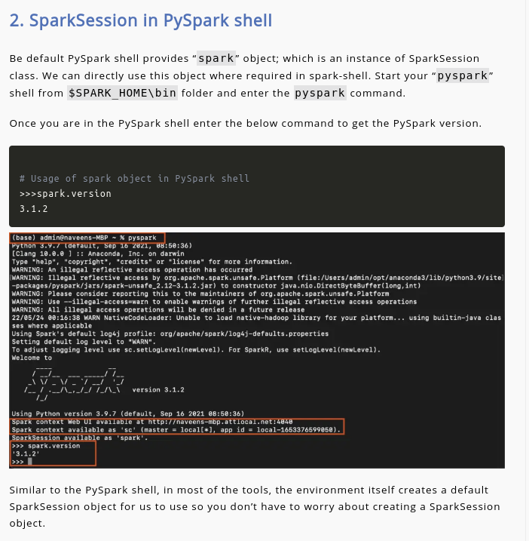

Slide 9
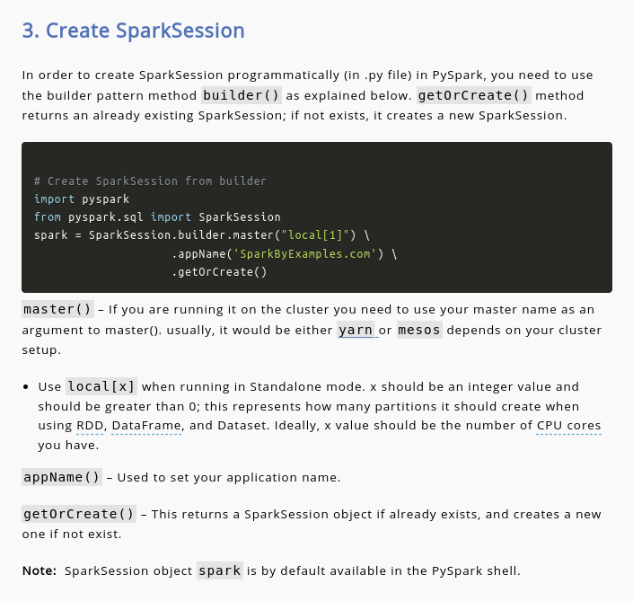

Slide 10
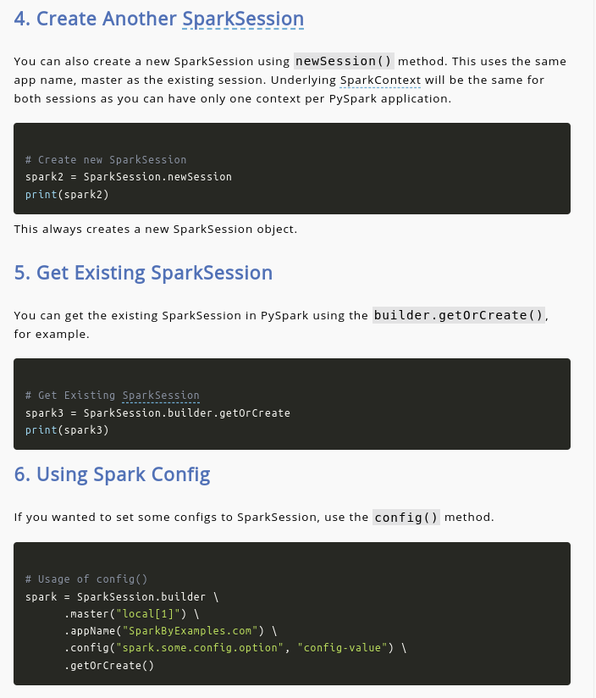

Slide 11
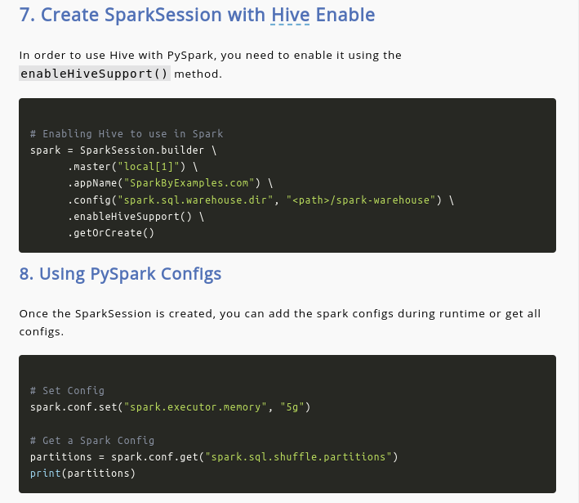

Slide 12
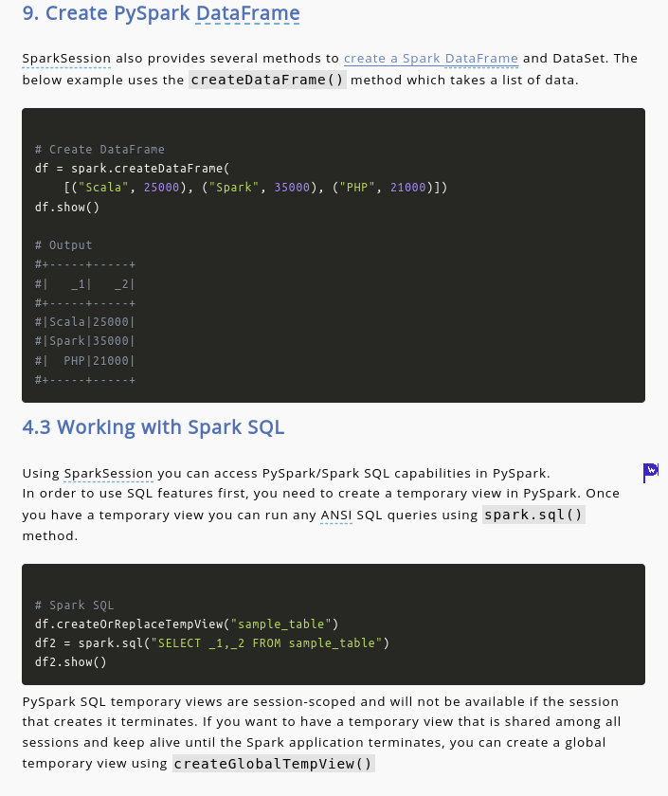

Slide 13
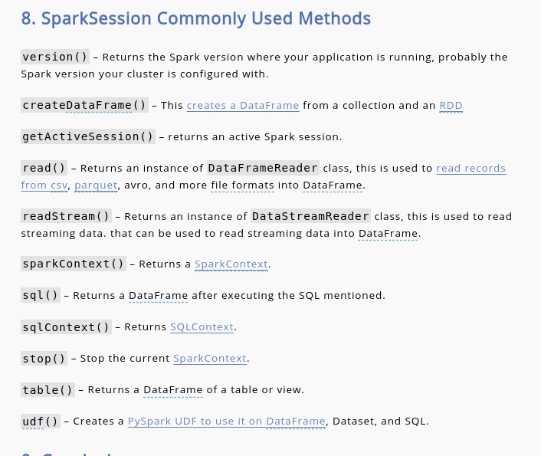

Slide 14
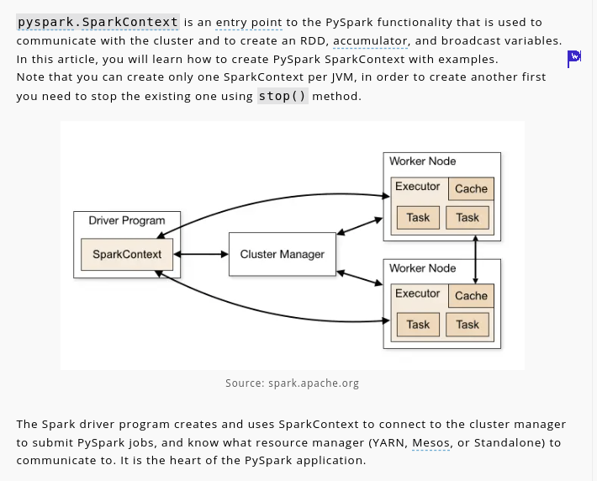
PySpark Context

Slide 15
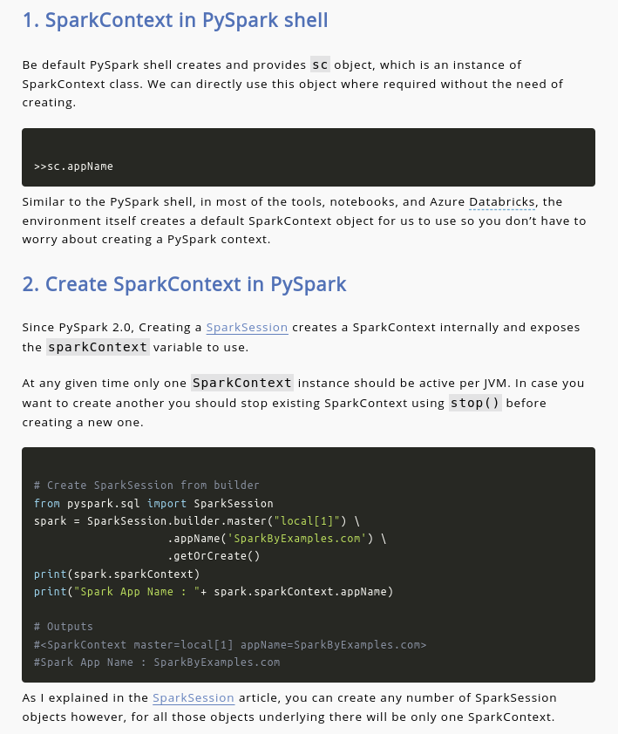

Slide 16
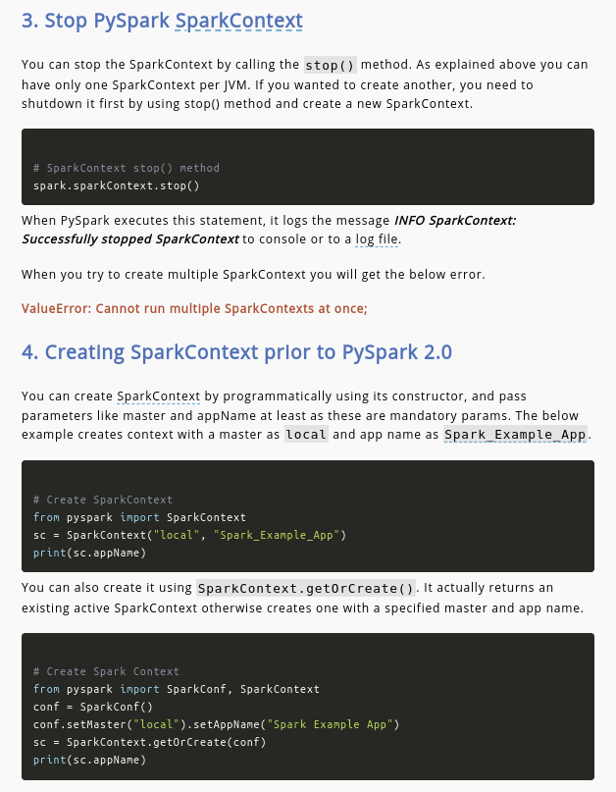

Slide 17
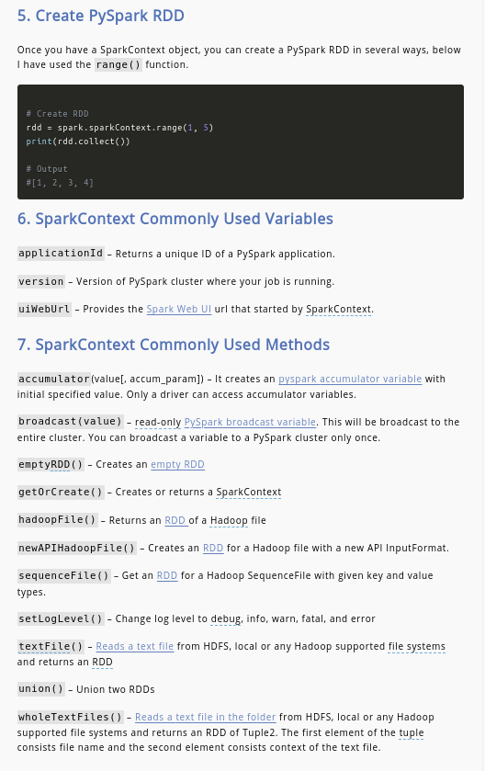

Slide 18
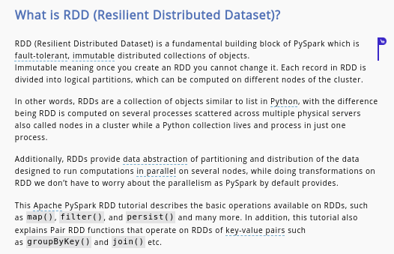
PySpark-RDD

Slide 19
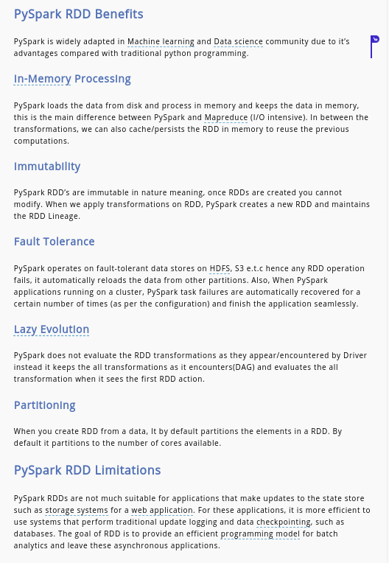

Slide 20
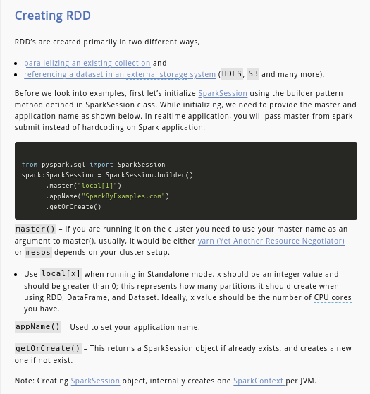

Slide 21
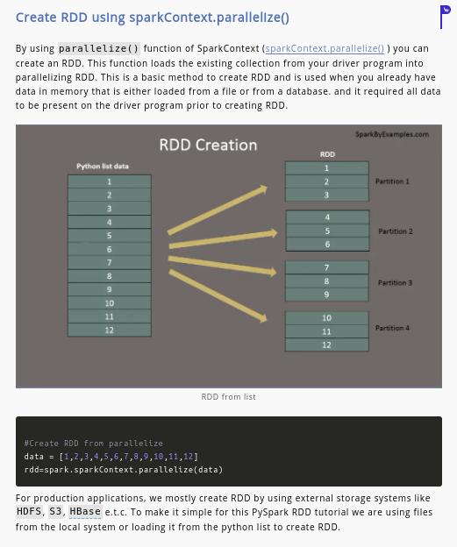

Slide 22
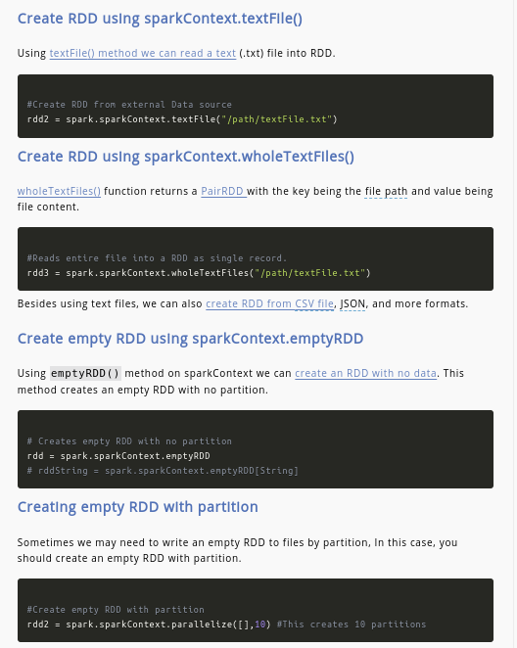

Slide 23
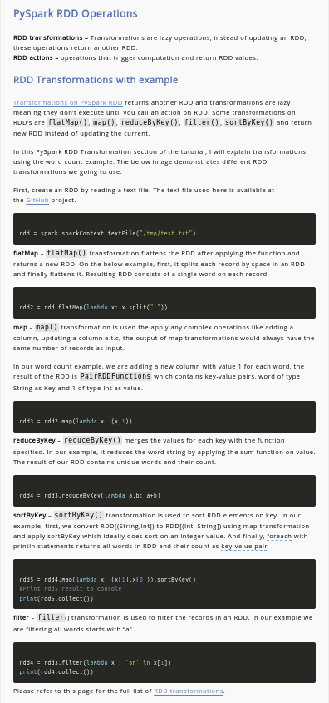

Slide 24
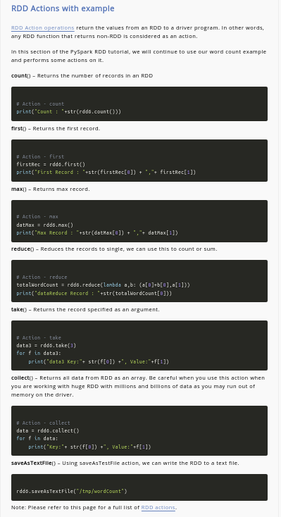

Slide 25
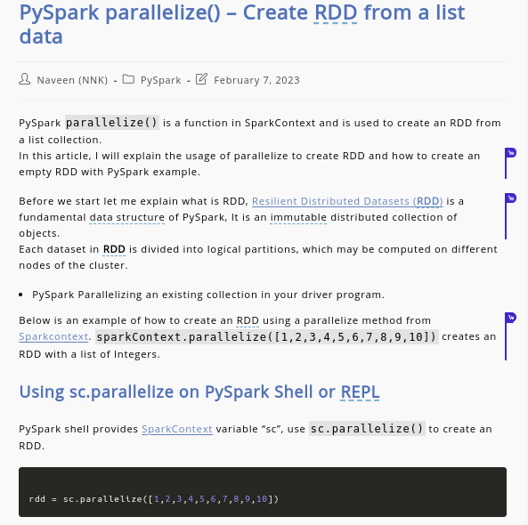
PySpark Parallelize

Slide 26
