Slide 1

1

Slide 2
INTRODUCTION
MapReduce is the core component of Hadoop that process huge amount of data in parallel by dividing the work into a set of independent tasks. In MapReduce data flow in step by step from Mapper to Reducer.
MapReduce is the data processing layer of Hadoop. It is a software framework for easily writing applications that process the vast amount of structured and unstructured data stored in the Hadoop Distributed Filesystem (HDFS). It processes the huge amount of data in parallel by dividing the job (submitted job) into a set of independent tasks (sub-job). By this parallel processing speed and reliability of cluster is improved. We just need to put the custom code (business logic) in the way map reduce works and rest things will be taken care by the engine.

Slide 3
○ Job
GENERAL TERMS
A complete user defined computation or program
Tasks
A subset of computation
Can be either execution of MAP or REDUCE
Task Attempt
An attempt to run a task.
If an attempt fails, Job Tracker tries to start an another task attempt for the same task.
By Default, total number of task attempts for a task is four
3

Slide 4

○ JobTracker
DAEMONS
Client submits the computation to JobTracker
Assign a task to the TaskTracker who has free slots and where data is stored if possible
It tries to provide data locality as much as possible.
TaskTracker
Spawns a JVM process for each input split as directed by Job Tracker
Send periodic heartbeats to Job Tracker
4

Slide 5
HADOOP /MAPREDUCE
In Hadoop, MapReduce works by breaking the data processing into two phases: Map phase and Reduce phase. The map is the first phase of processing, where we specify all the complex logic/business rules/costly code. Reduce is the second phase of processing, where we specify light-weight processing like aggregation/summation.
The data for a MapReduce task is stored in input files, and input files typically lives in HDFS. The format of these files is arbitrary, while line-based log files and binary format can also be used.
5

Slide 6
COMPONENTS OF MAPREDUCE
InputFormat defines how these input files are split and read. It selects the files or other objects that are used for input. InputFormat creates InputSplit.
Input Splits are created by InputFormat, logically represent the data which will be processed by an individual Mapper (We will understand mapper below). One map task is created for each split; thus the number of map tasks will be equal to the number of InputSplits. The split is divided into records and each record will be processed by the mapper.
Record Reader communicates with the InputSplit in Hadoop MapReduce and converts the data into key-value pairs suitable for reading by the mapper. By default, it uses TextInputFormat for converting data into a key-value pair. RecordReader communicates with the InputSplit until the file reading is not completed. It assigns byte offset (unique number) to each line present in the file. Further, these key-value pairs are sent to the mapper for further processing.

Slide 7
MAPPER &COMBINER
It processes each input record (from RecordReader) and generates new key-value pair, and this key-value pair generated by Mapper is completely different from the input pair. The output of Mapper is also known as intermediate output which is written to the local disk. The output of the Mapper is not stored on HDFS as this is temporary data and writing on HDFS will create unnecessary copies (also HDFS is a high latency system). Mappers output is passed to the combiner for further process

Slide 8
BLOCK VS SPLIT
split |  | split |  | split
1 2 3 4 5 6 7 8 9 10
Block boundary | Block boundary |  | Block boundary
file
lines
8

Slide 9
PARTITIONER
Hadoop MapReduce, Partitioner comes into the picture if we are working on more than one reducer (for one reducer partitioner is not used).
Partitioner takes the output from combiners and performs partitioning. Partitioning of output takes place on the basis of the key and then sorted. By hash function, key (or a subset of the key) is used to derive the partition.
According to the key value in MapReduce, each combiner output is partitioned, and a record having the same key value goes into the same partition, and then each partition is sent to a reducer. Partitioning allows even distribution of the map output over the reducer.
Number of Partitions is equal to the number of reducers.
9

Slide 10
Shuffling and Sorting
Now, the output is Shuffled to the reduce node (which is a normal slave node but reduce phase will run here hence called as reducer node). The shuffling is the physical movement of the data which is done over the network. Once all the mappers are finished and their output is shuffled on the reducer nodes, then this intermediate output is merged and sorted, which is then provided as input to reduce phase.

Slide 11
REDUCER & RECORD WRITER
Reducer takes the set of intermediate key-value pairs produced by the mappers as the input and then runs a reducer function on each of them to generate the output. The output of the reducer is the final output, which is stored in HDFS
Record Writer writes these output key-value pair from the Reducer phase to the output files.

Slide 12
OUTPUT FORMAT
The way these output key-value pairs are written in output files by RecordWriter is determined by the OutputFormat. OutputFormat instances provided by the Hadoop are used to write files in HDFS or on the local disk. Thus the final output of reducer is written on HDFS by OutputFormat instances.

Slide 13

Input split size
mapred.min.split.size | mapred.max.split.size | dfs.block.size | Split Size
1 (default) | Long.MAX_VALUE (default) | 64 MB (default) | 64 MB
1 (default) | Long.MAX_VALUE (default) | 128 MB | 128 MB
128 MB | Long.MAX_VALUE (default) | 64 MB (default) | 128 MB
1 (default) | 10 MB | 64 MB (default) | 10 MB

Slide 14
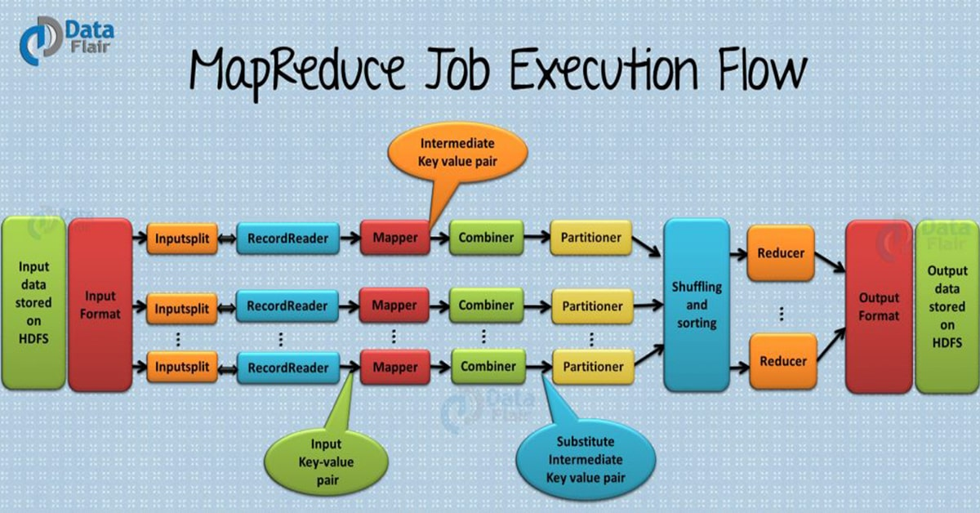
MAP REDUCE FLOW DIAGRAM

Slide 15
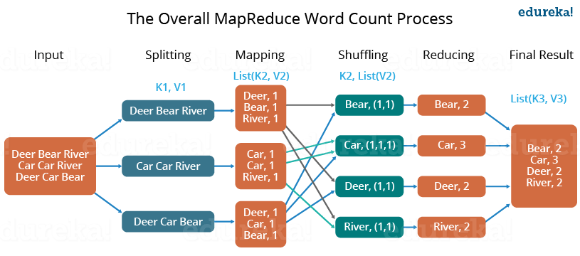

Slide 16
Benefits of Hadoop MapReduce
Speed: MapReduce can process huge unstructured data in a short time.
Fault-tolerance: The MapReduce framework can handle failures.
Cost-effective: Hadoop has a scale-out feature that enables users to process or store data in a cost-effective manner.
Scalability: Hadoop provides a highly scalable framework. MapReduce allows users to run applications from many nodes.
Data availability: Replicas of data are sent to various nodes within the network. This ensures copies of the data are available in the event of failure.
Parallel Processing: In MapReduce, multiple job-parts of the same dataset can be processed in a parallel manner. This reduces the time taken to complete a task.

Slide 17
Applications of Hadoop MapReduce
The following are some of the practical applications of the MapReduce program.
E-COMMMERCE
E-commerce companies such as Walmart, E-Bay, and Amazon use MapReduce to analyze buying behavior. MapReduce provides meaningful information that is used as the basis for developing product recommendations. Some of the information used include site records, e-commerce catalogs, purchase history, and interaction logs.

Slide 18
Social networks
The MapReduce programming tool can evaluate certain information on social media platforms such as Facebook, Twitter, and LinkedIn. It can evaluate important information such as who liked your status and who viewed your profile.
Entertainment
Netflix uses MapReduce to analyze the clicks and logs of online customers. This information helps the company suggest movies based on customers’ interests and behavior.

Slide 19
CONCLUSION
MapReduce is a crucial processing component of the Hadoop framework. It’s a quick, scalable, and cost-effective program that can help data analysts and developers process huge data.
This programming model is a suitable tool for analyzing usage patterns on websites and e-commerce platforms. Companies providing online services can utilize this framework to improve their marketing strategies.

