Slide 1


Slide 2
SPARK -INRO
Spark is a really fast and general engine for large-scale data processing.
A general purpose distributed computation engine. That is to say, it can run across multiple servers in a coherent way and they can read distributed data sets and process that data based on code you have written to run within the Spark (“engine”).
Spark runs on Hadoop, Apache Mesos, Kubernetes, standalone, or in the cloud. It can access diverse data sources.

Slide 3
RDD
Resilient: Fault tolerant and is capable of rebuilding data on failure
Distributed: Distributed data among the multiple nodes in a cluster
Dataset: Collection of partitioned data with values
RDDs are immutable distributed collection of elements of your data that can be stored in memory or disk across a cluster of machines.
The data is partitioned across machines in your cluster that can be operated in parallel with a low-level API that offers transformations and actions.
RDDs are fault tolerant as they track data lineage information to rebuild lost data automatically on failure.

Slide 4
DATAFRAME
Unlike an RDD, data is organized into named columns, like a table in a relational database.
Designed to make large data sets processing even easier, DataFrame allows developers to impose a structure onto a distributed collection of data, allowing higher-level abstraction; it provides a domain specific language API to manipulate your distributed data; and makes Spark accessible to a wider audience, beyond specialized data engineers

Slide 5
Spark VS Hadoop:
Apache Spark achieves high performance for both batch and streaming data, using a state-of-the-art DAG scheduler, a query optimizer, and a physical execution engine.
Spark runs programs up to 100x faster than Hadoop MapReduce in memory, or 10x faster on disk.
Fault tolerance ,Lineage graph

Slide 6
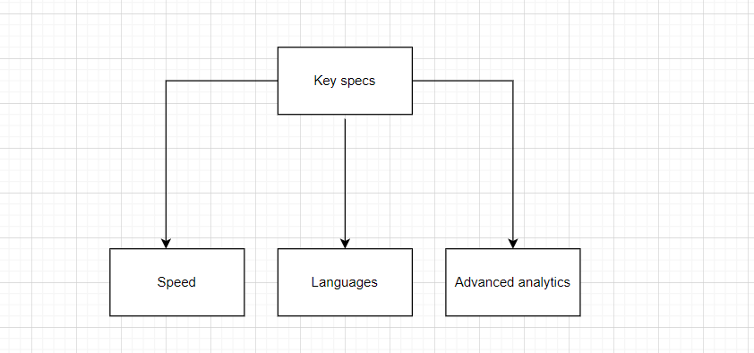
SPARK-FEATURES
Speed − Spark helps to run an application in Hadoop cluster, up to 100 times faster in memory, and 10 times faster when running on disk. This is possible by reducing number of read/write operations to disk. It stores the intermediate processing data in memory.
Supports multiple languages − Spark provides built-in APIs in Java, Scala, or Python. Therefore, you can write applications in different languages. Spark comes up with 80 high-level operators for interactive querying.
Advanced Analytics − Spark not only supports ‘Map’ and ‘reduce’. It also supports SQL queries, Streaming data, Machine learning (ML), and Graph algorithms.

Slide 7
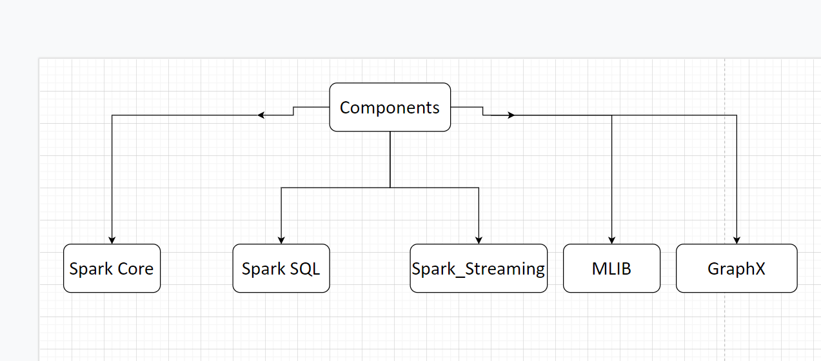
SPARK -COMPONENTS
Spark Core
Spark Core is the underlying general execution engine for spark platform that all other functionality is built upon. It provides In-Memory computing and referencing datasets in external storage systems.
It provides a generalized execution model to support a wide variety of applications, and Java,Scala, and Python APIs for ease of Development
Spark SQL
Spark SQL is a component on top of Spark Core that introduces a new data abstraction called SchemaRDD, which provides support for structured and semi-structured data.

Slide 8
Spark Streaming:
Spark Streaming leverages Spark Core's fast scheduling capability to perform streaming analytics. It ingests data in mini-batches and performs RDD (Resilient Distributed Datasets) transformations on those mini-batches of data.
MLlib (Machine Learning Library):
MLlib is a distributed machine learning framework above Spark because of the distributed memory-based Spark architecture. It is, according to benchmarks, done by the MLlib developers against the Alternating Least Squares (ALS) implementations. Spark MLlib is nine times as fast as the Hadoop disk-based version of Apache Mahout (before Mahout gained a Spark interface).
GraphX:
GraphX is a distributed graph-processing framework on top of Spark. It provides an API for expressing graph computation that can model the user-defined graphs by using Pregel abstraction API. It also provides an optimized runtime for this abstraction

Slide 9
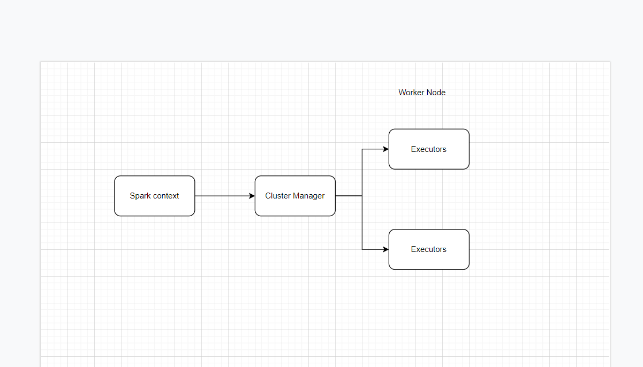
SPARK ARCHITECTURE OVERVIEW
Apache Spark has a well-defined layered architecture where all the spark components and layers are loosely coupled. This architecture is further integrated with various extensions and libraries. Apache Spark Architecture is based on two main abstractions:
Resilient Distributed Dataset (RDD)
Directed Acyclic Graph (DAG)
View on spark Architecture:

Slide 10
SparkContext:
Main entry point for Spark functionality. A SparkContext represents the connection to a Spark cluster, and can be used to create RDDs, accumulators and broadcast variables on that cluster.
Only one SparkContext should be active per JVM. You must stop() the active SparkContext before creating a new one.
param: config a Spark Config object describing the application configuration.
Any settings in this config overrides the default configs as well as system properties.
from pyspark import SparkContext, SparkConf
conf = SparkConf() \
.setAppName('app') \
.setMaster(master)
sc = SparkContext(conf=conf)

Slide 11
SQLContext
SQLContext is the entry point to SparkSQL which is a Spark module for structured data processing. Once SQLContext is initialised, the user can then use it in order to perform various “sql-like” operations over Datasets and Dataframes.
In order to create a SQLContext, you first need to instantiate a SparkContext as shown below:
PySpark
from pyspark import SparkContext, SparkConf
from pyspark.sql import SQLContext
conf = SparkConf() \
.setAppName('app') \
.setMaster(master)
sc = SparkContext(conf=conf)
sql_context = SQLContext(sc)

Slide 12
SparkSession:
Spark 2.0 introduced a new entry point called SparkSession that essentially replaced both SQLContext and HiveContext. Additionally, it gives to developers immediate access to SparkContext. In order to create a SparkSession with Hive support, all you have to do is
from pyspark.sql import SparkSession
spark_session = SparkSession \
.builder \
.enableHiveSupport() \
.getOrCreate()
# Two ways you can access spark context from spark session
spark_context = spark_session._sc
spark_context = spark_session.sparkContext

Slide 13
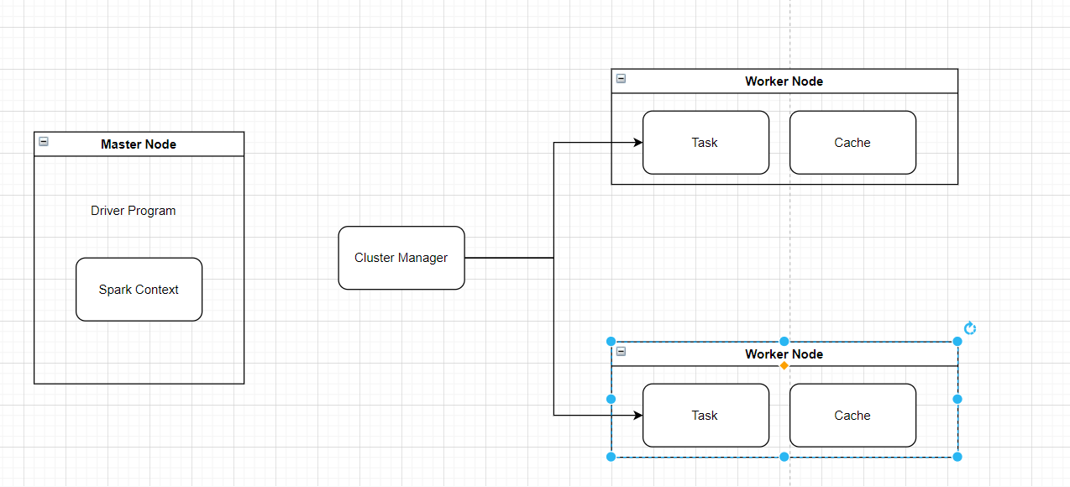
Working of Spark Architecture
As you have already seen the basic architectural overview of Apache Spark, now let’s dive deeper into its working.
In your master node, you have the driver program, which drives your application. The code you are writing behaves as a driver program or if you are using the interactive shell, the shell acts as the driver program.

Slide 14
Inside the driver program, the first thing you do is, you create a Spark Context.
Assume that the Spark context is a gateway to all the Spark functionalities.
It is similar to your database connection. Any command you execute in your database goes through the database connection. Likewise, anything you do on Spark goes through Spark context.
Now, this Spark context works with the cluster manager to manage various jobs.
The driver program & Spark context takes care of the job execution within the cluster.
A job is split into multiple tasks which are distributed over the worker node.
Anytime an RDD is created in Spark context, it can be distributed across various nodes and can be cached there.
Worker nodes are the slave nodes whose job is to basically execute the tasks. These tasks are then executed on the partitioned RDDs in the worker node and hence returns back the result to the Spark Context.
Spark Context takes the job, breaks the job in tasks and distribute them to the worker nodes. These tasks work on the partitioned RDD, perform operations, collect the results and return to the main Spark Context.

Slide 15
If you increase the number of workers, then you can divide jobs into more partitions and execute them parallelly over multiple systems. It will be a lot faster.
With the increase in the number of workers, memory size will also increase & you can cache the jobs to execute it faster.
In Depth of RDD:
It is a layer of abstracted data over the distributed collection. It is immutable in nature and follows lazy transformations.
Now you might be wondering about its working. Well, the data in an RDD is split into chunks based on a key.
RDDs are highly resilient, i.e, they are able to recover quickly from any issues as the same data chunks are replicated across multiple executor nodes.
Thus, even if one executor node fails, another will still process the data. This allows you to perform your functional calculations against your dataset very quickly by harnessing the power of multiple nodes.
Moreover, once you create an RDD it becomes immutable. By immutable I mean, an object whose state cannot be modified after it is created, but they can surely be transformed

Slide 16
Talking about the distributed environment, each dataset in RDD is divided into logical partitions, which may be computed on different nodes of the cluster.
Due to this, you can perform transformations or actions on the complete data parallelly. Also, you don’t have to worry about the distribution, because Spark takes care of that.
There are two ways to create RDDs − parallelizing an existing collection in your driver program, or by referencing a dataset in an external storage system, such as a shared file system, HDFS, HBase, etc.
With RDDs, you can perform two types of operations:
Transformations: They are the operations that are applied to create a new RDD.
Actions: They are applied on an RDD to instruct Apache Spark to apply computation and pass the result back to the driver.
RDD Transformation:
Spark Transformation is a function that produces new RDD from the existing RDDs. It takes RDD as input and produces one or more RDD as output. Each time it creates new RDD when we apply any transformation. Thus, the so input RDDs, cannot be changed since RDD are immutable in nature.
Applying transformation built an RDD lineage, with the entire parent RDDs of the final RDD(s). RDD lineage, also known as RDD operator graph or RDD dependency graph. It is a logical execution plan i.e., it is Directed Acyclic Graph (DAG) of the entire parent RDDs of RDD.

Slide 17
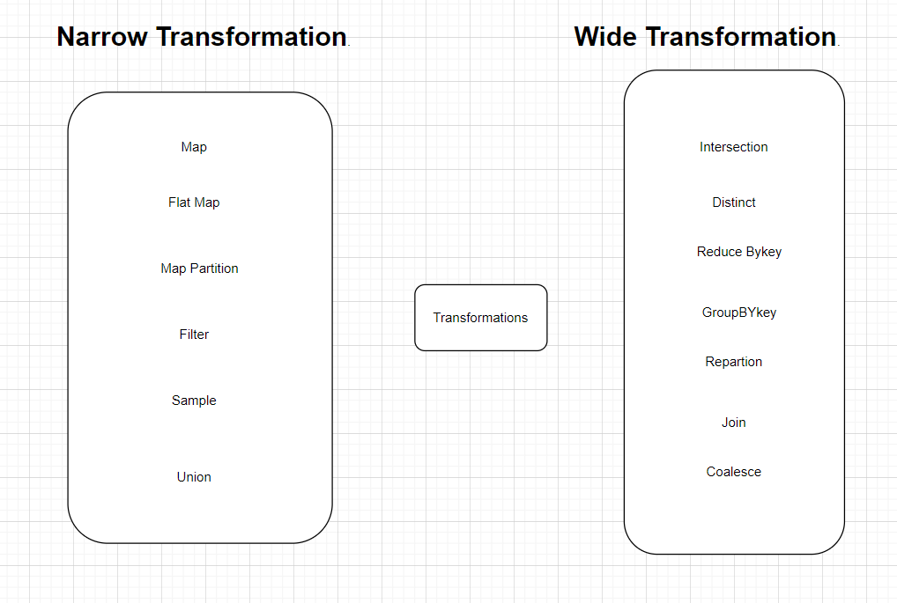

Slide 18
Coalesce():
To avoid full shuffling of data we use coalesce() function.
In coalesce() we use existing partition so that less data is shuffled.
Using this we can cut the number of the partition.
Suppose, we have four nodes and we want only two nodes. Then the data of extra nodes will be kept onto nodes which we kept.
The coalesce will decrease the number of partitions of the source RDD to numPartitions define in coalesce argument.
Repartition():
Repartition is a method in spark which is used to perform a full shuffle on the data present and creates partitions based on the user's input. The resulting data is hash partitioned and the data is equally distributed among the partitions.
The repartition function allows us to change the distribution of the data on the Spark cluster. This distribution change will induce shuffle (physical data movement) under the hood, which is quite an expensive operation.

Slide 19
RDD Action
Transformations create RDD from each other, but when we want to work with the actual dataset, at that point action is performed. When the action is triggered after the result, new RDD is not formed like transformation.
Thus, Actions are Spark RDD operations that give non-RDD values.
The values of action are stored to drivers or to the external storage system.
Count()
Collect()
Take()
Top()
CountBYValue()
Reduce()
forEach()
Aggregate()

Slide 20
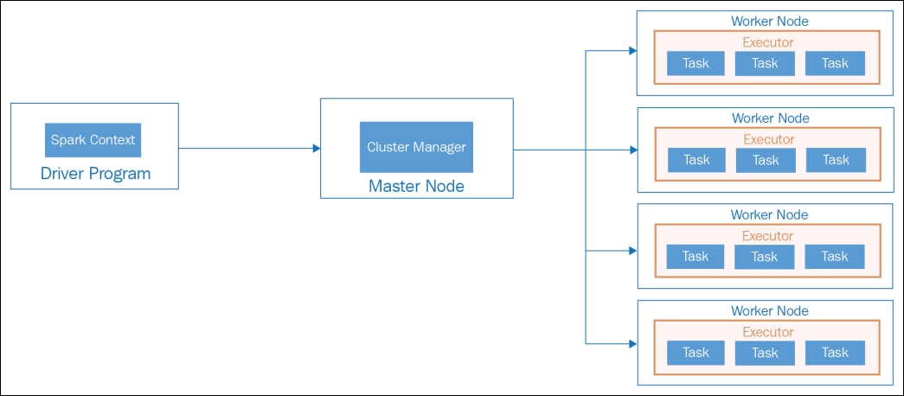
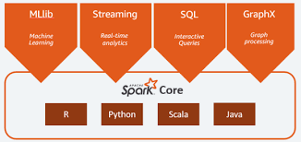
SPARK ARCHITECTURE FLOW

Slide 21
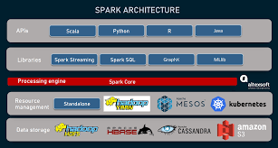

Slide 22
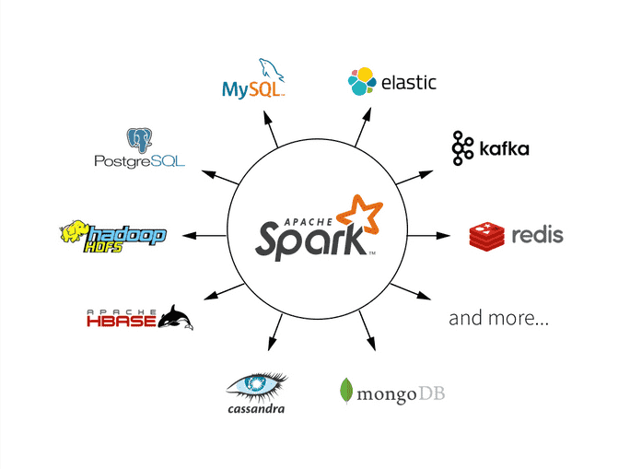

Slide 23
Yet to discuss
SPARKSQL
OPTIMIZATIONS of SPARK
FILE FORMAT
COMPRESSION MECHANISMS

