Slide 1

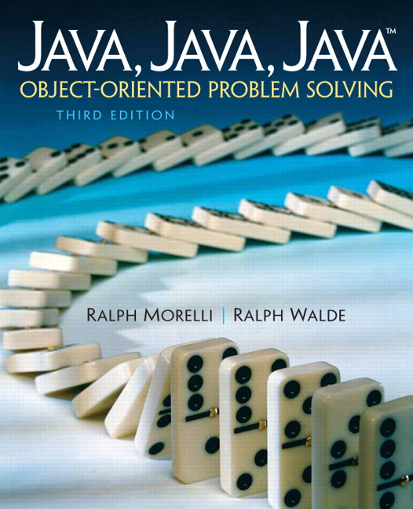
JAVA, JAVA, JAVA
presentation slides for
Object-Oriented Problem Solving
Third Edition
Ralph Morelli | Ralph Walde
Trinity College
Hartford, CT
published by Prentice Hall

Slide 2
Java, Java, Java
Object Oriented Problem Solving
Chapter 1
Java Program Design
and Development

Slide 3
Objectives
Know the basic steps involved in program development.
Understand some basic Java language elements.
Know how to use simple output operations.
Be able to identify different types of errors in a program.
Understand how a Java program is translated into machine language.
Understand the difference between a Java application and a Java applet.
Know how to edit, compile, and run programs.

Slide 4
Outline
Designing Good Programs
Designing a Riddle Program
Java Language Elements
Editing, Compiling, and Running a Java Program
From the Java Library: The System and PrintStream classes.

Slide 5
Designing Good Programs
Always precede coding with careful design.
Remember: The sooner you begin to type code, the longer the program will take to finish.
Design includes designing classes, data, methods, and algorithms.
Design is followed by coding, testing, and revision.

Slide 6
The Program Development Process
Problem Specification
Problem Decomposition
Design Specification
Data, Methods, and Algorithms
Coding into Java
Testing, Debugging, and Revising

Slide 7
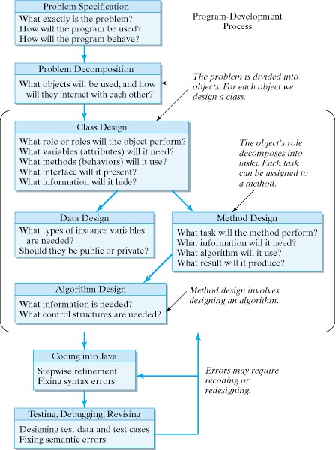
Object-Oriented Program Development

Slide 8
Problem Specification
What exactly is the problem to be solved?
How will the program be used?
How will the program behave?
Problem Specification: Design a class that represent a riddle with a given question and answer. The definition of this class should make it possible to store different riddles and retrieve a riddle’s question and answer independently.

Slide 9
Problem Decomposition
Divide-and-Conquer: What objects will be used and how will they interact?
Nouns: In OOD, choosing objects means looking for nouns in the problem specification.
Problem Specification: Design a class that represent a riddle with a given question and answer. The definition of this class should make it possible to store different riddles and retrieve a riddle’s question and answer independently.

Slide 10
Object Design Questions
What role will the object perform?
What data or information will it need?
  Look for nouns.
Which actions will it take?
  Look for verbs.
What interface will it present to other objects?
  These are public methods.
What information will it hide from other objects?
  These are private.

Slide 11
Design Specification for a Riddle
Class Name: Riddle
Role: To represent a riddle
Attributes (Information or instance variables)
  Question: A variable to store the question (private)
  Answer: A variable to store the answer (private)
Behaviors (public methods)
  Riddle(): A method to set a riddle’s question and answer
  getQuestion(): A method to return a riddle’s question
  getAnswer(): A method to return a riddle’s answer

Slide 12
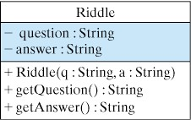
UML Design Specification
Instance variables -- memory locations used for storing the information needed.
Class Name
Hidden
information
What data does it need?
What behaviors
will it perform?
Public
interface
Figure 1.3. A UML Class Diagram
Methods -- blocks of code used to perform a specific task.

Slide 13
Method Design
What specific task will the method perform?
What information will it need to perform its task?
What result will the method produce?
What algorithm (step-by-step description of the solution) will the method use?

Slide 14
Method Specification: getQuestion()
Method Name: getQuestion()
Task: To return the riddle’s question
Information Needed (variables)
  Question: A variable to store the riddle’s answer (private)
Algorithm: return question
(This is a very simple method!)

Slide 15
Coding into Java
public class Riddle extends Object // Class header
{
private String question; // Instance variables
private String answer;
public Riddle(String q, String a) // Constructor method
{
question = q;
answer = a;
}
public String getQuestion() // Access method
{
return question;
} // getQuestion()
public String getAnswer() // Access method
{
return answer;
} // getAnswer()
} // Riddle class

Slide 16
Syntax
The syntax of a programming language is the set of rules that determines whether its statements are correctly formulated.
Example Rule: All Java statements must end with a semincolon.
Syntax error: question = q
Syntax errors can be detected by the compiler, which will report an error message.

Slide 17
Semantics
The semantics of a programming language is the set of rules that determine the meaning of its statements.
Example Rule: In a + b, the + operator will add a and b.
Semantic error: User intended to add a and b but coded a - b.
Semantic errors cannot be detected by the compiler, because it can’t read the programmer’s mind.

Slide 18
Java Language Elements
A Java program is made up of class definitions.
A class definition contains a header and a body.
A method is a named section of code that can be called by its name.
Multi-line and single-line comments are used to document the code.

Slide 19
Java Language Elements: Class Definition
public class HelloWorld extends Object // Class header
{ // Start of class body
private String greeting = “Hello World!”; // Instance variable
public void greet() // Method definition header
{ // Start of method body
System.out.println(greeting); // Output statement
} // greet() // End of greet method body
public static void main(String args[]) // Method definition header
{ // Start of method body
HelloWorld helloworld; // Reference variable
helloworld = new HelloWorld(); // Object instantiation stmt
helloworld.greet(); // Method call
} // main() // End of method body
} // HelloWorld // End of class body

Slide 20
Java Keywords
abstract continue for new switch
assert default goto package synchronized
boolean do if private this
break double implements protected throw
byte else import public throws
case enum instanceof return transient
catch extends int short try
char final interface static void
class finally long strictfp volatile
const float native super while

Slide 21
Java Language Elements: Identifiers
An identifier must begin with a letter (A to Z, a to z) and may be followed by any number of letters or digits (0 to 9) or underscores (_). An identifier may not be identical to a Java keyword.
Style: Class names begin with a capital letter and use capitals to distinguish words within the name: HelloWord, TextField
Style: Variable and method names begin with a lowercase letter and use capitals to distinguish words within the name: main(), getQuestion()

Slide 22
Data Types
Java data are classified according to data type.
Types of Objects (Riddle, Rectangle, String) versus primitive data types (int, double, boolean).
A literal value is an actual value (“Hello”, 5, true).
Java’s Primitive Data Types.

Slide 23
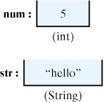
Variables
A variable is a typed container that can store a value of a certain type.
Value
Type
Figure 1.6. A variable is a typed container.

Slide 24
Statements
A statement is a segment of code that takes some action in a program.
A declaration statement declares a variable and has the general form:
  Type VariableName ;
  // Type variableName ;
  HelloWorld helloworld ;
  int int1, int2;

Slide 25
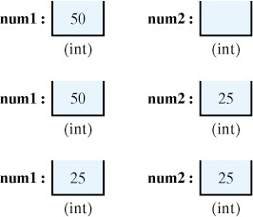
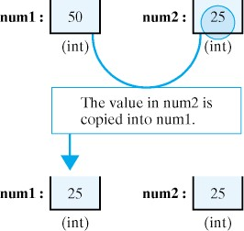
Assignment Statements
An assignment statement stores a value in a variable and has the general form:
  VariableName = Value ;
  greeting = “Hello World”;
  num1 = 50;
  num2 = 10 + 15;
  num1 = num2;
Figure 1.7
Figure 1.8. In the assignment
num1 = num2 ;
num2’s value is copied into num1.

Slide 26
Expressions and Operators
An expression is Java code that specifies or produces a value in the program.
Expressions use operators (=, +, <, …)
Expressions occur within statements:
  num1 + num2 // An addition of type int
  num1 < num2 // A comparison of type boolean
  num = 7 // An assignment expression of type int
  square(7) // A method call expression of type int
  num == 7 // An equality expression of type boolean
  num = square(7) ; // An assignment statement

Slide 27
Class Definition
A Java program consists of one or more class definitions.
A class definition contains a class header:
  ClassModifiers_{opt} class ClassName Pedigree_{opt}
And a class body, which is code contained within curly brackets: {…}
  public class HellowWorld extends Object
  public class HellowWorld extends Object
  {
  }

Slide 28
Declaring an Instance Variable
In general an instance variable declaration takes the following form:
  Modifiers_{opt} Type VariableName InitialzerExpression_{opt}
  private String greeting = “Hello World”;
  int num;
  double realNum = 5.05;
  static int count = 0;
In these examples the types are String, int, double and the variable names are greeting, num, realNum, and count.

Slide 29
Declaring an Instance Method
A method definition consists of a method header:
  Modifiers_{opt} ReturnType MethodName (ParameterList_{opt})
Followed by a method body, which is executable code contained within curly brackets: {…}
public void greet() // Method definition header
{ // Start of method body
System.out.println(greeting); // Executable statement
} // greet() // End of greet method body
public static void main(String args[]) // Method definition header
{ HelloWorld helloworld; // Reference variable
helloworld = new HelloWorld(); // Object instantiation stmt
helloworld.greet(); // Method call
} // main()

Slide 30
Applications vs. Applets
Java Applications
Stand-alone program
Runs independently
Has a main() method
No HTML file
Run using JDK’s java interpreter
Java Applets
Embedded program.
Runs in a Web browser
No main() method.
Requires an HTML file
Run using JDK’s appletviewer

Slide 31
The HelloWorld Application
public class HelloWorld extends Object // Class header
{ // Start of class body
private String greeting = “Hello World!”; // Instance variable
public void greet() // Method definition header
{ // Start of method body
System.out.println(greeting); // Output statement
} // greet() // End of greet method body
public static void main(String args[]) // Method definition header
{ // Start of method body
HelloWorld helloworld; // Reference variable
helloworld = new HelloWorld(); // Object instantiation stmt
helloworld.greet(); // Method call
} // main() // End of method body
} // HelloWorld // End of class body

Slide 32
The HelloWorldApplet Program
/**
* HelloWorldApplet program
*/
import java.applet.Applet; // Import the Applet class
import java.awt.Graphics; // and the Graphics class
public class HelloWorldApplet extends Applet // Class header
{ // Start of body
public void paint(Graphics g) // The paint method
{
g.drawString("HelloWorld!",10,10);
} // End of paint
} // End of HelloWorld
These statements import Java class names.
This statement displays “HelloWorld!” on the browser window.

Slide 33
Qualified Names
A qualified name takes the form reference.elementName
where reference refers to some object (or class or package) and elementName is the name of one of the object’s (or class’s or package’s) elements.
Use: To refer to elements in Java’s package, class, element hierarchy.
Context dependent.
System.out.println(); //println() method in System.out class
pet1.eat(); // eat() method in pet1 object
java.awt.Button // Button class in java.awt package

Slide 34
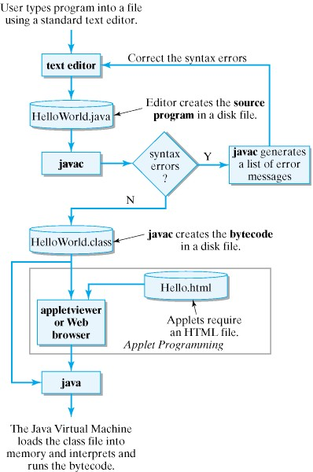
Editing, Compiling, and Running

Slide 35
The Java Development Process
Step 1: Editing the Program
  Software: Any text editor will do.
Step 2: Compiling the Program
  Software: Java Development Kit (JDK)
  JDK: javac HelloWorld.java
Step 3: Running the Program
  JDK: java HelloWorld (Application)
  JDK: appletviewer file.html (Applet)

Slide 36
Editing a Java Program
Software: A text editor (vi, emacs, BBEdit).
Program source code must be saved in a text file named HelloWorld.java where HelloWorld is the name of the public class contained in the file.
Remember: Java class names and file names are case sensitive.

Slide 37
Compiling a Java Program
Compilation translates the source program into Java bytecode.
  Bytecode is platform-independent
JDK Command: javac HelloWorld.java
Successful compilation will create the bytecode class file: HelloWorld.class

Slide 38
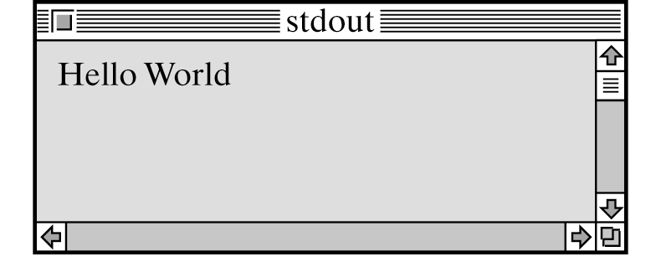
Running a Java Application
The class file (bytecode) is loaded into memory and interpreted by the Java Virtual Machine (JVM)
JDK Command: java HelloWorld

Slide 39
Running a Java Applet
Running an applet requires an HTML file containing an <applet> tag:
<HTML>
...
<APPLET CODE=“HelloWorldApplet.class”
WIDTH=200 HEIGHT=200>
</APPLET>
...
</HTML>
JDK Command: appletviewer file.html
Browser: Open the applet’s HTML file

Slide 40
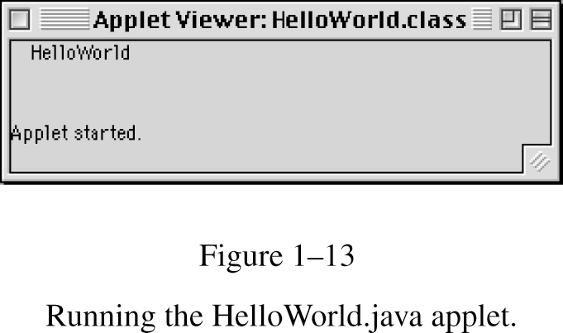
Running a HelloApplet
Try running HelloWorldApplet

Slide 41
Coding into Java
Stepwise Refinement is the right way to code.
  Code small stages at a time, testing in between.
  Errors are caught earlier.
Syntax rules must be followed.
  Syntax is the set of rules that determine whether a particular statement is correctly formulated
Semantics must be understood.
  Semantics refers to the meaning (effect on the program) of each Java statement.

Slide 42
Testing, Debugging, and Revising
Coding, testing, and revising a program is an iterative process.
The java compiler catches syntactic errors, producing error messages.
The programmer must test thoroughly for semantic errors.
  Semantic errors are errors which manifest themselves through illogical output or behavior.
  Errors are corrected in the debugging phase

Slide 43
Writing Readable Programs
Style, in addition to working code, is the mark of a good programmer. Style consists of:
  Readability.
    Code should be well-documented and easy to understand.
  Clarity.
    Conventions should be followed and convoluted code avoided.
  Flexibility.
    Code should be designed for easy maintenance and change.

Slide 44
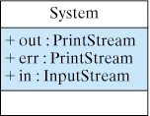
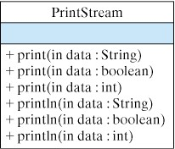
Java Library: System and PrintStream
The java.lang.System class contains PrintStream objects that perform Input/Output (I/O).
The java.lang.PrintStream class contains the print() and println() methods that perform output.

Slide 45
Example: OldMacDonald Program
public class OldMacDonald // Class header
{ // Start of body
public static void main(String argv[]) // Main method
{
System.out.println(“Old MacDonald had a farm.”);
System.out.println(“E I E I O.”);
System.out.println(“And on his farm he had a duck.”);
System.out.println(“E I E I O.”);
System.out.println(“With a quack quack here.”);
System.out.println(“And a quack quack there.”);
System.out.println(“Here a quack, there a quack.”);
System.out.println(“Everywhere a quack quack.”);
System.out.println(“Old MacDonald had a farm”);
System.out.println(“E I E I O.”);
} // End of main
} // End of OldMacDonald

Slide 46
Summary: Technical Terms
keyword
literal value
object instantiation
operator
package
parameter
primitive data type
pseudocode
qualified name
semantics
stepwise refinement
syntax
algorithm
applet
application program
assignment statement
comment
compound statement (block)
data type
declaration statement
default constructor
executable statement
expression
identifier

Slide 47
Summary: Key Points
A Java applet is an embedded program that runs within the context of a WWW browser. Java applets are identified in HTML documents by using the <applet> tag.
A Java application runs in stand-alone mode. Applications must have a main() method.
Java programs are first compiled into bytecode and then interpreted by the Java Virtual Machine (JVM).

Slide 48
Summary: Key Points
A Java source program must be stored in a file that has a .java extension.
A Java bytecode file has the same name as the source file but a .class extension.
The name of the source file must be identical to the name of the public class defined in the file.
Java is case sensitive.

Slide 49
Summary: Key Points
Good program design requires that each object and each method have a well-defined task.
Coding Java should follow the stepwise refinement approach.
A stub method is a method with a complete header and an incomplete body.

Slide 50
Summary: Key Points
A syntax error results when a statement violates one of Java’s grammar rules.
A semantic error or logic error is an error in the program’s design and cannot be detected by the compiler.
Testing a program can only reveal the presence of bugs, not their absence.
Good programs should be designed for readability, clarity, and flexibility.

