Slide 1

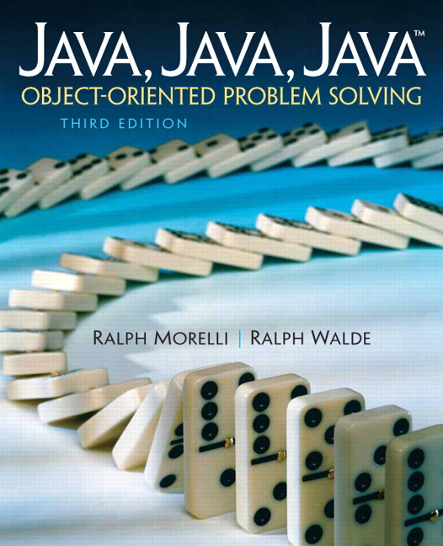
JAVA, JAVA, JAVA
presentation slides for
Object-Oriented Problem Solving
Third Edition
Ralph Morelli | Ralph Walde
Trinity College
Hartford, CT
published by Prentice Hall

Slide 2
Java, Java, Java
Object Oriented Problem Solving
Chapter 10: Exceptions

Slide 3
Objectives
Understand Java's exception handling mechanisms.
Be able to use the Java try/catch statement.
Know how to design effective exception handlers.
Appreciate the importance that exception handling plays in program design.
Be able to design your own Exception subclasses.

Slide 4
Outline
Introduction
Handling Exceptional Conditions
Java’s Exception Hierarchy
Handling Exceptions within a Program
Error Handling and Robust Program Design
Creating and Throwing Your Own Exceptions
From the Java Library: JOptionPane

Slide 5
Introduction
No matter how well designed a program is, there is always the chance that some kind of error will arise during its execution.
A well-designed program should include code to handle errors and other exceptional conditions when they arise.
This chapter describes Java's exception handling features.

Slide 6
Handling Exceptional Conditions
The avgFirstN() method expects that N > 0.
If N = 0, a divide-by-zero error occurs in avg/N.
/**
* Precondition: N > 0
* Postcondition: avgFirstN() equals the average of (1+2+…+N)
*/
public double avgFirstN(int N) {
double sum = 0;
for (int k = 1; k <= N; k++)
sum += k;
return sum/N; // What if N is 0 ??
} // avgFirstN()
Bad Design: Doesn’t guard against divide-by-0.

Slide 7
Traditional Error Handling
Error-handling code built right into the algorithm:
/**
* Precondition: N > 0
* Postcondition: avgFirstN() equals the average of (1+2+…+N)
*/
public double avgFirstN(int N) {
double sum = 0;
if (N <= 0) {
System.out.println(“ERROR avgFirstN: N <= 0. Program terminating.”);
System.exit(0);
}
for (int k = 1; k <= N; k++)
sum += k;
return sum/N; // What if N is 0 ??
} // avgFirstN()
It’s sometimes risky to exit a program like this.

Slide 8
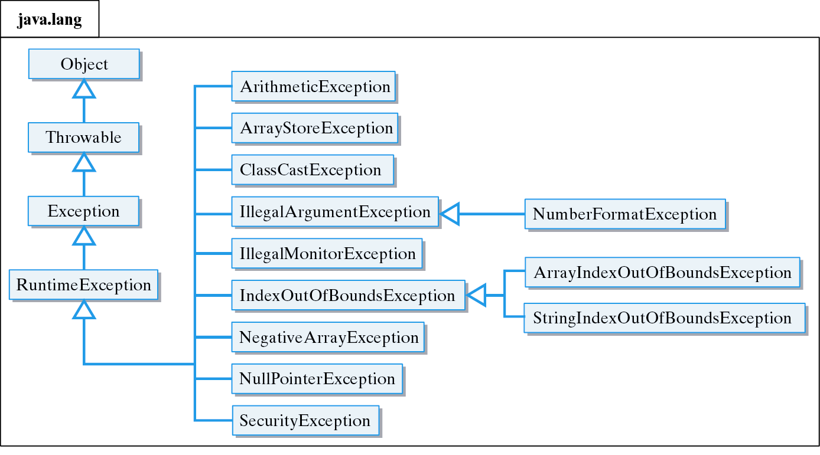
Java’s Exception Hierarchy
Unchecked exceptions belong to a subclass of RuntimeException and are not monitored by the compiler.

Slide 9
Some Important Exceptions
Class Description
ArithmeticException Division by zero or some other kind of arithmetic problem
ArrayIndexOutOfBounds- An array index is less than zero or Exception greater than or equal to the array's length
FileNotFoundException Reference to a unfound file IllegalArgumentException Method call with improper argument
IndexOutOfBoundsException An array or string index out of bounds
NullPointerException Reference to an object which has not been instantiated
NumberFormatException Use of an illegal number format, such as when calling a method
StringIndexOutOfBoundsException A String index less than zero or greater than or equal to the String's length

Slide 10
Some Common Exceptions
Class Method Exception Raised Description
Double valueOf(String) NumberFormatException The String is not a double
Integer parseInt(String) NumberFormatException The String is not a int
String String(String) NullPointerException The String is null
indexOf(String) NullPointerException The String is null
lastIndexOf(String) NullPointerException The String is null
charAt(int) StringIndexOutOfBounds
Exception The int is invalid index
substring(int) StringIndexOutOfBounds
Exception The int is invalid index
substring(int,int) StringIndexOutOfBounds
Exception An int is invalid index

Slide 11
Checked Exceptions
Checked exception must either be caught or declared within the method where it is thrown.
Monitored by the Java compiler.
Example: IOException
IOException must be declared ...
public static void main(String argv[]) throws IOException {
BufferedReader input = new BufferedReader
(new InputStreamReader(System.in));
String inputString = input.readLine(); // May throw IOException
}
...because readLine() may cause it.

Slide 12
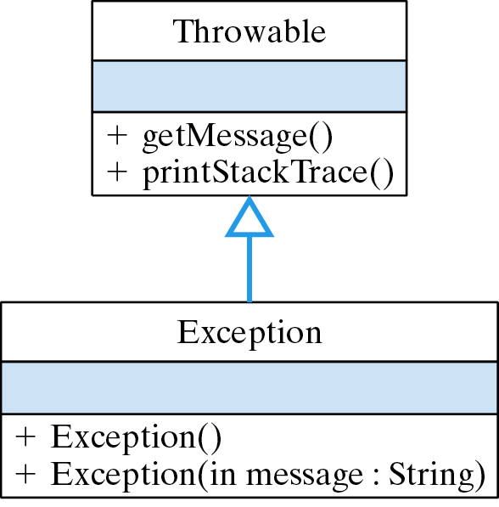
The Exception Class
Simple: only constructor methods.

Slide 13
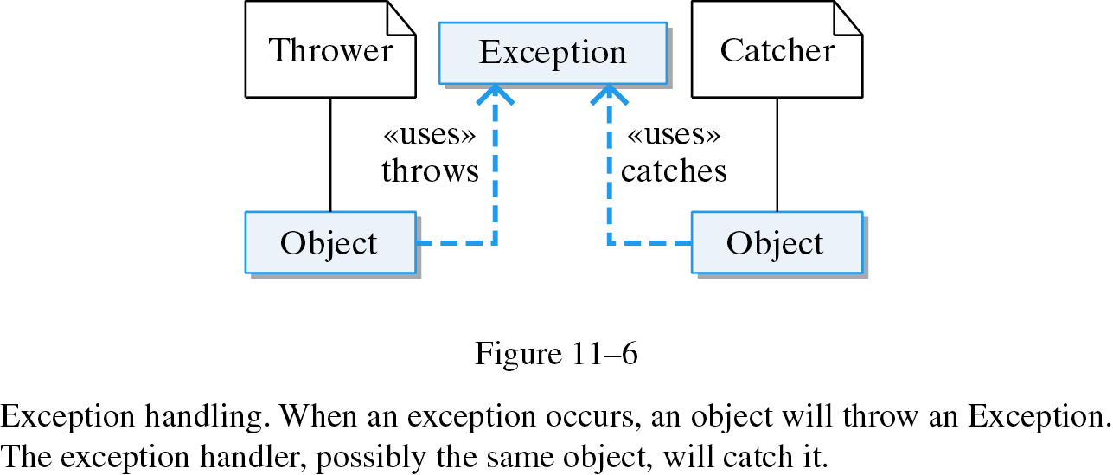
Exception Handling
When an exception occurs, an object will throw an exception. The exception handler, possibly the same object, will catch it.

Slide 14
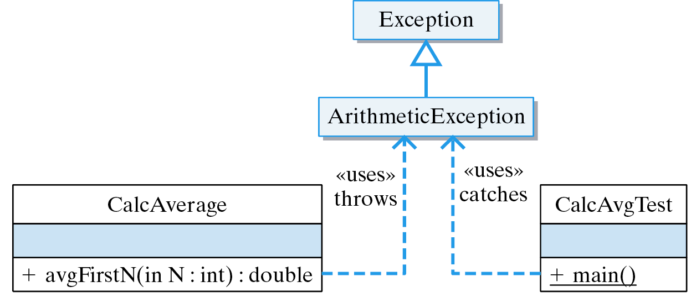
Example: Two Classes
Throw in one class...
…Catch in the other.

Slide 15
Try, Throw and Catch
public class CalcAverage {
public double avgFirstN(int N ){
double sum = 0;
try { // Try block: exception thrower
if (N <= 0)
throw new Exception("ERROR: Can't average 0 slements");
for (int k = 1; k <= N; k++)
sum += k;
return sum/N;
}
}// avgFirstN()
} // CalcAverage
public class CalcAvgTest {
public static void main(String args[]) {
try {
CalcAverage ca = new CalcAverage();
System.out.println(“AVG + “ + ca.avgFirstN(0));
} catch (ArithmeticException e) { // Catch block: exception handler
System.out.println(e.getMessage());
e.printStackTrace();
System.exit(0);
}
}// main()
} // CalcAvgTest
Throw in one class...
...Catch in the other.
Effective Design: Java’s exception handling mechanism allows you to separate normal code from exception handling code.

Slide 16
Try/Throw/Catch
A try block contains statements that may cause an exception. It signals your intention to handle the exception.
Throwing an exception is like pulling the fire alarm. Once an exception is thrown, control is transferred to an appropriate catch clause.
Exceptions are handled in the catch clause.
The finally block is optional. Unless the program is exited, it is executed whether an exception is thrown or not.

Slide 17
Try/Throw/Catch (cont)
try {
// Block of statements
// At least one of which may throw an exception
if ( /* Some condition obtains */ )
throw new ExceptionName();
} catch (ExceptionName ParameterName) {
// Block of statements to be executed
// If the ExceptionName exception is thrown in try
}
... // Possibly other catch clauses
} catch (ExceptionName2 ParameterName) {
// Block of statements to be executed
// If the ExceptionName2 exception is thrown in try
} finally {
// Optional block of statements that is executed
// Whether an exception is thrown or not
}

Slide 18
Restrictions on try/catch/finally
A try block must be followed by one or more catch clauses.
A catch clause may only follow a try block.
A throw statement is used to throw both checked and unchecked exceptions.
Unchecked exceptions belong to RuntimeException or its subclasses.
Checked exceptions must be caught or declared.
A throw statement must be contained within the dynamic scope of a try block, and the type of Exception thrown must match at least one of the try block’s catch clauses. Or, the throw statement must be contained within a method or constructor that has a throws clause for the type of thrown Exception.

Slide 19
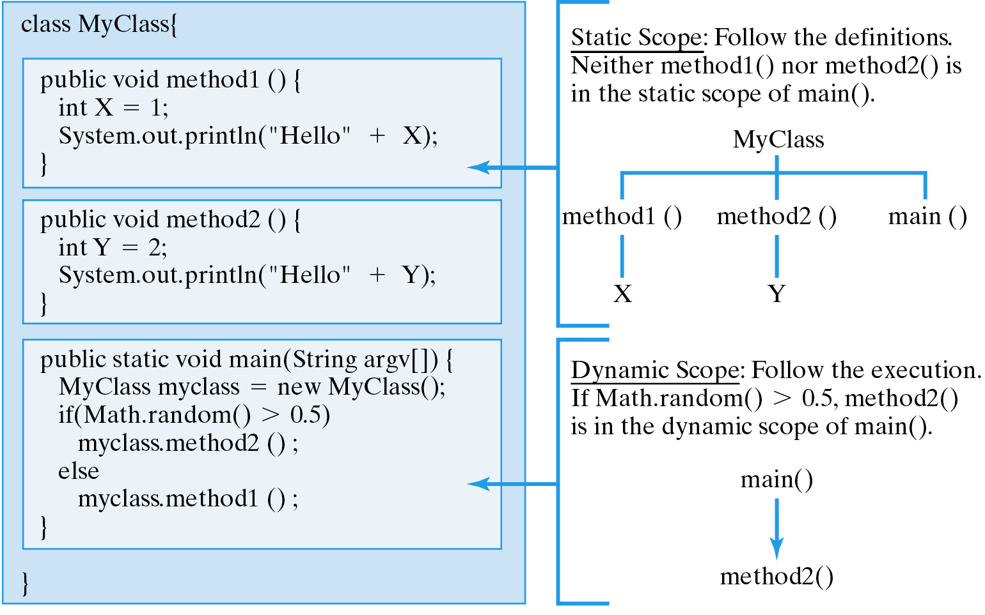
Dynamic versus Static Scope
Static scope: how the program is written.
Dynamic scope: how the program is run.

Slide 20
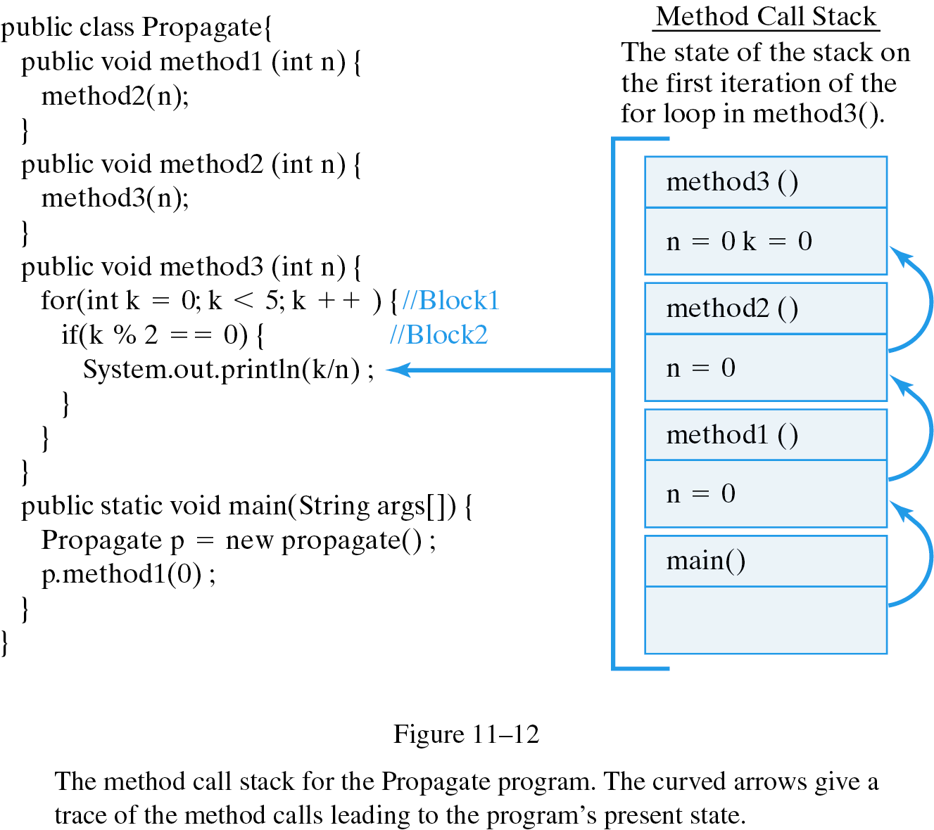
The Method Call Stack
The method call stack keeps track of the methods that are called during program execution. The current method is on the top of the stack.
Dynamic scope: main() calls method1() which calls method2() which calls method3().

Slide 21
Finding a Catch Block
Search upward through the static scope and backward through the dynamic scope.
Dynamic scope: If no handler found in method3() Java searches method2(), then method1(), then main().
Static scope: If an error occurs in k/n, Java searches up this branch for an exception handler.

Slide 22
Default Exception Handling
Java can handle unchecked exceptions itself.
public class CalcAverage {
public double avgFirstN(int N ){
double sum = 0;
try { // Try block: exception thrower
if (N <= 0)
throw new Exception("ERROR: Can't average 0 slements");
for (int k = 1; k <= N; k++)
sum += k;
return sum/N;
}
} // avgFirstN()
public static void main(String args[]) {
CalcAverage ca = new CalcAverage();
System.out.println( "AVG + " + ca.avgFirstN(0));
} // main()
} // CalcAverage
No catch clause for ArithmeticException, so Java handles the exception itself.
java.lang.ArithmeticException: ERROR: Can't average 0 elements
at CalcAverage.avgFirstN(CalcAverage.java:9)
at CalcAverage.main(CalcAverage.java:20)
at com.mw.Exec.run(JavaAppRunner.java:47)

Slide 23
Robust Program Design
Four ways to handle exceptions:
Kind of Exception Kind of Program Action to be Taken
Caught by Java Let Java handle it
Fixable condition Fix the error and resume execution
Unfixable condition Stoppable Report error and terminate
Unfixable condition Not stoppable Report error and resume processing
Your own programs: letting Java handle exceptions may be the best choice.
During program development: exceptions help you identify bugs.
Commercial software: the program should handle its exceptions because the user can’t.

Slide 24
Handling Strategies
Print Error Message and Terminate. Unless the error can be fixed, it’s better to terminate a program than to allow it to spread bad data -- e.g., the divide-by-zero example.
Log the Error and Resume: A heart monitor program cannot be terminated.

Slide 25
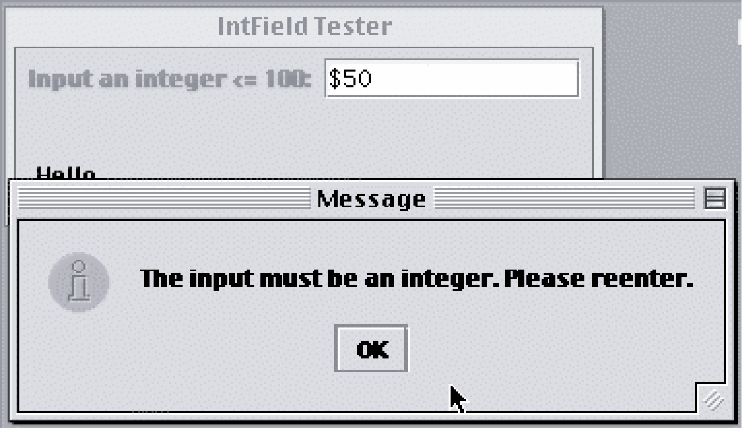
Erroneous Input Error
Erroneous input should be anticipated and fixed.

Slide 26
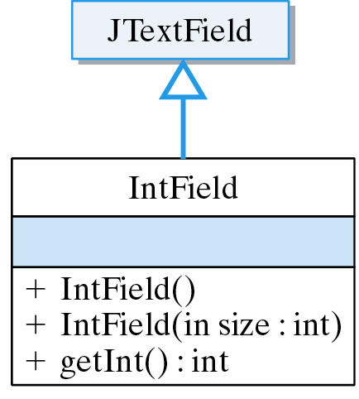
Fixable Error: The IntField Class
An IntField is a JTextField that accepts only integer input or throws an exception.

Slide 27
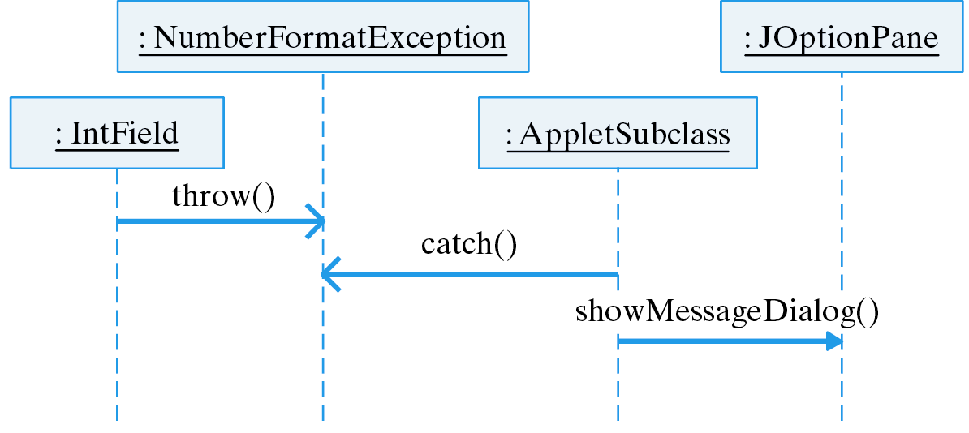
The NumberFormatException
If the user types a non-integer, the IntField throws a NumberFormatException, which is caught by the applet.

Slide 28
Fix the Error and Resume
Fixable Errors. If the user does not input an integer ...
import javax.swing.*;
public class IntField extends JTextField {
public IntField () {
super();
}
public IntField (int size) {
super(size);
}
public int getInt() throws NumberFormatException {
return Integer.parseInt(getText());
} // getInt()
} // IntField
parseInt() throws an exception when “57%” is input.

Slide 29
Fix the Error and Resume (cont)
…Print an error message and ask the user to reenter the data.
getInt() may throw an exception
public void actionPerformed(ActionEvent e) {
try {
userInt = intField.getInt();
message = "You input " + userInt + " Thank you.";
} catch (NumberFormatException ex) {
JOptionPane.showMessageDialog(this,
"The input must be an integer. Please reenter.");
} finally {
repaint();
}
} // actionPerformed()

Slide 30
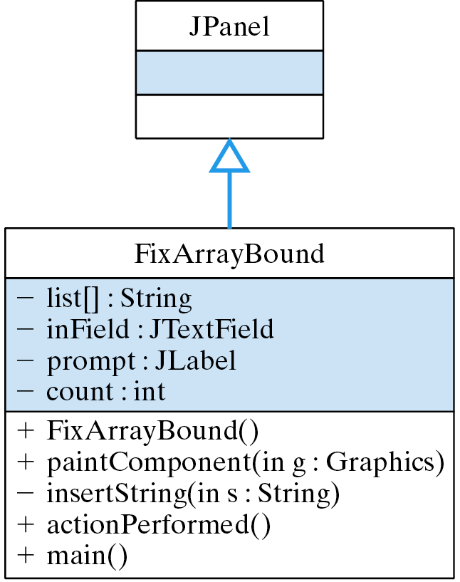
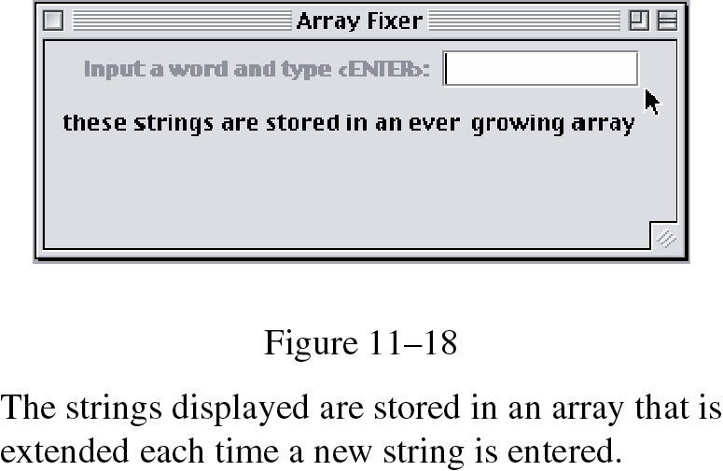
Example: To Fix or Not to Fix
Should you use an exception to extend an array?
The FixArrayBound class uses exception handling to extend the size of array whenever a new element is inserted.

Slide 31
When Not to Use an Exception
Effective Design: Exceptions should not be used to handle routine conditions.
If an array is routinely overflowed, use a Vector.
If array size is exceeded ...
private void insertString(String str) {
try {
list[count] = str;
} catch (ArrayIndexOutOfBoundsException e) {
String newList[] = new String[ list.length + 1 ]; // Create new array
for (int k = 0; k < list.length ; k++) // Copy old to new
newList[k] = list[k];
newList[count] = str; // Insert item into new
list = newList; // Make old point to new
} finally { // Since the exception is now fixed
count++; // Increase the count
}
} // insertString()
…extend its size.
Source code: FixArrayBound.java

Slide 32
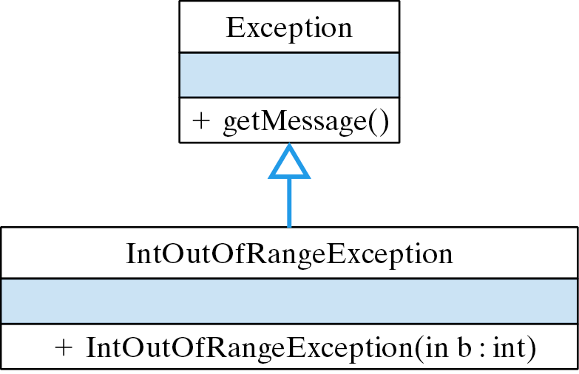
Programmer-Defined Exceptions
Programmer-defined exceptions are defined by extending the Exception class.
Thrown when an integer exceeds a certain bound.

Slide 33
Creating Your Own Exceptions
An exception for validating that an integer is less than or equal to a certain maximum value:
/**
* IntOutOfRangeException reports an exception when an
* integer exceeds its bound.
*/
public class IntOutOfRangeException extends Exception {
public IntOutOfRangeException (int Bound) {
super("The input value exceeds the bound " + Bound);
}
}
This error message will be printed when this exception is thrown.

Slide 34
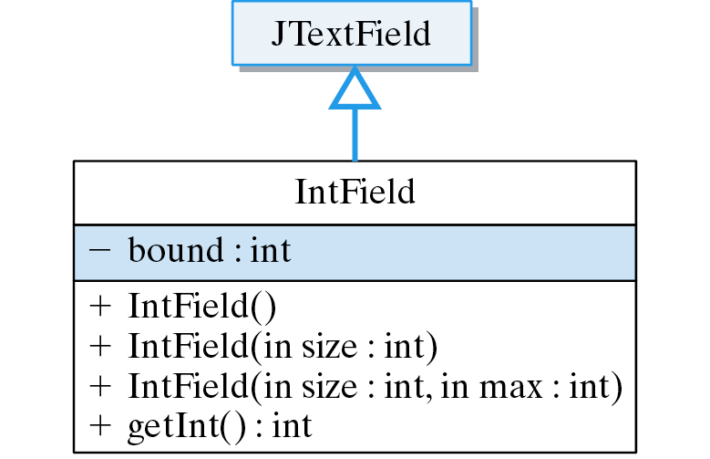
Example: Bounded Input
Modified IntField that only accepts integers that are less than a certain bound.
An IntField with a bound.
Throws exception if bound exceeded.

Slide 35
Implementation: IntField
Bound is set in the IntField constructor.
public class IntField extends JTextField {
private int bound = Integer.MAX_VALUE;
public IntField(int size, int max) {
super(size);
bound = max;
}
public int getInt() throws NumberFormatException,
IntOutOfRangeException {
int num = Integer.parseInt(getText());
if (num > bound)
throw new IntOutOfRangeException(bound);
return num;
} // getInt()
// The rest of the class is unchanged
} // IntField
New constructor lets us set the bound.
Throw exception if bound exceeded.

Slide 36
Using Your Own Exception
The IntFieldTester class tries to input an integer within a certain range:
public class IntFieldTester extends JPanel implements ActionListener {
// Code deleted here
public void actionPerformed(ActionEvent evt) {
try {
userInt = intField.getInt();
message = "You input " + userInt + " Thank you.";
} catch (NumberFormatException e) {
JOptionPane.showMessageDialog(this,
"The input must be an integer. Please reenter.");
} catch (IntOutOfRangeException e) {
JOptionPane.showMessageDialog(this, e.getMessage());
} finally {
repaint();
}
} // actionPerformed()
// Code deleted here
} // IntFieldTester
Get user’s input.
Handle exceptions.
An error dialog window.
Applet Version Demo: IntField Tester

Slide 37
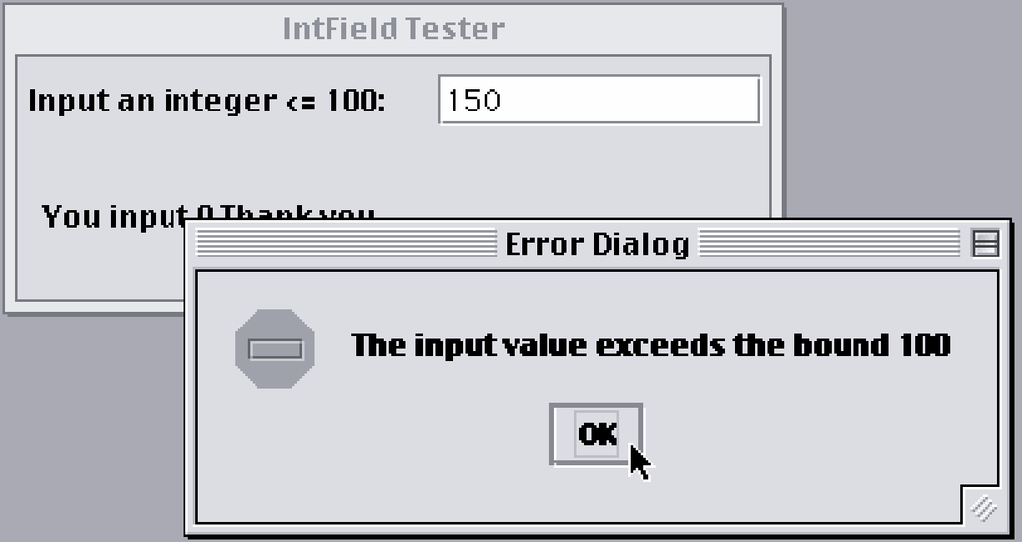
From the Java Library: JOptionPane
A JOptionPane is a dialog box.
A file dialog is used when you open or save a file. A warning dialog or error dialog communicates an error or warning message.
Message icon.

Slide 38
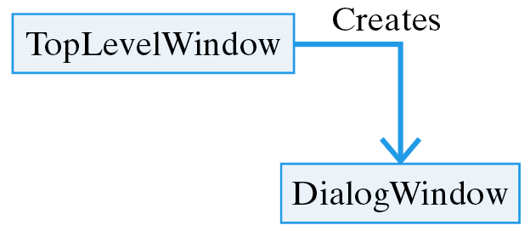
JOptionPane
JOptionPane.showMessageDialog():
catch (NumberFormatException e) {
JOptionPane.showMessageDialog(this,
"The input must be an integer. Please reenter.");
}
Standard message icons:
JOptionPane.PLAIN_MESSAGE
JOptionPane.INFORMATIONAL_MESSAGE // Default
JOptionPane.WARNING_MESSAGE
JOptionPane.QUESTION_MESSAGE
JOptionPane.ERROR_MESSAGE
Types of dialogs:
Message Dialog Presents a simple error or informational message
Confirm Dialog Prompts the user to confirm a particular action
Option Dialog Lets the user choose from a couple of options
Input Dialog Prompts and inputs a string

Slide 39
Effective Design
Unfixable Error. If possible, it’s better to terminate the program abnormally than to allow the error to propagate.
Normal versus Exceptional Code. The exception handler --- the catch block --- is distinct from the (normal) code that throws the exception --- the try block.
Using an Exception. If your exception handler is not significantly different from Java’s, let Java handle it.

Slide 40
Effective Design
Handling Exceptions.
  Report the exception and terminate the program;
  Fix the exceptional condition and resume normal execution.
  Report the exception to a log and resume execution.
Program Development. Exceptions help identify design flaws during program development.
Report and Resume. Failsafe programs should report the exception and resume.

Slide 41
Effective Design
Defensive Design. Anticipate potential problems, especially potential input problems.
Fixing an Exception. Handle fixable exceptions locally. This is both clearer and more efficient.
Library Exception Handling. Many library classes leave exception handling to the application.
Truly Exceptional Conditions. Use exceptions to handle truly exceptional conditions, not for expected conditions.

Slide 42
Technical Terms
catch block
catch an exception
checked exception
dialog box
dynamic scope
error dialog
exception
exception handler
finally block
method call stack
method stack trace
modal dialog
static scope
throw an exception
try block
unchecked exception

Slide 43
Summary Of Important Points
In Java, when an error occurs, you throw an Exception which is caught by exception handler code . A throw statement --- throw new Exception() --- is used to throw an exception.
A try block is contains one or more statements that may throw an exception. Embedding a statement in a try block indicates your awareness that it might throw an exception and your intention to handle the exception.

Slide 44
Summary Of Important Points (cont)
Checked exceptions must be caught or declared by the method in which they occur.
Unchecked exceptions (subclasses of RuntimeException) are handled by Java if they are not caught in the program.
A catch block contains statements that handle the exception that matches its parameter.
A catch block can only follow a try block.
There may be more than one catch block for each try block.

Slide 45
Summary Of Important Points (cont)
The try/catch syntax separates the normal parts of an algorithm from special exceptional handling code.
A method stack trace is a trace of a program’s method calls -- Exception.printStackTrace().
Static scoping: how the program is written. Depends on declarations and definitions.
Dynamic scoping: how the program is executed. Depends on method calls.

Slide 46
Summary Of Important Points (cont)
Finding a Catch Block: Search upward through the static scope, and backward through the dynamic scope.
The Java Virtual Machine handles unchecked exceptions not caught by the program.
Many Java library methods throw exceptions when an error occurs.
Example: Java's integer division operator will throw an ArithmeticException if an attempt is made to divide by zero.

Slide 47
Summary Of Important Points (cont)
Four ways to handle an exception:
  Let Java handle it.
  Fix the problem and resume the program.
  Report the problem and resume the program.
  Print an error message and terminate.
The (optional) finally block contains code that will be executed whether an exception is raised or not.
Exceptions should be used for exception truly exceptional conditions, not for normal program control.
User-defined exceptions can extend the Exception class or one of its subclasses.

