Slide 1

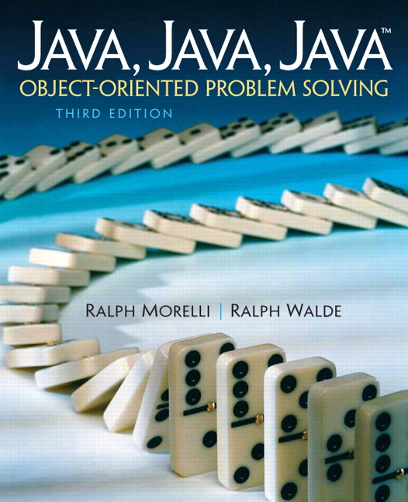
JAVA, JAVA, JAVA
presentation slides for
Object-Oriented Problem Solving
Third Edition
Ralph Morelli | Ralph Walde
Trinity College
Hartford, CT
published by Prentice Hall

Slide 2
Java, Java, Java
Object Oriented Problem Solving
Chapter 11: Files, Streams, and Input/Output Techniques

Slide 3
Objectives
Be able to read and write text files.
Know how to read and write binary files.
Understand the use of InputStreams and OutputStreams
Be able to design methods for performing input and output.
Know how to use the File class.
Be able to use the JFileChooser class.

Slide 4
Outline
Introduction
Streams and Files
Case Study: Reading and Writing Files
The File Class
Reading and Writing Binary Files
Reading and Writing Objects
From the Java Library: JFileChooser
Using the File Data in Programs

Slide 5
Introduction
Input refers to reading data from some external source into a running program.
Output refers to writing data from a running program to some external destination.
A file is a collection of data stored on a disk or CD or some other storage medium.
Files and their data persist beyond the duration of the program.

Slide 6
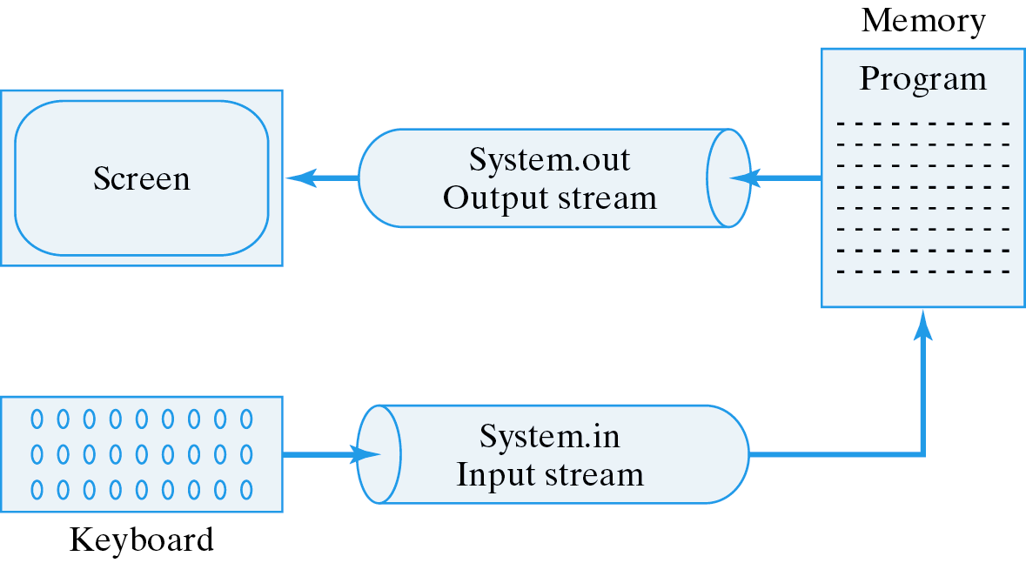
Streams and Files
A stream is an object that delivers information to and from another object.
All I/O in Java is based on streams.
System.out
System.in

Slide 7
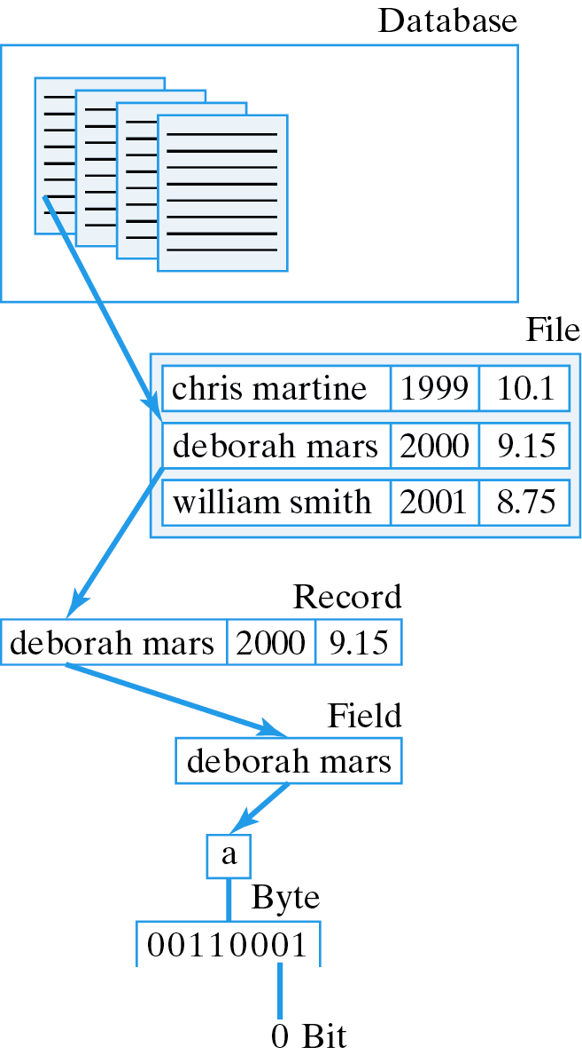
The Data Hierarchy
Data can be arranged in a hierarchy.
A database is a collection of files.
A byte is a collection of bits.

Slide 8
Binary Files and Text Files
A binary file is processed as a sequence of bytes, whereas a text file is processed as a sequence of characters. Both types store data as a sequence of bits and bytes (0’s and 1’s).
Text files are portable because they are based on the ASCII code.
Binary files are not portable because they use different representations of binary data.
Java binaries are platform independent because Java defines the sizes of binary data.

Slide 9
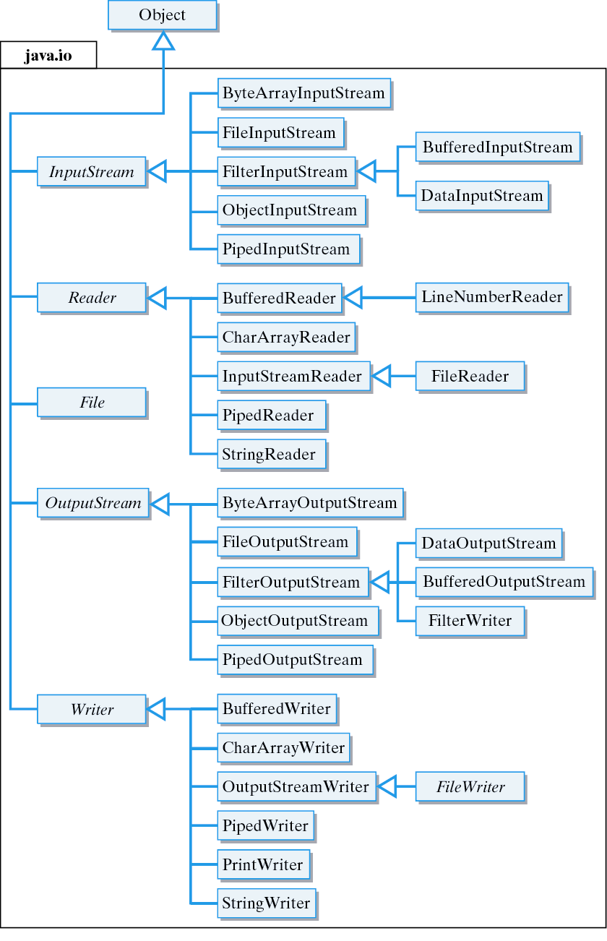
Java Input and Output Streams
JavaInput and Output Streams

Slide 10
Some of the Main Stream Classes
Class Description
InputStream Abstract root class of all binary input streams
FileInputStream Provides methods for reading bytes from a binary file
BufferedInputStream Provides input data buffering for reading large files
DataInputStream Provides methods for reading Java's primitive data types
OutputStream Abstract root class of all binary output streams
FileOutputStream Provides methods for writing bytes to a binary file
BufferedOutputStream Provides output data buffering for writing large files
DataOutputStream Provides methods for writing Java's primitive data types
Reader Abstract root class for all text input streams
BufferedReader Provides buffering for character input streams
FileReader Provides methods for character input on files
StringReader Provides input operations on Strings
Writer Abstract root class for all text output streams
BufferedWriter Provides buffering for character output streams
FileWriter Provides methods for output to text files
PrintWriter Provides methods for printing binary data as characters
StringWriter Provides output operations to Strings

Slide 11
Which Stream to Use?
Binary I/O: For binary I/O we use subclasses of DataInputStream and DataOutputStream.
Text I/O: Subclasses of Reader and Writer are normally used for text I/O.

Slide 12
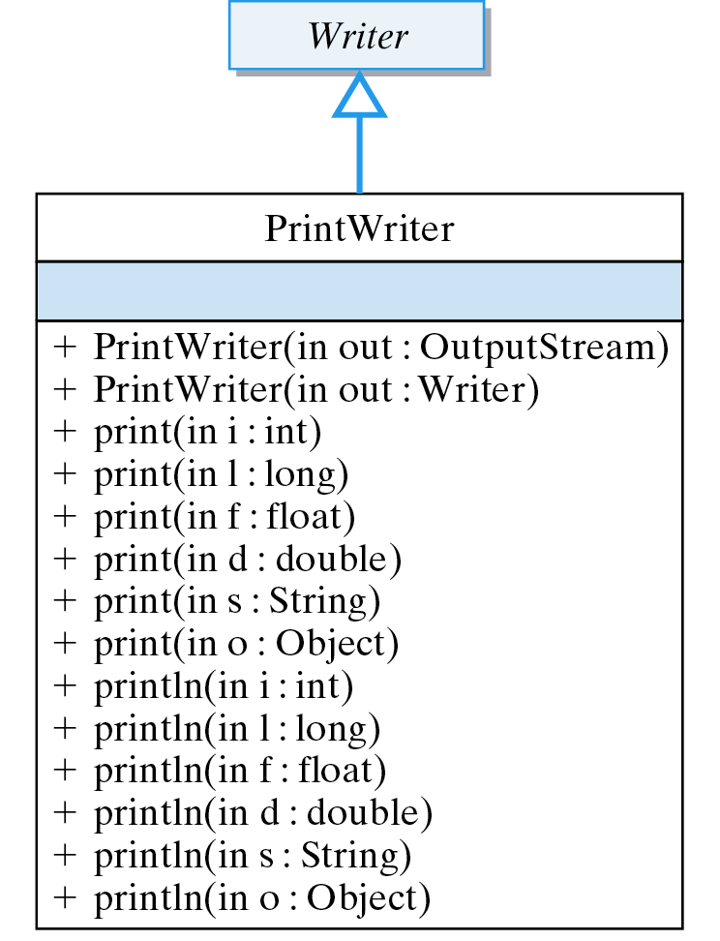
Example: PrintWriter
Example: PrintWriter has methods for printing all types of data.

Slide 13
Buffering and Filtering
A buffer is a relatively large region of memory used to temporarily store data during I/O.
BufferedInputStream and BufferedOutputStream are designed for this purpose.
Buffering improves efficiency.
The StringReader and StringWriter classes provide methods for treating Strings and StringBuffers as I/O streams.

Slide 14
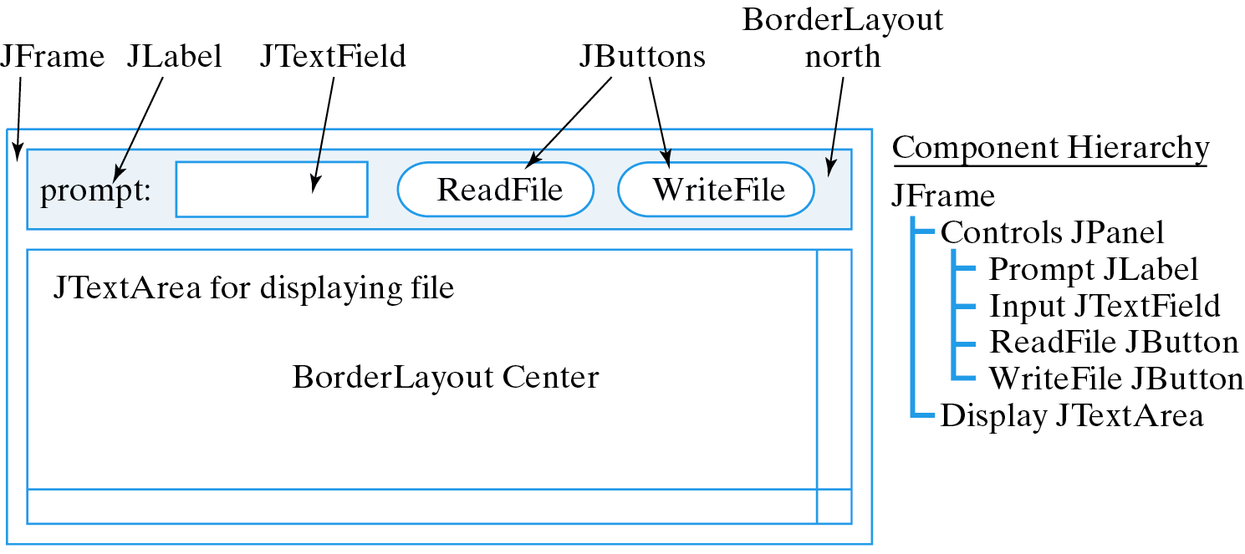
Case Study: Reading and Writing Text Files
Problem Statement: One of the subtasks of a text editor (lab project) is to be able to read and write data to and from a text file.
GUI Design:

Slide 15
Writing to a Text File
Text file format: a sequence of characters divided into 0 or more lines and ending with a special end-of-file character.
End-of-line (\n) and end-of-file (\eof) characters.
one\ntwo\nthree\nfour\eof
Basic algorithm:
  Connect an output stream to the file.
  Write text into the stream, possibly with a loop.
  Close the stream.

Slide 16
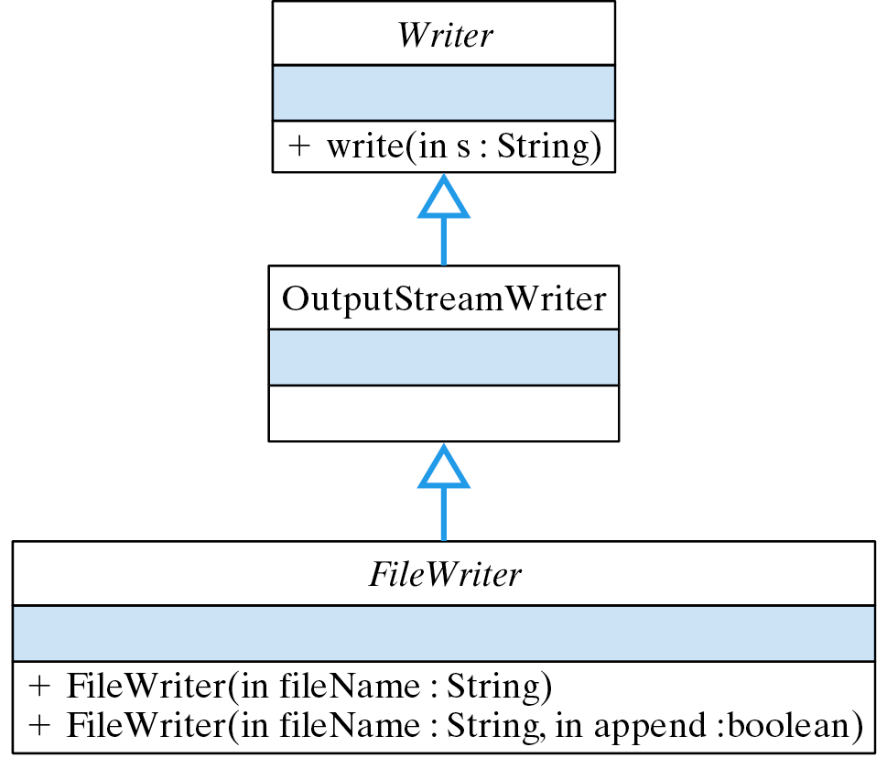
Choosing a Stream
FileWriter is designed for writing files but does not define a write() method.
But it inherits an appropriate write method from its Writer superclass.
To find the right I/O method, it is sometimes necessary to search the Java class hierarchy.

Slide 17
The writeTextFile() Method
writeTextFile() takes a string from a JTextArea and writes it to a file.
Connect output stream to file.
private void writeTextFile(JTextArea display, String fileName) {
try {
FileWriter outStream
= new FileWriter (fileName);
outStream.write (display.getText());
outStream.close();
} catch (IOException e) {
display.setText("IOERROR: " + e.getMessage() + "\n");
e.printStackTrace();
}
} // writeTextFile()
Catch IOException.

Slide 18
Code Reuse: Designing Text File Output
To design an I/O method, use I/O libraries:
  What library methods do we need for the task?
  What library streams have the desired methods?
Example: Connecting PrintWriter and FileOutputStream so we can use PrintWriter’s println(String) and:
Connecting the streams.
PrintWriter outStream = // Create an output stream
new PrintWriter(new FileOutputStream(fileName)); // And open file
outStream.print (display.getText()); // Write the entire display textoutStream.close(); // Close the output stream
Using the method.

Slide 19
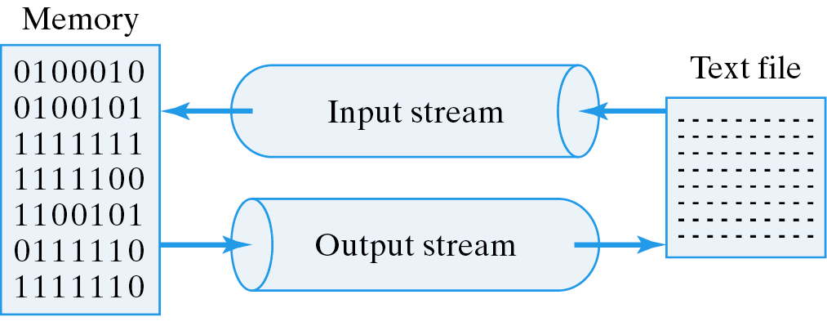
Reading from a Text File
Basic algorithm:
  Connect an input stream to the file.
  Read the text data using a loop.
  Close the stream.

Slide 20
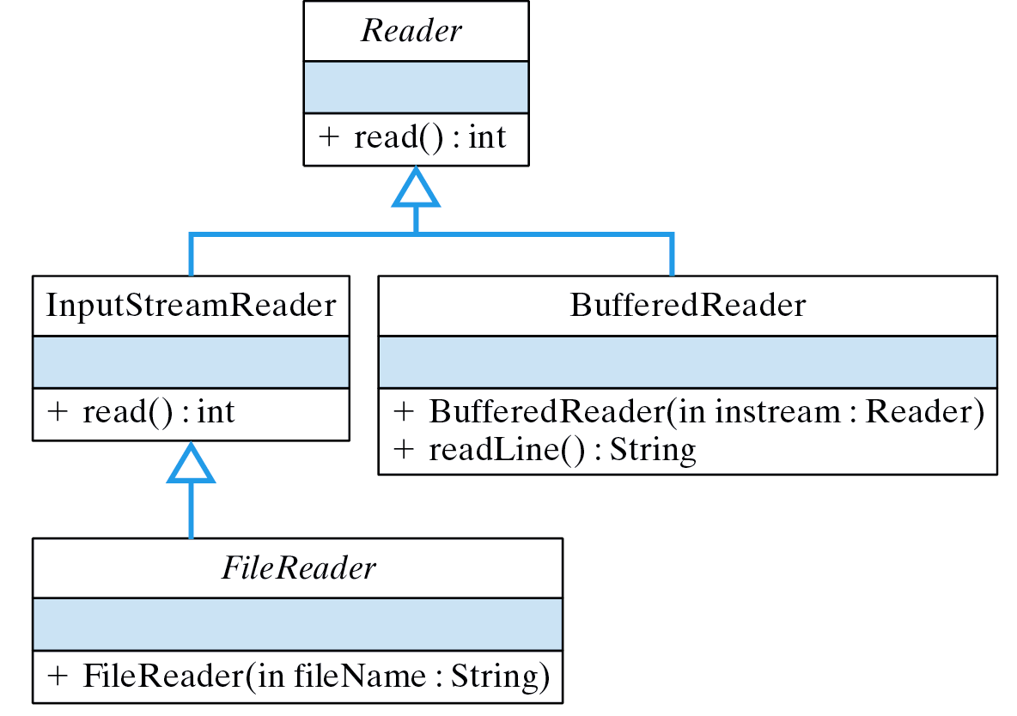
Choosing methods and streams
We need the FileReader(filename) constructor and the BufferedReader readLine(String) method
Connecting the streams.
BufferedReader inStream
= new BufferedReader(new FileReader(fileName));

Slide 21
The readTextFile() Method
private void readTextFile(JTextArea display, String fileName) {
try {
BufferedReader inStream // Create and open the stream
= new BufferedReader (new FileReader(fileName));
String line = inStream.readLine(); // Read one line
while (line != null) { // While more text
display.append(line + "\n"); // Display a line
line = inStream.readLine(); // Read next line
}
inStream.close(); // Close the stream
} catch (FileNotFoundException e) {
display.setText("IOERROR: File NOT Found: " + fileName + "\n");
e.printStackTrace();
} catch ( IOException e ) {
display.setText("IOERROR: " + e.getMessage() + "\n");
e.printStackTrace();
}
} // readTextFile()
readLine() returns null at end-of-file
Exception handling.

Slide 22
The Read Loop
Read loops are designed to work on empty files.
try to read one line of data and store it in line // Loop initializer
while (line is not null) { // Loop entry condition
process the data
try to read one line of data and store it in line // Loop updater
}
A while loop iterates 0 or more times.

Slide 23
Code Reuse: Designing Text File Input
We can also read one character at a time:
int ch = inStream.read(); // Initializer: try to read the next character
while (ch != -1) { // Loop-entry-condition: while more characters
display.append((char)ch + ""); // Append the character
ch = inStream.read(); // Updater: try to read next character
}
Basic file reading loop:
try to read data into a variable // Loop initializer
while ( read was successful ) { // Loop entry condition
process the data
try to read data into a variable // Loop updater
}

Slide 24
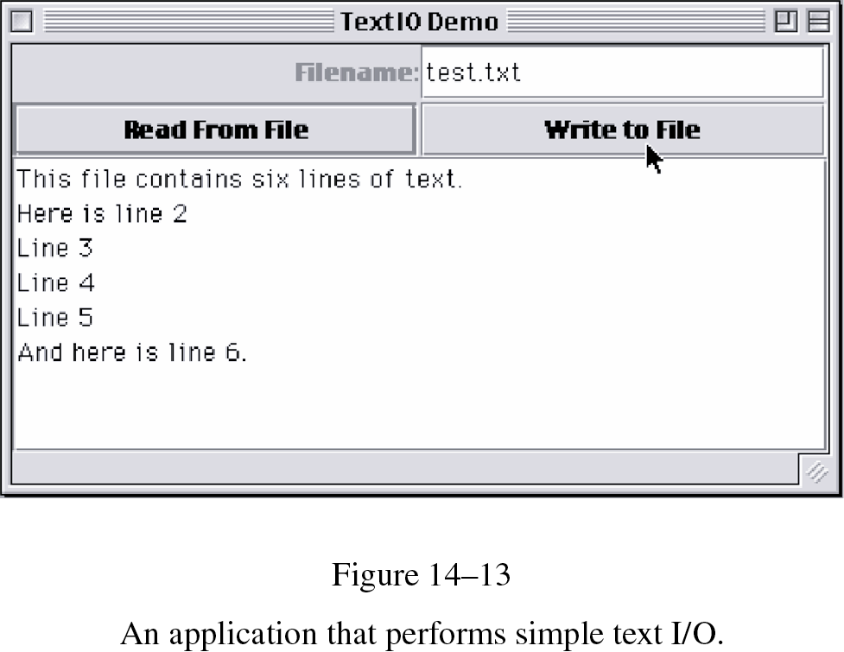
The TextIO Application: GUI
Write an application that reads and writes text files.

Slide 25
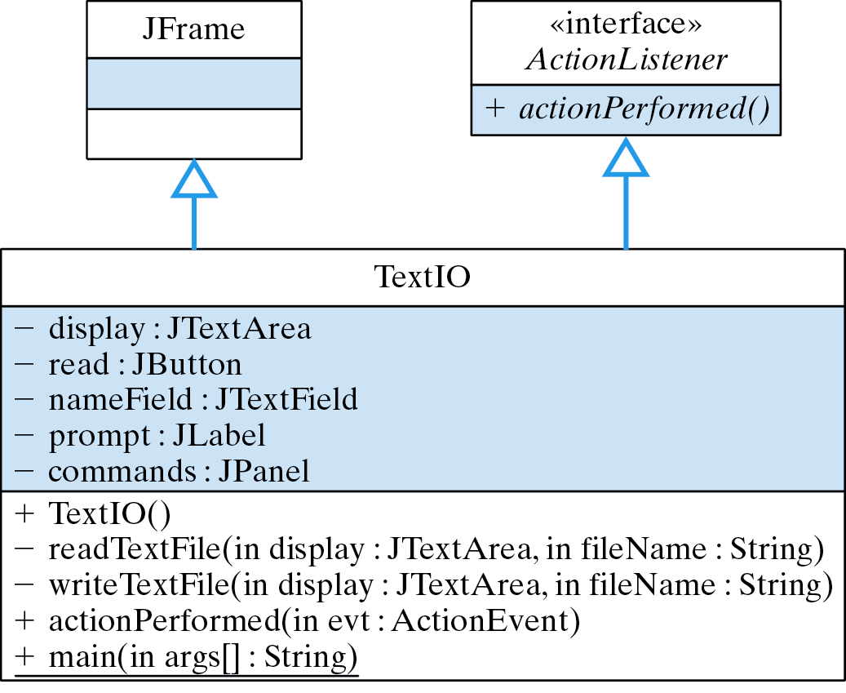
The TextIO Application: Design

Slide 26
The TextIO Application
Packages:
import javax.swing.*; // Swing components
import java.awt.*;
import java.io.*;
import java.awt.event.*;
Class:
public class TextIO extends JFrame implements ActionListener {
public TextIO() {} // Constructor
public static void main(String args[]) {
TextIO tio = new TextIO();
tio.setSize(400, 200);
tio.setVisible(true);
tio.addWindowListener(new WindowAdapter() { // Quit
public void windowClosing(WindowEvent e) {
System.exit(0);
}
});
} // main()
} //TextIO

Slide 27
The TextIO Application (cont)
public void actionPerformed(ActionEvent evt) {
String fileName = nameField.getText();
if (evt.getSource() == read) {
display.setText("");
readTextFile(display, fileName);
}
else writeTextFile(display, fileName);
} // actionPerformed()
Control:

Slide 28
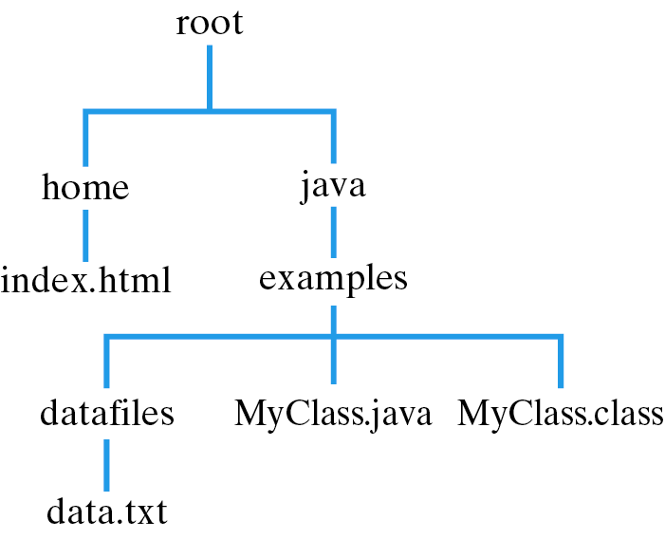
Files and Paths
A path is a description of a file's location in its hierarchy:
Absolute path name:
  /root/java/example/MyClass.java
Relative path name:
  MyClass.java

Slide 29
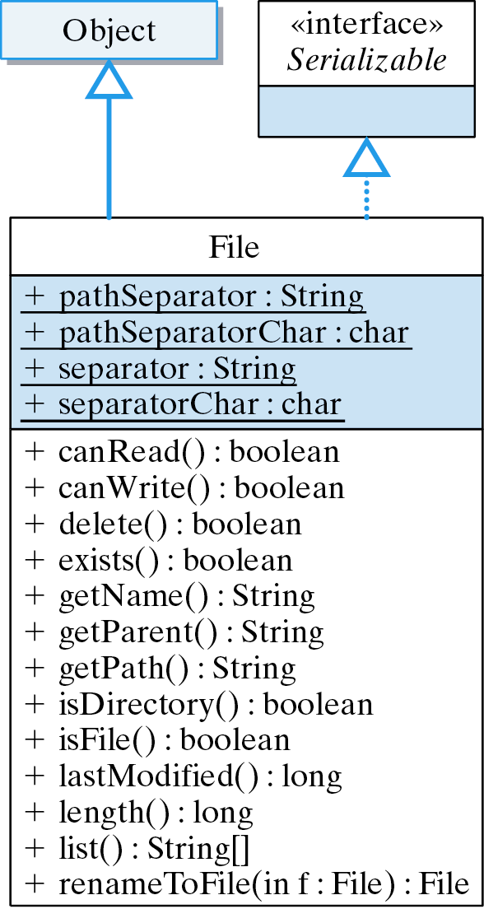
The File Class
Platform independence:
Unix: /
Windows: \

Slide 30
The isReadableFile() Method
Create a file object from the file name.
private boolean isReadableFile(String fileName) {
try {
File file = new File(fileName);
if (!file.exists())
throw (new FileNotFoundException("No such File:" + fileName));
if (!file.canRead())
throw (new IOException("File not readable: " + fileName));
return true;
} catch (FileNotFoundException e) {
System.out.println("IOERROR: File NOT Found: " + fileName + "\n");
return false;
} catch (IOException e) {
System.out.println("IOERROR: " + e.getMessage() + "\n");
return false;
}
} // isReadableFile
Check existence and readability.

Slide 31
The isWriteableFile() Method
Create a file object from the file name.
private boolean isWriteableFile(String fileName) {
try {
File file = new File (fileName);
if (fileName.length() == 0)
throw (new IOException("Invalid file name: " + fileName));
if (file.exists() && !file.canWrite())
throw (new IOException("IOERROR: File not writeable: " + fileName));
return true;
} catch (IOException e) {
display.setText("IOERROR: " + e.getMessage() + "\n");
return false;
}
} // isWriteableFile()
Check writeability.

Slide 32
Reading and Writing Binary Files
Binary files have NO end-of-file character.
Basic algorithm:
  Connect a stream to the file.
  Read or write the data, possibly using a loop.
  Close the stream.
Sample Data:
int
String
double
Name0 24 15.06
Name1 25 5.09
Name2 40 11.45
Name3 52 9.25

Slide 33
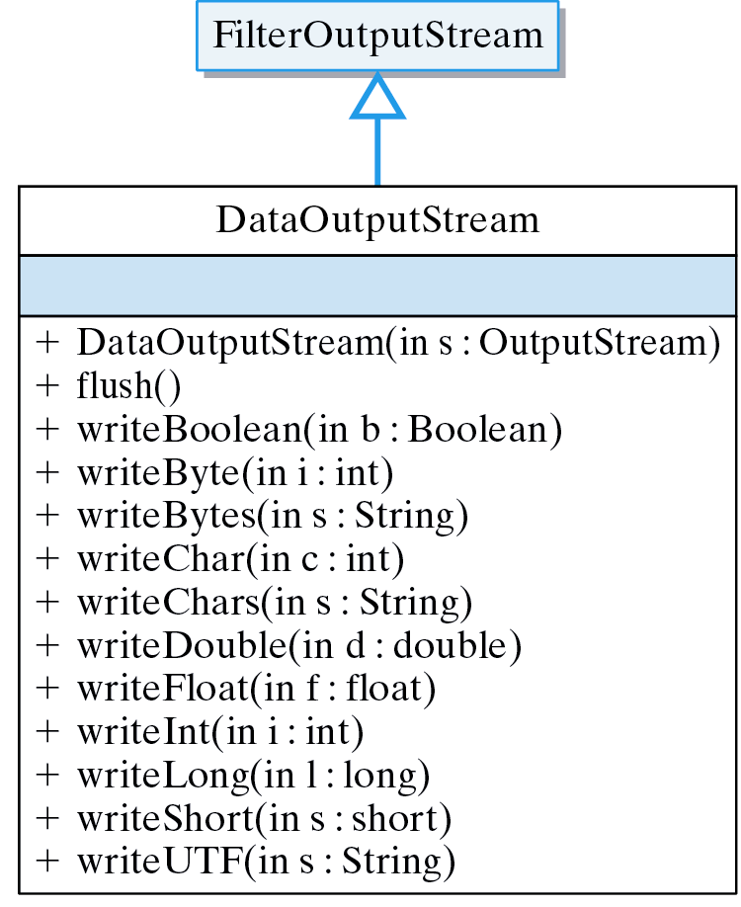
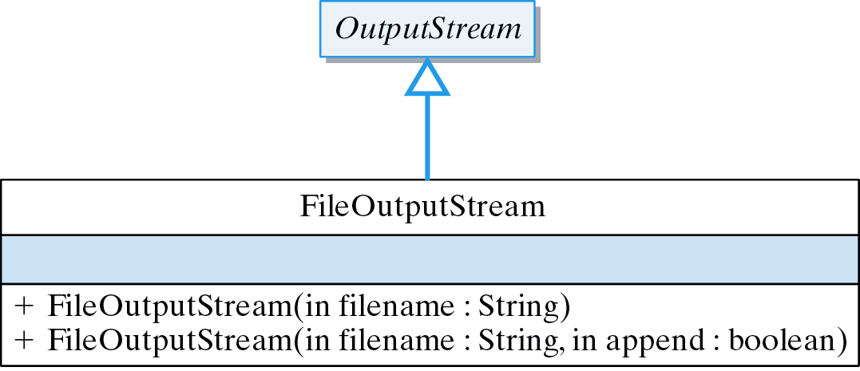
Output Method Design
What streams and methods to use?
DataOutputStream contains the right methods.
FileOutputStream has the right constructor.

Slide 34
Writing Binary Data
Connecting the streams to the file:
DataOutputStream outStream
= new DataOutputStream(new FileOutputStream (fileName));
Writing data to the file:
for (int k = 0; k < 5; k++) { // Output 5 data records
outStream.writeUTF("Name" + k); // Name
outStream.writeInt((int)(20 + Math.random() * 25)); // Random age
outStream.writeDouble(Math.random() * 500); // Random payrate
}
Unicode Text Format (UTF) is a coding scheme for Java's
Unicode character set.
Name0 24 15.06
Name1 25 5.09

Slide 35
The writeRecords() Method
Write 5 records.
private void writeRecords( String fileName ) {
try {
DataOutputStream outStream // Open stream
= new DataOutputStream(new FileOutputStream(fileName));
for (int k = 0; k < 5; k++) { // Output 5 data records
String name = "Name" + k;
outStream.writeUTF("Name" + k); // Name
outStream.writeInt((int)(20 + Math.random() * 25)); // Age
outStream.writeDouble(5.00 + Math.random() * 10); // Payrate
} // for
outStream.close(); // Close the stream
} catch (IOException e) {
display.setText("IOERROR: " + e.getMessage() + "\n");
}
} // writeRecords()
Handle exception.

Slide 36
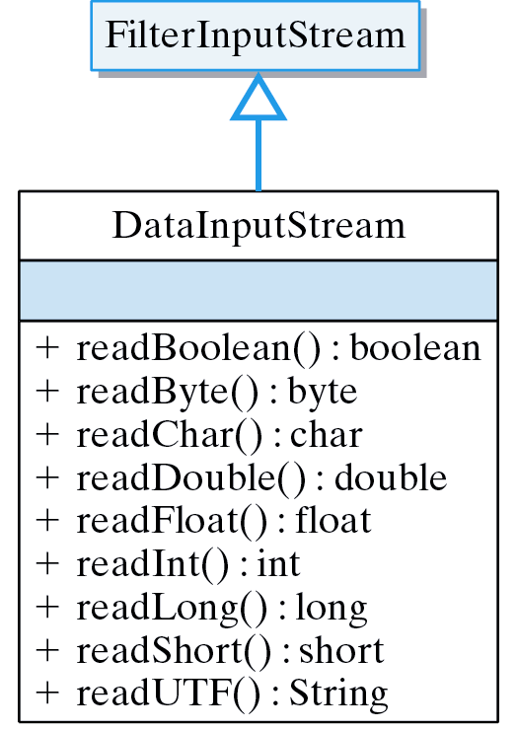
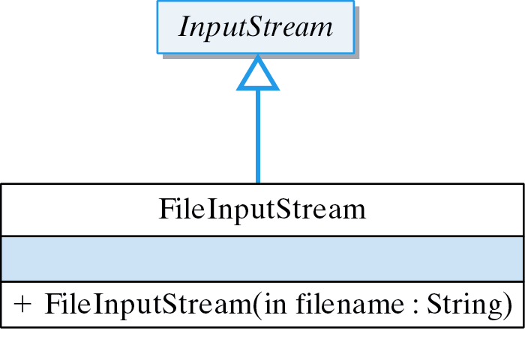
Input Method Design
What streams and methods to use?
DataInputStream contains the right methods.
FileInputStream has the right constructor.

Slide 37
The Read Loop
Binary files have no end-of-file marker.
Data input routine matches data output routine.
try {
while (true) { // Infinite loop
String name = inStream.readUTF(); // Read a record
int age = inStream.readInt();
double pay = inStream.readDouble();
display.append(name + " " + age + " " + pay + "\n");
} // while
} catch (EOFException e) {} // Until EOF exception
End of file is signaled by EOFException.

Slide 38
The readRecords() Method
Connect streams.
private void readRecords(String fileName) {
try {
DataInputStream inStream
= new DataInputStream(new FileInputStream(fileName)); // Open stream
display.setText("Name Age Pay\n");
try {
while (true) { // Infinite loop
String name = inStream.readUTF(); // Read a record
int age = inStream.readInt();
double pay = inStream.readDouble();
display.append(name + " " + age + " " + pay + "\n");
} // while
} catch (EOFException e) { // Until EOF exception
} finally {
inStream.close(); // Close the stream
}
} catch (FileNotFoundException e) {
display.setText("IOERROR: File NOT Found: " + fileName + "\n");
} catch (IOException e) {
display.setText("IOERROR: " + e.getMessage() + "\n");
}
} // readRecords()
EOF Nested try block.
Note finally.
Catch IOExceptions.

Slide 39
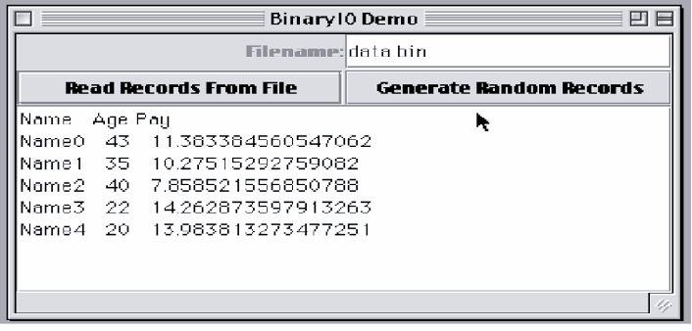
The BinaryIO Application: GUI

Slide 40
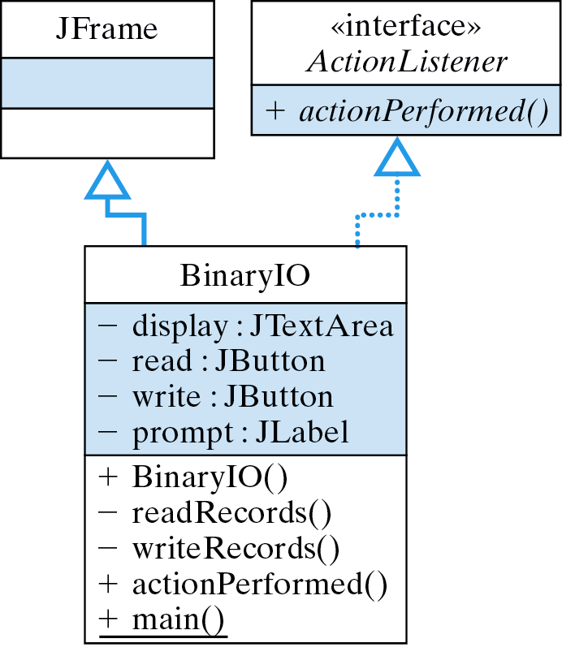
The BinaryIO Application: Design

Slide 41
Abstracting Data from Files
Binary read routine ust match write routine:
readUTF();
readInt():
readDouble();
writeUTF();
writeInt():
writeDouble();
A binary file is a sequence of 0’s and 1’s:
010100110011001001010100110011000001010011001100101101010011001100
Interpretable as two 32-bit ints or one 64-bit double or eight 8-bit ASCII characters.
Effective Design: Data Abstraction. Data are raw. The program determines type.

Slide 42
Reading and Writing Objects
Object serialization is the process of writing an object as a series of bytes.
Deserialization is the opposite (input) process.

Slide 43
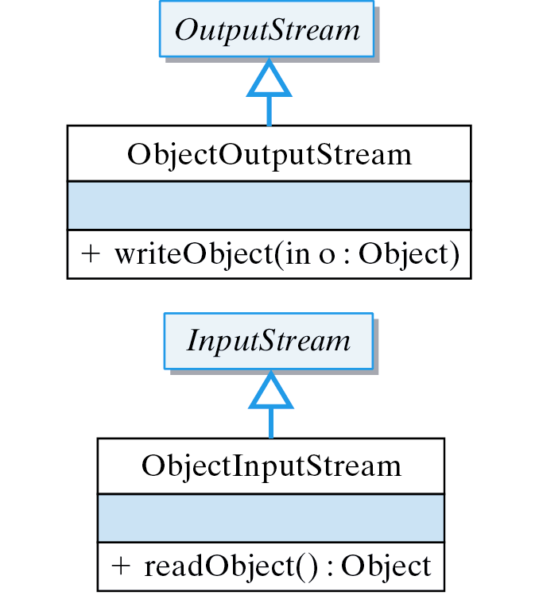
Object I/O Classes
ObjectOutputStream is used for object output.
ObjectInputStream is used for object input.

Slide 44
The Student Class
import java.io.*;
public class Student implements Serializable {
private String name;
private int year;
private double gpr;
public Student() {}
public Student (String nameIn, int yr, double gprIn) { name = nameIn;
year = yr;
gpr = gprIn;
}
public String toString() {
return name + "\t" + year + "\t" + gpr;
}
} // Student
An object can contain other objects.

Slide 45
The Student Serialization Methods
public void writeToFile(FileOutputStream outStream)
throws IOException
{
ObjectOutputStream ooStream = new
ObjectOutputStream(outStream);
ooStream.writeObject(this);
ooStream.flush();
} // writeToFile()
public void readFromFile(FileInputStream inStream)
throws IOException, ClassNotFoundException
{
ObjectInputStream oiStream = new ObjectInputStream(inStream);
Student s = (Student)oiStream.readObject();
this.name = s.name;
this.year = s.year;
this.gpr = s.gpr;
} // readFromFile()
Recursively writes the object to the stream.
Recursively reads the object from the stream.

Slide 46
The writeRecords() Method
private void writeRecords(String fileName) {
try {
FileOutputStream outStream = new FileOutputStream(fileName);
for (int k = 0; k < 5; k++) { // Generate 5 random objects
String name = "name" + k;
int year = (int)(2000 + Math.random() * 4);
double gpr = Math.random() * 12;
Student student = new Student(name, year, gpr); // Object
display.append("Output: " + student.toString() + "\n");
student.writeToFile(outStream) ; // and write it to file
} //for
outStream.close();
} catch (IOException e) {
display.append("IOERROR: " + e.getMessage() + "\n");
}
} // writeRecords()
Serialization

Slide 47
The readRecords() Method
private void readRecords(String fileName) {
try {
FileInputStream inStream = new FileInputStream(fileName);
display.setText("Name\tYear\tGPR\n");
try {
while (true) { // Infinite loop
Student student = new Student(); // Create a student
student.readFromFile(inStream); // and read its data
display.append(student.toString() + "\n");
}
} catch (IOException e) { // Until IOException
}
inStream.close();
} catch (FileNotFoundException e) {
display.append("IOERROR: File NOT Found: " + fileName + "\n");
} catch (IOException e) {
display.append("IOERROR: " + e.getMessage() + "\n");
} catch (ClassNotFoundException e) {
display.append("ERROR: Class NOT found " + e.getMessage() + "\n");
}
} // readRecords()
Deserialization

Slide 48
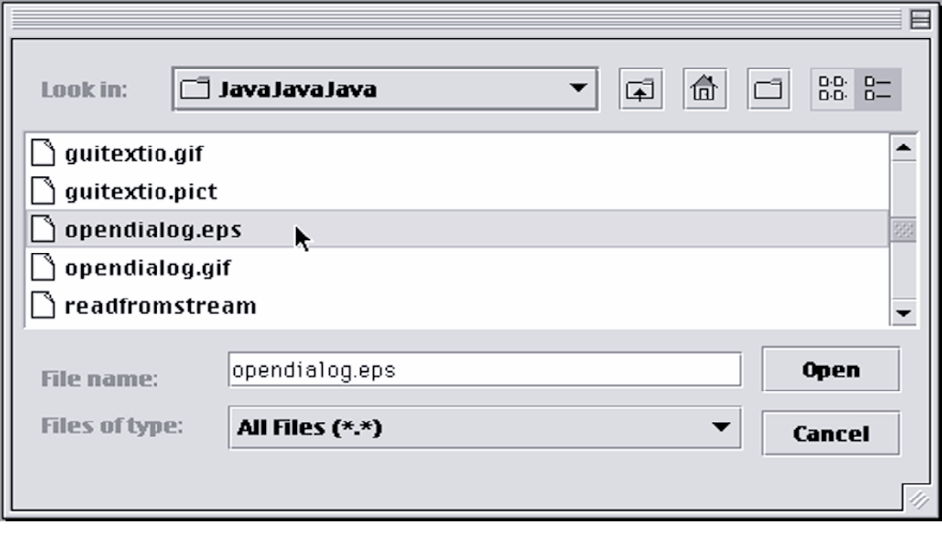
From the Java Library: JFileChooser
A JFileChooser provides a dialog box for selecting a file or directory when opening or saving a file.

Slide 49
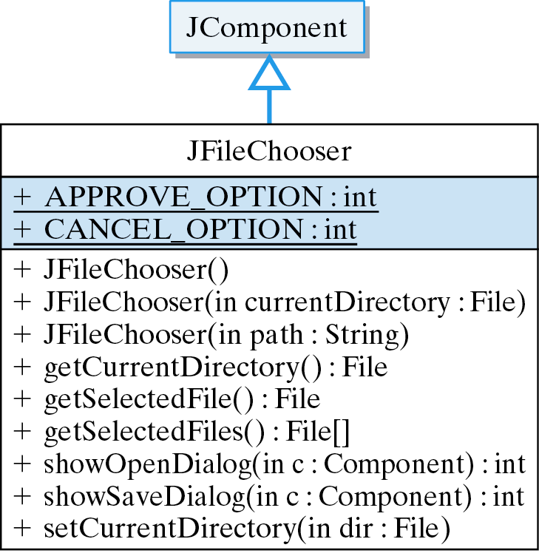
JFileChooser Class

Slide 50
Example: Opening a File
Display the dialog.
JFileChooser chooser = new JFileChooser();
int result = chooser.showOpenDialog(this);
if (result == JFileChooser.APPROVE_OPTION) {
File file = chooser.getSelectedFile();
String fileName = file.getName();
display.setText("You selected " + fileName);
} else
display.setText("You cancelled the file dialog");
Interpret the user’s action.

Slide 51
Using Command-Line Arguments
In a command-line interface arguments specified on the command line are input to the main() method.
Command line.
java FileCopy file.txt newfile.txt
Array containing “file.txt” and “newfile.txt”
public static void main(String args[]) {
FileCopy fc = new FileCopy();
if (args.length >= 2)
fc.fileCopy(args[0], args[1]);
else {
System.out.println("Usage: java FileCopy srcFile destFile");
System.exit(1);
}
} // main()

Slide 52
The WordGuess Program Revisted
Revise the WordGuess program to read secret words from a file.
Insert the following code into the WordGuess constructor.
Source code here: WordGuess.java and WordGuesser.java
try {
FileReader fr = new FileReader("secretwords.txt");
BufferedReader inStream = new BufferedReader(fr);
String line = inStream.readLine();
arraySize = Integer.parseInt(line);
wordArray = new String[arraySize];
line = inStream.readLine();
int k = 0;
while((line != null) && (k < arraySize)) {
wordArray[k] = line;
line = inStream.readLine();
k++;
} // while
inStream.close();
} catch(FileNotFoundException e){
e.printStackTrace();
} catch(IOException e){
e.printStackTrace();
} //catch

Slide 53
Technical Terms
absolute path name
binary file
buffer
buffering
database
data hierarchy
directory
end-of-file character
field
file
filtering
input
object serialization
output
path
record
relative path name
Unicode Text Format (UTF)

Slide 54
Summary Of Important Points
A file is a collection of data stored on a disk.
A stream is an object that delivers data to and from other objects.
An InputStream (e.g., System.in) is a stream that delivers data to a program from an external source.
An OutputStream (e.g., System.out) is a stream that delivers data from a program to an external destination.
The java.io.File class provides methods for interacting with files and directories.

Slide 55
Summary Of Important Points (cont)
The data hierarchy: a database is a collection of files. A file is a collection of records. A record is a collection of fields. A field is a collection of bytes. A byte is a collection of 8 bits. A bit is one binary digit, either 0 or 1.
A binary file is a sequence of 0's and 1's that is interpreted as a sequence of bytes. A text file is a sequence of 0s and 1s that is interpreted as a sequence of characters.

Slide 56
Summary Of Important Points (cont)
Buffering is a technique in which a temporary region of memory (buffer) is used to store data during input or output.
A text file is divided into lines by the \n character and ends with a special end-of-file character.
Standard I/O algorithm: (1) Open a stream to the file, (2) perform the I/O, (3) close the stream.
Most I/O methods generate an IOException.

Slide 57
Summary Of Important Points (cont)
Effective I/O design: (1) What streams should I use to perform the I/O? and (2) What methods should I use to do I/O?
Text input methods return null or -1 when they encounter the end-of-file character.
Binary read methods throw EOFException when they read past the end of the file.
Object serialization/deserialization is the process of writing/reading an object to/from a stream.

