Slide 1

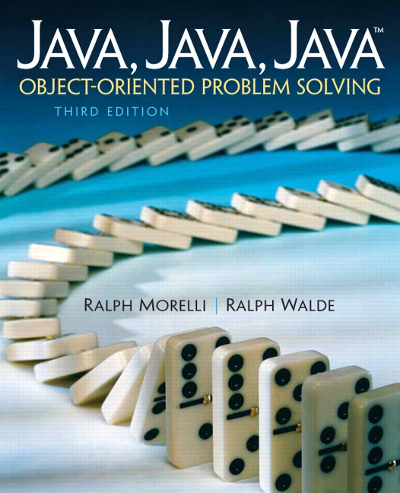
JAVA, JAVA, JAVA
presentation slides for
Object-Oriented Problem Solving
Third Edition
Ralph Morelli | Ralph Walde
Trinity College
Hartford, CT
published by Prentice Hall

Slide 2
Java, Java, Java
Object Oriented Problem Solving
Chapter 12: Recursive
Problem Solving

Slide 3
Objectives
Understand the concept of recursion.
Know how to use recursive programming techniques.
Have a better appreciation of recursion as a problem solving technique.

Slide 4
Outline
Introduction
Recursive Definition
Recursive String Methods
Recursive Array Processing
Drawing (Recursive) Fractals
Object-Oriented Design: Tail Recursion
Object-Oriented Design: Recursion or Iteration?
From the Java Library: JComboBox

Slide 5
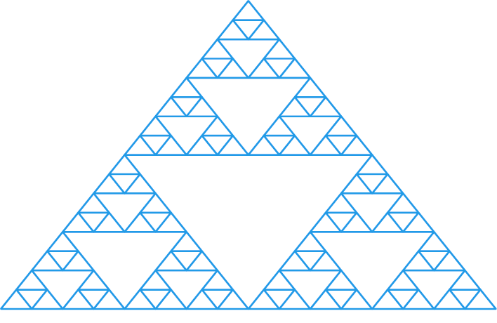
Introduction
The Sierpinski gasket is a fractal pattern, a structure that exhibits self-similarity at every scale.
Chapter goal: recursion as a problem solving technique and as alternative to loops.
Divide-and-Conquer Approach: Divide the gasket into smaller, self-similar patterns.

Slide 6
Recursion as Repetition
Recursive method: a method that calls itself.
Iterative method: a method that uses a loop.
hello(N) prints “Hello” N times.
public void hello(int N) {
for (int k = 0; k < N; k++)
System.out.println("Hello");
} // hello()
public void hello(int N) {
if (N > 0) {
System.out.println("Hello");
hello(N - 1);
}
} // hello()
Iterative, repeats the loop N times.
Recursive, calls itself N times.

Slide 7
Trace of Recursive hello()
Trace of hello(5) :
public void hello(int N) {
if (N > 0) {
System.out.println("Hello");
hello(N - 1);
}
} // hello()
Stop when N = 0.
hello(5)
Print “Hello”
hello(4)
Print “Hello”
hello(3)
Print “Hello”
hello(2)
Print “Hello”
hello(1)
Print “Hello”
hello(0)
Decrement N on each recursive call.

Slide 8
Recursion versus Iteration
Recursion is an alternative to iteration.
Languages like LISP and PROLOG use recursion instead of loops.
Loops use less computational overhead than method calls.
Effective Design: Efficiency. Iterative algorithms are generally more efficient than recursive algorithms that do the same thing.

Slide 9
Recursion as a Problem Solving
Divide-and-conquer: Divide the problem into smaller problems.
Self-similarity: Each subproblem is similar to the original problem.
Factorial Example:
  n! = n * (n-1) * (n-2) * … * 1
Recursion: 4! = 4 * 3!
4! = 4 * 3 * 2 * 1 = 4 * 3! = 24
3! = 3 * 2 * 1 = 3 * 2! = 6
2! = 2 * 1 = 2 * 1! = 2
1! = 1 * 0! = 1
0! = 1

Slide 10
Recursive Definition
Recursive definition of factorial(n):
n! = 1 if n = 0 // Boundary (or base) case
n! = n * (n-1)! if n > 0 // Recursive case
Divide-and-Conquer: n! is defined in terms of a smaller, self-similar problem, (n-1)!
Effective Design: Recursive Definition. The base case serves as the bound for the algorithm. The recursive case defines the nth case in terms of the n-1st case.

Slide 11
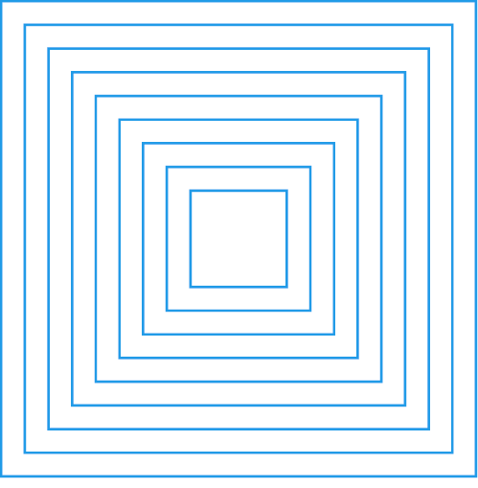
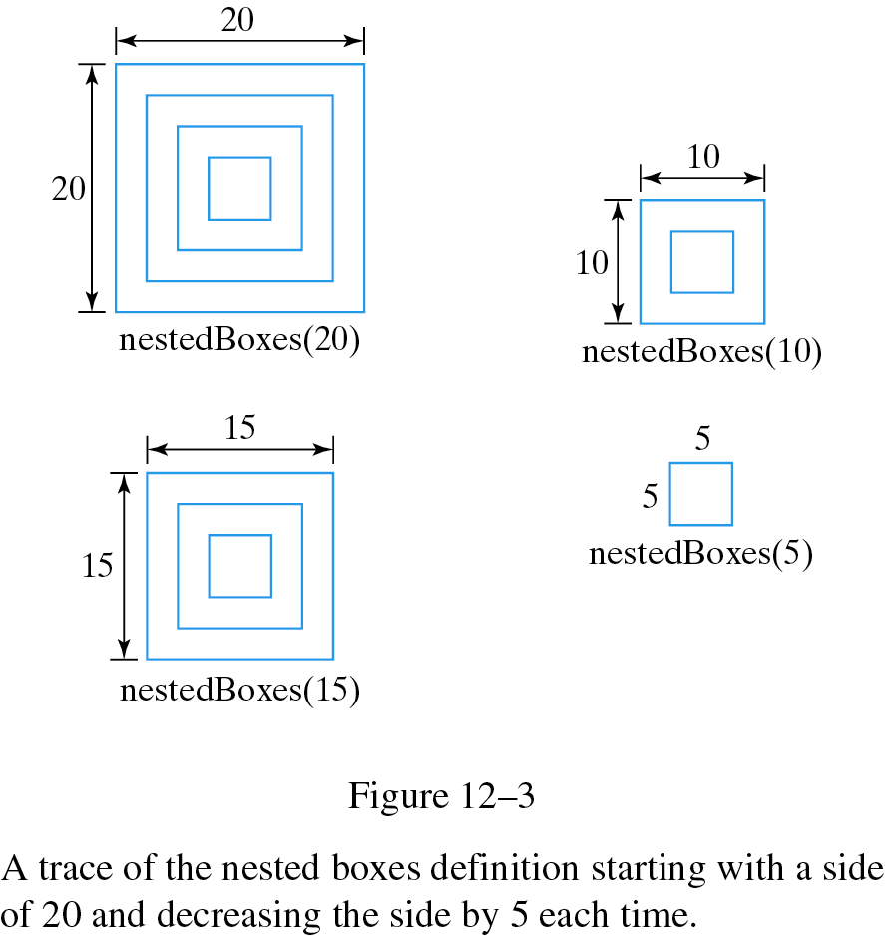
Drawing a Nested Pattern
Draw the nested box pattern:
  Base case: if side < 5
  do nothing
  Recursive case: if side >= 5
  draw a square
  draw a smaller pattern inside the square
For nestedBoxes(20):

Slide 12
Recursive printString(s)
Head-and-tail recursion: print the head, and recursively print the tail of the string.
Head of String s: s.charAt(0)
Tail of String s: s.substring(1)
For Hello, print H and recursively print ello.
public void printString(String s) {
if (s.length() == 0)
return; // Base case: do nothing
else {
System.out.print(s.charAt(0)); // Recursive case: print head
printString(s.substring(1)); // Print tail of the string
}
} // printString()
Recursion parameter.

Slide 13
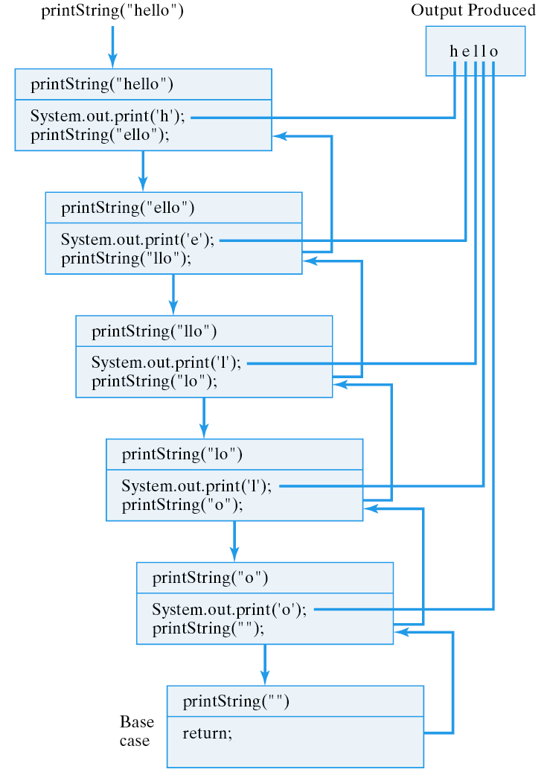
Tracing printString(“hello”)

Slide 14
Effective Design
Recursive Progress. Each recursive call must make progress toward the bound, or base case.
Recursion and Parameters. Recursive methods use a recursion parameter to control progress toward its bound.
Head/Tail Algorithm. Divide a sequential structure into its head and tail. Process the head, and recurse on the tail.

Slide 15
Printing the String Backwards
Reverse Head/Tail: Recursively process the tail, then process the head:
public void printReverse(String s) {
if (s.length() > 0) { // Recursive case:
printReverse(s.substring(1)); // Print tail of the string
System.out.print(s.charAt(0)); // Then print the first char
}
} // printReverse()
For Hello, recursively printing ello then printing H will give olleH

Slide 16
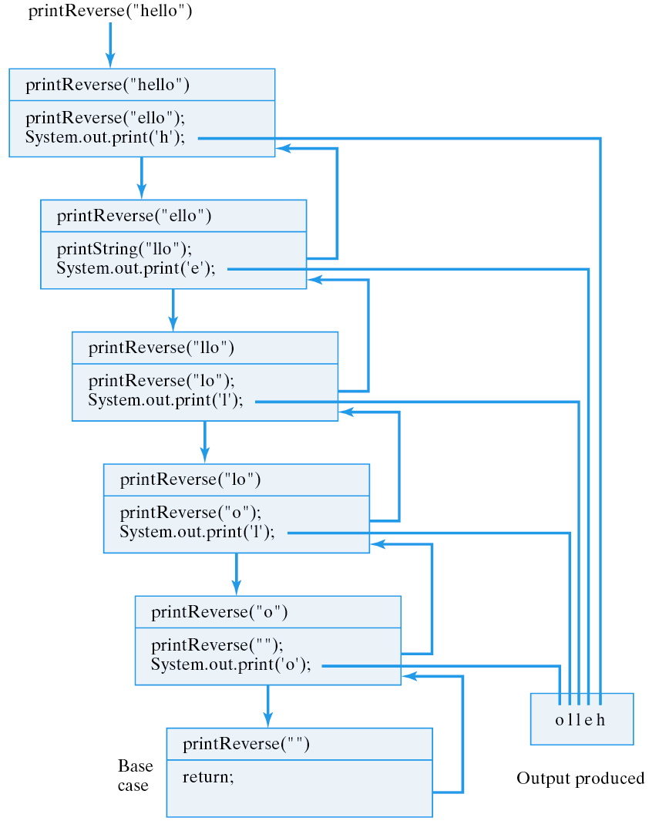
Tracing printReverse("hello")
public void printReverse(String s) {
if (s.length() > 0) {
printReverse(s.substring(1));
System.out.print(s.charAt(0));
}
} // printReverse()
Last-In-First-Out (LIFO). Procedure call follows a LIFO protocol.

Slide 17
Counting Characters in a String
Count the number of ch’s in a string s.
Algorithm: Count the head of s then recursively count the ch’s in the tail of s.
Embedded recursive call
/**
* Pre: s is a non-null String, ch is any character
* Post: countblanks() == the number of occurrences of ch in s
*/
public int countChar(String s, char ch) {
if (s.length() == 0) // Base case: empty string
return 0;
else if (s.charAt(0) == ch) // Recursive case 1
return 1 + countChar(s.substring(1), ch); // Head equals ch
else // Recursive case 2
return 0 + countChar(s.substring(1), ch); // Head is not the ch
} // countChar()
Return is done after the recursive call.

Slide 18
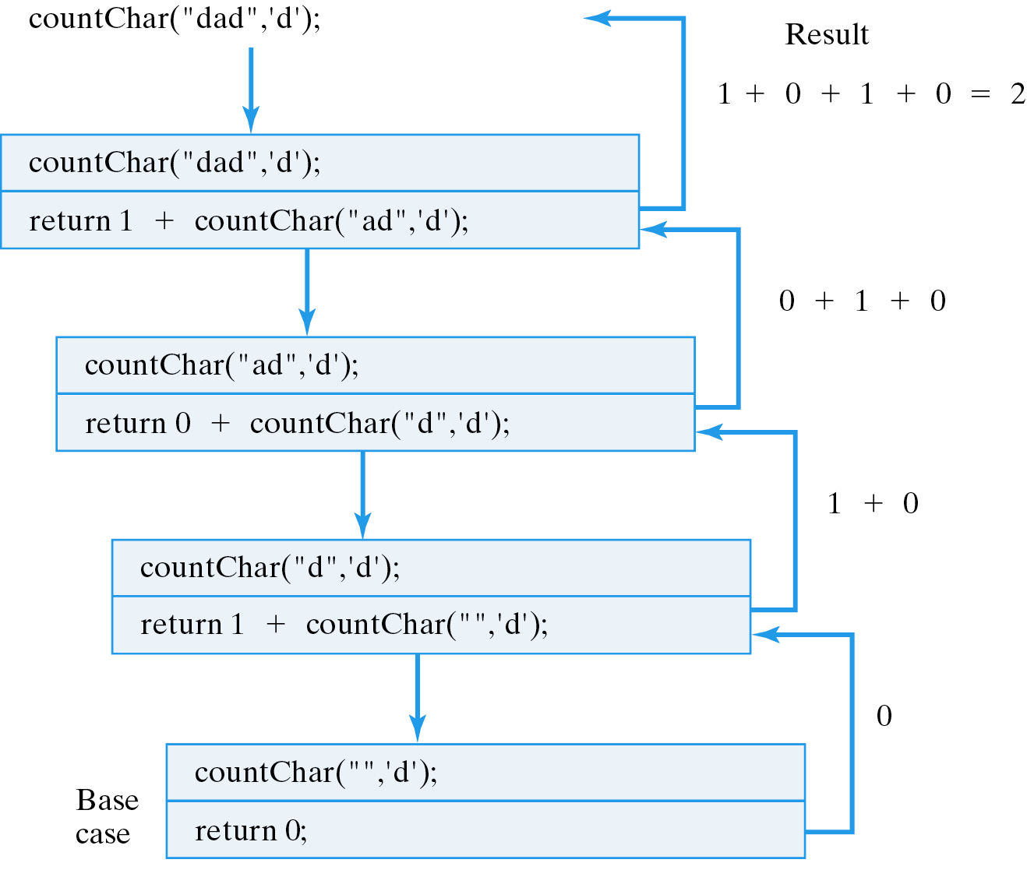
Tracing countChar("dad", 'd')
Embedded recursive call: the results are accumulated.
public int countChar(String s, char ch) {
if (s.length() == 0)
return 0;
else if (s.charAt(0) == ch)
return 1 + countChar(s.substring(1), ch);
else
return 0 + countChar(s.substring(1), ch);
} // countChar()

Slide 19
Converting a String
Replace every occurrence of ch1 with ch2 in the string str.
Algorithm: If necessary, replace the head then recursively convert the tail.
Embedded recursive call
public static String convert(String str, char ch1, char ch2) {
if (str.length() == 0) // Base case: empty string
return str;
else if (str.charAt(0) == ch1) // Recursive 1: ch1 at head
return ch2 + convert(str.substring(1), ch1, ch2); // Replace it
else // Recursive 2: ch1 not at head
return str.charAt(0) + convert(str.substring(1), ch1, ch2);
} // convert()
Return is done after the recursive call.

Slide 20
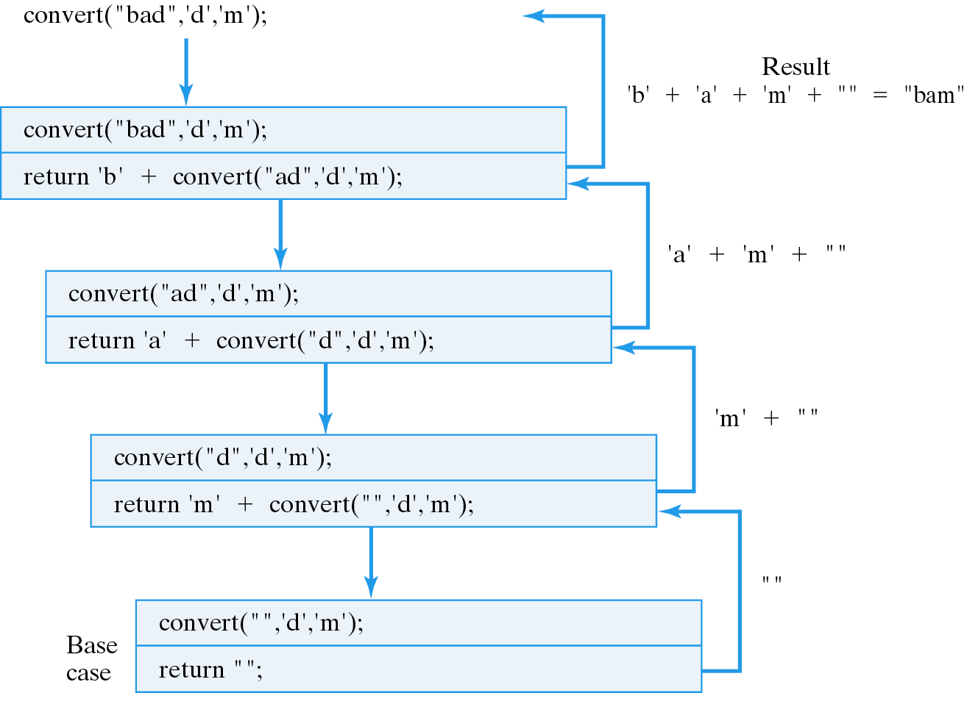
Tracing convert("bad",'d','m')
Embedded recursive call: the results are accumulated.

Slide 21
Example: Tossing N Coins
Write a recursive method that prints all possible outcomes when N coins are tossed.
/**
* printOutcomes(str, N) prints out all possible outcomes
* beginning with str when N more coins are tossed.
* Pre: str is a string of Hs and Ts.
* Pre: N is a positive integer.
* Post: none
*/
public static void printOutcomes(String str,int N){
if (N == 1){ // The base case
System.out.println(str + "H");
System.out.println(str + "T");
} else { // The recursive case
printOutcomes(str + "H", N - 1);
printOutcomes(str + "T", N - 1);
} //else
} // printOutcomes()

Slide 22
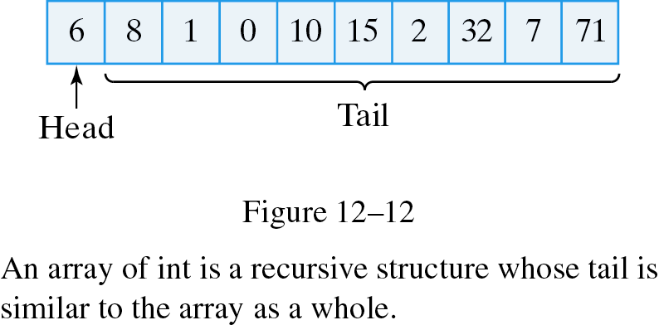
Recursive Array Processing
Arrays also have a recursive structure.
Recursive search: check the head then recursively search the tail.
Recursive sort: put the smallest number at the head then recursively sort the tail.

Slide 23
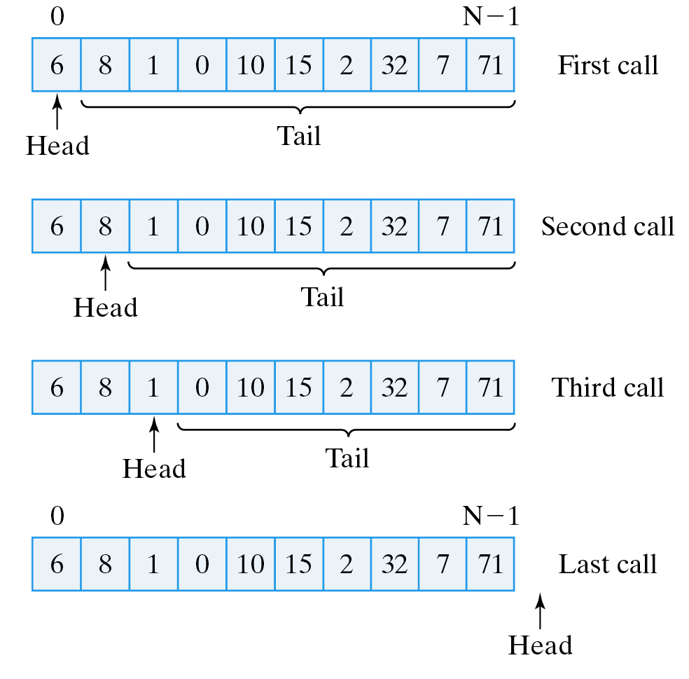
Recursive Sequential Search
Pseudo-code:
If the array is empty, return -1 // Failure
If the head matches the key, return its index // Success
If the head doesn't match the key, // Recursive
return the result of searching the tail of the array
Use a parameter to represent the location of the head. The tail starts at head+1.

Slide 24
The Recursive search() Method
Recursion parameter: 0 … arr.length
/**
* search(arr, head, key) --- Recursively search arr for key
* starting at head
* Pre: arr != null and 0 <= head <= arr.length
* Post: if arr[k] == key for some k, 0 <= k < arr.length, return k
* else return -1
*/
private int search(int arr[], int head, int key) {
if (head == arr.length) // Base case: empty list - failure
return -1;
else if (arr[head] == key) // Base case: key found --- success
return head;
else // Recursive case: search the tail
return search(arr, head + 1, key);
}

Slide 25
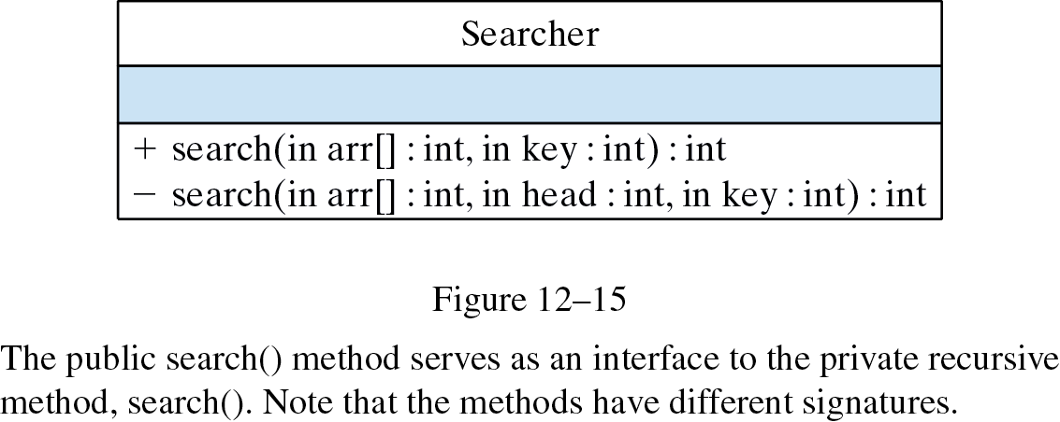
Information Hiding
Initialize the recursion parameter.
/**
* search(arr,key) -- searches arr for key.
* Pre: arr != null and 0 <= head <= arr.length
* Post: if arr[k] == key for some k, 0 <= k < arr.length, return k
* else return -1
*/
public int search(int arr[], int key) {
return rSearch(arr, 0, key); // Call rSearch to do the work
}
Design Issue: The user shouldn’t have to call search(arr, 0, 25)
Information Hiding: search(arr, 25) hides search(arr,0,25) from the user.

Slide 26
Effective Design
Information Hiding. Unnecessary implementation details -- recursion versus iteration --should be hidden. Users of a class or method should see only what they need to know.
public static void main(String args[]) {
int numbers[] = {0, 2, 4, 6, 8, 10, 12, 14, 16, 18};
Searcher searcher = new Searcher();
for (int k = 0; k <= 20; k++) {
int result = searcher.search(numbers, k);
if (result != -1)
System.out.println(k + " found at " + result);
else
System.out.println(k + " is not in the array ");
} // for
} // main()
Search for 0 to 20 in the array.

Slide 27
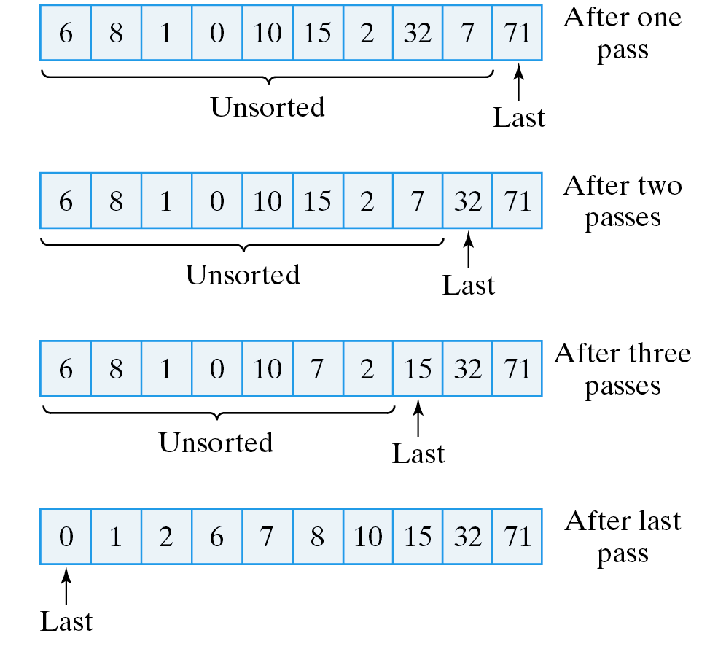
Recursive Selection Sort
private void selectionSort(int arr[], int last) {
if (last > 0) {
int maxLoc = findMax (arr, last); // Find the largest element
swap(arr, last, maxLoc); // Put it in the last location
selectionSort(arr, last - 1); // Move down the array
}
} // selectionSort()
Recursion parameter, last.

Slide 28
The swap() and findLast() Methods
Use a temp variable.
/** swap(arr0, el1, el2) swaps el1 and el2 in the arrary, arr */
private void swap(int arr[], int el1, int el2) {
int temp = arr[el1]; // Assign the first element to temp
arr[el1] = arr[el2]; // Overwrite first with second
arr[el2] = temp; // Overwrite second with temp (i.e., first)
} // swap()
/** findMax(arr, N) returns the index of the largest
* value between arr[0] and arr[N], N >= 0.
* Pre: 0 <= N <= arr.length -1
* Post: arr[findMax()] >= arr[k] for any k between 0 and N.
*/
private int findMax(int arr[], int N) {
int maxSoFar = 0;
for (int k = 0; k <= N; k++)
if (arr[k] > arr[maxSoFar])
maxSoFar = k;
return maxSoFar;
} // findMax()
Traverse the array and keep track of the index of the largest.

Slide 29
Drawing (Recursive) Fractals
A fractal is a geometric shape that exhibits a recursive structure in which each of its parts is a smaller version of the whole.
Examples: trees, shells, coast lines.
Nested Box Algorithm:
Draw a square.
If more divisions are desired
draw a smaller nested box within the square.

Slide 30
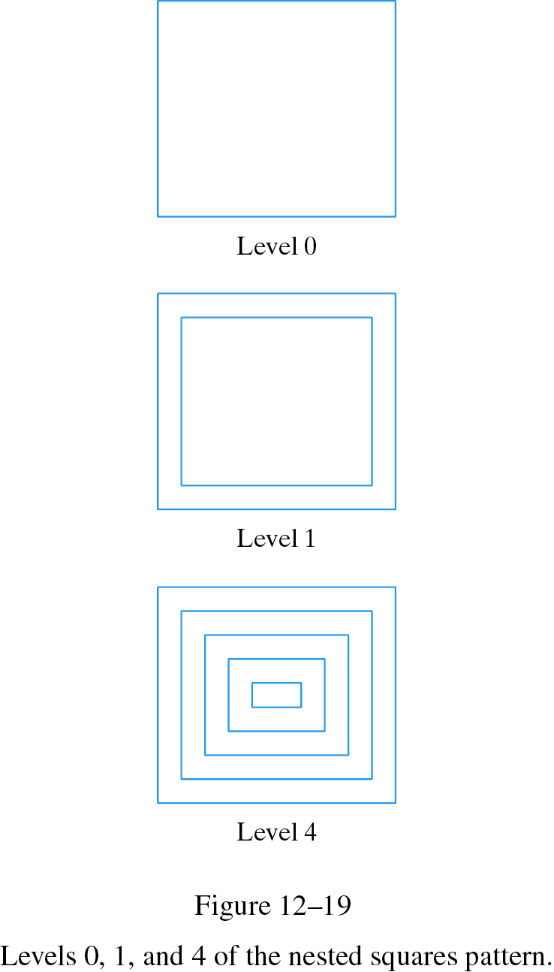
The Recursive drawBoxes() Bethod.
Design: The level recursion parameter.
private void drawBoxes(Graphics g, int level, Point loc, int side, int delta) {
g.drawRect(loc.x, loc.y, side, side );
if (level > 0) {
Point newLoc = new Point(loc.x + delta, loc.y + delta);
drawBoxes(g, level - 1, newLoc, side - 2 * delta, delta);
}
} // drawBoxes()
Need Graphics for drawing.
(loc.x, loc.y)
Delta, change in side
side

Slide 31
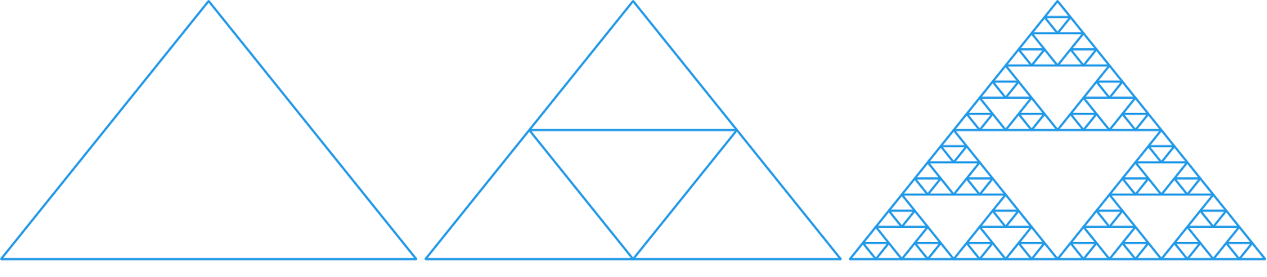
The Sierpinski Gasket
Algorithm:
Base case: draw a triangle.
Recursive case: if level > 0,
draw three smaller gaskets within the triangle.
Smaller triangles at one vertex and midpoints of two sides.

Slide 32
The drawGasket() Method
Recursion parameter
private void drawGasket(Graphics g, int lev, Point p1, Point p2, Point p3) {
g.drawLine(p1.x, p1.y, p2.x, p2.y); // Base case: Draw a triangle
g.drawLine(p2.x, p2.y, p3.x, p3.y);
g.drawLine(p3.x, p3.y, p1.x, p1.y);
if (lev > 0) { // If more divisions desired, draw 3 smaller gaskets
Point midP1P2 = new Point( (p1.x + p2.x) / 2, (p1.y + p2.y) / 2 );
Point midP1P3 = new Point( (p1.x + p3.x) / 2, (p1.y + p3.y) / 2 );
Point midP2P3 = new Point( (p2.x + p3.x) / 2, (p2.y + p3.y) / 2 );
drawGasket(g, lev - 1, p1, midP1P2, midP1P3);
drawGasket(g, lev - 1, p2, midP1P2, midP2P3);
drawGasket(g, lev - 1, p3, midP1P3, midP2P3);
}
} // drawGasket()
Level 0
Level 1
Level 7
p1
[(p1.x +p2.x) / 2, (p1.y +p2.y) / 2 ]
Midpoint
p2
p3

Slide 33
Object-Oriented Design: Tail Recursion
A tail recursive method is one such that its recursive calls are its last actions.
public void printHello(int N) {
if (N > 0) {
System.out.println("Hello");
printHello(N - 1);
}
} // printHello()
Obviously tail recursive.
public void printHello(int N) {
if (N > 1) {
System.out.println("Hello");
printHello(N - 1); // This will be the last executed statement
} else
System.out.println("Hello");
} // printHello()
Also tail recursive. Its last action is a recursive call.

Slide 34
Convert Tail Recursive to Iterative
Tail recursive algorithms are relatively simple to convert into iterative algorithms.
public void printHello(int N) {
if (N > 0) {
System.out.println("Hello");
printHello(N - 1);
}
} // printHello()
Recursion parameter becomes loop counter
public void printHelloIterative(int N) {
for (int k = N; k > 0; k--)
System.out.println("Hello");
}
Non-tail-recursive algorithms are difficult to convert to iterative.

Slide 35
Design: Recursion or Iteration?
Whatever can be done recursively can be done iteratively, and vice versa.
Iterative algorithms use less memory.
Iterative algorithms have less computational overhead.
For many problems recursive algorithms are easier to design (e.g., Sierpinski Gasket).
Effective Design: Unless efficiency is an issue, choose the approach that easier to understand, develop, and maintain.

Slide 36
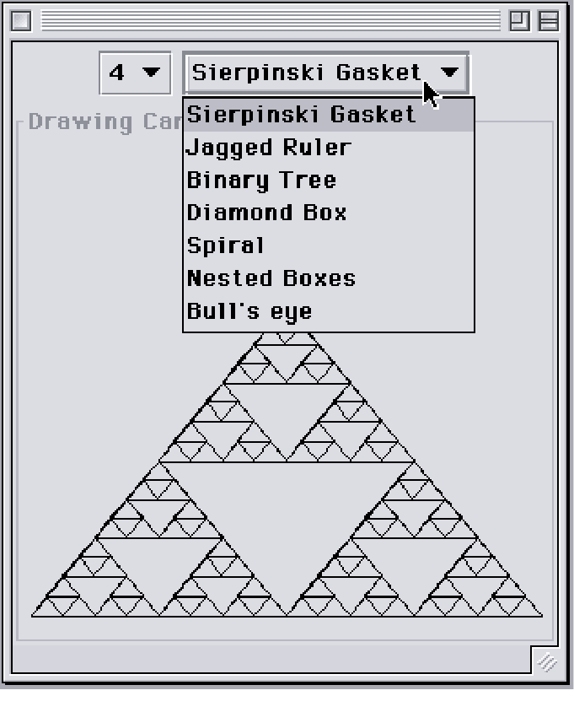
From the Java Library: JComboBox
A JComboBox is similar to a java.awt.Choice component.
A javax.swing.JComboBox

Slide 37
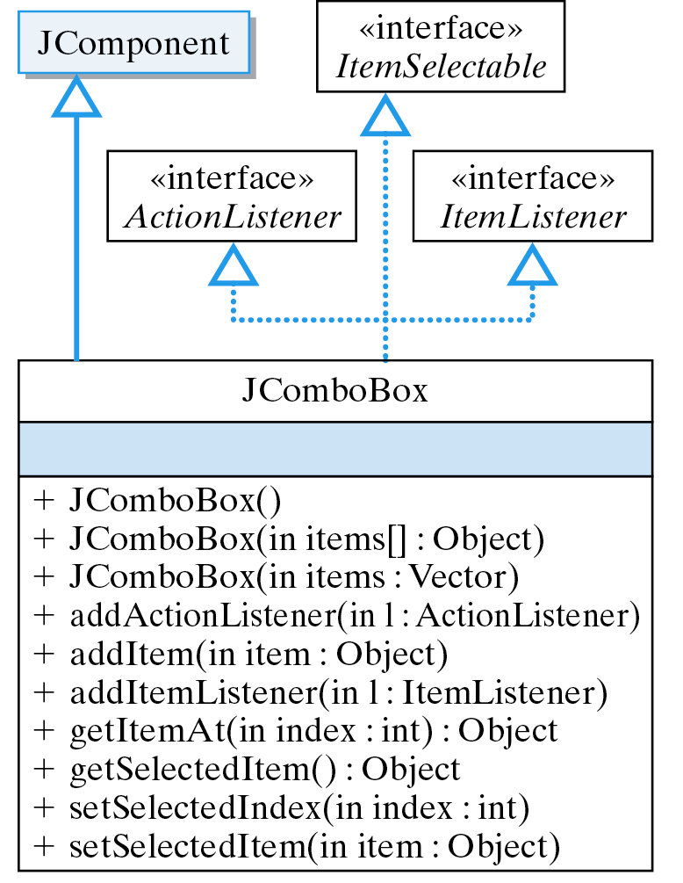
JComboBox: Design
A JComboBox implements ActionListener and ItemListener interfaces, making it useful for menus.
Menu selection interface.

Slide 38
Example: The Recursive Patterns Menus
Create JComboBoxes
private String items[] = {"Sierpinski Gasket","Nested Boxes"};
private JComboBox patterns = new JComboBox(items);
private JComboBox levels = new JComboBox();
for (int k=0; k < 10; k++) // Add 10 levels
levels.addItem(k + "" );
levels.setSelectedItem("4"); // Select level 4 as default
Add menu items.
controls.add(levels); // Add to panel
controls.add(patterns);
levels.addItemListener(this); // Add listenerers
patterns.addItemListener(this);
Add listeners.
public void itemStateChanged(ItemEvent e) {
canvas.setPattern(patterns.getSelectedIndex(),
levels.getSelectedIndex());
repaint();
}
Handle a selection.

Slide 39
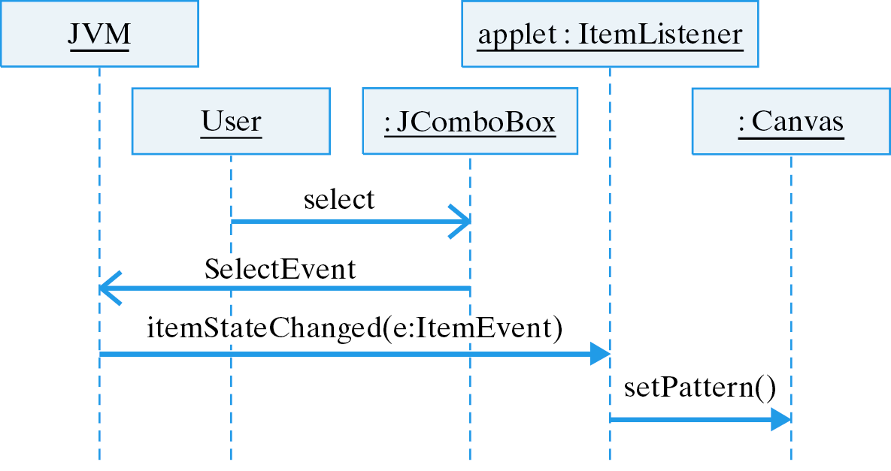
Selecting a JComboBox Menu Item

Slide 40
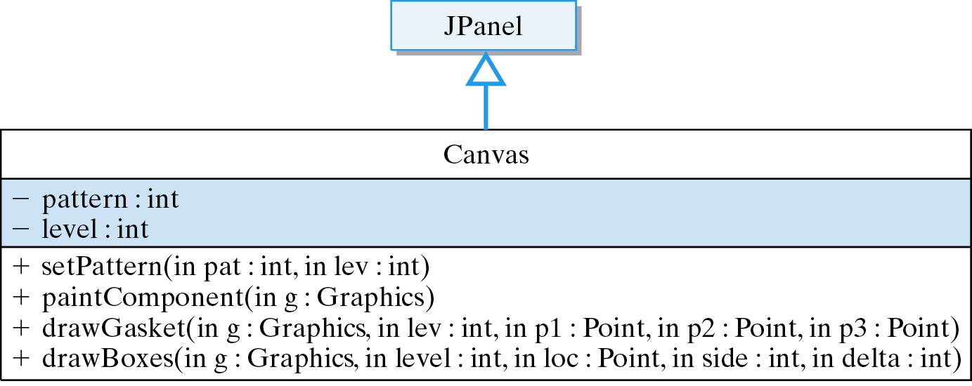
The Canvas Class

Slide 41
Technical Terms
base case
computational overhead
head-and-tail algorithm
iterative method
last-in-first-out (LIFO)
method call stack
recursion parameter
recursive case
recursive definition
recursive method
self-similarity
tail recursive

Slide 42
Summary Of Important Points
A recursive definition defines the nth case of a concept in terms of the (n-1)st case plus a limiting condition.
A recursive method is one that calls itself. It is usually defined in terms of a base case and a recursive case
A recursion parameter is generally used to to control the recursion.
Any algorithm that can be done iteratively can also be done recursively, and vice versa.

Slide 43
Summary Of Important Points (cont)
The base case defines a limit and each recursive call should make progress toward the limit.
Recursive methods use more memory and computation than iterative methods.
A recursive method is tail recursive if and only if each of its recursive calls is the last action executed by the method.

