Slide 1


JAVA, JAVA, JAVA
presentation slides for
Object-Oriented Problem Solving
Third Edition
Ralph Morelli | Ralph Walde
Trinity College
Hartford, CT
published by Prentice Hall

Slide 2
Java, Java, Java
Object Oriented Problem Solving
Chapter 13: Graphical User Interfaces

Slide 3
Objectives
Gain more experience with the Swing component set.
Understand the relationship between the AWT and Swing.
Learn more about Java's event model.
Be able to design and build simple Graphical User Interfaces (GUI)s.
Appreciate how object-oriented design principles were used to extend Java's GUI capabilities.

Slide 4
Outline
Introduction
Java GUIs: From AWT to Swing
The Swing Component Set
Object-Oriented Design: Model-View-Controller Architecture
The Java Event Model
Case Study: Designing a Basic GUI
Containers and Layout Managers
Checkboxes, Radio Buttons, and Borders
Menus and Scroll Panes

Slide 5
Introduction
A Graphical User Interface (GUI) creates a certain way of interacting with a program.
It is what gives a program its look and feel.
A GUI uses a set of basic components, such as buttons, text fields, labels, and text areas.
Java’s GUI classes provide an excellent example of object oriented design.

Slide 6
A Brief History
The original AWT was suitable for Java applets but not for full-fledged application development.
AWT 1.1 (JDK 1.1) had better event handling but did not have enough GUI components and was too dependent on (nonportable) native code,.
In 1997 Netscape and Sun developed a set of GUI classes written entirely in Java. The Java Foundation Classes (JFC), including the Swing component set, were released with JDK 2.0.
A Swing program can have the same look and feel on a Mac, Windows, or Unix platform.

Slide 7
Heavyweight versus Lightweight Components
Heavyweight components: AWT components (java.awt.Button), based on the peer model (java.awt.peer.ButtonPeer), use native code.
Lightweight components: written in pure Java (more portable).
All Swing components except for JApplet, JDialog, JFrame, and JWindow are lightweight.
Developing lightweight (pure Java) components: extend java.awt.Component and override paint():
public class LightWeightButton extends Component {
public void paint(Graphics g) {
/* Java code goes here */
}
}

Slide 8
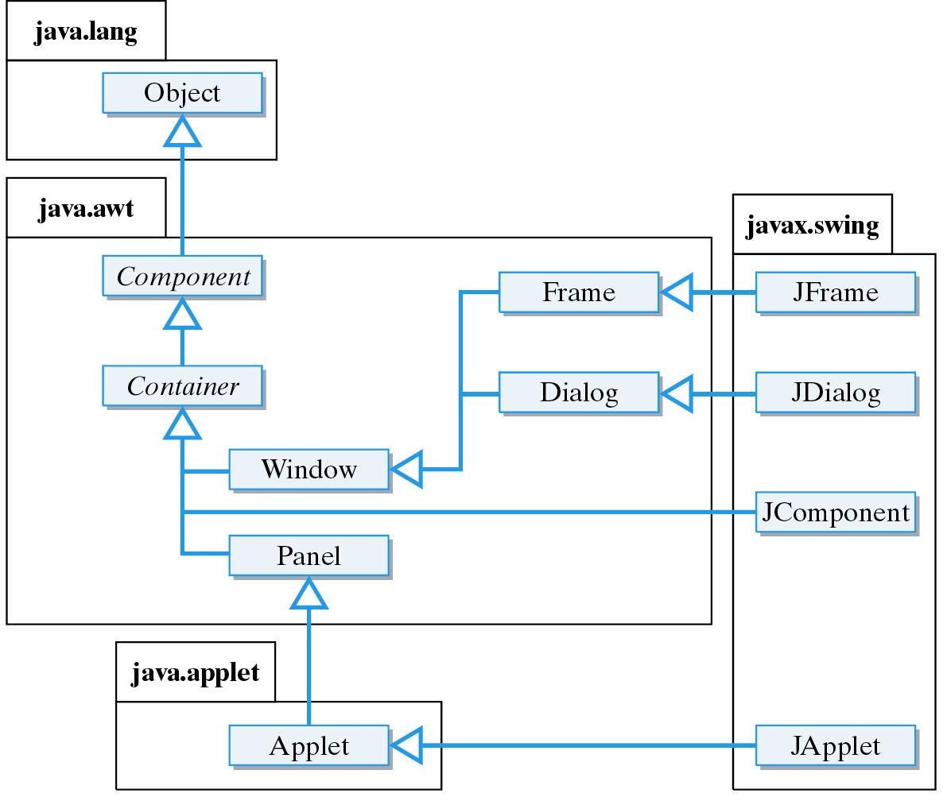
Swing Hierarchy
The top-level Swing windows are heavyweight. They depend on the native system.
JWindow

Slide 9
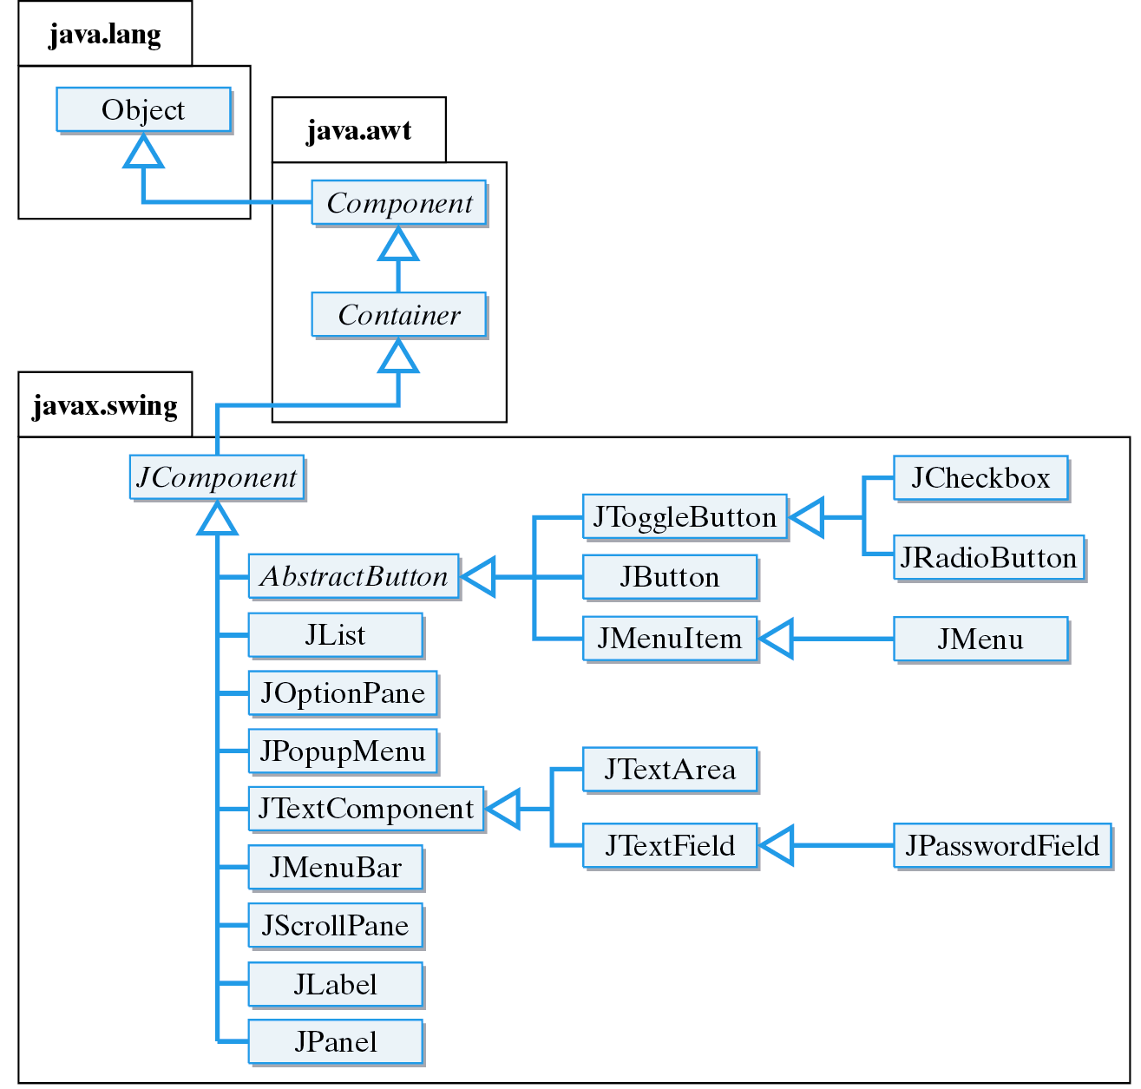
Swing Hierarchy (Part II)
Swing components names start with ‘J’.

Slide 10
AWT and Swing
Swing’s top-level windows -- JApplet, JDialog, JFrame, and JWindow -- are extensions of their AWT counterparts.
The base Swing class (JComponent) is derived from java.awt.Container. So Swing components are fundamentally based on the AWT.
Both Swing and AWT are used to build GUIs.
All GUI programs use classes defined in the AWT:
  layout managers (java.awt.FlowLayout),
  fonts (java.awt.Font),
  colors (java.awt.Color).

Slide 11
The Swing Component Set
Swing packages
  javax.swing.event.* contains Swing events and listeners; similar to java.awt.event.*
  javax.swing.plaf.* contains Swing's look-and-feel classes
  javax.swing.text.* contains the classes for JTextField and JTextComponent, the Swing classes that replace the AWT's TextField and TextArea classes.
Platform independent look and feel.
  javax.swing.plaf.windows looks like Windows
  javax.swing.plaf.motif looks like Unix (XWindows)

Slide 12
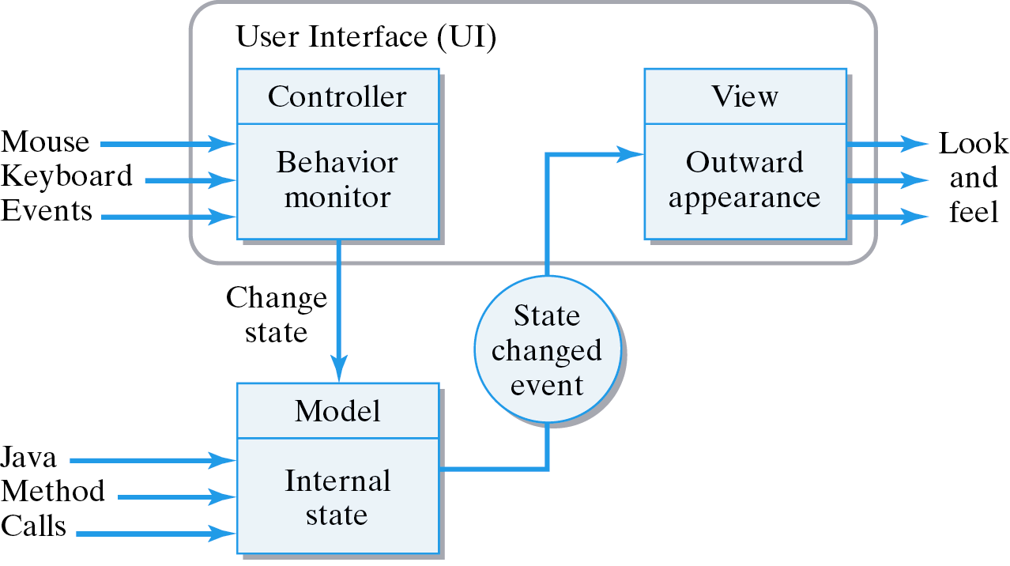
Model-View-Controller Architecture
Model-View-Controller (MVC) : Swing components composed of 3 aspects: state (model), look (view), and behavior (controller).
For, some Swing components, 3 separate classes are used for its MVC. For others, such as JButton, the VC are combined into a single User Interface class.
JButton click: the controller puts model in pressed state, which changes its outward appearance (view).

Slide 13
Pluggable Look and Feel
UIManager: To set look and feel in a program use the UIManager.setLookAndFeel() method:
Metal is a special Java plaf
public static void main(String args[]) {
try {
UIManager.setLookAndFeel
(“javax.swing.plaf.metal.MetalLookAndFeel”);
} catch (Exception e) { }
} // main()
To set default look-and-feel edit swing.defaultlaf property in the Java properties file (which is usually found in javaHomeDirectory/lib).

Slide 14
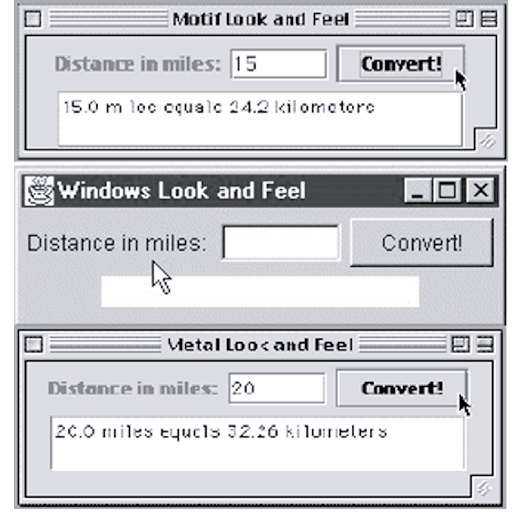
Different Look and Feel

Slide 15
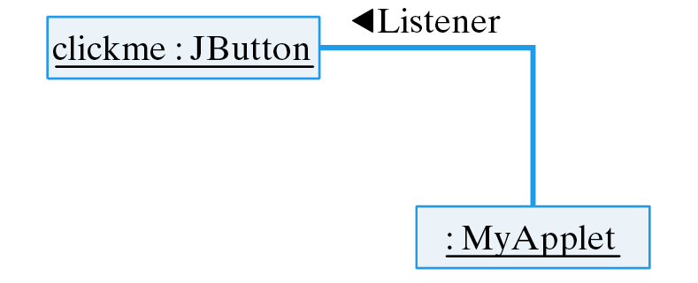
The Java Event Model
All events are handled by objects called listeners.

Slide 16
Creating an ActionListener
import javax.swing.*;
import java.awt.*;
import java.awt.event.*;
import java.applet.*;
public class MyGUI extends JFrame implements ActionListener {
private JButton clickme = new JButton("ClickMe");
public void MyGUI() {
getContentPane().add(clickme); // Add clickme to the applet
clickme.addActionListener(this); // and assign it a listener
setSize(200,200);
setVisible(true);
} // MyGUI()
public void actionPerformed(ActionEvent e) {
if (e.getSource() == clickme) {
clickme.setText(clickme.getText() + "*");
}
} // actionPerformed()
public static void main(String args[]) {
MyGUI gui = new MyGUI();
}
} // MyGUI
Button click events are handled by ActionListeners
The applet is the listener.
The actionPerformed() method contains code that handles the button click.

Slide 17
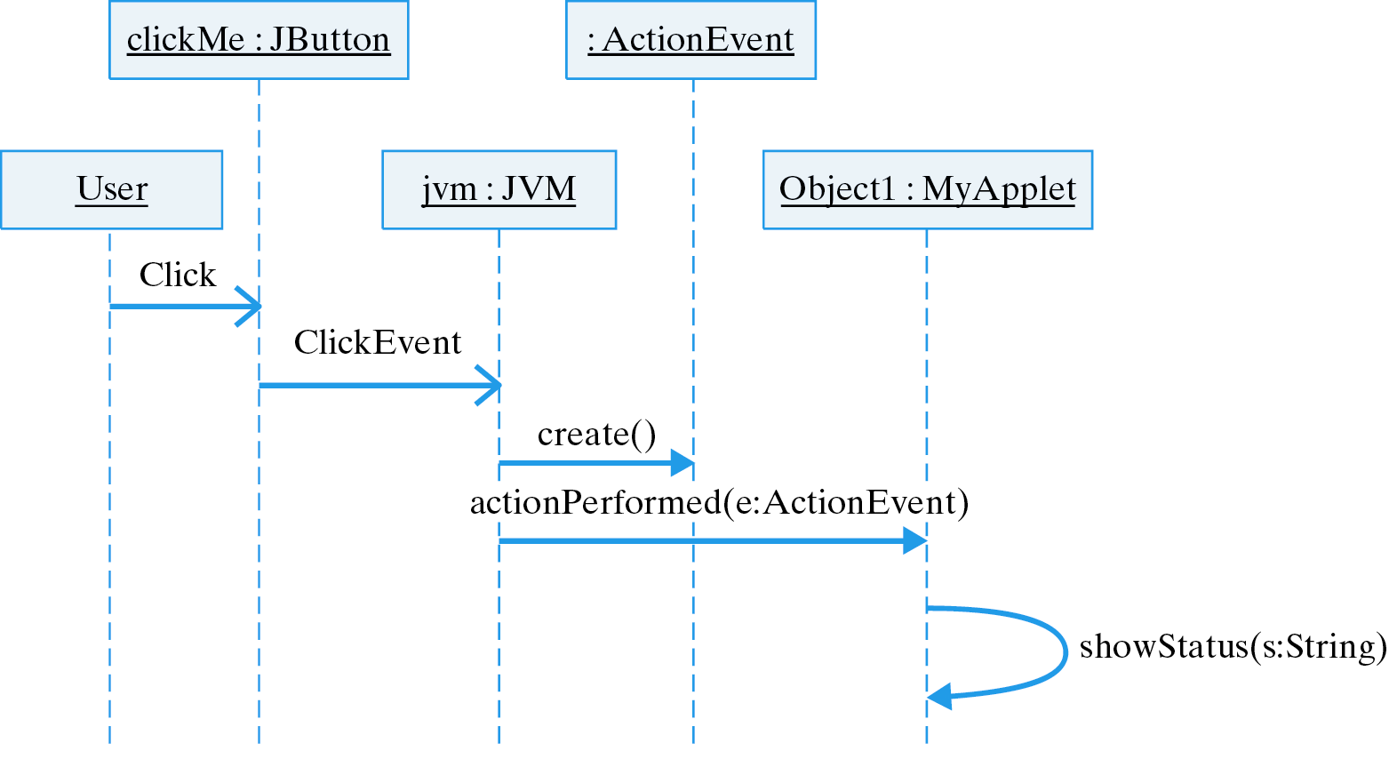
Handling an ActionEvent

Slide 18
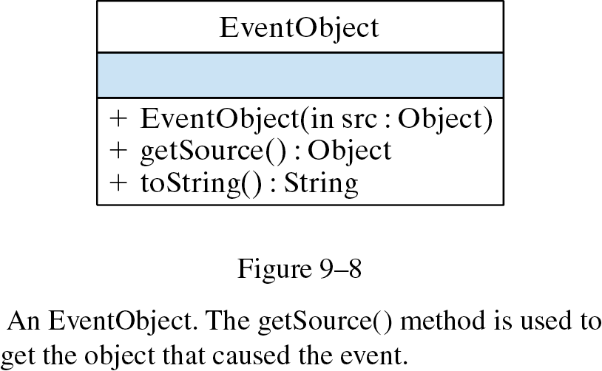
The EventObject Class
The getSource() method is used to get the Object that caused the event.

Slide 19
Event Classes
AWT events for each type of component.
Components Events Description
Button, JButton ActionEvent User clicked button
CheckBox, JCheckBox ItemEvent User toggled a checkbox
CheckboxMenuItem,
JCheckboxMenuItem ItemEvent User toggled a checkbox
Choice, JPopupMenu ItemEvent User selected a choice
Component, JComponent ComponentEvent Component was moved or resized
FocusEvent Component acquired or lost focus
KeyEvent User typed a key
MouseEvent User manipulated the mouse
Container, JContainer ContainerEvent Component added/removed from container
List, JList ActionEvent User double-clicked a list item
ItemEvent User clicked a list item
Menu, JMenu ActionEvent User selected menu item
Scrollbar, JScrollbar AdjustmentEvent User moved scrollbar
TextComponent, JTextComponent TextEvent User edited text
TextField, JTextField ActionEvent User typed Enter key
Window, JWindow WindowEvent User manipulated window

Slide 20
New Swing Event Classes
Newly defined Swing events.
Component Events Description
JPopupMenu PopupMenuEvent User selected a choice
JComponent AncestorEvent An event occurred in an ancestor
JList ListSelectionEvent User double-clicked a list item
ListDataEvent List's contents were changed
JMenu MenuEvent User selected menu item
JTextComponent CaretEvent Mouse clicked in text
UndoableEditEvent An undoable edit has occurred
JTable TableModelEvent Items added/removed from table
TableColumnModelEvent A table column was moved
JTree TreeModelEvent Items added/removed from tree
TreeSelectionEvent User selected a tree node
TreeExpansionEvent User changed tree node
JWindow WindowEvent User manipulated window

Slide 21
Case Study: Designing a Basic GUI
Basic User Interface Tasks:
  Provide help/guidance to the user.
  Allow input of information.
  Allow output of information.
  Control interaction between the user and device.

Slide 22
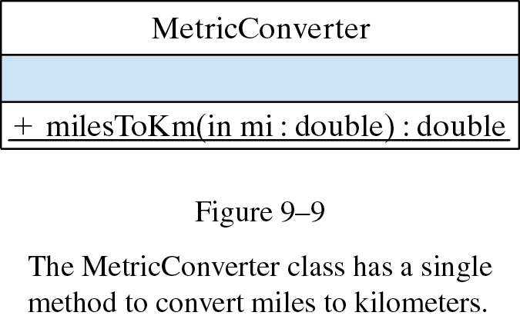
The MetricConverter Class
Problem Description: Design a GUI for a Java application that converts miles to kilometers. The class that performs the conversions is defined as:
public class MetricConverter {
public static double milesToKm(double miles) {
return miles / 0.62;
}
}

Slide 23
GUI Design: Choosing Components
Swing objects for input, output, control, guidance:
  Guidance: A JLabel displays a short string of text or an image. It can serve as a prompt.
  Input: A JTextField allows editing of a single line of text. It can get the user’s input.
  Output: A JTextArea allows editing of multiple lines of text. We’ll use it to display results.
  Control: A JButton is an action control. By implementing the ActionListener interface we will handle the user's action events.

Slide 24
GUI Design: The Top-Level Window
For applets, top-level window is JApplet.
For applications, a JFrame is used.
Both JApplet and JFrame are subclasses of Container and are suitable for holding the interface components.
Both JApplet and JFrame are heavyweight components.

Slide 25
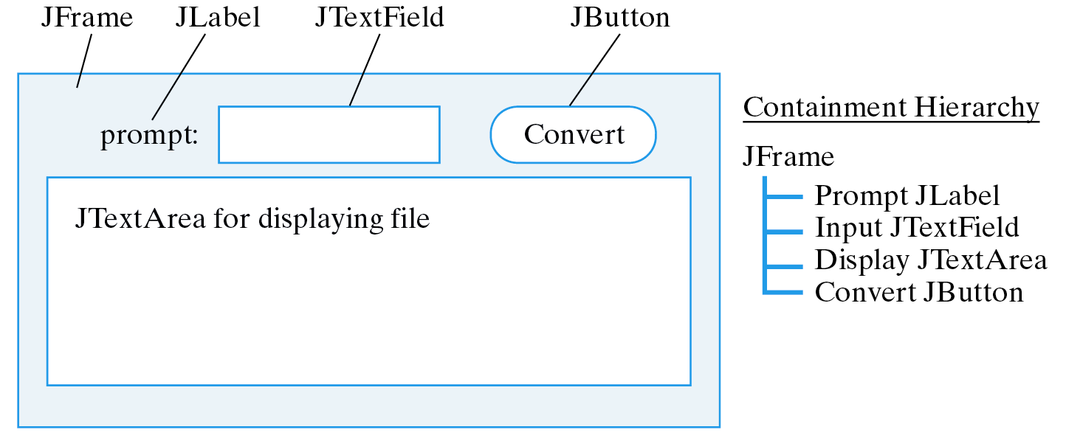
GUI Design: Layout
In a FlowLayout components are arranged left to right in rows within the container.
The containment hierarchy shows which components are contained in containers.
The top-level window is a JFrame.

Slide 26
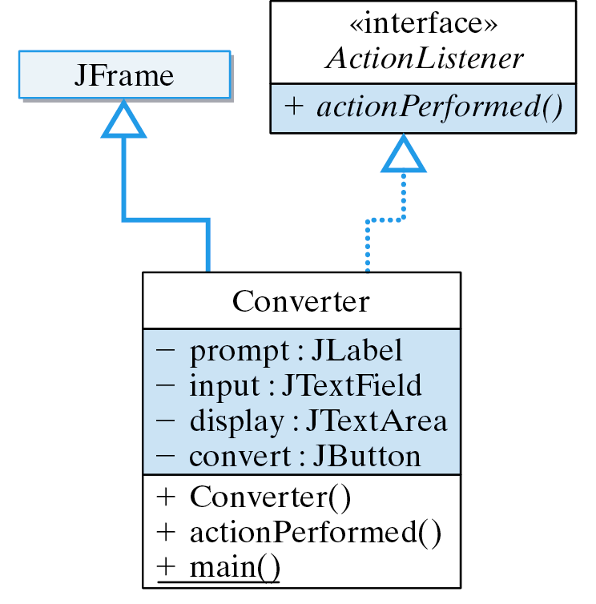
Class Design
Uses

Slide 27
Implementing the Converter Class
import javax.swing.*; // Packages used
import java.awt.*;
import java.awt.event.*;
public class Converter extends JFrame implements ActionListener{
private JLabel prompt = new JLabel("Distance in miles: ");
private JTextField input = new JTextField(6);
private JTextArea display = new JTextArea(10,20);
private JButton convert = new JButton("Convert!");
public Converter() {
getContentPane().setLayout(new FlowLayout());
getContentPane().add(prompt);
getContentPane().add(input);
getContentPane().add(convert);
getContentPane().add(display);
display.setLineWrap(true);
display.setEditable(false);
convert.addActionListener(this);
} // Converter()
public void actionPerformed( ActionEvent e ) {
double miles =
Double.valueOf(input.getText()).doubleValue();
double km = MetricConverter.milesToKm(miles);
display.append(miles + " miles equals " + km +
" kilometers\n");
} // actionPerformed()
} // Converter
Declare the components.
For top-level Swing windows, components are added to the content pane.
Invoke MetricConverter when the JButton is clicked.
Convert String to double.

Slide 28
Instantiating the Top-Level JFrame
It is necessary to set the size and visibility.
public static void main(String args[]) {
Converter f = new Converter();
f.setSize(400, 300);
f.setVisible(true);
// Quit the application
f.addWindowListener(new WindowAdapter() {
public void windowClosing(WindowEvent e) {
System.exit(0);
}
});
} // main()
An anonymous inner class is used to create an adapter to listen for window close events. (See Appendix F)

Slide 29
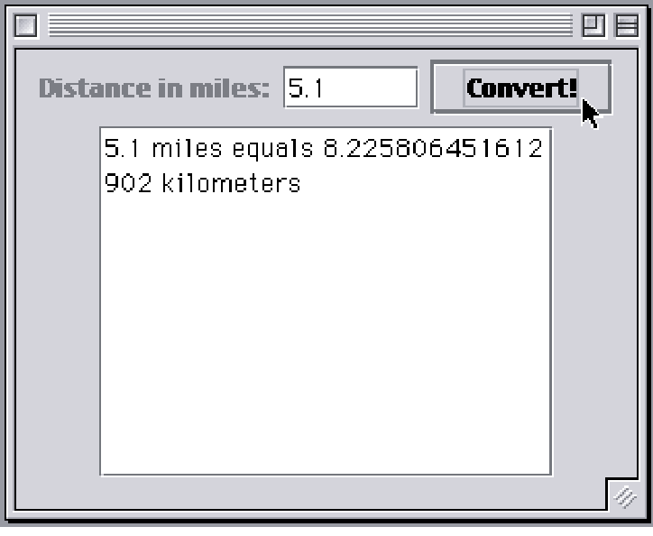
GUI Design Critique
The user has to manually clear the input field.
  Effective Design: Minimize the user’s burden.
The user has to use both keyboard and mouse.
  Effective Design: Minimize the number of input devices needed to perform a single task.

Slide 30
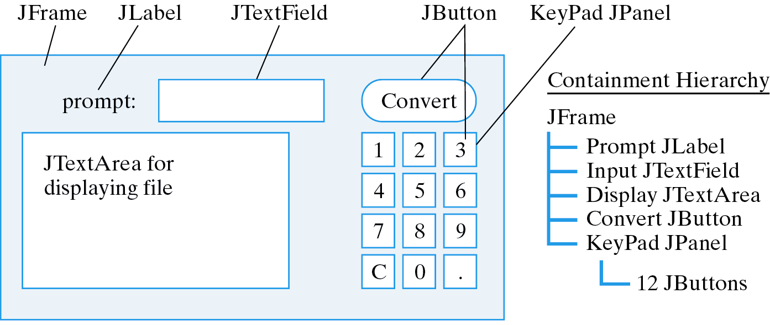
Extending the GUI: Button Array
Make the JTextField a control so the user doesn’t have to use the mouse to perform conversions.
Implement a 10-key pad so a conversion can be done with just the mouse control.
Effective Design: Redundant controls.
Note the use of a JPanel to hold buttons.

Slide 31
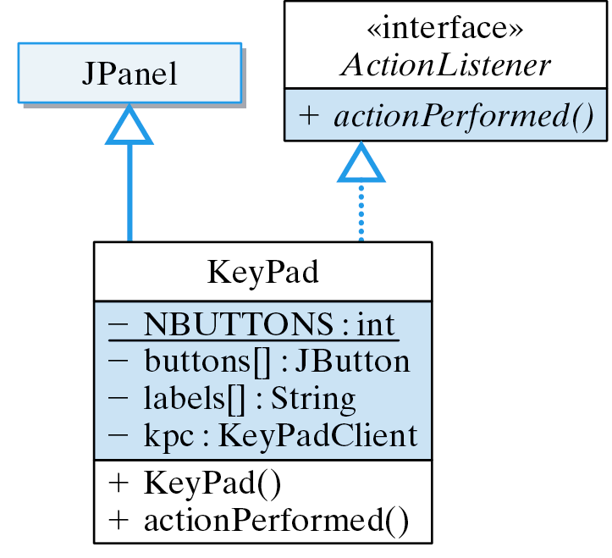
The KeyPad JPanel
The KeyPad JPanel handles its own actions.
Reference to the client.

Slide 32
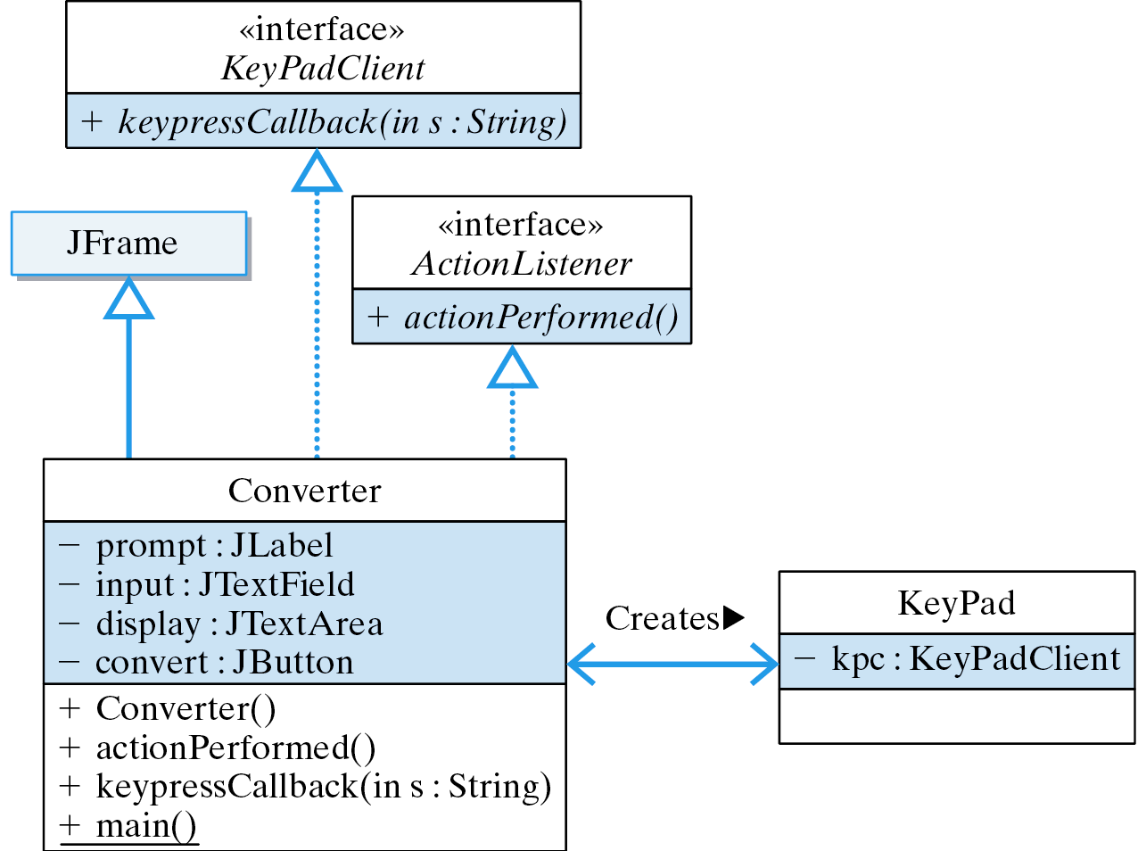
The Callback Method Design
The Converter creates the KeyPad. The KeyPad calls the keypressCallback() method whenever a key is pressed.

Slide 33
Implementation: The KeyPad Class
public class KeyPad extends Jpanel implements ActionListener {
private final static int NBUTTONS = 12;
private KeyPadClient kpc; // Owner of the KeyPad
private JButton buttons[]; // An array of buttons
private String labels[] = // And their labels
{ "1","2","3",
"4","5","6",
"7","8","9",
"C","0","." };
public KeyPad(KeyPadClient kpc) {
this.kpc = kpc;
buttons = new JButton[NBUTTONS]; // Create the array
for(int k = 0; k < keyPad.length; k++) { // For each button
buttons[k] = new JButton(labels[k]); // Create it w/label
buttons[k].addActionListener(this); // and a listener
add(buttons[k]); // and add to panel
} // for
}
public void actionPerformed(ActionEvent e) {
String keylabel = ((Jbutton)e.getSource()).getText();
kpc.keypressCallback(keylabel);
}
}
Buttons and labels stored in arrays.
Callback.

Slide 34
Implemention: The Callback Method
KeyPad’s actionPerformed() calls the client’s keypressCallback() method, passing it the key’s label.
Clear the input
public void keypressCallback(String s) {
if (s.equals(“C”))
input.setText(“”); // Clear the input
else
input.setText(input.getText() + s); // Type the key
}
Keypad Input: Concatenate button’s label with the contents of the input field.

Slide 35
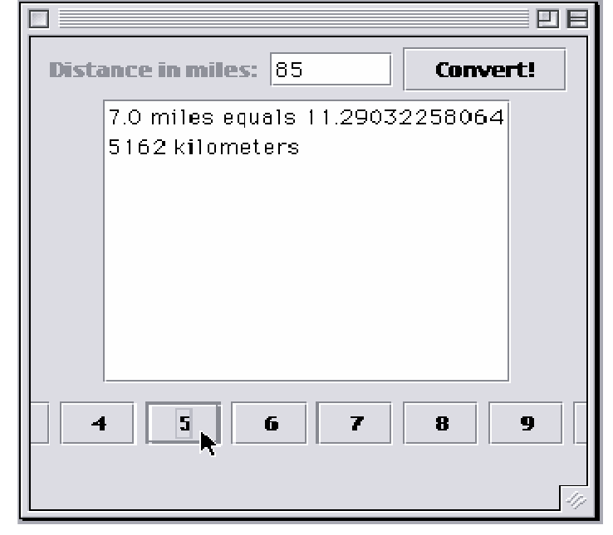
GUI Design Critique
Problem: The default layout for a JPanel is FlowLayout but we need GridLayout.
We got the keypad layout wrong!

Slide 36
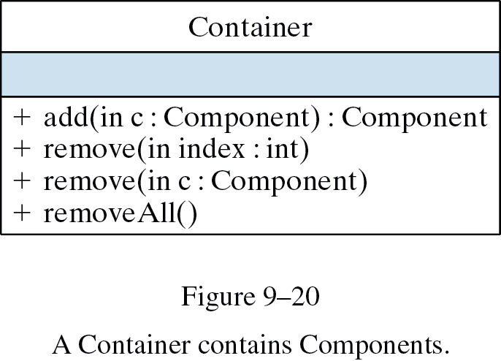
Containers
A container is a component that contains other components -- e.g., JPanel, JFrame, JApplet.
Container methods:

Slide 37
Layout Managers
A layout manager is an object that manages the layout and organization of a container, including:
  Size of container.
  Size of each element in the container.
  Position and spacing between elements.

Slide 38
Types of Layout Managers
Manager Description
java.awt.BorderLayout Arranges elements along the north, south, east, west, and in the center of the container.
java.swing.BoxLayout Arranges elements in a single row or single column.
java.awt.CardLayout Arranges elements like a stack of cards, with one visible at a time.
java.awt.FlowLayout Arranges elements left to right across the container.
java.awt.GridBagLayout Arranges elements in a grid of variable sized cells (complicated).
java.awt.GridLayout Arranges elements into a two-dimensional grid of equally sized cells.
java.swing.OverlayLayout Arranges elements on top of each other.

Slide 39
Default Layout Managers
In AWT, the default layout for applets was FlowLayout.
Container Layout Manager
JApplet BorderLayout (on its content pane)
JBox BoxLayout
JDialog BorderLayout (on its content pane)
JFrame BorderLayout (on its content pane)
JPanel FlowLayout
JWindow BorderLayout (on its content pane)
Top-level windows use BorderLayout

Slide 40
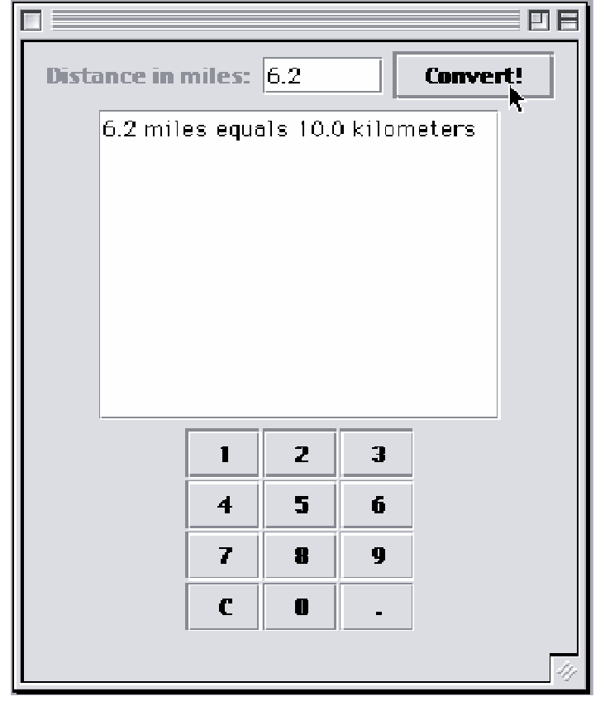
The GridLayout Manager
A GridLayout arranges components in a two-dimensional grid.
keypadPanel.setLayout(
new GridLayout(4,3,1,1));
4 rows and 3 columns
1 space between each row and column
Design Critique: We should use BorderLayout for top-level window.

Slide 41
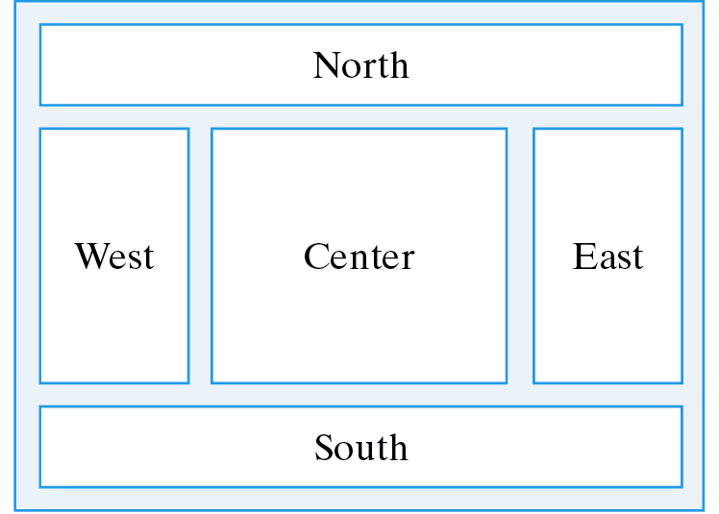
The BorderLayout Manager
A BorderLayout divides the container into five areas: north, south, east, west, and center.
Horizontal and vertical gaps.
Use add(Component, String) method to add components to a border layout :
getContentPane().setLayout(new BorderLayout(2, 2));
getContentPane().add(keypadPanel, "East");

Slide 42
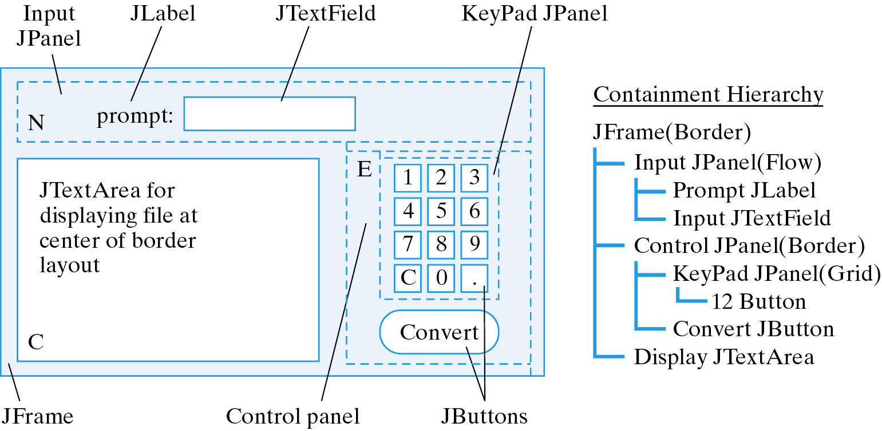
Converter: BorderLayout Design
Panels are used to group components by function.
All the controls are grouped together.

Slide 43
Converter: BorderLayout Implementation
The GUI is layed out in the constructor.
public Converter() {
getContentPane().setLayout(new BorderLayout());
initKeyPad();
JPanel inputPanel = new JPanel(); // Input panel
inputPanel.add(prompt);
inputPanel.add(input);
getContentPane().add(inputPanel,"North");
JPanel controlPanel = new JPanel(new BorderLayout(0, 0));// Controls
controlPanel.add(keypadPanel, "Center");
controlPanel.add(convert, "South");
getContentPane().add(controlPanel, "East");
getContentPane().add(display,"Center"); // Output display
display.setLineWrap(true);
display.setEditable(false);
convert.addActionListener(this);
input.addActionListener(this);
} // Converter()

Slide 44
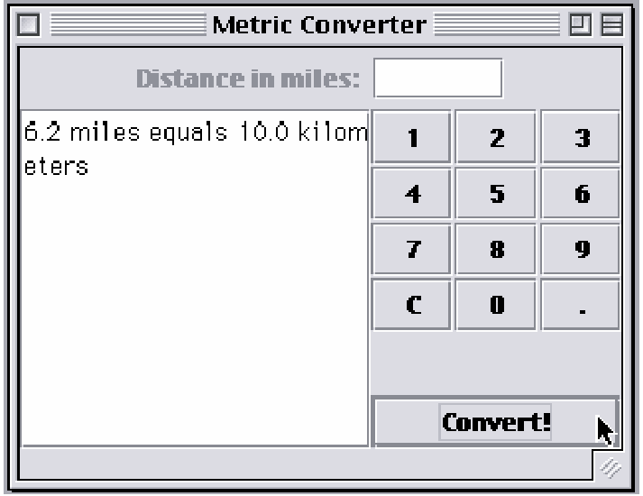
Converter: Final Version
In BorderLayout, when one or more areas is not used, then one or more of the other areas fills its space, except for the center, which would be left blank if unused.
The unused south area is filled by center and east.
Outputs

Slide 45
Checkboxes
A JCheckBox is a button which always displays its current state (selected or not).
Used to select one or more options from a set.
An array of checkboxes.
private JCheckBox titles[] = new JCheckBox[NTITLES];
private String titleLabels[] =
{"Chess Master - $59.95", "Checkers Pro - $39.95",
"Crossword Maker - $19.95"};
for(int k = 0; k < titles.length; k++) {
titles[k] = new JCheckBox(titleLabels[k]);
titles[k].addItemListener(this);
choicePanel.add(titles[k]);
}
An array of checkbox labels.
Each checkbox is given a listener and added to a JPanel.

Slide 46
Radio Buttons
A JRadioButton is a button that belongs to a ButtonGroup of mutually exclusive alternatives. Only one button from the group may be selected at a time.
private ButtonGroup optGroup = new ButtonGroup();
private JRadioButton options[] = new JRadioButton[NOPTIONS];
private String optionLabels[] = {"Credit Card", "Debit Card",
"E-cash"};
for(int k = 0; k < options.length; k++) {
options[k] = new JRadioButton(optionLabels[k]);
options[k].addItemListener(this);
optionPanel.add(options[k]);
optGroup.add(options[k] );
}
options[0].setSelected(true); // Set the first button on
Add each button to the button group.

Slide 47
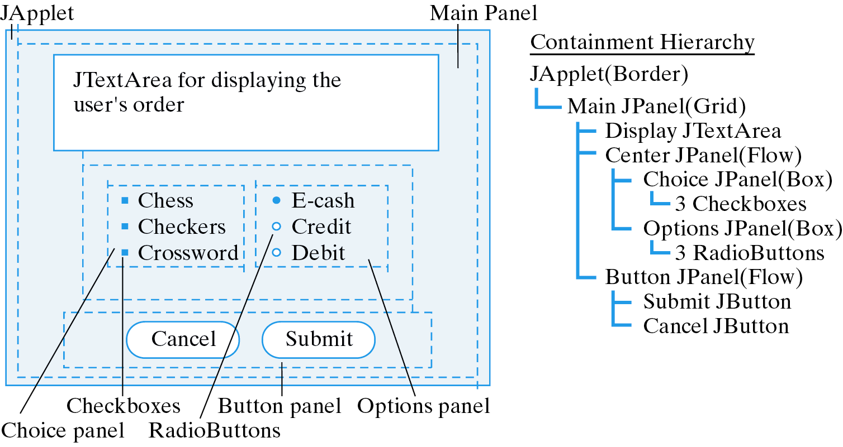
Design: The Online Order Form
Problem: Design an applet-based order form that can be used for ordering software over the Web.
Checkboxes
RadioButtons

Slide 48
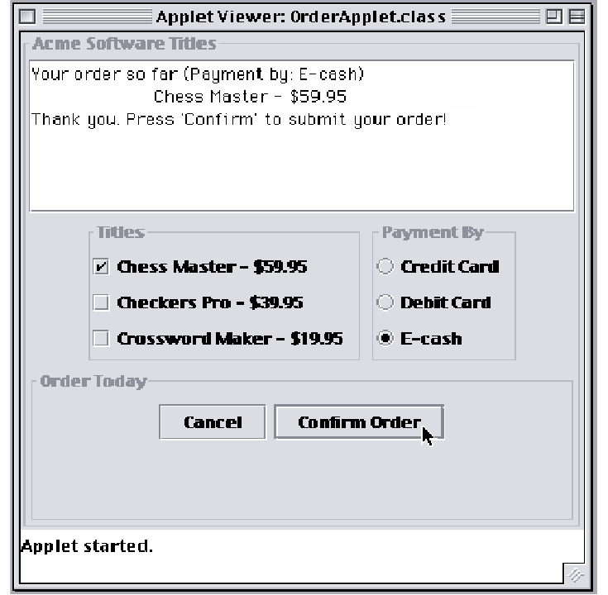
The Order Form Applet
A Swing Titled Border
choicePanel.setBorder(
BorderFactory.createTitledBorder("Titles"));

Slide 49
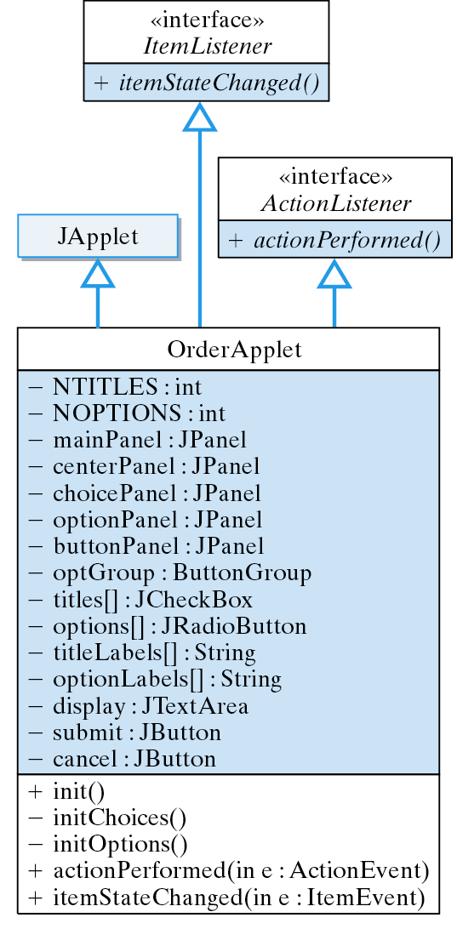
Class Design
The OrderApplet makes extensive use of GUI components.

Slide 50
The ItemListener Interface
ItemEvents are associated with items that make up menus, including JCheckBoxes and RadioButtons.
They are handled by the ItemListener interface, which consists of the itemStateChanged() method.
In the OrderApplet, each time the user selects a title or an option, the following method is executed.
Display the user’s selections.
public void itemStateChanged(ItemEvent e) {
display.setText("Your order so far (Payment by: ");
for (int k = 0; k < options.length; k++ )
if (options[k].isSelected())
display.append(options[k].getText() + ")\n");
for (int k = 0; k < titles.length; k++ )
if (titles[k].isSelected())
display.append("\t" + titles[k].getText() + "\n");
} // itemStateChanged()

Slide 51
The OrderApplet Class: Initialization
public class OrderApplet extends JApplet implements ItemListener, ActionListener {
private final int NTITLES = 3, NOPTIONS = 3;
private JPanel mainPanel = new JPanel(),
centerPanel = new JPanel(),
choicePanel = new JPanel(),
optionPanel = new JPanel(),
buttonPanel = new JPanel();
public void init() {
mainPanel.setBorder(
BorderFactory.createTitledBorder("Acme Software Titles"));
mainPanel.setLayout(new GridLayout(3, 1, 1, 1));
cancel.addActionListener(this);
submit.addActionListener(this);
initChoices();
initOptions();
buttonPanel.setBorder(
BorderFactory.createTitledBorder("Order Today"));
buttonPanel.add(cancel);
buttonPanel.add(submit);
centerPanel.add(choicePanel);
centerPanel.add(optionPanel);
mainPanel.add( display);
mainPanel.add(centerPanel);
mainPanel.add( buttonPanel);
getContentPane().add(mainPanel);
setSize(400,400);
} // init()
} // OrderApplet
import javax.swing.*;
import javax.swing.border.*;
import java.awt.*;
import java.awt.event.*;
Panel hierarchy.
The init() method sets the layouts and adds components to panels.

Slide 52
OrderApplet Class: Handling Actions
The “Submit” button serves a dual purpose.
public void actionPerformed(ActionEvent e) {
String label = submit.getText();
if (e.getSource() == submit) {
if (label.equals("Submit Order")) {
display.append(
"Thank you. Press 'Confirm' to submit for your order!\n");
submit.setText("Confirm Order");
} else {
display.append(
"Thank you. You will receive your order tomorrow!\n");
submit.setText("Submit Order");
}
} else
display.setText(
"Thank you. Maybe we can serve you next time!\n");
} // actionPerformed()

Slide 53
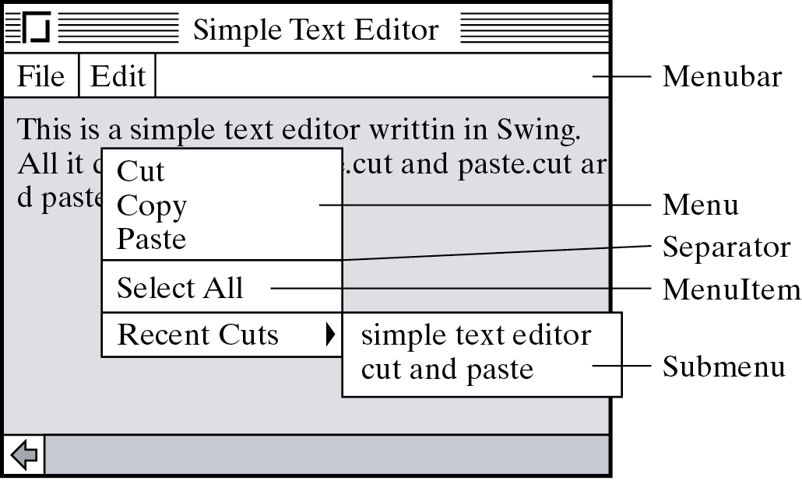
Menus
Menus allow a program to grow without cluttering the interface.
A JMenuBar is a horizontal list of menus.
A JMenu is a clickable area on the menu bar that is associated with a JPopupMenu, a small window that diplays JMenuItems.
JSeparators are used to group menu items.

Slide 54
Menu Example
Menus are added to the menu bar.
Menus are hierarchical.
private void initFileMenu() {
fileMenu = new JMenu("File"); // Create the file menu
mBar.add(fileMenu); // and add it to the menu
openItem = new JMenuItem("Open"); // Open item
openItem.addActionListener( this );
openItem.setEnabled(false);
fileMenu.add(openItem);
saveItem = new JMenuItem("Save"); // Save item
saveItem.addActionListener(this);
saveItem.setEnabled(false);
fileMenu.add(saveItem);
fileMenu.addSeparator(); // Separator
quitItem = new JMenuItem("Quit"); // Quit item
quitItem.addActionListener(this);
fileMenu.add(quitItem);
} // initFileMenu()
Menu items are added to the menu.
Action listeners are associated with menu items.

Slide 55
Handling Menu Actions
Menu item selections generate ActionEvents.
Algorithm: Multiway selection. Test for each menu item and take appropriate action.
Need to cast source object.
public void actionPerformed(ActionEvent e) {
JMenuItem m = (JMenuItem)e.getSource();
if ( m == quitItem ) { // Quit
dispose();
} else if (m == copyItem) // Copy
scratchPad = display.getSelectedText();
} else if (m == pasteItem) { // Paste
display.insert(scratchPad, display.getCaretPosition());
} else if ( m == selectItem ) {
display.selectAll(); // Select entire document
}
} // actionPerformed()
A scratchpad (String) is used to store text.

Slide 56
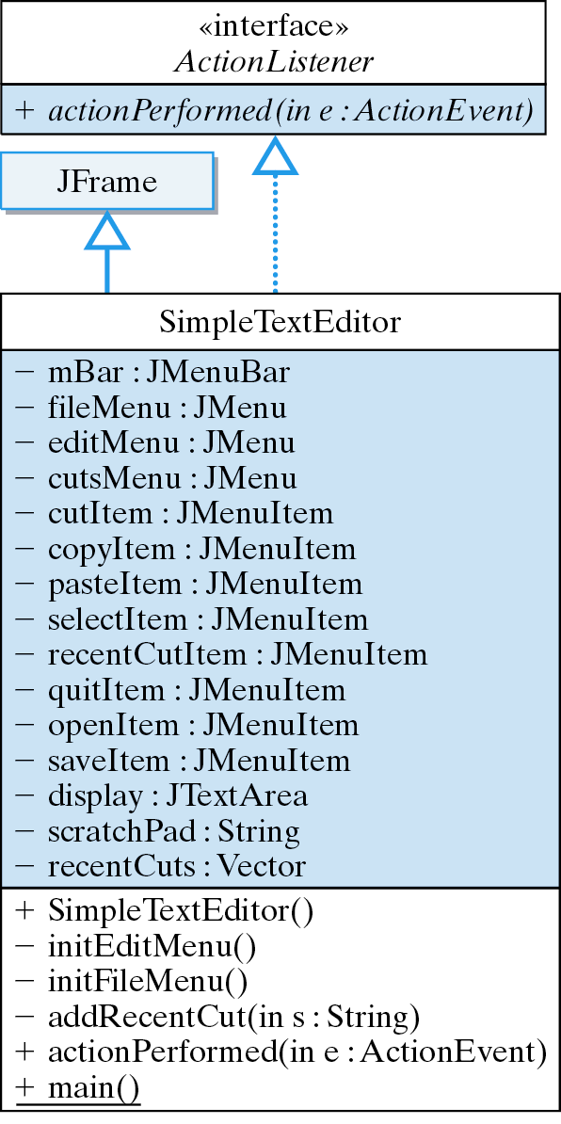
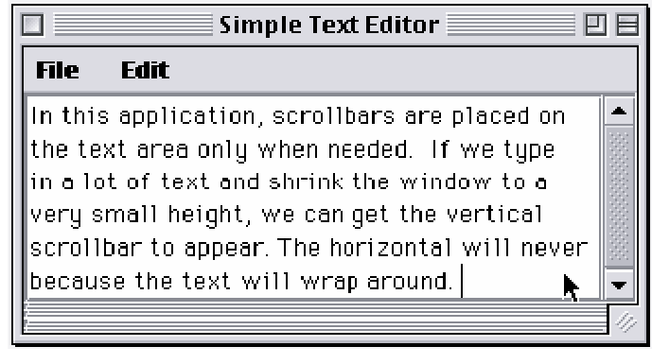
SimpleTextEditor Design

Slide 57
Scroll Panes
A JScrollPane is an object that manages scrolling within a window or JTextArea.
this.getContentPane().add(new JScrollPane(display));
This parameter refers to the scrollable component.
The parts of a scroll pane.

Slide 58
Scroll Pane Example
Scroll bars appear on the text area only when they are needed.
Horizontal scroll bar is unnecessary.

Slide 59
Technical Terms
callback design
content pane
containment hierarchy
controller
event model
layout manager
lightweight component
listener
model
model-view-controller (MVC)
peer model
pluggable look and feel
view
widget hierarchy

Slide 60
Summary Of Important Points
Graphical User Interface (GUI) components:
  Abstract Windowing Toolkit (AWT): JDK 1.0 -1.2.
  Swing: the GUI part of Java Foundation Classes (JFC) JDK 1.1, 1.2 (Java 2).
    Written entirely in Java (pure Java).
    Platform-independent look and feel.
    Pluggable look-and-feel:
      Windows 95 style
      Unix-like Motif style
      Java Metal style

Slide 61
Summary Of Important Points (cont)
Model-View-Controller (MVC): Components divided into three separate objects: look (view), state (model), and behavior (controller).
User interface classes -- combine look behavior, for a pluggable look-and-feel.
Peer model : every AWT component has a peer in the native windowing system. This model is less efficient and more platform dependent than the MVC model.

Slide 62
Summary Of Important Points (cont)
Event model is based on event listeners -- objects responsibile for handling the component’s events.
User interface design: guidance of the user, input, output and control.
Containment hierarchy: A hierarchy of the containers and their contents in a GUI (JPanels and other Containers).
Content pane: Used by top-level Swing classes --- JApplet, JDialog, JFrame, and JWindow --- as their component container.

Slide 63
Summary Of Important Points (cont)
A GUI should minimize the number of input devices that users need to manipulate.
Redundancy: some forms -- e.g., two independent but complete sets of controls --- are desirable.
Layout manager: manages the arrangement of the components in a container (flow, border, grid and box layouts).
A radio button belongs to a group such that only one button may be selected at a time. A checkbox is a toggle button that always displays its state.
Interface Design: reduce chance of user error and make it easy to recover from errors when they do occur.

