Slide 1

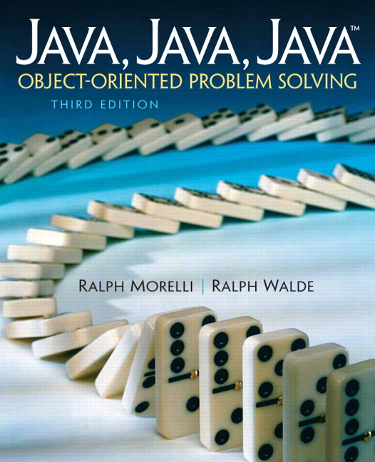
JAVA, JAVA, JAVA
presentation slides for
Object-Oriented Problem Solving
Third Edition
Ralph Morelli | Ralph Walde
Trinity College
Hartford, CT
published by Prentice Hall

Slide 2
Java, Java, Java
Object Oriented Problem Solving
Chapter 14: Threads and Concurrent Programming

Slide 3
Objectives
Understand the concept of a thread.
Know how to design and write multithreaded programs.
Be able to use the Thread class and the Runnable interface.
Understand the life-cycle of a thread.
Know how to synchronize threads.

Slide 4
Outline
What Is a Thread?
From the Java Library: The Thread class
Thread States and Life Cycle
Using Threads to Improve Interface Responsiveness
Case Study: Cooperating Threads
Case Study: The Game of Pong

Slide 5
What Is a Thread?
A thread (or thread of control) is a sequence of executable statements within a program.
Java Application: starts at main() and executes statements in sequence.
The Java Virtual Machine in multi-threaded -- it has more than one thread executing.
Garbage collector thread -- a JVM thread to collect memory of discarded objects.

Slide 6
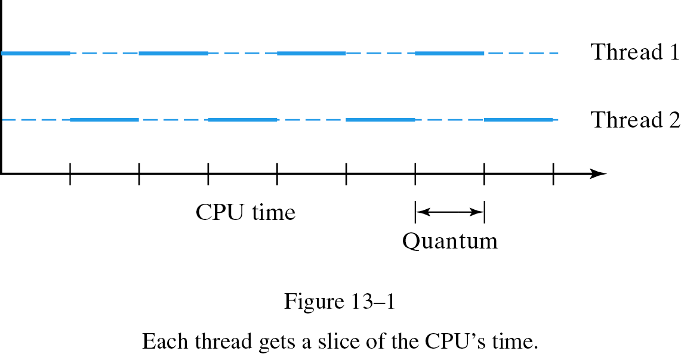
Concurrent Execution of Threads
Multitasking is the technique of concurrently executing several tasks within a program.
On a sequential computer the threads share the single CPU (Central Processing Unit).
Time slicing -- each thread alternatively gets a slice (quantum) of the CPU's time.

Slide 7
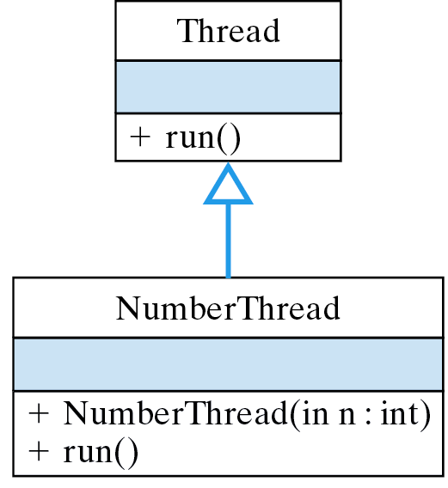
Multithreaded Numbers
Create several NumberThreads and have each thread print its ID number 10 times.
NumberThread overrides the inherited run() method..

Slide 8
The NumberThread Class
A NumberThread prints its ID 10 times.
public class NumberThread extends Thread {
int num;
public NumberThread(int n) {
num = n;
}
public void run() {
for (int k=0; k < 10; k++) {
System.out.print(num);
} //for
} // run()
} // NumberThread
When a thread is started, it executes its run() method.

Slide 9
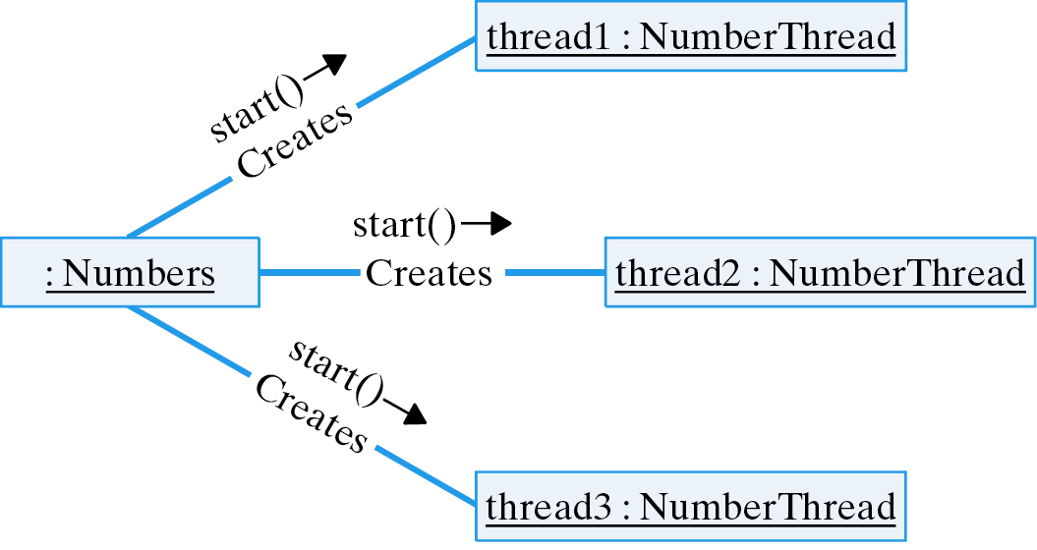
The Numbers Class
Creates NumberThreads and starts each one..

Slide 10
Starting Multiple Threads
Create 5 NumberThreads and start each one.
public class Numbers {
public static void main(String args[]) {
NumberThread number1, number2, number3, number4, number5;
number1 = new NumberThread(1); number1.start();
number2 = new NumberThread(2); number2.start();
number3 = new NumberThread(3); number3.start();
number4 = new NumberThread(4); number4.start();
number5 = new NumberThread(5); number5.start();
} // main()
} // Numbers
Output: The threads run in the order they were started.
11111111112222222222333333333344444444445555555555

Slide 11
Starting Multiple Threads
The order and timing of threads is unpredictable.
111111111111111111111111111111111111111111111111111111111111111111111
111111111111111111111111111111111111111111111111111111111111111111111
111111111111111111111111111111111111111111111111111111111111112222222
222222222222222222222222222222222222222222222222222222222222222222222
222222222222222222222222222222222222222222222222222222222222222222222
222222222222222222222222222222222222222222223333333333333333333333333
333333333333333333333333333333333333333333333333333333333333333333333
333333333333333333333333333444444444444444444444444444444444444444444
444444444444444444444444444444444444444444444444444444444444444444444
444444444455555555555555555555555555555555555555555555555555555555555
555555555555555555555555555555555555555555555555555555555555552222222
222233333333333333333333333333333333333333333333333333333333333333333
333333333333334444444444444444444444444444445555555555555555555555555
555555555555555555555555555555555555555555555555555555444444444444444
4444444444444444444444444444444444

Slide 12
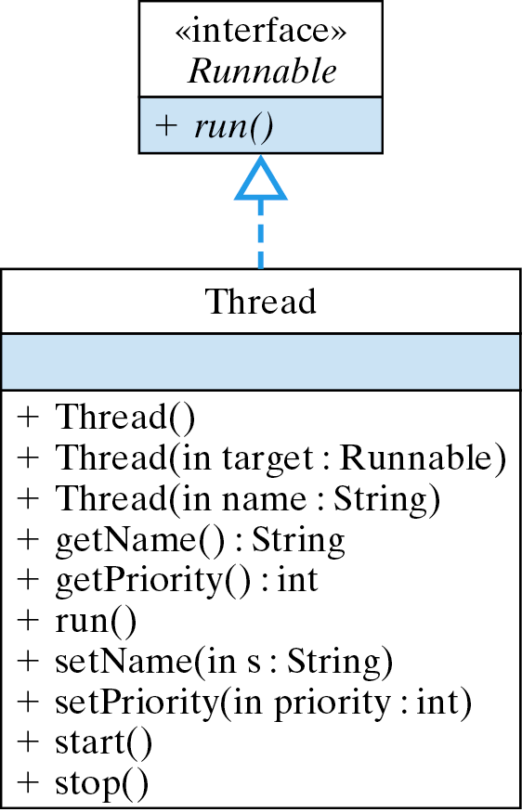
The java.lang.Thread Class

Slide 13
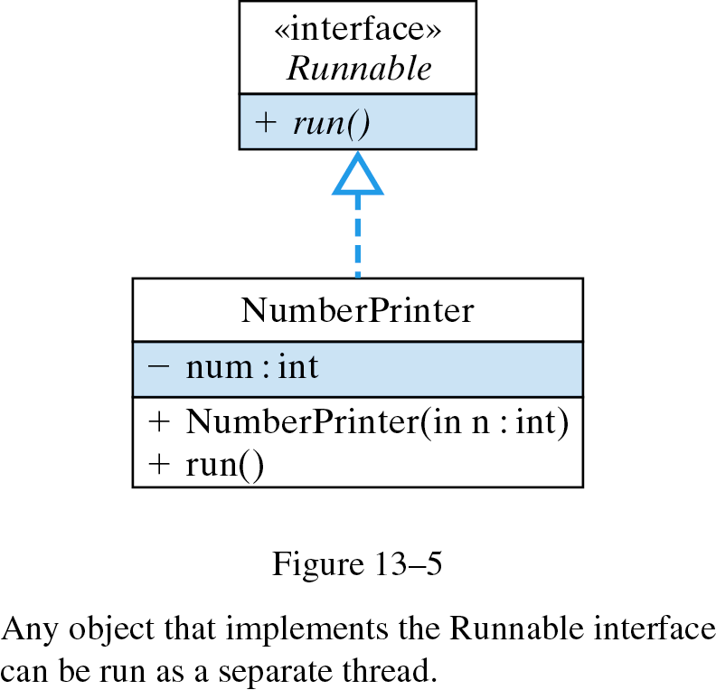
The Runnable Interface
Any object that implements the Runnable interface can be run as a separate thread.
A Runnable object implements run().

Slide 14
A Thread is a Runnable Object
A Thread can be passed a Runnable object.
public class NumberPrinter implements Runnable {
int num;
public NumberPrinter(int n) {
num = n;
}
public void run() {
for (int k=0; k < 10; k++)
System.out.print(num);
} // run()
} // NumberPrinter
A Runnable object implements run().
Create a Runnable object.
Thread number1;
number1 = new Thread(new NumberPrinter(1));
number1.start();

Slide 15
Thread Control
setPriority(int) sets a thread’s priority to an value between Thread.MIN_PRIORITY and Thread.MAX_PRIORITY.
Set NumberThread’s priority to its ID number.
public NumberThread(int n) {
num = n;
setPriority(n);
}
Run 2 million iterations, printing on every million.
for (int k = 0; k < 2000000; k++)
if (k % 1000000 == 0)
System.out.print(num);
Threads run in priority order.
5544332211

Slide 16
Design Issues
The Runnable interface lets you turn an existing class into a thread.
A higher priority thread will preempt threads of lower priority.
Thread implementation is platform dependent.
A high-priority thread that never gives up the CPU can starve lower-priority threads.

Slide 17
Forcing Threads to Sleep
The sleep() method causes the thread to yield for a fixed amount of real time.
For example, a revised NumberPrinter run() method.
Sleep up to 1000 milliseconds.
public void run() {
for (int k=0; k < 10; k++) {
try {
Thread.sleep((long)(Math.random() * 1000));
} catch (InterruptedException e) {
System.out.println(e.getMessage());
}
System.out.print(num);
} // for
} // run()
Threads run in random order.
14522314532143154232152423541243235415523113435451

Slide 18
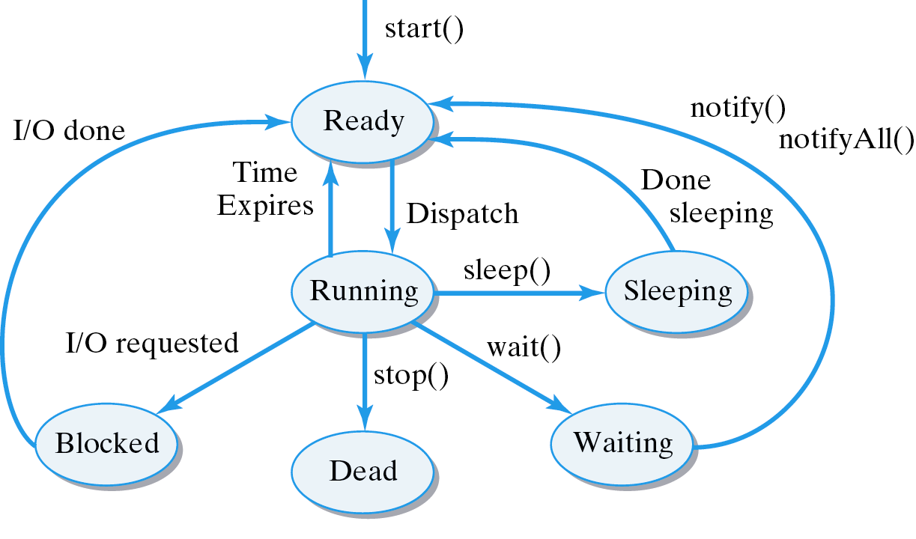
Thread States and Life Cycle
Thread life cycle consists of several states.
State Description
Ready Ready to run and waiting for the CPU. Running Executing on the CPU. Waiting Waiting for some event to happen.
Sleeping Sleeping for a time.
Blocked Waiting for I/O to finish.
Dead Terminated
Key: Regular font-- System control
method() -- program control

Slide 19
The Asynchronous Nature of Threads
Threads are asynchronous -- their timing and order of execution is unpredictable.
It is not possible to determine when a thread thread might be preempted.
Several Machine Instructions
Single Java Statement
(1) Fetch 5 from memory and store it
in register A.
(2) Add 3 to register A.
(3) Assign the value in register A to N.
int N = 5 + 3;
Where preemptions could occur.

Slide 20
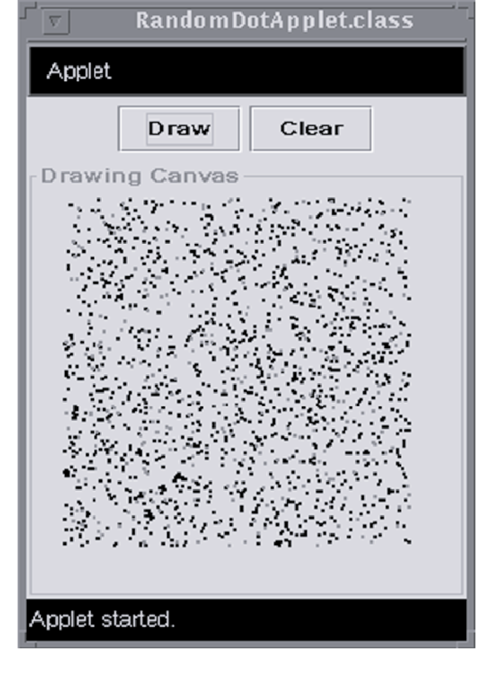
Case Study: Improving Responsiveness
A multithreaded program can be executing in a loop and still respond to user input.
Test User Response: Stop the program from drawing random dots as soon as the first red dot appears. Report the number of red dots.

Slide 21
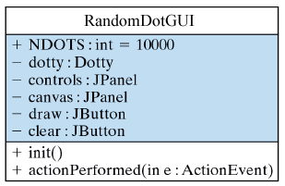
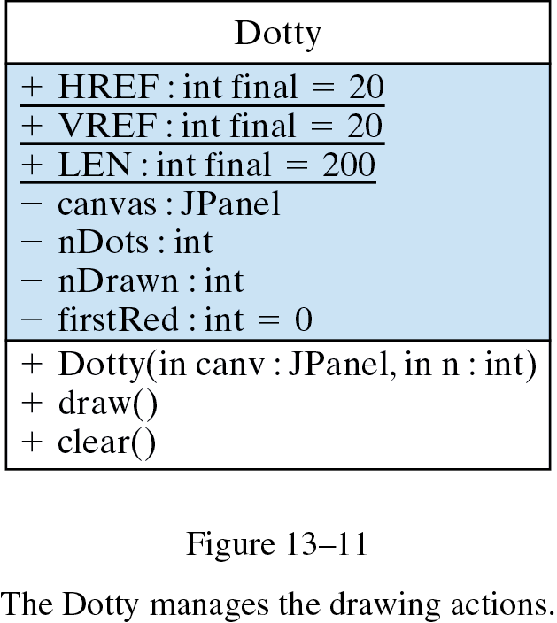
Design: Problem Decomposition
RandomDotApplet -- handles the GUI.
Dotty -- draws the N dots
Uses
Constructor supplies N and reference to JPanel.

Slide 22
Design: RandomDot Applet
Problem Decomposition
  RandomDotGUI -- manages GUI.
  Dotty -- contains draw() and clear()
Initial Definition RandomDotGUI
Dotty handles the drawing.
import java.awt.*;
import javax.swing.*; // Import Swing classes
import java.awt.event.*;
public class RandomDotGUI extends JFrame implements ActionListener{
public final int NDOTS = 10000;
private Dotty dotty; // The drawing class
private JPanel controls = new JPanel();
private JPanel canvas = new JPanel();
private JButton draw = new JButton("Draw");
private JButton clear = new JButton("Clear");
} // RandomDotApplet
GUI elements.

Slide 23
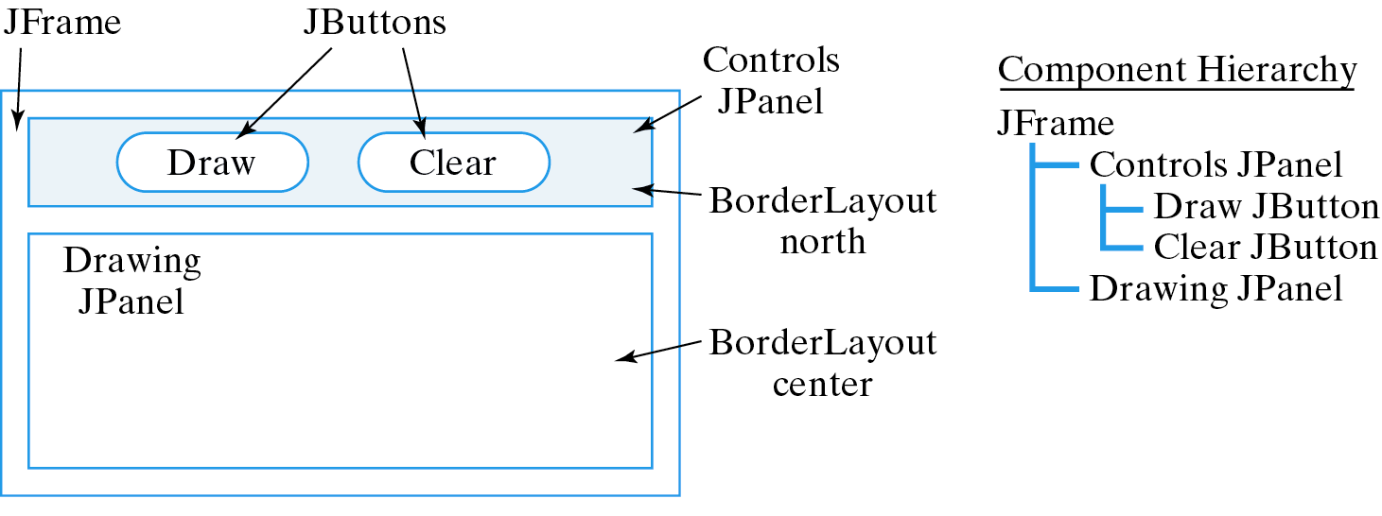
GUI Design: RandomDotGUI
GUI:
public RandomDotGUI() {
getContentPane().setLayout(new BorderLayout());
draw.addActionListener(this);
clear.addActionListener(this);
controls.add(draw);
controls.add(clear);
canvas.setBorder(BorderFactory.createTitledBorder("Drawing Canvas"));
getContentPane().add("North", controls);
getContentPane().add("Center", canvas);
getContentPane().setSize(400, 400);
} // init()

Slide 24
Design: Dotty Class
A Dotty object draws N dots on a JPanel.
Unthreaded Dotty.
import java.awt.*;
import javax.swing.*; // Import Swing classes
public class Dotty {
private static final int HREF = 20, VREF = 20, LEN = 200;
private JPanel canvas;
private int nDots; // Number of dots to draw
private int nDrawn; // Number of dots drawn
private int firstRed = 0; // Number of the first red dot
public Dotty(JPanel canv, int dots) {
canvas = canv;
nDots = dots;
}
} // Dotty
Constructor supplies N and reference to JPanel.

Slide 25
Dotty Methods: draw() and clear()
public void draw() {
Graphics g = canvas.getGraphics();
for (nDrawn = 0; nDrawn < nDots; nDrawn++) {
int x = HREF + (int)(Math.random() * LEN);
int y = VREF + (int)(Math.random() * LEN);
g.fillOval(x, y, 3, 3); // Draw a dot
if ((Math.random() < 0.001) && (firstRed == 0)) {
g.setColor(Color.red); // Change color to red
firstRed = nDrawn;
}
} //for
} // draw()
public void clear() { // Clear screen and report result
Graphics g = canvas.getGraphics();
g.setColor(canvas.getBackground());
g.fillRect(HREF, VREF, LEN + 3, LEN + 3);
System.out.println("Number of red dots = " + (nDrawn-firstRed));
} // clear()
Draw N dots.
At some random point, switch color to red.
Report results.

Slide 26
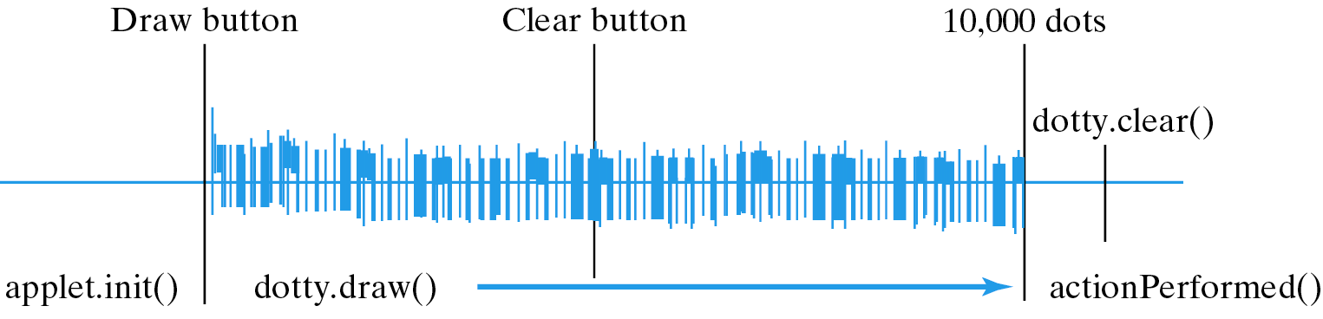
Implementation: Single-threaded Control
GUI and Dotty are part of same thread.
public void actionPerformed(ActionEvent e) {
if (e.getSource() == draw) {
dotty = new Dotty(canvas, NDOTS);
dotty.draw();
} else {
dotty.clear();
}
} // actionPerformed()
Poor Response Time: The applet’s clear() must wait until dotty’s draw() loop ends.

Slide 27
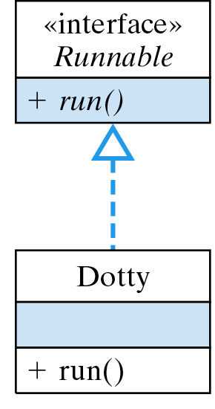
Multithreaded Design
Applet and Dotty are separate threads.
Dotty will run as a separate thread from the applet.

Slide 28
Implementation: A Runnable Dotty
If a thread sleeps, waiting threads can run.
public class Dotty implements Runnable {
private static final int HREF = 20, VREF = 20, LEN = 200;
private JPanel canvas;
private int nDots; // Number of dots to draw
private int nDrawn; // Number of dots drawn
private int firstRed = 0; // Number of the first red dot
private boolean isCleared = false; // The panel is cleared
public void run() {
draw();
}
public Dotty(JPanel canv, int dots) {
canvas = canv;
nDots = dots;
}
} // Dotty
Make Dotty Runnable.
isCleared controls draw() loop
run() just calls draw()

Slide 29
Modified draw() and clear()
public void draw() {
Graphics g = canvas.getGraphics();
for (nDrawn = 0; !isCleared && nDrawn < nDots; nDrawn++) {
int x = HREF + (int)(Math.random() * LEN);
int y = VREF + (int)(Math.random() * LEN);
g.fillOval(x, y, 3, 3); // Draw a dot
if (Math.random() < 0.001 && firstRed == 0) {
g.setColor(Color.red); // Change color to red
firstRed = nDrawn;
}
try {
Thread.sleep(1) ; // Sleep for an instant
} catch (InterruptedException e) {
System.out.println(e.getMessage());
} //try
} //for
} // draw()
public void clear() { // Clear screen and report result
isCleared = true;
Graphics g = canvas.getGraphics();
g.setColor(canvas.getBackground());
g.fillRect(HREF, VREF, LEN + 3, LEN + 3);
System.out.println("Number of red dots = " + (nDrawn-firstRed));
} // clear()
Stop if panel is cleared.
Sleep after each dot.
Stop the draw() loop.

Slide 30
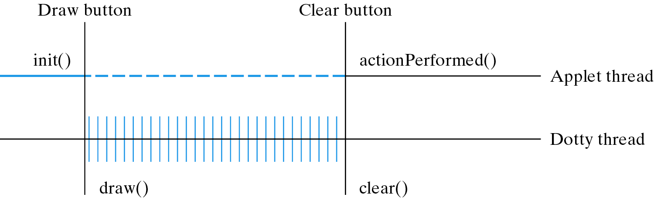
Implementation: Multithreaded Control
If Dotty sleeps, the GUI thread can run.
public void actionPerformed(ActionEvent e) {
if (e.getSource() == draw) {
dotty = new Dotty( canvas, NDOTS );
dottyThread = new Thread(dotty);
dottyThread.start();
} else {
dotty.clear();
}
} // actionPerformed()
Create a Dotty thread and start it drawing.
Good Response Time: Because Dotty sleeps after every dot, clear() will run immediately.

Slide 31
Design Issues
Effective Design: Use a separate thread for an interactive interface.
Tradeoff: Dotty draws a little slower but the interface is more responsive.
Algorithm: The correct way to stop a thread is to make its run() method dependent on a variable (e.g., isCleared).

Slide 32
Case Study: Cooperating Threads
Cooperating threads require explicit synchronization and coordination.
Problem: Simulate a bakery waiting line with a clerk and one or more customers. Use a take-a-number device to manage waiting.
Class Decomposition:
  Bakery: main program, starts the threads.
  TakeANumber: keeps who’s next.
  Clerk: serves the next customer
  Customer: waits on line.

Slide 33
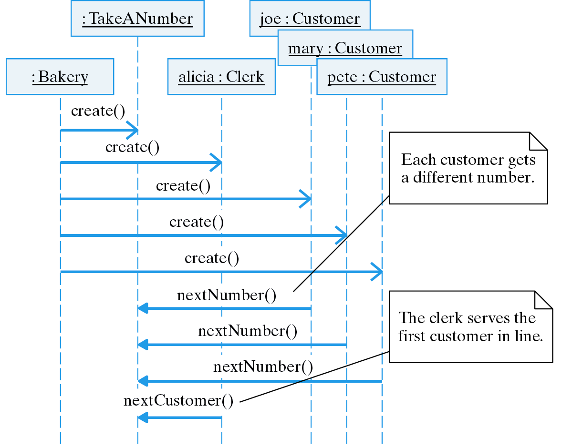
The Multithreaded Bakery Simulation

Slide 34
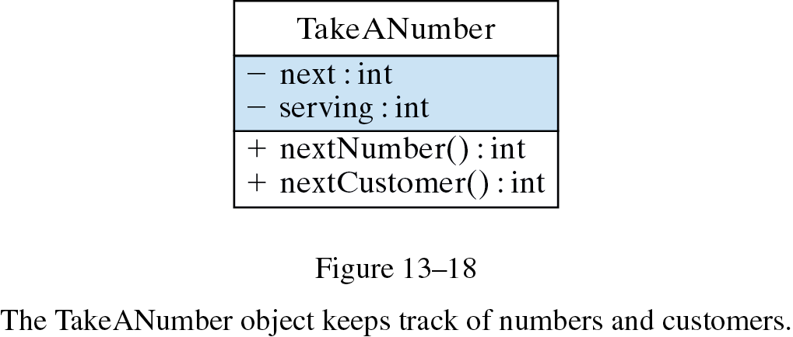
TakeANumber Class (Version 1)
Shared Resource: A TakeANumber object is shared by several threads.
class TakeANumber {
private int next = 0; // Next place in line
private int serving = 0; // Next customer to serve
public synchronized int nextNumber() {
next = next + 1;
return next;
} // nextNumber()
public int nextCustomer() {
++serving;
return serving;
} // nextCustomer()
} // TakeANumber
Used by customers.
Used by clerk.
A synchronized method cannot be preempted.

Slide 35
Java Monitors and Mutual Exclusion
Monitor: a mechanism than ensures only one thread at a time can execute a synchronized method.
When a synchronized method -- nextNumber() -- is called, its object -- TakeANumber -- is locked.
Mutual exclusion: While an object is locked, none of its synchronized methods can be run.
While one customer is getting a number, it can’t be preempted by another customer.
Effective Design: Synchronization. To provide mutually exclusive access to an object’s methods, declare them synchronized.

Slide 36
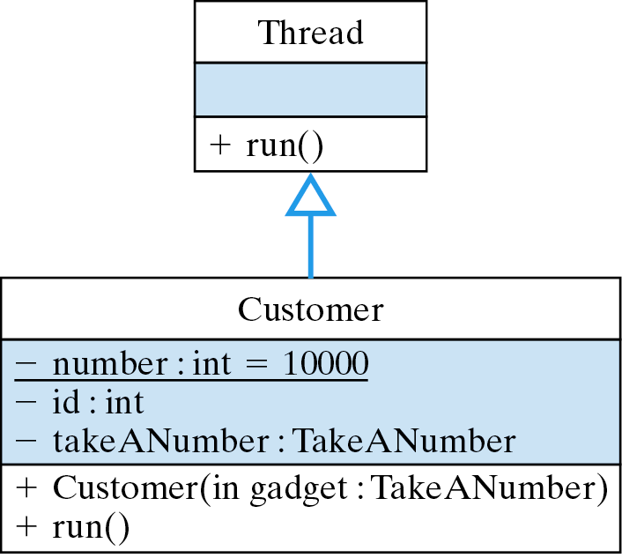
Design: The Customer Class
Customers take the next number.
Class variable.
Unique ID.

Slide 37
Implementation: The Customer Class
Customers take the next number.
Class variable.
public class Customer extends Thread {
private static int number = 10000; // Initial ID number
private int id;
private TakeANumber takeANumber;
public Customer( TakeANumber gadget ) {
id = ++number;
takeANumber = gadget;
}
public void run() {
try {
sleep( (int)(Math.random() * 1000 ) );
System.out.println("Customer " + id + " takes ticket " + takeANumber.nextNumber());
} catch (InterruptedException e) {
System.out.println("Exception " + e.getMessage());
}
} // run()
} // Customer
Unique ID.
This customer may have to wait.

Slide 38
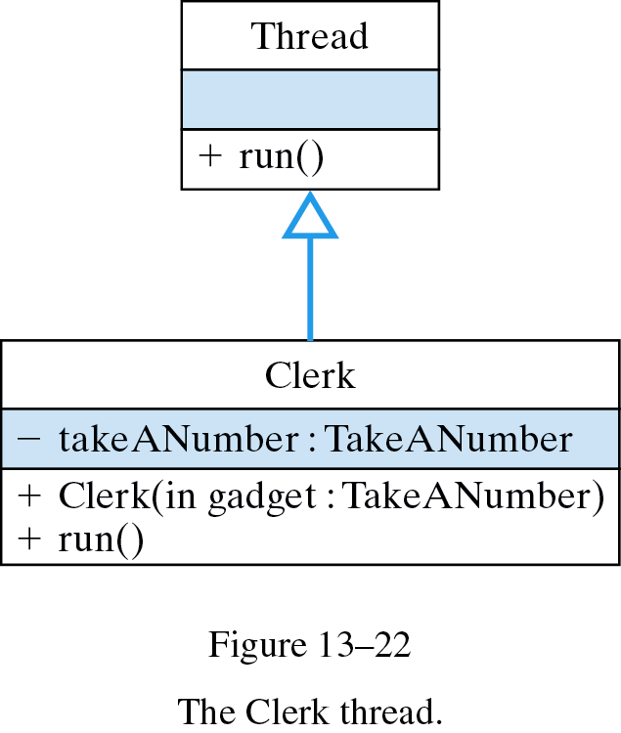
Design: The Clerk Class
Clerks repeatedly serve the next customer.

Slide 39
Implementation: The Clerk Class
Clerks repeatedly serve the next customer.
public class Clerk extends Thread {
private TakeANumber takeANumber;
public Clerk(TakeANumber gadget) {
takeANumber = gadget;
}
public void run() {
while (true) {
try {
sleep( (int)(Math.random() * 50));
System.out.println("Clerk serving ticket " + takeANumber.nextCustomer());
} catch (InterruptedException e) {
System.out.println("Exception " + e.getMessage() );
}
} //while
} //run()
} // Clerk
Infinite loop.
Serve next customer.

Slide 40
The Bakery Class
Bakery starts clerk and customer threads, passing each a reference to TakeANumber.
public class Bakery {
public static void main(String args[]) {
System.out.println( "Starting clerk and customer threads" );
TakeANumber numberGadget = new TakeANumber();
Clerk clerk = new Clerk(numberGadget);
clerk.start();
for (int k = 0; k < 5; k++) {
Customer customer = new Customer(numberGadget);
customer.start();
}
} // main()
} // Bakery
1 clerk
5 customers

Slide 41
Problem: Nonexistent Customers
Problem: Clerk doesn’t wait for customers.
Starting clerk and customer threads
Clerk serving ticket 1
Clerk serving ticket 2
Clerk serving ticket 3
Clerk serving ticket 4
Clerk serving ticket 5
Customer 10004 takes ticket 1
Customer 10002 takes ticket 2
Clerk serving ticket 6
Customer 10005 takes ticket 3
Clerk serving ticket 7
Clerk serving ticket 8
Clerk serving ticket 9
Clerk serving ticket 10
Customer 10001 takes ticket 4
Customer 10003 takes ticket 5
Clerk thread should wait until a customer takes a number.

Slide 42
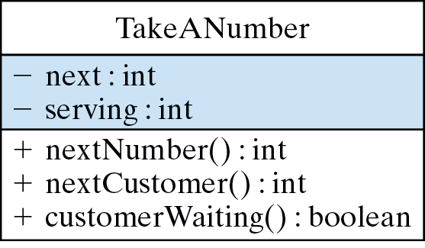
Redesign: Check for Customers
Clerk should check if customers are waiting.

Slide 43
Synchronize: Clerk Waits for Customers
Solution: Modify Clerk run() method ...
public void run() {
while (true) {
try {
sleep((int)(Math.random() * 50));
if (takeANumber.customerWaiting())
System.out.println("Clerk serving ticket " + takeANumber.nextCustomer());
} catch (InterruptedException e) {
System.out.println("Exception " + e.getMessage() );
}
} // while
} // run()
Clerk checks for customer.
public boolean customerWaiting() {
return next > serving;
}
And TakeANumber:

Slide 44
Thread Cooperation
Effective Design: Thread cooperation must be designed into the algorithm.
Starting clerk and customer threads
Customer 10003 takes ticket 1
Clerk serving ticket 1
Customer 10005 takes ticket 2
Clerk serving ticket 2
Customer 10001 takes ticket 3
Clerk serving ticket 3
Customer 10004 takes ticket 4
Clerk serving ticket 4
Customer 10002 takes ticket 5
Clerk serving ticket 5
Service follows customer’s arrival.

Slide 45
Problem: Critical Sections
A critical section is a section of a thread that should not be preempted in the middle.
If we simulate the preemption of:
System.out.println("Customer " + id + " takes ticket " + takeANumber.nextNumber());
What if another thread runs here?
public void run() { // Customer.run()
try {
int myturn = takeANumber.nextNumber();
sleep( (int)(Math.random() * 1000 ) );
System.out.println("Customer " + id + " takes ticket " + myturn);
} catch (InterruptedException e) {
System.out.println("Exception " + e.getMessage());
}
} // run()

Slide 46
Problem: Misleading Output
If there’s a break (preemption) between a customer’s taking a number and reporting its number, we could get:
Logically, our code insures that the clerk can’t serve until a ticket is taken but ...
Starting clerk and customer threads
Clerk serving ticket 1
Clerk serving ticket 2
Clerk serving ticket 3
Customer 10004 takes ticket 4
Clerk serving ticket 4
Clerk serving ticket 5
Customer 10001 takes ticket 1
Customer 10002 takes ticket 2
Customer 10003 takes ticket 3
Customer 10005 takes ticket 5
… this output does not reflect the true state of the simulation.

Slide 47
Creating a Critical Section
Let TakeANumber report the state.
Critical Sections: Synchronized methods cannot be preempted.
public class TakeANumber {
private int next = 0; // Next place in line
private int serving = 0; // Next customer to serve
public synchronized int nextNumber(int custId) {
next = next + 1;
System.out.println( "Customer " + custId + " takes ticket " + next );
return next;
}
public synchronized int nextCustomer() {
++serving;
System.out.println(" Clerk serving ticket " + serving );
return serving;
}
public synchronized boolean customerWaiting() {
return next > serving;
}
} // TakeANumber

Slide 48
Revised Customer and Clerk
The clerk and customers do no reporting.
public void run() { // Customer.run()
try {
sleep((int)(Math.random() * 2000));
takeANumber.nextNumber(id);
} catch (InterruptedException e) {
System.out.println("Exception: " + e.getMessage() );
}
} // run()
Just take a number.
Just serve a customer.
public void run() { // Clerk.run()
for (int k = 0; k < 10; k++) {
try {
sleep( (int)(Math.random() * 1000));
if (takeANumber.customerWaiting())
takeANumber.nextCustomer();
} catch (InterruptedException e) {
System.out.println("Exception: " + e.getMessage());
}
} // for
} // run()

Slide 49
The Thread Coordination Principle
Correct output:
Starting clerk and customer threads
Customer 10001 takes ticket 1
Clerk serving ticket 1
Customer 10003 takes ticket 2
Customer 10002 takes ticket 3
Clerk serving ticket 2
Customer 10005 takes ticket 4
Customer 10004 takes ticket 5
Clerk serving ticket 3
Clerk serving ticket 4
Clerk serving ticket 5
Customers served in the correct order no matter how they arrive.
Effective Design: Use critical sections to enforce mutual exclusion and to coordinate threads.

Slide 50
Busy Waiting Problem
Even though its threads are properly coordinated, our bakery simulation uses busy waiting in the Clerk class:
Busy waiting. Wait in a loop.
public void run() {
for (int k = 0; k < 10; k++) {
try {
sleep( (int)(Math.random() * 1000));
if (takeANumber.customerWaiting())
takeANumber.nextCustomer();
} catch (InterruptedException e) {
System.out.println("Exception: " + e.getMessage());
}
} // for
} // run()

Slide 51
Using wait/notify to Coordinate Threads
The wait() method puts a thread into a waiting state, and notify() takes a thread out of waiting and places it in the ready queue.
Alternative Design: The clerk waits to be notified by a customer.
This requires modifications to TakeANumber and Clerk classes.
Producer/Consumer Model: two threads share a resource, one serving to produce it and the other to consume it.

Slide 52
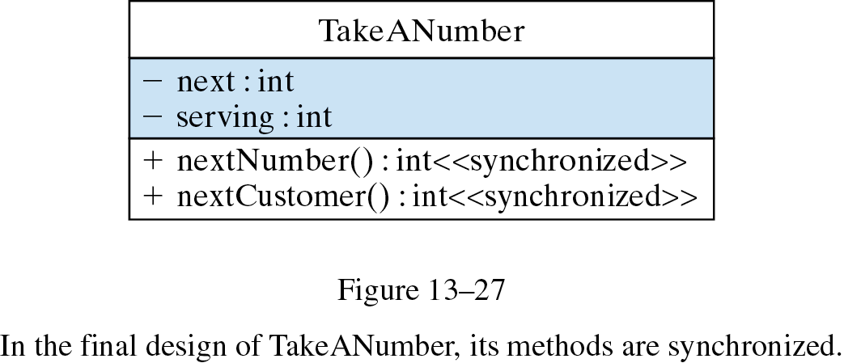
Final TakeANumber Design
These methods use wait() and notify() to coordinate clerk and customers.

Slide 53
Revised TakeANumber Class
The clerk must wait for a customer to arrive.
public synchronized int nextCustomer() {
try {
while (next <= serving) {
System.out.println(" Clerk waiting ");
wait();
}
} catch(InterruptedException e) {
System.out.println("Exception " + e.getMessage() );
} finally {
++serving;
System.out.println(" Clerk serving ticket " + serving );
return serving;
}
} // nextCustomer()
public synchronized int nextNumber(int custId) {
next = next + 1;
System.out.println( "Customer " + custId +
" takes ticket " + next );
notify();
return next;
} // nextNumber()
A customer must notify the clerk that is has arrived.

Slide 54
Revised Clerk Class
The Clerk run() method is now simplified to:
public void run() {
while (true) {
try {
sleep((int)(Math.random() * 1000));
takeANumber.nextCustomer();
} catch (InterruptedException e) {
System.out.println("Exception: " + e.getMessage() );
}
} // while
} // run()
Infinite loop.
Starting clerk and customer threads
Customer 10004 takes ticket 1
Customer 10002 takes ticket 2
Clerk serving ticket 1
Clerk serving ticket 2
Customer 10005 takes ticket 3
Customer 10003 takes ticket 4
Clerk serving ticket 3
Customer 10001 takes ticket 5
Clerk serving ticket 4
Clerk serving ticket 5
Clerk waiting
New Output
Clerk will be notified when a new customer arrives.

Slide 55
Restrictions on wait/notify Mechanism
Both wait() and notify() are methods of the Object class. This enables them to lock objects.
A wait() method can be used within any synchronized method, not just within a Thread.
Both wait() and notify() must be used within synchronized methods. Otherwise you will cause a IllegalMonitorStateException with the message “current thread not owner.”
When wait() is used within a synchronized method, the lock on that object is released, allowing other methods to call the object’s synchronized methods.

Slide 56

CASE STUDY: The Game of Pong
In Pong the user can bounce a ball within a rectangular region using a paddle that moves up and down along the right edge.

Slide 57
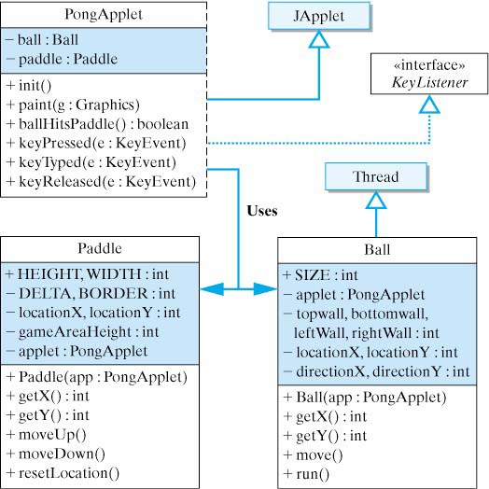
Pong Game Design
The Pong Ball will run as a separate thread.
The applet will listen for keystrokes that control the Paddle.

Slide 58
Pong Implementation
PongApplet.java
Paddle.java
Ball.java
The KeyListener Interface: whenever an up or down arrow is pressed, one of the paddle methods is called.
/**
* keyPressed() is invoked every time a KeyEvent occurs.
* It getscthe key's code and checks whether the up
* or down arrow keys were pressed. If so it moves
* the paddle.
*/
public void keyPressed( KeyEvent e) { // Check for arrow keys
int keyCode = e.getKeyCode();
if (keyCode == e.VK_UP) // Up arrow
pad.moveUp();
else if (keyCode == e.VK_DOWN) // Down arrow
pad.moveDown();
} // keyPressed()
public void keyTyped(KeyEvent e) {}
public void keyReleased( KeyEvent e) {} // Unused

Slide 59
Technical Terms
asynchronous
blocked
busy waiting
concurrent
critical section
dispatched
fetch-execute cycle
lock
monitor
multitasking
multithreaded
mutual exclusion
priority scheduling
producer/consumer model
quantum
queue
ready queue
round-robin scheduling
scheduling algorithm
thread
thread life cycle
time slicing

Slide 60
Summary Of Important Points
Multitasking is the technique of executing several tasks at the same time within a single program.
Time slicing allows several threads to share a single CPU over a given time period.
A thread can be a subclass of Thread or a class that implements Runnable. It must implement the run() method.
The sleep() method removes a thread from the CPU for a determinate time, giving other threads a chance to run.

Slide 61
Summary Of Important Points (cont)
The setPriority() method sets a thread’s priority.
Threads are asynchronous. Their timing and duration is unpredictable.

