Slide 1

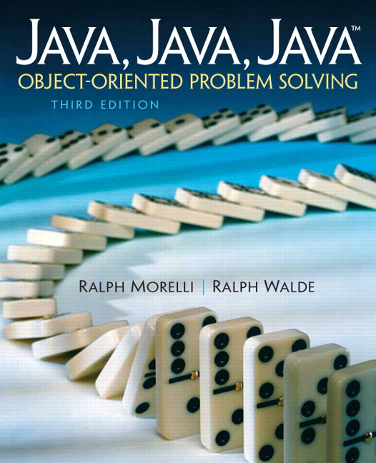
JAVA, JAVA, JAVA
presentation slides for
Object-Oriented Problem Solving
Third Edition
Ralph Morelli | Ralph Walde
Trinity College
Hartford, CT
published by Prentice Hall

Slide 2
Java, Java, Java
Object Oriented Problem Solving
Chapter 15: Sockets and Networking

Slide 3
Objectives
Understand some basic facts about networks.
Know how to use Java's URL class to download network resources from an applet or application.
Be able to design networking applications using the client/server model.
Understand how to use Java's Socket and ServerSocket classes.

Slide 4
Outline
An Overview of Networks
Using Network Resources from an Applet
From the Java Library: java.net.URL
The Slide Show Applet
Network Resources from an Application
Client/Server Communication via Sockets
Case Study: Generic Client/Server Classes
Java Network Security Restrictions
In the Laboratory: The Internet CyberPet

Slide 5
An Overview of Networks
A local area network (LAN) is usually a privately owned network located within a single office or a single organization.
A Wide Area Network (WAN) spans a wide geographical distance -- e.g, MCI or Sprint.
Its topology refers to a network’s shape.
One of Java’s strengths is the support it provides for the Internet and client/server programming.

Slide 6
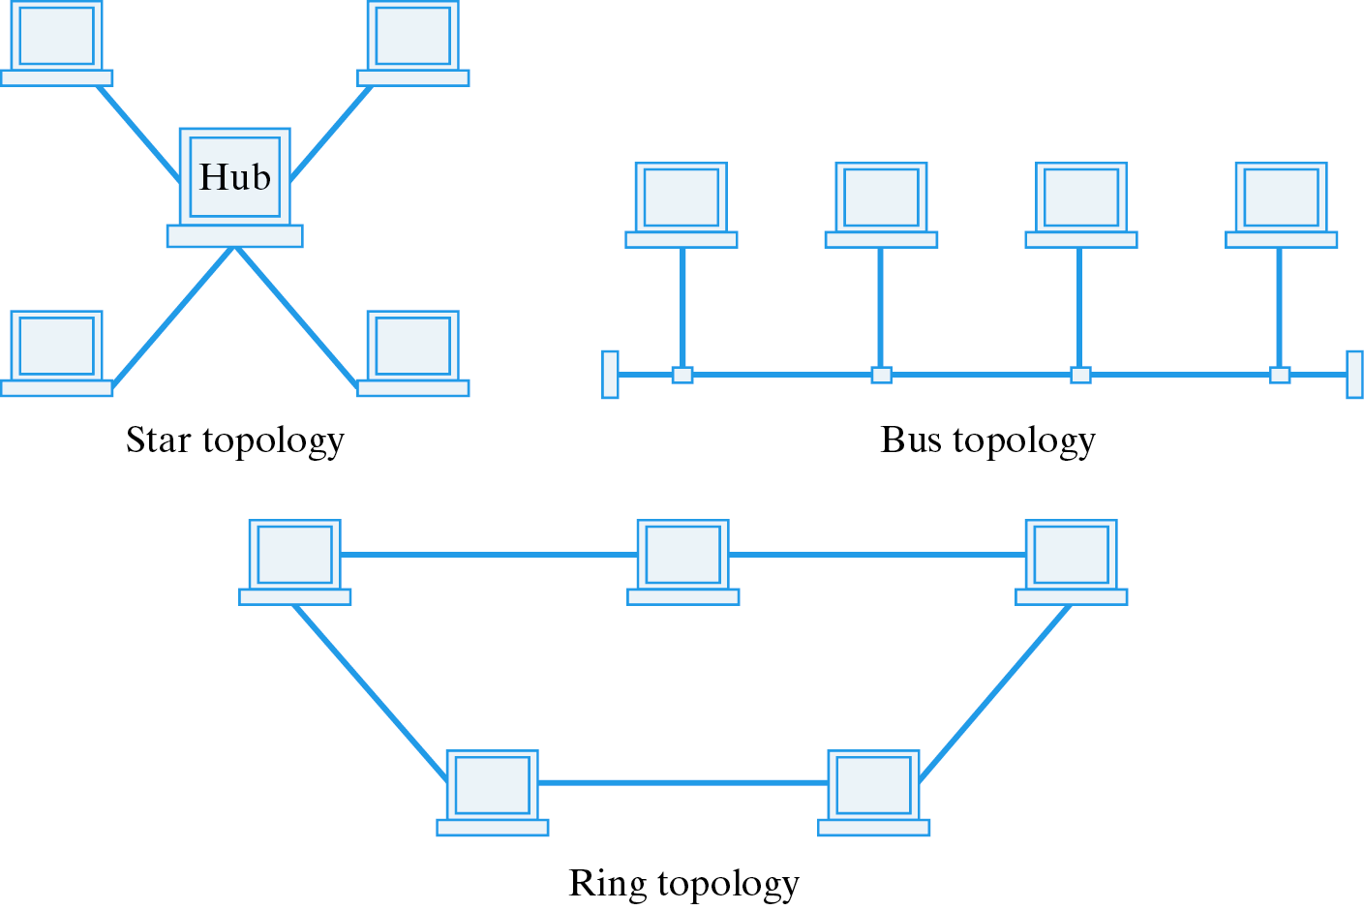
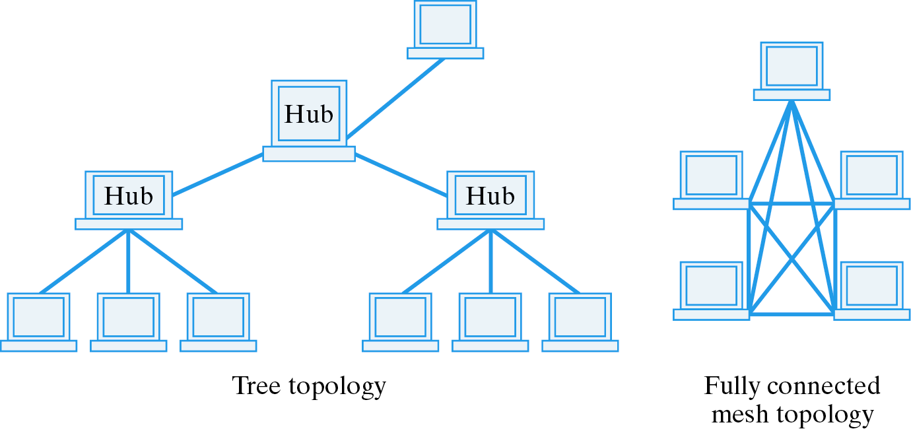
Network Topologies
Networks come in many shapes, each with different levels of connectivity.

Slide 7
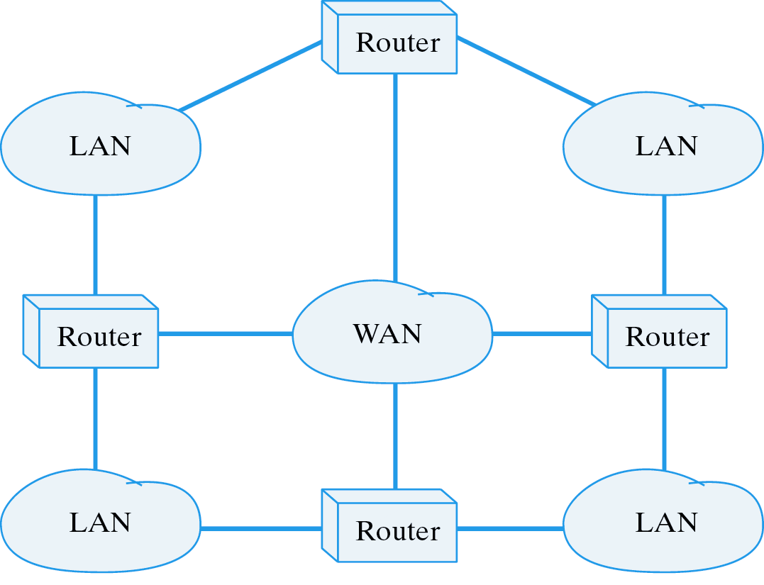
Internets
An internet is a collection of two or more distinct networks, joined by routers.
The Internet is one example.

Slide 8
Network Protocols
A protocol is a set of rules that governs the communication of information.
Examples:
  SMTP: Simple Mail Transfer Protocol
  HTTP: HyperText Transfer Protocol
  FTP: File Transfer Protocol
HTTP uses a Uniform Resource Locator (URL) to specify an address on the Internet:
METHOD://HOST/PATH
HTTP://www.prenhall.com/morelli/index.html

Slide 9
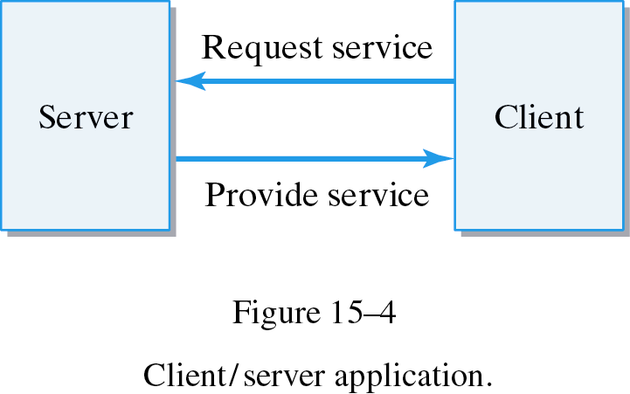
Client/Server Applications
A client/server application divides a task between two computers, client and server.
Examples: HTTP, SMTP, FTP .
Client/Server Protocol:
Server: Set up a service on a particular host computer.
Client: Contact the server and request the service.
Server: Accept a request from a client and provide the service.

Slide 10
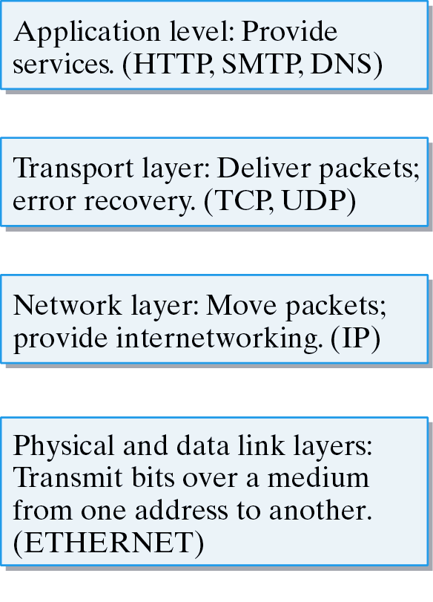
Network Protocols
A network is divided into several layers of protocols:
Application protocols.
Low-level transmission protocols.

Slide 11
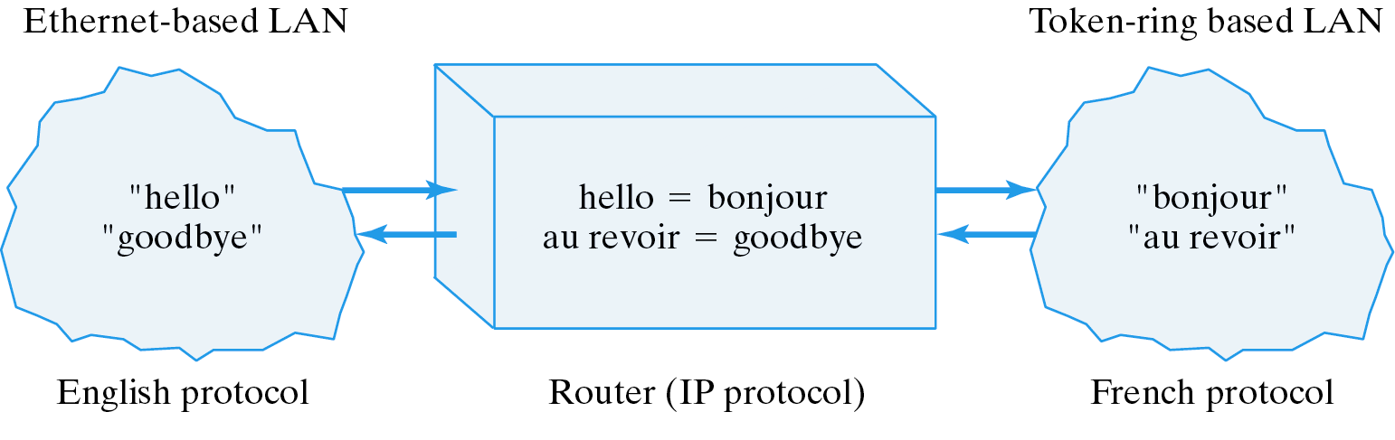
The IP Protocol
The Internetworking Protocol (IP) translates between one network protocol and another.
IP makes internetworking possible:

Slide 12
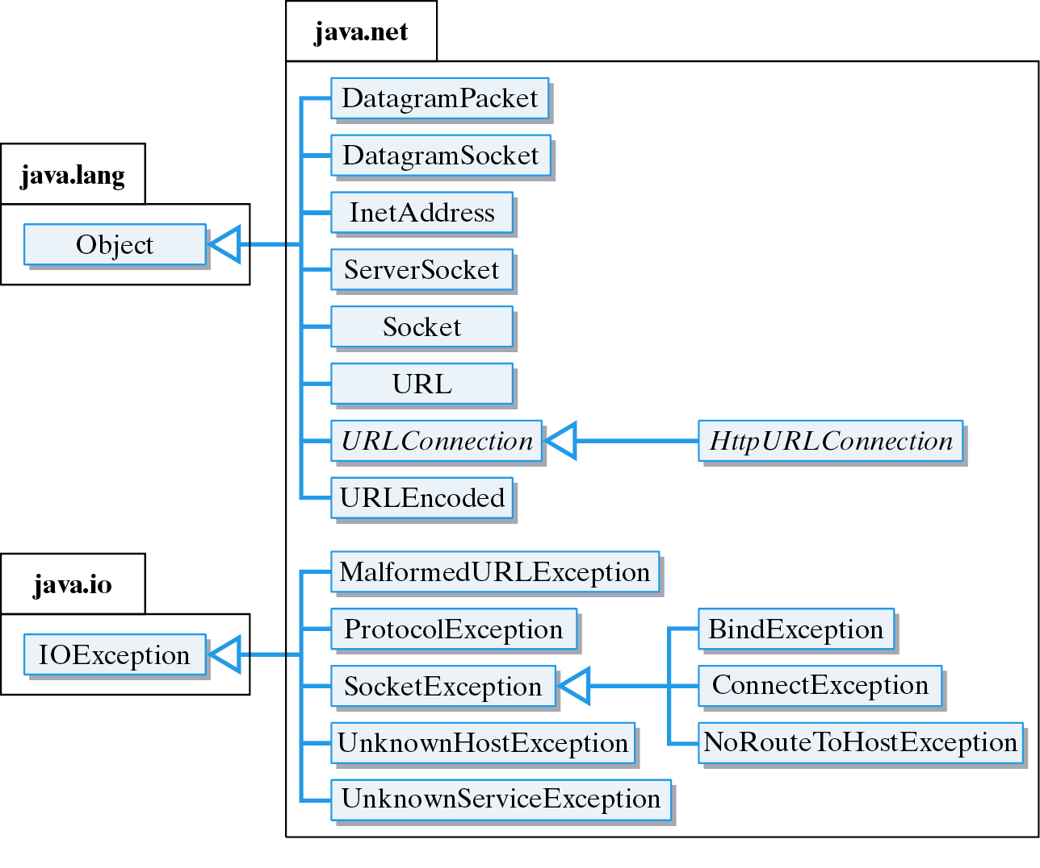
The java.net Package

Slide 13
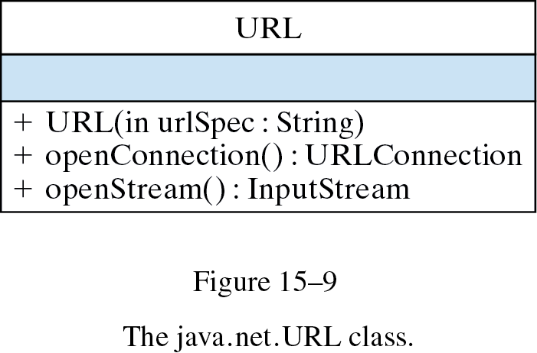
From the Java Library: java.net.URL
Methods for connecting to a Web site:
Example:
URL of resource.
URL url;
try {
url = new URL("http://www.prenhall.com:80/morelli/index.html");
} catch (MalformedURLException e) {
System.out.println("Malformed URL: " + url.toString()) ;
}

Slide 14
Code Reuse: java.applet.Applet
Methods for downloading resources:
public class Applet extends Panel {
public AppletContext getAppletContext();
public AudioClip getAudioClip(URL url);
public Image getImage(URL url);
public void play(URL url);
public void showStatus(String msg);
}
Download and play a sound.
Download and store an image.
URL url;
try {
url = new URL("http://www.prenhall.com/morelli/sounds/sound.au");
play(url);
url = new URL("http://www.prenhall.com/morelli/gifs/demo.gif") ;
imgRef = getImage(url);
} catch (MalformedURLException e) {
System.out.println("Malformed URL: " + url.toString()) ;
}

Slide 15
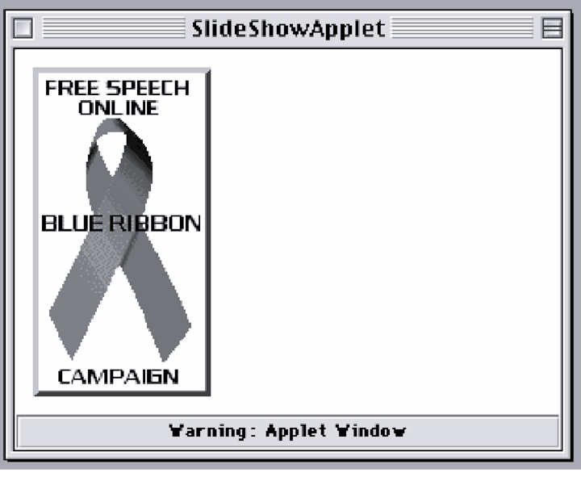
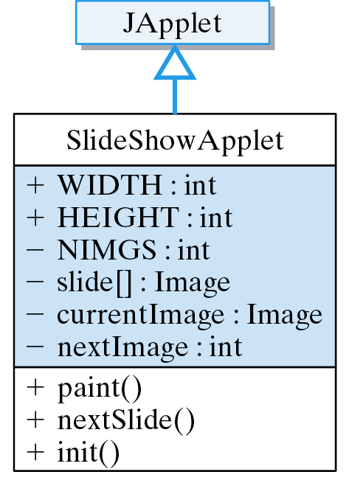
SlideShowApplet
Task: Download slides from a Web site.
Basic Algorithm: Repeat
  Generate the URL for the next slide.
  Use the URL to download the image or document.
  Display the image or document.

Slide 16
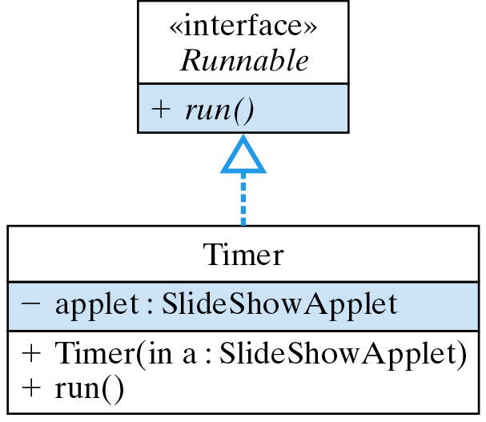
SlideShowApplet: Decomposition
The applet serves as a user interface. It downloads and displays slides.
The Timer thread times slide changes.
Uses

Slide 17
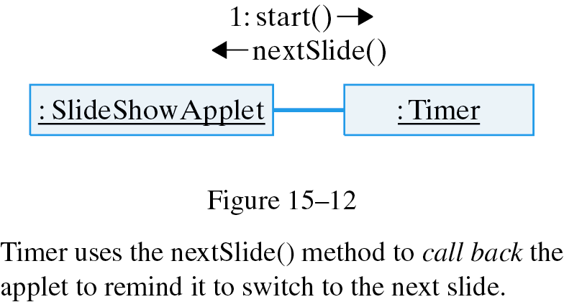
Slide ShowApplet: Design
User Interface Design: Painting Images
public void paint(Graphics g) {
if (currentImage != null)
g.drawImage(currentImage, 10, 10, this);
}
Algorithm: Reduce network traffic by downloading images once into an array.
Callback method: nextSlide() called repeatedly by the timer.

Slide 18
The Slide Show Applet (cont)
Storing the Images:
private static final int NIMGS = 3;
private Image[] slide = new Image[NIMGS];
private Image currentImage = null;
private int nextImg = 0;
Displaying the images:
public void paint(Graphics g) {
g.setColor(getBackground());
g.fillRect(0, 0, WIDTH, HEIGHT);
if (currentImage != null)
g.drawImage(currentImage, 10, 10, this);
} //paint()
public void nextSlide() {
currentImage = slide[nextImg];
nextImg = (nextImg + 1) % NIMGS;
repaint();
} // nextSlide()
Design: Callback method called by timer thread.

Slide 19
SlideShowApplet.init() Method
Download the images and start the timer.
Construct the URLs, demo0.gif, demo1.gif, ...
public void init() {
URL url = null;
try {
for (int k=0; k < NIMGS; k++) {
url = new URL("http://www.prenhall.com/morelli/gifs/demo"
+ k + ".gif") ;
slide[k ] = getImage( url );
}
} catch (MalformedURLException e) {
System.out.println("ERROR: Malformed URL: " + url.toString() );
}
Thread timer = new Thread(new Timer(this));
timer.start();
setSize( WIDTH, HEIGHT );
} // init()
Timer thread.

Slide 20
The Timer Class: Implementation
public class Timer implements Runnable {
private SlideShowApplet applet;
public Timer( SlideShowApplet app ) {
applet = app;
}
public void run() {
try {
while ( true ) {
applet.nextSlide();
Thread.sleep(5000);
}
} catch (InterruptedException e) {
System.out.println(e.getMessage());
}
} // run()
} // Timer
Needs a reference to the applet.
Repeatedly ask for the next slide.

Slide 21
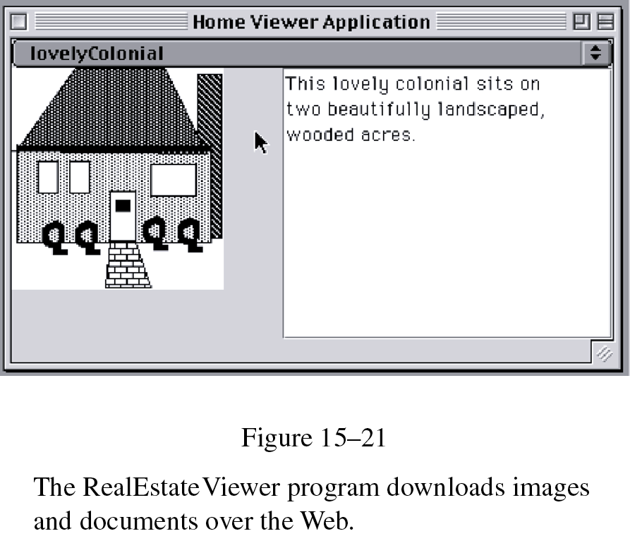
The RealEstateViewer Application
Applets have limited use over networks because of security constraints.
Goal: An application that uses text and images from an online real estate database.

Slide 22
Downloading a Text File from the Web
Downloading a file uses an input stream:
URL url;
InputStream data;
try {
url = new URL(fileURL); // Create a URL
data = url.openStream(); // Open a stream to the URL
// READ THE FILE INTO MEMORY // Read the data
data.close(); // Close the stream
} catch (MalformedURLException e) { // May be thrown by URL()
System.out.println(e.getMessage());
} catch( IOException e ) { // May be thrown by read or close
System.out.println(e.getMessage());
}

Slide 23
Reading the Data
Just like reading from a data file:
private void readTextIntoDisplay(URL url) throws IOException {
BufferedReader data
= new BufferedReader(new
InputStreamReader(url.openStream()));
display.setText(""); // Reset the text area
String line = data.readLine();
while (line != null) { // Read each line
display.append(line + "\n"); // And add it to the display
line = data.readLine();
}
data.close();
} // readTextIntoDisplay()
BufferedReader.readLine()
returns null at end-of-file.

Slide 24
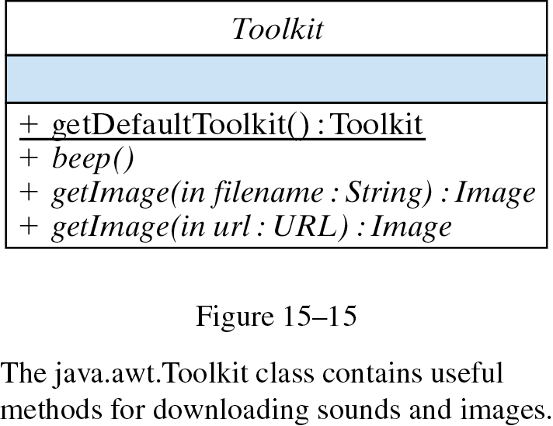
Code Reuse: The java.awt.Toolkit Class
Use java.awt.Toolkit to download images:
Example:
Method composition.
Image currentImage = Toolkit.getDefaultToolkit().getImage(url);

Slide 25
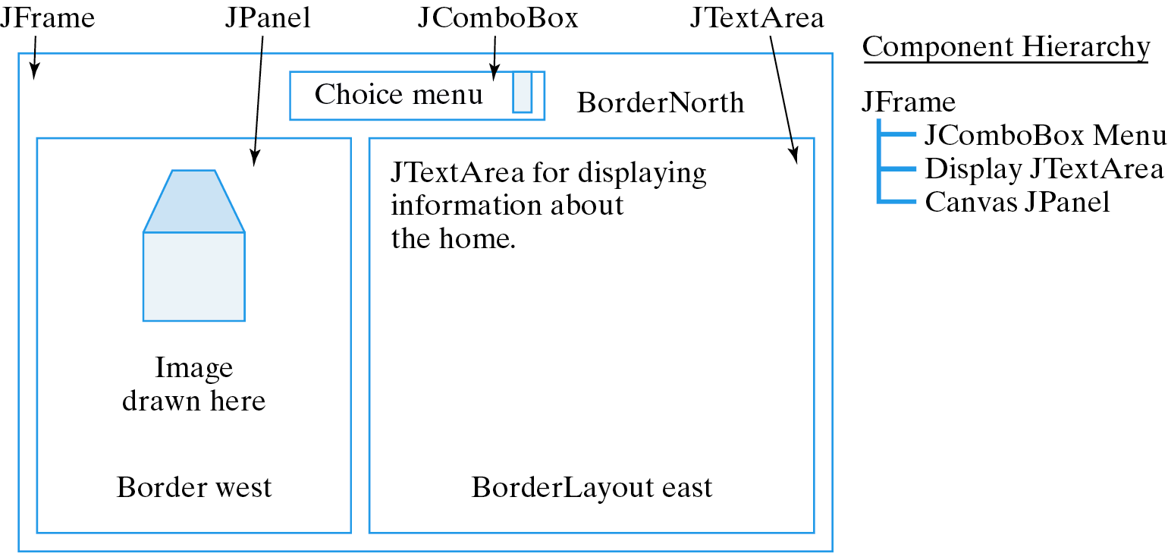
RealEstateViewer: GUI Design

Slide 26
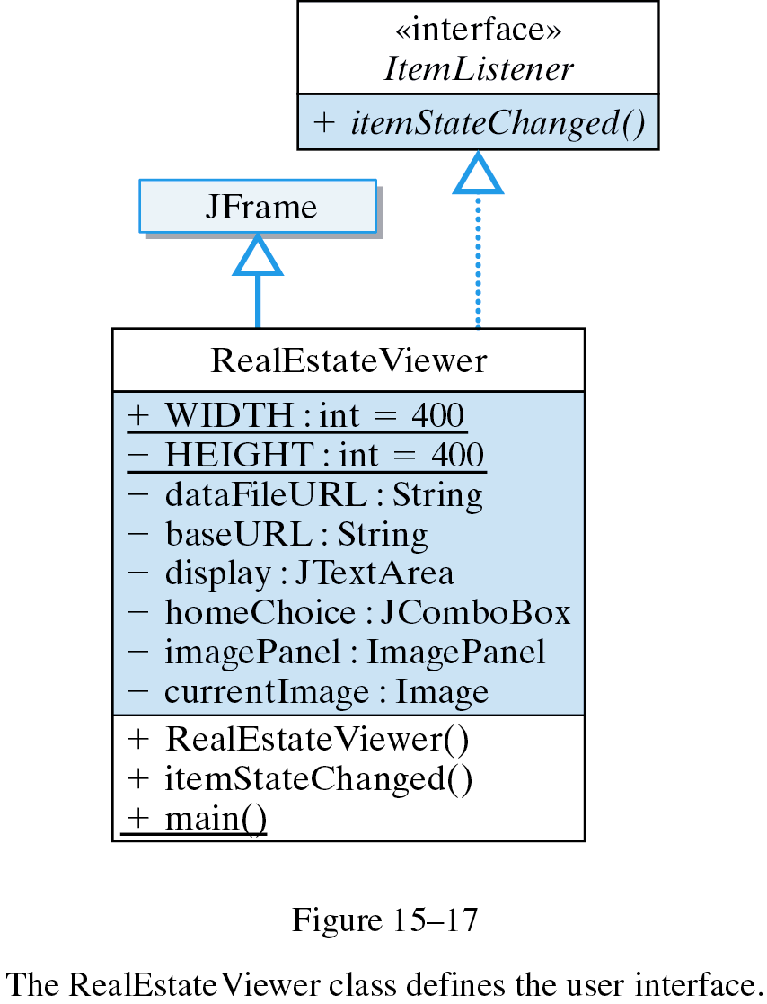
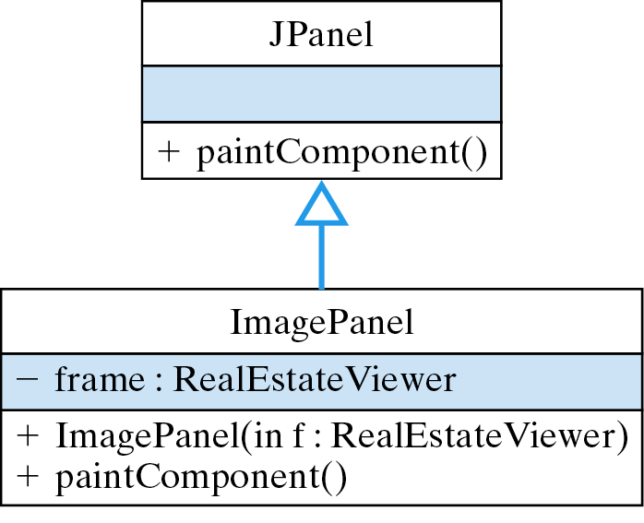
RealEstateViewer : Classes
Uses

Slide 27
RealEstateViewer : Implementation
public class RealEstateViewer extends JFrame implements ItemListener {
public static final int WIDTH=400,HEIGHT=200;
private final String dataFileURL =
"http://www.prenhall.com/morelli/homes/homes.txt";
private final String baseURL =
"http:// www.prenhall.com/morelli/homes/";
private JTextArea display = new JTextArea(20,20);
private JComboBox homeChoice = new JComboBox();
private ImagePanel imagePanel = new ImagePanel(this);
public Image currentImage = null;
public RealEstateViewer () {} // Constructor
public void itemStateChanged( ItemEvent evt ) { } // ItemListener
public static void main(String args[]) {
RealEstateViewer viewer = new RealEstateViewer();
viewer.setSize(viewer.WIDTH,viewer.HEIGHT);
viewer.setVisible(true);
viewer.addWindowListener(new WindowAdapter() { // Quit
public void windowClosing(WindowEvent e) {
System.exit(0);
}
});
} // main()
} // RealEstateViewer
Displays the image.
import java.awt.*;
import java.awt.event.*;
import java.net.*;
import java.io.*;
import javax.swing.*;

Slide 28
The ImagePanel Class
The ImagePanel handles the drawing.
Reference to top-level window.
import javax.swing.*;
import java.awt.*;
public class ImagePanel extends JPanel {
private RealEstateViewer frame;
public ImagePanel(RealEstateViewer parent) {
frame = parent;
}
public void paintComponent(Graphics g) {
if (frame.currentImage != null)
g.drawImage(frame.currentImage, 0, 0, this);
}
} // ImagePanel
Display the current image.

Slide 29
Method Design
Constructor Method:
public RealEstateViewer () {
super("Home Viewer Application"); // Set the window title
homeChoice.addItemListener( this);
this.getContentPane().add("North",homeChoice);
this.getContentPane().add("East",display);
this.getContentPane().add("Center",imagePanel);
display.setLineWrap(true);
initHomeChoices(); // Set up the choice box
showCurrentSelection(); // Display the current home
}
Handling Menu Selections:
public void itemStateChanged(ItemEvent evt) {
showCurrentSelection();
}

Slide 30
Downloading the Menu Items
Menu choices downloaded from data file.
private void initHomeChoices() {
try {
URL url = new URL(dataFileURL);
BufferedReader data = new BufferedReader(new
InputStreamReader(url.openStream()));
String line = data.readLine();
while (line != null) {
homeChoice.addItem(line);
line = data.readLine();
}
data.close();
} catch (MalformedURLException e) {
System.out.println( "ERROR: " + e.getMessage()) ;
} catch (IOException e) {
System.out.println( "ERROR: " + e.getMessage()) ;
}
} // initHomeChoices()
The file’s URL.
Add to choice box.

Slide 31
Downloading Home Information
Get user’s menu choice and download.
private void showCurrentSelection() {
URL url = null;
String choice = homeChoice.getSelectedItem().toString(); // Get choice
try {
url = new URL(baseURL + choice + ".txt") ; // Create url
readTextIntoDisplay(url); // Download and display text file
url = new URL(baseURL + choice + ".gif"); // Download image
currentImage = Toolkit.getDefaultToolkit().getImage(url);
Toolkit.getDefaultToolkit().beep(); // Alert the user
repaint();
} catch (MalformedURLException e) {
System.out.println( "ERROR: " + e.getMessage()) ;
} catch (IOException e) {
System.out.println("ERROR: " + e.getMessage()) ;
}
} // showCurrentSelection()
Use the Toolkit.

Slide 32
Home Viewer

Slide 33
Reusing Code
Object Oriented Design: Reuse existing methods and classes.
Effective Design: Before writing code to perform a particular task, search the available libraries to see if there is already code that performs that task.

Slide 34
Client/Server Communication via Sockets
A socket is a two-way communication channel.
A server program creates a socket at a certain port and waits for a client to request a connection.
Client-server communication is based on a well-defined protocol.
Example: A Web server uses port 80 and the HTTP Protocol.

Slide 35
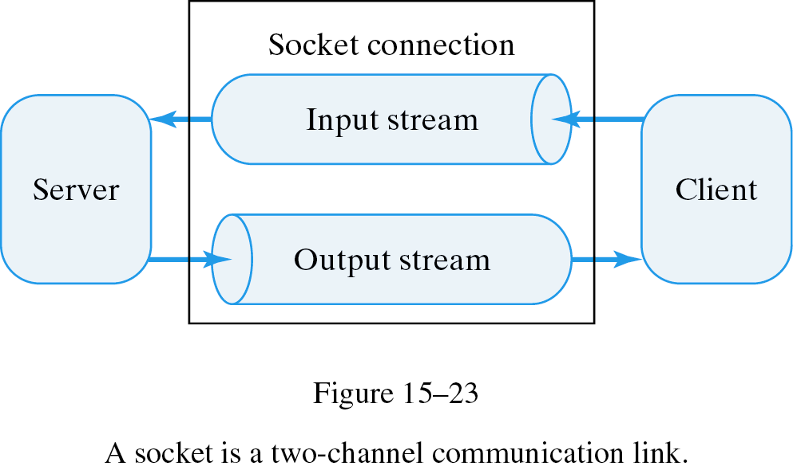
Socket Streams
Each socket has two streams, one for input and one for output.
Analogy: two-way phone call.
  Server: Waits for phone to ring then begins service.
  Client: Dials the service phone number (URL), makes a connection to it and requests service.

Slide 36
Basic Server Protocol
Pseudocode:
Java:
1. Create a SocketServer and port number.
2. Listen for and accept a connection from a client.
3. Converse with the client.
4. Close the socket.
Socket socket; // Reference to the socket
ServerSocket port; // The port where the server will listen
try {
port = new ServerSocket(10001, 5); // Create a port
socket = port.accept(); // Wait for client call
// Communicate with the client
socket.close();
} catch (IOException e) {
e.printStackTrace();
}

Slide 37
Basic Client Protocol
Pseudocode:
Java:
1. Open a socket connection to the server, given its address.
2. Converse with the server.
3. Close the connection.
Socket connection; // Reference to the socket
try {
connection = new Socket(”java.cs.trincoll.edu", 10001);// Connect
// Carry on a two-way communication
connection.close(); // Close the socket
} catch (IOException e ) {
e.printStackTrace();
}

Slide 38
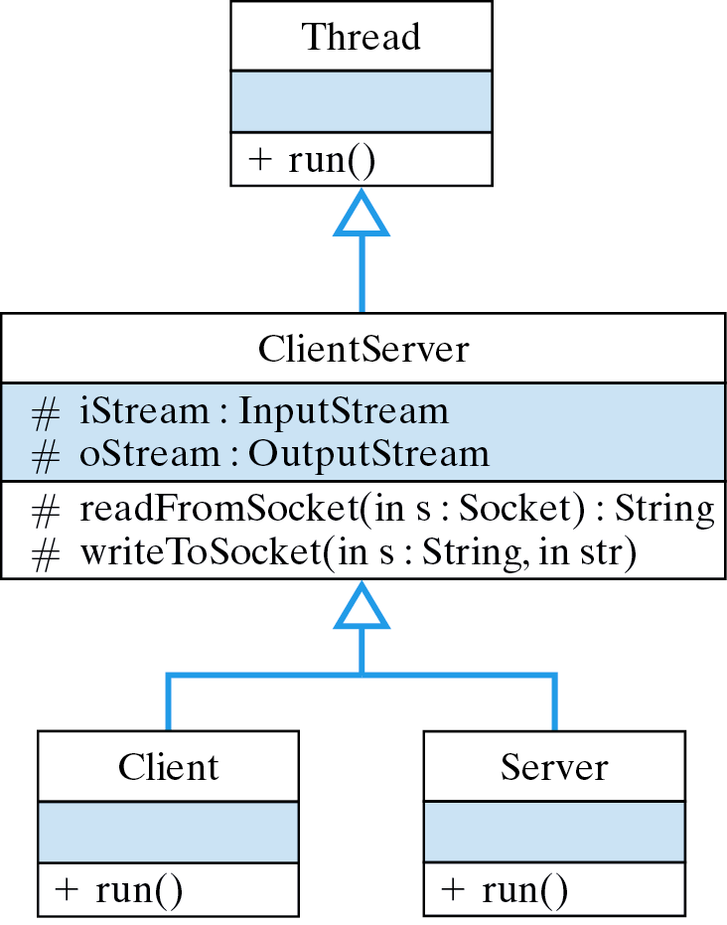
Client/Server Design
Both client and server are threads that share I/O methods.

Slide 39
The writeToSocket() Method
A method to write a string to a socket:
protected void writeToSocket(Socket sock, String str)
throws IOException
{
oStream = sock.getOutputStream();
for (int k = 0; k < str.length() ; k++)
oStream.write(str.charAt(k));
} // writeToSocket()
Get the output stream.
Write each byte.
A socket automatically creates its own streams.
Don’t close the socket stream after an I/O operation unless you are done with the socket.

Slide 40
The readFromSocket() Method
A method to read from a socket:
protected String readFromSocket(Socket sock) throws IOException {
iStream = sock.getInputStream();
String str="";
char c;
while ( ( c = (char) iStream.read() ) != '\n')
str = str + c + "";
return str;
}
Get the input stream.
Read each byte and convert to char.
Protocol Design: If the client writes bytes, the server must read bytes, and vice versa.

Slide 41
Case Study: A Generic Client/Server
Problem Statement: Design generic client/server classes that can be used for a wide variety of services.
Use inheritance and polymorphism to design methods that can be used by a variety of subclasses.
Communication will take place using strings, as in the previous examples.

Slide 42
Test Case: An Echo Service
Test Case: An echo service.
Client
Side:
CLIENT: connected to 'troy.cs.trincoll.edu'
SERVER: Hello, how may I help you?
CLIENT: type a line or 'goodbye' to quit
INPUT: hello
SERVER: You said 'hello'
INPUT: this is fun
SERVER: You said 'this is fun'
INPUT: goodbye
SERVER: Goodbye
CLIENT: connection closed
Keyboard input.
Server
Side:
Echo server at troy.cs.trincoll.edu/157.252.16.21 waiting for connections
Accepted a connection from troy.cs.trincoll.edu/157.252.16.21
Closed the connection
Accepted a connection from troy.cs.trincoll.edu/157.252.16.21
Closed the connection

Slide 43
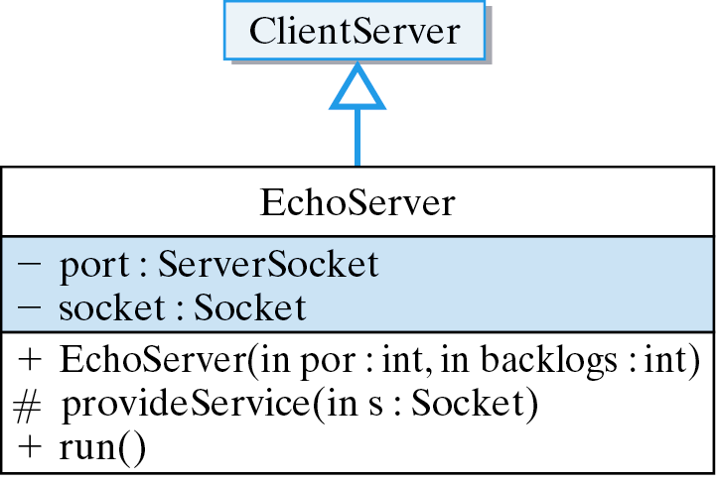
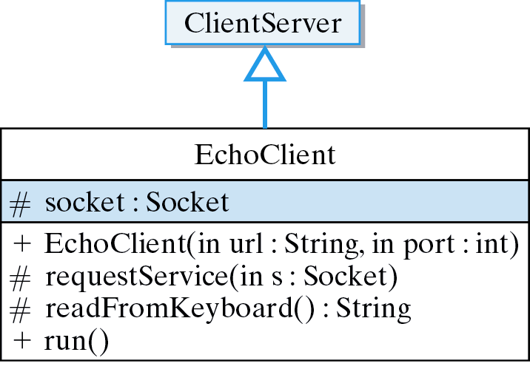
Design: EchoServer and EchoClient
Provides the specific service.
Requests a specific service.

Slide 44
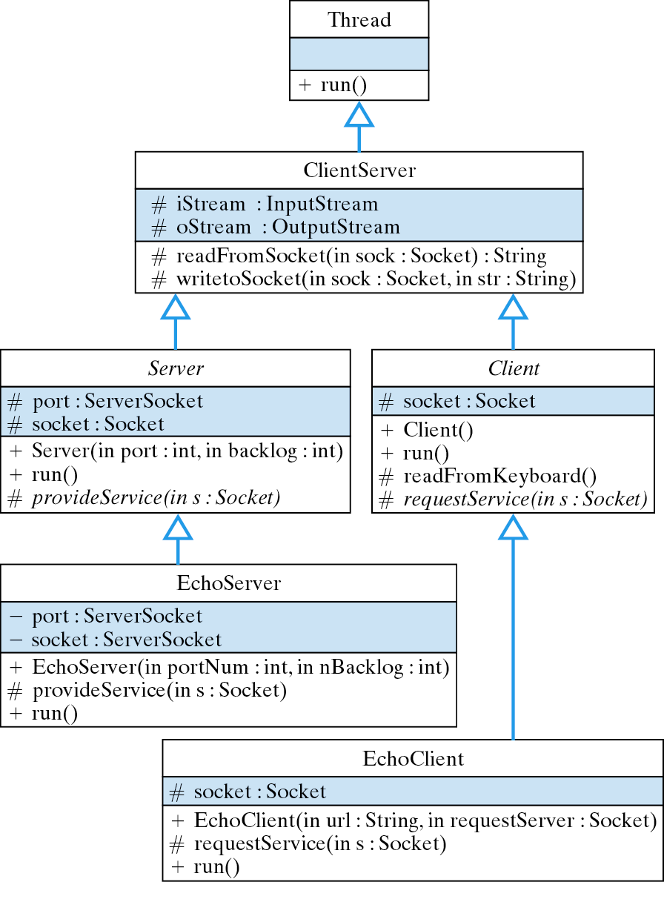
Problem Decomposition
Object Oriented Design:
Shared methods go here.
Basic client/server protocol defined here.
Specific echo service defined here.

Slide 45
Development Strategy
Initial Design
We will generalize EchoServer and EchoClient to produce Server and Client.
ClientServer
EchoServer
EchoClient
Final Design
ClientServer
Abstraction
Server
Client
EchoServer
EchoClient

Slide 46
The ClientServer Superclass
import java.io.*;
import java.net.*;
public class ClientServer extends Thread {
protected InputStream iStream; // Inheritable variables
protected OutputStream oStream;
protected String readFromSocket(Socket sock) throws IOException {
iStream = sock.getInputStream();
String str="";
char c;
while ( ( c = (char) iStream.read() ) != '\n')
str = str + c + "";
return str;
} // readFromSocket()
protected void writeToSocket(Socket sock, String str)
throws IOException {
oStream = sock.getOutputStream();
if (str.charAt( str.length() - 1 ) != '\n')
str = str + '\n';
for (int k = 0; k < str.length() ; k++)
oStream.write(str.charAt(k));
} // writeToSocket()
} // ClientServer
A Thread subclass.
Shared methods.

Slide 47
The EchoServer Class
Extends ClientServer
import java.net.*;
import java.io.*;
public class EchoServer extends ClientServer {
private ServerSocket port;
private Socket socket;
public EchoServer(int portNum, int nBacklog) {
try {
port = new ServerSocket (portNum, nBacklog);
} catch (IOException e) {
e.printStackTrace();
}
}
public void run() { } // Stub method
} // EchoServer
Catch IOException.
To be completed.

Slide 48
The EchoServer.run() Method
Infinite loop.
public void run() {
try {
System.out.println("Echo server at " +
InetAddress.getLocalHost() + " waiting for connections ");
while(true) {
socket = port.accept();
System.out.println("Accepted a connection from " +
socket.getInetAddress());
provideService(socket);
socket.close();
System.out.println("Closed the connection\n");
}
} catch (IOException e) {
e.printStackTrace();
}
} // run()
Accept connection.
Provide some service.

Slide 49
The provideService() Method
Defines the echo protocol.
Inherited from ClientServer.
protected void provideService (Socket socket) {
String str="";
try {
writeToSocket(socket, "Hello, how may I help you?\n");
do {
str = readFromSocket(socket);
if (str.toLowerCase().equals("goodbye"))
writeToSocket(socket, "Goodbye\n");
else
writeToSocket( socket, "You said '" + str + "'\n");
} while (!str.toLowerCase().equals("goodbye"));
} catch (IOException e) {
e.printStackTrace();
}
} // provideService()
Lowercase reduces errors.
Protocol Design: service stops when client says “goodbye”

Slide 50
The EchoClient Class
import java.net.*;
import java.io.*;
public class EchoClient extends ClientServer {
protected Socket socket;
public EchoClient(String url, int port) {
try {
socket = new Socket(url, port);
System.out.println("CLIENT: connected to " + url +
":" + port);
} catch (Exception e) {
e.printStackTrace();
System.exit(1);
}
} // EchoClient()
public void run() { } // Stub method
} // EchoClient
Extends ClientServer.
To be completed.

Slide 51
The EchoClient.run() Method
The client requests the echo service.
Service request.
public void run() {
try {
requestService(socket);
socket.close();
System.out.println("CLIENT: connection closed");
} catch (IOException e) {
System.out.println(e.getMessage());
e.printStackTrace();
}
} // run()

Slide 52
The requestService() Method
Defines the echo protocol.
protected void requestService(Socket socket) throws IOException {
String servStr = readFromSocket(socket); // Check for "Hello"
System.out.println("SERVER: " + servStr); // Report server’s response
System.out.println("CLIENT: type a line or 'goodbye' to quit"); // Prompt
if (servStr.substring(0,5).equals("Hello")) {
String userStr = "";
b {
userStr = readFromKeyboard(); // Get input from user
writeToSocket(socket, userStr + "\n"); // Send it to server
servStr = readFromSocket(socket); // Read response
System.out.println("SERVER: " + servStr); // Report response
} while (!userStr.toLowerCase().equals("goodbye")); // Until goodbye
}
} // requestService()
Utility method.

Slide 53
Testing the Echo Service
Server’s Computer:
public static void main(String args[]) {
EchoServer server = new EchoServer(10001, 3);
server.start();
} // main()
public static void main(String args[]) {
EchoClient client = new
EchoClient(”java.cs.trincoll.edu",10001);
client.start();
} // main()
Client’s Computer:
CLIENT: connected to java.cs.trincoll.edu:10001
SERVER: Hello, how may I help you?
CLIENT: type a line or 'goodbye' to quit
INPUT: this is a test
SERVER: You said 'this is a test'
INPUT: goodbye
SERVER: Goodbye
CLIENT: connection closed
Client’s
Session:

Slide 54
Abstracting the Generic Server
Polymorphism. We define provideService() as an abstract method within a superclass.
import java.net.*;
import java.io.*;
public abstract class Server extends ClientServer {
protected ServerSocket port;
protected Socket socket;
public Server(int portNum, int nBacklog) {} // Stub
public void run() { } // Stub
protected abstract void provideService(Socket socket);
} // Server
Implemented in subclass.
The constructor and run() methods are the same as in the original EchoServer class.

Slide 55
The Revised EchoServer
Polymorphism: provideService() is implemented differently for different services.
import java.net.*; import java.io.*;
public class EchoServer extends Server {
public EchoServer( int port, int backlog) {
super(port,backlog);
}
protected void provideService (Socket socket) {
String str="";
try {
writeToSocket(socket, "Hello, how may I help you?\n");
do {
str = readFromSocket(socket);
if (str.toLowerCase().equals("goodbye"))
writeToSocket(socket, "Goodbye\n");
else
writeToSocket(socket, "You said '" + str + "'\n");
} while (!str.toLowerCase().equals("goodbye"));
} catch (IOException e) {
e.printStackTrace();
}
} // provideService()
public static void main(String args[]) {
EchoServer server = new EchoServer(10001,5);
server.start();
} // main()
} // EchoServer

Slide 56
Abstracting the Generic Client
Polymorphism. We define requestService() as an abstract method within a superclass.
import java.net.*;
import java.io.*;
public abstract class Client extends ClientServer {
protected Socket socket;
public Client(String url, int port) { } // Stub
public void run() { } // Stub
protected abstract void requestService(Socket socket)
throws IOException;
} // Client
Implemented in subclass.
The constructor and run() methods are the same as in the original EchoClient class.

Slide 57
The Revised EchoClient
requestService() is polymorphic.
import java.net.*; import java.io.*;
public class EchoClient extends Client {
public EchoClient( String url, int port ) {
super(url,port);
}
protected void requestService(Socket socket) throws IOException {
String servStr = readFromSocket(socket); // Check FOR "Hello"
System.out.println("SERVER: " + servStr); // Report server's response
System.out.println("CLIENT: type a line or 'goodbye' to quit"); // Prompt
if ( servStr.substring(0,5).equals("Hello") ) {
String userStr = "";
do {
userStr = readFromKeyboard(); // Get input from user
writeToSocket(socket, userStr + "\n"); // Send it to server
servStr = readFromSocket(socket); // Read server's response
System.out.println("SERVER: " + servStr); // Report response
} while(!userStr.toLowerCase().equals("goodbye")); // Until goodbye
}
} // requestService()
public static void main(String args[]) {
EchoClient client = new EchoClient(”java.cs.trincoll.edu", 10001);
client.start();
} // main()
} // EchoClient

Slide 58
Effective Design
Inheritance. By placing client/server functionality into generic superclasses, you can simplify the creation of new services.
Polymorphism. New services are created by implementing polymorphic methods -- requestService() and provideService().
Other polymorphic methods: requestService() and provideService() are similar to Applet.init() and Applet.paint() methods.

Slide 59
Java Network Security Restrictions
Trusted Code: Located in certain files.
Bytecode Verification: Java checks any untrusted code it receives.
Sandbox Model: Java limits the capabilities of applets.
Example: An applet can only make socket connections to its home server.
Untrusted code:
  Limited use of system, thread and AWT methods.

Slide 60
Technical Terms
busy waiting
callback method
client
client/server protocols
domain name
ethernet protocol
HyperText Transfer Protocol (HTTP)
internet
Internet
internetworking protocol (IP)
packet
port
protocol
router
sandbox security model
server
socket
trusted code
Uniform Resource Locator (URL)
World Wide Web (WWW)

Slide 61
Summary Of Important Points
An internet is a collection of two or more distinct networks joined by routers, which translate one network's language to the other's. The Internet uses the Internet Protocol (IP) as the translation medium.
A protocol is a set of rules that control the transfer of information between two computers in a network. ( HyperText Transfer Protocol (HTTP), Simple Mail Transfer Protocol (SMTP), File Transfer Protocol (FTP).

Slide 62
Summary Of Important Points (cont)
A client/server application divides its task between a client, which requests service, and a server, which provides service.
Lower-level protocols, such as the ethernet protocol and token ring protocol, govern the transmission of data between computers on a single network.
A Uniform Resource Locator (URL) is standard way of specifying addresses on the Internet.

Slide 63
Summary Of Important Points (cont)
Files of text or data (images, audio files) on the Internet or Web can be downloaded using InputStreams and OutputStreams.
The java.awt.Toolkit contains methods for downloading images into an application.
A socket is a two-way communication channel between two running programs on a network.
The java.net.Socket class is used to set up sockets for client/server applications.

