Slide 1

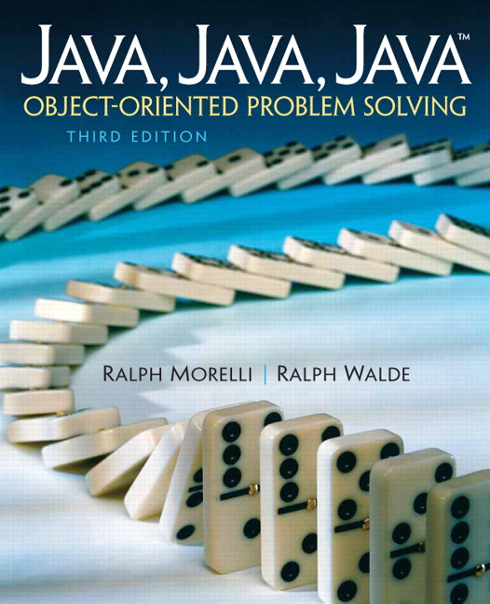
JAVA, JAVA, JAVA
presentation slides for
Object-Oriented Problem Solving
Third Edition
Ralph Morelli | Ralph Walde
Trinity College
Hartford, CT
published by Prentice Hall

Slide 2
Java, Java, Java
Object Oriented Problem Solving
Chapter 16: Data Structures: Lists, Stacks, and Queues

Slide 3
Objectives
Understand the concepts of a dynamic data structure and an Abstract Data Type (ADT).
Be able to create and use dynamic data structures such as linked lists and binary search trees.
Understand the stack, queue, set, and map ADTs.
Be able to use inheritance to define extensible data structures.
Know how to use the TreeSet, TreeMap, HashSet, and HashMap library classes.
Be able to use the Java generic type construct.

Slide 4
Outline
The Linked List Data Structure
Object-Oriented Design: The List Abstract Data Type (ADT)
The Stack ADT
The Queue ADT
From the Java Library: The Java Collections Framework and Generic Types
Using the Set and Map interfaces
The Binary Search Tree Data Structure

Slide 5
The Linked List Data Structure
A dynamic data structure is one that can grow or shrink. A linked list is an example.
A static data structure is one whose size is fixed during a program’s execution.
A self-referential object is one that contains a reference to an object of the same type.
A linked list is a list in which a collection of nodes are linked together by references from one node to the next.
The nodes of a linked list are self-referential.

Slide 6
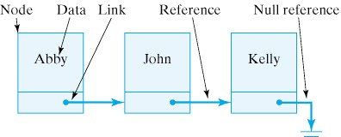
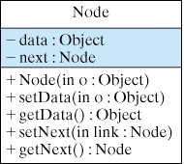
A Node Class
Each node stores some data and a reference (or link) to another node.
A linked list is terminated with a null reference.

Slide 7
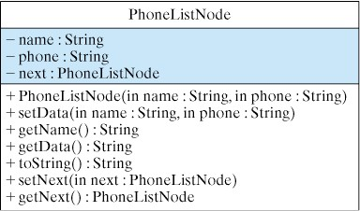
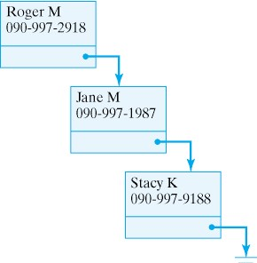
Example: The Dynamic Phone List
• The definition of a PhoneListNode is a specialization of the generic node definition.
Data in each node is a name and a phone number.

Slide 8
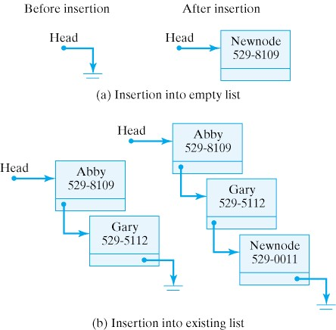
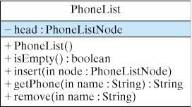
Manipulating the Phone List
• PhoneList object contains PhoneListNode reference.
• This example inserts new node at the end of the list.

Slide 9
Inserting Nodes into a List
If list is empty set head to newNode.
Else traverse list and insert newNode at end.
public void insert(PhoneListNode newNode){
if (isEmpty())
head = newNode; // Insert at head of list
else {
PhoneListNode current = head; // Start traversal at head
while (current.getNext() != null) // While not the last node
current = current.getNext(); // go to next node.
current .setnext(newNode); // Do the insertion
} // else
} // insert()

Slide 10
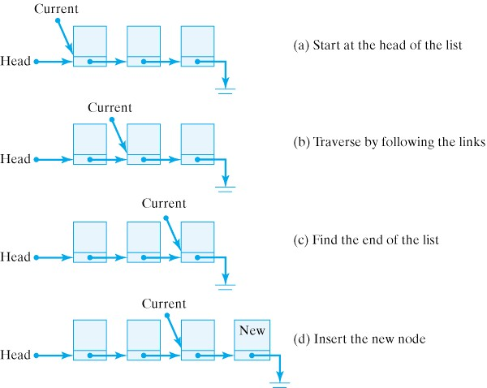
Traversing a List to Find its End

Slide 11
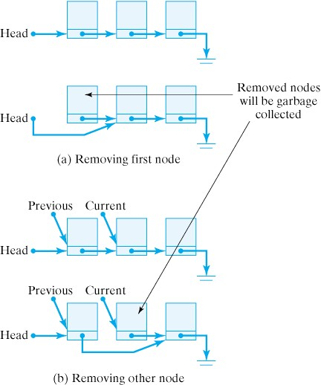
Removing a Node from a List

Slide 12
Java Code for Removing a Node
public String remove(String name) { // Remove an entry by name
if (isEmpty()) // Case 1: empty list
return "Phone list is empty";
PhoneListNode current = head;
PhoneListNode previous = null;
if (current.getName().equals(name)) { // Case 2: remove first node
head = current.getNext();
return "Removed " + current.toString() ;
}// if
while((current.getNext()!= null)&&(!current.getName().equals(name))){
previous = current;
current = current.getNext();
}// while
if (current.getName().equals(name)) { // Case 3: remove named node
previous.setNext(current.getNext());
return "Removed " + current.toString();
} else
return ("Sorry. No entry for " + name); // Case 4: node not found
} // remove()

Slide 13
OOD: The List Abstract Data Type(ADT)
An Abstract Data Type (ADT) involves two components: the data being stored and manipulated and the methods and operations that can be performed on the data.
A List ADT is similar to the Phone List except that it can be used to store and manipulated any kind of data.
An ADT should hide implementation details and provide a collection of public methods as its interface with users.

Slide 14
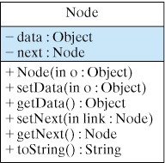
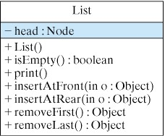
The List ADT Node and List Classes
Access methods use any kind of Objects
The List class has methods for inserting or removing from either end of the List

Slide 15
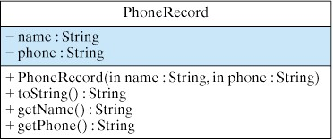
A PhoneRecord Class
This class will be used to test the List ADT
It has the same data as PhoneListNode.
public class PhoneRecord {
private String name;
private String phone;
public PhoneRecord(String s1,String s2){
name = s1;
phone = s2;
}// PhoneRecord() constructor
public String toString() {
return name + " " + phone;
}// toString()
public String getName( ) {
return name;
}// getName()
public String getPhone( ) {
return phone;
}// getPhone()
} // PhoneRecord

Slide 16
Testing the List ADT
public static void main( String argv[] ) {
// Create list and insert heterogeneous nodes
List list = new List();
list.insertAtFront(new PhoneRecord("Roger M", "997-0020"));
list.insertAtFront(new Integer(8647));
list.insertAtFront(new String("Hello World"));
list.insertAtRear(new PhoneRecord("Jane M", "997-2101"));
list.insertAtRear(new PhoneRecord("Stacy K", "997-2517"));
System.out.println("Generic List");
list.print(); // Print the list
Object o; // Remove objects and print resulting list
o = list.removeLast();
System.out.println(" Removed " + o.toString());
System.out.println("Generic List:");
list.print();
o = list.removeLast();
System.out.println(" Removed " + o.toString());
System.out.println("Generic List:");
list.print();
o = list.removeFirst();
System.out.println(" Removed " +o.toString());
System.out.println("Generic List:");
list.print();
} // main()

Slide 17
The Stack ADT
A Stack is a special type of List.
It allows insertions and removals only at the front of the list.
Thus it enforces last-in/first-out (LIFO) behavior.
The stack insert operation is called push.
The stack remove operation is called pop.
Stacks behave like stacks of dishes.
Stacks are used in a number of computing tasks like managing calls to methods.

Slide 18
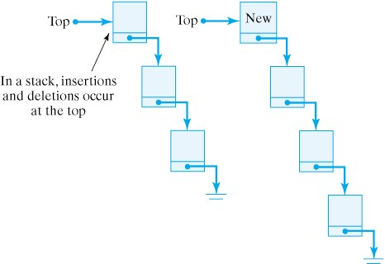
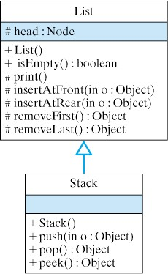
The Stack class
The Stack class is a subclass of List.
The peek() method returns the top element.

Slide 19
Implementation of the Stack class
Stack class methods simply call List methods insertAtFront() and removeFirst().
public class Stack extends List {
public Stack() {
super(); // Initialize the list
}
public void push( Object obj ) {
insertAtFront( obj );
}
public Object pop() {
return removeFirst();
}
} // Stack

Slide 20
Testing the Stack class
This program reverses the letters of a string.
Note how Objects are converted to chars.
public static void main( String argv[] ) {
Stack stack = new Stack();
String string = "Hello this is a test string";
System.out.println("String: " + string);
for (int k = 0; k < string.length(); k++)
stack.push(new Character( string.charAt(k)));
Object o = null;
String reversed = "";
while (!stack.isEmpty()) {
o = stack.pop();
reversed = reversed + o.toString();
}
System.out.println("Reversed String: " + reversed);
} // main()

Slide 21
The Queue ADT
A Queue is a special type of List.
It only allows insertions at the end of the list and removals at the front of the list.
Thus it enforces first-in/first-out (FIFO) behavior.
A queue insert operation is called enqueue.
A queue remove operation is called dequeue.
Queues behave like a line at a salad bar.
Queues are used in a number of computing tasks like scheduling a computer’s CPU.

Slide 22
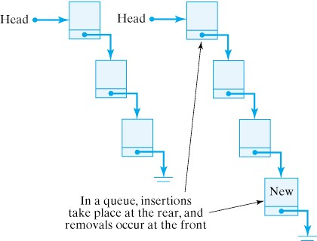
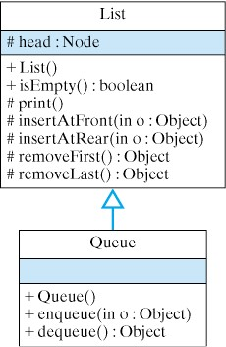
The Queue class
The Queue class is a subclass of List.
The dequeue() method uses removeLast().

Slide 23
Implementation of the Queue class
Queue class methods simply call List methods insertAtRear() and removeFirst().
public class Queue extends List {
public Queue() {
super(); // Initialize the list
}
public void enqueue(Object obj) {
insertAtRear(obj);
}
public Object dequeue() {
return removeFirst();
}
// Queue

Slide 24
Testing the Queue class
This main() is similar to the one for stack.
This time the letters are not reversed.
public static void main(String argv[]) {
Queue queue = new Queue();
String string = "Hello this is a test string";
System.out.println("String: " + string);
for (int k = 0; k < string.length(); k++)
queue.enqueue( new Character(string.charAt(k)));
System.out.println("The current queue:");
queue.print();
Object o = null;
System.out.println("Dequeuing:");
while (!queue.isEmpty()) {
o = queue.dequeue();
System.out.print( o.toString() );
}
} // main()

Slide 25
The Java Collections Framework and Generic Types
The Java Collections Framework is a group of classes and interfaces in java.util.* that implement abstract data types.
The Generic Type construct allows a programmer to specify a type for the objects stored in a data structure.
Java 5.0 has reimplemented the Java Collections Framework using generic types.
The Java Collections Framework includes implementations of LinkedList, Stack, Queue, and numerous other abstract data types.

Slide 26
Generic Types in Java
The generic type syntax is ClassName<E> where ClassName is a class or interface from the Java 5.0 Collections Framework and E is an unspecified class or interface name.
One benefit of generic types is that type checking of the ADT method arguments can be done at compile time.
A second benefit of using generic types is that the return type of objects returned from a data structure will be of the proper type, that is, of the declared type.

Slide 27
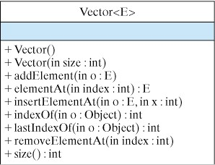
Using the Generic Vector Type
The following Java code is an example of using a generic type. It creates a Vector object which can store String objects where Vector is in the Java 5.0 Collections Framework.
Vector<String> strVec =
new Vector<String>();
strVec.addElement(“alpha”);
strVec.addElement(“beta”);
String str =
strVec.elementAt(0);

Slide 28
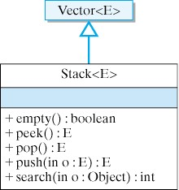
Using Methods of Stack<E>
Stack<E> is a subclass of Vector<E> in the Java 5.0 Collections Framework.
Stack<String> stk =
new Stack<String>();
stk.push(“alpha”);
stk.push(“beta”);
String str = stk.pop();

Slide 29
List<E> Interface and LinkedList<E> Class
The LinkedList<E> and ArrayList<E> classes both implement the List<E> interface.
A LinkedList<E> is appropriate for use when data will always be traversed in the same order that it is entered and a relatively small amount of data is involved.
An ArrayList<E> is appropriate for use when data will be traversed in an order different from how it is entered or a large amount of data is involved.

Slide 30
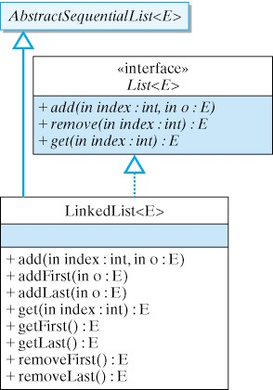
Methods of List<E> and LinkedList<E>
•ArrayList<E> also implements the methods of List<E>

Slide 31
Using List<E> and LinkedList<E>
The following code demonstrates how a variable of type List<PhoneRecord> can be instantiated with an object of type LinkedList<PhoneRecord>.
public static void testList() {
List<PhoneRecord> theList =
new LinkedList<PhoneRecord>();
// new ArrayList<PhoneRecord>() could also be used.
theList.add(new PhoneRecord("Roger M", "090-997-2918"));
theList.add(new PhoneRecord("Jane M", "090-997-1987"));
theList.add(new PhoneRecord("Stacy K", "090-997-9188"));
theList.add(new PhoneRecord("Gary G", "201-119-8765"));
theList.add(new PhoneRecord("Jane M", "090-997-1987"));
System.out.println("Testing a LinkedList List");
for (PhoneRecord pr : theList)
System.out.println(pr);
} // testList()

Slide 32
Set<E> Interface and TreeSet<E> Class
The TreeSet<E> and HashSet<E> classes both implement the Set<E> interface.
The Set<E> methods are for locating data elements using an ordering of the data when the searching needs to be done more quickly than can be done with a list.
Whether a TreeSet<E> is more appropriate than a HashSet<E> depends on issues connected to properties of binary search trees and hash functions.

Slide 33
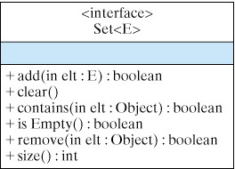
Methods of the Set<E> Interface
TreeSet<E> and HashSet<E> classes both implement methods of the Set<E> interface.
This is a partial list of methods of Set<E>.

Slide 34
Using Set<E> and TreeSet<E>
public static void testSet() {
Set<PhoneRecord> theSet = new TreeSet<PhoneRecord>();
// new HashSet<PhoneRecord>(); could also be used.
theSet.add(new PhoneRecord("Roger M", "090-997-2918"));
theSet.add(new PhoneRecord("Jane M", "090-997-1987"));
theSet.add(new PhoneRecord("Stacy K", "090-997-9188"));
theSet.add(new PhoneRecord("Gary G", "201-119-8765"));
theSet.add(new PhoneRecord("Jane M", "090-987-6543"));
System.out.println("Testing TreeSet and Set");
PhoneRecord ph1 =
new PhoneRecord("Roger M", "090-997-2918");
PhoneRecord ph2 =
new PhoneRecord("Mary Q", "090-242-3344");
System.out.println("Roger M contained in theSet is");
System.out.println(theSet.contains(ph1));
System.out.println("Mary Q contained in theSet is");
System.out.println(theSet.contains(ph2));
for (PhoneRecord pr : theSet) System.out.println(pr);
} // testSet()

Slide 35
Map<K,V> Interface and TreeMap<K,V> Class
The TreeMap<K,V> and HashMap<K,V> classes both implement the Map<K,V> interface.
The Map<K,V> methods are for locating a value from V given a key from K.
Whether a TreeMap<K,V> may be more appropriate than HashMap<K,V> depends on issues connected to properties of binary search trees and hash functions.

Slide 36
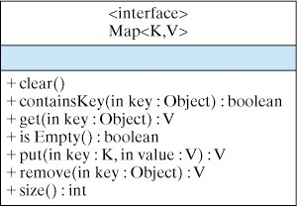
Methods in the Map<K,V> Interface
A partial list of methods in Map<K,V>.

Slide 37
Using Map<K,V> and TreeMap<K,V>
The following code demonstrates how Map<String,String> can be used with TreeMap<String,String>.
public static void testMap() {
Map<String,String> theMap = new TreeMap<String,String>();
// new HashMap<String,String>(); could also be used.
theMap.put("Roger M", "090-997-2918");
theMap.put("Jane M", "090-997-1987");
theMap.put("Stacy K", "090-997-9188");
theMap.put("Gary G", "201-119-8765");
theMap.put("Jane M", "090-233-0000");
System.out.println("Testing TreeMap and Map");
System.out.println("Stacy K has phone ");
System.out.println(theMap.get("Stacy K"));
System.out.println("Jane M has phone ");
System.out.println(theMap.get("Jane M"));
} // testMap()

Slide 38
The Binary Search Tree Data Structure
Instead of using TreeSet<E> or TreeMap<K,V>, one could implement one’s own binary search tree data structure.
A binary search tree is a binary tree in which the ordered data stored at any node is greater than all the data stored in its left subtree and less than all the data stored in its right subtree.
Data in a binary search tree must be comparable. So assume it implements the Comparable interface.

Slide 39
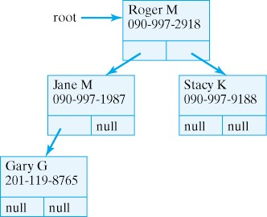
A Name and Phone Binary Search Tree
Nodes have left and right references to nodes.

Slide 40
Design for Binary Search Tree Program
public class PhoneTreeNode {
private String name;
private String phone;
private PhoneTreeNode left;
private PhoneTreeNode Right;
public PhoneTreeNode(String nam,String pho){ }//constructor
public void setData(String nam,String pho){ }
public String getName(){ }
public boolean contains(String nam,String pho){ }
public void insert(String nam,String pho){ }
// other methods
} // PhoneTreeNode class
public class PhoneTree {
private PhoneTreeNode root;
public PhoneTree(){ }//constructor
public boolean contains(String nam,String pho){ }
public void insert(String nam,String pho){ }
// other methods
} // PhoneTree class

Slide 41
contains() for PhoneTreeNode and PhoneTree
An implementation of a single method in each class to give a flavor of the Java code.
public boolean contains(String nam,String pho){
if (name.equals(nam)) return true;
else if (name.compareTo(nam)< 0){// name < nam
if (right == null) return true;
else return right.contains(name,pho);
}else { // name > nam
if (left == null) return true;
else return left.contains(name,pho);
} //else
}// contains() in PhoneTreeNode
public boolean contains(String nam,String pho){
if (root == null) return false;
else return root.contains(nam,pho);
} // contains() in PhoneTree

Slide 42
Technical Terms
Abstract Data Type (ADT)
binary search tree
data structure
dequeue
dynamic structure
enqueue
first-in/first-out (FIFO)
generic type
Java collections framework
key
last-in/first-out (LIFO)
link
linked list
list
pop
push
queue
reference
self-referential object
stack
static structure
traverse
value

Slide 43
Summary Of Important Points (part 1)
A data structure is used to organize data and make them more efficient to process. An array is an example of a static structure because its size does not change during a program’s execution. A vector is an example of a dynamic structure, one whose size can grow and shrink during a program’s execution.
A linked list is a linear structure in which the individual nodes of the list are joined together by references. A reference is a variable that refers to an object. Each node of the list has a link variable that refers to another node. An object that can refer to the same kind of object is said to be self-referential.

Slide 44
Summary Of Important Points (part 2)
The Node class is an example of a self-referential class. It contains a link variable that refers a Node. By assigning references to the link variable , Nodes can be chained together into a linked linked list. In addition to their link variables, Nodes contain data variables that should be accessed through public methods.
Depending on the use of a linked list, nodes can be inserted at various locations in the list: at the head, the end, or in the middle of the list.

Slide 45
Summary Of Important Points (part 3)
Traversal algorithms must be used to access the elements of a singly linked list. To traverse a list, you start at the first node and follow the links of the chain until you reach the desired node.
Depending on the application, nodes can be removed from the front, rear, or middle of a linked list. Except for the front node, traversal algorithms are used to locate the desired node.

Slide 46
Summary Of Important Points (part 4)
In developing list algorithms, it is important to test them thoroughly. Ideally, you should test every possible combination insertions and removals that the list supports. Practically, you should test every independent case of insertions and removals that the list supports.
An Abstract Data Type (ADT) combines two elements: a collection of data, and the operations that can be performed on the data. For a list ADT, the data are the values (Objects or ints) contained in the nodes that make up the list, and the operations are insertion, removal, and tests of whether the list is empty.

Slide 47
Summary Of Important Points (part 5)
In designing an ADT, it is important to provide a public interface that can be used to access the ADTs data. The ADTs implementation should not matter to the user and therefore should be hidden. A java class definition, with its public and private aspects, is perfectly suited to implement and ADT.
A stack is a list that allows insertions and removals only at the front of the list. A stack insertion is called a push, and a stack removal is called a pop. The first element in a stack is usually called the top of the stack. The Stack ADT can easily be defined as a subclass of List. Stacks are used for managing method call and returns in programming languages.

Slide 48
Summary Of Important Points (part 6)
A queue is a list that only allows insertions at the rear and removals from the front. A insertion is called an enqueue, and a queue removal is called a dequeue. The Queue ADT can easily be defined as a subclass of List. Queues are used for managing various lists of used by the CPU scheduler - such as the ready, waiting, and blocked queues.
A binary search tree is a binary tree in which the ordered data stored at any node is greater than all the data stored in its left subtree and less than all the data stored in its right subtree.

