Slide 1

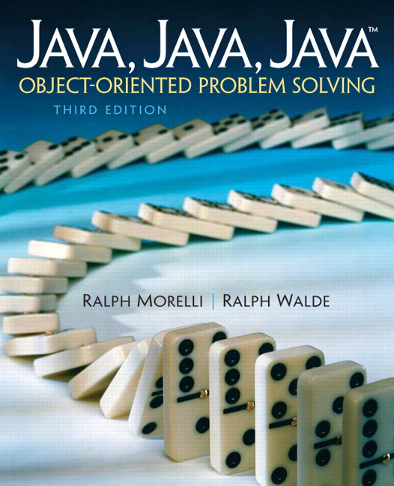
JAVA, JAVA, JAVA
presentation slides for
Object-Oriented Problem Solving
Third Edition
Ralph Morelli | Ralph Walde
Trinity College
Hartford, CT
published by Prentice Hall

Slide 2
Java, Java, Java
Object Oriented Problem Solving
Chapter 2 Objects:
Using, Creating, and Defining

Slide 3
Objectives
Learn how to use variables to store data.
Be familiar with creating and using objects.
Understand the relationship between classes and objects.
Understand the difference between objects and primitive data.
Understand the difference between the static and instance elements of a class.
Be able to understand and a simple class in Java.
Be familiar with some of the basic principles of object-oriented programming.

Slide 4
Outline
Using String Objects
Drawing Shapes with a Graphics Object
Class Definition
Case Study: Simulating a Two-Person Game
From the Java Library: java.util.Scanner

Slide 5
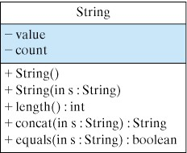
Using String Objects
Strings are used in most computer programs.
A partial representation of the String class.
If we have a String object named str, here’s how we print its length:
System.out.println(str.length()); // Print str’s length

Slide 6


Creating and Combining Strings
To create a String object in a program, first declare a String variable.
Use new and a String constructor to create an object;
String str; // Declare a String variable named str
str = new String(“Hello”); // Create a String object
String str2 = new String(“”); // Declare and create an empty String

Slide 7
String Examples
Using the length() and concat() methods.
Shortcut way of doing the same thing.
Using the equals() method.
System.out.println(str.length()); // Prints 5
System.out.println(str2.length()); // Prints 0
String s1 = new String(“George ”);
String s2 = new String(“Washington”);
System.out.println(s1.concat(s2)); // Prints George Washington
String s1 = “George ”;
String s2 = “Washington”;
System.out.println(s1 + s2); // Prints George Washington
String s1 = “Hello”, s2 = “Hello”, s3 = “hello”;
String s4; // s4 is null
System.out.println(s1.equals(s2)); // Prints true
System.out.println(s1.equals(s3)); // Prints false
System.out.println(s4.equals(s3)); // Null pointer error because s4 is null

Slide 8
What is printed by this program?
public class StringPuns
{
public static void main(String args[])
{ String s = new String("string");
String s1 = s.concat(" puns.");
System.out.println("Here are the top 5 " + s1);
String s2 = "5. Hey baby, wanna ";
String s3 = s + " along with me.";
System.out.println(s2 + s3);
System.out.println("4. I've got the world on a " + s + ".");
String s4 = new String("two");
String s5 = ". You have more class than a ";
System.out.print(s4.length());
System.out.println(s5 + s + " of pearls.");
System.out.print("2. It is ");
System.out.print(s.equals("string"));
System.out.println(" that I am no " + s + " bean.");
String s6 = " quintet.";
System.out.println("1. These puns form a " + s + s6);
} // main()
} // StringPuns class

Slide 9
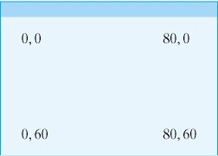
Using a Graphics Object
A Graphics object was used in HelloWorldApplet to draw “HelloWorld” on a browser:
  public void paint (Graphics g)
  { g.drawString(“Hello World”, 10, 10);
  g.drawString(“Welcome to Java”, 10, 35);
  }
In a Java window, the origin of the coordinate system, the point (0,0), is at the top-left corner.

Slide 10
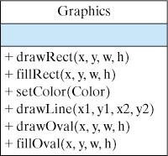
Graphics Drawing Methods
The Graphics class contains useful drawing methods.
Some Examples:
  g.setColor(Color.blue); // Sets the drawing color to blue
  g.fillRect(25, 25, 140, 40); // Draws a 140x40 blue rectangle // at coordinate (25,25)
  g.setColor(Color.black); // Sets the drawing color to black
  g.drawRect(25,25,140,40); // Draws the rectangle outline

Slide 11
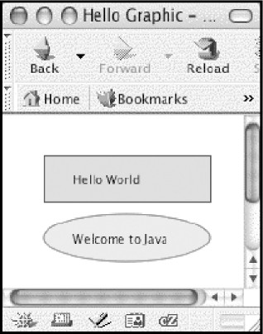
The HelloWorldGraphic Applet
The HelloWorldGraphic applet draws the following picture
Click the link for the source code or click here to run it.

Slide 12
Class Definition
Five basic design questions:
  What role will the object perform?
  What data or information will it need?
  What actions will it take?
  What public interface will it present to other objects?
  What information will it hide (keep private) from other objects?

Slide 13
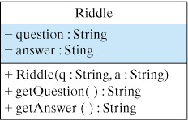
The Riddle Class
A class is a blueprint. It describes an object's form but it has no content.
The instance variables, question and answer, have no values yet.
The class contains an object’s method definitions

Slide 14
The Riddle Class Definition
public class Riddle
{ private String question; //Instance variables
private String answer;
public Riddle(String q, String a) // Constructor
{ question = q;
answer = a;
} // Riddle constructor
public String getQuestion() // Instance method
{ return question;
} // getQuestion()
public String getAnswer() // Instance method
{ return answer;
} //getAnswer()
} //Riddle class
A public class is accessible to other classes
Instance variables are usually private
An object’s public methods make up its interface

Slide 15
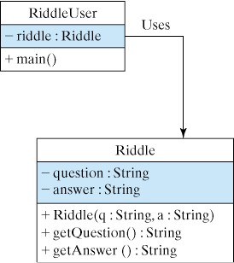
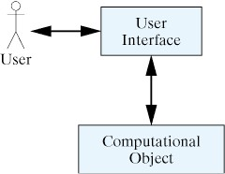
The RiddleUser Class
The RiddleUser class will create and use 1 or more Riddle instances.
An application has a main() method
Figure 2.13. The user interface handles interactions
between the user and the rest of the program.

Slide 16
The RiddleUser Class Definition
Class
Definition
public class RiddleUser
{
public static void main(String argv[])
{ Riddle riddle1 = new Riddle(
"What is black and white and red all over?",
"An embarrassed zebra.");
Riddle riddle2 = new Riddle(
"What is black and white and read all over?",
"A newspaper.");
System.out.println("Here are two riddles:");
System.out.println(riddle1.getQuestion());
System.out.println(riddle2.getQuestion());
System.out.println("The answer to the first riddle is:");
System.out.println(riddle1.getAnswer());
System.out.println("The answer to the second is:");
System.out.println(riddle2.getAnswer());
} // main()
} // RiddleUser
An application must
have a main() method
Object
Creation
Object
Use
Object
Use

Slide 17
Define, Create, Use
Class definition: Define one or more classes (Riddle, RiddleUser)
Object Instantiation: Create objects as instances of the classes (riddle1, riddle2)
Object Use: Use the objects to do tasks (riddle1.getAnswer() )

Slide 18
Case Study: A Two-Person Game
Design Steps
  Problem Specification
  Problem Decomposition
  Class Design: OneRowNim
  Method Decomposition

Slide 19
Problem Specification
Design a program that simulates the game of One-Row Nim with a row of sticks.
A OneRowNim object will keep track of how many sticks remain and whose turn it is.
A OneRowNim object should allow a player to pick up 1, 2, or 3 sticks.
A OneRowNim object should know when the game is over and who won the game.

Slide 20
Problem Decomposition
What objects do we need?
The OneRowNim object will represent and manage the game.
We design OneRowNim to be used with different kinds of interfaces (Chapter 4).

Slide 21
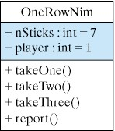
Class Design: OneRowNim
State:
  Two int variables, nSticks and player
  nSticks keeps tracks of the remaining sticks.
  player keeps track of whose turn it is.
Methods:
  A takeOne() method to pick up 1 stick.
  A takeTwo() method to pick up 2 sticks.
  A takeThree() method to pick up 3 sticks.
  A report() method describes the game’s state.

Slide 22
OneRowNim Class Specification
Class Name: OneRowNim
  Role: To represent and simulate a One-Row Nim game
Information Needed (instance variables)
  nSticks: Stores the number of sticks left (private)
  player : Stores whose turn it is (private)
Manipulations Needed (public methods)
  takeOne(), takeTwo(), takeThree()-- Methods to pick up 1, 2, or 3 sticks.
  report(): A method to report the current state of the game (nSticks and player )

Slide 23
OneRowNim Class Definition
public class OneRowNim
{ private int nSticks = 7; // Start with 7 sticks.
private int player = 1; //Player 1 plays first.
public void takeOne()
{ nSticks = nSticks - 1;
player = 3 - player;
} // takeOne()
public void takeTwo()
{ nSticks = nSticks - 2;
player = 3 - player;
} // takeTwo()
public void takeThree()
{ nSticks = nSticks - 3;
player = 3 - player;
} // takeThree()
public void report()
{ System.out.println("Number of sticks left: " + nSticks);
System.out.println("Next turn by player " + player);
} // report()
} // OneRowNim1 class

Slide 24


The OneRowNim Class
A class is a blueprint. In this case every OneRowNim created will…
  Have 7 sticks.
  Player 1 will have the first turn.
But after calling the game.takeThree() method, the game object will change to:

Slide 25
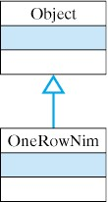
The Class Header
Example:
public class OneRowNim
In General:
  ClassModifiers_{opt} class ClassName Pedigree_{opt}
public class OneRowNim extends Object

Slide 26
Identifiers
An identifier is a name for a variable, method, or class.
Rule: An identifier in Java must begin with a letter, and may consist of any number of letters, digits, and underscore (_) characters.
Legal: OneRowNim, takeOne, nSticks
Illegal: One Row Nim, 5sticks, game$, n!

Slide 27
Declaring Instance Variables
Examples:
// Instance variables
private int nSticks = 7;
private int player = 1;
In General
  FieldModifiers_{opt} TypeId VariableId Initializer_{opt}
Fields or instance variables have class scope. Their names can be used anywhere within the class.

Slide 28
Public/Private Access
Instance variables should usually be declared private. This makes them inaccessible to other objects.
Generally, public methods are used to provide carefully controlled access to the private variables.
An object’s public methods make up its interface -- that part of its makeup that is accessible to other objects.

Slide 29
Public/Private Access (cont)
Possible Error: Public instance variables can lead to an inconsistent state
Example: Suppose we make nSticks and player public variables.
  nim.nSticks = -1; // Inconsistent
  nim.player = 0; // State
The proper way to change the game’s state:
  nim.takeOne(); // takeOne() is public method

Slide 30
Java’s Accessibility Rules
Packages contain classes which contain members
(methods and fields).
Access is determined from the top down.
If no explicit declaration given, a default is used.

Slide 31
Initializer Expressions
General Form: Variable = expression
The expression on the right of the assignment operator (=) is evaluated and its value is stored in the variable on the left.
Examples:
    private int nSticks = 7;
    private int player = “joe”; // Type error
Type error: You can’t assign a String value to an int variable

Slide 32
Method Definition
Example
public void MethodName() // Method Header
{ // Start of method body
} // End of method body
The Method Header
  MethodModifiers_{opt} ResultType MethodName (ParameterList )
  public static void main (String argv[] )
  public void takeOne ()
  public void takeTwo ()
  public void report ()

Slide 33
Method Definition
Header: This method, named takeOne, is accessible to other objects (public), and does not return a value (void).
public void takeOne()
{
nSticks = nSticks - 1;
player = 3 - player;
} // takeOne()
Body: a block of statements that removes one stick and changes the player’s turn

Slide 34
Designing Methods
The public methods serve as a class’s interface.
If a method is intended to be used to communicate with or pass information to an object, it should be declared public.
A class’s methods have class scope. They can be used anywhere within the class.
Methods that do not return a value should be declared void.

Slide 35
The Simple Assignment Statement
General Form: VariableName = Expression
The expression on the right of the assignment operator (=) is evaluated and its value is stored in the variable on the left.
Examples:
    nSticks = nSticks - 1;
    player = 3 - player;
    player = “joe”; // Type error
Type error: The value being assigned must be the same type as the variable.

Slide 36
Creating OneRowNim Instances
A reference variable refers to an object by storing the address of the object.
game
// Declare a reference variable
OneRowNim game;
The reference variable, game, will refer to a OneRowNim objet, (b),
but its initial value is null.
(a)
(b)
// Create an instance
game = new OneRowNim();
game
(c) After instantiation, game refers to a OneRowNim object
(c)

Slide 37
Using OneRowNim Objects
Objects are used by calling one of their public methods:
game.report(); // Tell game to report
game.takeOne(); // Tell game to take one stick away

Slide 38
OneRowNimTester Application
The OneRowNimTester is an application with main() method.
public class OneRowNimTester
{
public static void main(String args[])
{ OneRowNim1 game = new OneRowNim();
game.report();
game.takeThree();
game.report();
game.takeThree();
game.report();
game.takeOne();
game.report();
} //main()
}

Slide 39
Tracing OneRowNim
To trace OneRowNim, download its sourcecode, compile it and run it.
  OneRowNim.java
  OneRowNimTester.java
See also Figure 2.22 on page 88.

Slide 40
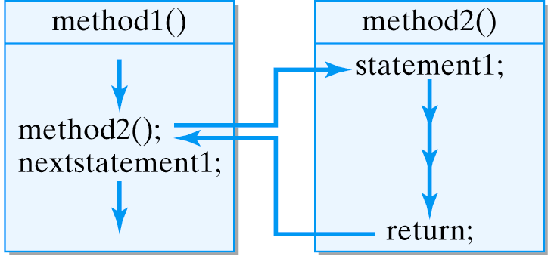
Method Call and Return
A method call causes a program to transfer control to the first statement in the called method.
A return statement returns control to the calling statement.

Slide 41
Object Oriented Design
Encapsulation: The OneRowNim class encapsulates a state and a set of actions.
Information Hiding: OneRowNim’s state is defined by private variables, nSticks and player.
Interface: OneRowNim’s interface is defined in terms of its public methods.
Generality/Extensibility: We can easily extend OneRowNim’s functionality.

Slide 42
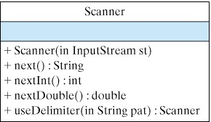
From the Library: java.util.Scanner
The java.util.Scanner class is new in J2SE 5.0
It provides a simple means of reading keyboard input in Java.

Slide 43
Example: Input a Number
import java.util.Scanner;
public class TestScanner
{
public static void main(String[] args)
{ // Create Scanner object
Scanner sc = new Scanner(System.in);
System.out.print("Input an integer:"); // Prompt
int num = sc.nextInt(); // Read an integer
System.out.println(num + " squared = " + num*num);
} //main()
} // TestScanner class
Read an integer.

Slide 44
Example: Waiting for User Input
import java.util.Scanner;
public class TestScanner2
{
public static void main(String[] args)
{ // Create Scanner object
Scanner sc = new Scanner(System.in);
Riddle riddle = new Riddle(
"What is black and white and red all over?",
"An embarrassed zebra.");
System.out.println("Here is a riddle:");
System.out.println(riddle.getQuestion());
System.out.print("To see the answer, "); // Prompt
System.out.println("type a letter and enter.");
String str = sc.next(); // Wait for input
System.out.println(riddle.getAnswer());
} //main()
} // TestScanner2 class
Wait for the user to type any letter before displaying the answer.

Slide 45
Summary: Technical Terms
access modifier assignment statement
class scope escape sequence
field declaration floating point number
flow of control keyword
identifier initializer expression
instance integer
interface literal
method call and return qualified name
void method wrapper class

Slide 46
Summary: Key Points
A Java program is a set of interacting objects.
A Java class serves as a template for objects.
Classes contain instance variables (state) and methods.
Java class hierarchy organizes all classes into a single subclass and superclass relationship rooted in Object.
A class definition:
  header, which names the class and describes its use and pedigree
  body , which contains its details.
A pedigree describes where it fits in the Java class hierarchy.

Slide 47
Summary: Key Points (cont)
A class definition encapsulates the data and methods needed to carry out the class’s task.
Design Goals:
  Well-defined purpose
  Well-articulated (public) interface
  Hidden implementation details (private state)
  General and Extensible.
A boolean is a primitive type that can be true or false.
Object interface: The public class elements
Keyword: a term that has special meaning.

Slide 48
Summary: Key Points (cont)
An identifier begins with a letter followed by any number of letters, digits and the underscores (_) and cannot be identical to a keyword.
Field declaration (instance variable)
  reserves memory within the object
  associates a name and type with the location
  specifies its accessibility (public or private)
Information Hiding: Instance variables should be private.
Identifier Scope: Where an identifier can be used.
Class scope: Fields and methods can be used anywhere in the class.

Slide 49
Summary: Key Points (cont)
Method definition:
  Header: names the method and provides other general information
  Body: contains its executable statements.
Methods that have a return type must return a value of that type.
Methods that don’t return a value should be declared void.
A method’s formal parameters are variables that are used to bring information into the method.

Slide 50
Summary: Key Points (cont)
A qualified name is one which involves the dot operator (.) and is used to refer to an object's methods and instance variables.
Declaring a reference variable creates a name for an object but doesn't create the object itself.
Instantiating a reference variable creates an object and assigns the variable as its name or reference.
Execution of a Java application begins with the first statement in the body of the main() method.

