Slide 1

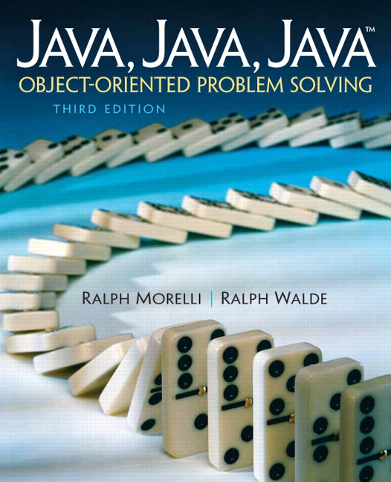
JAVA, JAVA, JAVA
presentation slides for
Object-Oriented Problem Solving
Third Edition
Ralph Morelli | Ralph Walde
Trinity College
Hartford, CT
published by Prentice Hall

Slide 2
Java, Java, Java
Object Oriented Problem Solving
Chapter 3 Methods:
Communicating with Objects

Slide 3
Objectives
Understand the role that methods play in an object-oriented program.
Know how to use parameters and arguments to pass data to an object.
Understand how constructor methods are used to instantiate objects.
Know the difference between passing a value and passing a reference to an method.
Know how to design your own methods.
Learn the if-else and while control structures.

Slide 4
Outline
Passing Information to an Object
Constructor Methods
Retrieving Information from an Object
Passing a Value and Passing a Reference
Flow of Control: Control Structures
The Improved OneRowNim
From the Java Library: Object
Object-Oriented Design: Inheritance and Polymorphism
Drawing Lines (Optional Graphics Methods)

Slide 5
Types of Methods
A accessor method is a public method used to get the value of an object’s instance variable.
  bankAccount.getAccountNumber()
A mutator method is a public method used to set the value of an instance variable.
  bankAccount.setAccountNumber(1098)
BankAccount
accountNumber: int
+getAccountNumber(): int
+setAccountNumber(int:N)

Slide 6
Passing Information to an Object
Parameters are used to pass information to an object via a method.
A formal parameter is a variable that stores data while it is being passed to a method.
Parameters make methods more general.
  takeSticks(int num) where num specifies how many sticks to take can replace:
  takeOne(),
  takeTwo(),
  …

Slide 7
Parameter Scope
Scope defines where a variable can be used in a program.
Local Scope: a parameter’s scope is limited to the method in which it is declared.
Class Scope: an instance variable can be accessed anywhere within the class instance.

Slide 8
Arguments and Parameters
Arguments refer to the values that are used in the method call or method invocation.
Qualified names (dot notation), are used to refer to methods within other classes.
The arguments used in the method call must match the parameters defined in method definition.
game.takeSticks(3);
public void takeSticks(int num) {…}

Slide 9
Passing an int to OneRowNim
The main() method creates a OneRowNim game and invokes its takeSticks() method to remove 3 sticks:
public static void main (String argv[])
{
OneRowNim game; // Declare a OneRowNim object
game = new OneRowNim();// Instantiate the reference
game.takeSticks(3); // Remove 3 sticks
} // main()
public void takeSticks(int num)
{ nSticks = nSticks - num;
player = 3 - player;
}

Slide 10
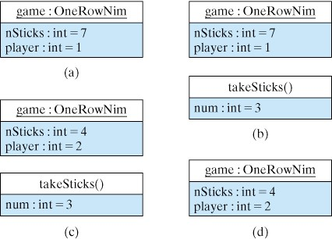
Parameters are Temporary Storage
Tracing the execution of game.takeSticks(3).
We use takeSticks() to change the state of the game.
The parameter num temporarily stores the value 3.
Before calling takeSticks(3)
Before executing body of takeSticks()
After executing body of takeSticks()
After control leaves takeSticks()

Slide 11
Constructor Methods
Used to create and initialize an instance (object) of a class
Not inherited by subclasses
Used to initialize instance variables
Defined as public or private
Do not return a value
Example:
public OneRowNim()
{
nSticks = 7;
player = 1;
}

Slide 12
Constructors and Initialization
Constructors provide a flexible way to initialize an object’s instance variables
Given this constructor definition:
public OneRowNim(int sticks)
{
nSticks = sticks;
player = 1;
}
We can create a 21-stick or 13-stick game:
OneRowNim game1 = new OneRowNim(21);
OnoRowNim game2 = new OneRowNim(13);

Slide 13
Default Constructors
If no constructor is coded, Java provides a default constructor.
If a class is public, the default constructor will also be public.
OneRowNim: Invoking the default constructor:
OneRowNim game = new OneRowNim();
Is equivalent to invoking a constructor defined as:
public OneRowNim() { }

Slide 14
Overloading and Method Signatures
A method name is overloaded if there is more than one method with the same name:
public OneRowNim () { } // Constructor #1
public OneRowNim (int sticks) // Constructor #2
{
nSticks = sticks;
}
A method is uniquely identified by its method signature, which includes the method name plus the the number, order, and types of its parameters.

Slide 15
Constructor Invocation
A constructor is invoked only once, in conjunction with the new keyword, when an instance of an object is created.
The arguments in the method call must match the parameters in the method definition.
Constructor invocations
OneRowNim game1 = new OneRowNim(); game1.takeSticks(3);
OneRowNim game2 = new OneRowNim(21);

Slide 16
Retrieving Information from an Object
Methods with non-void return types can be used to retrieve information from an object.
A method that returns a value may or may not have a formal parameter list.
Return Type
Parameters
public double average (int n1, int n2)
{
return (n1 + n2) / 2;
}
Return Value

Slide 17
OneRowNim’s getSticks() Method
public int getSticks()
{
return nSticks;
}
getSticks() takes no parameters, and returns the value of the nSticks instance variable
OneRowNim game1 = new OneRowNim(21);
System.out.println(game1.getSticks());
game1.getSticks() has the value 21
System.out.println(“Sticks= “ + pet1.getName());
Nested Method Call: We can
use the returned value in method
calls and expressions.
We can assign the
returned value to a variable
int s = game1.getSticks();

Slide 18
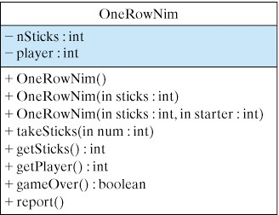
The Expanded OneRowNim Class

Slide 19
Passing a Value vs. Passing a Reference
Passing a primitive value differs from passing a reference value
Values of type int, boolean, float, and double are examples of primitive types. A primitive argument cannot be changed by a method call.
All objects (String, OneRowNim) are reference types. Reference arguments can be changed by a method call.

Slide 20
Passing a Primitive Value
For primitive type parameters, a copy of the argument’s value is passed to the method.
public void primitiveCall(int n)
{
n = n + 1;
}
int x = 5;
primitiveCall(x);
primitiveCall() will be passed an int value
5
x stores the value 5
5 is copied into n when primitiveCall() is called. So primitiveCall() has no access to x itself and x remains equal to 5 even though n is incremented.

Slide 21
Primitive Call Example
What values will k and n have after myMethod() is invoked?
public class PrimitiveCall
{
public static void myMethod(int n)
{
System.out.println("myMethod: n= " + n);
n = 100;
System.out.println("myMethod: n= " + n);
} // myMethod()
public static void main(String argv[])
{
int k = 5;
System.out.println("main: k= " + k);
myMethod(k);
System.out.println("main: k= " + k);
} // main()
} // PrimitiveCall

Slide 22
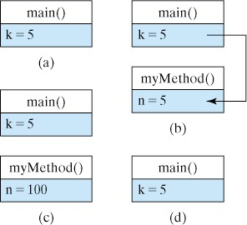
Tracing the Passing of a Primitive Value
Tracing the values of the variables k and n.
Before calling myMethod()
Before executing body of myMethod()
Just after executing the body of myMethod()
After control returns to main()

Slide 23
Passing a Reference Value
For reference parameters, a reference to an object is passed to the method.
public void referenceCall(OneRowNim g)
{
g.takeSticks(3);
}
OneRowNim x = new OneRowNim(7);
referenceCall(x);
referenceCall() will be passed
a reference to a OneRowNim
Before: x refers to a OneRowNim with 7 sticks
After: Passing x is like passing the object itself. x’s nSticks will be 4 after the method call.

Slide 24
Reference Call Example
What values will k and n have after myMethod() is invoked?
public class ReferenceCall
{
public static void myMethod(OneRowNim g)
{ System.out.print("myMethod: Number of sticks: ");
System.out.println(g.getSticks());
g.takeSticks(3);
System.out.print("myMethod: Number of sticks: ");
System.out.println(g.getSticks());
} // myMethod()
public static void main(String argv[])
{ OneRowNim game = new OneRowNim(10);
System.out.print("main: Number of sticks: ");
System.out.println(game.getSticks());
myMethod(game);
System.out.print("main: Number of sticks: ");
System.out.println(game.getSticks());
}// main()
} // ReferenceCall

Slide 25
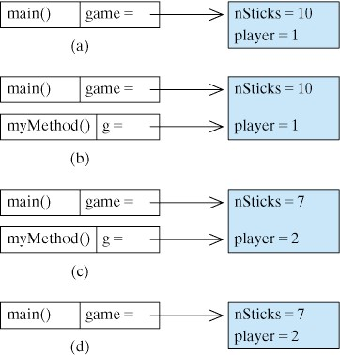
Tracing the Passing of a Reference
Tracing the state of OneRowNim.
Before calling myMethod(game)
Before executing the body of myMethod()
After executing the body of myMethod()
After control returns to main()

Slide 26
Flow of Control: Control Structures
Selection Control Structures allow the program to select one of multiple paths of execution.
The path is selected based on some conditional criteria, as is the case in a flowchart.

Slide 27
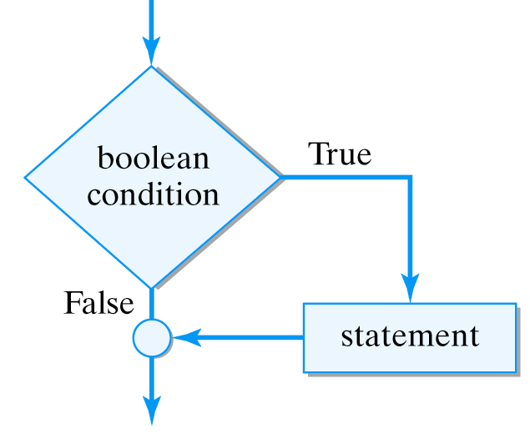
The Simple If Statement
if ( boolean expression )
statement ;
If the boolean expression evaluates to true, the statement will be executed. Otherwise, it will be skipped.

Slide 28
Boolean Expressions
Boolean expressions are expressions that evaluate to either true or false.
Examples of Boolean Expressions:
  true false
  nSticks <= 0 (1 + 1) == 2
== is the equality operator in Java

Slide 29
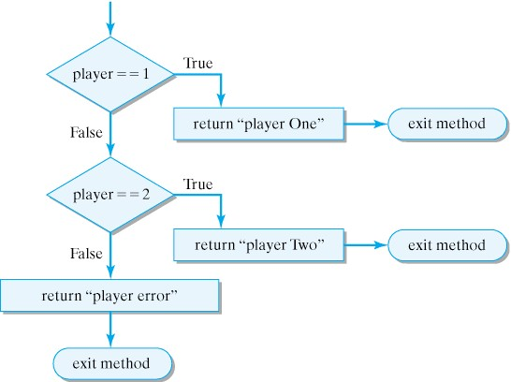
The getPlayerString() Method
public String getPlayerString()
{
if (player == 1)
return “Player One”;
if (player == 2)
return “Player Two”;
return “Player error”;
}

Slide 30
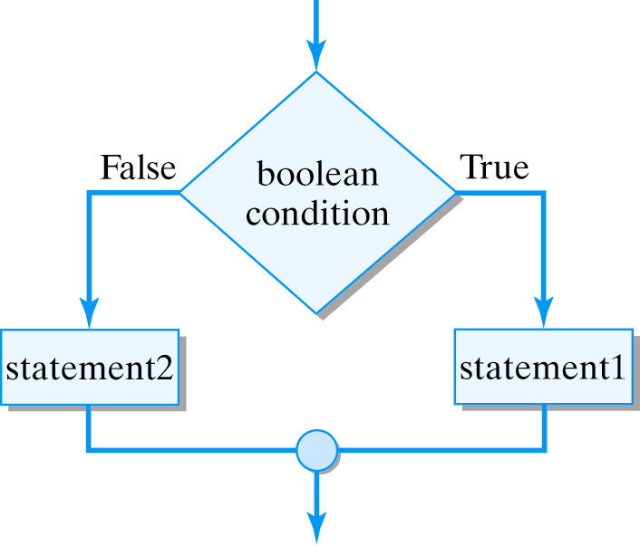
The If-Then-Else Statement
if ( boolean expression )
statement1 ;
else
statement2 ;
If the boolean expression is true, execute statement1, otherwise execute statement2.

Slide 31
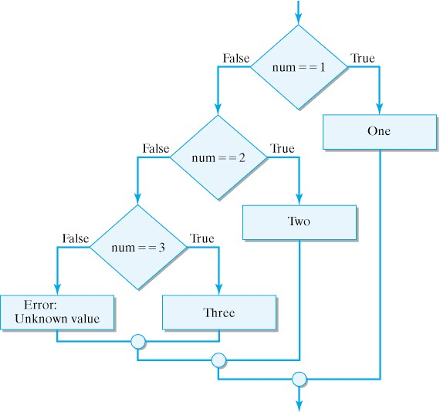
Multiway Selection
We can embed if-then-else clauses to create multiway selection structures.
Note that this complicated structure has one entry and one exit.

Slide 32
Selection Statement Examples
if (player == 1)
{ String s = ”Player One";
System.out.println(s);
}
Simple If
If-then-else
if (player == 1)
System.out.println(”Player One");
else
System.out.println(”Player Two");
Multiway Selection
if (num == 1)
System.out.println(”One");
else if (num == 2)
System.out.println(”Two");
else if (num == 3)
System.out.println(”Three");
else
System.out.println("Error: unknown value");

Slide 33
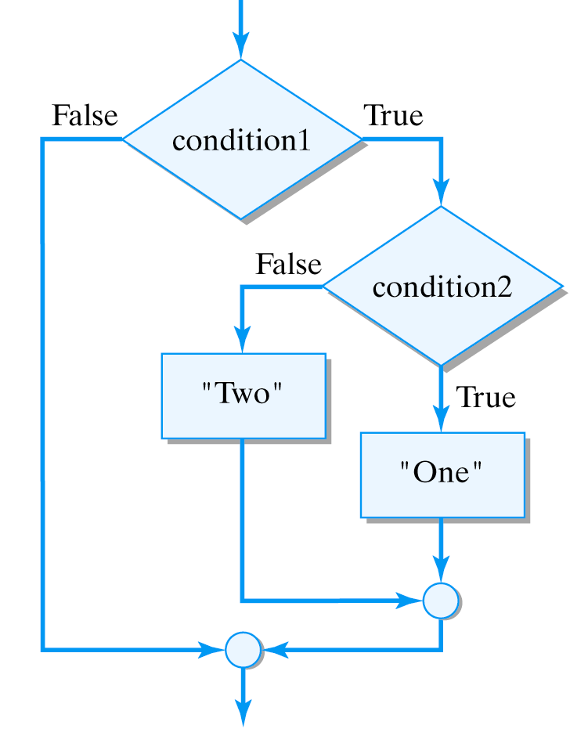
The Dangling Else Problem
Rule: An else clause matches the closest previous unmatched if clause.
Indentation (which the compiler ignores) should reflect the statement’s logic.
Incorrect Indentation
Correct Indentation
if (condition1)
if (condition2)
System.out.println("One");
else
System.out.println("Two");
if (condition1)
if (condition2)
System.out.println("One");
else
System.out.println("Two");

Slide 34
The While Structure
While structure to sum the squares of the numbers from 1..max:
Initializers
public int sumSquares(int max)
{ int num = 1;
int sum = 0;
while (num <= max)
{ sum = sum + num * num; // Add square to sum
num = num + 1; // Increment num by 1
} // while
return sum;
}// sumSquare()
Loop entry condition: enter the loop if this condition is true
Loop body
Updater: brings num closer to max
Java’s while statement:
The while statement has no built-in initializer and updater.
while ( loop entry condition )
loop body ;

Slide 35
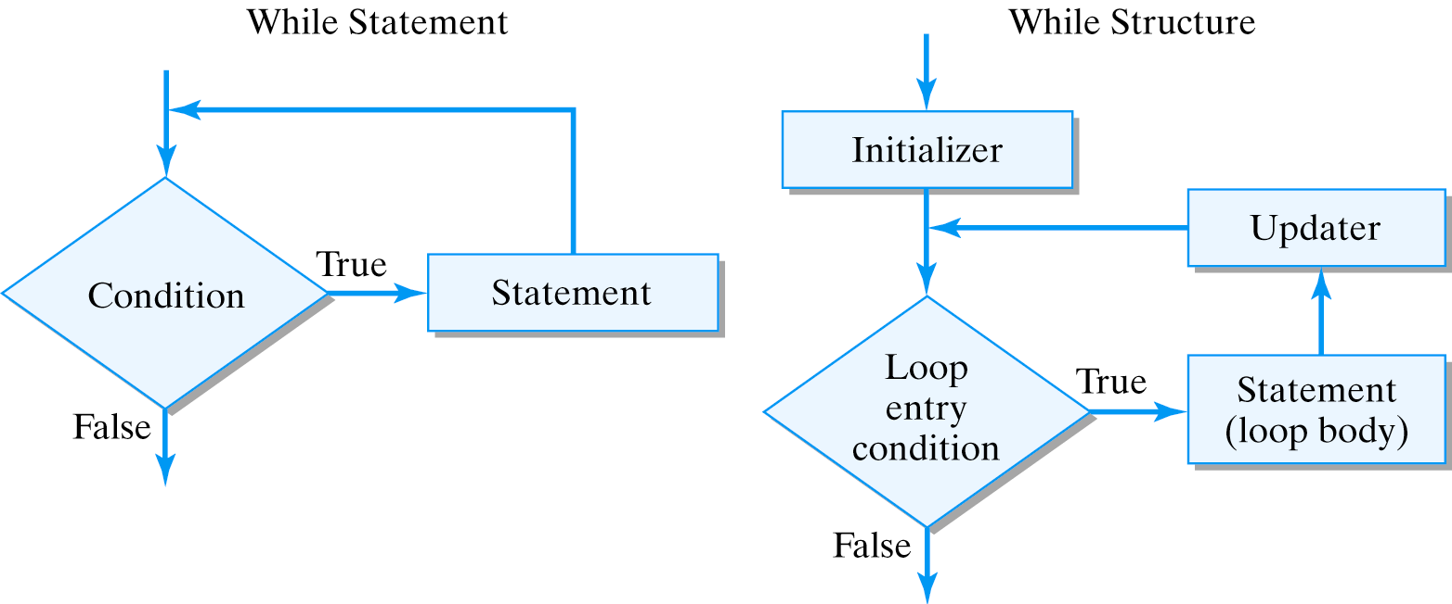
Principles of the While Structure
Effective Design: Loop structure. A loop structure must include an initializer, a boundary condition, and an updater. The updater should guarantee that the boundary condition is reached, so the loop will eventually terminate.

Slide 36
Testing the Improved OneRowNim
Download, compile, and run:
  OneRowNim.java and TestOneRowNim.java
import java.util.Scanner; // Allows us to read keyboard input
public class TestOneRowNim
{
public static void main(String argv[])
{ Scanner sc = new Scanner(System.in);
OneRowNim game = new OneRowNim(11);
while(game.gameOver() == false)
{ game.report(); // Prompt the user
System.out.print("Input 1, 2, or 3: "); // Get input
int sticks = sc.nextInt(); // Get move
game.takeSticks(sticks); // Do move
System.out.println();
} // while
game.report(); // The game is now over
System.out.print("Game won by player ");
System.out.println(game.getWinner());
} // main()
} // TestOneRowNim

Slide 37
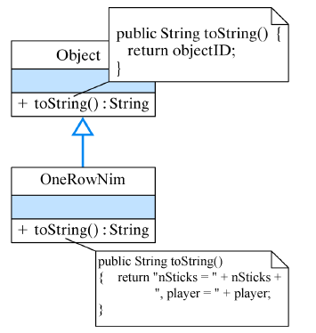
Overriding Object’s toString() Method
To report OneRowNim’s state, we can override the toString() method inherited from Object.

Slide 38
Overriding toString()
We add the following method to OneRowNim:
public String toString()
{ return “nSticks = “ + nSticks + “, player = “ + player;
}// toString()
We can then use toString() as follows:
public class TestToString
{
public static void main(String argv[])
{ OneRowNim g1 = new OneRowNim(11);
OneRowNim g2 = new OneRowNim(13);
g1.takeSticks(2);
System.out.println(g1.toString()); // nSticks = 9, player = 2
System.out.println(g2.toString()); // nSticks = 13, player = 1
} //main
} //TestToString

Slide 39
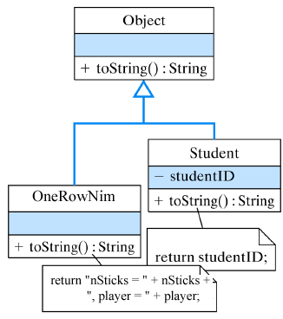
The Polymorphic toString() Method
A polymorphic method behaves differently when invoked on different types of objects.
Object obj;
obj = new Student(“12345”); // obj refers to a Student
System.out.println(obj.toString()); // 12345
obj = new OneRowNim(11); // obj refers to a OneRowNim
System.out.println(obj.toString()); // nSticks = 11,player = 1

Slide 40
Drawing Lines (Optional Graphics)
The Graphics class contains a drawLine() method:
Click on this link for a drawing demo:
  Draw Sticks Demo
Download and review the source code:
  DrawSticksApplet.java
public void drawline(int x1, int y1, int x2, int y2)

Slide 41
Technical Terms
accessor method
class scope
formal parameter
if statement
if-else statement
local scope
loop structure
method overloading
method signature
multiway selection
mutator method
override
polymorphism
repetition structure
scope
selection
side effect
while statement
while structure

Slide 42
Summary Of Important Points
A formal parameter is a place holder in a method declaration and it always consists of a type followed by variable identifier.
An argument is a value that is passed to a method via a formal parameter when the method is invoked.
A method's parameters constrain the type of information that can be passed to a method.

Slide 43
Summary of Important Points (cont)
Parameter Passing. When an argument of primitive type is passed to a method, it cannot be modified within the method.
When an argument of reference type is passed to a method, the object it refers to can be modified within the method.
Except for void methods, a method invocation or method call is an expression which has a a value of a certain type.

Slide 44
Summary of Important Points (cont)
The signature of a method consists of its name, its return type, and the number and type of its formal parameters.
A class may not contain more than one method with the same signature.
A constructor is a method that is invoked when an instance object is created. If a class does not contain a constructor method, the Java compiler supplies a default constructor.

Slide 45
Summary of Important Points (cont)
The if statement executes a statement only if its boolean condition is true.
The if-else statement statement executes one or the other of its statements depending on the value of its boolean condition.
Multiway selection allows one and only one of several choices to be selected depending on the value of its boolean condition.
The while statement is used for coding loop structures.

