Slide 1

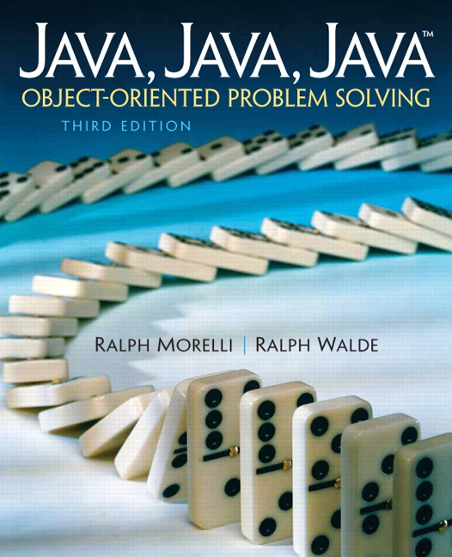
JAVA, JAVA, JAVA
presentation slides for
Object-Oriented Problem Solving
Third Edition
Ralph Morelli | Ralph Walde
Trinity College
Hartford, CT
published by Prentice Hall

Slide 2
Java, Java, Java
Object Oriented Problem Solving
Chapter 4 Input/Ouput:
Designing the User Interface

Slide 3
Objectives
Understand the importance of the user interface.
Know how to use a simple command-line interface.
Be able to program and use a simple Graphical User Interface (GUI)..
Understand the concept of event-driven programming.
Know how to program and use a Java applet.

Slide 4
Outline
Introduction
The java.applet.Applet Class
The User Interface
A Command-Line Interface
A Graphical User Interface (GUI)
Case Study: The One-Row Nim Game
From the Java Library: java.io.File and File Input (Optional)

Slide 5
Introduction
A user interface is a program’s input and output capabilities.
An input operation is action that transfers data from the user to the computer’s main memory.
An output operation is action that transfers data from main memory to an ouput device.
An command-line interface allows the user to type commands a keyboard.
A graphical user interface (GUI) uses graphical objects (windows, buttons) for I/O.

Slide 6
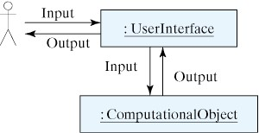
The User Interface
The user interface transmits data back and forth between the user and the program’s computational objects.

Slide 7
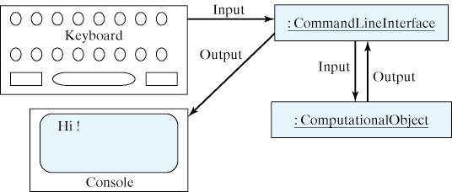
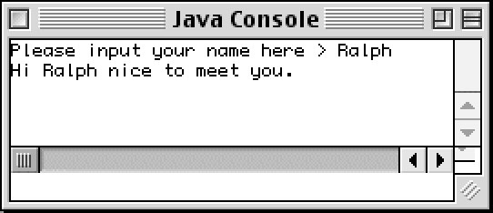
A Command-Line Interface
In a command-line interface or console interface input is take from the keyboard and output is directed to the console.
The Java console is a window that accepts keyboard input.

Slide 8
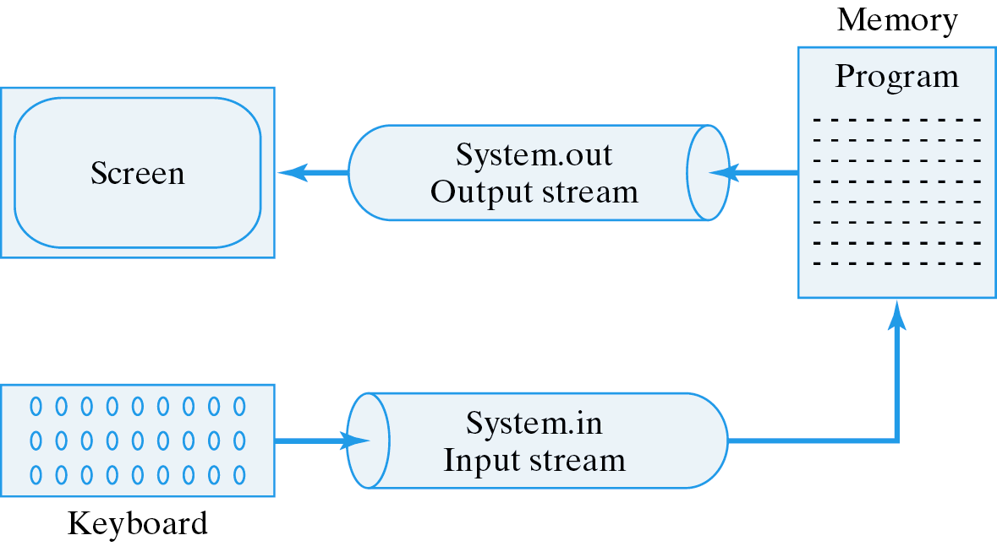
Input and Output Streams
In Java, input and output are handled by streams.

Slide 9
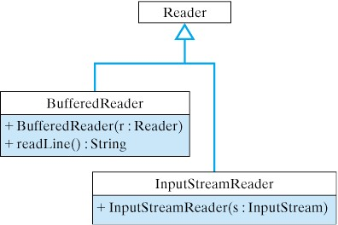
Using BufferedReader for Input
A BufferedReader object performs buffered input. A buffer is memory where data is held until needed by the program.
BufferedReader input = new BufferedReader(new InputStreamReader(System.in)); // Reads from System.in
String inputString = input.readLine(); // Reads 1 line of input.

Slide 10
Inputting Numbers from the Keyboard
A wrapper class, such as Integer or Double, can be used for extracting int or double values from a String.
A code segment to calculate a runner’s pace
int m = Integer.parseInt(“55”); // Assigns 55 to m
double num = Double.parseDouble(“55.2”); // Assigns 55.2 to num
String inputString = new String();
System.out.println("How many total miles did you run? ");
inputString = input.readLine(); // Input a String
double miles = Double.parseDouble(inputString); // Convert
System.out.println("How many minutes did it take you? ");
inputString = input.readLine(); // Input another String
double minutes = Double.parseDouble(inputString); // Convert
System.out.println("Your average pace was " +
minutes/miles + " minutes per mile");

Slide 11
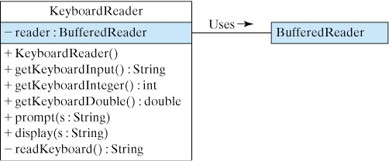
The KeyboardReader Class
Let’s design a class that we can use to manage keyboard input and console output.
The KeyboardReader uses a BufferedReader object to handle the input operations.
A good user interface should have methods to perform input and output and to prompt the user.

Slide 12
The KeyboardReader Implementation
The KeyboardReader readKeyBoard() method handles any exceptions that occur during input.
import java.io.*;
public class KeyboardReader
{ private BufferedReader reader; // A BufferedReader is used for input
public KeyboardReader() {
reader = new BufferedReader // Create a BufferedReader
(new InputStreamReader(System.in)); // and connect it to System.in
}
/********* Code is deleted from here ***********/
private String readKeyboard()
{ String line = "";
try // Try/catch is used to handle I/O exceptions.
{ line = reader.readLine();
} catch (IOException e)
{ e.printStackTrace();
}
return line;
}
} // KeyboardReader

Slide 13
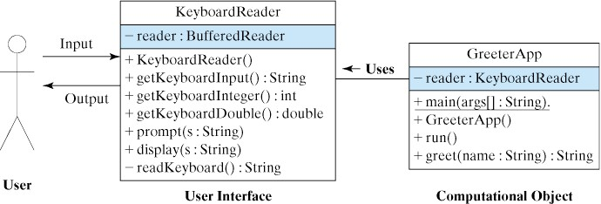
The KeyboardReader User Interface
We use KeyboardReader as an interface between the user and a computational object.
DEMO: Download and run:
  KeyboardReader.java
  GreeterApp.java

Slide 14
A Graphical User Interface (GUI)
A GUI uses windows and point-and-click interaction rather than keyboard input.
A GUI uses event driven programming to control the interaction.
Let’s develop a GUI that is extensible so that it can be used in a wide variety of applications.

Slide 15
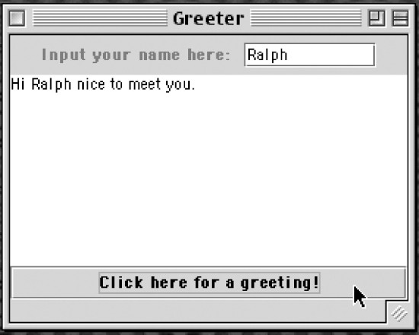
Java’s GUI Components
Java contains many standard GUI components that we can use in our programs.
A JLabel for the prompt.
A JTextField for input.
A JTextArea for displaying output.
A JButton for control.

Slide 16
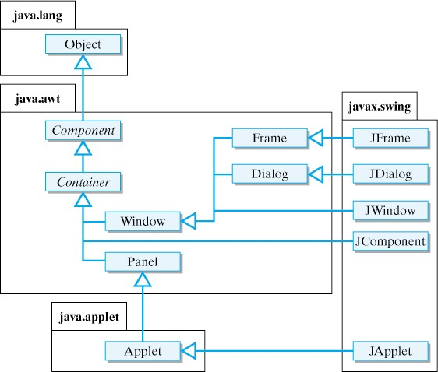
Top-Level Swing and AWT Classes
The javax.swing and java.awt packages contain Java’s GUI components.
Note the inheritance relationships.
Superclass
Subclass
A subclass inherits characteristics of its superclasses.

Slide 17
Class Inheritance
Note the inheritance relationships.
A subclass inherits characteristics of its superclasses.
A JDialog is a specialized Window
Superclass
Dialog
Subclass
JDialog
public class JDialog extends Dialog { … }
public class Dialog extends Window { … }
public class Window extends Container { … }
public class Container extends Component { … }
public class Component extends Object { … }

Slide 18
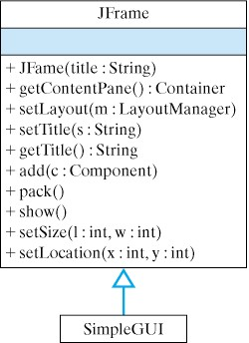
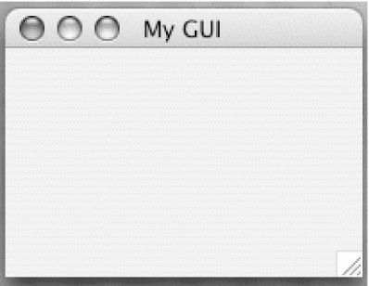
Top-Level Windows
All GUIs must be contained in a top-level window.
For example, this GUI extends a JFrame.
import javax.swing.*;
public class SimpleGUI extends JFrame
{
public SimpleGUI(String title)
{ setSize(200,150);
setLocation(100, 150);
setTitle(title);
setVisible(true); // Displays the JFrame
} // SimpleGUI()
public static void main(String args[])
{ new SimpleGUI("My GUI");
} // main()
} // SimpleGUI class

Slide 19
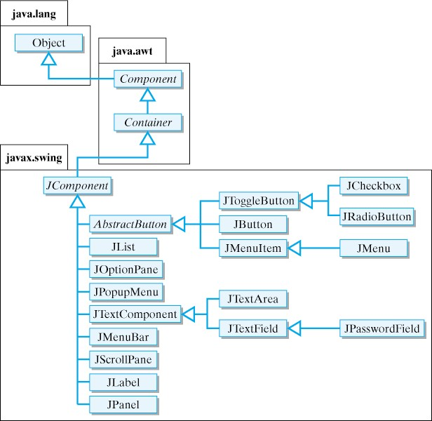
Components for Input, Output, Control
The Swing package contains components for input, output, and control.

Slide 20
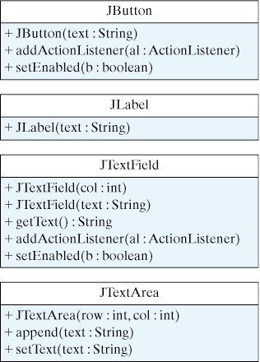
Declaring and Creating Components
In the program, we declare variables for each component and use constructors to instantiate the components.
// Declare instance variables for the components
private JLabel prompt;
private JTextField inField;
private JTextArea display;
private JButton goButton;
// Instantiate the components
prompt = new JLabel("Please type your name here: ");
inField = new JTextField(10); // 10 chars wide
display = new JTextArea(10, 30); // 10 rows x 30 columns
goButton = new JButton("Click here for a greeting!");

Slide 21
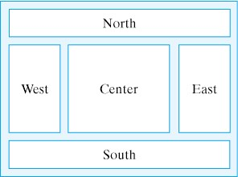
Adding Components to Window
We use the add() methods in the Container class to add components to a JPanel, which is then added to the top-level window.
Top-level windows use a contentPane to hold components.
The contentPane has a BorderLayout to arrange the components.
JPanel inputPanel = new JPanel();
inputPanel.add(prompt); // Add JLabel to panel
inputPanel.add(inField); // Add JTextField to panel
inputPanel.add(goButton); // Add JButton to panel
contentPane.add("South", inputPanel); // Add to JFrame

Slide 22
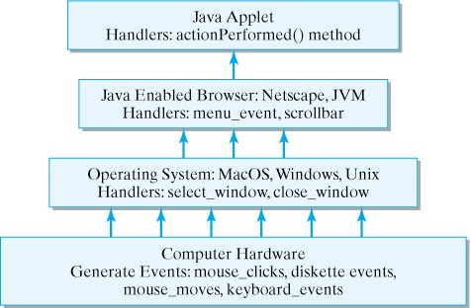
Controlling the GUI’s Action
GUIs use event-driven programming.
Events are handled by methods in the applet.
Events are triggered by user actions (mouse, keyboard).
Java’s Event Model

Slide 23
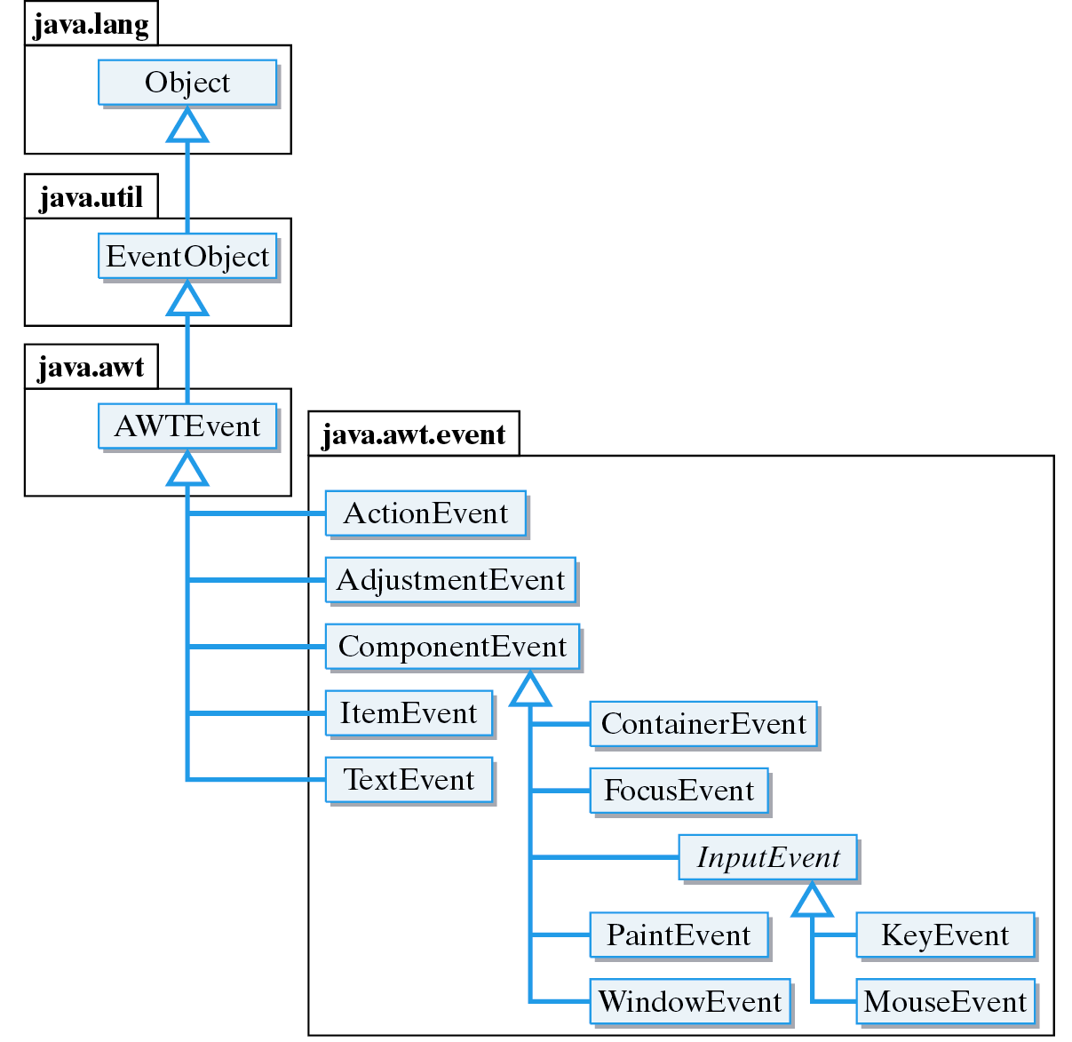
The Java Event Hierarchy
An action event occurs when an applet Button is clicked.
An key event occurs when the user types a key.
An mouse event occurs when the mouse is moved.

Slide 24
The ActionListener Interface
A listener is an object that listens for certain types of events and then takes action.
An ActionListener listens for ActionEvents, the kind that occur when you click on a JButton or hit return in a JTextField.
An interface is a class that contains abstract methods and constants (no instance variables).
An abstract method is one that lacks an implementation. It has no body.
public abstract interface ActionListener extends EventListener
{
public abstract void actionPerformed(ActionEvent e);
}

Slide 25
Implementing an ActionListener
If we want our program to serve as a listener for action events, we must implement the ActionListener interface.
This means we must implement the actionPerformed() method.
By associating the ActionListener interface with a JButton, we cause Java to call actionPerformed() whenever the JButton is clicked.

Slide 26
An ActionListener Example
GreeterGui.java implements an ActionListener.
public class GreeterGUI extends Frame implements ActionListener
{ ...
private JButton goButton; // Declare the button variable
...
public void buildGUI()
{ ...
goButton = new JButton("Click here for a greeting!"); // Create the button
goButton.addActionListener(this); // Associate it with this object
...
}
...
public void actionPerformed(ActionEvent e) // This method is called
{ if (e.getSource() == goButton) // whenever goButton is clicked.
{ String name = inField.getText();
display.append(greeter.greet(name) + "\n");
}
}
...
}
The keyword this refers to this GreeterGUI object, which is defined as an ActionListener.

Slide 27
Using the GUI in Applications and Applets
The GUI can easily be used with applications...
public class GreeterApplication
{
public static void main(String args[])
{
new GreeterGUI("Greeter");
}
}
…or applets.
import javax.swing.*;
public class GreeterApplet extends JApplet
{
public void init()
{
new GreeterGUI("Greeter");
}
}

Slide 28
Embedding the GUI in a Web Page
A JFrame cannot be contained in an JApplet.
To embed the applet in a web page, we move the entire GUI into a JPanel and add the JPanel to the JApplet.
GreeterGUIPanel.java contains the JPanel definition.
GreeterPanelApplet.java contains the JApplet definition.
Click here to run a demo of GreeterPanelApplet.
Add the JPanel to the JApplet’s content pane.
import javax.swing.*;
public class GreeterPanelApplet extends JApplet
{ public void init()
{ getContentPane().add(new GreeterGUIPanel());
}
}

Slide 29
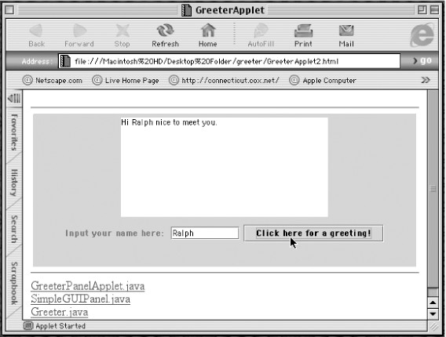
The Greeter Applet
Click here to run a demo of GreeterPanelApplet.

Slide 30
Case Study: OneRowNim Game
We develop alternative user interfaces for OneRowNim.
This will require some revisions to OneRowNim, which is the computational object.
A command-line application uses OneRowNim as computational object and KeyboardReader as the user interface.
The GUI version uses a OneRowNimGUI as the user interface.

Slide 31
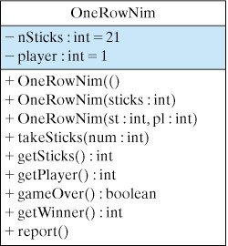
The OneRowNim Class
We use the OneRowNim class from Chapter 3.
OneRowNim.java

Slide 32
Command-Line OneRowNim
The command-line application uses the following control algorithm (pseudocode):
Create a game object with 21 sticks
Create a reader object
sticksLeft = game:get the number of sticks left
reader:display the rules of the game
while (game: the game is not over)
whoseMove = game: find out whose turn it is
if (whoseMove == user)
game: user chooses number of sticks to take
else
game: computer chooses number of sticks to take
sticksLeft = game: get the number of sticks left
reader: report the number of sticks left
// At this point the game is over.
if game: the user is the winner
reader: report that the user wins
else
reader: report that the computer wins

Slide 33
GUI Version OneRowNim
In the GUI version, we use GUI components for input (JTextField), output (JTextArea), and control (JButton).
Control of the game is in the actionPerformed() method.
public void actionPerformed(ActionEvent e)
{ if (e.getSource() == goButton)
{ userMove();
computerMove();
int sticksLeft = game.getSticks();
display.append("There are " + sticksLeft + " sticks left.\n");
if (game.gameOver())
endGame();
} // if
} // actionPerformed()
OneRowNimGUI.java is the full implementation.

Slide 34
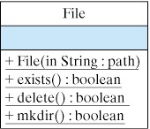
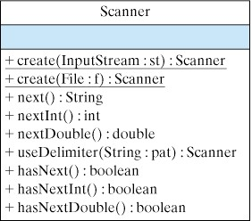
File I/O with the File and Scanner Classes
We frequently want to read data from a file.
A text file stores a sequence of characters. It can be created by a standard text editor.
The java.io.File class can be used with the Scanner class to read a text file into a program.
The Scanner class performs the I/O operations:

Slide 35
The File and Scanner Classes
We use the File class to associate an external text file with an object in the program.
We associate the File object with a Scanner object as follows:
We then can use Scanner methods to read text from the file. The next() method reads the next line from a text file:
File theFile = new File(“riddles.txt”);
try
{ File theFile = new File("riddles.txt");
fileScan = new Scanner(theFile);
fileScan = fileScan.useDelimiter("\r\n");
} catch (IOException e)
{ e.printStackTrace();
} //catch()
String question = fileScan.next(); // Read next line

Slide 36
Example: Reading Riddles From a File
The ReaderFileReader program reads riddles that have been stored in a text file and displays them.
In the text file, riddles are stored on separate lines. For each riddle, the question appears on one line followed by the answer:
What is black and white and red all over?
An embarrassed zebra
What is black and white and read all over?
A newspaper
What other word can be made with the letters of ALGORITHM?
LOGARITHM

Slide 37
Technical Terms
abstract class
abstract interface
abstract method
applet
Application Programming Interface (API)
event-driven programming
Graphical User Interface (GUI)
import declaration
inheritance
inheritance hierarchy
interface
polymorphic method

