Slide 1

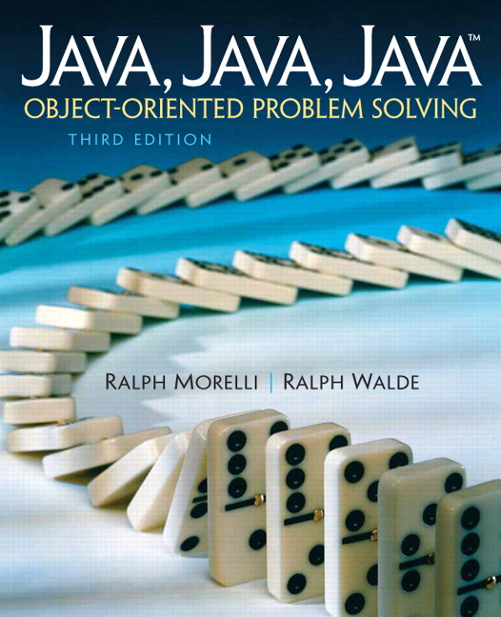
JAVA, JAVA, JAVA
presentation slides for
Object-Oriented Problem Solving
Third Edition
Ralph Morelli Ralph Walde
Trinity College
Hartford, CT
published by Prentice Hall

Slide 2
Java, Java, Java
Object Oriented Problem Solving
Chapter 5: Java Data and Operators

Slide 3
Objectives
Understand the role that data play in effective program design.
Be able to use all of Java's primitive types and their operators.
Appreciate the use of information hiding.
Be able to use class constants and class methods in a program.
Know how to use Java's Math and NumberFormat classes.
Be able to perform data conversions.

Slide 4
Outline
Boolean Data and Operators
Numeric Data and Operators
Java Library: Math, NumberFormat Classes
Numeric Processing Examples
Character Data and Operators
Example: Character Conversions
Problem Solving = Representation + Action

Slide 5
Programming = Representation + Action
Representation: finding a way to look at a problem.
  Seeing the problem as related to a known problem.
  Being able to divide the problem into smaller solvable problems.
  Choosing the right kinds of objects and structures.
Action: the process of taking well-defined steps to solve a problem.
Given a particular way of representing the problem, what steps must we take to arrive at its solution?

Slide 6
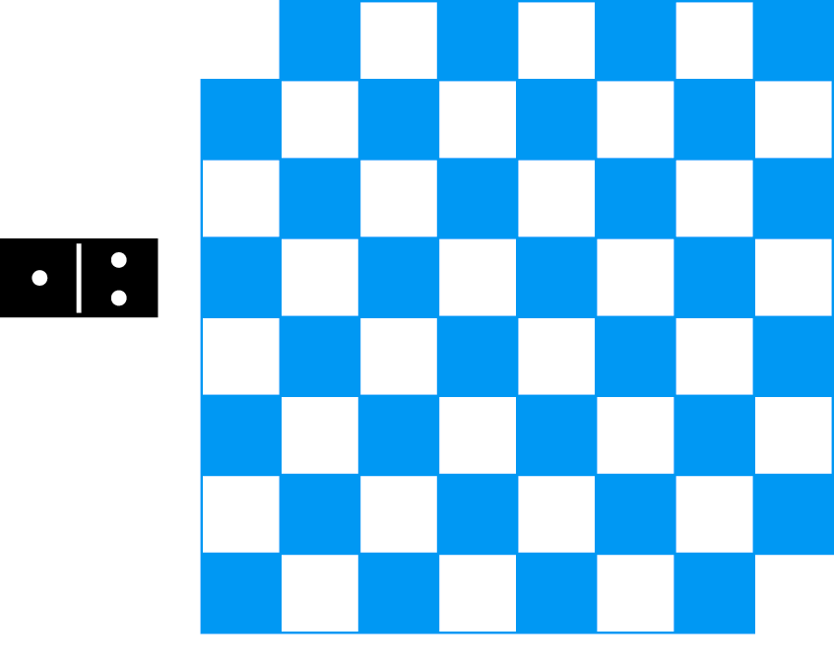
Two Ways to Represent a Problem
Problem: Can a chessboard with its top-left and bottom-right squares removed be completely tiled by dominoes?
Representation #1: Search problem. There are 2³¹ = 2,147,483,000 different search possibilities.
Representation #2: As a mathematics problem. Can’t tile 32 black squares and 30 white squares with 31 dominoes.

Slide 7
Boolean Data and Operators
Truth table definitions of the boolean operators: AND (&&),
OR (||), EXCLUSIVE-OR (^) and NOT (!).
Boolean data have only two possible values, true and false.
o1 || o2 is true if either o1 or o2 is true.
!o1 is true when o1 is false.
o1 && o2 is true only if both o1 and o2 are true.
o1 ^ o2 is true if either o1 or o2 is true, but not when both are true.

Slide 8
Boolean Operator Precedence
Precedence Order of Boolean Operators.
In a mixed expression, NOT would be evaluated before XOR, which would be evaluated before AND, which would be evaluated before OR.
AND is evaluated before OR because it has higher precedence.
EXPRESSION EVALUATION
true || true && false true || false ==> true
(true || true) && false true && false ==> false
(true || (true && false) true || false ==> true
Parentheses can override the built-in precedence order.

Slide 9
Short Circuit Evaluation
In short circuit evaluation, a boolean expression is evaluated left to right and the evaluation is discontinued as soon as the truth value is determined.
EXPRESSION EVALUATION
expr1 && expr2 If expr1 is false, the expression is false.
expr1 || expr2 If expr1 is true, the expression is true.
Practical Use: Guarding against null pointer error.
OneRowNim game; // Uninstantiated reference variable
if (!game.gameOver()) // Null pointer error
game.takeSticks(num);
if (game != null && (!game.gameOver()) // Short circuit
game.takeSticks(num);

Slide 10
Using Boolean’s in OneRowNim
public class OneRowNim // Partial Listing
{
private boolean onePlaysNext = true;
public OneRowNim (int sticks, int starter)
{ nSticks = sticks;
onePlaysNext = (starter == 1);
} // Constructor
public boolean takeSticks (int num)
{ if (num < 1 || num > 3 || num > nSticks)
return false;
else
{ nSticks = nSticks - num;
onePlaysNext = !onePlaysNext;
return true;
}
} // takeSticks()
public int getPlayer ()
{ if (onePlaysNext) return 1;
else return 2;
} // getPlayer()
}

Slide 11
Numeric Data Types
Each bit can represent two values.
An n-bit quantity can represent 2^{n} values. 2⁸ = 256 possible values.
Effective Design: Platform Independence. In Java a data type’s size is part of its definition and therefore remains consistent across all platforms.

Slide 12
Numeric Data: Limitations
Numeric types are representations of number systems, so there are tradeoffs:
  A finite number of integers can be represented.
  A finite number of values between 1.11 and 1.12..
Debugging Tip: A round-off error is the inability to represent certain numeric values exactly.
A float can have at most 8 significant digits. So 12345.6789 would be rounded off to 12345.679.
Debugging Tip: Significant Digits. In using numeric data the data type you choose must have enough precision to represent the values your program needs.

Slide 13
Standard Arithmetic Operators
Typed Operators: Integer division gives an integer result. Mixed integer and floating point expressions give a floating point result.
3/2 ==> value 1 An integer result
3.0/2.0 ==> value 1.5 A floating point result
3/2.0 ==> value 1.5 A floating point result
3.0/2 ==> value 1.5 A floating point result
Modulus operator (%) gives remainder of integer division.
6 % 4 ==> 6 mod 4 equals 2
4 % 6 ==> 4 mod 6 equals 4
6 % 3 ==> 6 mod 3 equals 0
3 % 6 ==> 3 mod 6 equals 3

Slide 14
Promotion
Promotion Rule: When two different types are involved in an expression, the smaller type (fewer bits) is promoted to the larger type before the expression is evaluated.
3/2.0 ==> 3.0/2.0 ==> value 1.5 // Floating point result
3.0/2 ==> 3.0/2.0 ==> value 1.5 // Floating point result

Slide 15
Numeric Precedence
Precedence Rule: In a mixed expression arithmetic operators are evaluated in precedence order. Operators of the same precedence are evaluated from left to right.
Evaluate: 9 + 6 - 3 * 6 / 2
Step 1. ((9 + 6) - ((3 * 6) / 2 ))
Step 2. ((9 + 6) - (18 / 2 ) )
Step 3. ((9 + 6) - 9 )
Step 4. ( 15 - 9 )
Step 5. 6
Parentheses can be used to clarify precedence order.
Or to avoid subtle semantic errors.
5/3/2.0 // 0.5
5/(3/2.0) // 3.33

Slide 16
Increment/Decrement Operators
Unary increment and decrement operators.
Increment k, then use it.
Use k , then increment it.
Language Rule: If ++k or --k occurs in an expression, k is incremented or decremented before its value is used in the rest of the expression. If k++ or k-- occurs in an expression, k is incremented or decremented after its value is used in the rest of the expression.

Slide 17
Assignment Operators
Shortcut assignment operators: combine an arithmetic and assignment operation into a single expression.
Example
r += 3.5 + 2.0 * 9.3;
r = r + ( 3.5 + 2.0 * 9.3 ); // r = r + 22.1;

Slide 18
Relational Operators
Some relational operators require two symbols (which should not be separated by a space between them).

Slide 19
Numeric Operator Precedence
Precedence Rule: Relational and equality operations are performed after arithmetic operations.
Use parentheses to disambiguate and avoid syntax errors.
Evaluate: 9 + 6 <= 25 * 4 + 2
Step 1. (9 + 6) <= ( (25 * 4) + 2)
Step 2. (9 + 6) <= ( 100 + 2)
Step 3. 15 <= 102
Step 4. true
Evaluate: 9 + 6 <= 25 * 4 == 2
Step 1. ( (9 + 6) <= (25 * 4) ) == 2
Step 2. ( (9 + 6) <= 100 ) == 2
Step 3. ( 15 <= 100 ) == 2
Step 4. true == 2 // Syntax Error

Slide 20
From the Java Library: java.lang.Math
The java.lang.Math class provides common mathematical functions such as sqrt().
The Math class can not be subclassed or instantiated.
public final class Math {// final class cannot be subclassed
private Math() {} // private constructor cannot be invoked
...
public static native double sqrt (double a)
throws ArithmeticException;
}
All Math class methods are static class methods. They are invoked as follows:
Math.sqrt(55.3)

Slide 21
Math Class Methods

Slide 22
Math Class Example: Rounding
When representing currency, it is often necessary round numbers to two decimal places:
Algorithm to round 75.199999
1. Multiply the number by 100, giving 7519.9999.
2. Add 0.5 to the number giving 7520.4999.
3. Drop the fraction part giving 7520
4. Divide the result by 100, giving 75.20
In Java, using the Math.floor() method:
3
1
2
4
R = Math.floor(R * 100.0 + 0.5) / 100.0;

Slide 23
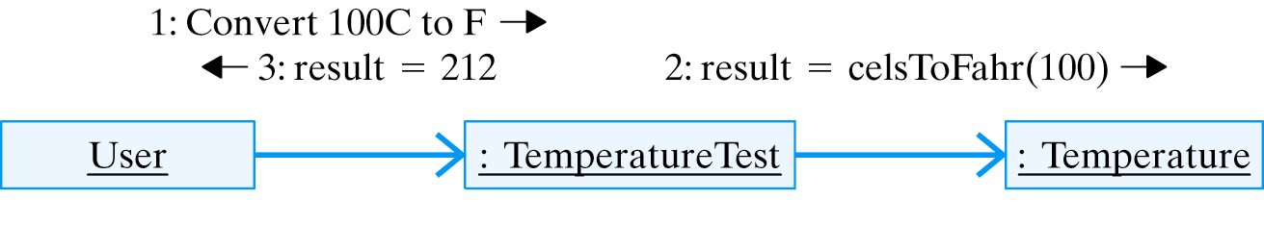
Example: Fahrenheit to Celsius
Design an applet that converts Fahrenheit to Celsius temperatures.
GUI Design: The applet will server as an interface between the user and the Temperature object.
The Temperature object will perform the conversions.

Slide 24
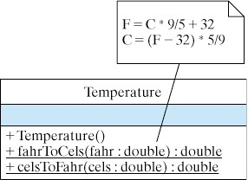
Design: Temperature Class
Note that static elements are underlined in UML.

Slide 25
Implementation: Temperature Class
Note the use of parentheses and the use of real number literals here.
public class Temperature {
public Temperature() {}
public static double fahrToCels(double temp) {
return (5.0 * (temp - 32.0) / 9.0);
}
public static double celsToFahr(double temp) {
return (9.0 * temp / 5.0 + 32.0);
}
} // Temperature
Potential Error Here: The expression
(9 / 5 * temp + 32)
evaluates to (temp + 32).

Slide 26
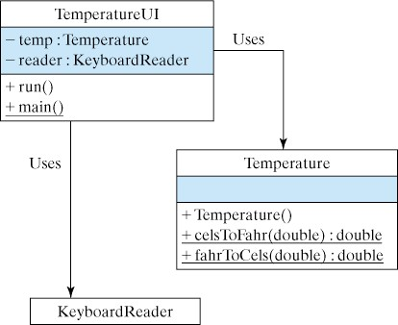
Implementation: TemperatureUI Class
Self-Study 5.14: Implement the TemperatureUI class and use it to test the Temperature class.
Download, compile and run the following:
  TemperatureUI.java
  Temperature.java

Slide 27
Implementation: Testing and Debugging
It is important to develop good test data. For this application the following tests would be appropriate:
  Test converting 0 degrees C to 32 degrees F.
  Test converting 100 degrees C to 212 degrees F.
  Test converting 212 degrees F to 100 degrees C.
  Test converting 32 degrees F to 0 degrees C.
These data test all the boundary conditions.
Testing Principle: The fact that your program runs correctly on some data is no guarantee of its correctness. Testing reveals the presence of errors, not their absence.

Slide 28
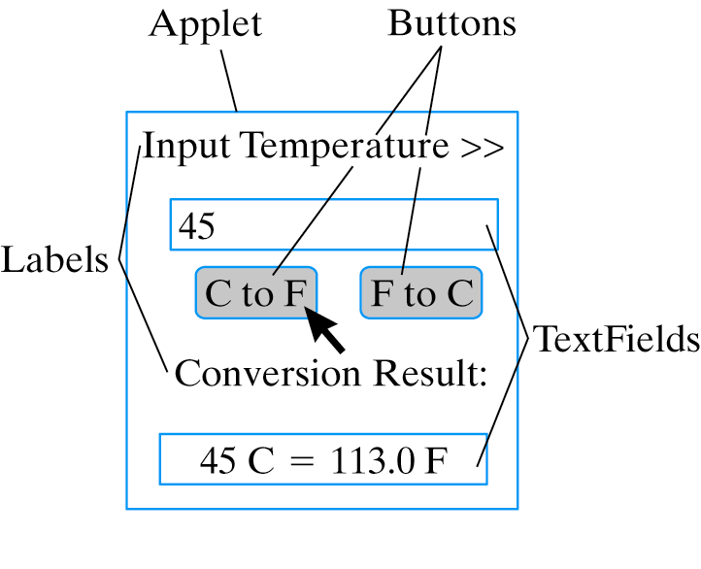
A GUI Version

Slide 29
Implementation: TemperatureUI Class
Self-Study 5.15: Implement the GUI following the design of the GUI in Chapter 4.
Click here for a Temperature applet demo.
Download, compile and run the following source files:
  TemperatureJPanel.java
  TemperatureJApplet.java
  Temperature.java

Slide 30
Using Class Constants
A class constant is a final static variable.
Readability: Use UPPERCASE for constant identifiers and use named constants instead of literal values.
Maintainability: Using constants instead of literals makes program easier to maintain.
Class constants can be used as initializers.
Revised OneRowNim.java with named constants.
public static final int PLAYER_ONE = 1;
public static final int PLAYER_TWO = 2;
public static final int MAX_PICKUP = 3;
public static final int MAX_STICKS = 7;
OneRowNim game = new OneRowNim(OneRowNim.MAX_STICKS);

Slide 31
A Winning Algorithm for OneRowNim
You can always win if you leave your opponent with 1, 5, 9, 13, 17, or 21 sticks.
The relationship common to these numbers:
So leave opponent with N such that N%4 == 1.
If there are sticksLeft sticks left, how many sticks, M, do we have to pick up to leave our opponent with N sticks such that N%4 == 1?
Some algebra to calculate M gives us:
N % 4 == 1
sticksLeft - M == N AND N % 4 == 1
(sticksLeft - M)% 4 == 1
Now let: (sticksLeft - M) == (Q * 4) + 1 and add M and subtract 1 from both sides to get:
(sticksLeft - 1) == (Q * 4) + M
M == (sticksLeft - 1) % 4

Slide 32
The Optimal move() Method
The following table verifies our calculation:
sticksLeft Before | (sticksLeft-1)%4 | sticksLeft After
9 | (9-1)%4 == 0 | Illegal move
8 | (8-1)%4 == 3 | 5
7 | (7-1)%4 == 2 | 5
6 | (6-1)%4 == 1 | 5
5 | (5-1)%4 == 0 | Illegal move
And gives the following move() method:
public int move()
{ int sticksLeft = nim.getSticks(); // Get number of sticks
if (sticksLeft % (nim.MAX_PICKUP + 1) != 1) // If winnable
return (sticksLeft - 1) % (nim.MAX_PICKUP +1); // Optimal
else { // Else pick random
int maxPickup = Math.min(nim.MAX_PICKUP, sticksLeft);
return 1 + (int)(Math.random() * maxPickup);
}
}

Slide 33
Character Data and Operators
The char type is a primitive data type.
A character is represented by a 16-bit unsigned integer.
A total of 2¹⁶ = 65536 characters can be represented.
Java uses the international Unicode character set.
The first 128 Unicode characters are identical to the characters in the 7-bit ASCII (American Standard Code for Information Interchange).

Slide 34
The ASCII Characters
Code 32 33 34 35 36 37 38 39 40 41 42 43 44 45 46 47
Char SP ! " # $ % & ' ( ) * + , - . /
Code 48 49 50 51 52 53 54 55 56 57
Char 0 1 2 3 4 5 6 7 8 9
Code 58 59 60 61 62 63 64
Char : ; < = > ? @
Code 65 66 67 68 69 70 71 72 73 74 75 76 77
Char A B C D E F G H I J K L M
Code 78 79 80 81 82 83 84 85 86 87 88 89 90
Char N O P Q R S T U V W X Y Z
Code 91 92 93 94 95 96
Char [ \ ] ^ _ `
Code 97 98 99 100 101 102 103 104 105 106 107 108 109
Char a b c d e f g h i j k l m
Code 110 111 112 113 114 115 116 117 118 119 120 121 122
Char n o p q r s t u v w x y z
Code 123 124 125 126
Char { | } ~

Slide 35
Character to Integer Conversions
Character data may be manipulated as characters or as integers.
Cast operator.
char ch = 'a';
System.out.println(ch); // Displays 'a'
System.out.println((int)'a'); // Displays 97
A cast operator converts one type of data (‘a’) into another (97).
Java allows certain implicit conversions but other conversions require an explicit cast.
char ch;
int k;
k = ch; // convert a char into an int
ch = k; // Syntax error: can’t assign int to char

Slide 36
Type Conversions
Rule: Java permits implicit conversions from a narrower to a wider type.
A cast operator must be used when converting a wider into a narrower type.
The cast operator can be used with any primitive type. It applies to the variable or expression that immediately follows it:
int m = 5, n = 4;
char ch = (char)(m + n); // Casts m plus n to a char
char ch = (char)m + n; // Error: right hand side is an int
Promotion Rule: Java promotes ‘5’ to 5 before carrying out the addition, giving 5 + 4 = 9.

Slide 37
Relational Operators
Since char data are represented as integers, Java can use integer order to represent lexical order.

Slide 38
Example Character Conversions
Convert a character from lowercase to uppercase.
(char)('a' - 32) ==> 'A'
// Here’s how it works:
Step 1. (char)((int)'a' - 32) // Java promotes 'a' to int
Step 2. (char)(97 - 32) // Subtract
Step 3. (char) (65) // Cast result to a char
Step 4. 'A' // Giving 'A'
Convert a digit to an integer by subtracting ‘0’.
('9' - '0') ==> (57 - 48) ==> 9
Promotion Rule: Java promotes ‘9’ to 9 and ‘0’ to 0 before carrying out the subtraction.

Slide 39
Conversion Methods
Return type is char
Parameter is char
public char toUpperCase (char ch) {
if ((ch >= 'a') && (ch <= 'z'))
return (char)(ch - 32);
return ch;
}
public int digitToInteger (char ch) {
if ((ch >= '0') && (ch <= '9'))
return ch - '0';
return -1 ;
}
Return type is int

Slide 40
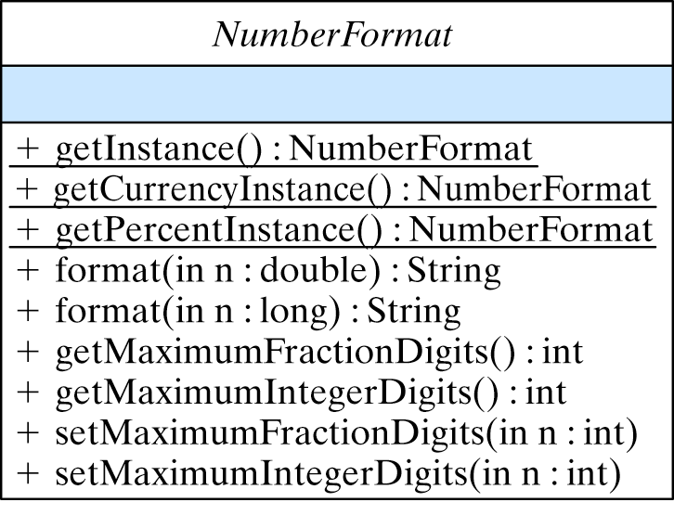
From the Java Library: NumberFormat
Java provides the java.text.NumberFormat class for representing currency and percentage values.
An abstract class cannot be instantiated...
…so use the static getInstance() methods to create an instance.

Slide 41
From the Java Library: NumberFormat
Java provides the java.text.NumberFormat class for representing currency and percentage values.
An abstract class cannot be instantiated...
public abstract class NumberFormat extends Format {
// Class methods
public static final NumberFormat getInstance();
public static final NumberFormat getCurrencyInstance();
public static final NumberFormat getPercentInstance();
// Public instance methods
public final String format(double number);
public final String format(long number);
public int getMaximumFractionDigits();
public int getMaximumIntegerDigits();
public void setMaximumFractionDigits(int newValue);
public void setMaximumIntegerDigits(int newValue);
}
…so use the getInstance() methods to create an instance.

Slide 42
Example: Calculating Compound Interest
Problem: Write an application that compares the difference between daily and annual compounding of interest for a Certificate of Deposit.
Use the formula a = p(1 + r)^{n}, where:
  a is the CD’s value at the end of the nth yr
  p is the principal or original investment amount
  r is the annual interest rate
  n is the number of years or compounding period
Effective Design: Method Length. Methods should be focused on a single task. If you find your method getting longer than 20-30 lines, divide it into separate methods.

Slide 43
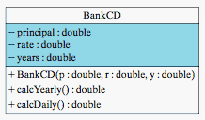
BankCD Implementation
Self-study Exercise 5.20. Design of the BankCD class for calculating interest compounded either yearly or daily.
public class BankCD
{ private double principal; // The CD's initial principal
private double rate; // CD's interest rate
private double years; // Number of years to maturity
public BankCD(double p, double r, double y)
{ principal = p;
rate = r;
years = y;
} // BandCD()
public double calcYearly()
{ return principal * Math.pow(1 + rate, years);
} // calcYearly()
public double calcDaily()
{ return principal * Math.pow(1 + rate/365, years*365);
} // calcDaily()
} // BankCD
Demo: TestBankCD.java and BankCD.java

Slide 44
Technical Terms
action
binary digit (bit)
binary operator
boundary value
cast operation
class constant
input-process-output
lexical order
named constant
operand
operator overloading
precedence order
promotion
representation
round-off-error
short-circuit evaluation
type conversion
unary operator
Unicode

Slide 45
Summary Of Important Points
Choosing an appropriate representation for a problem is often the key to solving it.
Scalability principle: a well-designed model or representation should be easily extensible.
Modularity principle: a well-designed representation contains methods that do not have to be modified each time the model is extended.
To evaluate complex expressions, it is necessary to understand the precedence order and associativity of the operators involved.
Parentheses can always be used to override an operator's built-in precedence.

Slide 46
Summary of Important Points (cont)
Java integer data: the 8-bit byte, 16-bit short, 32-bit int, and 64-bit long types. Integer literals are represented as int data in a Java program.
Java floating point data: the 32-bit float type and the 64-bit double type. Floating point literals are represented as float data.
If a data type uses n bits in its representation then it can represent 2^{n} different values.
Platform independence: Java’s primitive types are defined in terms of a specific number of bits.
Strong typing: Java distinguishes integer operations from floating point operations: (7/2) is 3, while (7.0/2) is 3.0.

Slide 47
Summary of Important Points
When revising a class that is used by other classes, it is a good idea to make it backward compatible. In revising a class that is used by other classes it is important to preserve as much of the class's interface as possible.
In Java, character data are based on the Unicode character set, which provides 2¹⁶ = 65,536 different character codes. To provide backwards compatibility with the ASCII code, the first 128 characters are the ASCII coded characters.

