Slide 1


JAVA, JAVA, JAVA
presentation slides for
Object-Oriented Problem Solving
Third Edition
Ralph Morelli | Ralph Walde
Trinity College
Hartford, CT
published by Prentice Hall

Slide 2
Java, Java, Java
Object Oriented Problem Solving
Chapter 6: Control Structures

Slide 3
Objectives
Be able to solve problems involving repetition.
Understand the difference among various loop structures.
Know the principles used to design effective loops.
Improve your algorithm design skills.
Understand the goals and principles of structured programming.

Slide 4
Outline
Flow of Control: Repetition Structures
Counting Loops
Example: Car Loan
Graphics Example: Drawing a Checkerboard
Conditional Loops
Examples: Computing Averages and Data Validation
Principles of Loop Design
The switch Multiway Selection Structure
Object-Oriented Design: Structured Programming

Slide 5
Flow-of-Control: Repetition Structures
Repetition structure: a control structure that repeats a statement or a sequence of statements.
Many programming tasks require a repetition structure.
If number of iterations is known, use a counting loop:
  Counting the number of times the letter ‘a’ occurs in a document:
  Printing the numbers between 1 and 5000 on invitation cards:
initialize totalAs to 0
for each character in the document
if the character is an 'a'
add 1 to totalAs
return totalAs as the result
for each number, N, from 1 to 5000
print N on the invitation card

Slide 6
Flow-of-Control: Repetition Structures
If number of iterations is unknown, we can use a conditional loop.
  Searching through the file for a student’s record:
  Computing the average monthly bear sightings:
repeat the following steps
read a record from the file
until Erika Wilson's record is read
compute Erika Wilson's GPA
return gpa as the result
initialize sumOfBears and numOfMonths to 0
repeat the following steps
read a number from the keyboard
add it to the sumOfBears
add 1 to numOfMonths
until the user wants to stop
divide sumOfBears by numOfMonths giving average

Slide 7
Counting Loops
The for statement is used for counting loops.
Zero-indexing: the loop counter or loop variable k, iterates between 0 and 99.
For statement syntax:
for (int k = 0; k < 100; k++) // For 100 times
System.out.println("Hello"); // Print "Hello"
for ( initializer ; loop entry condition ; updater )
for loop body ;

Slide 8
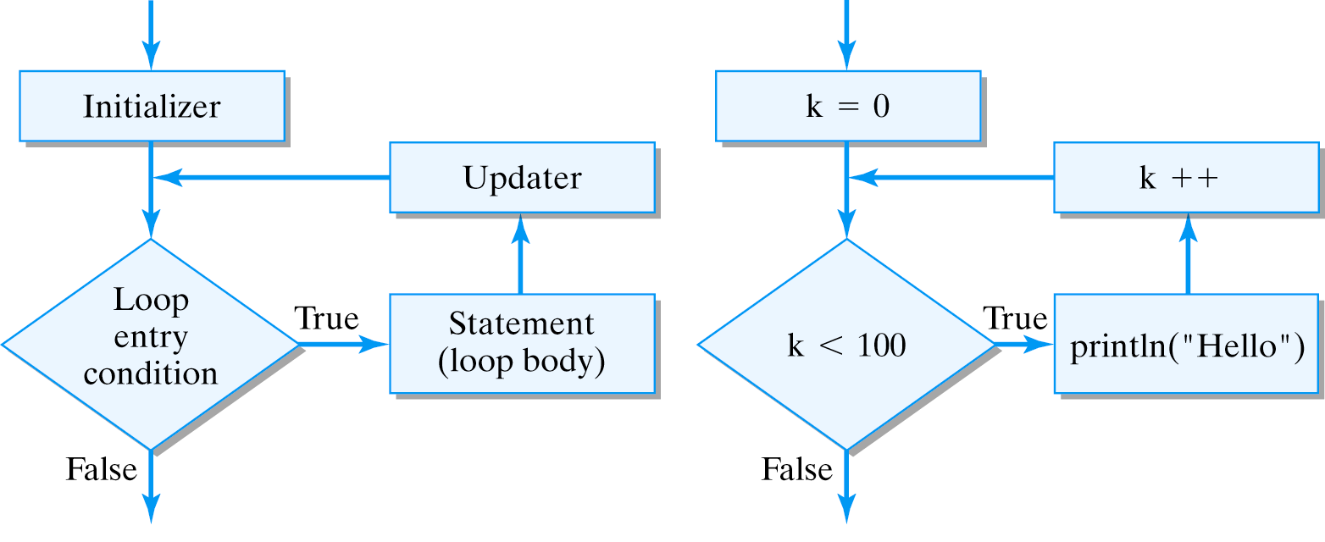
The For Structure
Syntax:
Semantics:
for ( k = 0 ; k < 100 ; k++ )
System.out.println(“Hello”);

Slide 9
Loop Variable Scope
If k is declared within the for statement, it cannot be used after the for statement:
for (int k = 0; k < 100; k++)
System.out.println("Hello");
System.out.println("k = " + k); // Syntax error, k is undeclared
If k is declared before the for statement, it can be used after the for statement:
int k = 0; // Declare the loop variable here
for (k = 0; k < 100; k++)
System.out.println("Hello");
System.out.println("k = " + k); // So it can be used here

Slide 10
Loop Bounds
A counting loop starts at an initial value and counts 0 or more iterations until its loop bound is reached.
The loop entry condition tests whether the loop bound has been reached.
public void countdown() {
for (int k = 10; k > 0; k--)
System.out.print(k + " ");
System.out.println("BLASTOFF");
} // countdown()
The updater must make progress toward the bound.
Infinite loop: A loops that fails to reach its bound.

Slide 11
Infinite Loops
Infinite loop examples:
for (int k = 0; k < 100 ; k--) // k goes 0, -1, -2, ...
System.out.println("Hello");
for (int k = 1; k != 100 ; k+=2) // k goes 1,3,…,99,101,...
System.out.println("Hello");
for (int k = 98; k < 100 ; k = k / 2) // k goes 98,49,24, …, 0,0,0
System.out.println("Hello");
In each case the updater fails to make progress toward the bound and the loop entry condition never becomes false.

Slide 12
Loop Indentation
Indentation improves readability.
The loop’s meaning is determined by its syntax.
Equivalent loops:
for (int k = 10 ; k > 0 ; k--) // Loop heading
System.out.print (k + " "); // Indent the body
System.out.println( "BLASTOFF" ); // After the loop
for (int k = 10 ; k > 0 ; k--)
System.out.print (k + " ");
System.out.println("BLASTOFF");
for (int k = 10 ; k > 0 ; k--) System.out.print(k + " ");
System.out.println("BLASTOFF");
for
(int k = 10 ; k > 0 ; k--)
System.out.print (k + " ");
System.out.println("BLASTOFF");

Slide 13
Compound Loop Body
Compound statement or block :a sequence of statements enclosed within braces, {...}.
For loop body: Can be a simple or compound statement.
for (int k = 0; k < 100; k++) // Print 0 5 10 15 ... 95
if (k % 5 == 0) // Loop body is a single if statement
System.out.println("k= " + k);
for (char k = 'a' ; k <= 'z'; k++) // Print 'a' 'b' 'c' ... 'z'
System.out.print (k + " "); // Loop body is a single print()
for (int k = 1 ; k <= 10; k++) { // Print 5 10 15 20 ... 50
int m = k * 5; // Begin body
System.out.print (m + " ");
} // End body
for (int k = 1 ; k <= 10; k++)
int m = k * 5; // Loop body
System.out.print (m + " "); // Syntax error: Outside scope of loop
Compound statement.
Debugging Tip: Don’t forget the braces!

Slide 14
Nested Loops
Suppose you wanted to print the following table:
1 2 3 4 5 6 7 8 9
2 4 6 8 10 12 14 16 18
3 6 9 12 15 18 21 24 27
4 8 12 16 20 24 28 32 36
You could use a nested for loop. The outer loop prints the four rows and in each row, the inner loop prints the 9 columns.
for (int row = 1; row <= 4; row++) { // For each of 4 rows
for (int col = 1; col <= 9; col++) // For each of 9 columns
System.out.print(col * row + "\t"); // Print 36 numbers
System.out.println(); // Start a new row
} // for row

Slide 15
Nested Loops (cont.)
The table shows the relationship between the row and column variables needed to print the following triangular pattern:
# # # # #
# # # #
# # #
# #
#
You could use the following nested for loop.
for (int row = 1; row <= 5; row++) { // For each row
for (int col = 1; col <= 6 - row; col++) // Print the row
System.out.print('#');
System.out.println(); // And a new row
} // for row

Slide 16
Example: Car Loan Table
Design a program to print a table for the total cost of car financing options.
Loan Rates
Years
8% 9% 10% 11%
Year 2 $23,469.81 $23,943.82 $24,427.39 $24,920.71
Year 3 $25,424.31 $26,198.42 $26,996.07 $27,817.98
Year 4 $27,541.59 $28,665.32 $29,834.86 $31,052.09
Year 5 $29,835.19 $31,364.50 $32,972.17 $34,662.19
Year 6 $32,319.79 $34,317.85 $36,439.38 $38,692.00
Year 7 $35,011.30 $37,549.30 $40,271.19 $43,190.31
Year 8 $37,926.96 $41,085.02 $44,505.94 $48,211.60
Nested loop algorithm: Outer loop iterates over the years 2 through 8. The inner loop iterates over the rates 8 through 11.
Cost Formula: a = p(1 +r)^{n} where total cots is a, for a loan of p at a rate of r for a period of n years.

Slide 17
Implementation: CarLoan Class
NumberFormat formats the output.
import java.text.NumberFormat;
public class CarLoan {
public static void main(String args[]) {
double carPrice = 20000; // Car's actual price
double carPriceWithLoan; // Cost of the car plus financing
NumberFormat dollars = NumberFormat.getCurrencyInstance();
NumberFormat percent = NumberFormat.getPercentInstance();
percent.setMaximumFractionDigits(2);
// Print table
for (int rate = 8; rate <= 11; rate++) // Print column heading
System.out.print("\t" + percent.format(rate/100.0) + "\t" );
System.out.println();
for (int years = 2; years <= 8; years++) { // For years 2..8
System.out.print("Year " + years + "\t"); // Print row heading
for (int rate = 8; rate <= 11; rate++) { // Calc and print value
carPriceWithLoan = carPrice *
Math.pow(1 + rate / 100.0 / 365.0, years * 365.0);
System.out.print(dollars.format(carPriceWithLoan) + "\t");
} // for rate
System.out.println(); // Start a new row
} // for years
} // main()
} // CarLoan

Slide 18

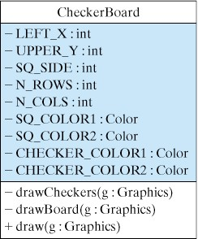
Checkerboard Example (Graphics)
A class to draw a checkerboard and checkers.
We use an applet as the GUI and the CheckerBoard class as the computational object.
Class constants.
import java.awt.*;
import java.applet.*;
import javax.swing.*;
public class CheckerBoardApplet extends JApplet {
private CheckerBoard theBoard;
public void init() {
theBoard = new CheckerBoard();
}
public void paint(Graphics g) {
theBoard.draw(g);
} // paint()
} // CheckerBoardApplet

Slide 19
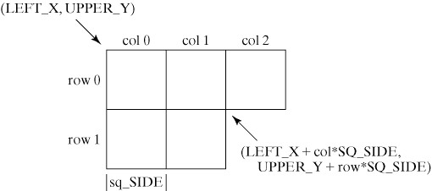
CheckerBoard Implementation
Calculating the locations of the checkerboard squares.
Note the use of class constants
Click here for Demo of Checkboard
CheckerBoard.java
CheckerBoardApplet.java

Slide 20
Conditional Loops
3N + 1 problem: If N is any positive integer, then the sequence generated by the following rules will always terminate at 1:
Non-counting algorithm:
The loop iterates as long as N != 1
Algorithm for computing the 3N+1 sequence
While N is not equal to 1, do: {
Print N.
If N is even, divide it by 2,
otherwise multiply N by 3 and add 1.
}
Print N
Sentinel bound. The loop terminates when N equals the sentinel value 1.

Slide 21
The While Structure
While structure to solve the 3N+1 problem:
Initializer
Loop entry condition
N = 50;
while (N != 1) { // While N not 1
System.out.print(N + " "); // Print N
if (N % 2 == 0) // If N is even
N = N / 2; // divide it by 2
else // If N is odd
N = 3 * N + 1; // multiply N by 3 and add 1
}
System.out.println(N); // Print N
Loop body
Updaters
Java’s while statement:
Unlike the for statement, the while statement has no built-in initializer and updater.
while ( loop entry condition )
loop body ;

Slide 22
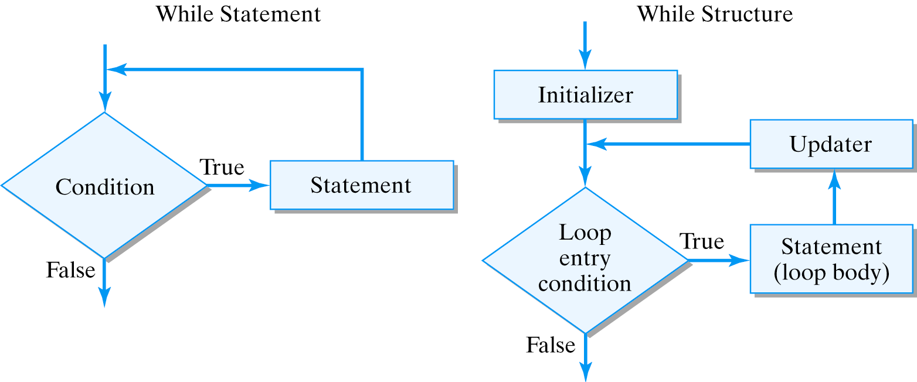
Principles of the While Structure
Effective Design: Loop structure. A loop structure must include an initializer, a boundary condition, and an updater. The updater should guarantee that the boundary condition is reached, so the loop will eventually terminate.

Slide 23
The Do-While Structure
Problem: How many days will it take for half the lawn to disappear if it loses 2% of its grass a day?
Initializer
public int losingGrass(double perCentGrass) {
double amtGrass = 100.0; // Initialize amount of grass
int nDays = 0; // Initialize day counter
do { // Repeat
amtGrass -= amtGrass * LOSSRATE; // Update grass
++nDays; // Increment days
} while (amtGrass > perCentGrass); // While 50% grass
return nDays / 7; // Return number of weeks
} // losingGrass()
Updater
Loop body
Limit bound: Terminate when a limit is reached.
Java’s do-while statement :
do
loop body
while ( loop entry condition ) ;
No built-in initializer or updater.

Slide 24
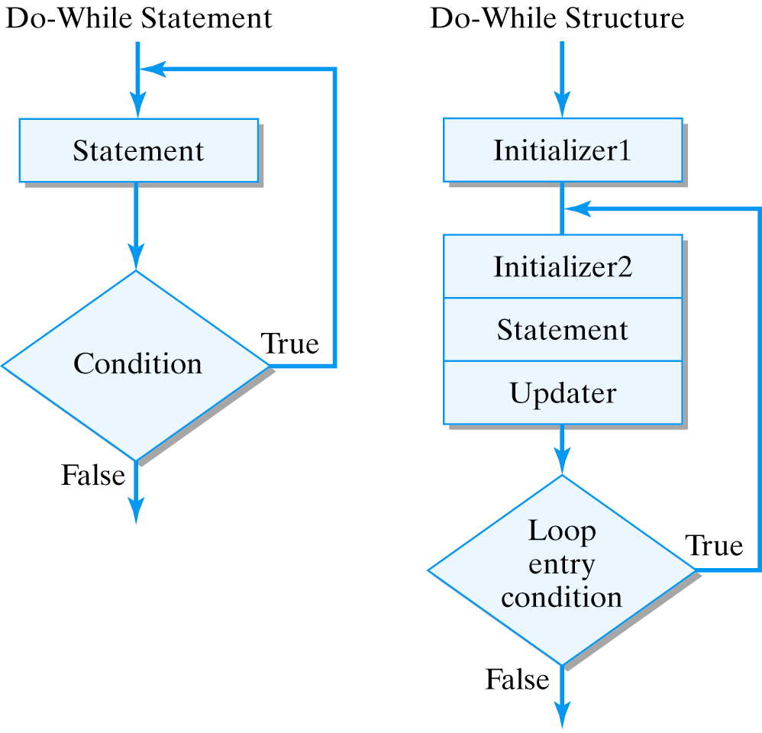
Principles of the Do-While Structure
Effective Design: Do-While Structure.
The do-while loop is designed for solving problems in which at least one iteration must occur.

Slide 25
Example: Computing Averages
Problem: Compute your exam average. Grades, represented as real numbers will be input from the keyboard using the sentinel value 9999 to signify the end of the list.
While loop works even if no grades are entered
initialize runningTotal to 0 // Initialize
initialize count to 0
prompt and read the first grade // Priming read
while the grade entered is not 9999 { // Sentinel bound
add it to the runningTotal
add 1 to the count
prompt and read the next grade // Update
}
if (count > 0) // Guard against dividing by 0
divide runningTotal by count
output the average as the result
Priming read: Read a value to initialize loop variable and to update it

Slide 26
Design: Modularity and Localization
Design: Use a KeyboardReader I/O and use separate methods for input and averaging tasks.
private KeyboardReader reader = new KeyboardReader();
public double inputAndAverageGrades() {
double runningTotal = 0;
int count = 0;
double grade = promptAndRead(); // Initialize: priming input
while (grade != 9999) { // Loop test: sentinel
runningTotal += grade;
count++;
grade = promptAndRead(); // Update: get next input
} // while
if (count > 0) // Guard against divide-by-zero
return runningTotal / count; // Return the average
else
return 0; // Special (error) return value
}
private double promptAndRead() throws IOException {
reader.prompt("Input grade (e.g., 85.3) or 9999 ” +
"to indicate the end of the list >> ");
double grade = reader.getKeyboardDouble();
System.out.println("You input " + grade + "\n");
return grade;
}

Slide 27
Design Issues
Effective Design: Modularity. Encapsulating code in a method helps reduce redundancy and makes it easier to debug and modify.
Effective Design: Method Decomposition. Methods should have a clear focus. Methods that are too long should be divided into separate methods.
Effective Design: User Interface. Use prompts to inform the user why you are asking for input and what you are asking for. It's also a good idea to confirm that the program has received the correct input.

Slide 28
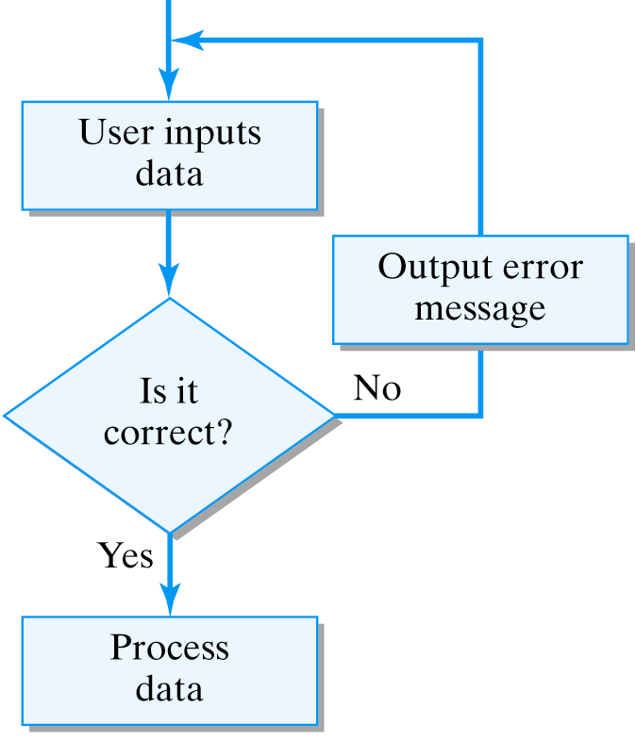
Example: Data Validation
Problem: Modify the previous program so that it won’t accept erroneous input data. Neither -10 nor 155 should be accepted as valid exam grades.
Algorithm: Use a do-while loop for this task because the user may take one or more attempts to input a valid grade:
Initialization and update are done by the same statement
do
Get the next grade // Initialize: priming input
if the grade < 0 or grade > 100 and grade != 9999 // Error case
print an error message
while the grade < 0 or grade > 100 and grade != 9999 // Sentinel test
// Continue on to compute the average

Slide 29
Main Program for Computing the Average
Object for reading keyboard input.
import java.io.*;
public class Validate {
private KeyboardReader input = new KeyboardReader();
// Stuff missing here
public static void main( String argv[] ) {
System.out.println("This program calculates average grade."); // Prompt
Validate avg = new Validate();
double average = avg.inputAndAverageGrades();
if (average == 0) // Error case
System.out.println("You didn't enter any grades.");
else
System.out.println("Your average is " + average );
} // main()
} // Validate
A basic input-process-output algorithm.
SourceCode/Demo: Validate.java
I/O Object: KeyboardReader.java

Slide 30
Principles of Loop Design
A counting loop can be used if you know in advance how many iterations are needed. The for statement is used for counting loops.
A while structure should be used if the loop body may be skipped entirely. The while statement is used.
A do-while structure should be used only if a loop requires one or more iterations. The do-while-statement should be used.
The loop variable, which is used to specify the loop entry condition, must be initialized to an appropriate value and updated on each iteration.

Slide 31
Principles of Loop Design
A loop's bound, which may be a count, a sentinel, or, more generally, a conditional bound, must be correctly specified in the loop-entry expression, and progress toward it must be made in the updater.
An infinite loop may result if either the initializer, loop-entry expression, or updater expression is not correctly specified.

Slide 32
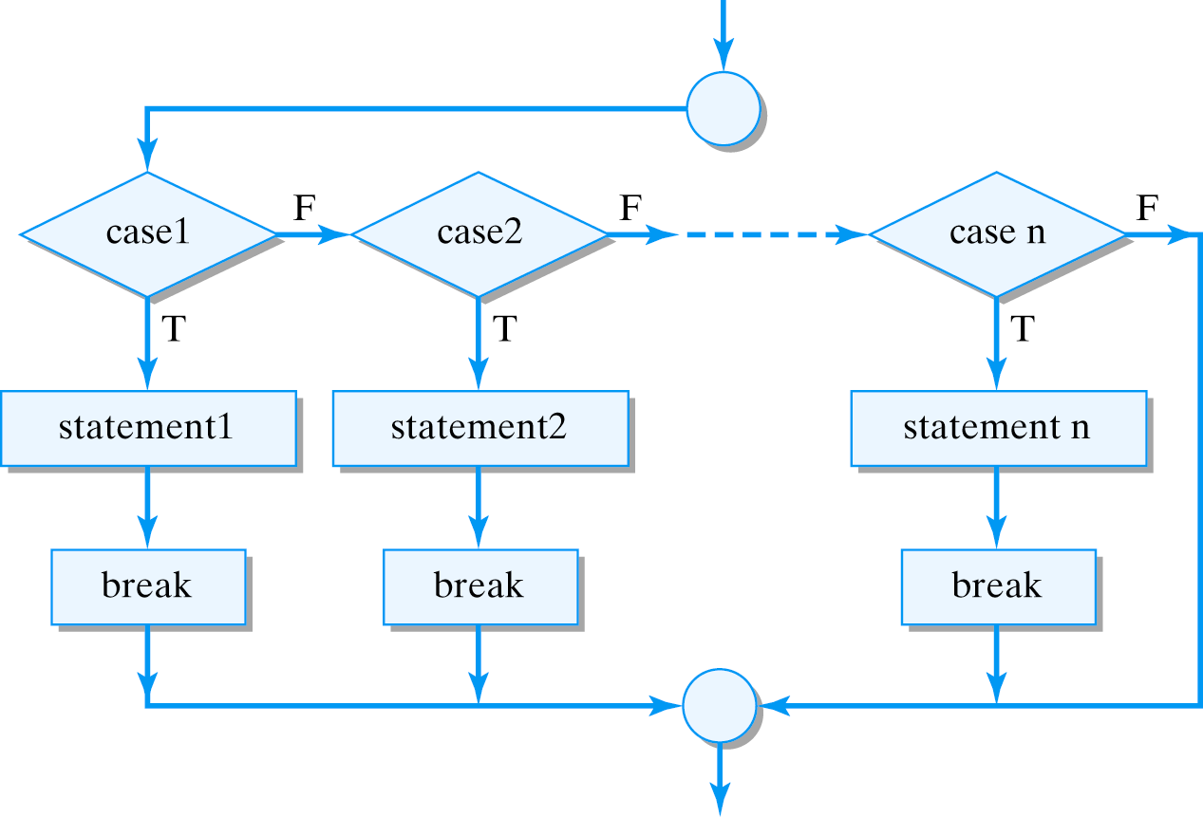
The Switch/Break Structure
Multiway selection can also be done with the switch/break structure.
switch ( integralExpression )
{
case integralValue2 :
statement1;
break;
case integralValue2 :
statement2;
break;
…
case integrealValueN :
statementN;
break;
default:
statementDefault;
}

Slide 33
Switch/Break Examples
Correct: Prints m=2
Error: Prints ch=b.ch=c, default
int m = 2;
switch (m) {
case 1 :
System.out.println(“m=1”);
break;
case 2 :
System.out.println(“m=2”);
break;
case 3 :
System.out.println(“m=3”);
break;
default:
System.out.println(“default”);}
char ch = ‘b’;
switch (ch) {
case ‘a’ :
System.out.println(“ch=a”);
case ‘b’ :
System.out.println(“ch=b”);
case ‘c’ :
System.out.println(“ch=c”);
default:
System.out.println(“default”);
}

Slide 34
Structured Programming
Structured programming: uses a small set of predefined control structures.
  Sequence --- The statements in a program are executed in sequential order unless their flow is interrupted by one of the following control structures.
  Selection--- The if, if/else, and switch statements are branching statements that allow choice by forking of the control path into two or more alternatives.
  Repetition --- The for, while, and do-while statements are looping statements that allow the program to repeat a sequence of statements.
  Method Call --- Invoking a method transfers control temporarily to a named method. Control returns to the point of invocation when the method is completed.

Slide 35
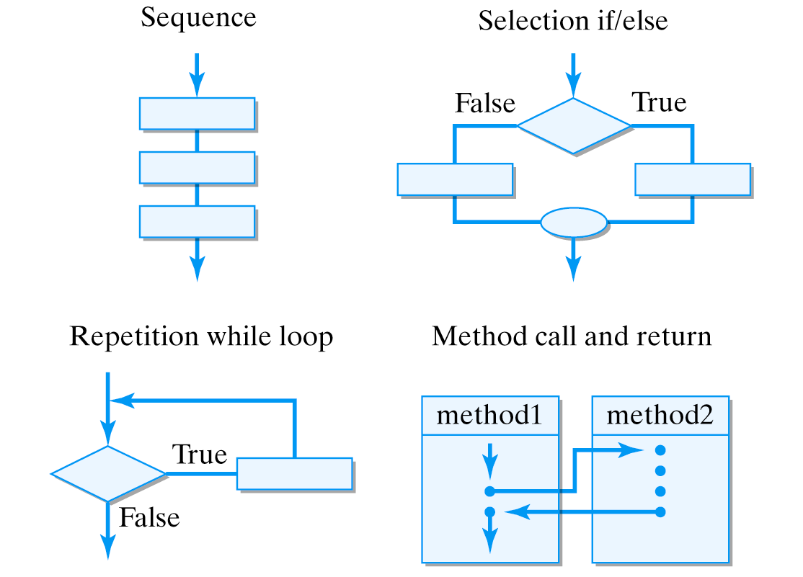
Structured Programming Constructs
No matter how large or small a program is, its flow of control can be built as a combination of these four structures.
Note that each structure has one entry and one exit.

Slide 36
Debugging: Structured vs. Unstructured Code
Unstructured Code uses goto Statement
k = 0; // 1. Unstructured code
System.out.println("k= " + k); // 2. k should equal 0 here
goto label1; // 3.
label2:
System.out.println("k= " + k); // 4. k should equal 1 here
With a goto statement, there’s no guarantee control will return to line 4.
Problem: If k does not equal 1 on line 4, how would you find the bug?
With a method call, control must return to line 4.
Structured Code uses a method call
k = 0; // 1. Unstructured code
System.out.println("k= " + k); // 2. k should equal 0 here
someMethod(); // 3.
System.out.println("k= " + k); // 4. k should equal 1 here

Slide 37
Preconditions and Postconditions
A precondition is a condition that must be true before some segment of code is executed.
A postcondition is a condition that must be true after some segment of code is executed.
Example: Pre- and postconditions for an assignment:
int k = 0; // Precondition: k == 0
k = 5; // Assignment to k
// Postcondition: k == 5
Example: Pre- and postconditions for a loop:
int k = 0; // Precondition: k == 0
while (k < 100) { // While loop
k = 2 * k + 2;
}
// Postcondition: k >= 100

Slide 38
Defensive Programming
/**
* factorial(n) -- factorial(n) is 1 if n is 0
* factorial(n) is n * n-1 * n-2 * ... * 1 if n > 0
* Precondition: n >= 0
* Postcondition: factorial(n) = 1 if n = 0
* = n * n-1 * n-2 * ... * 1 if n > 0
*/
public int factorial(int n) {
if (n < 0) {
System.out.println(“Error in factorial():, n = “ + n);
System.exit(0);
}
if (n == 0)
return 1;
else {
int f = 1; // Init a temporary variable
for (int k = n; k >= 1; k--) // For n down to 1
f = f * k; // Accumulate the product
return f; // Return the factorial
}
} // factorial()
Defensive Programming: If the precondition fails, report the error.
If precondition is OK, compute the factorial.

Slide 39
Using Preconditions and Postconditions
Design stage: Using pre- and postconditions helps clarify the design and provides a precise measure of correctness.
Implementation and testing stage: Test data can be designed to demonstrate that the preconditions and postconditions hold for any method or code segment.
Documentation stage: Using pre- and postconditions to document the program makes the program more readable and easier to modify and maintain.
Debugging stage: Using the pre- and postconditions provides precise criteria that can be used to isolate and locate bugs. A method is incorrect if its precondition is true and its postcondition is false. A method is improperly invoked if its precondition is false.

Slide 40
Design/Programming Tips
Preconditions and postconditions are an effective way of analyzing the logic of your program's loops and methods. They should be identified during the design phase and used throughout development, testing and debugging , and included in the program's documentation.
Develop your program's documentation at the same time that you develop its code.
Acquire and use standard programming techniques for standard programming problems. For example, using a temporary variable to swap the values of two variables is an example of a standard technique.
Use methods wherever appropriate in your own code to encapsulate important sections of code and thereby reduce complexity.

Slide 41
Technical Terms
conditional loop counting loop do-while statement
for statement infinite loop initializer
limit bound loop body loop bound
loop-entry condition nested loop postcondition
pre-condition repitition structure sentinel bound
switch/break structure unit indexing updater
while statement zero indexing

Slide 42
Summary Of Important Points
A repetition structure is a control structure that allows a statement or sequence of statements to be repeated.
All loop structures involve three elements -- an initializer, a loop entry condition or a loop boundary condition, and an updater.
Structured programming is the practice of writing programs that are built up from a small set of predefined control structures -- sequence, selection, repetition and method-call. An important feature of these structures is that each has a single entry and exit.
A precondition is a condition that must be true before a certain code segment executes. A postcondition is a condition that must be true when a certain code segment is finished. Preconditions and postconditions should be used in the design, coding, documentation, and debugging of algorithms and methods.

