Slide 1

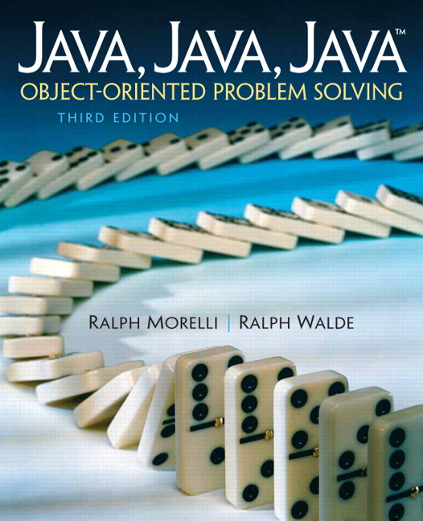
JAVA, JAVA, JAVA
presentation slides for
Object-Oriented Problem Solving
Third Edition
Ralph Morelli | Ralph Walde
Trinity College
Hartford, CT
published by Prentice Hall

Slide 2
Java, Java, Java
Object Oriented Problem Solving
Chapter 7: Strings and String Processing

Slide 3
Objectives
Be more familiar with Java Strings.
Know how to solve problems that involve manipulating strings.
Be able to use loops in designing string processing algorithms.

Slide 4
Outline
Introduction
Basics of the Java String Type
Finding Things within a String
Example: Keyword Search
From the Java Library: StringBuffer
Retrieving Parts of Strings
Example: Processing Names and Passwords
Processing Each Character in a String
Comparing Strings
From the Java Library: StringTokenizer
Handling Text in a Graphics Context (Optional)

Slide 5
Introduction
A data structure is a collection of data that is organized (structured) in some way.
A string is a collection of character (char) data. Strings are important data structures in a programming language
Strings are used to represent a wide variety of data.
In Java, the Object.toString() method represents an object as a string.

Slide 6
String Basics
A java.lang.String object is a sequence of characters plus a collection of methods for manipulating strings.
Unlike other Java objects, Strings have certain characteristics in common with the primitive data types.
For example, strings can have literals. A String literal is a sequence of zero or more characters contained in double quotes -- for example, “Socrates” and “” (empty string).

Slide 7
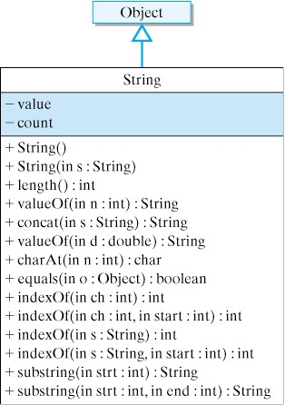
The String Class

Slide 8
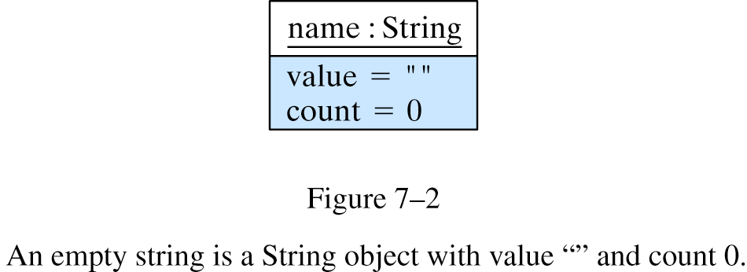
Constructing Strings
The String constructors:
public String(); // Creates an empty string
public String(String initial_value); // Creates a copy of a string
The following constructor statement creates a String object and makes name a reference to it:
String name = new String();
String instance variables.

Slide 9
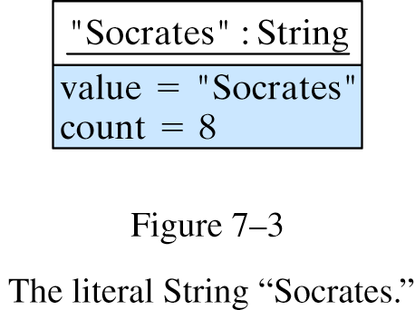
Constructing Strings (cont)
A literal -- e.g., “Socrates” -- is considered a reference to a String object. All occurrences of “Socrates” in a program refer to the same object.

Slide 10
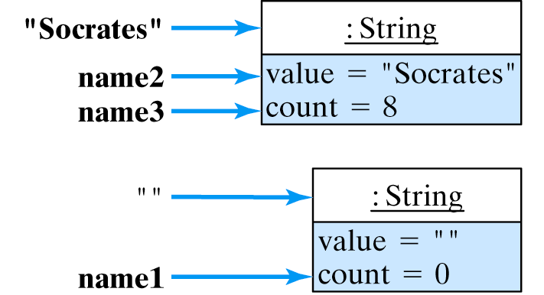
Constructing Strings (cont)
When literals are assigned to String variables Java makes those variables serve as references to the literals.
String name1 = ""; // Reference to the empty string
String name2 = "Socrates"; // References to "Socrates"
String name3 = "Socrates";

Slide 11
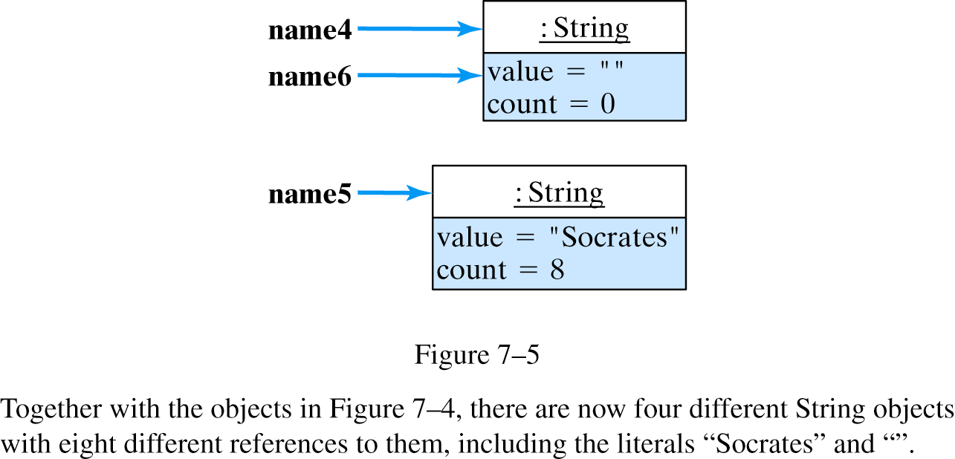
Constructing Strings (cont)
New String objects are created whenever the String constructors are used:
String name4 = new String(); // Creates an object
String name5 = new String("Socrates");
String name6 = name4;

Slide 12
Concatenating Strings
When surrounded on either side by a String, the + symbol is used as a binary concatenation operator. It has the effect of joining two strings together.
String lastName = "Onassis";
String jackie = new String("Jacqueline " + "Kennedy " + lastName);
“Jacqueline Kennedy Onassis”
Primitive types are automatically promoted to strings when mixed with concatenation operators.
System.out.println("The square root of 25 = " + 5);
Output: The square root of 25 = 5

Slide 13
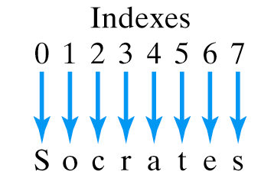
Indexing Strings
The number of characters in a string is its length.
String string1 = ""; // string1.length() ==> 0
String string2 = "Hello"; // string2.length() ==> 5
String string3 = "World"; // string3.length() ==> 5;
String string4 = string2 + " " + string3; // string4.length() ==> 11;
The position of a character within a string is called its index. Strings are zero indexed -- the first character is at index 0.
Note: Because of zero indexing, the last character in a string of 8 characters is at index 7.

Slide 14
Converting Data to String
The String.valueOf() methods are class methods that convert primitive types into String objects.
static public String valueOf( primitive type );
String number = new String (String.valueOf(128)); // Creates "128"
String truth = new String (String.valueOf(true)); // Creates "true"
String bee = new String (String.valueOf('B')); // Creates "B"
String pi = new String(String.valueOf(Math.PI)); // Creates "3.14159"
Recall that one refers to class methods by using the class name as the qualifier.
Note the difference between ‘B’ and “B”

Slide 15
Finding Things within a String
The indexOf() and lastIndexof() methods are instance methods that can be used to find the index position of a character or a substring within a String.
public int indexOf(int character);
public int indexOf(int character, int startingIndex);
public int indexOf(String string);
public int indexOf(String string, int startingIndex);
public int lastIndexOf(int character);
public int lastIndexOf(int character, int startingIndex);
public int lastIndexOf(String string);
public int lastIndexOf(String string, int startingIndex);

Slide 16
IndexOf() and LastIndexOf()
The indexOf() method searches from left to right within a String for either a character or a substring.
The lastIndexOf() method searches from right to left for a character or substring.
String string1 = "";
String string2 = "Hello";
String string3 = "World";
String string4 = string2 + " " + string3;
string1.indexOf('o') ==> -1 string1.lastIndexOf('o') ==> -1
string2.indexOf('o') ==> 4 string2.lastIndexOf('o') ==> 4
string3.indexOf('o') ==> 1 string3.lastIndexOf('o') ==> 1
string4.indexOf('o') ==> 4 string4.lastIndexOf('o') ==> 7
A return value of -1 means the character is not in the string.

Slide 17
IndexOf() and LastIndexOf()
The indexOf() and lastIndexOf() methods can also be used to find substrings, such as “or”.
String string1 = "";
String string2 = "Hello";
String string3 = "World";
String string4 = string2 + " " + string3;
string1.indexOf("or") ==> -1 string1.lastIndexOf("or") ==> -1
string2.indexOf("or") ==> -1 string2.lastIndexOf("or") ==> -1
string3.indexOf("or") ==> 1 string3.lastIndexOf("or") ==> 1
string4.indexOf("or") ==> 7 string4.lastIndexOf("or") ==> 7
A return value of -1 means that “or” is not in the string.

Slide 18
Example: Keyword Search
Finding a keyword within a string is a task that word processors and browsers must do.
Algorithm Design: Find every occurrence of some keyword, K, within a string, S:
Suppose S is our string and K is the keyword.
Initialize a counter variable and result string.
Set P to the indexOf() the first occurrence of K in S.
While ( P != -1 )
Increment the counter
Insert P into the result string
Set P to the next location of the keyword in S
Insert the count into the result string
Return the result string as a String
While loop because there may be 0 or more occurrences.
When P is -1, there are no more occurrences of K in S.

Slide 19
Implementation: Keyword Search
/**
* Pre: s and keyword are any Strings
* Post: keywordSearch() returns a String containing the
* number of occurrences of keyword in s, followed
* by the starting location of each occurrence
*/
public String keywordSearch(String s, String keyword) {
String resultStr = "";
int count = 0;
int ptr = s.indexOf(keyword);
while (ptr != -1) {
++count;
resultStr = resultStr + ptr + " ";
ptr = s.indexOf(keyword, ptr + 1); // Find next occurrence
}
resultStr = count + ": " + resultStr; // Insert the count
return resultStr; // Return as a String
} // keywordSearch()
Bound: When ptr is -1, no more occurrences of s.
Initializer
Updater
Test Performed Expected Result
keywordSearch( "this is a test","is") 2: 2 5
keywordSearch( "able was i ere i saw elba","a") 4: 0 6 18 24
keywordSearch( "this is a test","taste") 0:
Test data should test all possible outcomes.

Slide 20
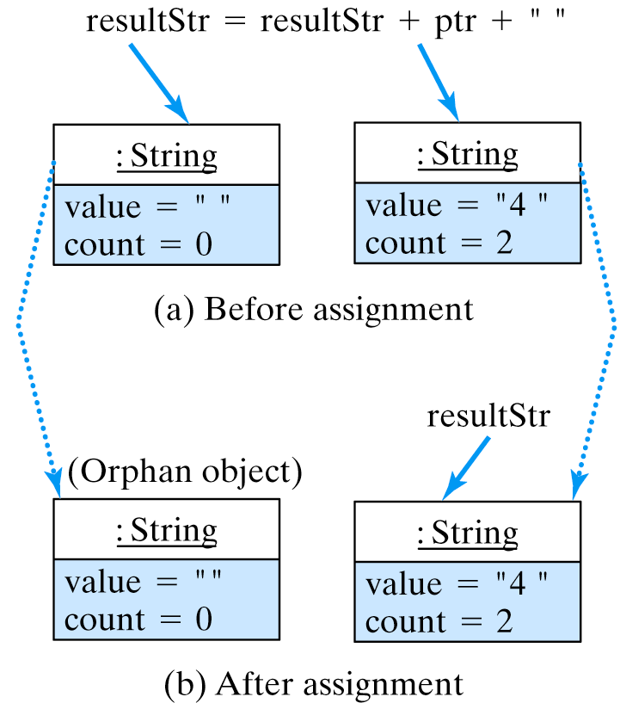
Automatic Garbage Collection
Immutability: Java Strings are cannot be modified. Whenever you assign a new value to a String, Java must create a new String object and discard the old one. In resultStr = resultStr + ptr + “ “;
Java will create a new object (b) referenced by resultStr:
The original resultStr object has no more references to it so it has to be garbage collected which takes time.
This is the new resultStr.

Slide 21
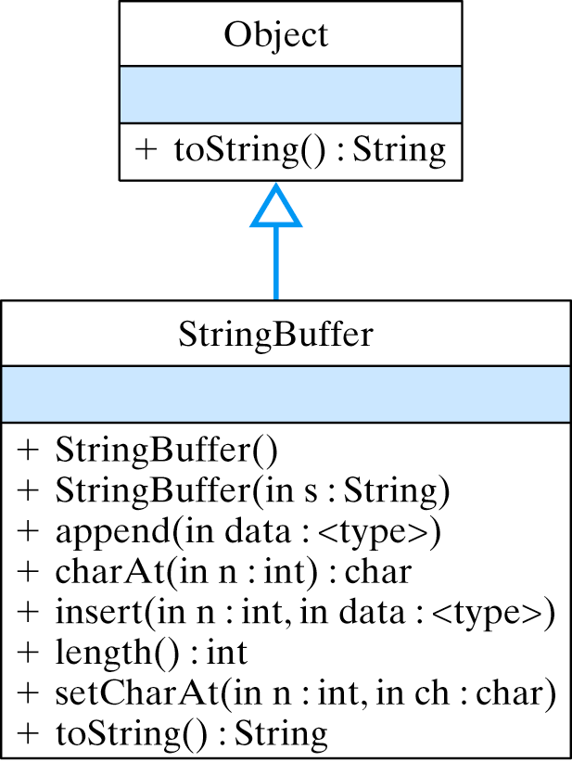
Library: java.lang.StringBuffer
Objects of java.lang.StringBuffer class are strings that can be modified. Some of its methods are:

Slide 22
The Revised keywordSearch()
public String keywordSearch(String s, String keyword) {
StringBuffer resultStr = new StringBuffer(); // Create StringBuffer
int count = 0;
int ptr = s.indexOf(keyword);
while (ptr != -1) {
++count;
resultStr.append(ptr + " "); // Insert letters into it
ptr = s.indexOf(keyword, ptr + 1);
}
resultStr.insert(0, count + ": ");
return resultStr.toString(); // Convert buffer back to a String
} // keywordSearch()
The revised keywordSearch() uses a local StringBuffer to build the result, but converts it back to String before returning.

Slide 23
Retrieving Parts of Strings
The String class contains methods to retrieve characters and substrings from a string.
Takes the substring from startIndex to the end of string.
public char charAt(int index)
public String substring(int startIndex)
public String substring(int startIndex, int endIndex)
Takes the substring from startIndex to endIndex
Note: endIndex points to index after the last character taken.
String str = "HelloWorld";
str.substring(5) ==> "World"
str.substring(3) ==> "loWorld";
// 0123456789
String str = "HelloWorld";
str.substring(5,7) ==> "Wo"
str.substring(0,5) ==> "Hello";
str.substring(5, str.length()) ==> "World"

Slide 24
Example: Names and Passwords
Problem: Suppose user names and passwords are stored as delimited strings where ‘:’ is the delimiter. Write methods to get the name and password.
Algorithm: Use the indexOf() and substring() methods.
smith:bg1s5xxx
mccarthy:2ffo900ssi
public String getName(String str) {
int posColon = str.indexOf(':'); // Find the delimiter
String result = str.substring(0, posColon); // Extract the name
return result;
}
public String getPassword(String str) {
int posColon = str.indexOf(':'); // Find the delimiter
String result = str.substring(posColon + 1); // Extract the password
return result;
}
These 3 could be a single statement:
return str.substring(0, str.indexOf(‘:’));

Slide 25
Processing Each Character in a String
For example, suppose you want to count the number of occurrences of a certain character in a string:
Use the string’s length as a bound.
// countChar counts the number of ch’s in str
// Precondition: Neither str nor ch are null
// Postcondition: countchar() == the number of ch in str
public int countChar(String str, char ch) {
int counter = 0; // Initialize a counter
for (int k = 0; k < str.length(); k++) // For each character
if (str.charAt(k) == ch) // If it's a ch
counter++; // count it
return counter; // Return the result
}
Possible off-by-one Error: Remember that the last character in a string is at index length()-1.

Slide 26
Method Design: reverse()
reverse() reverses the letters in its String parameter.
A StringBuffer is used to construct the reverse of s.
/**
* Pre: s is any non null string
* Post: s is returned in reverse order
*/
public String reverse(String s) {
StringBuffer result = new StringBuffer();
for (int k = s.length() -1; k >= 0; k--) {
result.append(s.charAt(k));
} //for
return result.toString();
} // reverse()
The result must be converted back to a String.

Slide 27
Method Design: capitalize()
capitalize() converts its parameter into a string with an initial capital letter (Capitalize).
Note use of toUpperCase(char) method.
/**
* Pre: s is any non null string
* Post: s is returned with only its first letter capitalized
*/
public String capitalize(String s) {
if (s.length() == 0)
return s;
StringBuffer result = new StringBuffer();
result.append(toUpperCase(s.charAt(0))); // Change first to UPPERCASE
for (int k = 1; k < s.length(); k++) { // Convert every other letter
result.append(toLowerCase(s.charAt(k)));
} //for
return result.toString();
} // capitalize()
private char toUpperCase(char ch) {
if ((ch >= ‘a’) && (ch <= ‘z’))
return (char)(ch - 32); // Explicit cast required
return ch;
}

Slide 28
Miscellaneous String Methods
The String class contains additional useful string manipulation methods, including the following:
Method Signature Example Value
boolean endsWith( String suffix) "Perfection".endsWith("tion") true
boolean startsWith(String prefix) "Perfection".startsWith("Per") true
String toUpperCase() "Perfection".toUpperCase() "PERFECTION"
String toLowerCase() "Perfection".toLowerCase() "perfection"
String trim() " Perfection ".trim() "Perfection"
Note that methods such as toUpperCase(), toLowerCase(), and trim() produce a new String object because Strings cannot be modified.

Slide 29
Comparing Strings
Strings are compared according to their lexicographic order.
Def: For strings s1 and s2, s1 precedes s2 in lexicographic order if its first character precedes the first character of s2. If their first characters are equal, then s1 precedes s2 if its second character precedes the second character of s2, and soon. Finally, the empty string is handled as a special case, preceding all other strings.
The following strings are arranged in lexicographic order:
" " "!" "0" "A" "Andy" "Z" "Zero" "a" "an" "and" "andy" "candy" "zero"

Slide 30
Lexicographic Order
A Java method that implements our definition of lexicographic order.
public boolean precedes(String s1, String s2) {
int minlen = Math.min(s1.length(), s2.length()); // Pick shorter length
int k = 0; // Start at the first character
while (k < minlen) { // While more characters
if (s1.charAt(k) < s2.charAt(k)) // If kth s1 < kth in s2
return true; // then s1 precedes s2
else if (s2.charAt(k) < s1.charAt(k)) // If kth in s2 < kth in s1
return false; // s1 does not precede s2
else // If neither case
k++; // go on to the next character
} // while
return s1.length() < s2.length(); // If all characters so far are equal
} // precedes() // s1 < s2 if it is shorter than s2

Slide 31
String Identity vs. String Equality
Methods for comparing strings:
public boolean equals(Object anObject); // Overrides Object.equals()
public boolean equalsIgnoreCase(String anotherString)
public int compareTo(String anotherString)
Two strings are equal if they have the same letters in the same order:
String s1 = "hello";
String s2 = "Hello";
s1.equals(s2) // false
s1.equals("hello”); // true
Error: Using == to compare two strings. For objects, o1 == o2 means o1 and o2 are identical.
The == operator is equivalent to Object.equals() method: o1.equals(o2) means o1 and o2 are identical.

Slide 32
String Identity vs. String Equality (cont)
Given the following declarations
We get the following equality results
String s1 = new String("hello");
String s2 = new String("hello");
String s3 = new String("Hello");
String s4 = s1; // s1 == s4
String s5 = "hello";
String s6 = "hello";
s1.equals(s2) ==> true
s1.equals(s3) ==> false
s1.equalsIgnoreCase(s3) ==> true
s1.equals(s4) ==> true
s1.equals(s5) ==> true
s1.equals(s6) ==> true
And the following identity results
s5 and s6 refer to the same (identical) literal object.
s1 == s2 ==> false
s1 == s3 ==> false
s1 == s4 ==> true
s1 == s5 ==> false
s5 == s6 ==> true

Slide 33
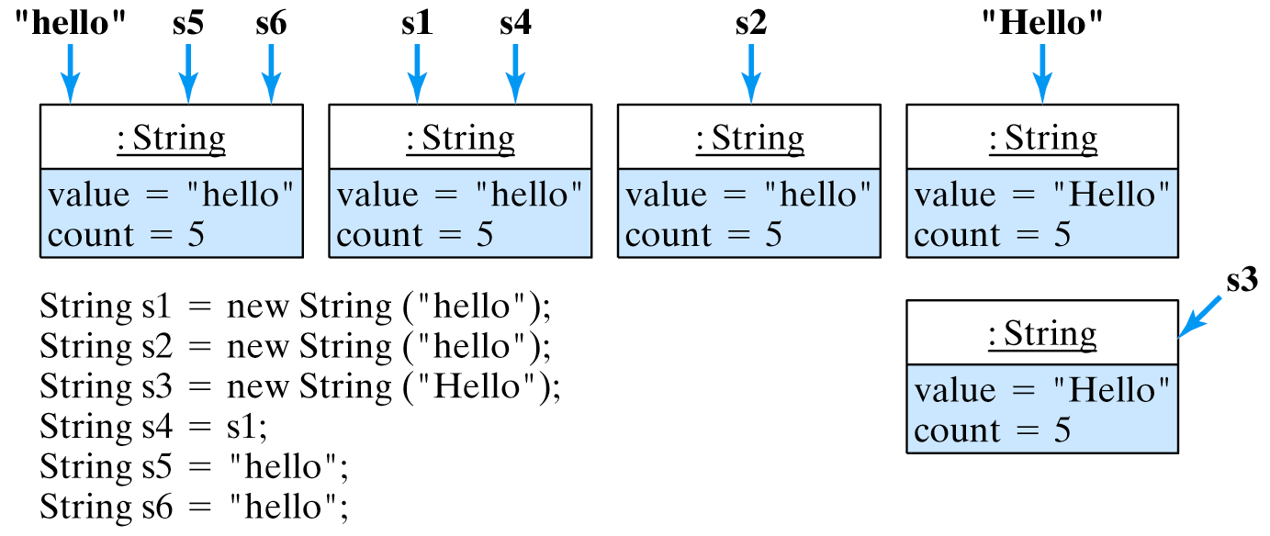
String Identity vs. String Equality (cont)
In this figure, s1, s2, s4, s5, and s6 are equal.
Strings s1 and s4 are identical, as are s5 and s6.

Slide 34
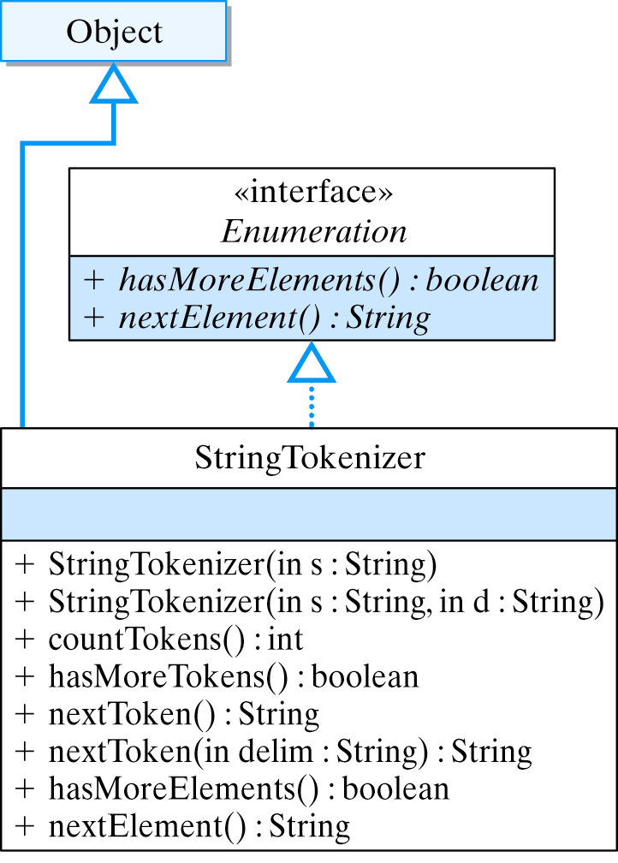
Library: java.util.StringTokenizer
Break up a string into its tokens -- e.g., breaking up a name and password pair in boyd:14irXp.
The StringTokenizer class is designed for this purpose.

Slide 35
StringTokenizer (cont)
A StringTokenizer breaks a string into tokens separated by delimiters, which by default value are the whitespace characters:
StringTokenizer sTokenizer
= new StringTokenizer("This is an English sentence.");
Tokens
This
is
an
English
sentence.
In this case, the period is part of last token
The delimiters can be specified as a String parameter:
StringTokenizer sTokenizer
= new StringTokenizer("http://troy.trincoll.edu/~jjj/index.html”, ":/");
Tokens
http
troy.trincoll.edu
~jjj
index.html

Slide 36
StringTokenizer (cont)
A while loop can be used to process each token in the tokenizer:
String url = "http://troy.trincoll.edu/~jjj/index.html";
StringTokenizer sTokenizer = new StringTokenizer(url, ":/"); // Initializer
while (sTokenizer.hasMoreTokens()) { // Loop entry condition
System.out.println(sTokenizer.nextToken()); // Updater
}
prints
http
troy.trincoll.edu
~jjj
index.html
In this example, the StringTokenizer() constructor initializes loop, the hasMoreTokens() method serves as the loop entry condition, and the nextToken() method is the updater. Of course, the StringTokenizer object keeps track of the tokens in its internal state.

Slide 37
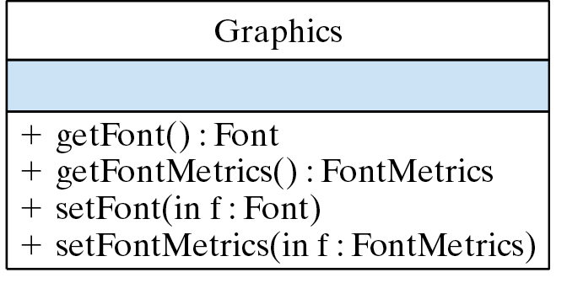
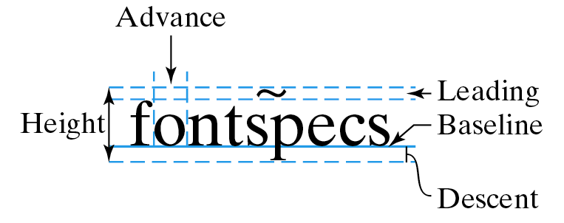
Handling Text in a Graphics Context
Each graphics context has an associated Font and FontMetrics object, accessible by:
A FontMetrics encapsulates font data -- e.g., height and width.

Slide 38
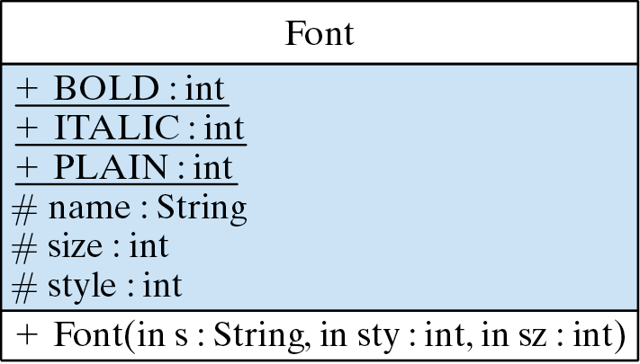
The Font Class
The Font class provides a platform-independent representation of an individual font.

Slide 39
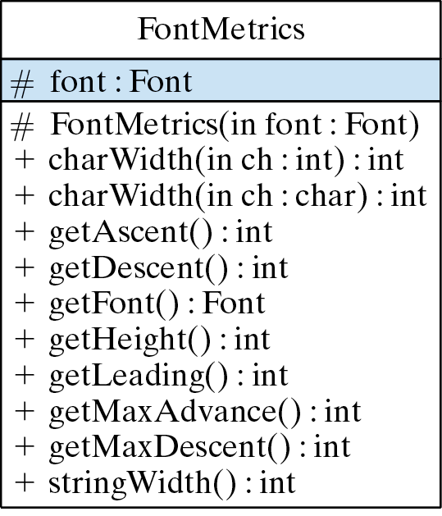
The FontMetrics Class
The FontMetrics class has methods for calculating font sizes.
Get the width of a character
Get the font’s height.
Or the width of a string.

Slide 40
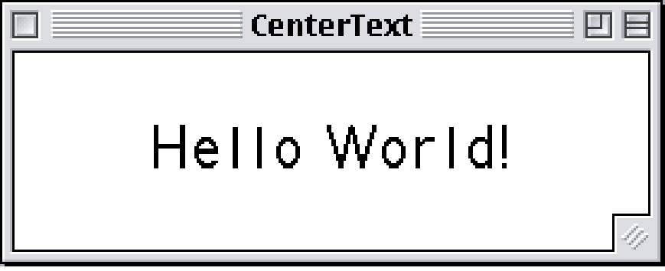
Example: Centering a Line of Text
Each time you resize the window, it picks a different font and centers “Hello World!”
Sourcecode/Demo: CenterText.java

Slide 41
Implementation: CenterText
For any font, center a string in the window.
No matter what font the system gives us ...
import java.awt.*;
import javax.swing.*;
public class CenterText extends JFrame {
// Print hello world! in center of frame
public void paint(Graphics g) {
String str = "Hello World!";
g.setFont(new Font("Random", Font.PLAIN, 24)); // Random font
FontMetrics metrics = g.getFontMetrics(); // Get its metrics
Dimension d = getSize(); // Get the frame's size
// Clear the frame
g.setColor(getBackground);
g.fillRect(0,0,d.width,d.height);
g.setColor(Color.black);
// Calculate coordinates
int x = (d.width - metrics.stringWidth(str)) / 2;
int y = (d.height + metrics.getHeight()) / 2;
g.drawString( str, x, y ); // Draw the string
} // paint()
} // CenterText
… use its metrics to center it.

Slide 42
Technical Terms
baseline concatenation copy constructor
data structure delimited string delimiter
empty string garbage collection glyph
lexicographic order logical font off-by-one error
orphan object physical font read only
string string index string literal
token unit indexed zero indexed

Slide 43
Summary Of Important Points
A String literal is a sequence of 0 or more characters enclosed within double quote marks. A String object is a sequence of 0 or more characters, plus a variety of class and instance methods and variables.
The String concatenation operator is the overloaded + symbol; it is used to combine two strings into a single String :
“hello” + “world” ==> “helloworld”.
Strings are indexed starting at 0 (zero indexing).

Slide 44
Summary Of Important Points (cont)
The indexOf() and lastIndexOf() methods are used for finding the first or last occurrence of a character or substring within a String.
The valueOf() methods are used to convert a nonstring into a String.
The length() method is used to determine the number of characters in a String.
The charAt() method is used to return the single character at a particular index position.
The various substring() methods are used to return the substring at particular index positions in a String.

Slide 45
Summary Of Important Points (cont)
The overloaded equals() method returns true if two Strings contain the same exact sequence of characters. The == operator, when used on Strings, returns true if two references designate the same String object.
A StringTokenizer is an object that can be used to break a String into a collection of tokens separated by delimiters. The whitespace characters, -- tabs, blanks, and newlines -- are the default delimiters.

