Slide 1

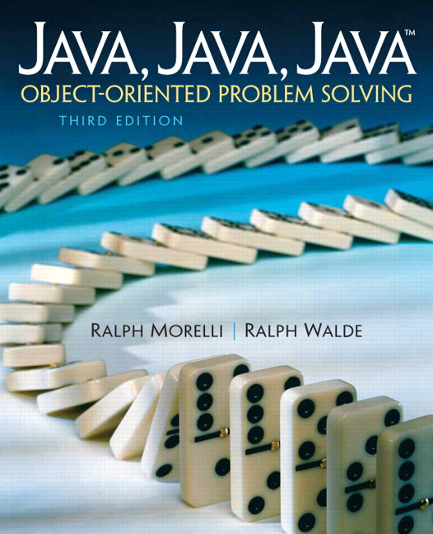
JAVA, JAVA, JAVA
presentation slides for
Object-Oriented Problem Solving
Third Edition
Ralph Morelli | Ralph Walde
Trinity College
Hartford, CT
published by Prentice Hall

Slide 2
Java, Java, Java
Object Oriented Problem Solving
Chapter 9: Arrays and Array Processing

Slide 3
Objectives
Know how to use array data structures.
Be able to solve problems that require collections of data.
Know how to sort an array of data.
Be familiar with sequential and binary search algorithms.
Have a better understanding of inheritance and polymorphism.

Slide 4
Outline
Introduction
One-Dimensional Arrays
Simple Array Examples
Example: Counting Frequencies of Letters
Array Algorithms: Sorting
Array Algorithms: Searching
Two-Dimensional and Multidimensional Arrays
Object-Oriented Design: Polymorphic Sorting
From the Java Library: Vector
Case Study: A N-Player Computer Game

Slide 5
Introduction
An array is a named collection of contiguous storage locations holding data of the same type.
Arrays elements: referenced by position within a structure rather than by name.
Example: 26 buttons ‘A’ to ‘Z’.
Without Arrays
With Arrays
JButton button1 = new JButton(“A”);
JButton button2 = new JButton(“B”);
JButton button3 = new JButton(“C”);
JButton button4 = new JButton(“D”);
JButton button5 = new JButton(“E”);
JButton button6 = new JButton(“F”);
…
JButton button26 = new JButton(“Z”);
JButton letter[] = new JButton[26];
for (int k = 0; k < 26; k++) {
char ch = (char)(‘A’ + k);
letter[k] = new JButton(“”+ ch);
}
The kth JButton in an array.
Reference by name

Slide 6
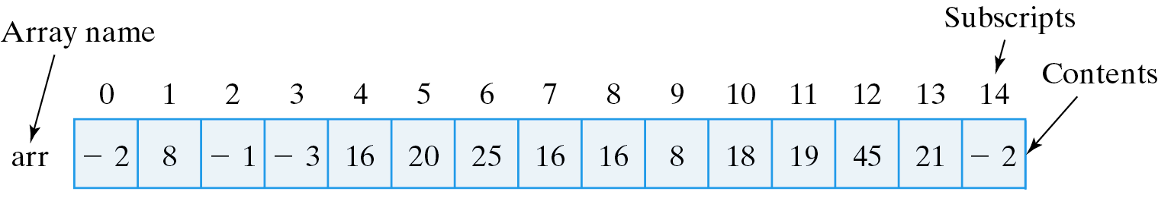
One-Dimensional Arrays
An array element is referred to its position within the array.
For an n-element array named arr, the elements are named arr[0], arr[1], arr[2], ...,arr[n-1].
The following array contains 15 int elements.
Arrays are zero indexed.
Array syntax : arrayname [ subscript ]
where arrayname is the array name and subscript is an integer giving the element’s relative position.

Slide 7
Referring to Array Elements
Valid References: Suppose j is 5 and k is 7.
arr[4] // Refers to 16
arr[j] // Is arr[5] which refers to 20
arr[j + k] // Is arr[5+7] which is arr[12] which refers to 45
arr[k % j] // Is arr[7%5] which is arr[2] which refers to -1
Invalid References:
arr[5.0] // 5.0 is a float and can't be an array subscript
arr['5'] // ‘5’ in Unicode would be out of bounds
arr["5"] // "5" is a string not an integer
arr[-1] // Arrays cannot have negative subscripts
arr[15] // The last element of arr has subscript 14
arr[j*k] // Since j*k equals 35

Slide 8
Are Arrays Objects?
Arrays are (mostly) treated as objects:
  Instantiated with the new operator.
  Have instance variables (e.g., length).
  Array variables are reference variables.
  As a parameter, a reference to the array is passed rather than copies of the array’s elements.
But…
  Arrays don’t fit into the Object hierarchy.
  Arrays don’t inherit properties from Object.

Slide 9
Some Array Terminology
An empty array is contains zero variables.
The variables are called components.
The length of the array is the number of components it has.
Each component of an array has the same component type.
A one-dimensional array has components that are called the array’s elements. Their type is the array’s element type.
An array’s elements may be of any type, including primitive and reference types.

Slide 10
Declaring and Creating an Array
Creating a one-dimensional array: Indicate both the array’s element type and its length.
Declare the array’s name and create the array itself.
int arr[]; // Declare a name for the array
arr = new int[15]; // Create the array itself
Combine two steps into one:
int arr[] = new int[15];
The array’s name is arr.
The array contains 15 int variables.
15 variables: arr[0], arr[1], .., arr[14] (zero indexed)

Slide 11
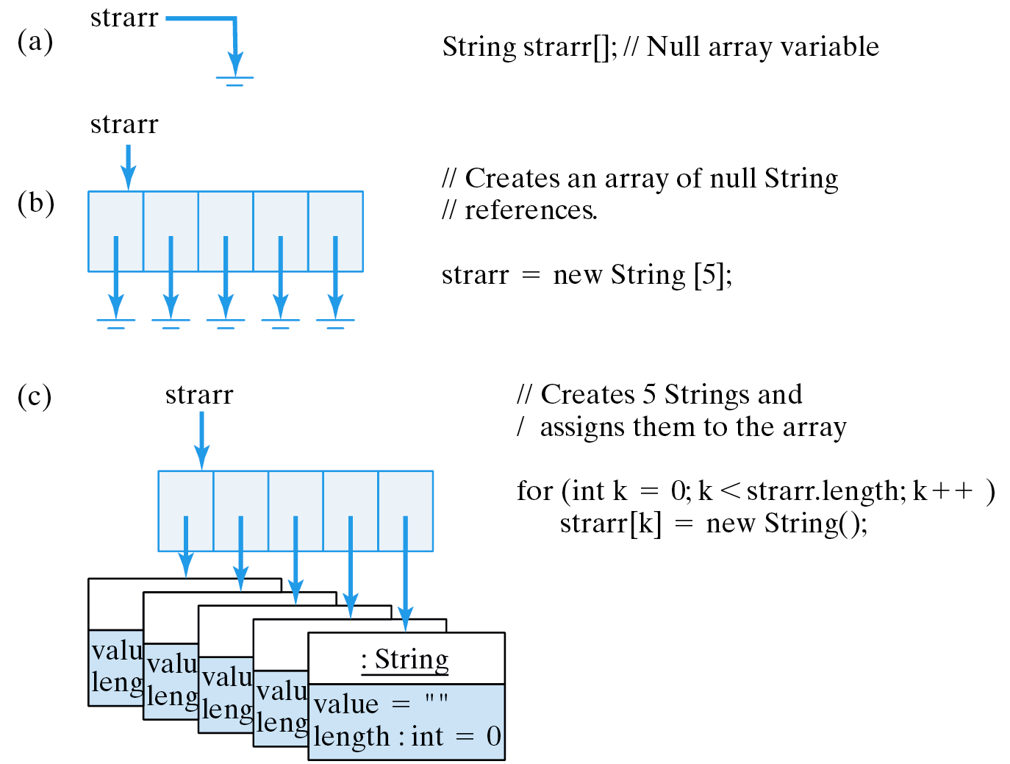
Creating an Array of Strings
Declare array variable.
Instantiate the array.
Store 5 Strings in it.

Slide 12
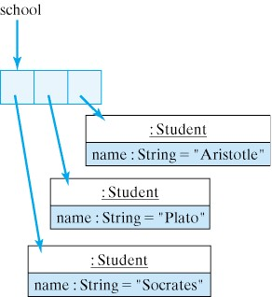
Creating an Array of Students
Student school[] = new Student[3]; // Create an array of 3 Students
school[0] = new Student("Socrates"); // Create the first Student
school[1] = new Student("Plato"); // Create the second Student
school[2] = new Student("Aristotle"); // Create the third Student
Debugging Tip: Creating a new array does not also create the objects that are stored in the array. They must be instantiated separately.
There are four objects here. One array and 3 Students.

Slide 13
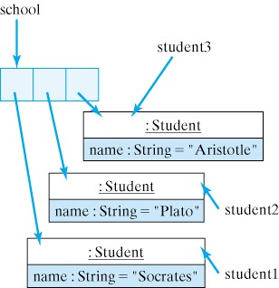
Creating an Array of Students
Student student1 = new Student (“Socrates”);
Student student2 = new Student (“Plato”); Student student3 = new Student (“Aristotle”); Student school[] = new Student [3];
school[0] = student1;
school[1] = student2;
school[2] = student3;
The array stores references to objects, not the objects themselves.

Slide 14
Initializing Arrays
Array elements are initialized to default values:
  Integer and real types are initialized to 0.
  Reference types (objects) are initialized to null.
Arrays can be assigned initial values when they are created:
int arr[] = { -2,8,-1,-3,16,20,25,16,16,8,18,19,45,21,-2 } ;
String strings[] = { "hello", "world", "goodbye", "love" } ;
Java Language Rule: When an array initialization expression is used, don’t use the keyword new to create the array.

Slide 15
Assigning and Using Array Values
Subscripted array variables are used like other variables:
arr[0] = 5;
arr[5] = 10;
arr[2] = 3;
strings[0] = "who";
strings[1] = "what";
strings[2] = strings[3] = "where";
A loop to assign the first 15 squares, 1, 4, 9 …, to the array arr:
for (int k = 0; k < arr.length; k++)
arr[k] = (k+1) * (k+1);
A loop to print the values of arr:
Note: length is an instance variable, not a method.
for (int k = 0; k < arr.length; k++)
System.out.println(arr[k]);

Slide 16
Example: Print an Array
Print an array of int and an array of double:
These must be static ...
public class PrintArrays {
static final int ARRSIZE = 10; // The array's size
static int intArr[] = new int[ARRSIZE]; // Create the int array
static double realArr[] = { 1.1, 2.2, 3.3, 4.4,
5.5, 6.6, 7.7, 8.8, 9.9, 10.10 }; // And a double array
public static void main(String args[]) {
System.out.println("Ints \t Reals");
for (int k = 0; k < intArr.length; k++)
System.out.println( intArr[k] + " \t " + realArr[k]);
} // main()
} // PrintArrays
Program Output
Ints Reals
0 1.1
0 2.2
0 3.3
0 4.4
0 5.5
0 6.6
0 7.7
0 8.8
0 9.9
0 10.1
… in order to refer to them in static main()
Uninitialized int array has default values of 0.

Slide 17
Example: Store the First 100 Squares
public class Squares {
static final int ARRSIZE = 100; // The array's size
static int intArr[] = new int[ARRSIZE]; // Create an int array
public static void main(String args[]) {
for (int k = 0; k < intArr.length; k++) // Initialize the array
intArr[k] = (k+1) * (k+1);
System.out.print("The first 100 squares are"); // Print a heading
for (int k = 0; k < intArr.length; k++)
{ // Print the array
if (k % 10 == 0)
System.out.println(" "); // 10 elements per row
System.out.print( intArr[k] + " ");
} // for
} // main()
} // Squares
Program Output
The first 100 squares are
1 4 9 16 25 36 49 64 81 100
121 144 169 196 225 256 289 324 361 400
441 484 529 576 625 676 729 784 841 900
961 1024 1089 1156 1225 1296 1369 1444 1521 1600
1681 1764 1849 1936 2025 2116 2209 2304 2401 2500
2601 2704 2809 2916 3025 3136 3249 3364 3481 3600
3721 3844 3969 4096 4225 4356 4489 4624 4761 4900
5041 5184 5329 5476 5625 5776 5929 6084 6241 6400
6561 6724 6889 7056 7225 7396 7569 7744 7921 8100
8281 8464 8649 8836 9025 9216 9409 9604 9801 10000

Slide 18
Generating Random Numbers
A random number generator generates numbers that can be used to simulate a coin toss or die roll.
The numbers generated are pseudorandom.
Math.random() generates a double value in the range [0.0, 1.0) -- that is, 0.0 to 0.999999999.
Using Math.random() to simulate a coin flip:
int coinFlip = (int)(Math.random() * 2); // Heads or tails
(Math.random() * 2) gives some value in the range 0.0 to 1.999999. When this value is converted to an int by (int), it gives either 0 or 1, corresponding to heads or tails.

Slide 19
Generating Random Numbers (cont)
An expression of the form
  (int)(Math.random() * N)
  will generate random integer values in the range 0 to N-1.
N is called the scaling factor.
To generate values in the range 0 to 5, use:
  (int)(Math.random() * 6);
To simulate a die roll we must shift the values into the range 1 to 6:
  int die = 1 + (int)(Math.random() * 6);

Slide 20
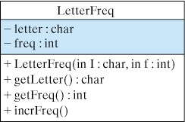
Example: Counting Letter Frequencies
Design a class that can be used to store the frequencies of letters of the alphabet.
public class LetterFreq {
private char letter; //A character being counted
private int freq; //The frequency of letter
public LetterFreq(char ch, int fre) {
letter = ch;
freq = fre;
}
public char getLetter() {
return letter;
}
public int getFreq() {
return freq;
}
public void incrFreq() {
freq++;
}
} //LetterFreq

Slide 21
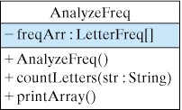
A Class to Count Frequencies
A class that counts letters in a document.
public class AnalyzeFreq {
private LetterFreq[] freqArr; // An array of frequencies
public AnalyzeFreq() {
freqArr = new LetterFreq[26];
for (int k = 0; k < 26; k++) {
freqArr[k] = new LetterFreq((char)('A' + k), 0);
} //for
}
public void countLetters(String str) {
char let; //For use in the loop.
str = str.toUpperCase();
for (int k = 0; k < str.length(); k++) {
let = str.charAt(k);
if ((let >= 'A') && (let <= 'Z')) {
freqArr[let - 'A'].incrFreq();
} // if
} // for
} // countLetters()
public void printArray() {
for (int k = 0; k < 26; k++) {
System.out.print("letter: " + freqArr[k].getLetter());
System.out.println(" freq: " + freqArr[k].getFreq());
} //for
} // printArray()
} //AnalyzeFreq
Note how it uses an array of LetterFreq objects to store letters and their frequencies.

Slide 22
Sorting Arrays
Sorting is the process of arranging an array’s elements into increasing or decreasing order.
The insertion sort algorithm views the array as divided into two parts, the sorted and unsorted parts. On each iteration, it moves one element from the unsorted to its correct position in the sorted part.
Insertion Sort of an array, arr, of N elements into ascending order
1. For k assigned 1 through N-1
2. Remove the element arr[k] and store it in x.
3. For i starting at k-1 and for all preceding elements greater than x
4. Move arr[i] one position to the right in the array.
5. Insert x at its correct location.

Slide 23
Method Design: insertionSort()
Array parameters are references. Changes made to the array in the method will persist.
/**
* Goal: Sort the values in arr into ascending order
* Pre: arr is not null.
* Post: The values arr[0]...arr[arr.length-1] will be
* arranged in ascending order.
*/
public void insertionSort(int arr[]) {
int temp; // Temporary variable for insertion
for (int k = 1; k < arr.length; k++) { // For each pass
temp = arr[k]; // Remove element from array
int i;
for (i = k-1; i >= 0 && arr[i] > temp; i--) // Move larger preceding
arr[i+1] = arr[i]; // elements right by one space
arr[i+1]= temp;
} // for
} // insertionSort()
Note how an array parameter is specified.
Note how an array argument is passed.
int myArr[] = { 21, 13, 5, 10, 14 };
insertionSort(myArr);

Slide 24
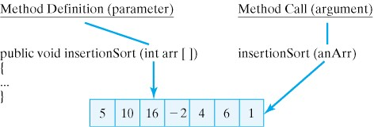
Passing an Array Parameter
When an array is passed to a method, both the array reference (anArr) and the parameter (arr) refer to the same object.

Slide 25
Pass by Value
Pass by Value: When a value of primitive type is passed to a method, a copy of the value is passed. Any changes to the copy, have no effect on the original value.
public void add1(int n) {
System.out.println("n = " + n);
n = n + 1;
System.out.println("n = " + n);
}
Num’s value is copied to n
For the add1() method, any changes made to its parameter n do not persist beyond the method.
int Num = 5;
System.out.println("Num = " + Num);
add1(Num);
System.out.println("Num = " + Num);
Num = 5
n = 5
n = 6
Num = 5
outputs

Slide 26
Pass by Reference
Pass by Reference: When a reference to an object (e.g., and array) is passed to a method, changes made to the object do persist beyond the method.
Suppose we have a Sort class containing the insertionSort() method and a print() method.
int intArr[] = { 21, 20, 27, 24, 19 }; // Initialize
Sort sorter = new Sort();
sorter.print(intArr); // Print
sorter.insertionSort(intArr); // Sort
sorter.print(intArr); // Print again
Outputs
21 20 27 24 19
19 20 21 24 27

Slide 27
Implementation: The Sort Class
public class Sort {
public void print(int arr[]) {
for (int k = 0; k < arr.length; k++) // For each integer
System.out.print( arr[k] + " \t "); // Print it
System.out.println();
} // print()
public static void main(String args[]) {
int intArr[] = { 21, 20, 27, 24, 19 };
Sort sorter = new Sort();
sorter.print(intArr);
sorter.bubbleSort(intArr);
sorter.print(intArr);
} // main()
} // Sort
public void insertionSort(int arr[]) {
int temp; // Temporary variable for insertion
for (int k = 1; k < arr.length; k++) { // For each pass
temp = arr[k]; // Remove element from array
int i;
for (i = k-1; i >= 0 && arr[i] > temp; i--) // Move larger preceding
arr[i+1] = arr[i]; // elements right by one
arr[i+1]= temp;
} // for
} // insertionSort()

Slide 28
Selection Sort Algorithm
Example: Sorting a deck of cards.
  Cards are arranged from 2 to Ace.
  Suits arranged clubs, diamonds, hearts, spades.
Strategy: Lay the 52 cards face up in a row. Select the smallest card (2 of clubs), and exchange it with the card in the first location. Move the next smallest to the second location, and so on.
1. For count assigned 1 to 51 // Outer loop
2. smallestCard = count
3. For currentCard assigned count+1 to 52 // Inner loop
4. If deck[currentCard] < deck[smallestCard]
5. smallestCard = currentCard
6. If smallestCard != count // You need to swap
7 Swap deck[count] and deck[smallestCard]

Slide 29
Algorithm Design: Swapping Elements
A temporary variable must be used when swapping the values of two variables in memory.
Suppose you have the array: 1 4 2 8
Swapping 4 and 2 the wrong way:
arr[pair-1] = arr[pair];
arr[pair] = arr[pair-1];
results in: 1 2 2 8
Swapping 4 and 2 the proper way:
temp = arr[pair-1]; // Save first element in temp
arr[pair-1] = arr[pair]; // Overwrite first with second
arr[pair] = temp; // Overwrite second with temp (i.e.,first)
results in: 1 2 4 8

Slide 30
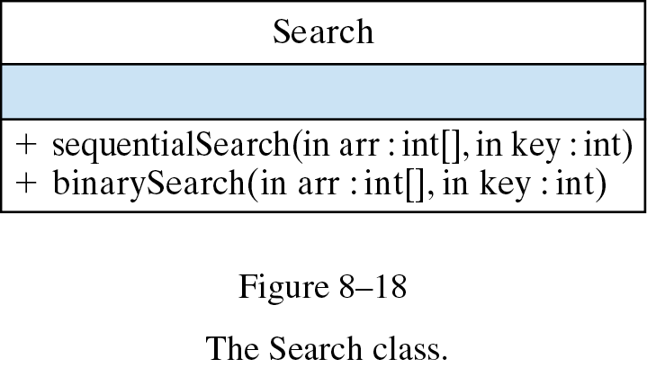
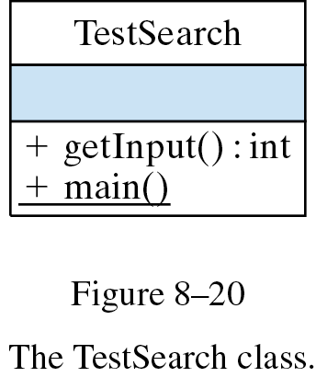
Design: The Search Class
Uses
Two different search() strategies.

Slide 31
Array Algorithm: Sequential Search
Problem: Search an array for a key value. If the array is not sorted, we have to search sequentially.
/**
* Performs a sequential search of an integer array
* @param arr is the array of integers
* @param key is the element being searched for
* @return the key's index is returned if the key is
* found otherwise -1 is returned
* Pre: arr is not null
* Post: either -1 or the key's index is returned
*/
public int sequentialSearch(int arr[], int key) {
for (int k = 0; k < arr.length; k++)
if (arr[k] == key)
return k;
return -1; // Failure
} // sequentialSearch()
Return as soon as the key is found.
Search fails if you get to the end of the array.

Slide 32
Array Algorithm: Binary Search
Binary search uses a divide-and-conquer strategy on a sorted array.
Divide the array in half on each iteration, limiting the search to that half which could contain the key.
Example: Guessing a number between 1 and 10.
1 2 3 4 5 6 7 8 9 10
Too high
Too low
First
guess
1 2 3 4
6 7 8 9 10
Second
guess
Second
guess

Slide 33
The binarySearch() Method
Algorithm Design: low and high point to first and last elements of the subarray, and mid gives its current midpoint.
If low becomes greater than high, the key is not in the array.
/**
* Pre: arr is an array of int in ascending order
* Post: -1 or arr[k] where arr[k] == key
*/
public int binarySearch(int arr[], int key) {
int low = 0; // Initialize bounds
int high = arr.length - 1;
while (low <= high) { // While not done
int mid = (low + high) / 2;
if (arr[mid] == key)
return mid; // Success
else if (arr[mid] < key)
low = mid + 1; // Search top half
else
high = mid - 1; // Search bottom half
} // while
return -1; // Post condition: low > high implies search failed
} // binarySearch()
Calculate a new midpoint.
Update low and high to cut the array in half.

Slide 34
Two-Dimensional Arrays
Two-dimensional array: an array whose components are themselves arrays.
Example: Compiling daily rainfall data. A one-dimensional array makes it hard to calculate average monthly rainfall:
double rainfall[] = new double[365];
A two-dimensional array is an array of arrays. The first is the 12 months, indexed from 0 to 11. Each month array is an array of 31 days, indexed from 0 to 30.
double rainfall[][] = new double[12][31];
Month index
Day index

Slide 35
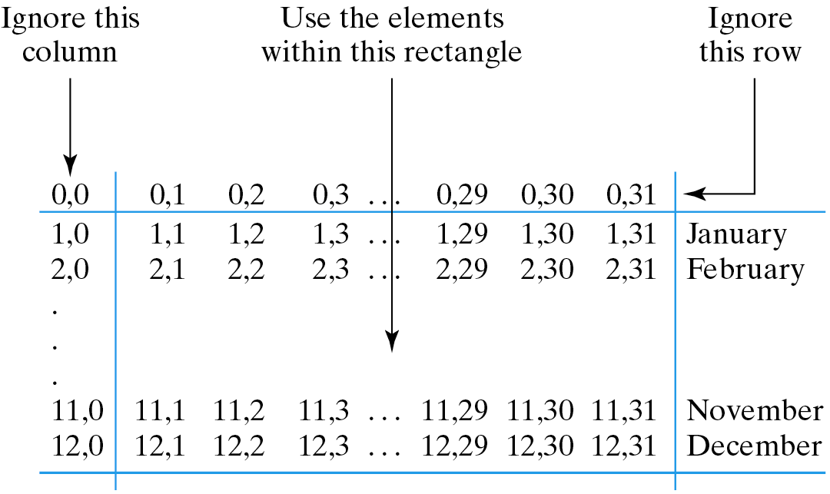
A More Appropriate 2-D Representation
What is rainfall[0][4] ? Avoid zero indexing by creating an extra row and column and ignoring the 0 indexes.
double rainfall[][] = new double[13][32];
Don’t use the 0 indexes.
January 5 is now at rainfall[1][5]
rainfall[1][5] = 1.15; // Rainfall for January 5
System.out.println(rainfall[4][1]); // April 1st
rainfall[13][32] = 0.15 ; // No such element
rainfall[11][32] = 1.3; // No such column
rainfall[13][30] = 0.74; // No such row

Slide 36
Initializing a Two-Dimensional Array
We can use unit indexed loops to initialize the two-dimensional rainfall array:
/**
* Initializes a 2-D array
* @param rain is a 2D-array of rainfalls
* Pre: rain is non null
* Post: rain[x][y] == 0 for all x,y in the array
* Note that the loops use unit indexing.
*/
public void initRain(double rain[][]) {
for (int month = 1; month < rain.length; month++)
for (int day = 1; day < rain[month].length; day++)
rain[month][day] = 0.0;
} // initRain()
A 2-D array parameter
Nested for loops iterate 12 x 31 times
Method call: pass the name of the 2-D array to the method:
initRain(rainfall); // Sample method call

Slide 37
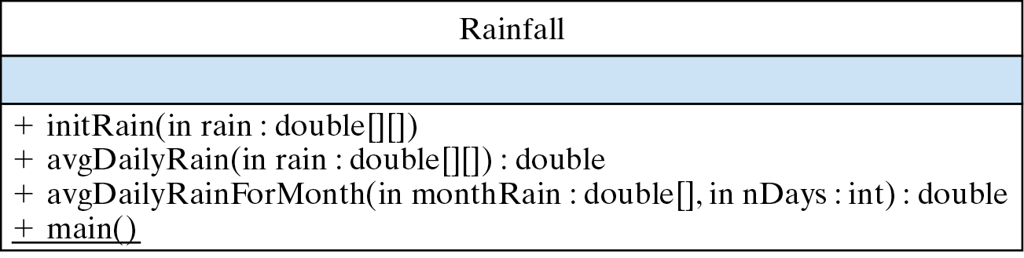
Example: Rainfall Data

Slide 38
Calculate Average Daily Rainfall
/**
* Computes average daily rainfall
* @param rain is a 2D-array of rainfalls
* @return The sum of rain[x][y] / 356
* Pre: rain is non null
* Post: The sum of rain / 365 is calculated
* Note that the loops are unit indexed
*/
public double avgDailyRain(double rain[][]) {
double total = 0;
for (int month = 1; month < rain.length; month++)
for (int day = 1; day < rain[month].length; day++)
total += rain[month][day];
return total/365;
} // avgDailyRain()
A 2-D array parameter
Nested for loops iterate 12 x 31 times
Method call uses the array’s name.
System.out.println("Daily Avg: " + avgRainForMonth(rainfall));

Slide 39
Calculate Average Rain for a Month
/**
* Computes average rainfall for a month
* @param rain is a 2D-array of rainfalls
* @param month is the month of the year, 1 ... 12
* @param nDays is the number of days in month, 1 ... 31
* @return The sum of rain[month] / nDays
* Pre: 1 <= month <= 12 and 1 <= nDays <= 31
* Post: The sum of rain[month] / nDays is calculated
*/
public double avgRainForMonth(double rain[][], int month, int nDays) {
double total = 0;
for (int day = 1; day < rain[month].length; day++)
total = total + rain[month][day];
return total/nDays;
} // avgRainForMonth()
Just iterate over the month array.
We have to tell it how many days in the month.
System.out.println("March Avg: " + avgRainForMonth(rainfall, 3, 31));

Slide 40
Calculate Average Rain for a Month (cont)
Pass just part of a 2-D array -- e.g., a month.
/**
* Computes average rainfall for a given month
* @param monthRain is a 1D-array of rainfalls
* @param nDays is the number of days in monthRain
* @return The sum of monthRain / nDays
* Pre: 1 <= nDays <= 31
* Post: The sum of monthRain / nDays is calculated
*/
public double avgRainForMonth(double monthRain[], int nDays) {
double total = 0;
for (int day = 1; day < monthRain.length; day++)
total = total + monthRain[day];
return total/nDays;
} // avgRainForMonth()
Pass the array for the given month.
We’re passing a reference to a 1-D array.
System.out.println("March Avg: " + avgRainForMonth(rainfall[3], 31));

Slide 41
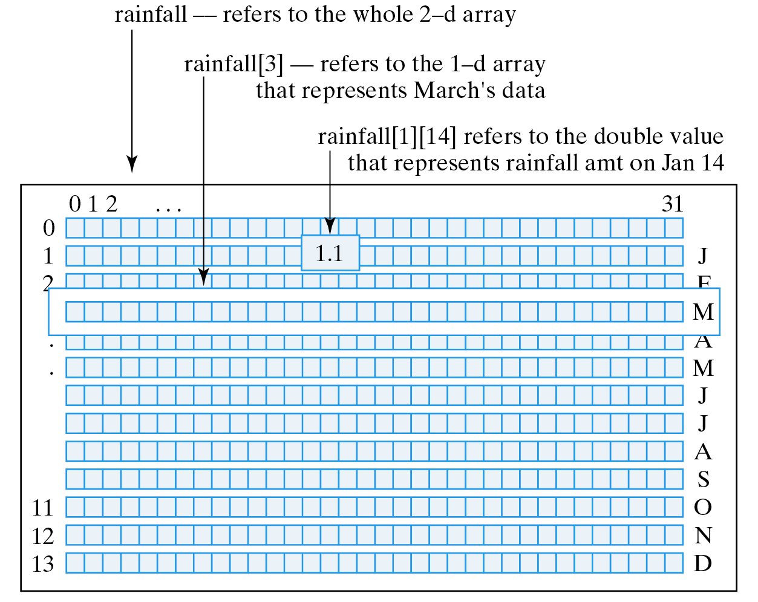
Array Arguments and Parameters
The argument in a method call must match the data type in the method definition. This applies to all parameters, including array parameters.

Slide 42
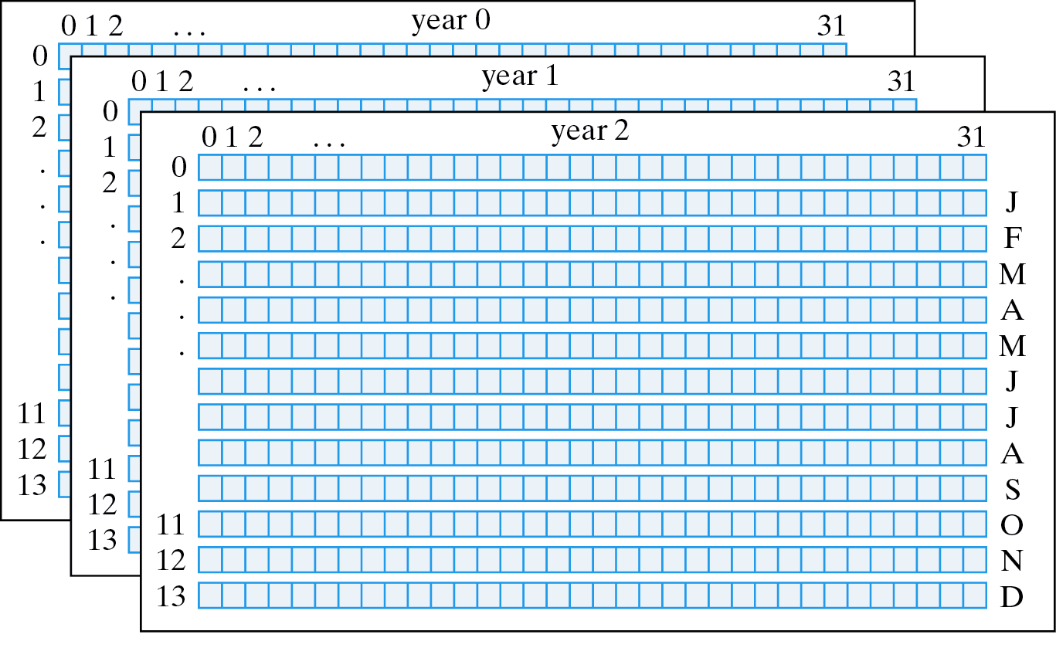
Multidimensional Arrays
A 3-dimensional array can be used to record rainfall over a ten year period.

Slide 43
A 3-D Rainfall Array
Declaring a 3-D Array:
final int NYEARS = 10;
final int NMONTHS = 13;
final int NDAYS = 32;
double rainfail[][][] = new double[NYEARS][NMONTHS][NDAYS];
Initializing a 3-D Array:
for (int year = 0; year < rainfall.length; year++)
for (int month = 0; month < rainfall[year].length; month++)
for (int day = 0; day < rainfall[year][month].length; day++)
rainfall[year][month][day] = 0.0;

Slide 44
Array Initializers
For small arrays, an initializer expression can be used to assign initial values:
A 2 x 3 array of int.
A 2 x 2 array of char.
int a[][] = { {1, 2, 3}, {4, 5, 6} } ;
char c[][] = { {'a', 'b'}, {'c', 'd'} } ;
double d[][] = { {1.0, 2.0, 3.0}, {4.0, 5.0}, {6.0, 7.0, 8.0, 9.0} } ;
A 3-row array of doubles where each row has a different length.
Each dimension of a multidimensional array can have a different length.

Slide 45
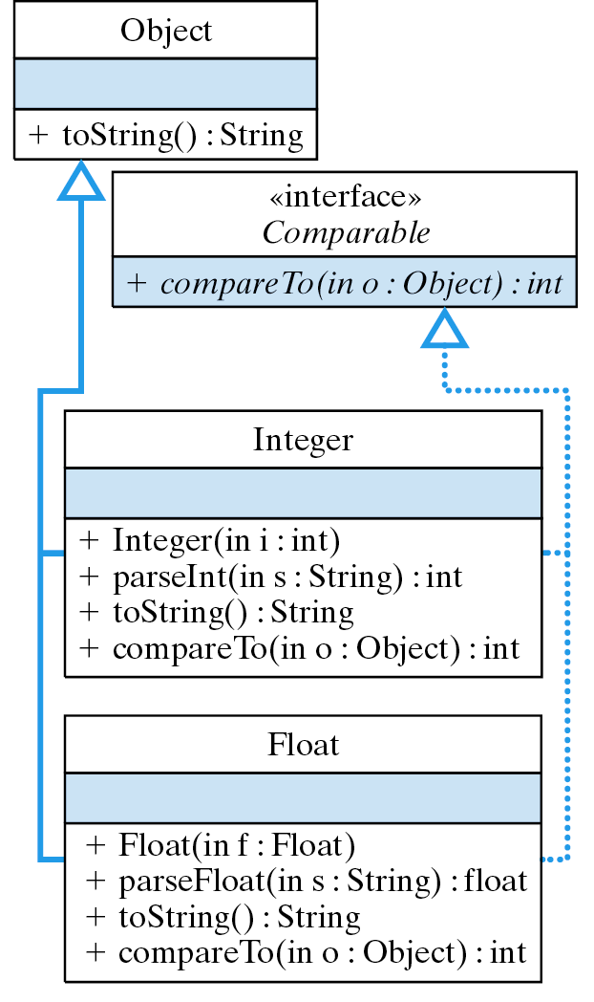
OOD: Polymorphic Sorting (Optional)
Task: Write a method that can sort an array of any kind of object.
Because the polymorphic compareTo() method imposes an order on its objects, it can be used to sort any kind of object.

Slide 46
OOD: Polymorphic sort() Method
An array of Comparables
// Polymorphic sort method
public static void sort(Comparable[] arr) {
Comparable temp; // Temporary variable for swap
for (int pass = 1; pass < arr.length; pass++) // For each pass
for (int pair = 1; pair < arr.length ; pair++ ) // For ea pair
if (arr[pair].compareTo(arr[pair-1]) < 0) { // Compare
temp = arr[pair-1]; // and swap
arr[pair-1] = arr[pair];
arr[pair] = temp;
} // if
} // sort()
The compareTo() method is polymorphic. It is implemented differently for each different type of Object.

Slide 47
OOD: The Comparable Interface
public abstract interface Comparable {
public int compareTo(Object obj) ;
}
Return value Meaning
< 0 this object < obj
0 this object == obj
> 0 this object > obj

Slide 48
OOD: Example Sort
Create and sort an array of Integer and an array of Float, both of which implement Comparable.
Two different kinds of array.
public static void main(String args[]) {
Integer iArr[] = new Integer[20]; // The arrays to sort
Float fArr[] = new Float[20]; // The arrays to sort
for (int k = 0; k < anArr.length; k++) { // Initialize with random values
iArr[k] = new Integer((int)(Math.random() * 10000));
fArr[k] = new Float(Math.random() * 10000);
}
sort(iArr); // Sort and print the arrays
print(iArr);
sort(fArr);
print(fArr);
} // main()
Sorted by the same method.

Slide 49
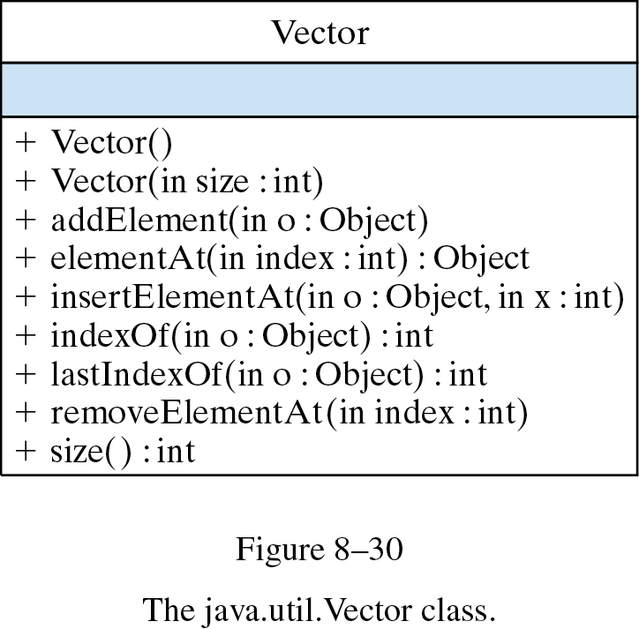
From the Library: java.util.Vector
The java.util.Vector class implements an array of objects that can grow as needed (dynamic).
Regular arrays are limited to their initial size. They cannot grow or shrink. (static)

Slide 50
Vector Illustration
Use a Vector to store items when you don’t know in advance how many items there are.
import java.util.Vector;
public class VectorDemo {
public static void printVector( Vector v) {
for (int k=0; k < v.size(); k++)
System.out.println(v.elementAt(k).toString());
} // printVector()
public static void main(String args[]) {
Vector vector = new Vector(); // An empty vector
int bound = (int)(Math.random() * 20);
for (int k = 0; k < bound; k++ ) // Insert a random
vector.addElement(new Integer(k)); // number of Integers
printVector(vector); // Print the elements
} // main()
} // VectorDemo

Slide 51
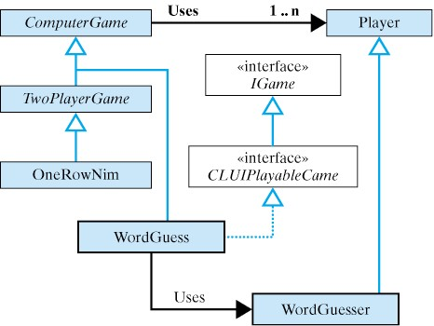
Case Study: an N - Player Game
We use array to store the players in an N-player game.
We use the following class hierarchy.
The ComputerGame class uses an array of Player objects.
A TwoPlayerGame is a special case of ComputerGame now.

Slide 52
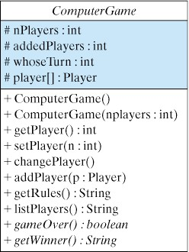
The ComputerGame Class
The ComputerGame class is abstract because its gameOver() and getWinner() methods are implemented in its subclasses.
Abstract class.
Note use of protected (#) variables so they can be inherited by subclasses.
Abstract methods.

Slide 53
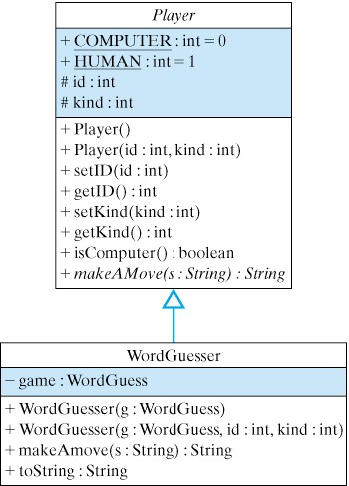
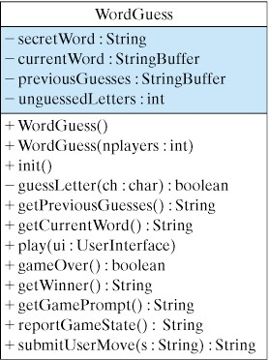
N-Player Word Guess Game
In the Word Guess game from Chapter 8 players take turns guessing a secret word.
We need only minor changes to the WordGuess and WordGuesser classes.
New constructor.
Rewrite the play() method.
The new WordGuesser is a subclass of Player.

Slide 54
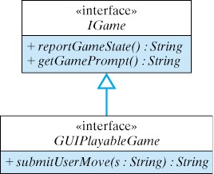
A GUI-Based Game (Optional)
We expand the ComputerGame hierarchy to allow GUI-based games.
We design a GUIPlayableGame interface to handle the interaction between the game and the user interface.
All games, command-line or GUI, implement these methods.
GUI games implement the submitUserMove() mehtod.
Note that Strings are used to pass information back and forth between the game and interface.

Slide 55
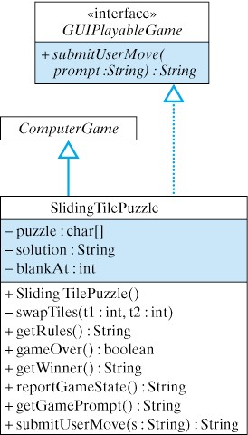
The Sliding Tile Puzzle
In the Sliding Tile Puzzle the goal is to move tiles into the correct locations.
The SlidingTilePuzzle class uses a char array to represent the puzzle and String to represent the puzzle’s solution.
SlidingTilePuzzle.java
Sliding Tile Demo: Applet version.
Inheritance: SlidingTilePuzzle inherits ComputerGame and GUIPlayableGame methods.

Slide 56
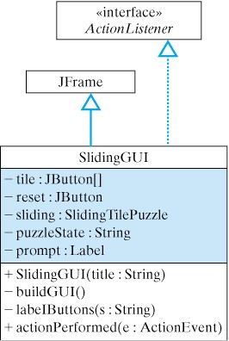
The SlidingGUI Class
The SlidingGUI class uses a JButton array to represent the puzzle’s tiles.
Its actionPeformed() method enforces the legal moves.
SlidingGUI.java
Inheritance: SlidingGUI is a JFrame that uses an array of JButtons to represent the tiles.

Slide 57
Technical Terms
array
array initializer
array length
binary search
data structure
element
element type
insertion sort
multidimensional array
one-dimensional array
polymorphic sort method
selection sort
sequential search
sorting
subscript
two-dimensional array

Slide 58
Summary Of Important Points
An array is a named collection of contiguous storage locations holding data of the same type.
An array’s values may be initialized by assigning values to each array location. An initializer expression may be included as part of the array declaration.
Insertion sort and selection sort are examples of array sorting algorithms. Both algorithms require making several passes over the array.

Slide 59
Summary Of Important Points (cont)
Array Parameters: When an array is passed as a parameter, a reference to the array is passed rather than the entire array itself.
Swapping two elements of an array, or any two locations in memory, requires the use of a temporary variable.
Sequential search and binary search are examples of array searching algorithms. Binary search requires that the array be sorted.
For multidimensional arrays, each dimension of the array has its own length variable.

