Slide 1

File Upload & Sharing Service A Scalable and Secure Approach to File Storage & Sharing
Sri Ram Chollangi Emp code: 919

Slide 2
Introduction
What is this project?
A File Upload & Sharing Service that allows users to upload files, generate shareable links, and set expiration rules.
Why is it needed?
Secure and easy file sharing.
Temporary storage with controlled access.
No need for third-party cloud services.
Key Features: ✅ Upload and retrieve files via API ✅ Generate unique download links ✅ Set expiration based on time or download count ✅ Store file metadata in a database

Slide 3
High-Level Architecture
System Components:
🧑‍💻 Client (User) → Uploads & downloads files.
🌐 Flask API Server → Handles file uploads, storage, and sharing logic.
🗄 SQLite Database → Stores file metadata (ID, filename, expiration, etc.).
📂 File Storage (Local/Cloud) → Stores uploaded files.
How It Works: 1️⃣ User uploads a file through an API request. 2️⃣ Flask backend stores the file and metadata in SQLite. 3️⃣ A unique download link is generated. 4️⃣ The user shares the link with others. 5️⃣ Flask API checks for expiration & download limits before serving the file.

Slide 4
Component Breakdown
1. Flask API (Backend)
Manages file uploads, retrieval, and sharing.
Generates unique, shareable download links.
Implements expiration mechanisms (time-based or download-limit-based).
2. SQLite Database (Metadata Storage)
Stores file details (ID, filename, storage path).
Tracks expiration time and download count.
Ensures file access is controlled & managed.

Slide 5
3. File Storage (Local or Cloud)
Stores the actual uploaded files securely.
Can be local storage or integrated with cloud solutions like GCP/AWS.
4. Sharing Mechanism
Generates a unique link (e.g., https://yourservice.com/download/<file_id>).
Links expire based on time or download count.
API checks validity before serving the file.

Slide 6
System Workflow
1️⃣ User Uploads a File
Sends a POST request to the Flask API with the file.
2️⃣ Flask API Processes the Request
Saves the file to storage (local/cloud).
Stores metadata in SQLite (file name, path, expiration, download limit).
3️⃣ API Generates a Unique Download Link
Example: https://yourservice.com/download/<file_id>
Sends the link in the response.

Slide 7
4️⃣ User Shares the Download Link
Others can use the link to download the file.
5️⃣ File Retrieval & Expiration Handling
When accessed, the API checks: ✅ If the file exists ✅ If it has expired ✅ If the download limit is reached
If valid, the API serves the file; otherwise, it returns an error.

Slide 8
Database Schema
Column Name | Data Type | Description
id | INTEGER (PK) | Unique file ID (Auto-incremented)
filename | TEXT | Original name of the uploaded file
filepath | TEXT | Location where the file is stored
upload_time | TIMESTAMP | When the file was uploaded
expiration_time | TIMESTAMP | When the file should expire (NULL if no expiration)
download_limit | INTEGER | Max allowed downloads (NULL if unlimited)
downloads | INTEGER | Current download count

Slide 9
Relationships & Functionality
Primary Key: id (Unique for each file).
Expiration Check: Flask API deletes/blocks expired files.
Download Count Update: Each time a file is downloaded, downloads increases.
Cleanup Mechanism: Files with exceeded expiration/download limits are removed.

Slide 10
Security Considerations
1. Secure File Uploads
✅ Validate file types to prevent malicious uploads. ✅ Restrict file size to prevent Denial of Service (DoS) attacks.
2. Secure Download Links
✅ Generate unique, hard-to-guess links. ✅ Implement token-based authentication (optional). ✅ Expire links after a set time or number of downloads.
3. Data Protection & Storage Security
✅ Store files in restricted-access directories. ✅ Encrypt file metadata in the database. ✅ Use HTTPS for secure communication.
4. Preventing Abuse
✅ Rate-limit API requests to prevent spamming. ✅ Implement logging & monitoring to detect suspicious activity. ✅ Periodically clean up expired files.

Slide 11
Technologies Used
1. Backend Development
Flask (Python) → Lightweight web framework for handling API requests.
2. Database
SQLite → Lightweight, embedded database for storing file metadata.
3. File Storage
Local Storage → Files stored on the server.
(Optional) Cloud Storage (GCP/AWS) → Scalable storage for larger deployments.
4. API & Web Communication
REST API (Flask Routes) → Handles file upload, download, and metadata queries.
HTTPS → Ensures secure communication.
5. Security & Performance Enhancements
JWT (Optional) → Token-based authentication for access control.
Gunicorn → WSGI server for production deployment.

Slide 12
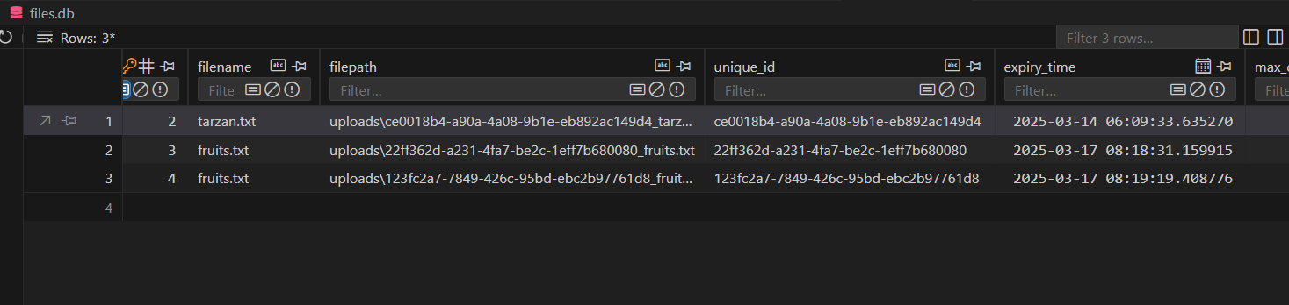
Output images:

Slide 13
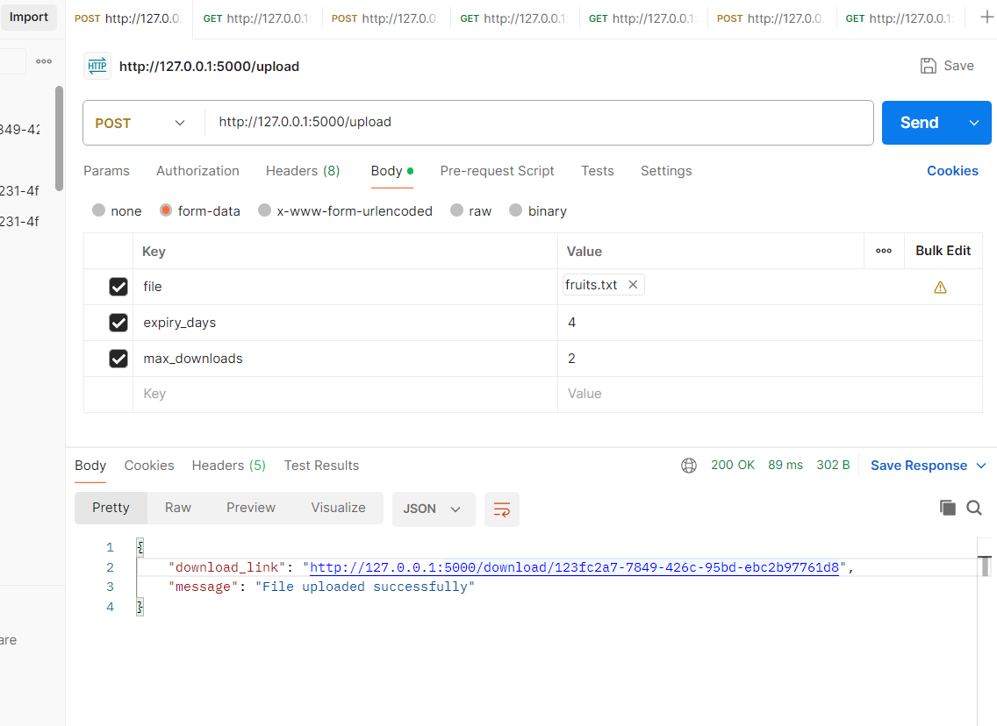

Slide 14
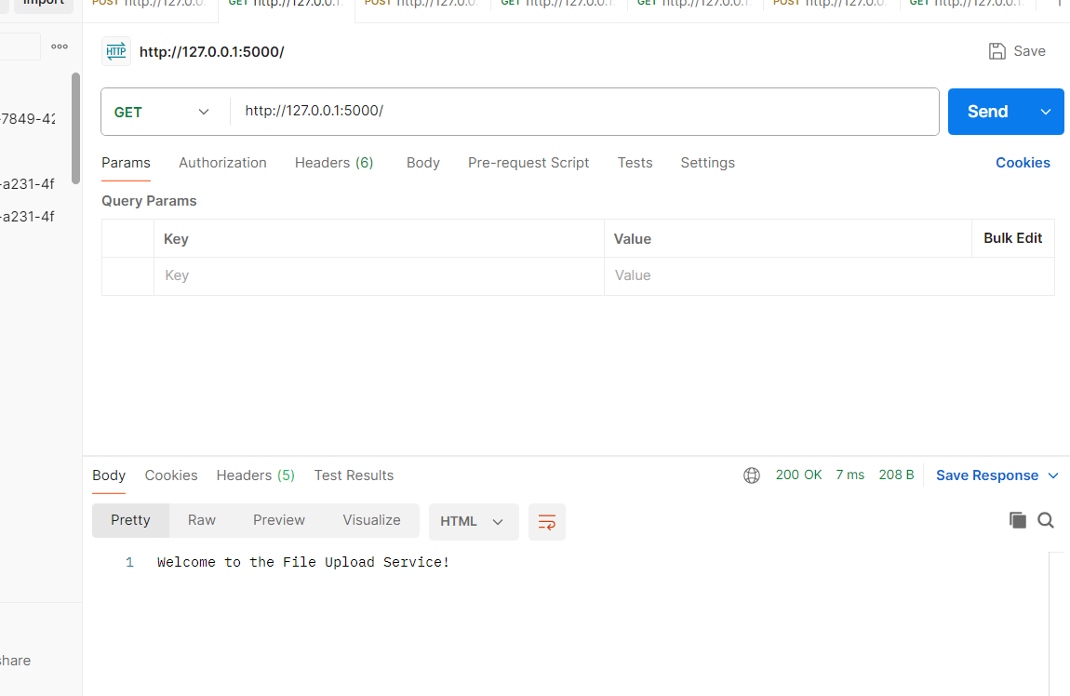

Slide 15
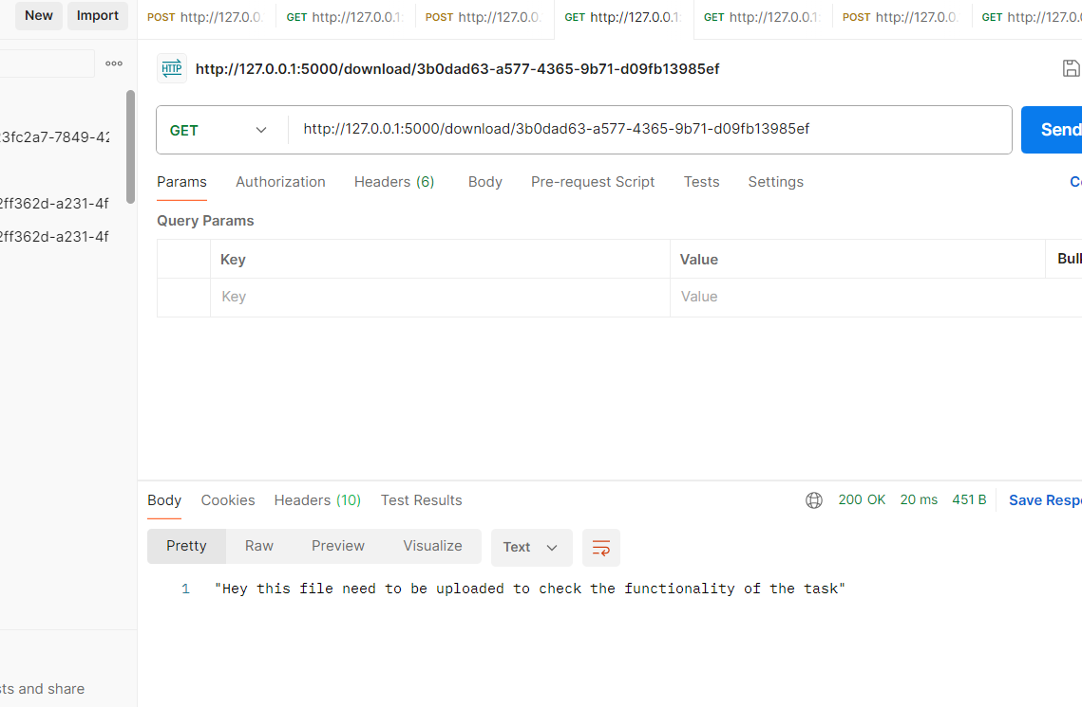

Slide 16
