Slide 1






CYBERSHIELD 2026
MACHINE MINDS
ECHO: Encrypted Communication Heuristic Observer - Behavioural Deanonymisation Framework
Lawful · Non-intrusive · Metadata-only network forensics
No decryption · No payload access · Full investigator insight
TRACK: 03-B: AI-DRIVEN CYBER DEFENSE AND FORENSICS
PROBLEM STATEMENT: DEANONYMISE COMMUNICATION
TEAM MEMBERS: 1. RAM KARTHIK G
2. RITHIKKAA S J
3. SAMYUKTHAA G
4. TAMIZH SELVI L

Slide 2



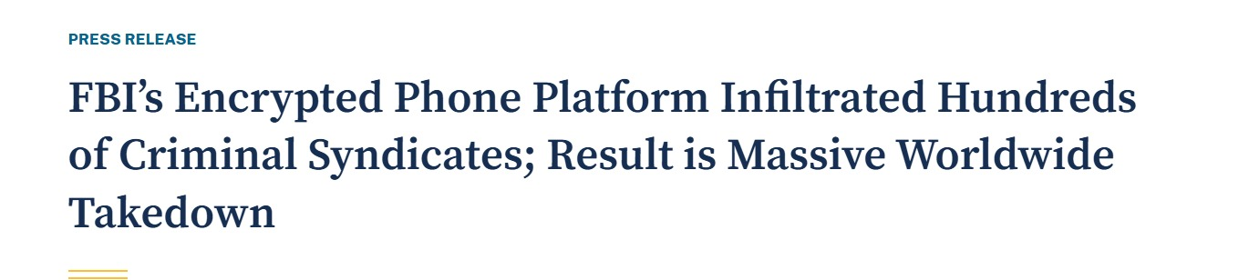
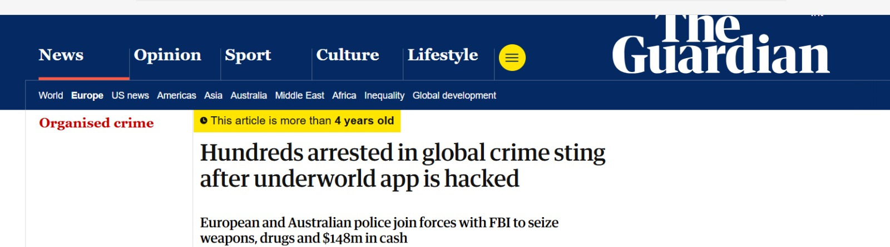
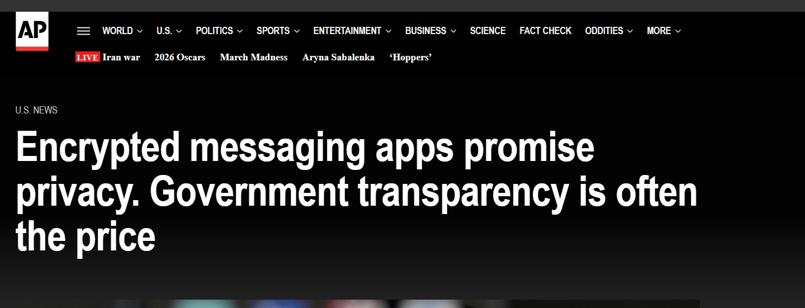
PROBLEM STATEMENT
100%
0%
∞
The Challenge
Traffic is encrypted
in modern comms apps
Content decryption
required or expected
Metadata signals
available to analyse
01
Encrypted comms hide identity
E2E-encrypted apps conceal user identity, message content & routing — making traditional forensics ineffective.
02
No payload access possible
Conventional device forensics fails to establish communication linkage or network attribution.
03
Investigators lack metadata tools
No unified tool exists to capture, correlate & visualize network-level metadata lawfully.

Slide 3







SOLUTION
NetMeta — What It Does
A lawful, non-intrusive forensic tool that analyses network-level metadata
to identify and characterise the remote communicating party (Party B).
Packet Capture
TLS Fingerprinting
Timing Analysis
Live interface or PCAP file. TCP/UDP metadata extraction only — zero payload access.
JA3 hash + SNI from ClientHello. Identifies app/client without decrypting traffic.
IAT stats, burst windows, session segmentation. Messaging apps leave timing signatures.
IP Profiling
Party B Correlation
Flask Dashboard
GeoIP, ASN, WHOIS enrichment. Heuristic risk scoring from ports & DNS patterns.
Multi-signal ranking of probable communicating endpoints. Evidence-backed confidence score.
Live investigator UI. Charts, Party B ranking, flow table, DNS log, TLS groups.

Slide 4
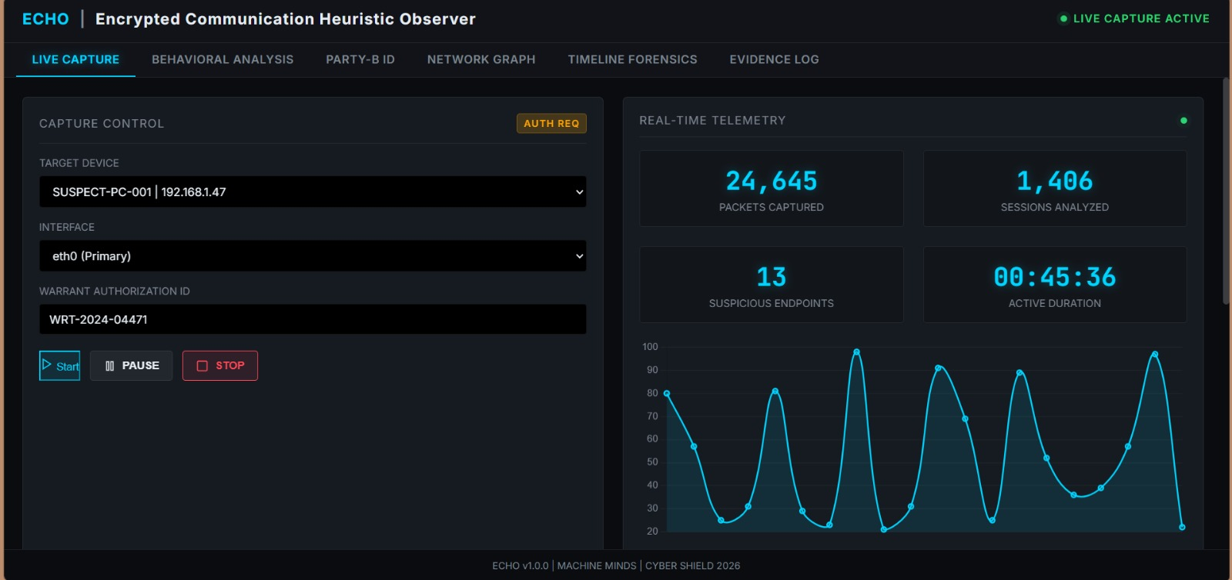
DEMO
Live Investigator Dashboard

Slide 5
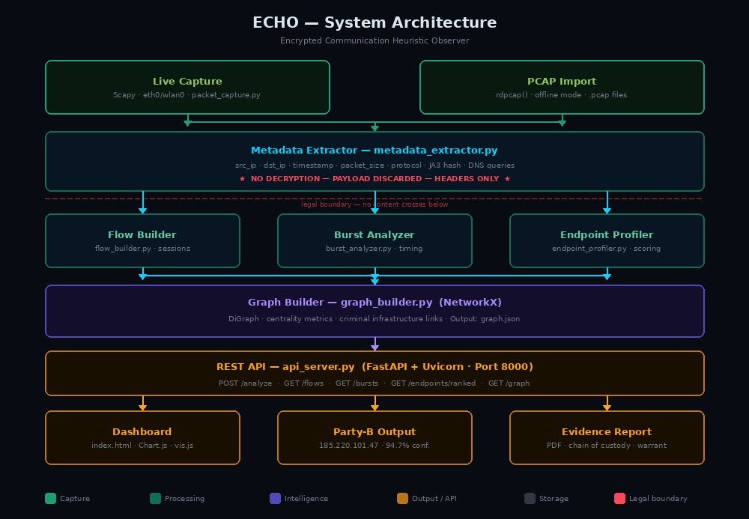

Slide 6

ARCHITECTURE
3-Layer Pipeline
CAPTURE LAYER
ANALYSIS LAYER
OUTPUT LAYER
Packet Capture (Scapy)
Timing Analyser
Flask Dashboard
Flow Extractor
IP Profiler (GeoIP/ASN)
REST API
→
→
TLS Inspector (SNI/JA3)
Flow Classifier
Party B Candidates
DNS Logger
Correlation Engine
CSV/Report Export

Slide 7
INNOVATION
What Makes Our Solution Unique
01
Pure Metadata Intelligence
02
JA3 App Fingerprinting
Unlike traditional tools that require decryption or MITM, NetMeta extracts maximum investigative value from observable metadata alone — legally and non-intrusively.
First-class JA3 TLS fingerprinting identifies which specific application (Signal, Telegram, WhatsApp) generated each encrypted flow — without seeing any content.
03
Timing-Based Session Detection
04
Multi-Signal Party B Ranking
Proprietary burst analysis segments passive traffic into communication sessions. Encrypted messaging apps leave unmistakable timing signatures even when content is hidden.
Combines frequency, volume, risk indicators, TLS-SNI, JA3 groups, and DNS co-occurrence into a single ranked evidence-backed confidence score for each endpoint.

Slide 8

CONCLUSION
Summary & Compliance
Lawful Capture
No Decryption
Actionable Output
Extensible Design
Operates only on observable metadata. Equivalent to CDR analysis. No unauthorised interception.
TLS/encrypted content is never accessed. Handshake metadata only - server name & fingerprint.
Ranked Party B candidates with evidence tags. Full REST API. Dashboard for investigators.
Modular Python codebase. Add threat intel feeds, IOCTA matching, or Wireshark PCAP import.
ECHO — Maximum intelligence from metadata, Zero decryption and Full investigative power

