Slide 1
Delta Headlines

Slide 2
Problem Statement
During war, real-time, accurate reporting is vital.
Manual transcription of newspaper images is inefficient and error-prone.
Our mission: Automate this process with AI to provide fast, reliable, and accessible wartime news.

Slide 3
Goal of the Project
✔ Extract text from e-newspaper articles
✔ Summarize news effectively
✔ Format content like a human news anchor
✔ Generate realistic human-like audio

Slide 4
System Architecture
📷 Image Input ➝ 🧠 OCR ➝ 📝 Summarization ➝ 🎙 Prompt Rewriting ➝ 🔊 Audio Generation

Slide 5
Step 1: Image Preprocessing
- Convert image to grayscale
- Apply thresholding (OTSU)
- Denoising and resizing for cleaner OCR input

Slide 6
Step 2: OCR Module
📚 Tool: Tesseract OCR with Pytesseract
- Extracts raw text from preprocessed images
- Handles different font sizes and multi-column layouts

Slide 7
Step 3: Summarization
🧠 Model: facebook/bart-large-cnn
- Trims long news content into digestible summaries
- Keeps core information intact

Slide 8
Step 4: Prompt Engineering
- Use LLM prompts to convert summaries to a formal news tone
- Example Prompt: 'Convert this into a news anchor style report...'
- Output is concise, impactful, and report-like

Slide 9
Step 5: Text-to-Speech (TTS)
🎤 Tool: gTTS (demo), Bark/ElevenLabs (future)
- Converts final script to natural-sounding audio
- Will support emotion modulation and language variety

Slide 10
Sample Pipeline Flow
🖼 Image ➝ Text ➝ Summary ➝ News Script ➝ Audio File
📁 Output: MP3 format, stored in Google Drive

Slide 11
Technology Stack
- Python, OpenCV, Tesseract OCR
- HuggingFace Transformers
- gTTS / ElevenLabs / Bark
- Flask / Streamlit (Web Interface)
- Google Drive Integration

Slide 12
Current Progress
✅ OCR Module Integrated
✅ Summarizer Working
✅ Prompt Engineering Prototype Ready
✅ Audio Generation Script Done

Slide 13
Testing Strategy
🔎 Evaluate OCR accuracy using Word Error Rate (WER)
🔊 Evaluate audio clarity using signal-to-noise ratio
📋 Manual review of generated summaries and audio

Slide 14
Challenges Faced
- Varying image resolutions
- Column-based newspaper formats
- Capturing news tone via prompts
- Balancing audio realism and speed

Slide 15
Innovations
- Prompt tuning for style adaptation
- Scalable batch processing
- Emotion-based voice modulation (in progress)

Slide 16
Extra Features Planned
- News filtering by topic
- Language translation
- Web app for live demo
- Telegram/Discord bot integration

Slide 17
Sample Output
📸 Newspaper Image
📝 Extracted: 'The conflict has escalated...'
🔎 Summarized: 'Tensions rise as...'
🎙 Final Script: 'Our AI reporter brings you this update...'
🔊 MP3 file generated

Slide 18
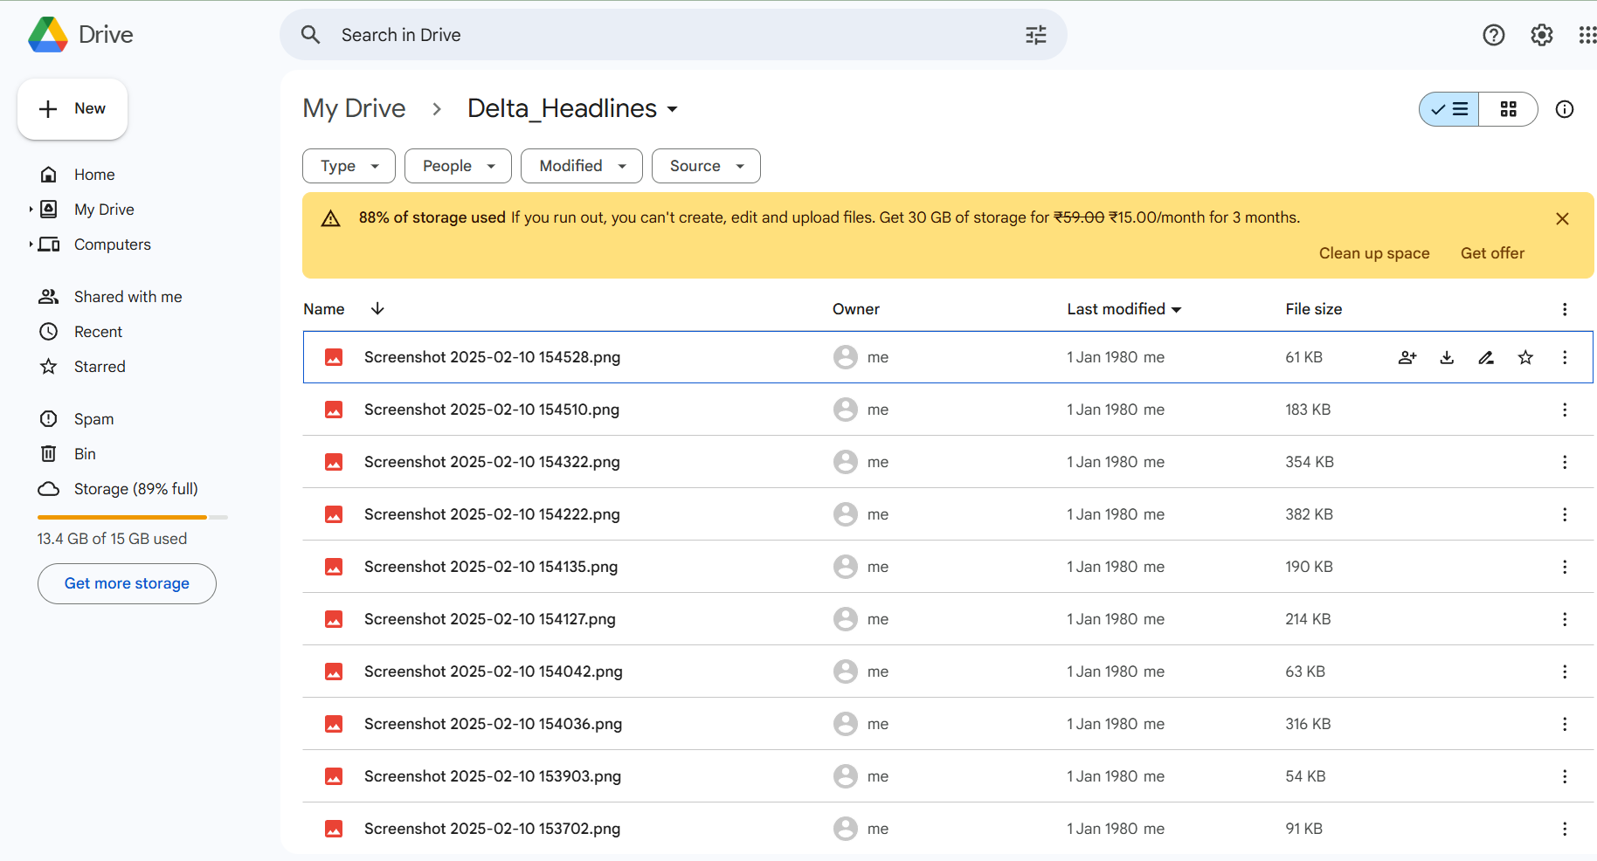
Input Images

Slide 19
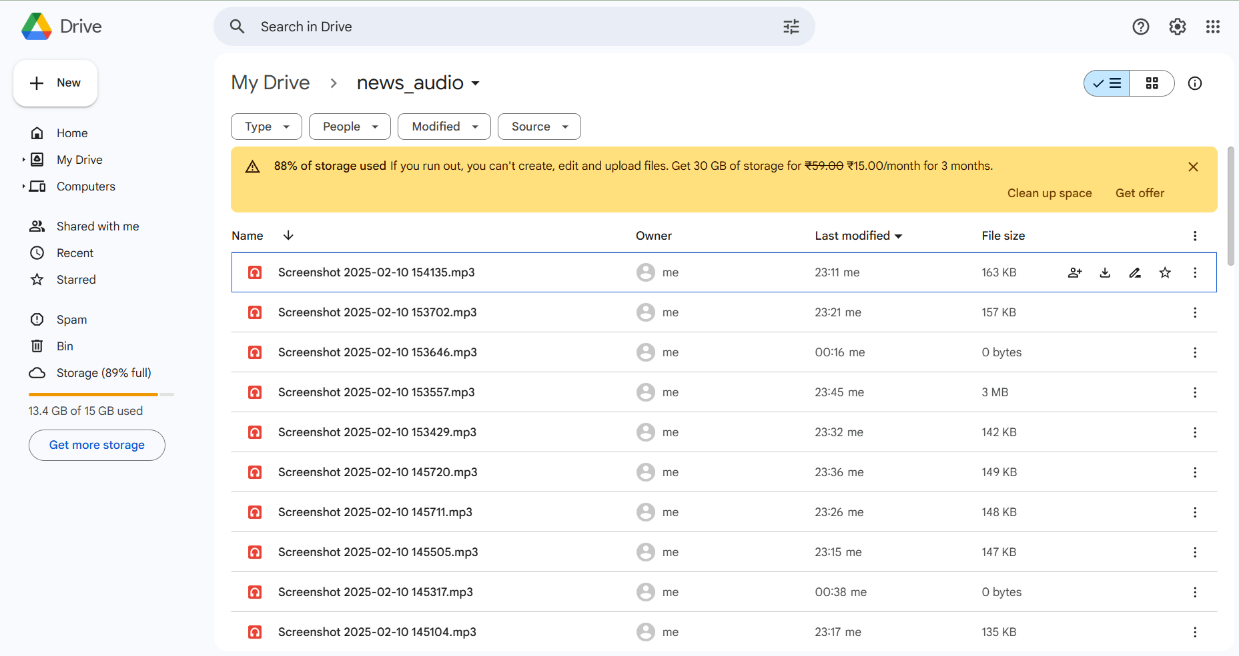
Output Audio files

Slide 20
Roadmap to Round 2
- Improve OCR for non-uniform layouts
- Test multilingual support
- Upgrade to better TTS engine
- Deploy beta web app

