Slide 1


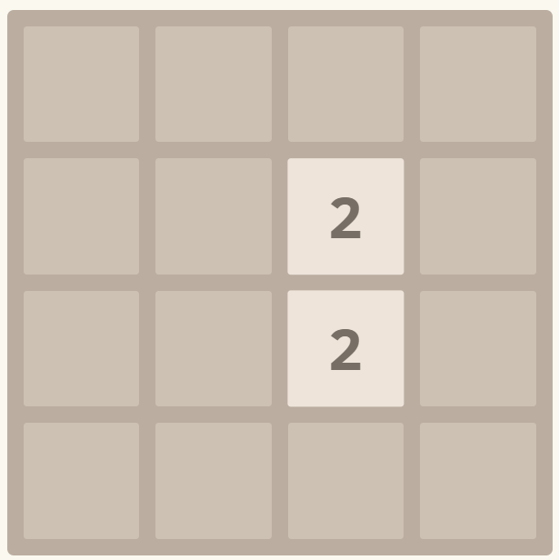
100
undo
20
Padding = 20
Cellsize = (width - 5*padding) / 4
75
75
400
20
400

Slide 2
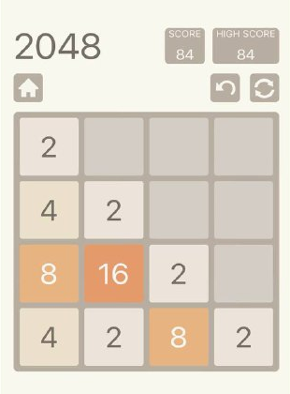
Padding = 20
Cellsize = (width - 5*padding) / 4

