Slide 1
Group meeting
Building a CPMG simulator we can trust
Validating the synthetic-data engine for the J-decoupling network
Objectives → what went wrong → what we fixed → where we stand
Notes:
30 min, questions welcome throughout. Plan: start with why we're building this at all, then the debugging story — including two mistakes.

Slide 2
The end goal
A network that removes the J-coupling artefact from a measured CPMG curve
Measured curve with J-coupling
DNN trained on synthetic pairs
Clean curve J-coupling removed
Why bother?
Why a network?
J-coupling to the amide proton distorts the 15N dispersion curve. That distortion is entangled with the exchange information we actually want (kₑₓ, pᴮ, Δω).
Removing it experimentally costs extra pulse-sequence machinery. Removing it computationally would be cheap and general.
The mapping from J-coupled → J-free is deterministic but has no closed form: it depends on kₑₓ, pᴮ, Δω, relaxation and the pulse sequence together.
That is exactly the kind of well-posed, hard-to-invert mapping a network handles well — given enough training data.
Notes:
Frame the project. The network is the destination; today is entirely about the training-data engine.

Slide 3
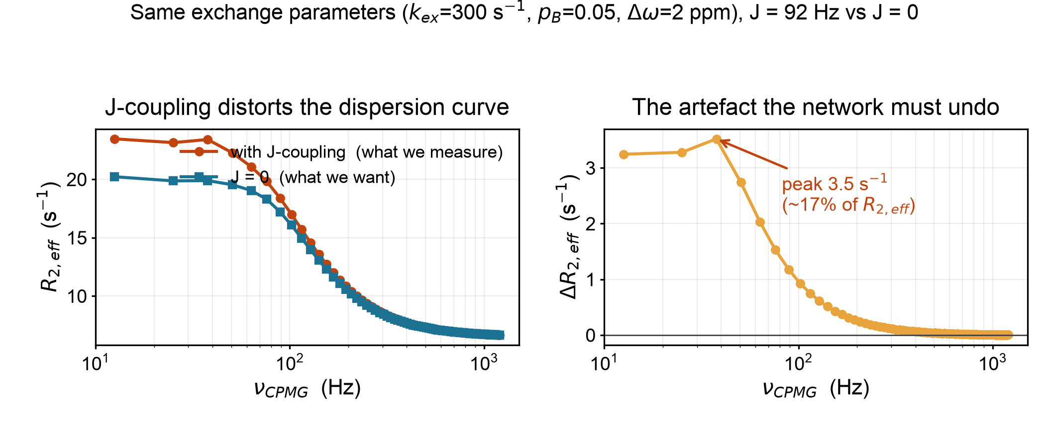
What the J-coupling artefact actually looks like
Our simulator, identical exchange parameters, J = 92 Hz vs J = 0
The artefact is largest at low ν_{CPMG} — exactly where the exchange information is richest. That is why it cannot simply be ignored.
Notes:
Peak ~3.5 s-1, about 17% of R2eff. Note it decays away by ~300 Hz. The overlap at high nu is real, not a plotting artefact.

Slide 4
The plan — and why it depends on the simulator
We cannot measure J-coupled / J-free pairs experimentally, so the training data must be simulated
Physics simulator Allard 1998,
32 × 32 Liouvillian
Synthetic dataset thousands of paired
curves (J = 92, J = 0)
Train the DNN learn J-coupled
→ J-free
Apply to real data clean curves →
better kₑₓ, pᴮ, Δω
we are here
Garbage in, garbage out
The network can only ever be as correct as the physics it is trained on. A systematic error in the simulator becomes a systematic error the network learns and reproduces — invisibly. So before generating millions of curves, the simulator has to be proven right.
Notes:
This is the justification for spending weeks on validation instead of jumping to the network. Expect a question here — the answer is that a biased simulator produces a confidently wrong network.

Slide 5
The simulator
Exact numerical propagation — no analytical approximation to the exchange problem
What it solves
What that buys us
Full Bloch–McConnell + relaxation in the 16-operator Cartesian product basis of Allard, Helgstrand & Härd (1998):
E, Hₓ, Hᵧ, H_z, Nₓ, Nᵧ, N_z,
2HₓN_z … 2H_zN_z
× 2 exchanging states → 32 × 32.
• proton bath and cross-relaxation
• CSA–DD cross-correlation
• scalar (J) coupling — the whole point
• finite pulse widths
Evolution by matrix exponential, so no fast/slow-exchange approximation is ever made.
How do we know it is right?
Two independent checks.
Audit the implementation line-by-line against the paper.
Benchmark it against ChemEx — the standard, widely used relaxation-dispersion package — by generating data with our simulator and asking ChemEx to recover the parameters we put in.
Notes:
Emphasise: the benchmark is a round-trip test. We know the ground truth because we generated it.

Slide 6
1
First attempt: it failed
1500 synthetic profiles, 100 grouped fits — ChemEx could not recover what we put in
–46%
+12%
+14%
pᴮ (minor population)
kₑₓ (exchange rate)
Δω (shift difference)
fitted ≈ 0.03 vs true 0.05–0.07
systematically overestimated
systematically overestimated
Too big and too systematic to be noise
Every group was biased the same way. Something was structurally wrong — either our physics, ChemEx's physics, or the way we were connecting the two.
This is where the real work started.
Notes:
Don't rush past this — the whole talk is the story of chasing this number down.

Slide 7
2
How we thought about it
Four candidate explanations — and how to tell them apart
Our physics is wrong
test: Audit the code against the paper.
We mis-implemented Allard.
ChemEx's physics is different
test: Compare the two matrices directly.
It models a smaller spin system.
The fitting is degenerate
test: Compare forward models with no fitting at all.
kₑₓ / pᴮ trade off against each other.
We are wiring them together wrong
test: Read ChemEx's source, not its docs.
Units, conventions, file formats.
Notes:
The useful move was designing tests that separate the hypotheses, rather than guessing which was true.

Slide 8
3
Hypothesis 1 — audit our own physics
Line-by-line against Allard, Helgstrand & Härd (1998)
We did find a bug
Everything else was correct
The DD–CSA cross-correlation prefactor was short by √3 relative to Eq. 33–34:
A_d · A_c = √(9d² · 3c²)
It fed the η_z and η_xy rates. Verified with SymPy, then fixed in 5 places.
r₂(N), r₁(N), σ, μ_mq and the exchange block all matched the paper exactly.
So the implementation was fundamentally sound — one real but narrow error.
Mistake #1 — we assumed this was the answer
It was a genuine bug, so it felt like the explanation. It was not. At the magic angle the cross-correlation term vanishes anyway, so it could not possibly account for a –46% pᴮ bias. Fixing it hardly changed the benchmark.
Lesson: finding *a* bug is not the same as finding *the* bug.
Notes:
Good place to invite questions. The lesson is generalisable and worth stating out loud.

Slide 9
4
Hypothesis 2 — compare the matrices themselves
Not curves, not fits. Read ChemEx's source and print its actual Liouvillian.
What we expected
What we found
A 32 × 32 matrix like ours, possibly with different conventions or a slightly different relaxation treatment.
cpmg_15n_ip declares Basis(type="ixyz").
That is three operators per state:
Nₓ, Nᵧ, N_z (× A, B) = 6 × 6
There is no proton in the basis at all.
Why that is not a criticism of ChemEx
For a fitting package this is a sensible, fast, well-tested choice — in-phase 15N CPMG is usually analysed exactly this way. But it means the two codes can only be compared where our 32 × 32 reduces to the same 6 × 6: J = 0, magic angle, no dipolar coupling.
Notes:
Anticipate defensiveness about ChemEx — make clear this is a modelling-scope difference, not a bug in their code.

Slide 10
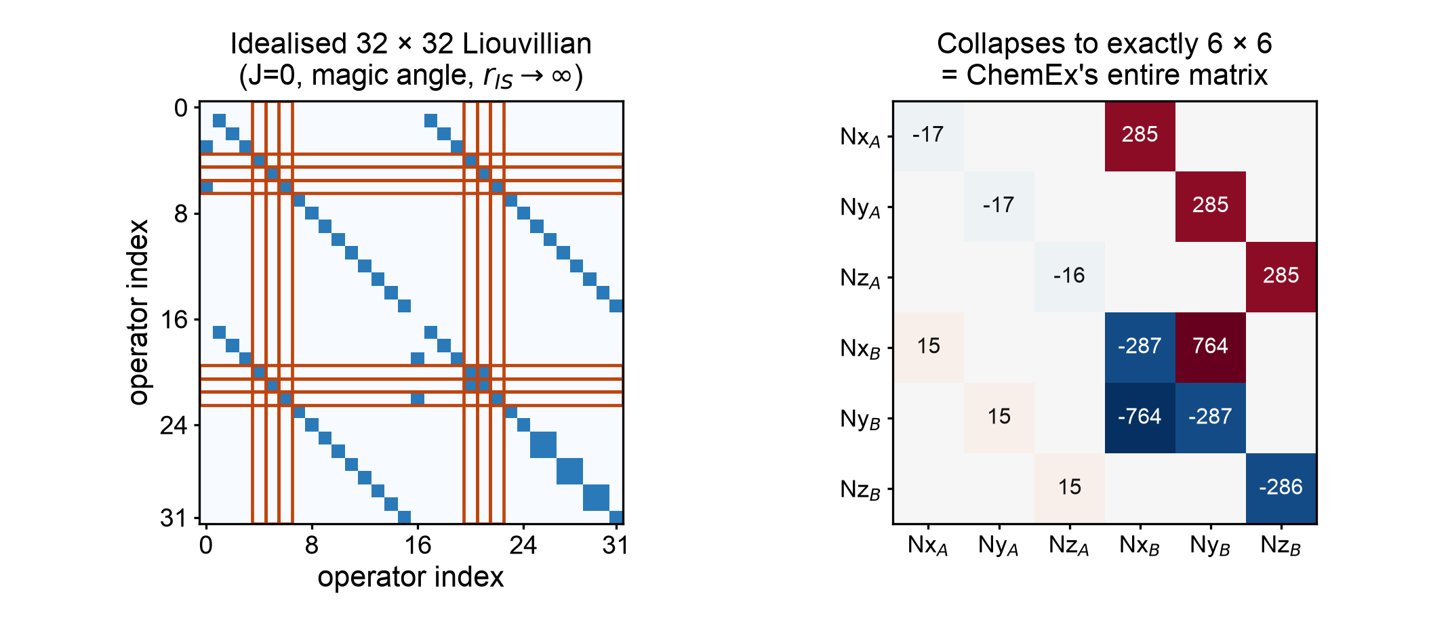
In that limit our matrix collapses onto theirs
Red = the only rows and columns the observable actually depends on (computed, not eyeballed)
Notes:
The dependency closure from the observable Nx gives exactly {E, Nx, Ny, Nz} x {A,B}. Drop the identity, which ChemEx omits, and you have their 6x6.

Slide 11
5
Result: the two matrices are identical
Eigenvalues are basis-independent — the strongest test available
Ours (32×32, collapsed) | ChemEx (6×6) | Physical mode
–300.5359 | –300.5359 | longitudinal exchange
–288.7159 ± 759.2445i | –288.7169 ± 759.0113i | state-B transverse
–15.1426 ± 4.9910i | –15.1416 ± 4.9922i | state-A transverse (observed)
–0.5359 | –0.5359 | R₁ relaxation
0.03%
The only two differences
• Sign of Δω — opposite rotation convention; R₂,eff depends on Δω², so nothing observable changes.
• |Δω| differs by 0.03% — we use γ_N/γ_H, ChemEx uses the IUPAC Ξ ratio.
largest difference
a units convention, not physics
So the physics engines agree. The problem had to be somewhere else entirely.
Notes:
Pivot of the talk. Everything before builds to this; everything after is about what was actually wrong.

Slide 12
6
The actual bug: pulse-sequence conventions
Same Liouvillian — but 'ncyc' means two different things in the two codes
 | Our simulator | ChemEx cpmg_15n_ip
180° pulses per labelled ncyc | ncyc | 2 × ncyc (two half-trains)
τ_cp | (T – ncyc·t₁₈₀) / (2·ncyc) | time_t2/(4·ncyc) – pw90
Reported ν_CPMG | 1/(4τ_cp) | ncyc / time_t2
Excitation / detection | starts on Nₓ, reads Nₓ | explicit 90° pulses, t_neg, t_equil
Two concrete errors
Why it looked like physics
• ncyc was off by a factor of 2 — ChemEx read our labels as half the real pulse count.
• time_t2 was 0.068 s; the data was generated with 0.04 s, rescaling every rate by 0.588.
Both errors distort the curve smoothly, in a way that mimics a different exchange regime. The fit absorbs them by shifting pᴮ — which is exactly what we saw.
Notes:
The factor of 2 is the headline. Worth saying plainly: we were feeding ChemEx a mislabelled x-axis.

Slide 13
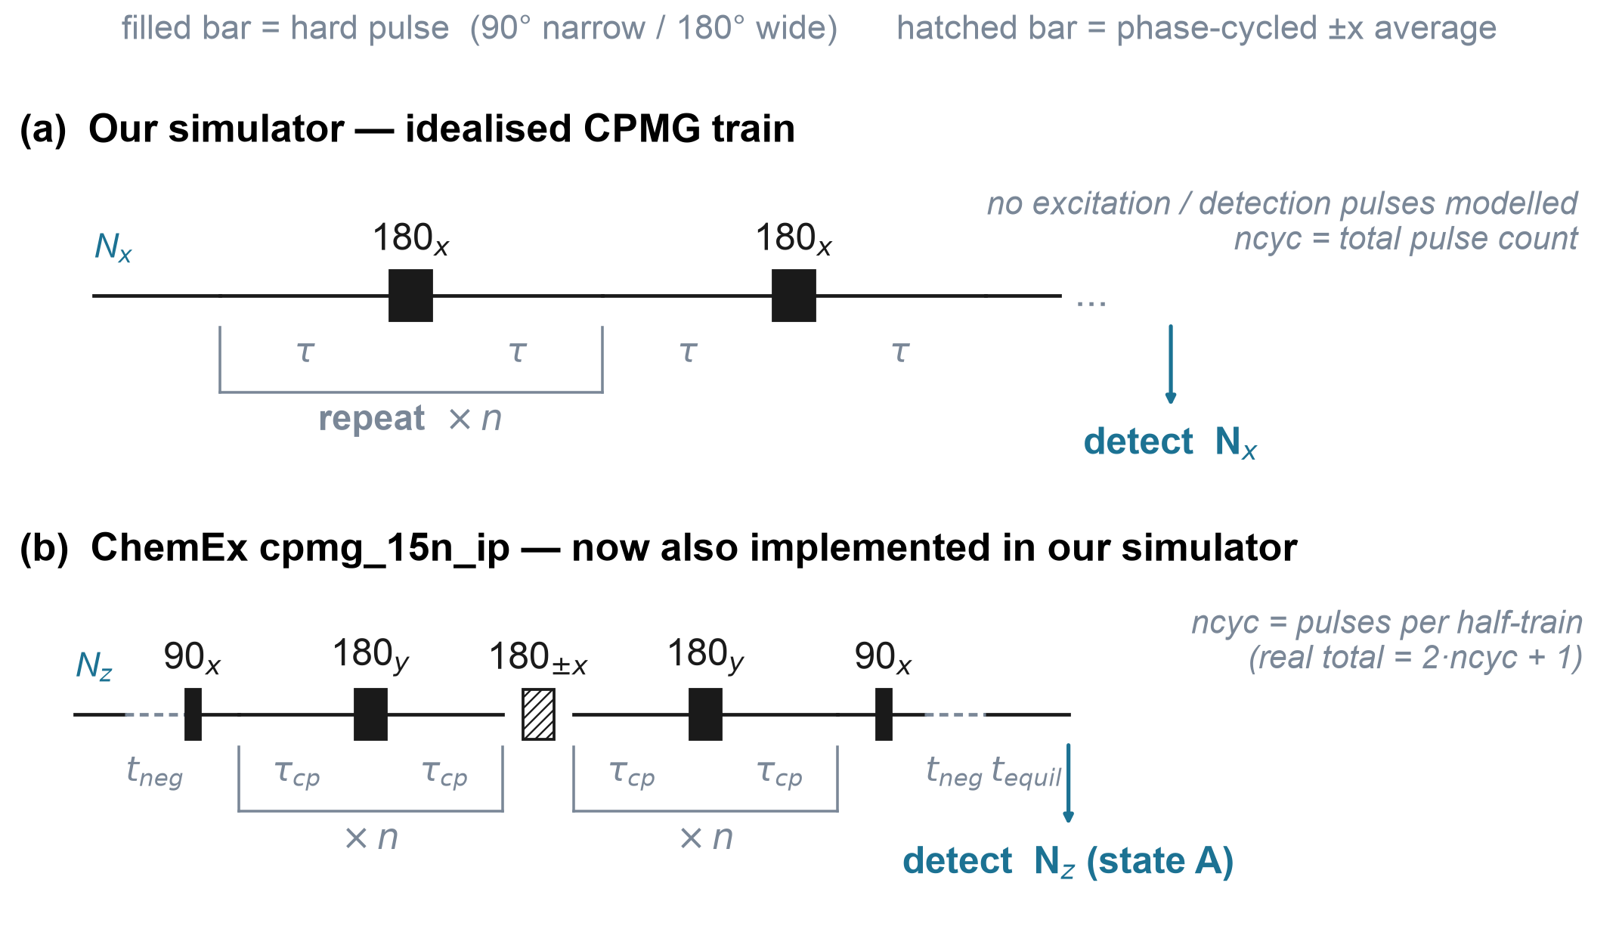
The two sequences, drawn out — both now implemented in our simulator
Notes:
Walk through (b): 90 excitation, t_neg finite-pulse correction, two mirrored half-trains around the phase-cycled 180, then 90 and detect. Our train (a) had none of the outer machinery.

Slide 14
7
Fixing the conventions
Regenerate the dataset with the correct ncyc labelling and time_t2
–46%
+5.4%
pᴮ error — before
pᴮ error — after
original dataset
ncyc and time_t2 corrected
Most of the bias was bookkeeping
But not all of it
Two configuration values — not the relaxation theory, not the exchange model, not the optimiser. kₑₓ improved from +12.2% to –5.1% at the same time.
A residual ~5% bias survived. The sequences were still structurally different, so we could not yet tell whether the rest was physics or more convention.
Notes:
Good moment to pause for questions. Then motivate why we went further rather than declaring victory at 5%.

Slide 15
8
Removing the last variable
Implement ChemEx's exact sequence inside our simulator, so only physics can differ
sim.simulate_cpmg(params, sequence="home")
sim.simulate_cpmg(params, sequence="chemex")
Mistake #2 — a five-percent residual we could not explain
After implementing the sequence, a stubborn ~5% gap remained that no sign or phase convention would remove. We spent a while flipping conventions before doing the systematic thing: swap in ChemEx's own propagators one at a time.
The culprit was the detection operator. ChemEx sets suffix_detect = "_a" — it detects ONLY the ground state's N_z, not the population-weighted sum over both states, which is what we had assumed.
One line, factor of 77
Matching that convention took the discrepancy from ~5% to 0.066% — the level of the known 0.03% gyromagnetic-ratio difference. At that point there is no residual bug on either side.
Notes:
The honest lesson: guessing conventions wasted time; ablation found it in one pass. Say that.

Slide 16
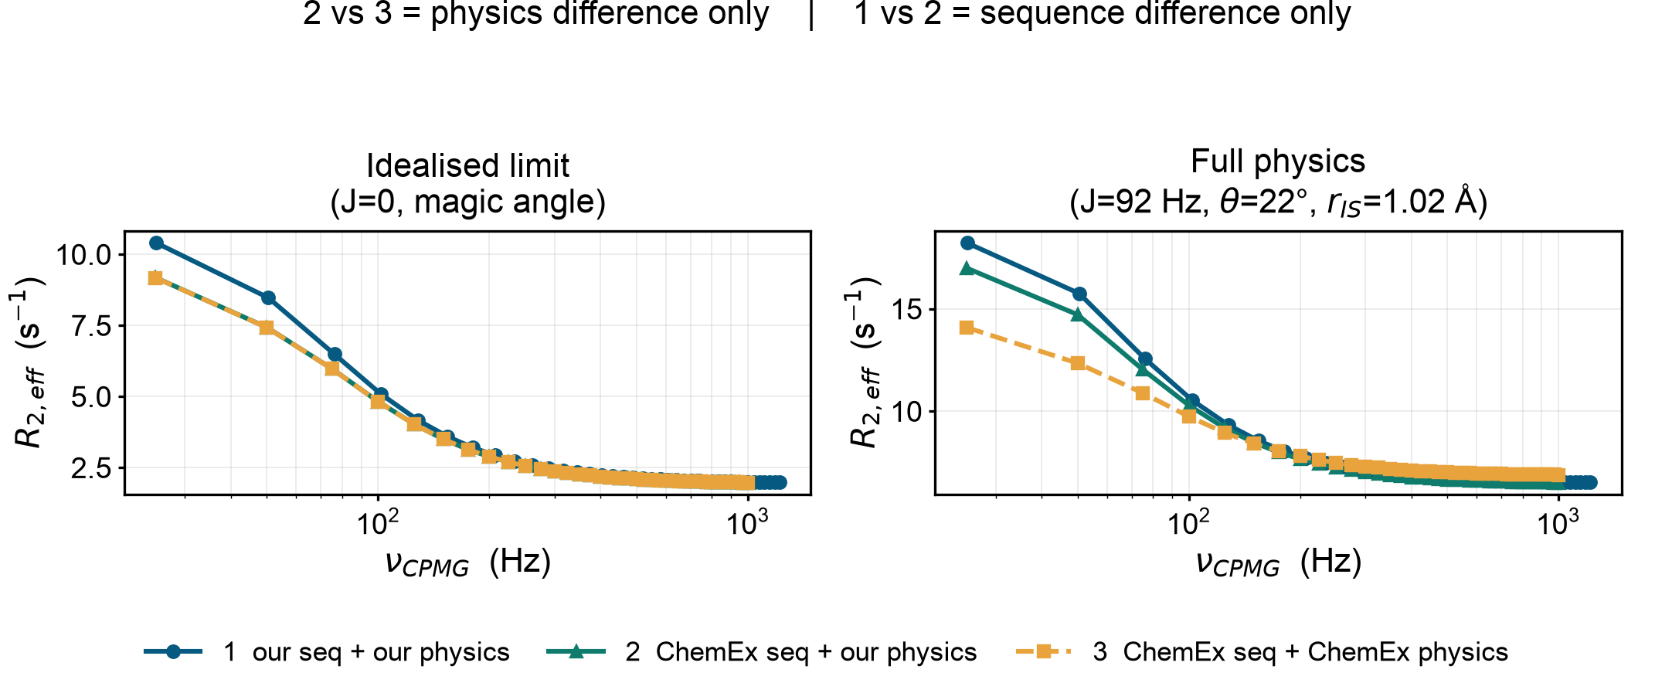
Now we can separate sequence from physics
Three forward models, no fitting anywhere
Left: curves 2 and 3 lie on top of each other (0.066%). Right: same sequence, but a 20.6% gap in Rₑₓ remains — that is genuine physics.
Notes:
This is the cleanest result in the talk. Curve 2 vs 3 changes only the physics engine; curve 1 vs 2 changes only the sequence.

Slide 17
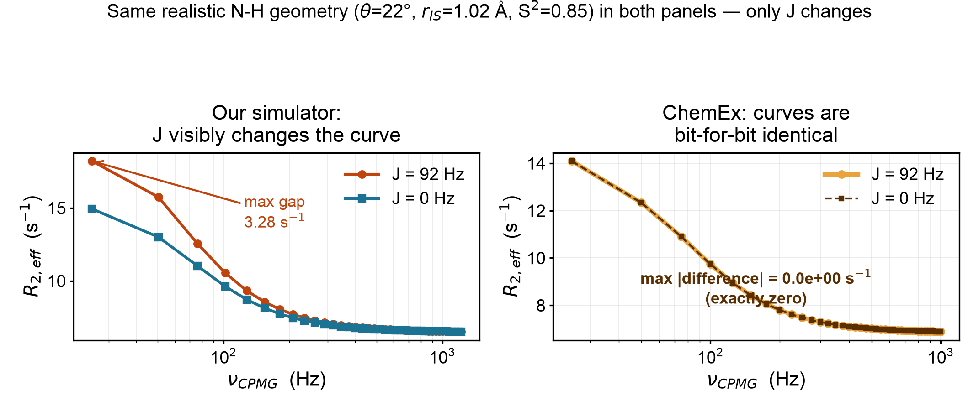
Isolating the effect of J alone
Same N-H geometry in both panels (θ=22°, r_IS=1.02 Å, S²=0.85) — only J changes
Left: our simulator responds to J, as expected. Right: ChemEx’s curve does not move at all — it has no channel for J-coupling.
Notes:
This directly answers the question raised on slide 16: the y-axis mismatch there came from geometry (theta, r_IS, S2), not from J. Here everything except J is held fixed. Left: our simulator moves with J, as it should. Right: ChemEx's curve is bit-for-bit identical for J=0 and J=92 -- proof its 6x6 basis has no channel for J-coupling at all.

Slide 18
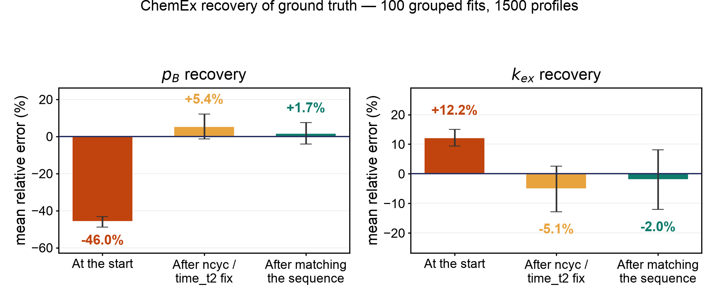
9
Refitting all 1500 profiles
Dataset regenerated with ChemEx's own sequence — 100/100 grouped fits converged
pᴮ: –46% → +5.4% → +1.7%. Remaining spread is dominated by the fast-exchange kₑₓ / pᴮ degeneracy (4 of 100 groups), not by model error.
Notes:
Mention the 4 degenerate groups voluntarily — near kex 1250-1430, where CPMG constrains the product not the individual values.

Slide 19
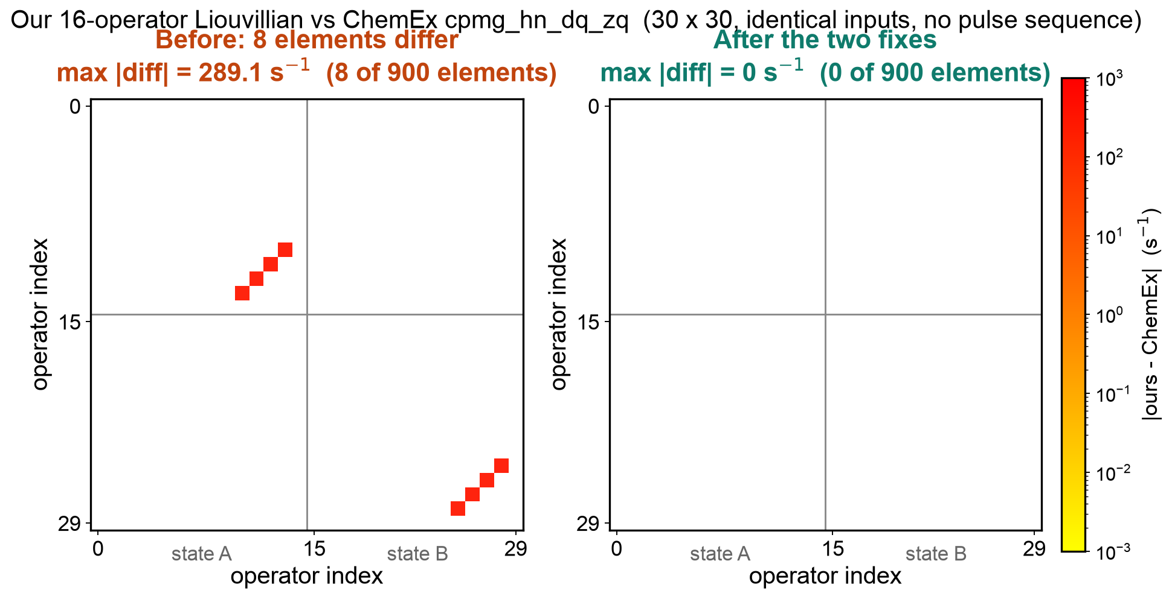
A much stronger test: ChemEx’s own 16×16
ChemEx also ships cpmg_hn_dq_zq, whose basis has all 15 operators — so we can compare every term, not just the collapsed six
892 of 900 elements matched immediately. The 8 that did not all sat in the multiple-quantum block, and all differed by exactly π·J.

Slide 20
10
Two real bugs — and where they came from
Both confined to the multiple-quantum block, which the in-phase experiment never reaches
Bug 1 — a sign, from a transcription slip
Bug 2 — J-coupling where it cannot act
Allard Eq. [19] is written dσ/dt = −P·σ, so every printed element must be negated going into the code. The μ_mq entries were copied with the printed signs instead — which swapped the DQ and ZQ relaxation rates. The formula itself (Eq. [32]) was perfect; only the placement was wrong.
A_d · A_c = √(9d² · 3c²)
It fed the η_z and η_xy rates. Verified with SymPy, then fixed in 5 places.
Four lines added ±π·J to the MQ block. But 2πJ·IzSz commutes exactly with all four MQ operators (verified numerically), so J cannot connect them — DQ and ZQ are not split by J in a two-spin system. Eq. [19] shows no πJ there either.
So the implementation was fundamentally sound — one real but narrow error.
After both fixes: all 900 elements identical (max difference exactly 0)
Impact: the in-phase ¹⁵N CPMG experiments never populate the MQ block, so every earlier result — the 6×6 validation, the ncyc fix, the 20.6% figure, all the fits — is unchanged. CW-CPMG does reach it through the ¹H decoupling field, so those profiles shift slightly.Fixing it hardly changed the benchmark.
Lesson: finding *a* bug is not the same as finding *the* bug.

Slide 21
What we learned along the way
Three things worth carrying into the next stage
Finding a bug ≠ finding the bug
The √3 error was real and worth fixing, but it explained none of the discrepancy. We nearly stopped there.
Read the source, not the documentation
The 6×6 basis, the state-A-only detection, and the 15-operator DQ/ZQ model that finally exposed our own MQ bugs — all only visible in the source.
Ablate, don't guess
Flipping conventions one at a time by intuition wasted days. Swapping components in systematically found it immediately.
Notes:
Group meetings are the right venue for this slide — the failure modes generalise beyond this project.

Slide 22
Where the simulator stands today
Validated, with a quantified statement of what it adds
Physics validated
Round-trip verified
Scope quantified
Matches ChemEx's full 15-operator Liouvillian on all 900 elements exactly. Three real bugs found and fixed along the way (√3, μ_mq sign, spurious πJ).
ChemEx recovers pᴮ to +1.7% and kₑₓ to –2.0% from data our simulator generates.
With sequence controlled, the 32×32 treatment changes Rₑₓ by 20.6% vs a 6×6 model at realistic J.
Why the 20.6% matters for this project
That gap is precisely the proton bath, CSA–DD cross-correlation and J-coupling that a reduced model cannot represent — and J-coupling is the very thing the network is supposed to learn to remove. A 6×6 simulator could not generate this training data at all. The larger treatment is not an indulgence; it is a requirement.
Notes:
Tie it back to the project goal — this is the answer to 'why did you need the big matrix?'

Slide 23
Next steps
Generate the training set
With the simulator validated, produce the paired (J-coupled, J-free) dataset at scale across kₑₓ, pᴮ, Δω and field.
Extend the benchmark
Repeat the matched-sequence comparison for the TROSY experiment, and check how the 20.6% physics gap propagates into fitted parameters.
Start the network
Architecture and training on synthetic pairs; then test on the CW-CPMG sequence (Hansen/Kay 2008), which is already implemented.
Everything is in the repo — simulator, both pulse sequences, the ChemEx benchmark harness and the full write-up.
Notes:
Close by returning to the project goal. Invite questions.

