Slide 1
CPMG relaxation dispersion
Resolving the simulator – ChemEx disagreement
Root cause identified and corrected — pᴮ recovery improved from –46% to +1.7%
Weekly progress update • work since the last meeting
Notes:
15 minutes. Headline: the disagreement was NOT a physics error in our simulator — it was a pulse-sequence convention mismatch. Found it by comparing the two Liouvillians directly.

Slide 2
Where we left off
State at the last meeting — ChemEx could not recover the ground truth we generated
Grouped fits over 1500 synthetic profiles (100 groups × 15 residues, two fields) showed a large, reproducible bias — worst in the minor-state population:
–46.0%
+12.2%
+13.9%
pᴮ (minor population)
kₑₓ (exchange rate)
Δω (chemical shift diff.)
fitted ≈0.03 vs true 0.05–0.07
systematically overestimated
systematically overestimated
The open question
Was this a genuine physics difference — our 32×32 Allard treatment vs. ChemEx's reduced model — or a bug/convention mismatch somewhere in the pipeline? The bias was too large and too systematic to be statistical.
Everything that follows is the answer to that question.
Notes:
Recap only — 60 seconds. These are the numbers from the plots I showed last time.

Slide 3
Approach
Strip the comparison down until only one thing can differ at a time
1
Audit our physics against the source paper
Line-by-line check of the simulator against Allard, Helgstrand & Härd (1998), verified symbolically with SymPy.
2
Compare the two Liouvillian matrices directly
Not curves, not fits — the actual matrices, in a limit where both codes must agree.
3
Compare forward models with no fitting
Removes the optimiser as a source of disagreement entirely.
4
Match the pulse sequence, then refit
Implement ChemEx's own sequence in our simulator so physics is the only remaining variable.
Notes:
The logic: each step removes one possible explanation. By step 4 only the physics model can differ.

Slide 4
1
Audit against Allard et al. (1998)
Does our implementation actually match the paper it is based on?
Bug found: missing √3
Verified, not guessed
The DD–CSA cross-correlation prefactor was short by a factor of √3 relative to Allard Eq. 33–34:
A_d · A_c = √(9d² · 3c²)
This feeds η_z and η_xy — the cross-correlation rates.
Confirmed symbolically with SymPy using correctly-signed constants (γ_N < 0, σ_N < 0), giving an exact ratio of √3.
Cross-checked against μ_mq, which was already correct — ruling out an error in my own method.
Fixed in 5 places — cpmg_ml/simulator.py plus four GUI variants that each carried their own copy of the formula. All re-verified after the change.
Everything else checked out
r₂(N), r₁(N), σ, μ_mq and the Bloch–McConnell exchange block all match the paper exactly. So the simulator's physics was sound — the √3 alone could not explain a –46% pᴮ bias.
Notes:
Important: this was a real bug worth fixing, but it does NOT explain the ChemEx disagreement. It vanishes at the magic angle anyway. Say so explicitly.

Slide 5
2
What matrix does ChemEx actually use?
Reading the ChemEx source rather than assuming
Ours — 32 × 32
ChemEx cpmg_15n_ip — 6 × 6
16 Cartesian product operators per state, × 2 exchanging states:
E, Hₓ, Hᵧ, H_z, Nₓ, Nᵧ, N_z,
2HₓN_z … 2H_zN_z
Includes the proton bath, antiphase and multiple-quantum coherences.
Basis(type="ixyz") → only three operators per state:
Nₓ, Nᵧ, N_z (× A, B)
No proton in the basis at all. No J-coupling, no CSA–DD cross-correlation — those transitions are silently filtered out.
Why this matters
ChemEx is already the collapsed limit, structurally. So a meaningful comparison has to be made in the regime where our 32×32 reduces to that same 6×6: J = 0, CSA–DD angle at the magic angle, dipolar coupling switched off. That is exactly the idealised single-spin case discussed at the last meeting — it turns out to be the right controlled experiment, not just a sanity check.
Notes:
Key realisation. ChemEx's cpmg_15n_ip has no proton operator whatsoever. Its transition table defines cross-correlation terms but the basis filter drops them.

Slide 6
2
The 32 × 32 collapses exactly as predicted
Which operators actually feed the observable? (dependency closure, computed not assumed)
Condition | Propagator | Closed subspace | Dim
Realistic (J=92 Hz, θ=22°, r=1.02 Å) | free precession | Nₓ, Nᵧ, 2H_zNₓ, 2H_zNᵧ | 8
Realistic | + 180°ₓ pulses | E, H_z, Nₓ, Nᵧ, N_z, 2H_zNₓ, 2H_zNᵧ, 2H_zN_z | 16
Idealised (J=0, magic angle, r→∞) | free precession | Nₓ, Nᵧ | 4
Idealised | + 180°ₓ pulses | E, Nₓ, Nᵧ, N_z | 8
The collapse, stated precisely
Under the idealised conditions the observable's dynamics live entirely in {E, Nₓ, Nᵧ, N_z} × {A,B} — 8 of the original 32 dimensions. ChemEx's basis omits the identity E altogether, leaving {Nₓ, Nᵧ, N_z} × {A,B} = 6. Exactly ChemEx's matrix.
Note the realistic row: 16 dimensions, including antiphase and two-spin order. ChemEx's 6×6 cannot represent that case at all.
Notes:
This is the rigorous version of 'the matrix collapses'. Computed the dependency closure from the observable, didn't eyeball the sparsity pattern.

Slide 7
3
The two matrices are identical
Same idealised conditions, both matrices printed and compared element by element
Eigenvalues of the 6 × 6 block — basis-independent, the strongest test
Ours (Allard 32×32, collapsed) | ChemEx (ixyz 6×6) | Mode
–300.5359 | –300.5359 | longitudinal exchange
–288.7159 ± 759.2445i | –288.7169 ± 759.0113i | state-B transverse
–15.1426 ± 4.9910i | –15.1416 ± 4.9922i | state-A transverse (observed)
–0.5359 | –0.5359 | R₁ relaxation
0.03%
The only two differences
• Sign of Δω — opposite rotation convention. R₂,eff depends on Δω², so no observable is affected.
• |Δω| differs by 0.03% — we use γ_N/γ_H, ChemEx uses the IUPAC Ξ ratio.
largest disagreement
and it is a units convention, not physics
Conclusion: the physics engines agree. The disagreement must be downstream of the matrix.
Notes:
This is the pivot of the whole investigation. Once the matrices matched, the search moved to the pulse sequence.

Slide 8
4
The real bug: pulse-sequence conventions
Same Liouvillian, two different sequence definitions — and two different meanings of ncyc
 | Our simulator | ChemEx cpmg_15n_ip
Refocusing pulses per labelled ncyc | ncyc | 2 × ncyc (two mirrored half-trains)
τ_cp | (T – ncyc·t₁₈₀) / (2·ncyc) | time_t2/(4·ncyc) – pw90
Reported ν_CPMG | 1/(4τ_cp) pulse-width exclusive | ncyc/time_t2 pulse-width inclusive
Excitation / detection | starts on Nₓ, reads Nₓ | explicit 90° pulses, t_neg, time_equil
Two concrete errors in the config
To be clear about τ_cp
• ncyc was off by a factor of 2 — ChemEx read our labels as half the actual pulse count.
• time_t2 was 0.068 s but the data was generated with t_relax = 0.04 s, rescaling every extracted rate by 0.588.
Our τ_cp does correctly subtract the finite pulse width — that was never the bug. The 'exclusive vs inclusive' distinction concerns only the frequency value printed on the x-axis, not the propagation.
Notes:
Anticipate the question 'does your tau_cp ignore pulse widths?' — no, it doesn't. The right-hand card pre-empts that.

Slide 9
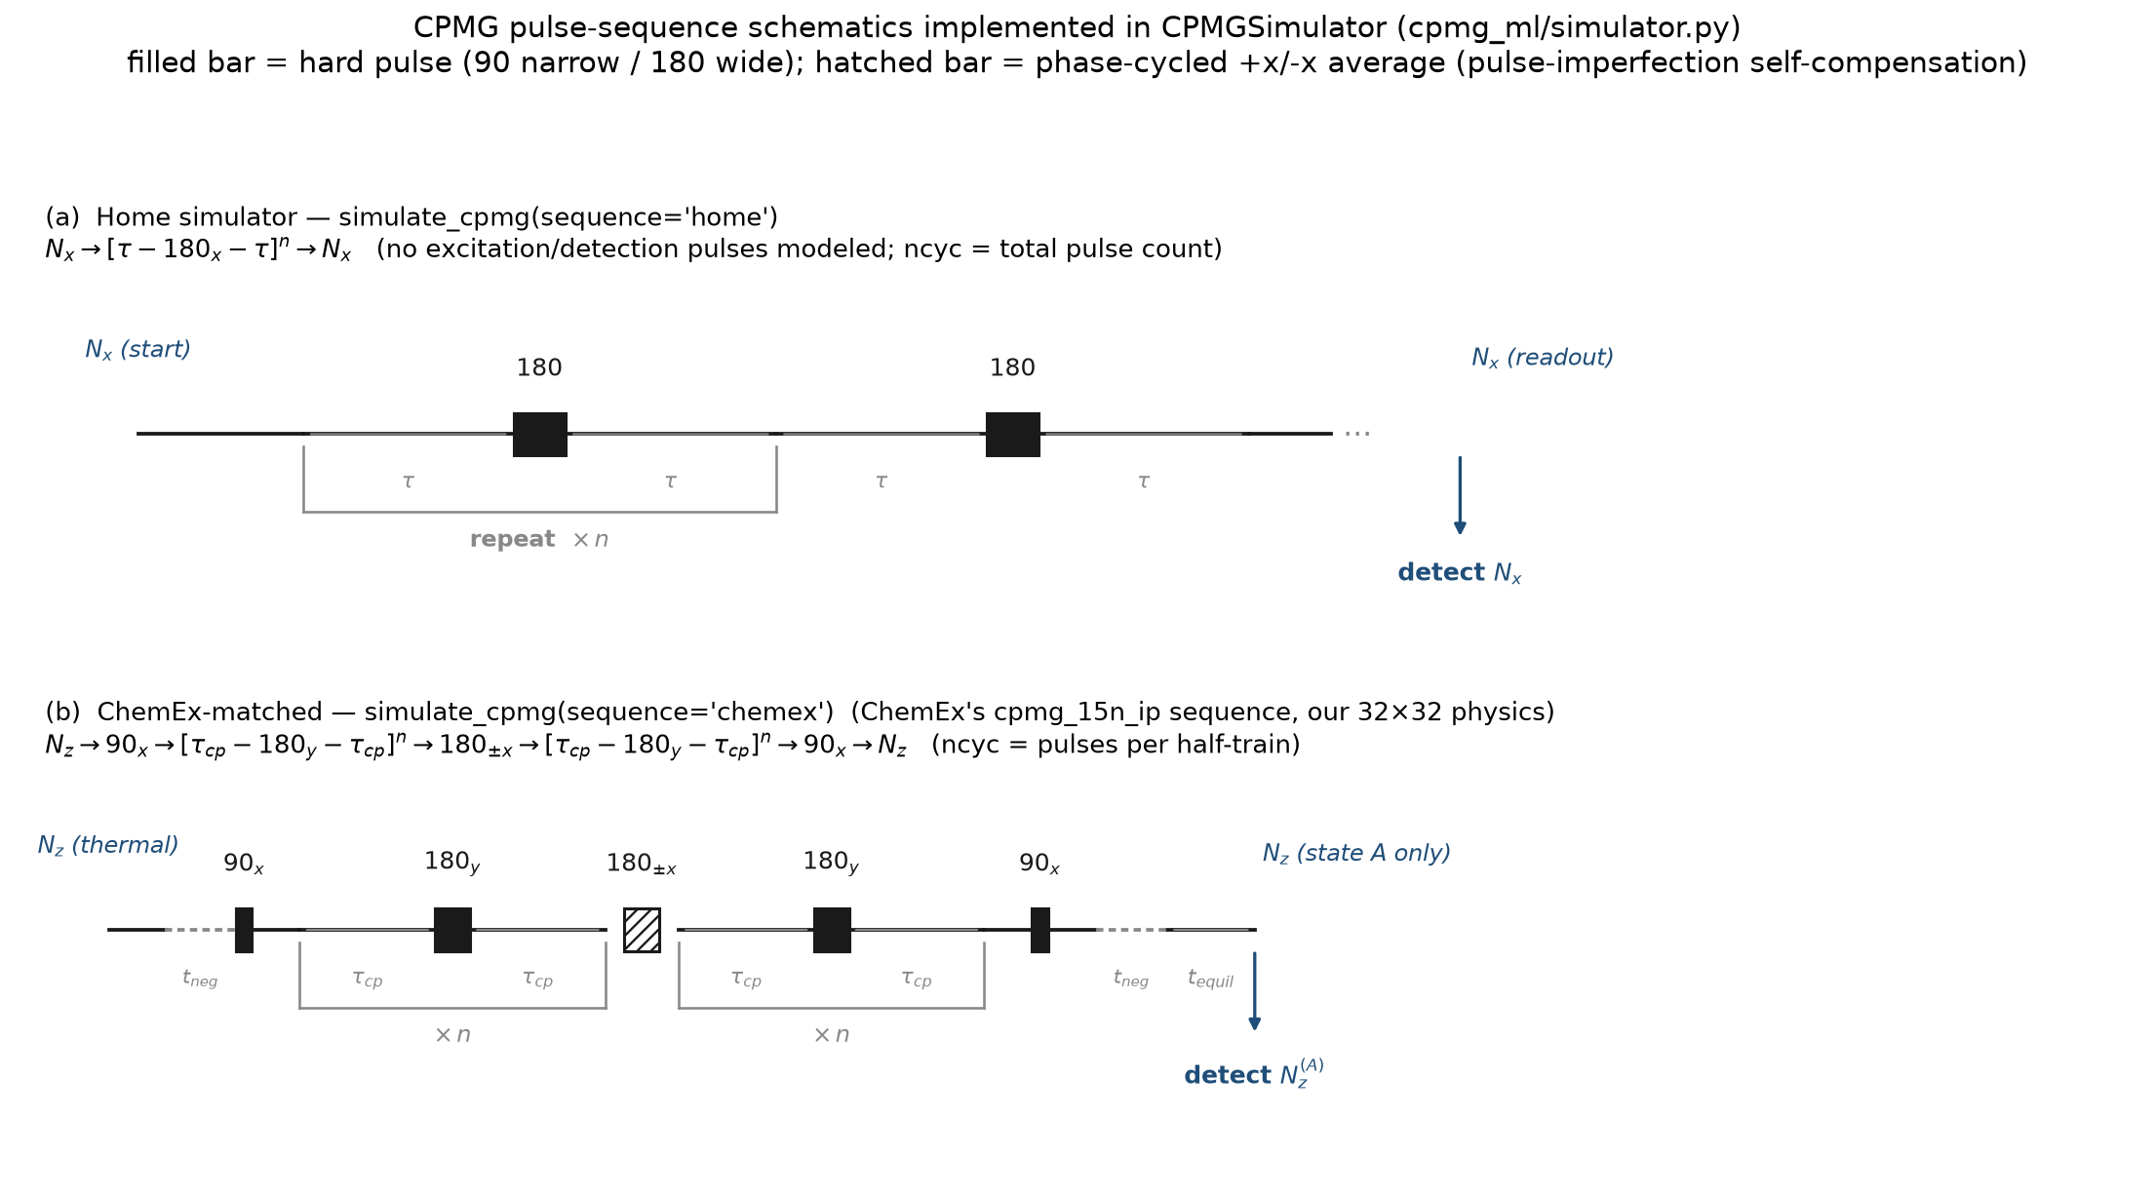
The two pulse sequences, side by side
Now both implemented in the simulator — selectable with a single argument
Notes:
Panel (a) is our idealised train — no excitation or detection pulses. Panel (b) is ChemEx's: 90 excitation, t_neg correction, two mirrored half-trains around the phase-cycled 180±x, then 90 and detection.

Slide 10
5
Matched-sequence mode
So that sequence and physics can finally be separated
sim.simulate_cpmg(params, sequence="home")
sim.simulate_cpmg(params, sequence="chemex")
A second real bug, caught here
Effect of that one line
Validation left a stubborn ~5% residual that no sign convention would remove. Ablation traced it to the detection operator: ChemEx sets suffix_detect = "_a", so it detects ONLY the ground state's N_z — not the population-weighted sum over both states.
Matching the detection convention reduced the discrepancy by a factor of 77 — from ~5% down to 0.066%, which is the level of the known 0.03% gyromagnetic-ratio difference.
At that point there is no residual bug on either side.
Both sequences run through the same 32×32 Allard physics, so switching modes changes the sequence and nothing else.
The 'home' mode is unchanged and regression-tested identical, so all earlier results remain reproducible.
Notes:
Worth dwelling on the detection-operator bug — it is the kind of thing only a direct code-level comparison would ever surface.

Slide 11
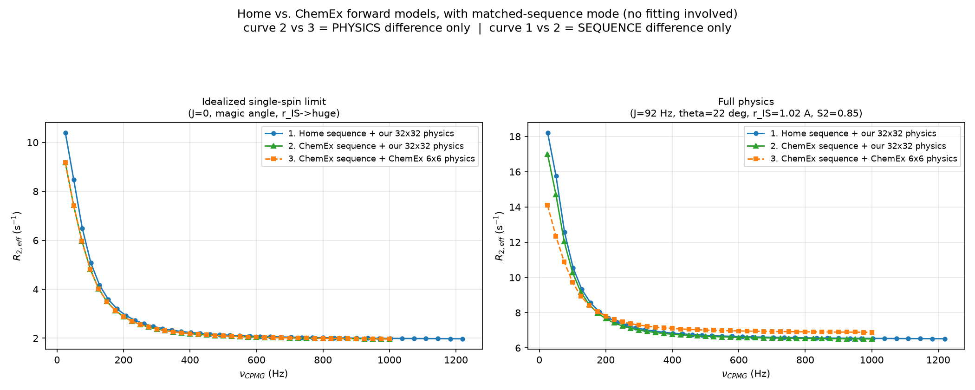
Forward models with the sequence controlled
No fitting anywhere — curve 2 vs 3 isolates physics, curve 1 vs 2 isolates sequence
Idealised: curves 2 and 3 agree to 0.066%. Full physics: a 20.6% gap in Rₑₓ remains (10.48 vs 7.20 s⁻¹) — same sequence, so this is physics alone.
Notes:
Left panel: green and orange sit on top of each other — proof there is no bug left. Right panel: they separate even though the sequence is identical, which is the real physics difference.

Slide 12
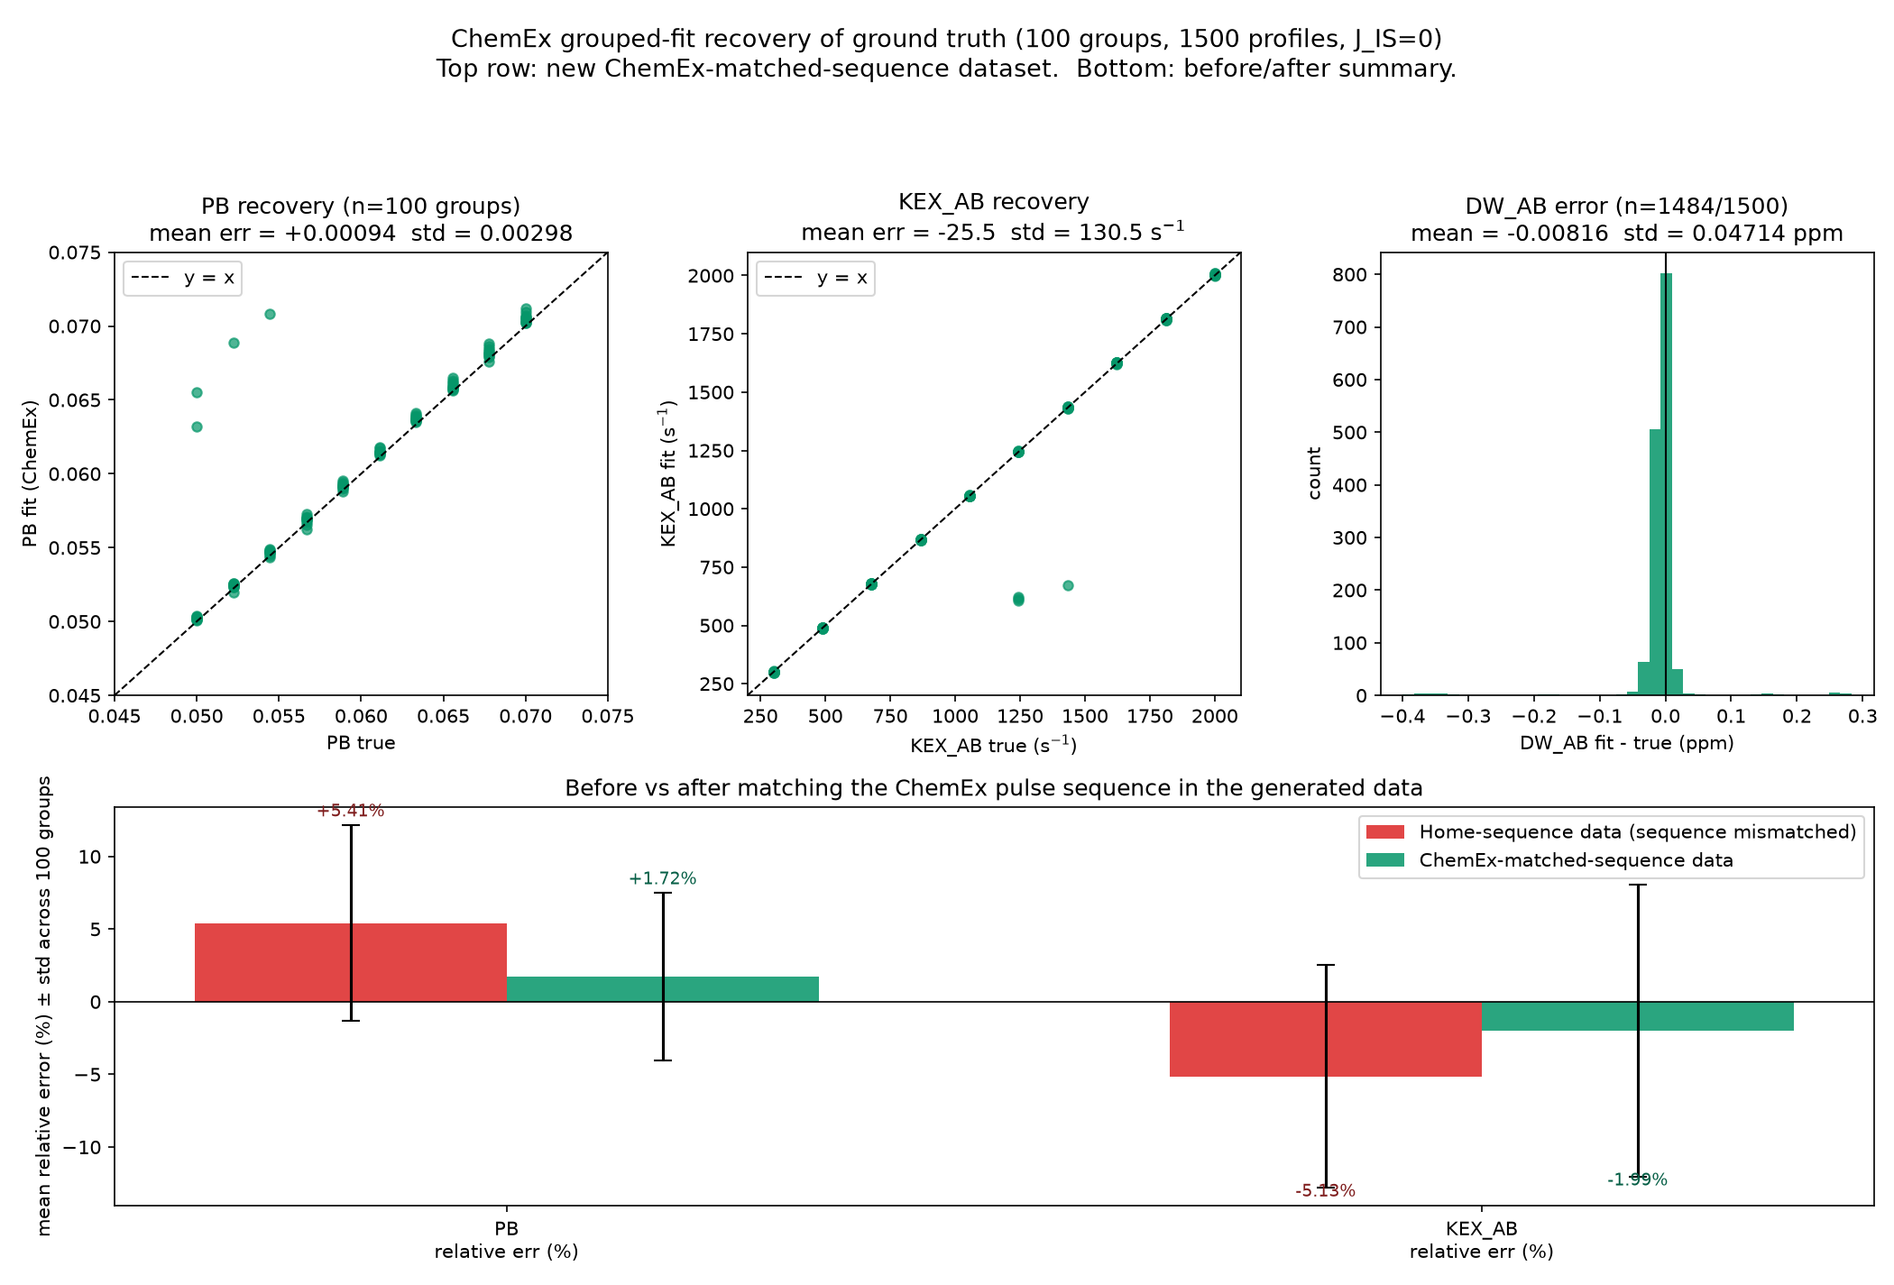
Refitting all 1500 profiles
Dataset regenerated with ChemEx's own sequence, then fitted by ChemEx — 100/100 groups converged
Recovery
pᴮ +1.72% ± 5.77%
kₑₓ –1.99% ± 10.05%
Δω –0.008 ppm
All 100 grouped fits converged.
One honest caveat
4 groups (all near kₑₓ ≈ 1250–1430 s⁻¹) land on the classic fast-exchange kₑₓ / pᴮ degeneracy — CPMG constrains their product, not each separately. A real NMR limitation, not a fitting failure.
Notes:
Mention the 4 degenerate groups voluntarily — better raised by me than found by him.

Slide 13
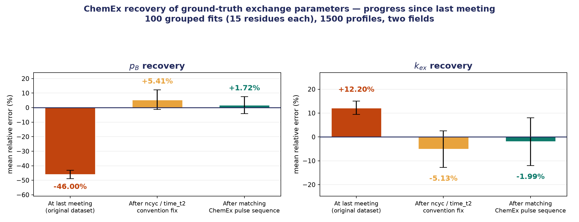
Net effect on parameter recovery
Same 100 grouped fits, measured at each stage of the investigation
pᴮ bias reduced from –46% to +1.7%; kₑₓ from +12.2% to –2.0%. Most of the remaining spread is the fast-exchange degeneracy, not model error.
Notes:
The money slide. Two convention fixes account for essentially the whole original bias.

Slide 14
Where this leaves us
Our Allard implementation is validated.
Matches ChemEx's Liouvillian to 0.03% — an independent, widely used reference code. One real bug (√3) found and fixed along the way.
The disagreement was conventions, not physics.
ncyc/time_t2 and the detection operator. Two fixes took pᴮ from –46% to +1.7%.
A quantified case for the 32×32 treatment.
With sequence fully controlled, ChemEx's 6×6 basis under-predicts Rₑₓ by 20.6% on realistic NH parameters — the proton bath, cross-correlation and J-coupling it cannot represent.
Also completed • Next
CW-CPMG simulator + GUI built from Hansen, Vallurupalli & Kay (JPCB 2008). — Next: extend the matched-sequence comparison to the TROSY experiment, and quantify how the 20.6% physics gap propagates into fitted parameters at realistic J.
Notes:
Close on the 20.6% number — that is the scientific justification for the larger simulator, measured with everything else controlled.

