Slide 1
CPMG De-J-Coupling
Simulator validated · first learned models · the noise limit
11 Aug → 3 Sep 2026
Weekly PI update
Notes:
Three things since 11 Aug: the simulator is now validated against ChemEx at the full 30x30 level and two real bugs were found and fixed; the first learned models are trained and work very well on clean data; and adding realistic noise revealed the binding constraint on the whole approach.

Slide 2
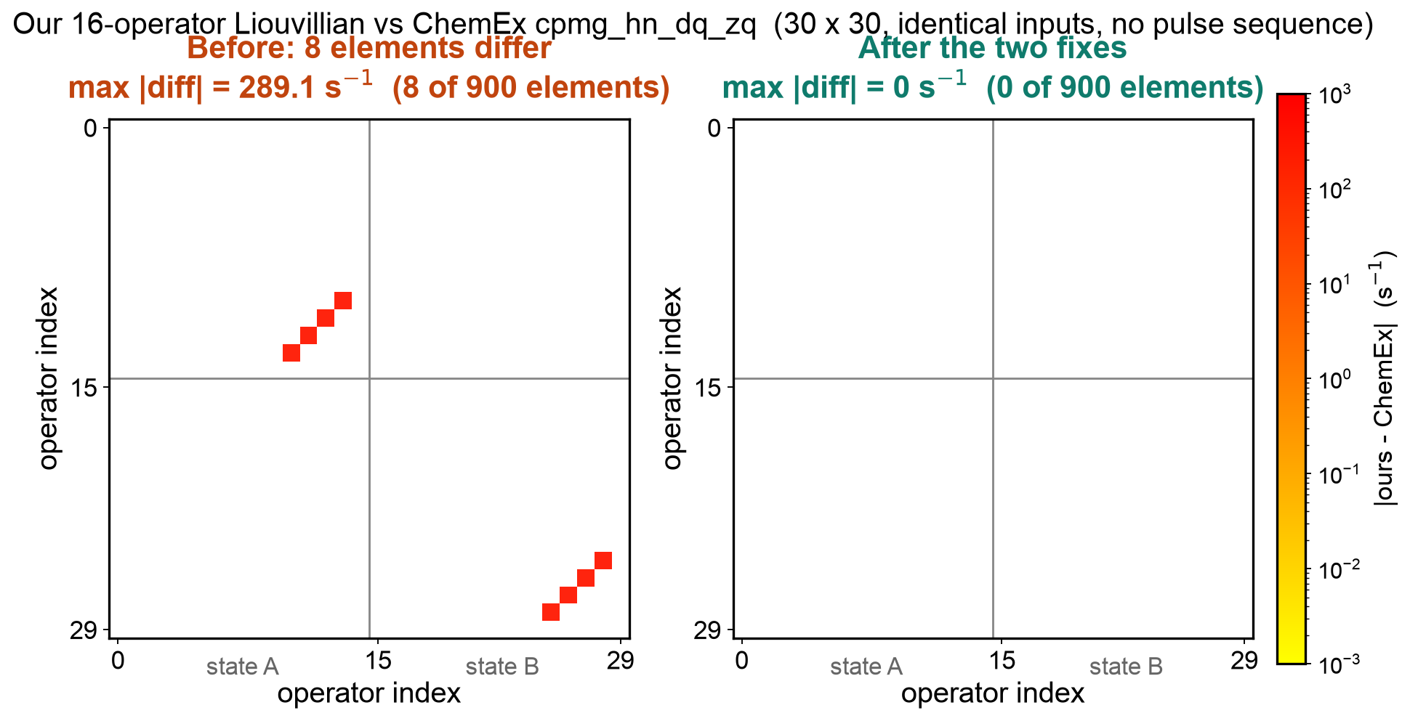
Simulator now validated at the full 30×30 level
Previous check was the collapsed 6×6 in-phase block only. Extending it to the DQ/ZQ basis exposed two genuine errors.
Bug 1 — sign of μ_mq Allard Eq. [19] is written dσ/dt = −P·σ, so every printed matrix element must be negated on the way into the code. The DQ/ZQ cross-relaxation term was not.
Bug 2 — spurious πJ in the MQ block A πJ coupling term had been added that does not appear in the paper. Verified [H_J, MQ] = 0 with explicit spin matrices — it should not be there.
Difference vs ChemEx cpmg_hn_dq_zq: before (left) and after (right) the fixes
Result: exact match All 900 elements agree to machine precision. In-phase results were unaffected; CW-CPMG was affected and is now corrected.
Notes:
Both bugs trace to the same root cause: converting Allard 1998 into code. Equation 19 carries a leading minus sign that is easy to drop, and one term was added that the paper never had. Dependency analysis shows in-phase experiments never reach the MQ block, so earlier in-phase results stand. CW-CPMG did reach it and has been re-run.

Slide 3
Synthetic data generated; models trained and benchmarked
540 k paired profiles (with-J → J-free) using the ChemEx pulse sequence. Models see only what a spectrometer knows: ν_CPMG, R₂ᵉᶠᶠ, B₀, B₁, J.
Baseline ladder — 500 k training set, clean data
Scaling the data mattered more than the architecture Going 60 k → 500 k profiles, same model, clean data: median error 0.069 → 0.010 s⁻¹ (6.8× better)
model params RMSE removed
identity (do nothing)
0
0.819
—
linear
3.4 K
0.541
33.9%
MLP
852 K
0.206
74.9%
Transformer
581 K
0.071
91.3%
FiLM-CNN
770 K
0.053
93.5%
93.5%
100×
of profiles fully corrected
(clean data, 500 k model)
margin over the artefact
being removed
Confirmed at 500 k (completed overnight): the convolutional network still wins, and by a wider margin — its typical error is 2× lower than either Transformer variant.
Notes:
Important design choice: the model is given only quantities knowable at the spectrometer. An earlier version conditioned on k_ex, p_B and delta-omega, which are exactly what the experiment is trying to measure, so it could never be used on real data. On the architecture question: the convolutional network wins at both dataset sizes, and at 500k its typical error is about half either Transformer variant, so the ranking is now on firm ground. Whether the Transformer carries a positional encoding made about one percentage point of difference in both directions across the two dataset sizes, i.e. within run-to-run variation, so nothing should be read into it.

Slide 4
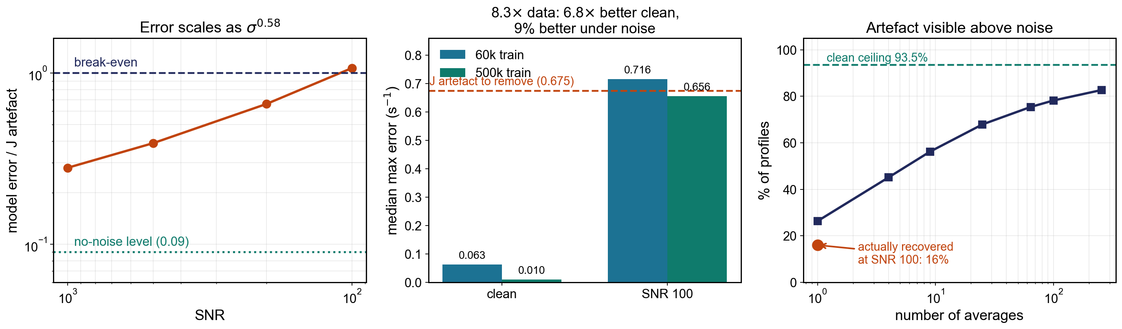
Adding realistic noise changed the picture
Noise in CPMG is Gaussian in intensity, not in R₂ᵉᶠᶠ. Because R₂ᵉᶠᶠ = −ln(I/I₀)/T, fast-relaxing points are far noisier — the interesting ones most of all.
A metric trap “% artefact removed” stays at 85% from SNR 1000 to SNR 100 — the models score well by denoising, which is not the task.
Sub-linear degradation Error grows as σ⁰·⁵⁸, not σ. The model exploits the artefact being smooth across ν while noise is independent.
Two different walls Clean performance was data-limited. Low-SNR performance is noise-limited — more data buys only 9%.
Notes:
The key methodological point is that the headline metric broke down under noise. It kept reporting 85% at every noise level because the denominator became dominated by noise rather than by the J artefact. We had to replace it with a comparison against the artefact's own magnitude.

Slide 5
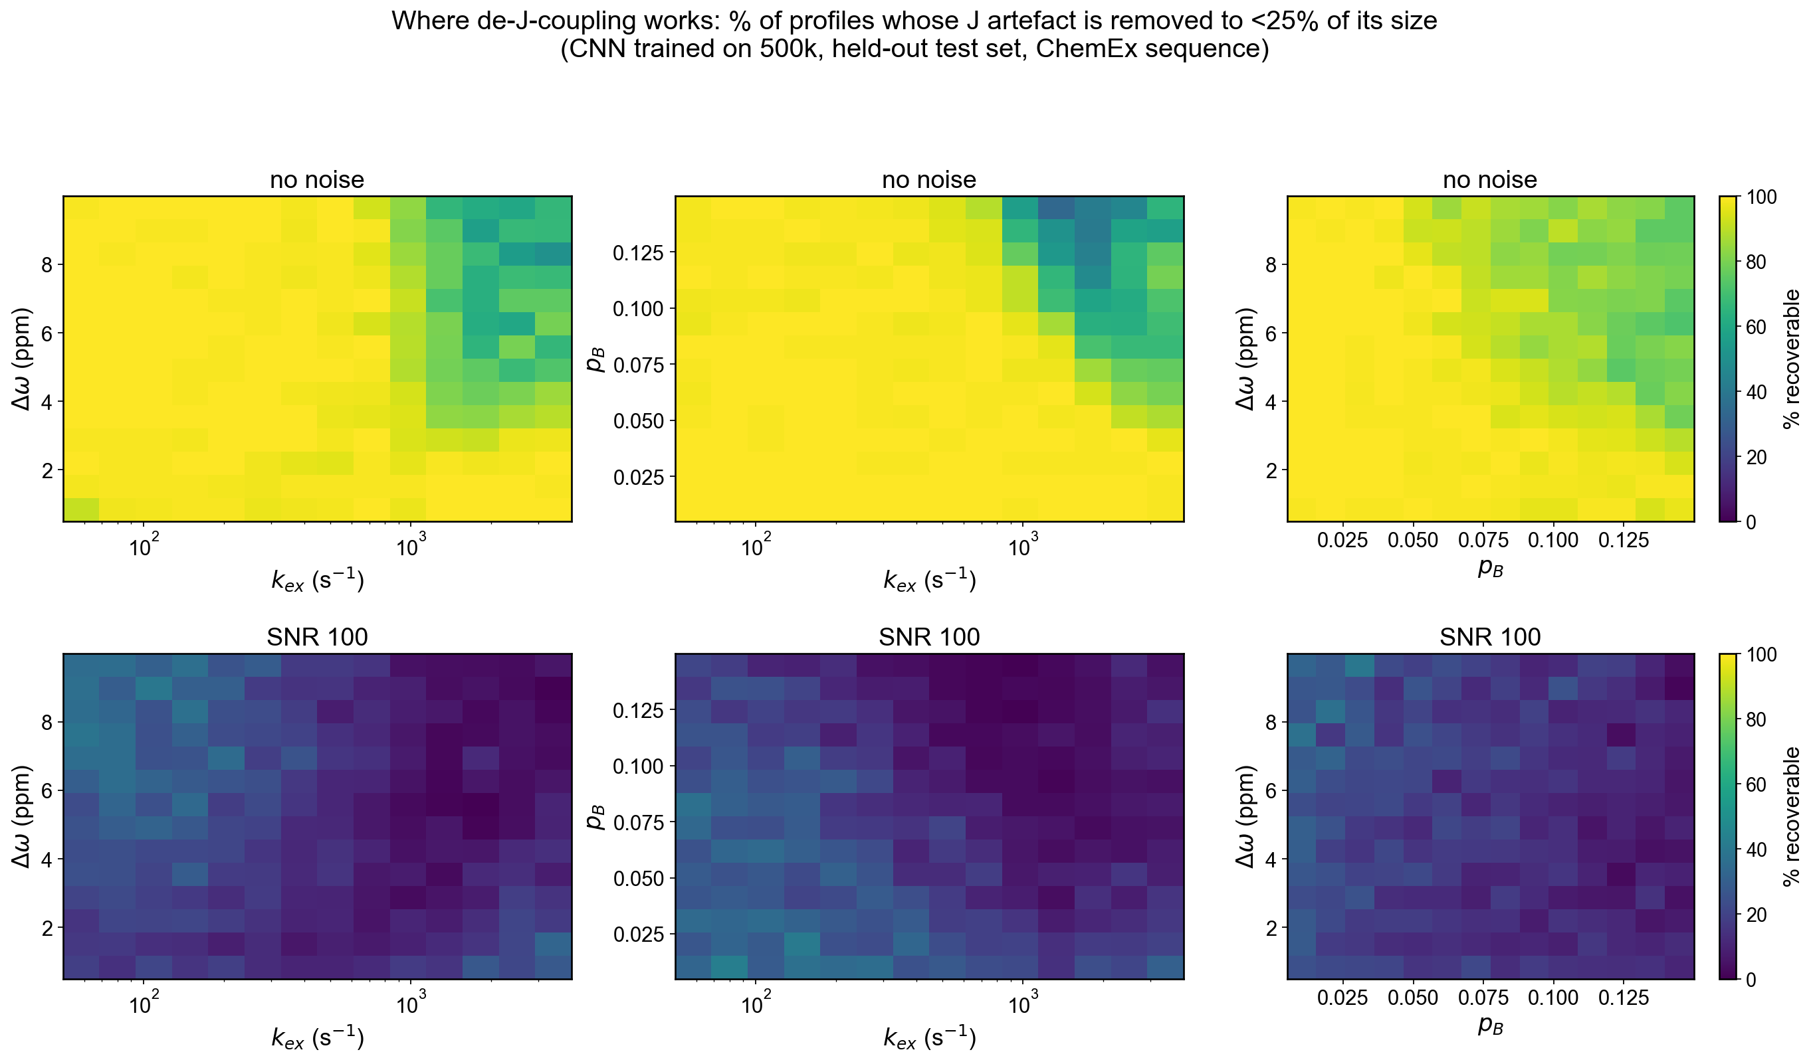
Where it works: per-profile recoverability
A profile counts as recovered only if ≥75% of its own artefact is removed — a stricter, per-profile test than any median-based number.
93.5% recovered with no noise — the method's own ceiling
26.3% have an artefact visible above noise at SNR 100 — a hard physics ceiling
16.0% actually recovered at SNR 100 — 61% of what is available
Median artefact 0.675 s⁻¹ vs median noise 1.589 s⁻¹ at SNR 100 — the signal sits 2.4× below the noise.
Clean (top row): near-uniform, failing only at high k_ex with large p_B or Δω. At SNR 100 (bottom): structure erased; what survives is the low-k_ex, low-p_B corner.
Notes:
This replaced an earlier, too-optimistic conclusion. Comparing the median model error against the median artefact suggested break-even at SNR 104 and that four to nine averages would suffice. Those are medians of two different distributions and say nothing about individual profiles. The per-profile test gives 16 percent.

Slide 6
Where it stands
The method works. The measurement does not yet.
Simulator
Validated against ChemEx at 30×30; two Allard-conversion bugs found and fixed.
Data + model
540 k paired profiles; 93.5% of profiles fully corrected on clean data.
Noise limit
At SNR 100 only 26.3% of artefacts are above the noise; 16.0% recovered.
Next
1
Narrow the parameter ranges — now the only free lever. The recoverable corner is well defined, and 4% of sampled points are physically unmeasurable.
2
Instrument time is the binding cost. More ν points and more averages are interchangeable at equal time; ~8× the current acquisition reaches ~60% detectability.
3
Validate against experimental data for a system with independently known exchange parameters.
Notes:
The headline for discussion: 93.5 percent clean recoverability says the simulator and the model are sound. The obstacle is entirely that the artefact sits under the noise at standard SNR. We checked whether the acquisition could be redesigned to get around this - more frequency points, longer relaxation delays - and it cannot: once you charge for the instrument time, sampling more points is no better than simply repeating the measurement. That makes narrowing the parameter ranges the only lever that costs nothing, which is the conversation I wanted to have with you.

