Slide 1
The Bruker export answered more than we asked
Two Stage-0 questions closed; a third turned into a corpus-quality finding
Field strength — is one simulated basis enough?
SETTLED
600 MHz covers 97.8% of rows (700 MHz: 2.2%, one study per pull). The single-field GISSMO basis is appropriate, and field is NOT a contributor to the fit-gate ceiling.
Pulse programme — is the lipid basis well defined?
SETTLED
cpmgpr* covers 99.7% of rows. The corpus is homogeneously CPMG, so macromolecule signal is suppressed corpus-wide and the empirical lipid basis is one object, not an average of two.
Chemical-shift axis — why does the fit gate stall?
THE FINDING
The corpus is not on a common ppm axis. ~40% of rows sit ~800 points — 60 linewidths — away from the rest. This is our own preprocessing, and it explains the ceiling.
Bonus — provenance recovered. The export's file paths carry MetaboLights accessions, so we now know the corpus draws on 11 studies (MTBLS798 alone is 54% of it). The repository never recorded this, and it cannot be recovered from the .npy files.
1
Notes:
Open by saying the export did its job: the two questions we needed for the metabolite basis are closed, both favourably. Then pivot.
Caveat to state up front if he asks: my FIRST reading of the referencing question was wrong. I tested it via SR = (SF - BF1)*1e6 and concluded referencing varied per spectrum. That is invalid -- proc_OFFSET is reported AFTER referencing, so each spectrum's ppm axis already absorbs its own SR. MTBLS798 proves it: SR = -81 Hz vs +6 Hz for MTBLS147, yet their OFFSETs differ by 0.11 ppm, not the 0.14 ppm SR would imply. The script's verdict logic was rewritten around the axis geometry. Better to volunteer this than be caught.
Scripts: code/analysis/bruker_param_audit.py. Commit 8cda56a.

Slide 2
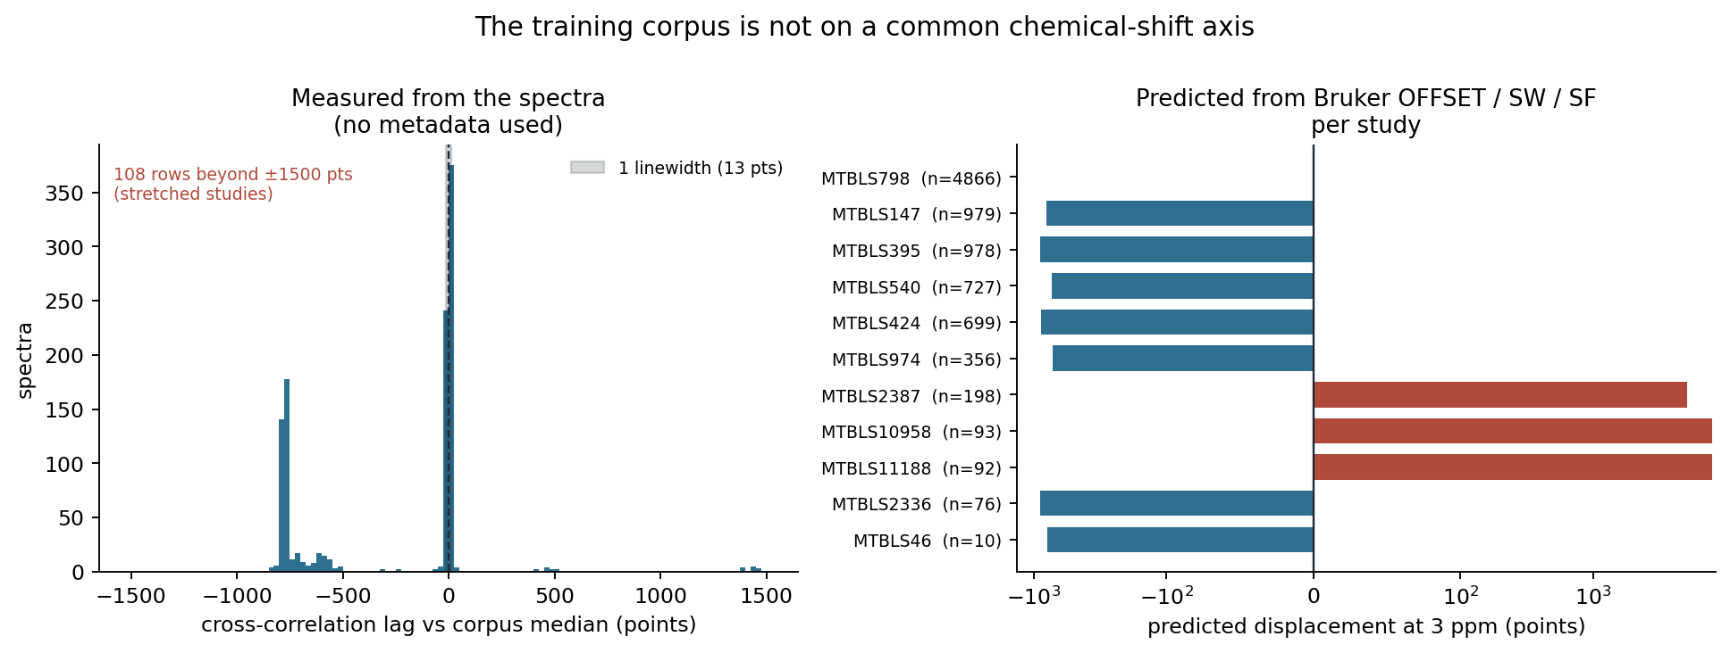
Confirmed two independent ways
alignSpectra.py interpolates to a common POINT COUNT and never reads a ppm axis
Left — measured from the spectra. Cross-correlating 1,200 rows against the corpus median, using no metadata at all: 50.8% at 0, 32.9% at −600 to −1,000, 6.2% beyond +3,000.
Right — predicted from metadata. Each row's peaks land at an index set by its own (OFFSET, SW, SF): 0 pts for MTBLS798, −720 to −900 for five studies, +5,100 to +8,000 for three that are also stretched 1.5−1.7×. Shares: 54% / 42% / 4%.
Scale: a 1.2 Hz linewidth is 13 points here. 63% of rows are displaced by more than one linewidth; 41% by more than fifty. These peaks do not overlap at all.
2
Notes:
The point of this slide is that the two panels were derived independently. The right panel uses only Bruker parameter files and never touches a spectrum. The left panel uses only spectra and never touches the metadata. They agree quantitatively.
Mechanism in one sentence: align_spectra_to_longest() in code/preprocessing/alignSpectra.py interpolates every spectrum to a common number of POINTS, and never reads a chemical-shift axis, so studies acquired over different windows put the same metabolite at different indices.
If he asks why nobody noticed: the spectra look completely normal one at a time. The defect only appears when you compare rows from different studies, and nothing in the pipeline ever did that explicitly.
Script: code/analysis/corpus_axis_misalignment.py. 1,200 rows, band 72,000-84,000, clear of the zeroed water window.

Slide 3
What this changes — and what it does not
One puzzle solved, one earlier conclusion needs re-reading, one new open question
0.45–0.51
r = 0.991
9,670 → ?
fit-gate R² ceiling, now explained.
Not the solver, not the basis —
the design cannot match
peaks 800 points away.
median nearest-neighbour from §19.
Under an 800-point offset this
CANNOT be cross-study — so the
near-duplicates are within-study.
the corpus is more fragmented
than its row count suggests.
Effective size is an open
question, not a known number.
Solved
Three rounds of ridge and bounds tuning on the fit-gate solver were treating a symptom. The unconstrained bound of 0.506 is exactly what a design should reach when it fits the majority axis and misses the rest.
Re-read, not retracted
The negative SSL result stands: copy-a-neighbour still matches the network, the few-shot record is still 0 wins / 3 losses, the noise floor is unchanged. But the MECHANISM sharpens — the pretext task is easy because near-duplicates exist within studies.
Newly open
Does re-pretraining on a correctly aligned corpus change the transfer conclusion? We cannot answer this from what we have. It is now the most important question in the queue.
3
Notes:
Be careful with the middle card. He may hear 'the corpus was broken' as 'so the negative result was an artefact'. It is not: copy-a-neighbour beating the network is a comparison BETWEEN two methods on the SAME corpus, so a shared defect does not explain the gap. What changes is the story of WHY the pretext task is too easy.
If he pushes on the third card -- yes, it is genuinely possible that a properly aligned corpus trains a better representation. I would not bet on it, because the copy-a-neighbour result suggests the objective is the problem rather than the alignment, but I cannot rule it out and should not pretend otherwise.
Documented in docs/SSL_vs_classical_analysis.md section 21 and docs/PI_outline.md 5h.

Slide 4
The decision I need from you
Rebuild from raw, or patch what we have
A — Rebuild from the raw archive
B — Patch the corpus we already have
RECOMMENDED
INTERIM
Re-interpolate every spectrum onto one ppm grid from (OFFSET, SW, SF).
Deterministic. No fitting, no free parameters, no judgement calls.
Cost: rebuilds the pipeline from raw and invalidates every checkpoint.
Requires the HDD, because the row → study mapping was never recorded.
Assign rows to axis groups by cross-correlation, then shift each group.
Fast, needs no raw data, and recovers most of the gross displacement.
But it is an estimate on damaged data — the stretched 4% cannot be undone.
Good enough to test whether alignment changes anything. Not publishable.
Also for discussion: (1) does this finding belong in the paper as a methodological point — index-based alignment is common and silently wrong; (2) the 778 Workbench spectra have no parameter export, so ~8% of the corpus is still uncharacterised; (3) data/BrC_T2D/…_metadata_mapping.csv holds patient names and must be de-identified before anything is shared.
My recommendation: rebuild. The defect is in the one coordinate that carries chemical meaning, and every downstream conclusion inherits it.
4
Notes:
Do not start either option before he chooses -- A invalidates every checkpoint we have, which is his call, not mine.
The honest argument for B first: it is cheap and it answers the scientific question (does alignment change transfer?) in days rather than weeks. If B shows no change, A becomes much less urgent. The argument for A is that B leaves us with a corpus we cannot defend in print, and we would end up doing A anyway.
A reasonable compromise if he wants one: run B to answer the question, commit to A before publication.
On the paper point: the label-permutation null cannot detect batch confounding (from the audit work) and index-based alignment is silently wrong -- two transferable methodological findings. Both are arguably publishable independent of the main negative result.
The PII item is not optional and should not be deferred again.

