Slide 1
Comparing Foundation Models with Classical ML
15-Day Progress Review
Eight experiments on why classical logistic regression still leads — two cheap wins, six refuted hypotheses, and one measurement result that changes how we read all of them.
8 experiments run
7 backbones pretrained
13 figures
16 commits
Shashank Sharma · Individual meeting, 30 July 2026 · covering 24 – 30 July
Notes:
30 min. Plan: 5 min recap + data fix, 10 min diagnosis experiments, 8 min scaling/objective failures, 7 min roadmap assessment and next steps. The most important slide is #18 on run-to-run noise — it changes how we read every other number.

Slide 2
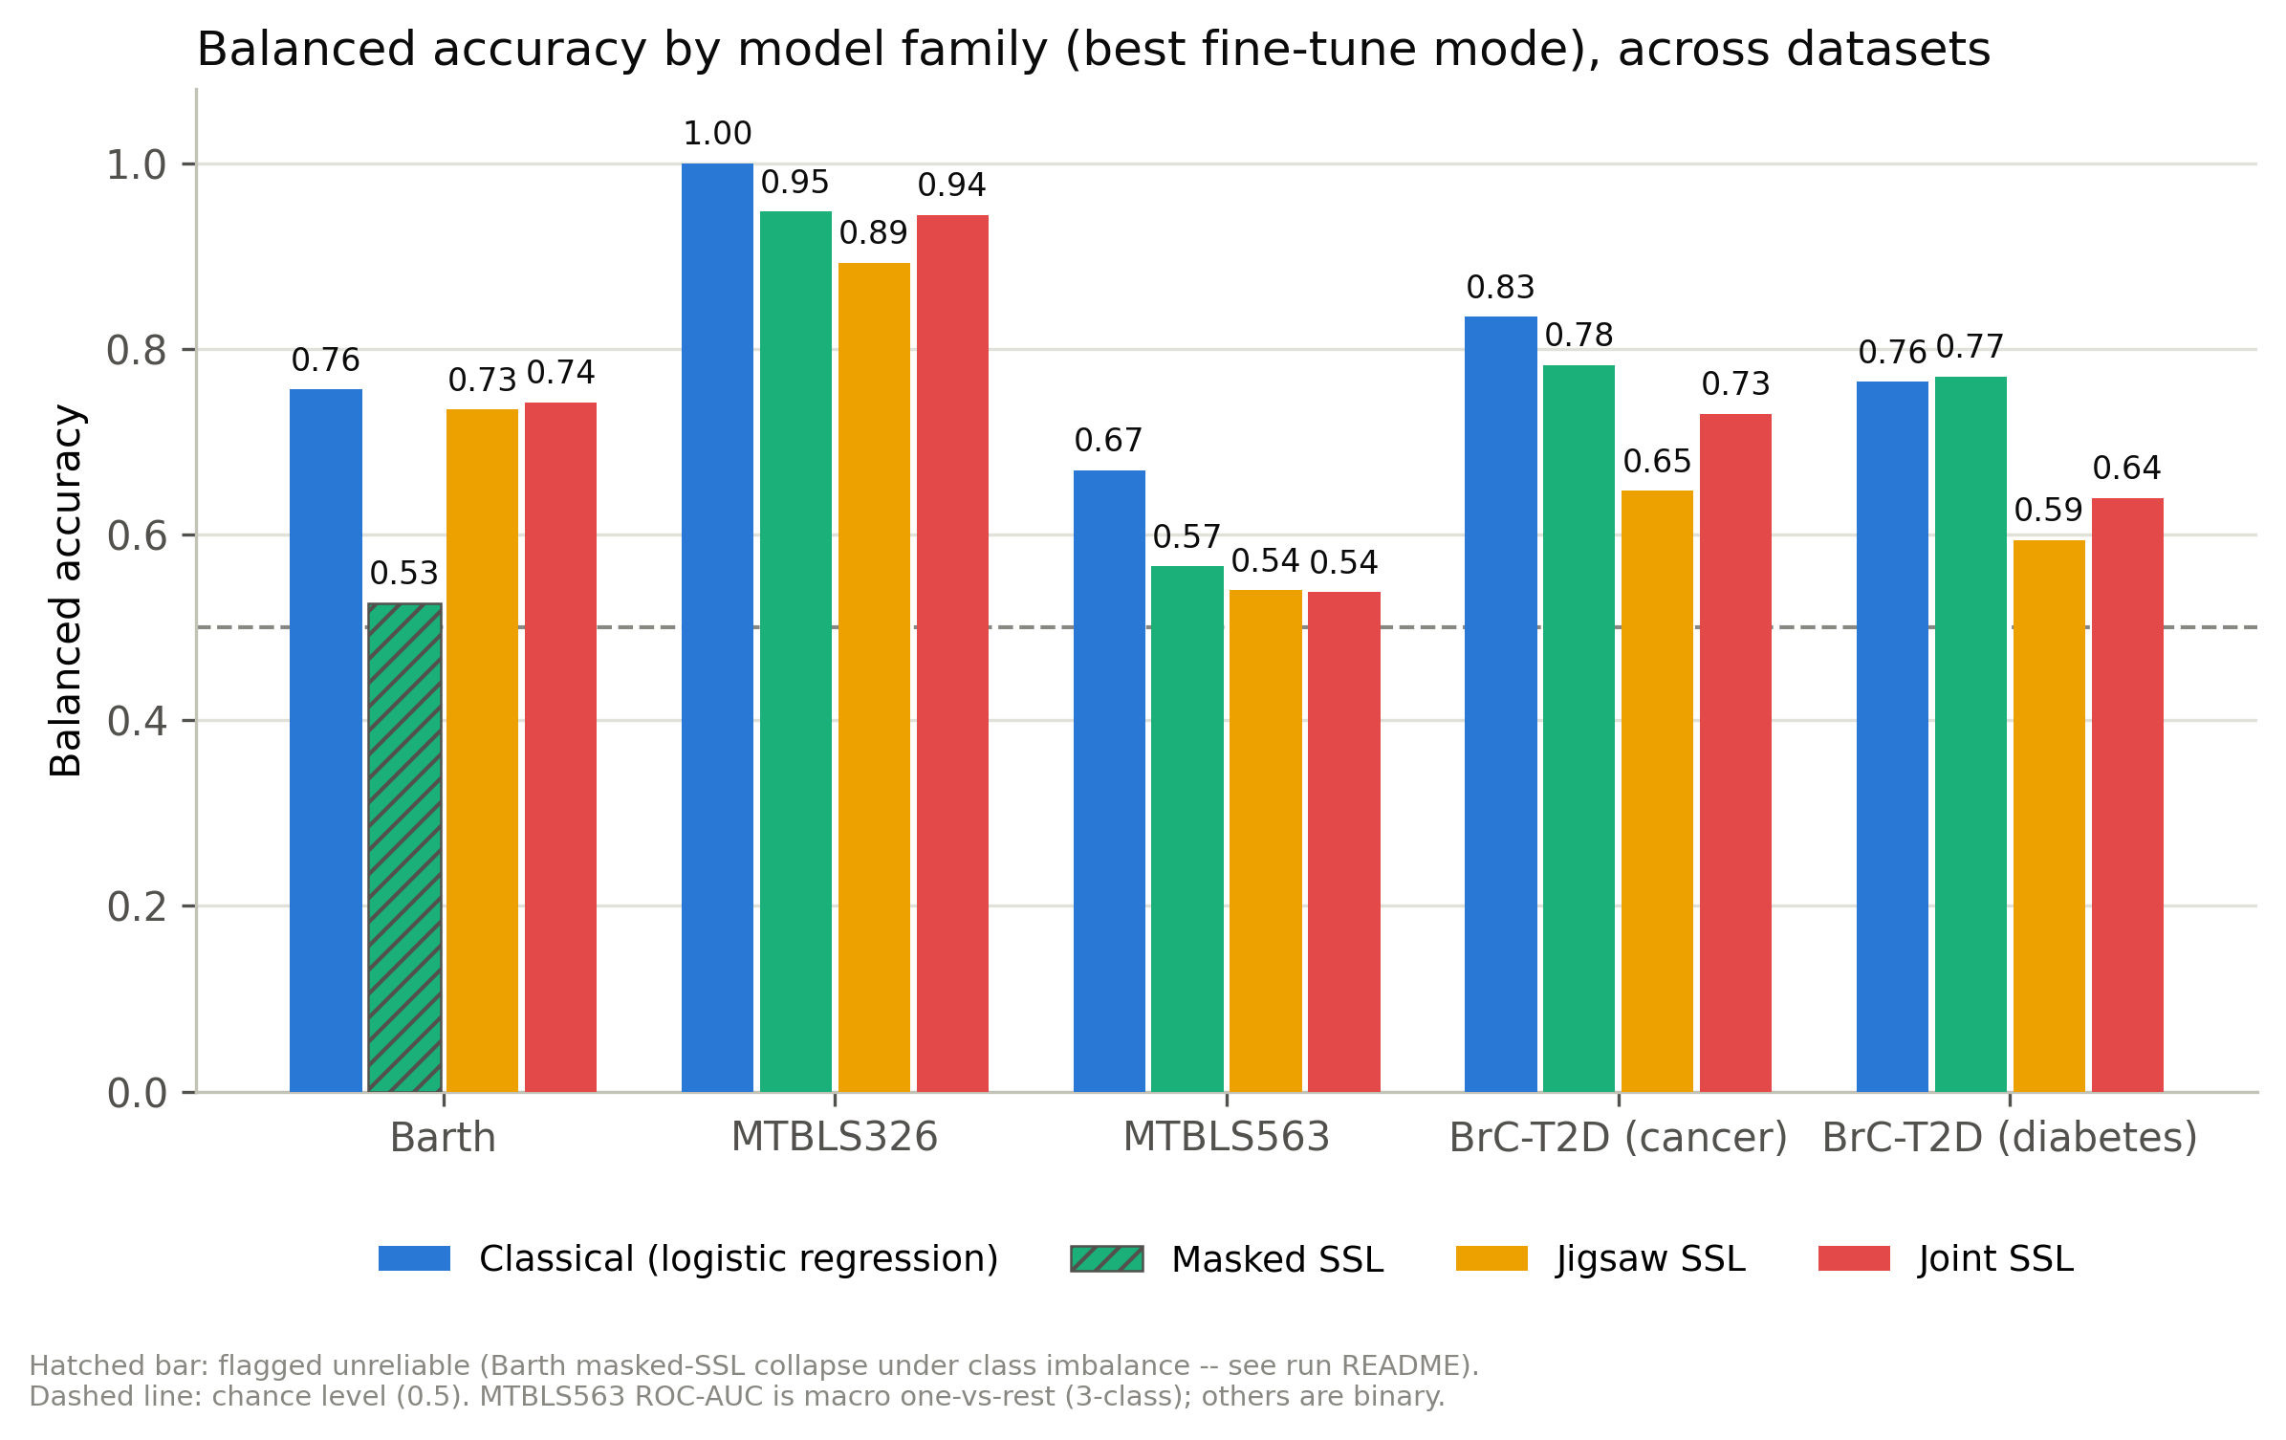
RECAP
Where we left off on 24 July
1
Classical ML set the bar
Logistic regression on binned absolute areas beat all three SSL families on every dataset. That result has survived every change since.
2
The question you set
“ML is better — it sets the bar. Can we better it? And is data the limiting factor?” Parts 1–3 attack the first half; Part 4 the second.
Presented last meeting: balanced accuracy by model family, pre-cleanup corpus.
!
What I did not know then
Two of those numbers were measured on data with a suppression bug, and none of them had error bars.
Notes:
Recap only, 60 seconds. The bar was set; the question was whether we can beat it. Part 4 returns to the data half of the question.

Slide 3
OVERVIEW
What happened in the last 15 days
1
Data correctness
2 of 8
A suppression bug and revised BrC-T2D labels forced a rebuild of every dataset. The benchmark was re-run from scratch.
interventions that improved accuracy
2
Why does classical win?
+0.078
Decomposed the gap into head-fitting versus representation. Two cheap fixes worked; the resolution hypothesis was refuted.
mean gain from those two — with no retraining
3
Scaling and objective
Four capacity experiments and two pretext-objective changes. All failed — and the last revealed a measurement problem.
0.069
4
Against your roadmap
accuracy swing from the pretraining corpus version alone — larger than any model change we tried
Where we sit on your decision tree, and what the peak-intensity data already says about whether more data would help.
Notes:
Set expectations: most of what I tried did not work, and that is the useful part. The bottom-right number is the headline, built up to in Part 3.

Slide 4
1
Data correctness first
Before any modelling conclusion could be trusted, two data problems had to be fixed.
An EDTA suppression bug that corrupted whole spectra, not just the artefact window
A revised BrC-T2D label file requiring a rebuilt dataset and re-extraction
Notes:
Two minutes. This is why the numbers moved between meetings.

Slide 5
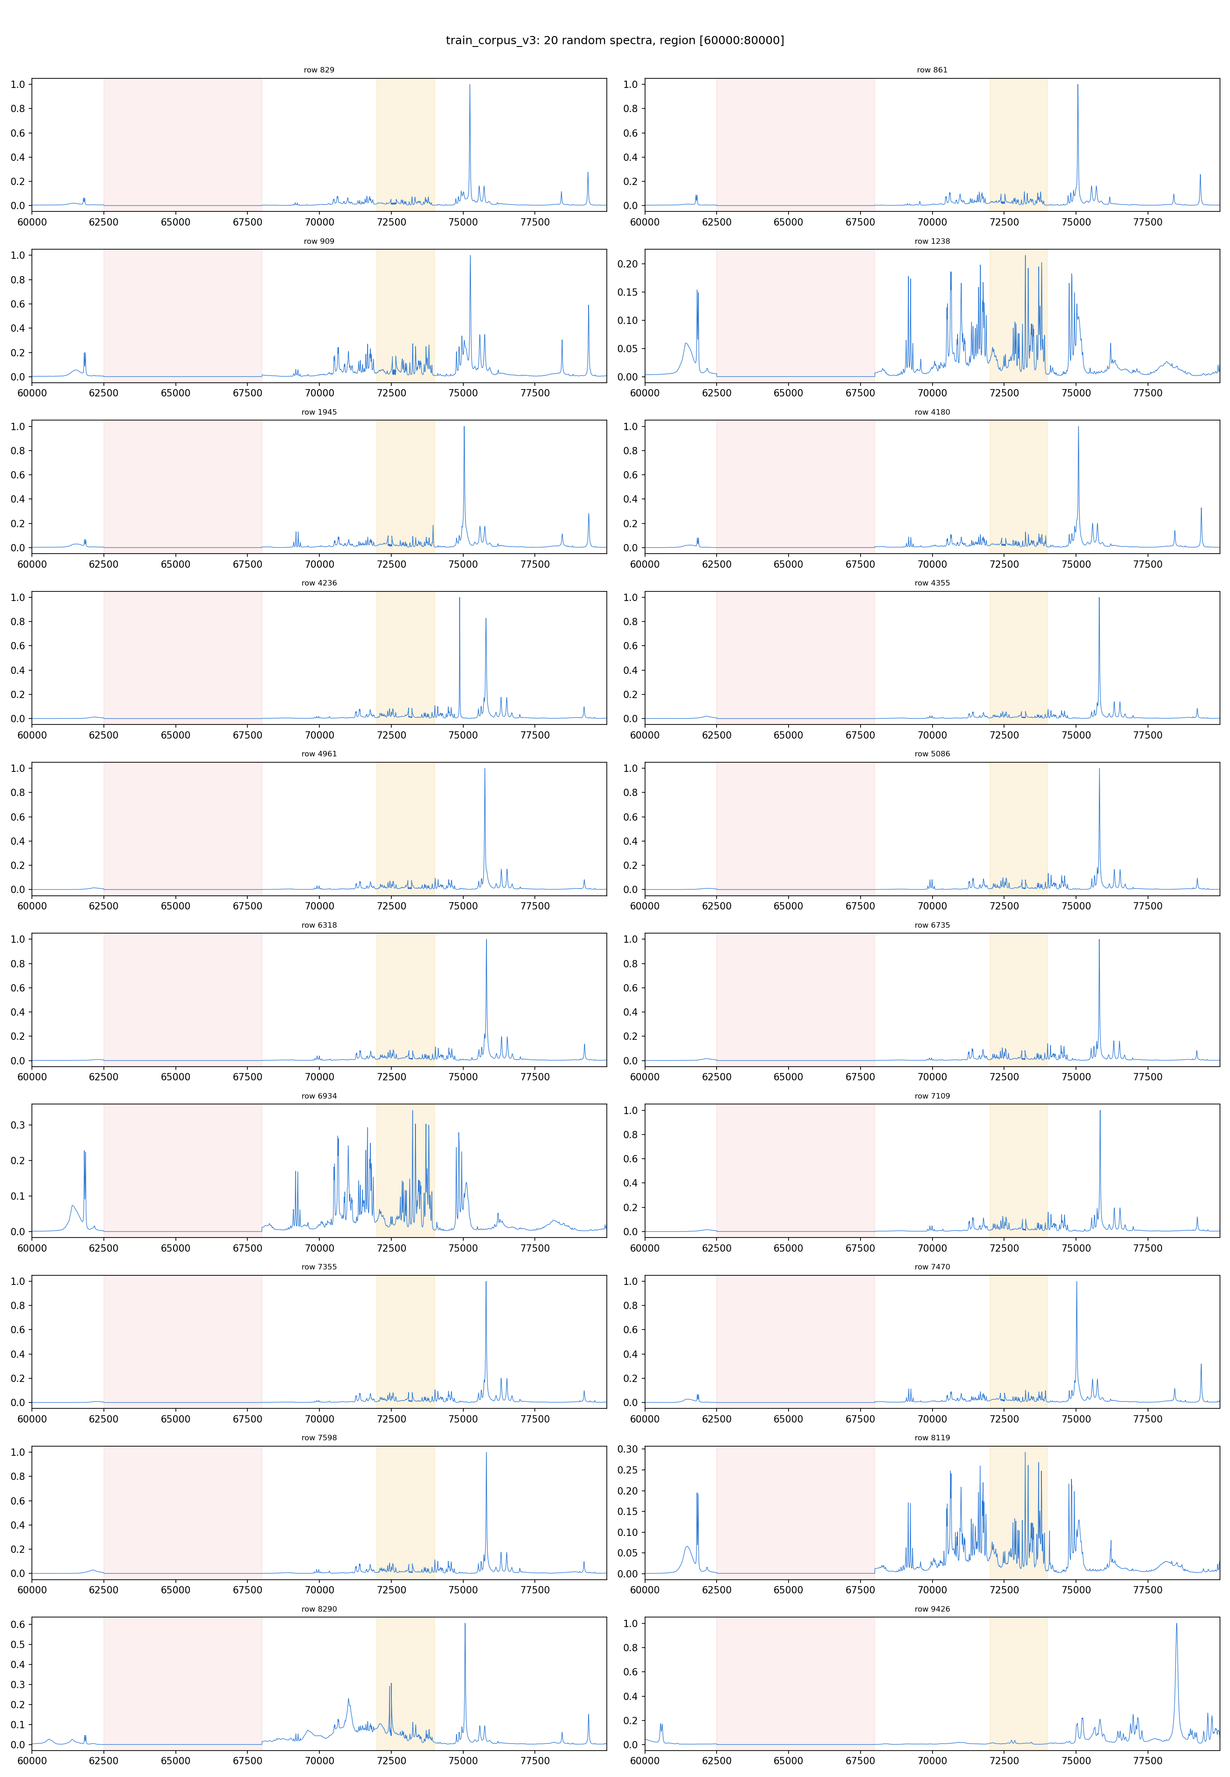
PART 1 · DATA
The suppression bug corrupted entire spectra
✗
Why one unsuppressed peak ruins the whole row
Spectra are row-wise min-max normalised. If an EDTA artefact survives suppression and becomes the row maximum, every real peak in that spectrum is compressed toward zero. The damage is global, not local to the artefact window.
✓
The fix, and how it was verified
The suppression cutoff is now capped at the baseline-to-peak midpoint, and detection is magnitude-based and metadata-free. Verification uses a flatness test — “was a hard mask applied” — instead of the peak-above-noise test that had been silently passing.
→
Result: dataset version v4
All five evaluation targets and the 9,670-spectrum corpus were rebuilt. Revised BrC-T2D labels were extracted and byte-verified against the source array: 4 samples genuinely changed label, and my first report of 41 changes was my own display artefact, which I caught by comparing all 78 rows. 7 rows repo-wide still retain a dominant EDTA peak — documented.
Corpus-wide suppression audit after the fix.
Notes:
Key insight: row-wise normalisation turns a local artefact into a global problem. Also own the mistake — my first count of changed labels was wrong and I caught it by byte-comparing all 78 rows.

Slide 6
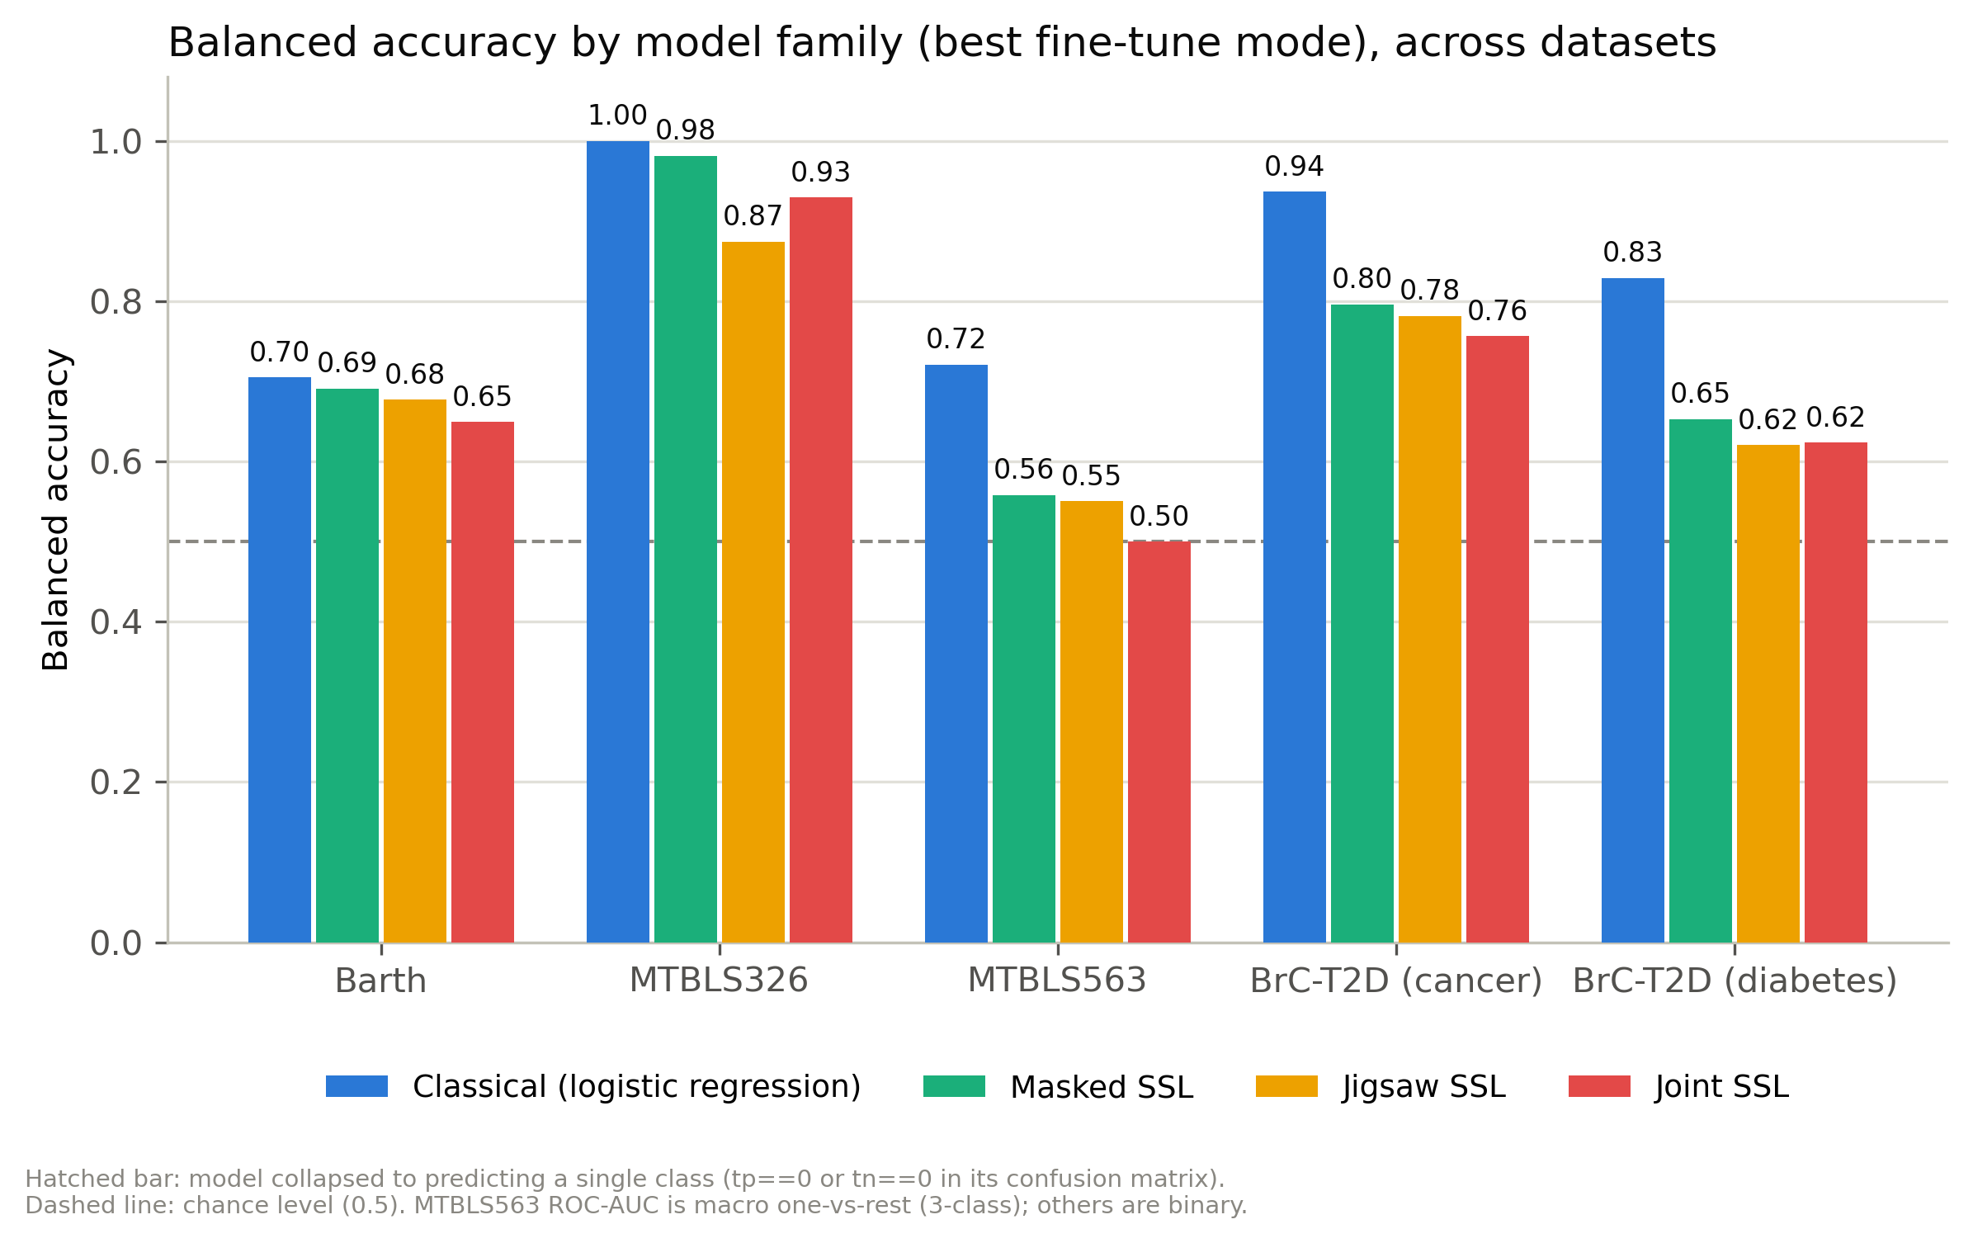
PART 1 · BENCHMARK
Re-run on clean data: the bar is unchanged
Classical logistic regression leads on all five targets
Target | Classical | Best SSL
Barth | 0.705 | 0.691
MTBLS326 | 1.000 | 0.981
MTBLS563 | 0.721 | 0.558
BrC-T2D cancer | 0.937 | 0.796
BrC-T2D diabetes | 0.829 | 0.653
≡
Both tracks are linear
The SSL head is also one linear layer on a pooled embedding, so this isolates the representation.
Balanced accuracy, best fine-tune mode per family, v4 data with revised labels.
▸
Ordering: masked > jigsaw ≈ joint
Held through every later experiment.
Notes:
The headline did not change after cleaning. Emphasise that both sides are linear classifiers, so this is a statement about representations, not classifier class.

Slide 7
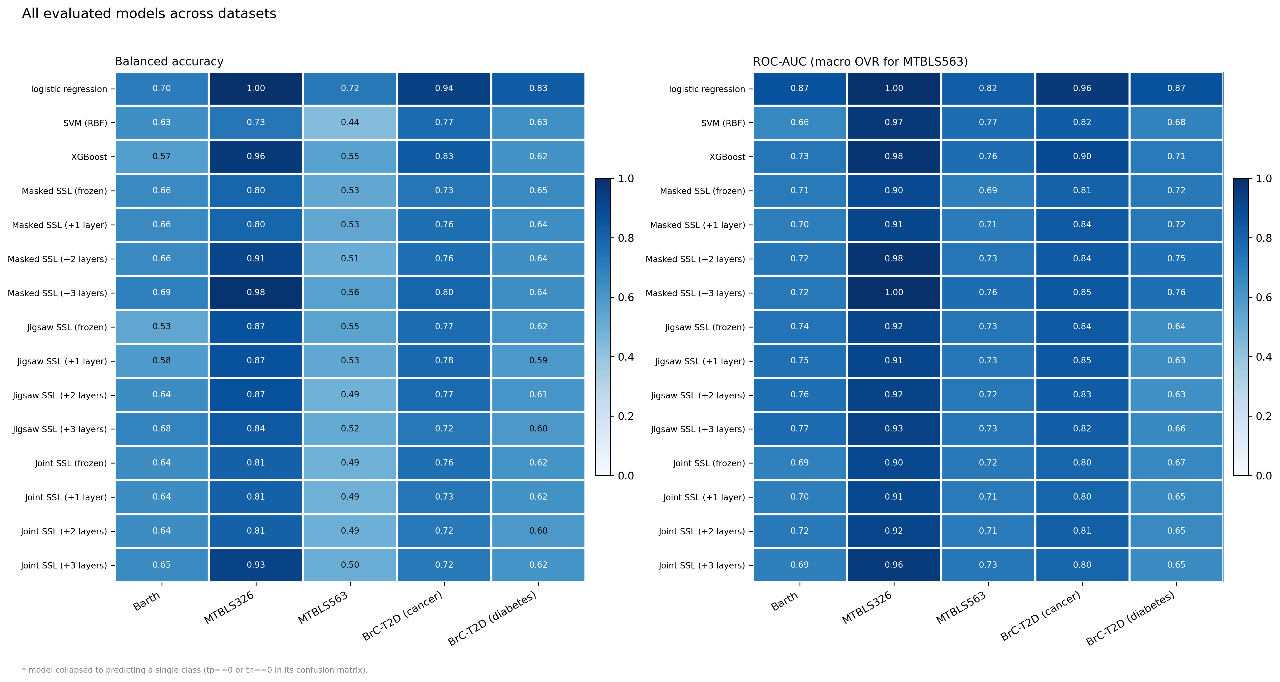
PART 1 · BENCHMARK
Every model × every fine-tuning mode
Frozen backbone versus unfreezing up to three layers, all families, all five targets. Degenerate cells — a model collapsing to a single predicted class — are now flagged live from the confusion matrix rather than from a stale hardcoded list.
Notes:
Do not read every cell. Two points: fine-tuning depth helps the masking family, and several joint/jigsaw cells collapse to single-class prediction, which is why degenerate cells are now auto-flagged.

Slide 8
2
Why does classical ML win?
If both classifiers are linear, the gap comes from either the head or the representation. So I measured which.
Experiment #1 — decompose the gap: head-fitting deficit versus representation ceiling
Experiments #2, #3, #4 — fix the head, test whether pretraining does anything, test the resolution hypothesis
Notes:
The analytical core of the two weeks. About 10 minutes.

Slide 9
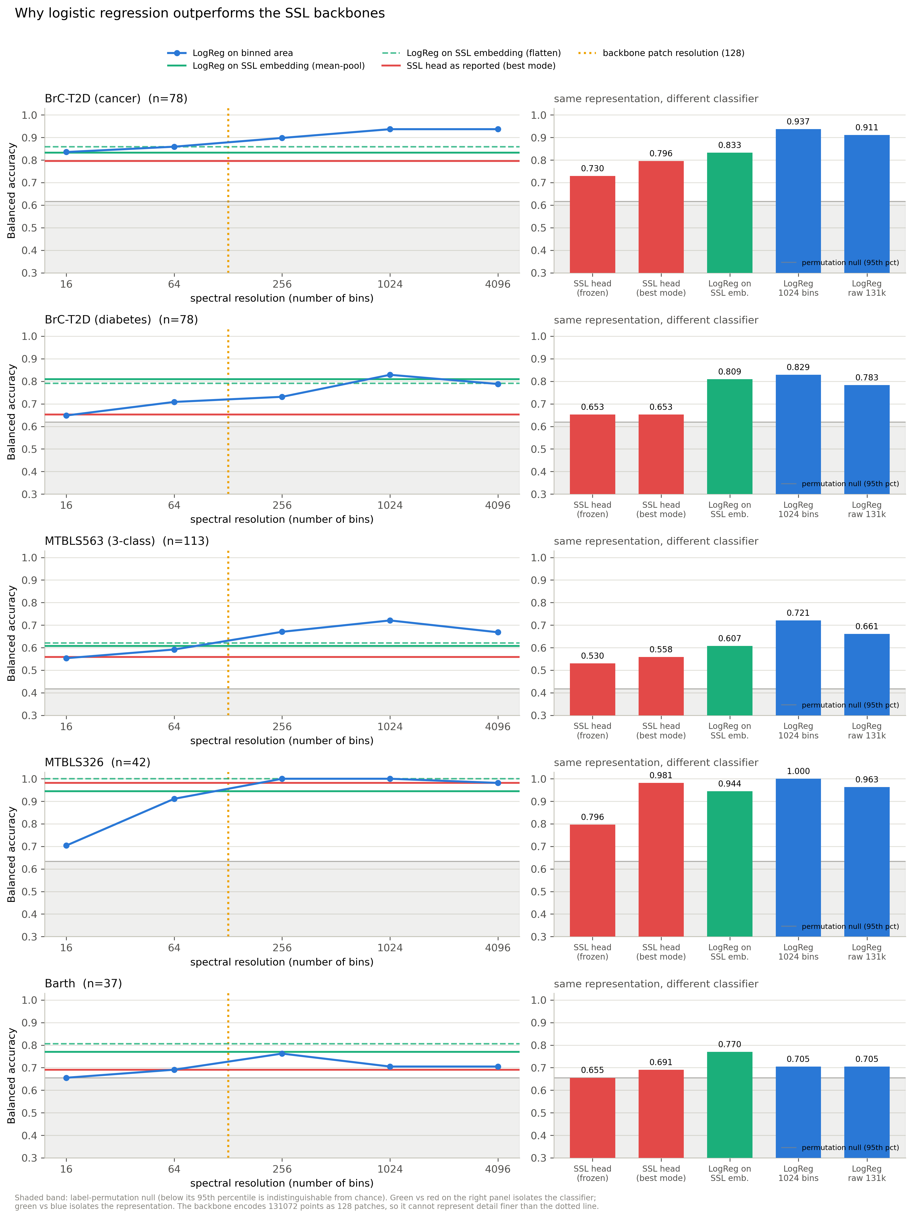
PART 2 · EXPERIMENT #1
Decomposing the gap: head versus representation
?
The method
Fit the same converged logistic regression on (a) binned absolute areas at many bin counts, (b) the raw spectrum, and (c) the frozen SSL embedding — under each dataset's real CV protocol, with a 200-draw label-permutation null.
Target | Where the gap lives | Read
BrC-T2D diabetes | 89% head-fitting | fixable
BrC-T2D cancer | ~70–75% representation | hard
MTBLS563 | ~70–75% representation | hard
Barth | embedding 0.770 beats binned 0.705 | already ahead
✓
Why this mattered
It split one vague question into two testable ones, and predicted which datasets a fix would flip. Barth was the tell: there the representation was never the problem, so a head fix alone should win it — which is exactly what happened two experiments later.
Bin-resolution sweep and permutation nulls.
Notes:
The most useful analysis of the two weeks: it turned 'SSL is worse' into two separately measurable deficits, and correctly predicted where the fixes would land.

Slide 10
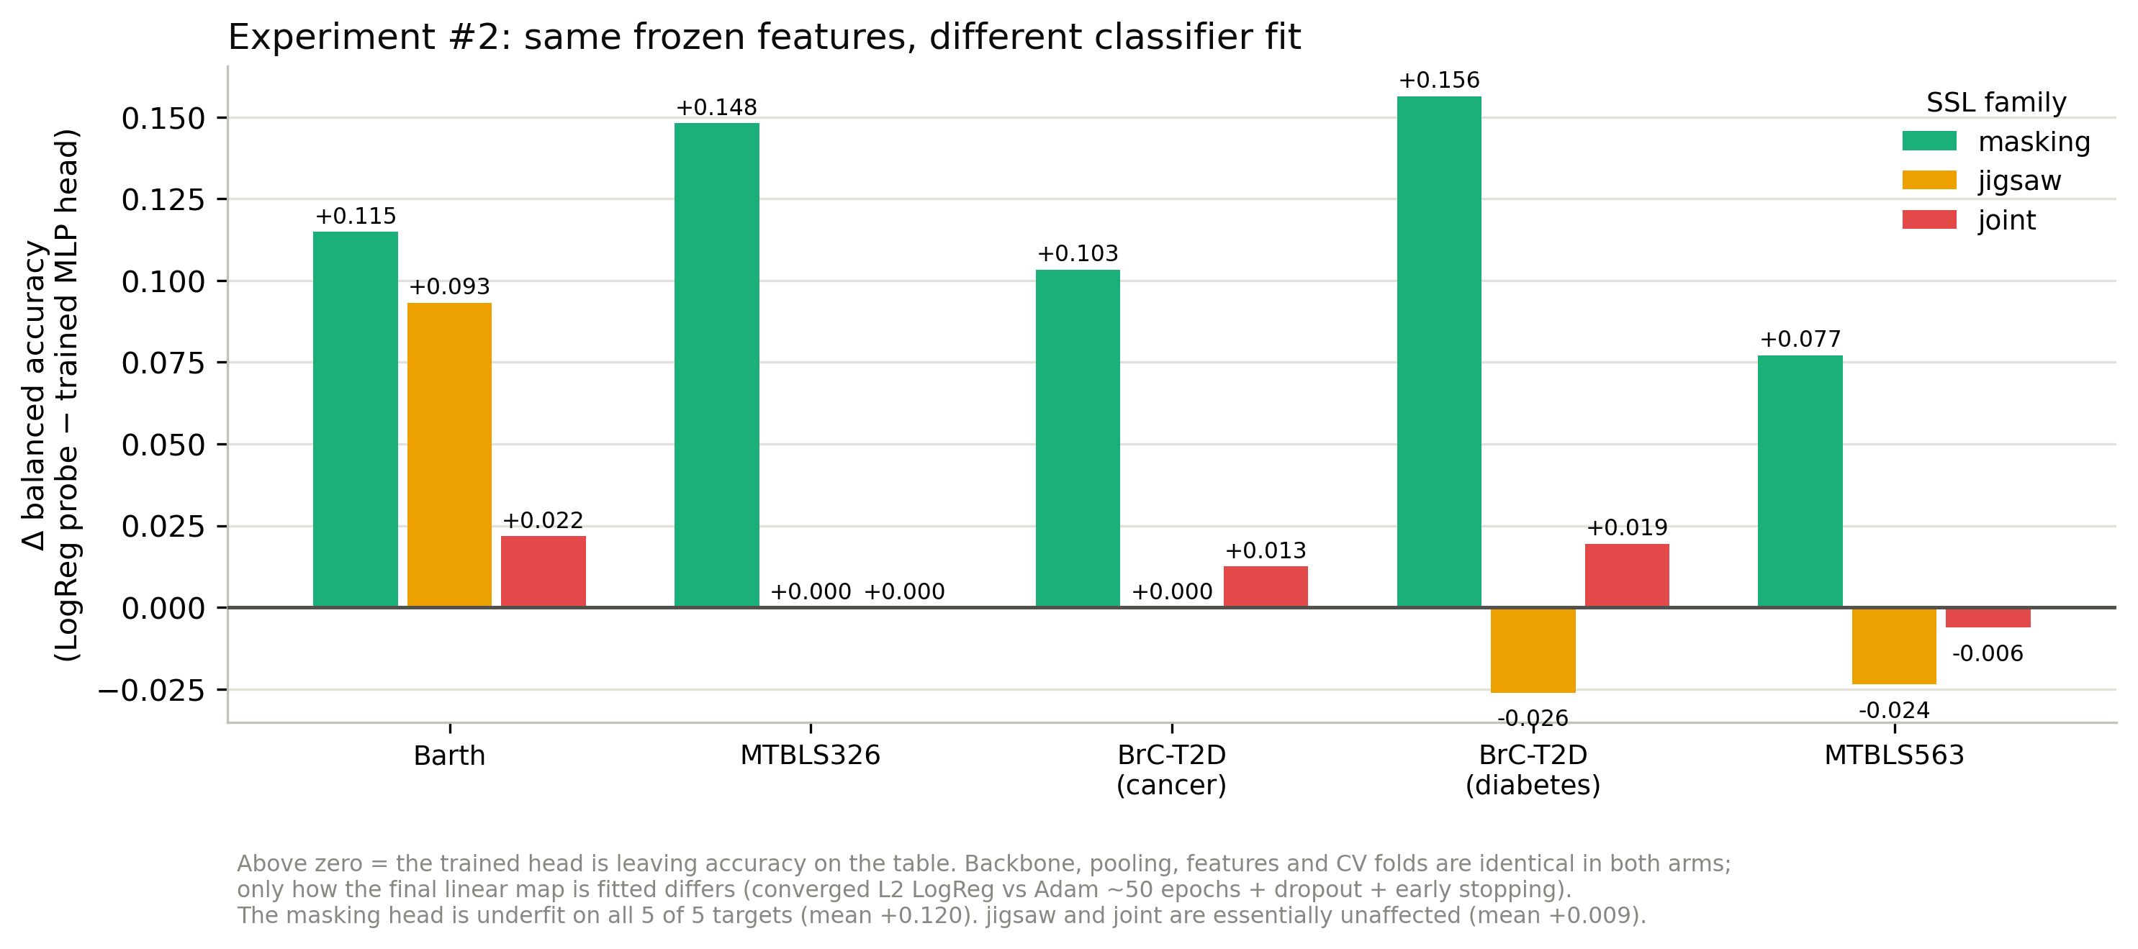
PART 2 · EXPERIMENT #2
Experiment #2: the masking head was underfit
+0.120
mean gain, masking family
5 of 5
targets improved (+0.077 to +0.156)
!
Not a modelling change
Identical frozen features, two ways of fitting the same linear map.
The head was always a linear layer. Replacing ~50 epochs of Adam on 40 samples with a converged L2 logistic regression is free. Jigsaw and joint were unaffected (+0.009).
Notes:
Cheap win one. Nothing about the model changed — only how the final linear layer was fitted. A pure evaluation-methodology gain.

Slide 11
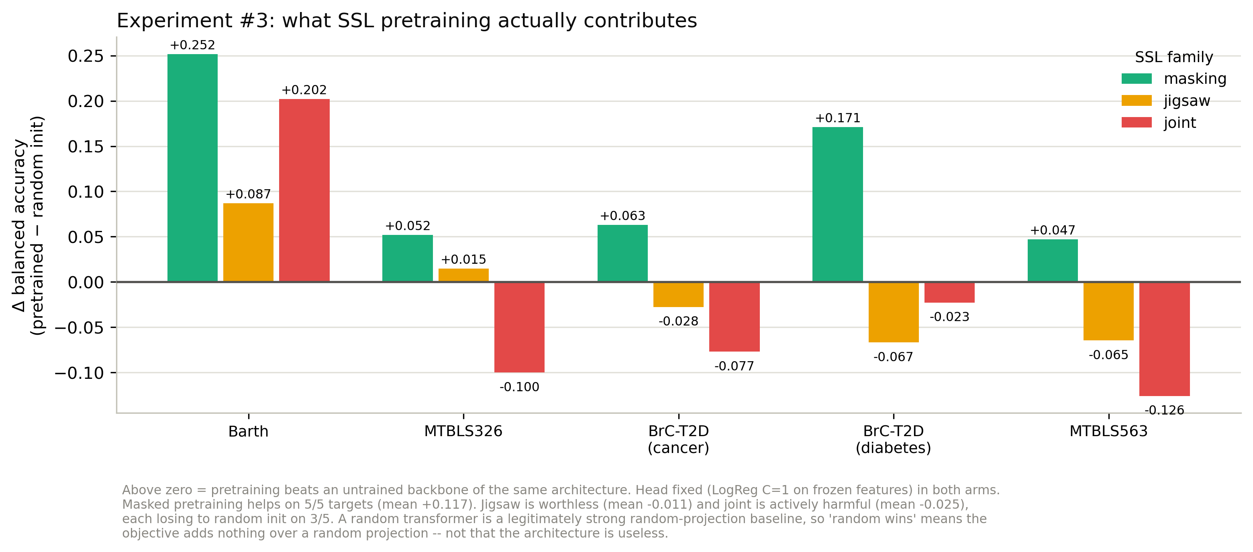
PART 2 · EXPERIMENT #3
Experiment #3: does pretraining contribute anything?
✓
Masked: +0.117 on 5 of 5
Masked pretraining genuinely works.
✗
Jigsaw −0.011 · Joint −0.025
A random joint backbone scores 0.846 on cancer versus 0.769 pretrained.
⟲
A correction I had to make
Pretrained versus a true random-initialisation control, head held fixed at a converged probe.
I first read an earlier ablation as “pretraining contributes nothing”. That flag only reinitialises the unfrozen layers — patch embedding and positional encoding stay pretrained — so it never tested the claim. This control loads no pretrained weights anywhere.
Notes:
Two messages: masked pretraining is real and worth keeping; jigsaw and joint are not earning their keep. Also own the earlier misreading — the control had to be rebuilt to actually answer the question.

Slide 12
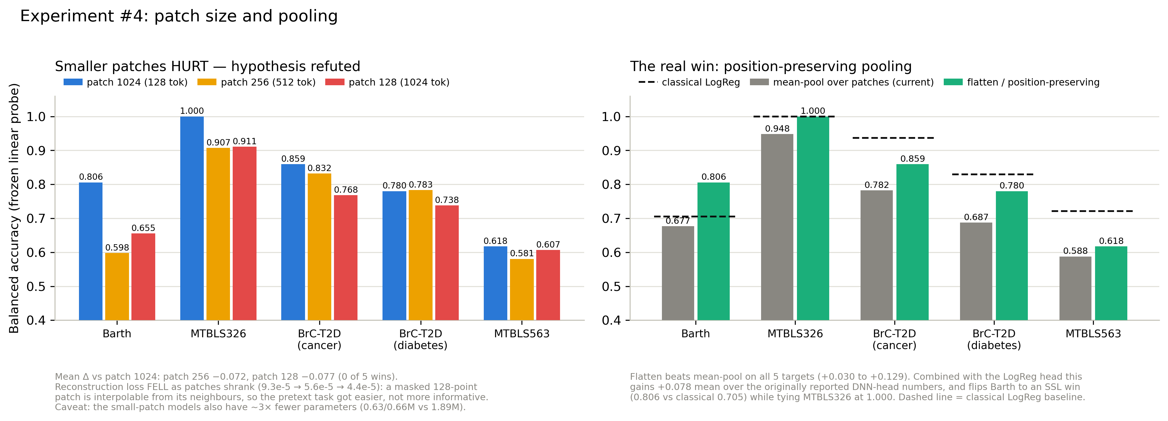
PART 2 · EXPERIMENT #4
Experiment #4: the resolution hypothesis, refuted
Left: shrinking the patch does not lift the ceiling — it lowers it. Right: what actually did work.
✗
Prediction: finer patches → better. Wrong.
∴
The mechanism — and my reasoning error
Patch 256 −0.072, patch 128 −0.077. Zero wins out of five targets.
Reconstruction loss FELL as patches shrank (9.3e-5 → 4.4e-5): a masked 128-point patch is interpolable from its neighbours. I asked what the encoder could represent, not whether the task still forced it to learn.
Notes:
The most instructive failure: the pretext task got easier, not the representation better. That diagnosis is what motivated experiment #7.

Slide 13
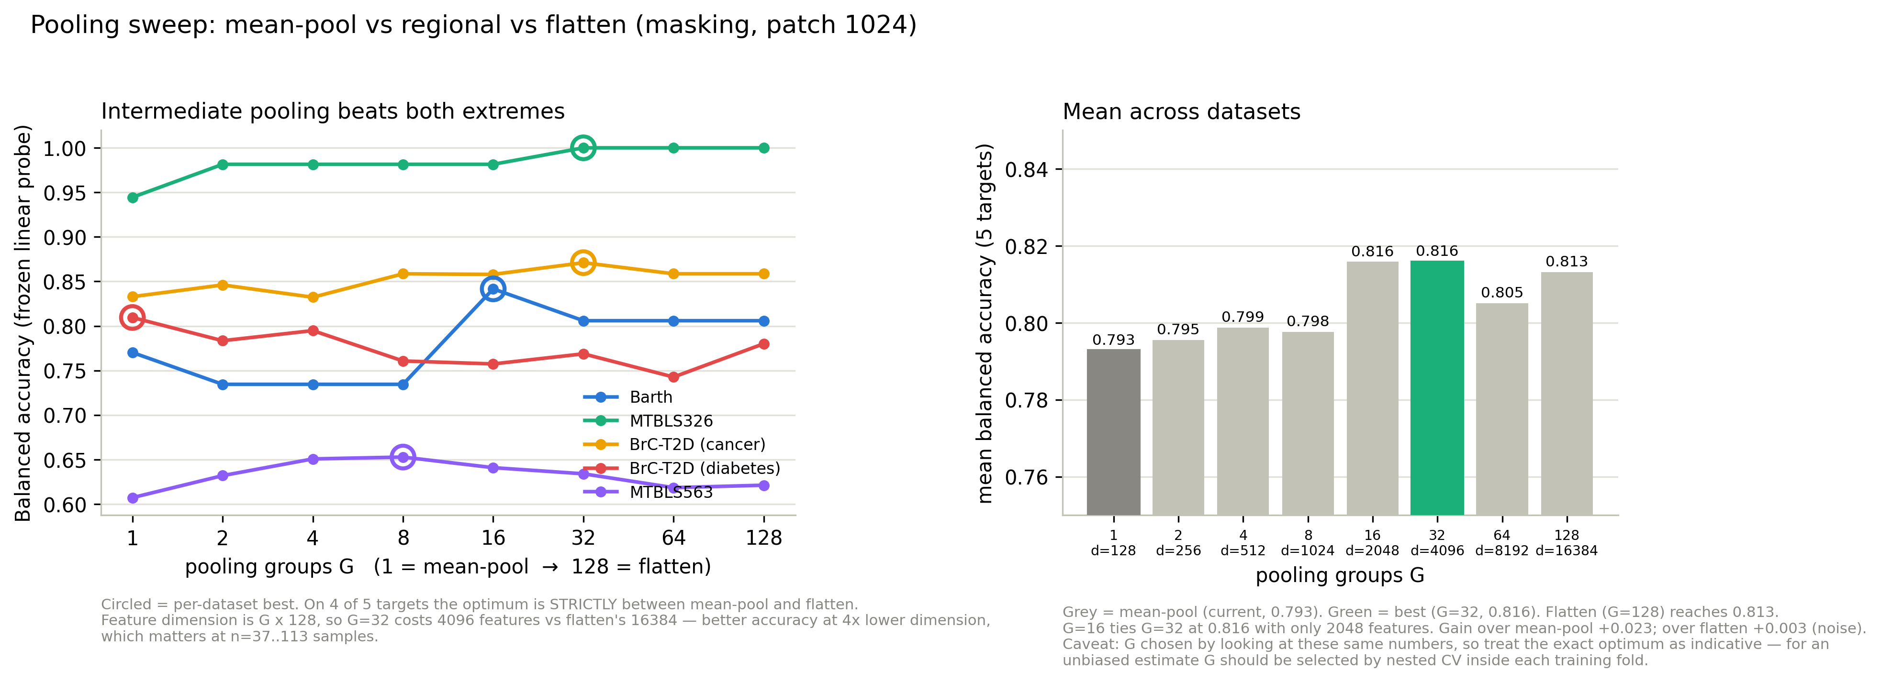
PART 2 · THE REAL WIN
The one intervention that clearly worked: pooling
Regional pooling sweep: G contiguous token groups. G = 1 is mean-pooling, G = 128 is a fully flattened embedding.
✓
Mean-pooling threw away position
◆
The optimum is in between
★
Why this one is trustworthy
Chemical-shift position IS the signal in NMR. Averaging tokens destroys it: +0.030 to +0.129 recovered, on 5 of 5.
G = 16 matches a full flatten with 2,048 features instead of 16,384, and beats both extremes on 4 of 5.
It is measured inside a fixed checkpoint, so it is paired — immune to the run-to-run noise in Part 3.
Notes:
Cheap win two, and the most robust positive result in the project because it is a paired comparison within one checkpoint. Flag that now — it pays off in Part 3.

Slide 14
PART 2 · WHERE THAT LEAVES US
Both cheap wins combined — no retraining required
Target | Originally reported | Probe + flatten pooling | Classical | Verdict
Barth | 0.691 | 0.806 | 0.705 | SSL wins +0.101
MTBLS326 | 0.981 | 1.000 | 1.000 | tie
BrC-T2D cancer | 0.796 | 0.859 | 0.937 | −0.078
BrC-T2D diabetes | 0.653 | 0.783 | 0.829 | −0.046
MTBLS563 | 0.558 | 0.621 | 0.721 | −0.100
+0.078
1 W · 1 T · 3 L
0 GPU-hours
mean gain over originally reported numbers
record versus classical, up from 0 W · 0 T · 5 L
both fixes are evaluation-side only
⚠
A caveat I want to be explicit about
Pooling G was chosen by inspecting these same datasets. From here on, configuration choices are made on a pre-committed selection subset (MTBLS563 + diabetes) and reported on the held-out three.
Notes:
The good-news slide. I flag the selection-bias caveat myself rather than have it asked — from here on I use a pre-committed selection subset.

Slide 15
3
Scaling and the pretext objective
Six more interventions. All failed — and the last exposed a problem with how we have been measuring everything.
Four capacity experiments: patch 128 / 256 / 2048, and a 2.7× wider-and-deeper backbone
Experiment #7: block masking and peak-weighted reconstruction, as a 2×2 factorial
Experiment #7b: replicates — and a noise floor that invalidates several earlier claims
Notes:
Eight minutes. The arc: I ran out of model-side ideas, then found my measurements were noisier than the effects I was chasing.

Slide 16
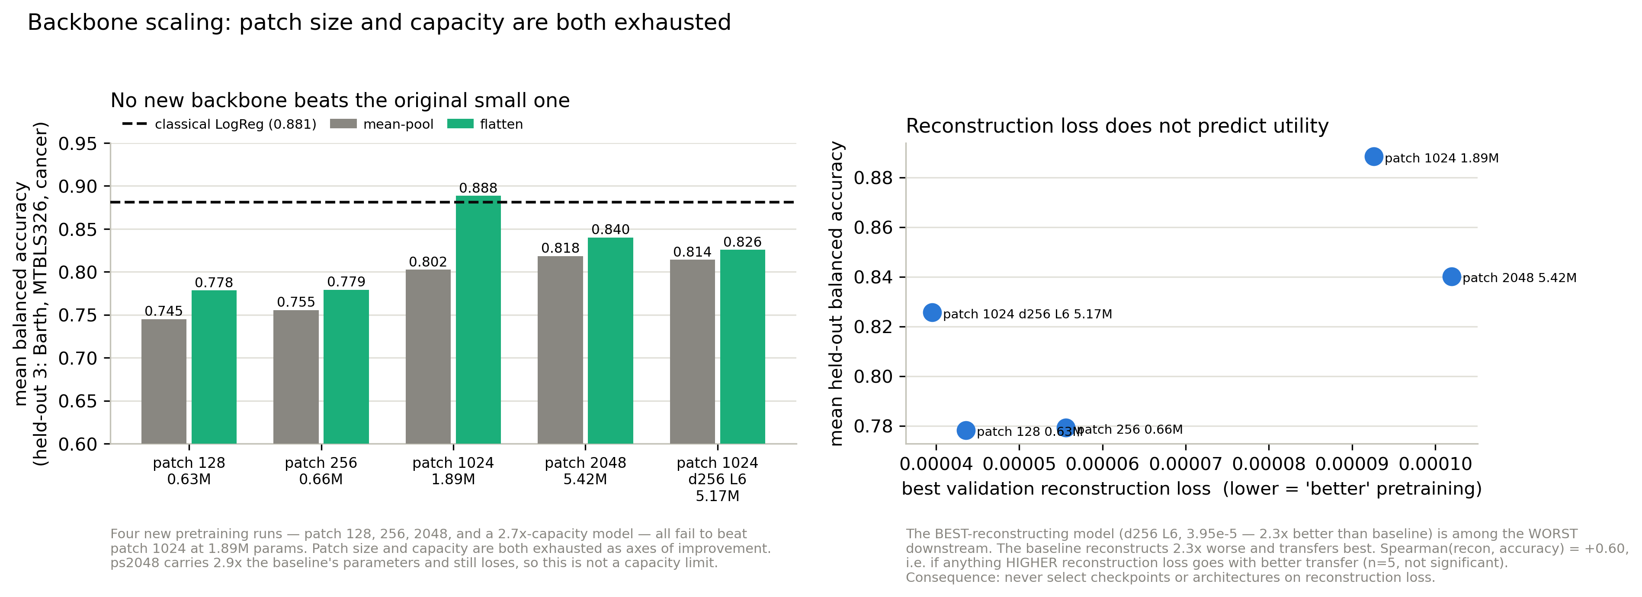
PART 3 · CAPACITY
Scaling the backbone: four attempts, no gain
Left: no new backbone beats the original 1.89M-parameter model at either pooling. Right: reconstruction loss does not predict transfer.
◆
Capacity is not the bottleneck
✗
Reconstruction loss misleads
⟲
This slide is partly withdrawn
A 5.42M-parameter model, 2.9× the baseline, still lost. Capacity papers over bad pooling rather than fixing it.
Spearman with held-out accuracy is +0.60 — the wrong sign. Rule adopted: never select on reconstruction loss.
Its reference is a v3-pretrained checkpoint while the comparisons are v4. Two slides on, that turns out to matter more than the effect.
Notes:
Present as it stood at the time, then flag that I later withdrew the strong conclusion. The honest position is that these backbones are indistinguishable.

Slide 17
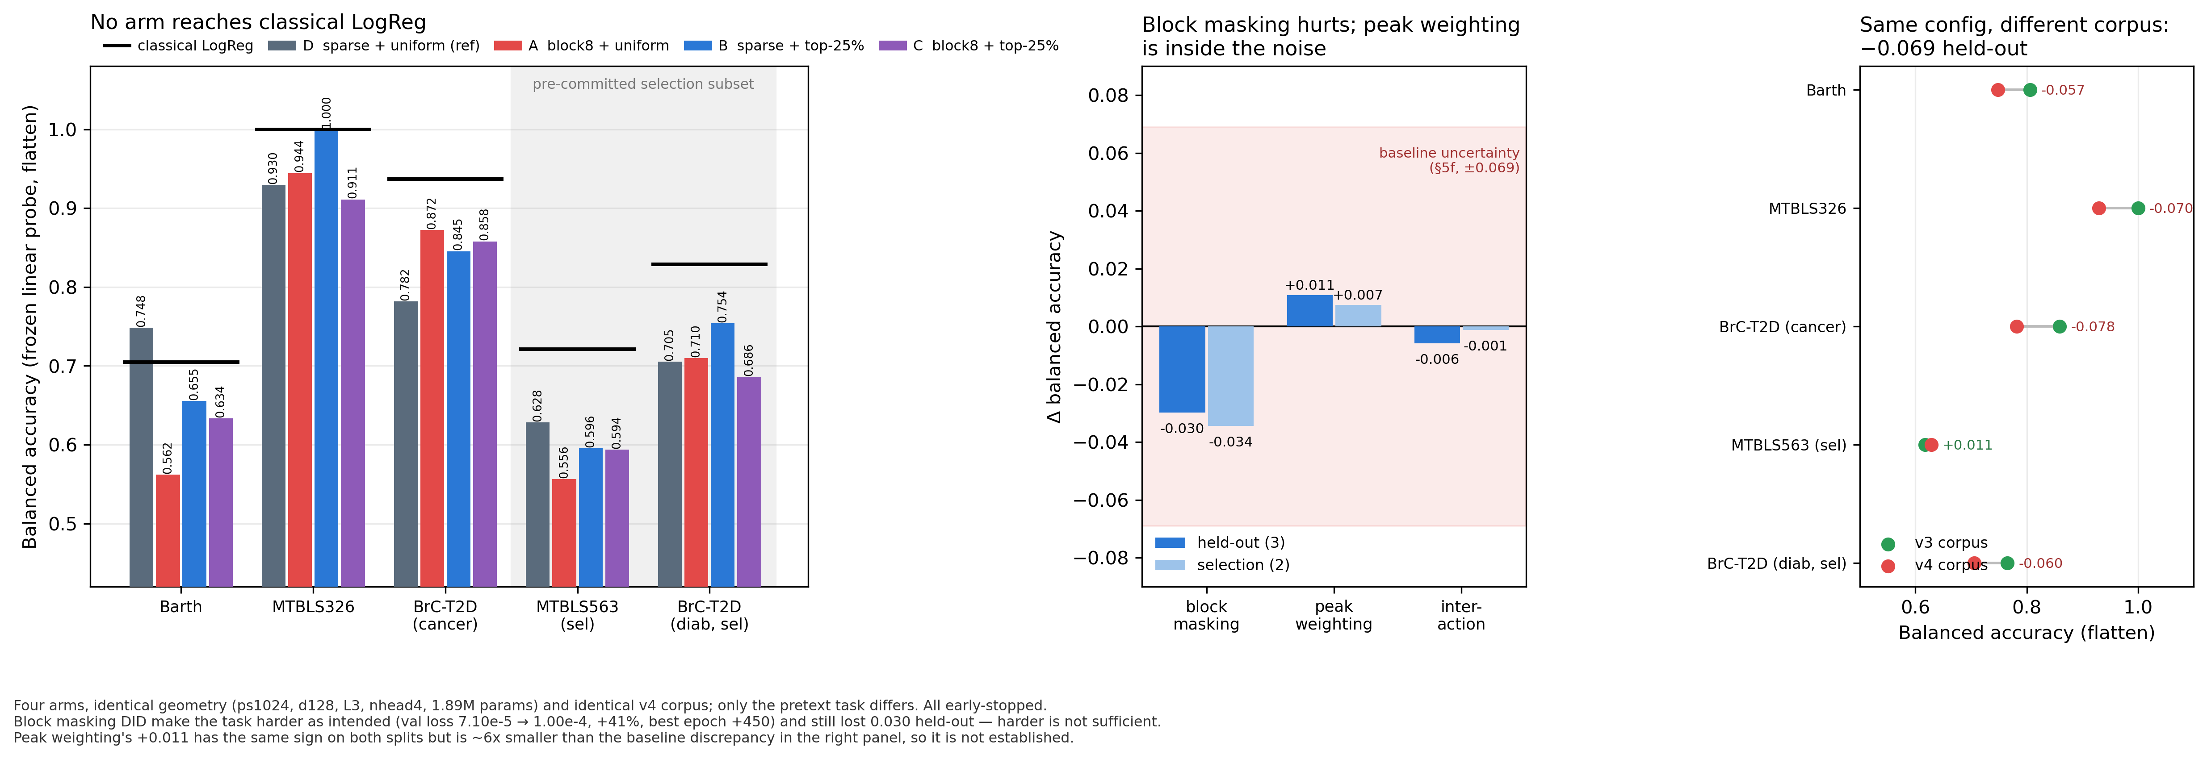
PART 3 · OBJECTIVE
Experiment #7: a harder, better-aligned pretext task
2×2 factorial. Identical geometry and corpus; only the pretext task differs. All four arms early-stopped normally.
A
Block masking: −0.030
B
Peak weighting: +0.011
✗
No arm reaches classical
Contiguous 8-patch spans, so neighbour interpolation cannot solve it. It DID make the task 41% harder — and still lost.
Loss restricted to the top 25% of patches by magnitude. The best arm here — but it reverses on the next slide.
Best held-out mean 0.834 against 0.881. The factorial's real payoff was its reference arm, which exposed the confound overleaf.
Notes:
Emphasise block masking: the mechanism provably fired — validation loss rose 41%, so the task really was harder — and transfer still dropped. A genuine negative result about MAE-style objectives on spectra.

Slide 18
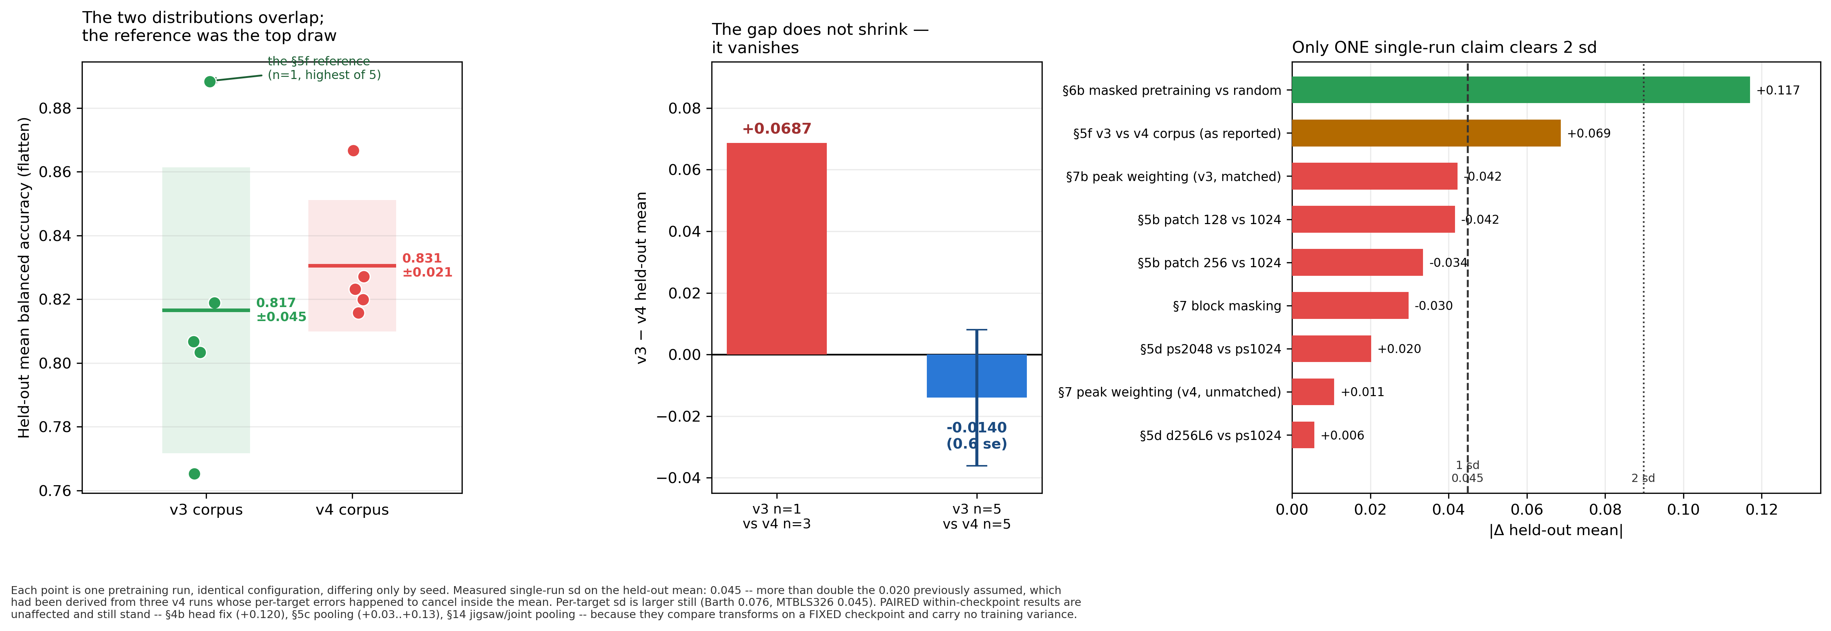
PART 3 · EXPERIMENT #7b → #15
The biggest effect we found wasn't real
Five seeds per corpus. Left: the two distributions overlap; the reference we built on was the top draw. Middle: the gap with error bars on both sides. Right: every single-run claim against the MEASURED sd.
1
It looked like v3 → v4 cost 0.069
2
…and so was almost everything else
3
Then we ran 5 seeds per corpus
Three v4 replicates land at 0.820 / 0.823 / 0.816 against a v3 reference of 0.888 — but that reference was a SINGLE run.
Peak weighting, block masking, every patch size and capacity arm all sit inside 1 sd. They were never resolvable at n=1.
v3 = 0.8165 ± 0.0449, v4 = 0.8305 ± 0.0206. The 0.888 was the top draw of five (+1.6 sd). The gap becomes −0.014 (0.6 se) — v4 marginally AHEAD. No corpus effect.
Notes:
Still the most important slide, but the lesson changed. Walk left to right: this is what a single unreplicated reference did. It generated two follow-up experiments (the 164-row ablation and the corpus-size sweep) and a headline recommendation, all chasing an effect that was not there. Be direct that this was caught by running the replicates, not by cleverness.

Slide 19
PART 3 · RECALIBRATION
Re-reading every claim against the noise floor
Claim | Effect | vs 0.045 sd | Status
Masked pretraining vs random init | +0.117 | 2.6× | survives
Pretraining corpus v3 vs v4 | +0.069 | 1.5× | retracted
Peak weighting (matched corpus) | −0.042 | 0.9× | within noise
Patch 128 vs 1024 | −0.042 | 0.9× | within noise
Patch 256 vs 1024 | −0.034 | 0.7× | within noise
Block masking | −0.030 | 0.7× | within noise
Patch 2048 vs 1024 | +0.020 | 0.5× | within noise
Wider / deeper backbone | +0.006 | 0.1× | within noise
⟲
The floor was 2× worse than assumed
0.020 came from three runs whose per-target errors cancelled — flagged as a fluke, then used anyway. Measured from 5 seeds: 0.045 (Barth 0.076).
✓
What is unaffected
The head fix and the pooling win are paired within-checkpoint comparisons, so run-to-run noise cannot explain them. They stand.
→
Standing rule adopted
No single-run difference below 0.09 (2 sd) is an effect. Either ≥5 replicates per arm (~23 GPU-h), or a paired within-checkpoint comparison.
Notes:
The uncomfortable slide. Three of eight previously-reported effects are within noise. Better I find this than a reviewer. Note the two positive results survive because they are paired.

Slide 20
4
Where we are on your roadmap
Mapping fifteen days of model-side work onto the decision tree you laid out — and what our own data already says about the data question.
The bar is set, and “can we better it” has been pursued hard: two wins, six failures
The data question already has an answer we have not been using
Notes:
Seven minutes. This is the part I most want your input on.

Slide 21
PART 4 · ROADMAP
Your decision tree, with status
Initial trials — masking, jigsaw, joint
DONE
Peak-intensity distributions vs increasing data
MEASURED
Does synthetic data help?
UNTESTED
All three pretrained and benchmarked on 5 targets.
60 canonical peaks across 9,670 spectra. Distributions converge at a median of 364 spectra.
The decisive experiment in your tree — and the one we have not run.
ML is better — sets the bar
DONE
Classical LR leads 5/5, confirmed on both v3 and v4.
Experimental y-distribution defined at all x?
PARTIAL
If no → more parameters
ALREADY BURNED
Yes at the 60 detected peaks; not across all 131,072 points. This is the open gate.
Tested out of order. Four capacity experiments, all at or below the noise floor.
Can we better it?
PURSUED HARD
8 interventions: 2 worked (+0.078, evaluation-side), 6 failed. Record now 1 win / 1 tie / 3 losses.
Use synthetic data (generative, or metabolite sums)
NOT STARTED
If no → we have hit a limit on these tasks
PREMATURE
Is data limiting?
PARTIAL ANSWER
A VAE (60 epochs) and a diffusion U-Net with sampler exist and are smoke-tested, but nothing generated has entered pretraining or evaluation.
Not concludable yet: the synthetic branch is untried, and n = 37–113 against a 0.035 noise floor may simply be too small to resolve differences.
Peak-intensity distributions already measured — next slide. Quantity is not the constraint; version and quality are.
Notes:
Walk the left column top to bottom, then middle, then right. Honest summary: fifteen days were spent entirely in the left column, and the middle and right columns are where your tree says the decisive work is.

Slide 22
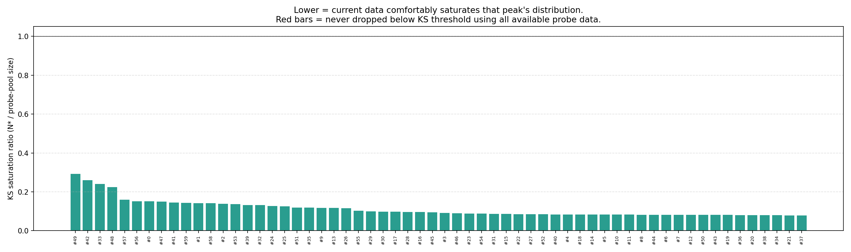
PART 4 · THE DATA QUESTION
“Is data limiting?” — what our own corpus says
KS saturation ratio per canonical peak: the fraction of the corpus needed before that peak's intensity distribution stops changing. All 60 peaks sit below 0.30; none is unsaturated.
364
60 / 60
0 / 60
9%
median spectra to converge, of 9,670
peaks already under 5% relative SEM
peaks needing more than 9,670
of the corpus is enough
→
More of the same data will not help
⚠
Two caveats before we lean on it
Saturated by a wide margin — more public spectra of this kind should not change them.
Covers 60 detected peaks, not all 131,072 points — and was computed on the pre-v3 corpus.
Notes:
The bridge from my model-side work to your data question. For quantity the answer looks like no. But the corpus-version result says quality matters a lot — a different and more interesting problem.

Slide 23
PART 4 · NEXT GATE
The synthetic-data branch: what exists, what is missing
Already built
Missing before the gate can be answered
1D VAE (encoder / decoder / loss) trained 60 epochs, with reconstruction previews every 5 epochs
Diffusion U-Net plus a Gaussian diffusion process, written and smoke-tested end to end
generate_spectra.py sampling CLI
A suppression-aware dataset loader, so generated spectra can respect the same artefact windows
Peak extraction and Needleman–Wunsch peak-list alignment, giving canonical positions to condition on
No generated spectrum has ever entered SSL pretraining or evaluation — the pipeline stops at sampling
No fidelity metric: we cannot yet say whether a generated spectrum's intensity distribution matches the experimental one
The linear-combination route (sums of pure metabolite spectra) is not implemented, and is the more physically defensible option
No agreed criterion, set in advance, for “does synthetic data help”
▸
Low infrastructure debt — the missing pieces are the connection to pretraining and an agreed success criterion.
Notes:
The infrastructure debt is low; most code exists. What is missing is the connection to pretraining and an agreed fidelity criterion. I would rather agree that criterion with you before spending GPU time than after.

Slide 24
PROPOSED NEXT TWO WEEKS
Ranked by evidence, not by novelty
1
Budget 5 replicates into every pretraining experiment
Three things I would like your view on
~23 GPU-h per arm. At a single-run sd of 0.045, that is the price of a reportable result — most of what we ran was below the resolution of the measurement.
Most model-side results were unresolvable at n = 1. Do we re-run the promising ones with replicates, or go straight to the synthetic-data branch?
What counts as “synthetic data helped” — downstream accuracy only, or distributional fidelity too?
With a measured sd of 0.045 at n = 37–113, should a larger evaluation cohort come before any further model work?
2
Prefer paired within-checkpoint comparisons
The three results that survived are all paired: they vary a transform on a FIXED checkpoint, cost no GPU time, and carry no training variance.
3
Re-run peak saturation beyond 60 peaks
Answers your “at all x” directly. Corpus version no longer matters, so either v3 or v4 will do.
4
Close the synthetic loop, with a criterion agreed first
Generate, compare intensity distributions against experimental, then pretrain on real + synthetic and evaluate. Needs ≥5 seeds to be readable.
Bottom line: our measurement noise (sd 0.045) was larger than almost every effect we chased. One single-run result survives — pretraining beats random init — plus three paired comparisons. The synthetic-data branch is still the right target, but it is only answerable with replicates budgeted in.
Notes:
Land on the three questions — they are the reason for the meeting. Priority 1 costs nothing and has the largest measured effect. Priority 3 needs their judgement before I spend GPU time.

