Slide 1
The rebuild is done, verified, and it answers two gates
Corpus and all four evaluation cohorts now sit on one real chemical-shift axis
Corpus rebuilt and verified
DONE
9,480 spectra from 18 studies, reprocessed from raw Bruker. Every spectral-width group peaks at scale 1.00 and carries the correct 2.780 ppm lactate CH3-to-CH separation.
All four cohorts rebuilt
DONE
MTBLS563 142, BrC-T2D 115, MTBLS326 43, Barth 40 - byte-identical ppm axes with the corpus, each verified independently. BrC-T2D recovered 125 spectra the old pipeline discarded.
Gate G1 - can pretraining beat classical ML?
ANSWERED
No. 0 wins, 24 losses, 5 ties across 6 targets x 5 label budgets with 5 seeds. The axis defect was not the reason SSL was losing.
Gate G2 - is data limiting?
ANSWERED
Quantity no, diversity yes. p(y|x) is pinned down for our 12 studies (99.8% of ppm bins) and does not transfer to a thirteenth (1.5%).
1

Slide 2
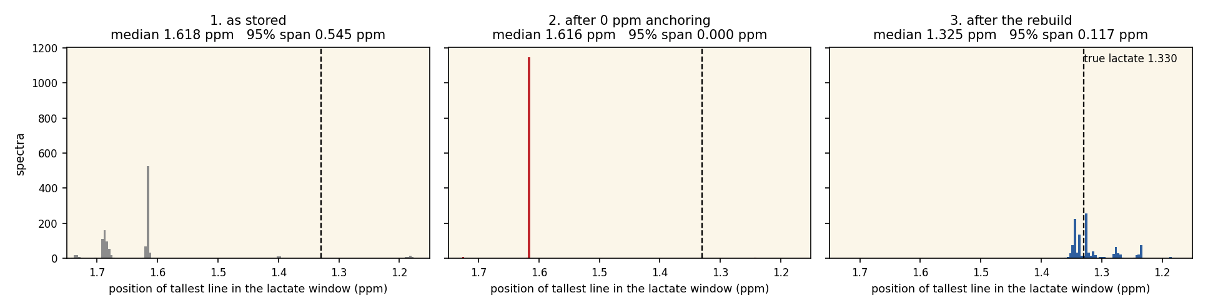
The decisive alignment measurement
Where does lactate actually land? The same measurement at each stage
As stored median 1.618 ppm, 95% span 0.546. Peak positions wander by half a ppm.
After 0 ppm anchoring span 0.000 - exact agreement, at 1.616 ppm, which is not where lactate is.
After the rebuild median 1.325 against a true 1.330, with 0.117 ppm of genuine inter-study spread.
Agreement between spectra is not the same as correctness. Only the rebuild has both.
2

Slide 3
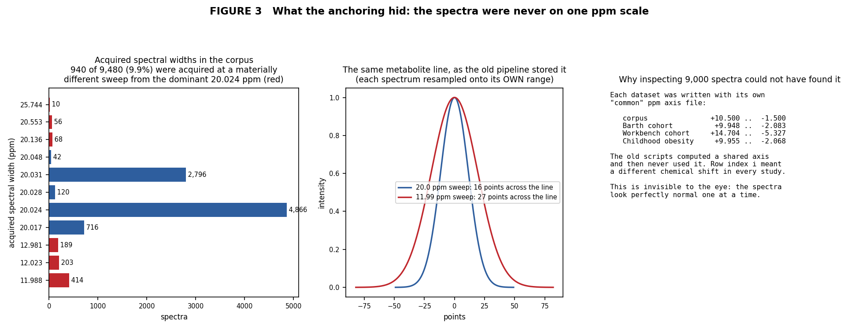
Why inspecting 9,000 spectra could not have found it
The defect exists only between rows - each spectrum looks perfectly normal alone
940 of 9,480 spectra (9.9%) were acquired at a materially different sweep width. The old pipeline resampled each onto its own ppm range, so one metabolite line occupied 16 points in one row and 27 in another. Four separate 'common axis' files were written and never used.
3

Slide 4
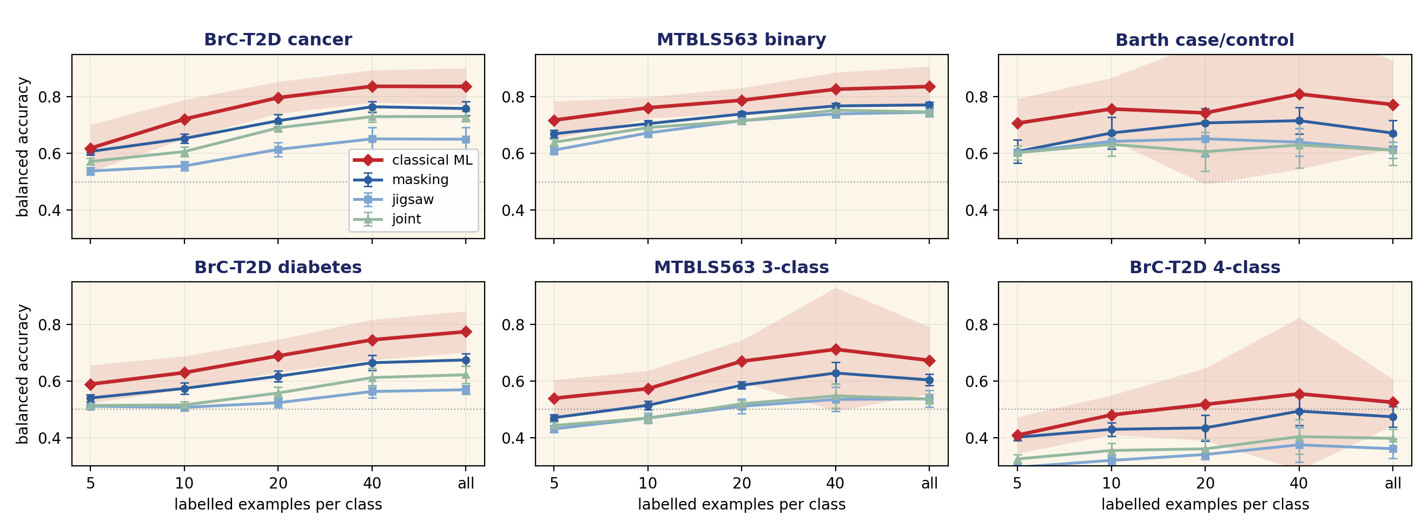
Gate G1: classical ML still wins
And the axis defect was not the reason - this reproduces on correct data
Balanced accuracy vs labelled examples per class. Error bars: sd across 5 pretraining seeds. Red band: +/- episode sd for classical. 50 paired episodes per point.
0 SSL wins / 24 classical wins / 5 ties. Classical leads in every cohort at every label budget, including k=5, so there is no few-shot crossover. The gap ranges +0.051 to +0.101.
Pretraining does work. Masking beats a random-init backbone by +0.081 to +0.121 on identical episodes - far above the 0.045 noise floor. Still less than a shrinkage LDA on 500 bins.
4
Notes:
Two claims withdrawn this week. (1) Effective rank does not predict transfer - I predicted joint would win on that basis, and masking won at every budget. (2) An apparent Barth win was selection bias from reporting the best of 15 checkpoints; every objective seed mean is below classical. The summary now reports seed means and marks best-of-15 as an upper bound.

Slide 5
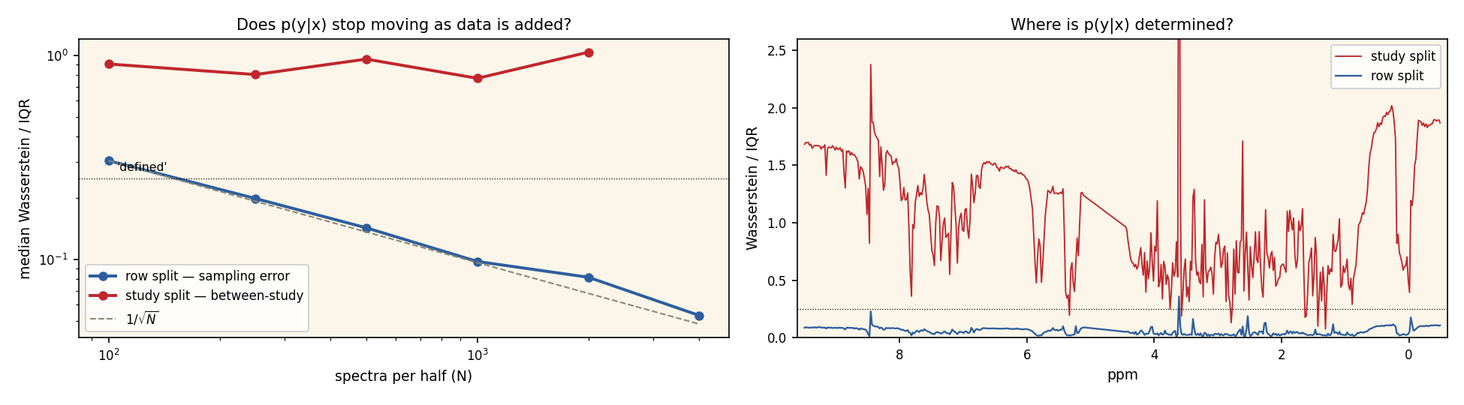
Gate G2: data quantity is not the constraint
Diversity is - and that changes what we ask the field for
Within our studies: defined. Sampling error falls as 1/sqrt(N) and by N = 4,000 resolves 99.8% of ppm bins. More spectra from these 12 studies would change nothing.
Across studies: not defined. Between-study variation is flat across a 20x range of N and resolves 1.5% of bins. Twelve studies do not determine a thirteenth.
A generator trained here would be sound and still reproduce a 12-study composition that does not cover a new cohort.
5

Slide 6
Does more data, or more diverse data, transfer better?
The scaling sweep - 33 pretraining runs across three machines
pretraining corpus | 10 labels /class | all labels
2,000 rows from 2 studies | 0.541 | 0.600
2,000 rows from 4 studies | 0.565 | 0.633
2,000 rows from 8 studies | 0.565 | 0.629
2,000 rows from 12 studies | 0.568 | 0.627
858 rows, all 12 studies | 0.557 | 0.624
6,410 rows, all 12 studies | 0.571 | 0.640
classical ML | 0.658 | 0.732
Diversity beats quantity, but both are small
At a fixed 2,000-row budget, going from 2 studies to 12 gains +0.027 at both label budgets - above seed noise, and it saturates after 4 studies.
Going from 858 rows to 6,410, with all 12 studies present throughout, gains only +0.015 and is not monotonic.
So diversity matters more than quantity, which agrees with the distributional result. But neither closes the ~0.10 gap to classical ML.
Masking, mean over 6 targets; seed sd 0.002-0.021. Columns = label budget.
What this means for gate G3
A generator trained on this corpus would reproduce a 12-study composition. The scaling result says a 12-study corpus is not much better than a 4-study one for transfer, so synthetic data drawn from it should not be expected to help. Worth one honest test, with a low prior.
The open question this raises
Saturation at 4 studies may mean the 2,000-row budget is the binding constraint rather than study count. Re-running the fixed-budget axis at 4,000 rows would separate those, and is the next cheap experiment.
Still untested
Fine-tuning rather than frozen probes. Phase 3 froze the backbone deliberately, so G1 is a verdict about representations, not about what the architecture could do if adapted.
6

