Slide 1
Foundation Model for
1D NMR Metabolomics
What we built, what we found, and the three things we got wrong
Shankararama Sharma
Group Meeting · August 2026
continues from 27 Feb 2026
9,670
spectra pretrained on
(was 2,146 in Feb)
5
evaluation targets
across 4 cohorts
15
numbered experiments
3 retractions
Notes:
45 min, questions welcome throughout. TIMING GUIDE (leaves ~8 min slack for interruptions): slides 1-4 framing + the arc ................ 6 min slides 5-9 what we built ................... 8 min slides 10-14 the headline + diagnosis ........ 9 min slides 15-21 the three mistakes .............. 10 min <- the important part slides 22-25 the few-shot result ............. 7 min slides 26-29 where we stand + discussion ..... 5 min If running long, slide 6 (preprocessing versions) and slide 9 (protocol) are the two that can be summarised in one sentence each. Do NOT cut 19, 20, 23 or 24.

Slide 2
The goal — unchanged since February
Why a foundation model is the right idea for metabolomics
1
The problem
Metabolomics cohorts are tiny — 10s to 100s of samples. Deep networks need far more than that to train from scratch.
2
The idea
Pretrain once on thousands of UNLABELLED spectra with a self-supervised task. No labels needed — we have plenty of raw spectra.
3
The payoff
Transfer that representation to a small labelled cohort. The backbone already knows what NMR spectra look like.
4
Success criterion
It must beat classical ML (binned intensities + logistic regression) on small datasets. That is the bar.
2
Notes:
This framing has not changed. Everything that follows is about whether we actually cleared the bar in item 4 — and the honest answer today is: not yet.

Slide 3
Where we were on 27 February
The state of play at the last group meeting
What was working
What was missing
Masked Spectra Modelling trained end-to-end
2,146 CPMG serum spectra from MetaboLights
Reconstruction was excellent — MSE ≈ 3×10⁻⁵, R² ≈ 0.98 at 25–35% masking
Full preprocessing pipeline: TopSpin → align → water-suppress → dedupe → normalise
Three evaluation routes sketched: embeddings+ML, classification head, ML-only
Only ONE test cohort (TBI, ~57 samples) — no way to tell general from idiosyncratic
No head-to-head against classical ML on identical folds
No control asking whether pretraining helped at all vs a random network
No error bars anywhere — every arm was a single training run
Reconstruction quality was our success metric. It turns out not to be one.
Most of the last five months went into fixing the right-hand column.
3
Notes:
Be upfront: the February deck showed a model that reconstructed beautifully and an evaluation that could not support conclusions. The reconstruction quality was real; it just turned out to be the wrong thing to optimise.

Slide 4
What happened since — the arc
Five months in one picture
1
2
3
4
5
6
Scale up
Compare
properly
Diagnose
the gap
Try to fix
the backbone
Learn to
measure noise
Test the
premise
2,146 → 9,670 spectra
4 cohorts, 5 targets
Same folds, same metric,
classical vs SSL
Head deficit vs
representation ceiling
Patch size, capacity,
objectives, corpus
10 seed replicates.
3 claims retracted
Few-shot benchmark
on all 5 targets
The honest summary of the arc
Steps 1–3 worked and produced two real improvements. Step 4 failed on every axis we tried. Step 5 revealed that most of step 4's "results" were noise. Step 6 tested the project's core premise directly — and it did not hold.
4
Notes:
This is the roadmap for the talk. I will spend most time on 5 and 6 because that is where the real learning is.

Slide 5
Step 1 — more data, and real evaluation cohorts
February had one test set. Now there are five targets across four independent cohorts.
Evaluation target | Size | Label | Protocol
Barth Syndrome | n = 37 | Case / Control | LOOCV
MTBLS326 | n = 42 | Yes / No (IP3R) | LOOCV
MTBLS563 | n = 113 | 3-class diagnosis | 10-fold
BrC-T2D — cancer | n = 78 | Cancer / No cancer | 10-fold
BrC-T2D — diabetes | n = 78 | Diabetes / No | 10-fold
Pretraining corpus
2,146 → 9,670
unlabelled CPMG serum / plasma spectra
MetaboLights + Metabolomics Workbench
131,072 points each, deduplicated
Two things to flag about the evaluation set
Barth and MTBLS326 use LOOCV, so they have NO fold variance — no error bars. Differences of 0.02 there are one sample.
MTBLS326's classical score is a perfect 1.000 on n=42. It clears a permutation null — but the batch audit (slide 23) shows it is CONFOUNDED BY DESIGN: cases are samples 1–27, controls 101–130, separate acquisition blocks. Barth passes the same audit cleanly.
5
Notes:
Corpus is still small for a foundation model — 9,670 is orders of magnitude below where masked pretraining usually starts to pay. That becomes one of my proposed next steps.

Slide 6
A detour worth mentioning — four preprocessing versions
We found a real bug. Then we found out it did not matter.
v1
v2
v3
v4
Water suppression only
points 62,500–68,000 → 0
EDTA window skipped
(left largely untouched)
Uniform magnitude-based
EDTA suppression
EDTA cutoff FIXED to the
baseline-to-peak midpoint
EDTA is a real contaminant problem
…but it does not matter downstream
Blood-collection tubes leave EDTA peaks that can dominate a spectrum and swamp the row normalisation.
v3 → v4 fixed a genuine cutoff bug: the suppression was removing too much of the surrounding signal.
7 rows repo-wide still retain a dominant EDTA peak — documented, not hidden.
We spent two whole experiments trying to explain a v3-vs-v4 downstream difference.
With 5 seeds per corpus that difference is −0.014 ± 0.022 — indistinguishable from zero (slide 19).
Lesson: fix the preprocessing because it is CORRECT, not because you measured a downstream gain from one run.
6
Notes:
Keep this short unless asked. The point is methodological: correctness and measurable downstream benefit are different justifications, and we conflated them.

Slide 7
The backbone, and the three objectives we tried
Architecture is unchanged from February; two more pretext tasks were added
Input spectrum
Patch split
+ mask
Patch embed
+ position
Transformer
encoder
Reconstruction
head
Output
131,072 points
1,024-pt patches
→ 128 tokens
mask 20–60%
Linear → 128-d
+ positional enc.
3 layers, 4 heads
ff 256, pre-norm
MLP → patches
masked regions
restored
1.89 M parameters · patch 1024 · d_model 128 · best val reconstruction 9.3×10⁻⁵
Masked (MSM)
Jigsaw
Joint
Hide 20–60% of patches, reconstruct them.
Shuffle spectral bins, predict the original order.
Masked + jigsaw together, shared encoder.
The one that works
No better than random init
Actively harmful
(the verdicts come from the random-init control on slide 14)
7
Notes:
Architecture questions likely here. Patch 1024 = 128 tokens over 131k points. That resolution limit becomes a hypothesis we test and refute later.

Slide 8
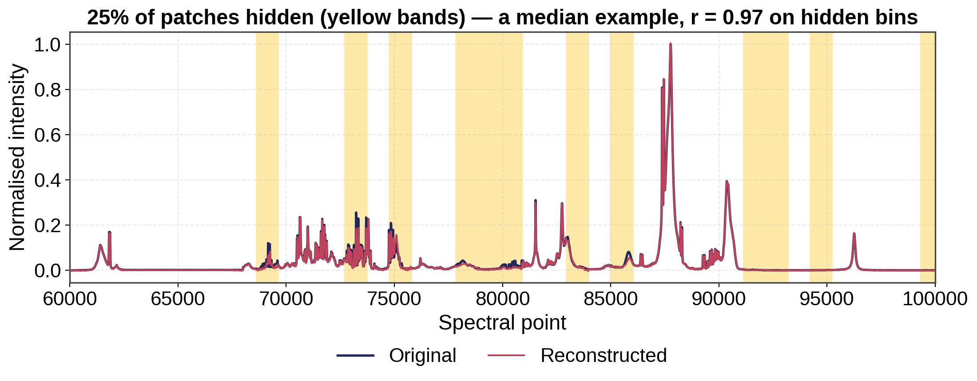
The pretext task itself works very well
Re-measured from February — and this is exactly where the trap was
Across 50 spectra: r = 0.940 ± 0.090 on the hidden bins only
The trap: the pretext task is genuinely solved well — and it still tells you almost nothing. (February's r = 0.999 was whole-spectrum, which includes the 75% of bins the model is handed.) Across five backbones BETTER reconstruction went with WORSE transfer, so we never select a checkpoint, architecture or epoch on reconstruction loss.
8
Notes:
This is the single most transferable lesson for anyone else in the group doing SSL: a beautiful reconstruction figure tells you almost nothing about whether the features are useful.

Slide 9
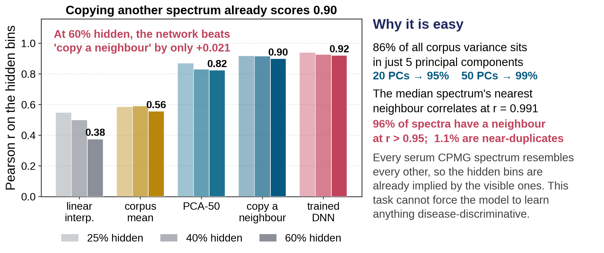
Why reconstruction was never the hard part
The number above has no baseline — so we built the baselines it was missing
No learning needed. Finding the most similar other spectrum and copying its hidden bins scores 0.90 at 60% masking. The trained network gets 0.92.
So the objective cannot bite. Disease signal is a small perturbation orthogonal to the few components that dominate the loss — which is why MSM never learned it.
9
Notes:
This slide is the mechanism for the whole negative result, so do not rush it. The honest framing: masked reconstruction on this corpus is close to a solved linear-algebra problem before any deep learning is involved. 86% of all corpus variance sits in 5 principal components, and the median spectrum's nearest neighbour correlates at r = 0.991. At 60% masking the model still sees ~52,000 points to pin down ~20 effective degrees of freedom. Two honest caveats if pushed: (1) the network does still beat every non-learned baseline, by about +0.02. It is learning something real, just something that is nearly free and not disease-related. (2) nn_copy benefits from same-study neighbours. Excluding close row-neighbours it drops from 0.90 to 0.885 — the conclusion does not change. Unexpected result worth mentioning: we predicted r was inflated by predicting empty baseline. It is not. Peak bins score 0.879 and baseline bins 0.855 at 60% masking, so the model really does reproduce peaks. It just does not need much skill to do so. Side finding: 1.1% of the corpus are near-duplicates at r > 0.9999 and 55% have a neighbour at r > 0.99, despite the corpus being built by a 'combine_unique' dedup step. Effective corpus size is smaller than 9,670. This matters for the corpus-scaling experiment on the next-steps slide.

Slide 10
How we compare now
The protocol that made everything after this interpretable
Identical folds
The validation gate
Both tracks see exactly the same splits — LOOCV for Barth / MTBLS326, stratified 10-fold (seed 42) for the rest.
Before drawing any conclusion, the harness had to reproduce the committed classical numbers to 6 decimal places on all five targets:
Identical metric
BrC-T2D cancer
BrC-T2D diabetes
MTBLS563
MTBLS326
Barth
0.936842
0.828877
0.720785
1.000000
0.704969
Balanced accuracy everywhere, because several targets are imbalanced (Barth is 14 / 23).
Both classifiers linear
Classical = StandardScaler → LogReg. SSL = frozen embedding → LogReg probe. So a difference is about the FEATURES, not the classifier.
Without this, none of the comparisons would mean anything.
10
Notes:
The 6-decimal gate is worth emphasising — it is what lets us attribute differences to the features rather than to a plumbing discrepancy.

Slide 11
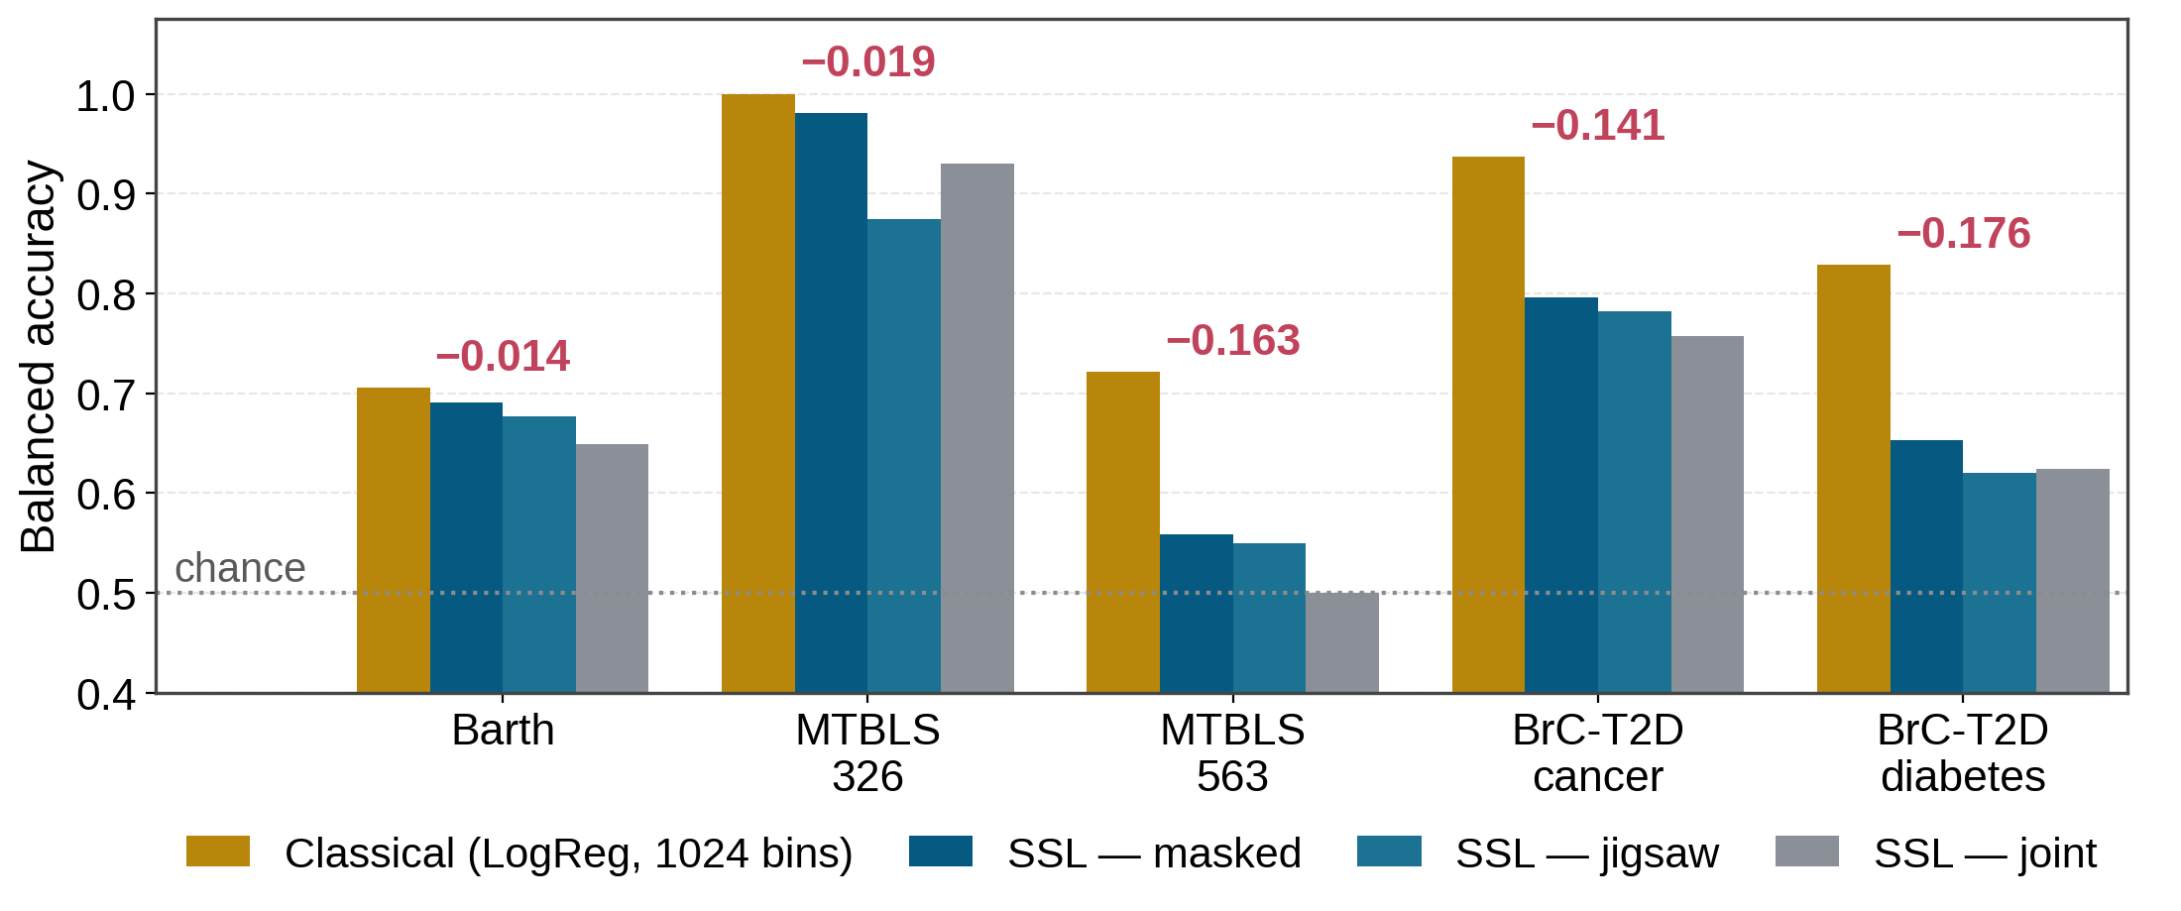
Step 2 result — classical ML beat every SSL family
Balanced accuracy, v4 data, best mode per family, identical folds
Consistent ordering: masked > jigsaw ≈ joint. Two of the gaps are large (0.14–0.18). Barth and MTBLS326 are effectively ties — half a sample and one sample respectively.
11
Notes:
This is the result that set the agenda for the next four months. Note it was measured with the reported DNN head and mean-pooling — both of which turned out to be fixable.

Slide 12
The gap is not one problem — it is two
Run the SAME logistic regression on the frozen SSL embedding to separate them
Head-fitting deficit
Representation ceiling
The SSL head is a linear layer trained by Adam for ~50 epochs on a handful of samples. LogReg on the IDENTICAL features fits the same linear map properly (L-BFGS to convergence, explicit L2, standardised inputs).
Whatever survives the better classifier is the embedding's own limit — information the backbone never encoded, which 1,024-bin integrated areas do carry.
Target | SSL head | LogReg on same embedding | LogReg @ 1024 bins | Head deficit | Representation ceiling
BrC-T2D cancer | 0.796 | 0.833 | 0.937 | 0.037 | 0.104
BrC-T2D diabetes | 0.653 | 0.810 | 0.829 | 0.157 | 0.019
MTBLS563 | 0.558 | 0.607 | 0.721 | 0.049 | 0.114
Barth | 0.691 | 0.770 | 0.705 | 0.079 | −0.065
MTBLS326 | 0.981 | 0.944 | 1.000 | −0.037 | 0.056
Diabetes is 89% a head problem — the embedding already supports 0.810. Cancer and MTBLS563 are mostly representation. Barth's embedding actually BEATS binned features (0.770 vs 0.705); the head was wasting it.
12
Notes:
The mixed picture is the useful part: there is no single fix, and for one target the SSL representation was already better than the classical features.

Slide 13
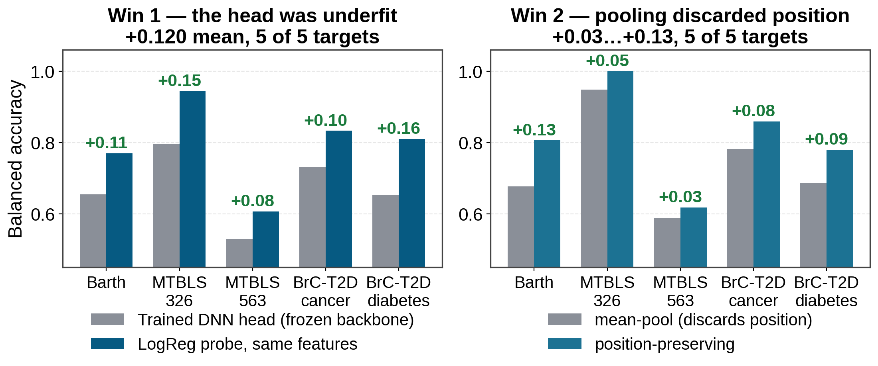
Two fixes that cost zero GPU time
Both are PAIRED comparisons — same frozen checkpoint, one thing changed. Both still stand today.
Why these two survived everything that came later: they vary a transform on a FIXED checkpoint, so they carry no pretraining run-to-run variance at all. That distinction turns out to be the whole story of this project.
13
Notes:
Pooling: the backbone makes 128 tokens, one per spectral region. Mean-pooling averages them and throws away WHERE the signal was — but chemical shift position is the discriminative information in NMR. Keeping position costs nothing. IF SOMEONE ASKS WHY THE PANELS DO NOT CHAIN (a fair question — the left panel's 'after' is not the right panel's 'before'): They are two independent paired experiments on the same checkpoint, read at different nhead. That checkpoint does not record nhead and the attention weight shapes are identical either way, so it loads silently under both. The left panel is read at nhead=8, the right at the true nhead=4. Each panel is internally valid because each is paired; the absolute heights are not comparable across panels. flatten pooling is almost nhead-invariant (Barth 0.8059 either way) while mean_pool is very sensitive (0.677 vs 0.770), which is exactly why the baselines differ. LEFT PANEL is the strict paired test from experiment #2: LogReg vs the trained MLP head on IDENTICAL frozen features — same backbone, same pooling, same folds, only the fitting of the final linear map differs. +0.120 mean, positive on 5 of 5.

Slide 14
Where those two fixes left us
SSL vs classical, after the head and pooling fixes — no retraining
Target | Reported Feb-style head | Probe + pooling fix | Classical LogReg | vs classical | Verdict
Barth | 0.691 | 0.806 | 0.705 | +0.101 | 1 seed *
MTBLS326 | 0.981 | 1.000 | 1.000 | 0.000 | confounded †
BrC-T2D cancer | 0.796 | 0.859 | 0.937 | −0.078 | classical
BrC-T2D diabetes | 0.653 | 0.783 | 0.829 | −0.046 | classical
MTBLS563 | 0.558 | 0.621 | 0.721 | −0.100 | classical
+0.078
0 → 1
0 h
mean improvement over the
February-style numbers
apparent win at the time
— retracted later, see #18
GPU time spent —
both fixes are post-hoc
* Barth's win rests on ONE pretraining seed — it does not survive n=5 (slide 22). † MTBLS326 is confounded by acquisition batch (slide 23). Neither target survives.
14
Notes:
Good news slide — but flag the asterisk as you show it, do not let it pass as a win. The two remaining large gaps are the two biggest cohorts, the ones with actual error bars. And the Barth 'win' is retracted later in the talk (experiment #18): 0.806 is the highest of five pretraining seeds and the group mean is 0.690, below classical's 0.705. The +0.078 mean improvement and the pooling win are both real and both survive; it is only the Barth-beats-classical claim that does not.

Slide 15
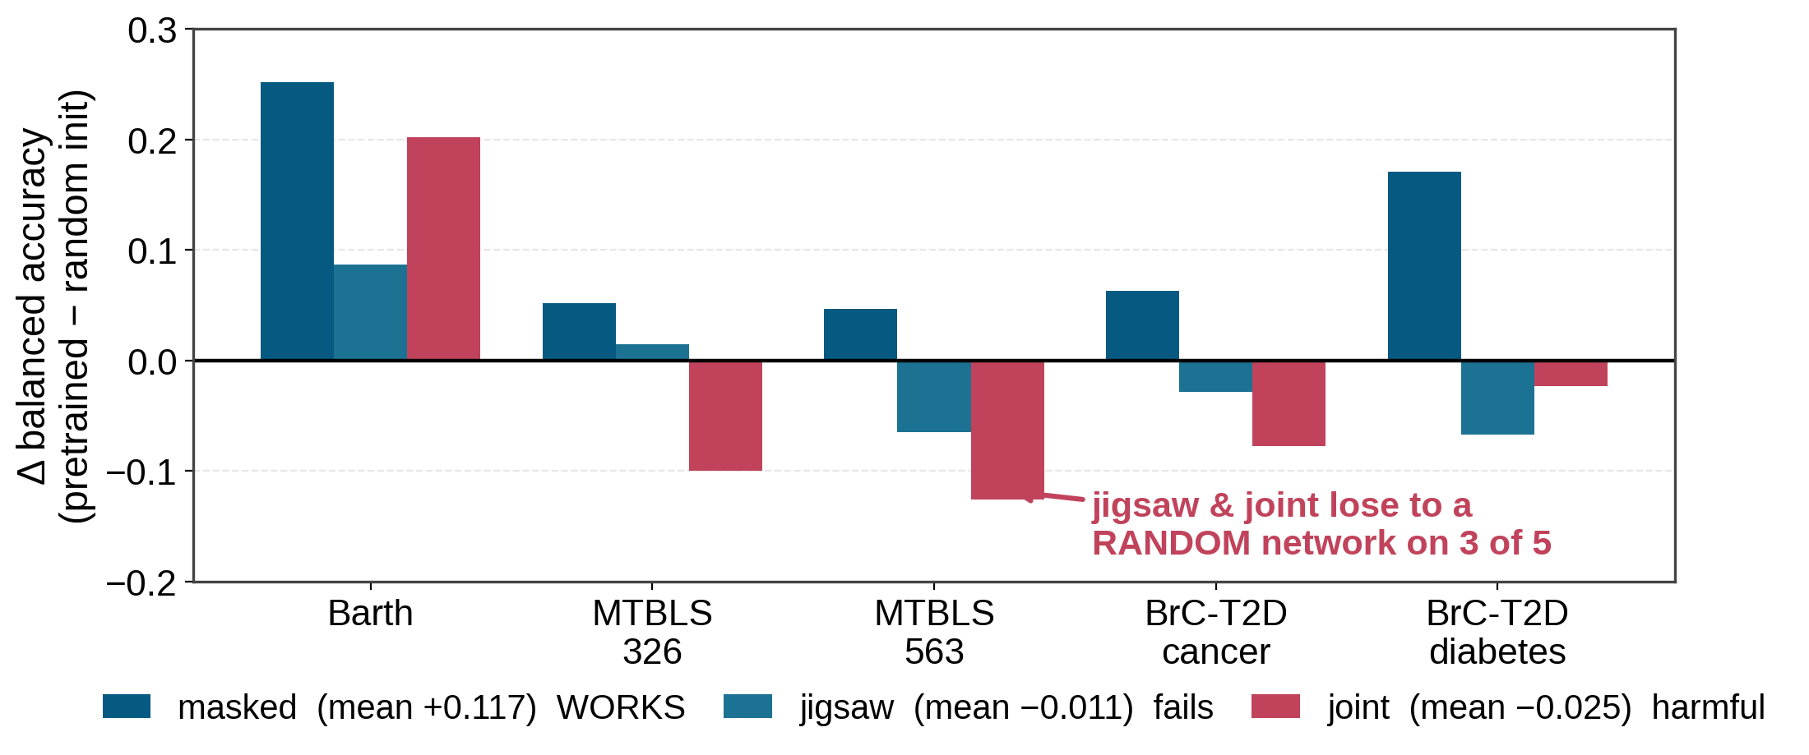
The control we were missing in February
Same architecture, NO pretrained weights anywhere, classifier held fixed — so any difference is the objective
Masked pretraining earns its keep: +0.117 mean, positive on 5 of 5. This is the ONLY single-run result in the whole project that clears the noise floor.
Jigsaw and joint add nothing over a RANDOM projection. A random transformer is a strong baseline — so this means the objective, not the architecture, is the problem.
15
Notes:
Decision from this: concentrate on masking. We stopped developing jigsaw and joint. If asked why random is strong — random-feature kernel methods are a real baseline.

Slide 16
Part 2
Three things we got wrong
and the one experiment that caught them all
1
2
3
A control that did not control
A backwards hypothesis
An effect that never existed
we read an ablation backwards
finer patches = an easier task
and it was our headline result
Notes:
I want to spend real time here — this is the part that changed how I work, and it is the part most transferable to everyone else in the group.

Slide 17
Mistake 1 — a control that did not control anything
We had an ablation we believed showed 'pretraining does not help'
What we thought it tested
What it actually tested
"Pretrained backbone vs random backbone." The numbers looked similar, so the reading was: pretraining is not buying us anything.
It re-initialised only the layers that were being UNFROZEN for fine-tuning, leaving the rest pretrained — and the head was underfit in both arms, which masked the difference.
The fix
Build a genuine control: load NO pretrained weights anywhere (patch embedding and positional encoding included), and hold the classifier fixed at a converged LogReg in both arms. That is the experiment on the previous slide — and read correctly, masked pretraining HELPS by +0.117.
Lesson
A control has to be checked as carefully as the thing it controls. We now verify explicitly that a random-init arm produces genuinely different embeddings before trusting it.
17
Notes:
Worth saying plainly: this one nearly sent us in the wrong direction entirely — we could have concluded the whole approach was dead.

Slide 18
Mistake 2 — a hypothesis that was exactly backwards
Our best explanation for the representation ceiling, tested properly and refuted
The hypothesis (very reasonable)
The backbone turns 131,072 points into 128 tokens, so it cannot represent detail finer than 128 positions. Classical LogReg uses 1,024 bins — 8× finer. So: shrink the patch, gain resolution.
Backbone | Barth | MTBLS326 | BrC cancer | BrC diab | MTBLS563 | mean Δ
patch 1024 (128 tokens) | 0.806 | 1.000 | 0.859 | 0.780 | 0.618 | baseline
patch 256 (512 tokens) | 0.598 | 0.907 | 0.832 | 0.783 | 0.581 | −0.072
patch 128 (1024 tokens) | 0.655 | 0.911 | 0.768 | 0.738 | 0.607 | −0.077
Finer patches won 0 of 5 targets — both arms were worse.
Why it failed — and this is the interesting part
Validation reconstruction loss FELL as patches shrank: 9.3×10⁻⁵ → 5.6×10⁻⁵ → 4.4×10⁻⁵. A masked 128-point patch is largely interpolable from its neighbours, so shrinking the patch made the pretext task EASIER, not more informative — the model can solve it by local smoothing without learning any metabolite structure. Patch size and mask ratio jointly set task difficulty; we moved the wrong knob.
18
Notes:
Also a confound worth admitting: the small-patch models have ~3x fewer parameters, because the patch embedding scales with patch size. The falling reconstruction loss is the independent evidence for the easier-task explanation.

Slide 19
Mistake 3 — the big one. An effect that was never there.
How a single number became the largest reported result in the project
1
July
A new experiment needed a v4-pretrained baseline. We trained one.
2
The observation
It scored 0.820 held-out. The v3 checkpoint every earlier number used scored 0.888. Same architecture, same hyperparameters, config verified byte-identical.
3
The conclusion we drew
"The pretraining corpus version is worth +0.069 — larger than every other effect we have measured." We even recommended reverting to v3.
4
What we did next
Two more experiments (#8, #13) hunting the MECHANISM: was it the 164 differing rows? Was it corpus size? Both came back inconclusive.
Nobody asked the obvious question: how much does the SAME configuration vary between two training runs?
19
Notes:
Pause here. Ask the room what they would have done. The answer we should have reached months earlier is: replicate the reference run before believing any of it.

Slide 20
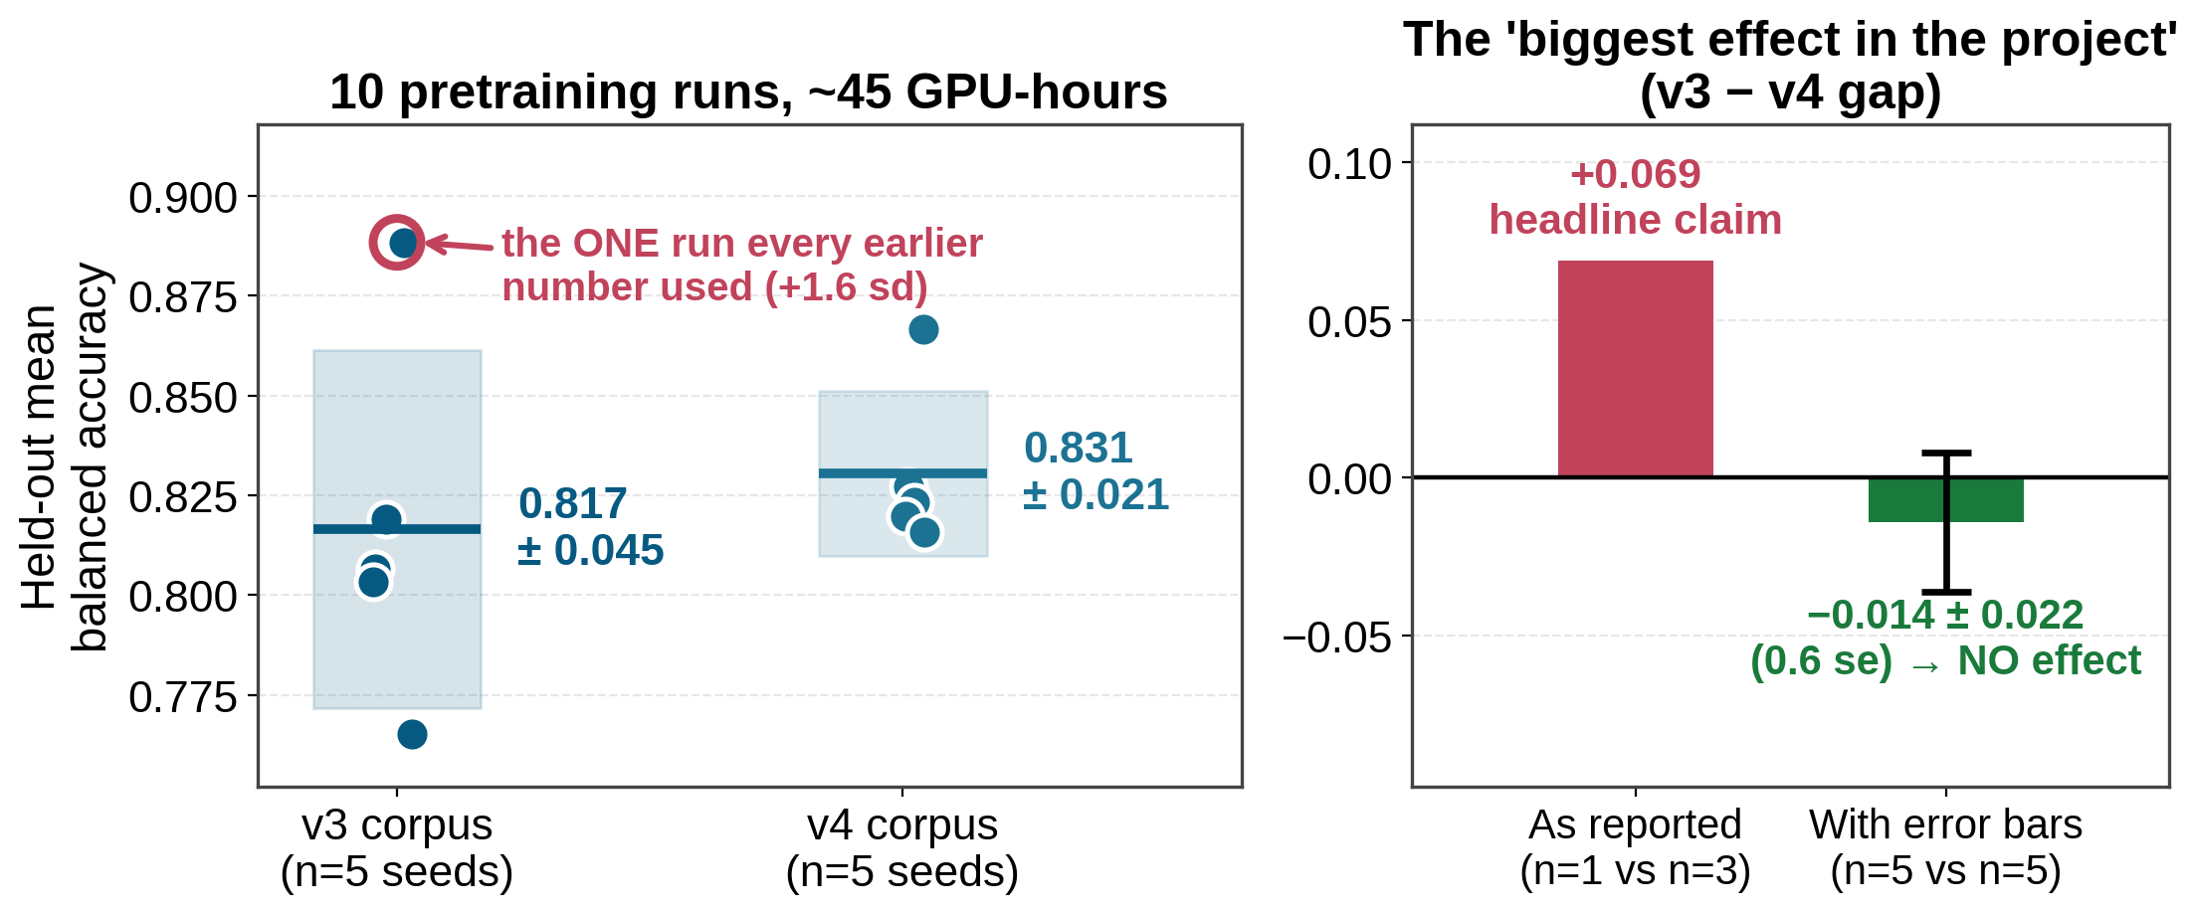
Experiment #15 — so we finally measured the noise
Ten pretraining runs, five per corpus, identical config differing only by random seed
The 0.888 reference was rank 1 of 5 and sits +1.6 sd above its own distribution. The gap does not shrink — it vanishes and marginally reverses. §5f retracted; experiments #8 and #13 were hunting the mechanism of a non-effect.
20
Notes:
~45 GPU-hours to learn that our headline result was a sampling artifact. Cheapest expensive lesson of the project. Emphasise: this was the student's own suggestion to run seeds.

Slide 21
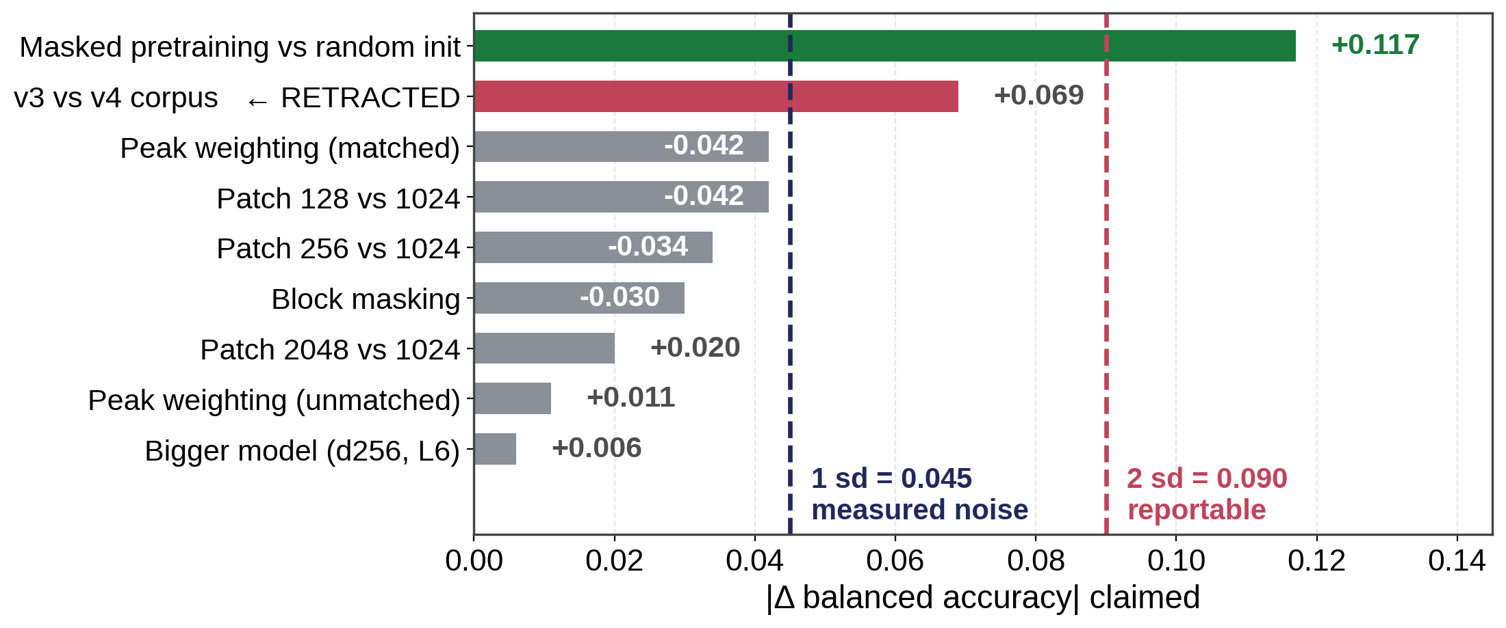
The worse news — the noise floor was 2× what we assumed
Every single-run claim in the project, re-scored against the measured spread
Measured sd = 0.045 on the held-out mean; per target up to 0.076 (Barth). We had been using 0.020 — which came from three runs whose errors happened to cancel.
New standing rule: no single-run difference below 0.09 is an effect. Either ≥5 replicates (~23 GPU-h) or a paired comparison — budgeted up front.
21
Notes:
The 0.020 floor is the deeper error: we had explicitly noted at the time that the three-run agreement looked like a fluke, called it a fluke in writing, and then adopted it as a floor anyway. That is what let three claims through.

Slide 22
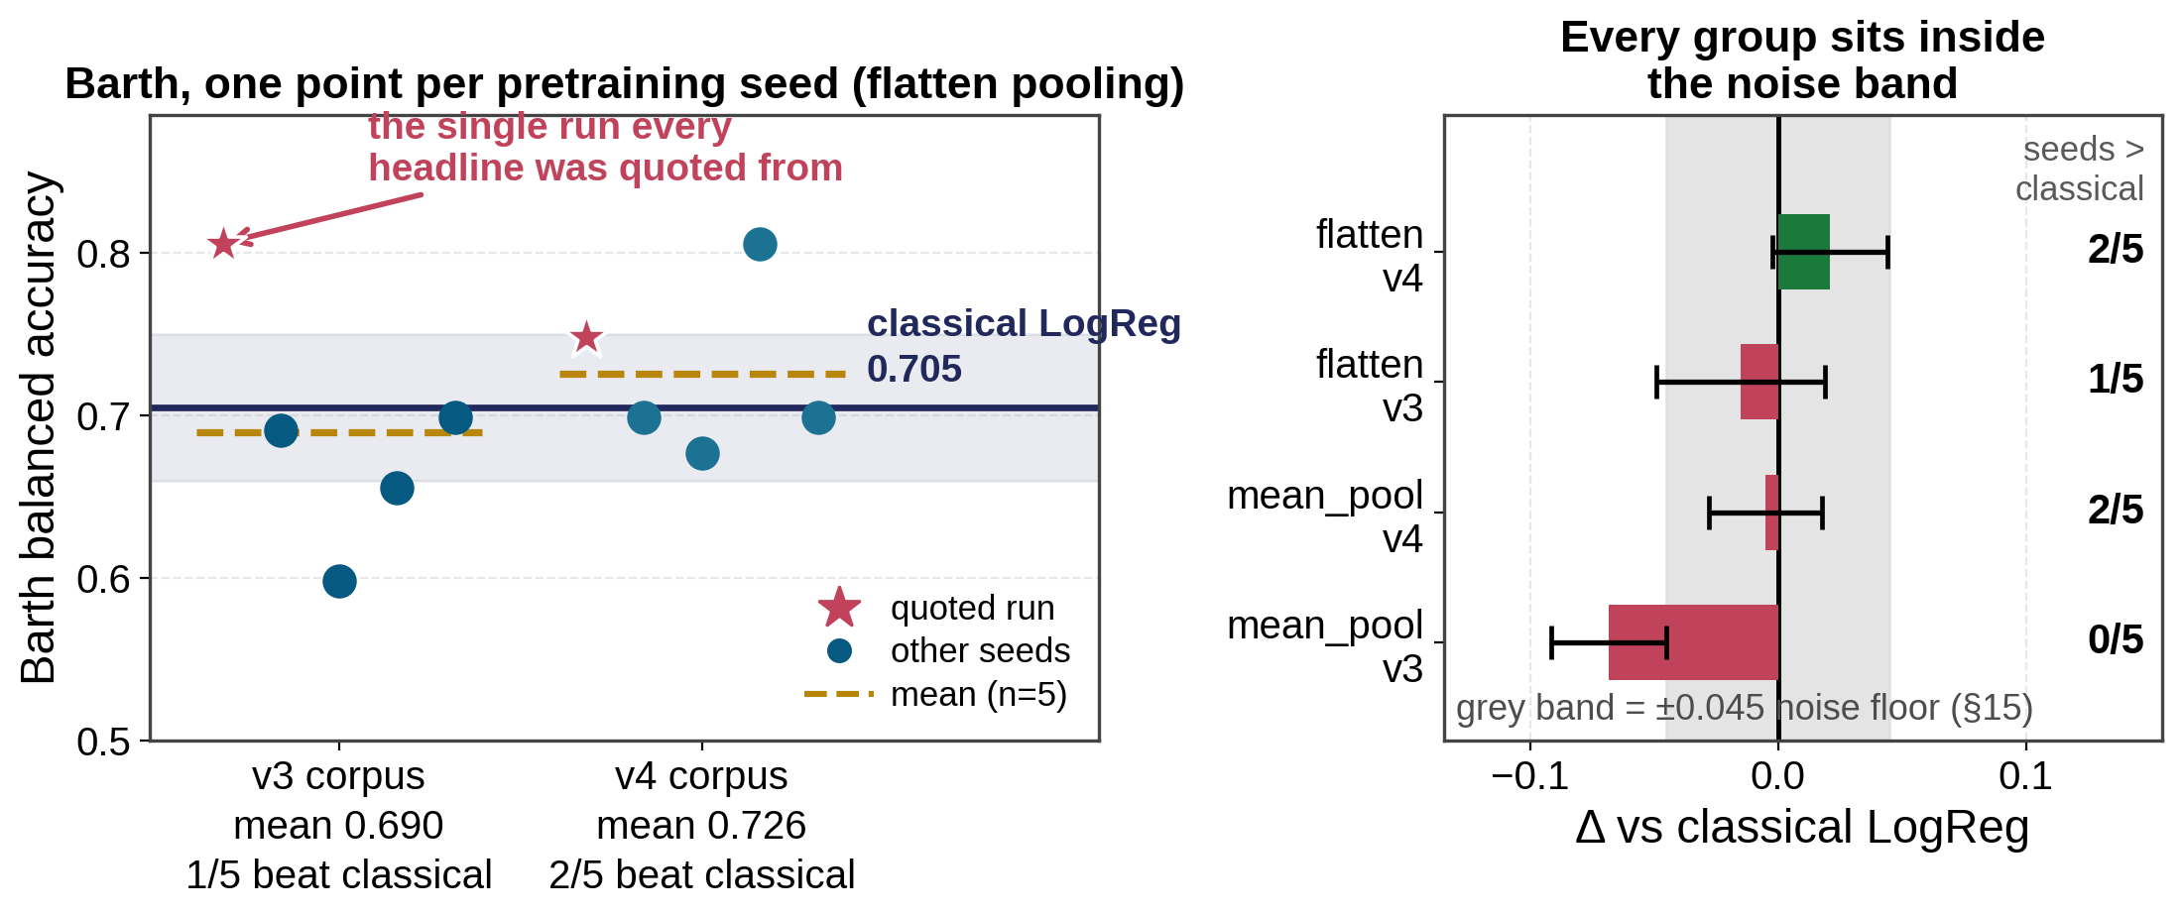
Applying that noise floor to our one win
Barth was the single target where SSL beat classical ML — so it had to be re-read the same way
The 0.806 was the highest of five seeds, 1.5 sd above its own group mean. Across all 20 readings (2 corpora × 2 poolings × 5 seeds) SSL beats classical on Barth in 5. Best group is +0.021 ± 0.023 — inside the noise floor. The scorecard goes to 0 wins.
22
Notes:
Say this one plainly — it is the same mistake as the corpus effect, just applied to a claim we liked. The Barth 'SSL WINS +0.101' on the earlier scorecard came from arm ps1024_nhead4_true, which is the original unseeded run — exactly the position experiment #15 showed to be selection-biased upward. The other four v3 seeds score 0.598 to 0.699, all BELOW classical's 0.705. Left panel: one point per pretraining seed, flatten pooling. Star = the run every headline was quoted from. Gold dashed = group mean. Navy line = classical LogReg 0.705, shaded band = the 0.045 noise floor. Right panel: all four (pooling x corpus) groups, delta vs classical with standard errors. Every one sits inside the grey noise band. The right-hand column counts how many of the 5 seeds beat classical. If asked 'so was Barth ever a win?' — no. Honest record is 0 wins, 1 tie (MTBLS326, where both are at ceiling), 4 losses. Importantly this STRENGTHENS the few-shot conclusion rather than weakening it: we no longer have one anomalous target to explain away.

Slide 23
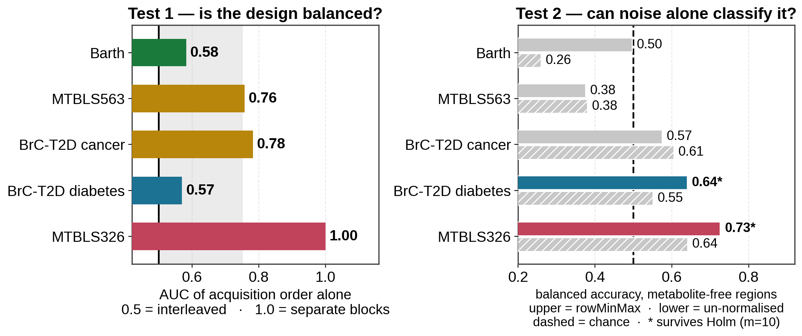
We audited all five targets for batch confounds
The check we had been deferring since February — one target fails outright
MTBLS326
Barth
BrC-T2D diabetes
563 / BrC cancer
UNUSABLE
clean
ambiguous
order caveat
cases = samples 1–27, controls = 101–130
interleaved; noise at exactly chance (0.497)
0.640 from noise — but only after rowMinMax
AUC 0.76–0.78; no surviving noise signal
23
Notes:
This closes the loop on the caveat from slide 5 — I flagged it as unverified, and it turned out badly. WHY THE PERMUTATION NULL MISSED IT. MTBLS326 clears a label-permutation null at p <= 0.02, and that is worthless here: permuting the labels destroys the batch structure and the biology at the same time. A fully confounded dataset passes that test. This is the single most important methodological point on the slide. TEST 1, the design. The trailing number in each sample folder is the original experiment number. Cancer = 1 to 27, control = 101 to 130. Disjoint and contiguous, zero overlap. So instrument drift, shim quality, tube lot, storage time and reagent batch are ALL perfectly collinear with the label. Biology and batch are not separable in this dataset by any method at any sample size. That is a fact about the experiment, not about our analysis. TEST 2, the measurement. Serum CPMG has no metabolite resonances above 9.5 ppm or below -0.5 ppm. Using ONLY those regions — 17% of the spectrum, pure noise and baseline — a LogReg classifies the label at 0.726 with p < 0.005 against a 200-permutation null. Biology cannot be visible there. THE CONTROL IS THE CLEVER BIT. The same noise features CANNOT predict early-versus-late acquisition within the cancer block (0.555, p = 0.28). So this is not smooth instrument drift — the noise separates the two BLOCKS specifically. Signature of two distinct acquisition sessions. One uncomfortable detail worth admitting: rowMinMax normalisation makes it WORSE. 0.726 normalised vs 0.641 un-normalised. Per-row min-max turns an absolute intensity offset into a noise-to-peak ratio, i.e. an SNR feature, which is exactly a technical quantity. Our own preprocessing made the confound more learnable. WHAT I DID NOT HAVE: the Bruker acqus DATE stamps, which would be definitive. The raw MTBLS326 folders are not on this machine. But test 1's verdict cannot change — the sample numbering is already disjoint. THE OTHER FOUR COHORTS, audited the same way: - Barth is CLEAN. Order AUC 0.58, and metabolite-free regions score exactly chance (0.497). The one target that passes both tests outright. Its metadata does show an anticoagulant imbalance (Fisher p = 0.14, OR 6) — underpowered rather than clean, worth noting since EDTA gives large NMR peaks. - MTBLS563 and BrC-T2D cancer: order caveat only. Order AUC 0.76 and 0.78, so classes are partly blocked in acquisition, but no signal-free effect survives Holm correction. BrC-T2D cancer's 0.605 has raw p = 0.045 and Holm p = 0.36 — one marginal hit out of ten tests is what chance looks like. Say 'not balanced', not 'confounded'. - BrC-T2D diabetes: ambiguous, and be honest about it. Design is fine, but noise regions predict diabetes at 0.640 — ONLY after rowMinMax (un-normalised: 0.551, p = 0.22). That pattern says SNR effect, not technical offset: per-row min-max makes noise bins encode noise-to-peak ratio, which tracks overall metabolite concentration, which can be real biology. Needs a normalisation-invariant re-check before calling it either way. MULTIPLE COMPARISONS. Ten signal-free tests (5 targets x 2 arrays), so one raw p < 0.05 is expected by chance. Everything above is Holm-corrected over that family. Do not let anyone catch you quoting the uncorrected number. A DEFECT IN OUR OWN PIPELINE. rowMinMax amplified a spurious signal on two of five targets (MTBLS326 0.641 to 0.726; diabetes 0.551 to 0.640). Per-row min-max converts absolute intensity into SNR, exactly the feature that leaks batch. Worth reconsidering. BOTTOM LINE, combining with the previous slide: Barth's win was a seed, MTBLS326 is confounded. On the three targets that remain admissible — MTBLS563 and the two BrC-T2D labels — the record is 0 wins, 3 losses, and those are the biggest cohorts with real error bars. This does NOT weaken the few-shot result; it removes a target that was making SSL look better than it is.

Slide 24
A fourth, more mundane failure — and the guardrails
Three wrong numbers in this project came from the same cause
Scoring unfinished checkpoints
Provenance stamp
Training writes a "best so far" checkpoint continuously. Evaluate one mid-run and you get a real-looking number for a model that was still training. It happened three times — including once when I claimed --seed was broken on GPU, because I compared a mid-training checkpoint against a finished one.
Checkpoints are written with finished: false and only flipped to true after the training loop exits cleanly.
Evaluator refuses
The probe evaluator hard-errors on an unfinished checkpoint and warns on legacy ones with no flag.
Also worth knowing
--seed DOES make training reproducible — two same-seed runs are byte-identical, max|ΔW| = 0. That earlier claim is retracted. Reproducibility was never the problem; run-to-run variance across DIFFERENT seeds was.
Loud failure on missing data
Analysis scripts now refuse a results directory missing an expected arm, instead of silently dropping it.
Every retraction in this project traces to one of two habits: comparing separately-trained networks, or trusting a checkpoint we had not verified was finished.
24
Notes:
Mention that all of this is now in a written lab record with the retractions kept in place rather than edited out, so the reasoning is auditable.

Slide 25
Part 3
Testing the premise directly
If pretraining helps anywhere, it must help when labels are scarce
The argument for doing this
Everything so far used the FULL dataset. At n=37–113 that is already close to the ceiling of what is learnable — the worst possible regime to look for a transfer advantage. Transfer is supposed to pay off with few labels. So: sweep the label budget from 2 per class upwards, and find where the SSL curve is above the classical one.
Notes:
This experiment was on the queue since July as #6. It is the one that actually tests what we set out to build.

Slide 26
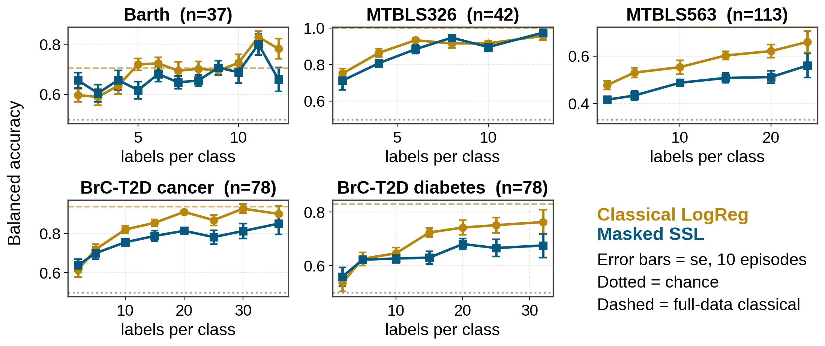
Experiment #6 — few-shot benchmark, all 5 targets
Every model sees the IDENTICAL support/query draws — 10 episodes per label budget
Masked SSL sits at or below classical in every panel, at every label budget. The premise was that SSL wins on the LEFT of these plots — there is no regime where the pretrained backbone wins.
26
Notes:
Note one methodological fix that mattered: the few-shot classifiers still had the OLD hardcoded mean-pooling. Left alone, that would have handicapped SSL by 0.03-0.13 in exactly the experiment meant to favour it. We ported the pooling fix in first.

Slide 27
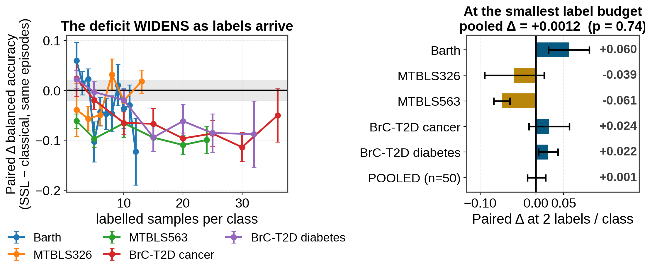
The same data, analysed as a PAIRED comparison
Shared episodes mean the episode-draw variance cancels — far more power than comparing two error bars
Pooled across all five targets at 2 labels/class: +0.0012 ± 0.0162, p = 0.74. Dead even. What looked like a low-shot edge is just both methods sitting near chance.
And the deficit WIDENS with more labels (negative trend on 4 of 5) — the opposite of what transfer learning predicts.
27
Notes:
Explain pairing plainly: for a fixed episode both models saw the same 4 training samples and the same test samples, so their difference removes the luck of the draw. Single-episode std is 0.07-0.15; the paired se is ~0.016.

Slide 28
Before believing a negative result, we tried to break it
The obvious objection, and what happened when we tested it
Target | labels /class | mean-pool (128 feat) | regional G=4 (512 feat) | regional G=16 (2048 feat)
Barth | 2 | 0.609 | 0.627 | 0.656
Barth | 5 | 0.564 | 0.603 | 0.617
BrC cancer | 2 | 0.543 | 0.590 | 0.639
BrC cancer | 5 | 0.597 | 0.644 | 0.700
MTBLS563 | 2 | 0.338 | 0.390 | 0.416
MTBLS563 | 5 | 0.338 | 0.387 | 0.433
The objection
Our pooling default (regional, G=16) gives 2,048 features. At 2 labels per class that is 2,048 features for 4 samples. Maybe we handicapped SSL precisely where we claim it has no advantage — a lower-dimensional pooling might win.
The check resolves in favour of the conclusion — G=16 wins 6 of 6
Lower-dimensional poolings are WORSE at every low-support point tested. Even letting SSL pick its best pooling post-hoc per point — which inflates SSL — the pooled result is −0.033 ± 0.014, p = 0.006. Still negative.
Also validated: the top of every few-shot curve lands just below that target's known full-data value (Barth 0.782 vs 0.705, cancer 0.900 vs 0.937, MTBLS326 0.957 vs 1.000). The harness measures what it should.
28
Notes:
I want to be seen trying to break my own negative result. If someone in the room has another way it could be an artifact, that is exactly the feedback I want.

Slide 29
Where the project stands today
Everything that survived, and everything that did not
STILL STANDING
RETRACTED or WITHIN NOISE
paired comparisons, plus the one 2 sd result
everything that rested on a single training run
Masked pretraining > random init
+0.117
v3 corpus better than v4
+0.069
n=5 → −0.014 (0.6 se)
2.6 sd, 5/5 targets
"Backbone scaling exhausted"
±0.02
within noise
LogReg probe > trained DNN head
+0.120
Patch size 128 / 256 hurt
−0.04
within noise
paired, 5/5
Block masking / peak weighting
−0.03 / +0.01
within noise
Position-preserving pooling
+0.03…+0.13
"SSL wins in few-shot"
+0.001
paired, 5/5
p = 0.74 — refuted
"SSL beats classical on Barth"
+0.101
n=5 → +0.021 (0.9 se)
Same pooling on jigsaw / joint
+0.079 / +0.049
"Reconstruction proves it learned"
r = 0.92
paired
copy-a-neighbour: 0.90
MTBLS326's perfect 1.000
1.000
confounded by batch
The pattern: every surviving result is PAIRED — one fixed checkpoint, one thing varied. Every retracted result compared two separately-trained networks.
29
Notes:
If there is one slide to remember, it is this one. The methodological pattern is cleaner than any individual result.

Slide 30
What I think this means
Reading the whole picture honestly
The findings are coherent, not contradictory
Masked pretraining DOES learn something real (+0.117 over random init). But it learns less discriminative signal than 1,024-bin integrated areas already carry — and reconstruction quality anti-correlates with transfer. Meanwhile every axis we pushed on the backbone (patch size, capacity, objective, corpus version) came back flat.
The most likely cause we have NOT tested
The contribution, reframed
This is now a rigorous negative result on 1D NMR SSL: five targets, paired tests, a measured noise floor, replicated. The methodology — the 0.045 floor, the paired protocol, the guardrails — is arguably a stronger contribution than a backbone that didn't beat logistic regression.
The corpus is 9,670 spectra. That is very small for a foundation model — orders of magnitude below where masked pretraining usually starts paying off. Experiment #13 only probed corpus size DOWNWARD, which cannot detect an under-training regime.
What I would NOT recommend
More architecture variants. We have tried four patch sizes, two capacities, three objectives and two corpora; with the noise floor now known, none of those experiments could have detected an effect smaller than 0.09 anyway. Any further single-run backbone tweak is not worth the GPU time.
30
Notes:
Be direct here. I would rather bring the group an honest negative with good methodology than keep tuning until something crosses a threshold by chance.

Slide 31
Proposed next steps
Re-ranked by what §18–§20 actually leave open
Widen the pretraining corpus — it does not cover our cohorts
1
Not "more data" — DIFFERENT data. Within the corpus a spectrum's nearest neighbour sits at r = 0.99; for our evaluation cohorts the nearest corpus match is only r = 0.37–0.78. We pretrain on a narrow, 55%-redundant distribution and then test far outside it. Fold the eval-like cohorts (incl. the unused TBI Tirupati set) into pretraining, dedup near-duplicates, re-measure. Also confirms no leakage today — there is none.
Change the objective — reconstruction is nearly free
2
Slide 9: copy-a-neighbour already scores 0.90 on hidden bins. A loss dominated by the 5 components holding 86% of variance cannot be forced to encode disease. Try variance-normalised or peak-weighted reconstruction, or a contrastive objective, and judge it by whether the pretext task is actually HARD (baseline-relative), not by r.
Reconsider rowMinMax, and settle the diabetes ambiguity
3
The audit (slide 23) found our own normalisation amplifies spurious signal on 2 of 5 targets: per-row min–max turns absolute intensity into an SNR feature, exactly what leaks batch. Re-run the pipeline under a normalisation-invariant scheme (PQN or unit-area) and re-check BrC-T2D diabetes, whose 0.640-from-noise appears only after rowMinMax.
Corpus scaling curve — only after near-duplicate dedup
4
Demoted. 55% of rows have a neighbour at r > 0.99, so subsampling by row count does not subsample information: the curve would flatten for the wrong reason. Needs ≥5 seeds per point (~23 GPU-h each).
Dropped from this list: supervised cross-cohort transfer (train the probe on one cohort, test on another). All five targets are different diseases with no shared label space — it is not executable on the data we have, at any sample size.
31
Notes:
This slide was reordered after the last group meeting's version — worth saying so. WHAT CHANGED AND WHY. The old priority 1 was 'cross-cohort transfer: train the probe on one cohort, test on another'. That was wrong on two counts and I am glad it was caught. (a) It conflated two different things. The 9,670-spectra pretraining is ALREADY unsupervised and already spans many cohorts — that part is done, and it is the sense in which the model is 'foundational'. (b) Read literally as supervised label transfer, it is not executable: Barth syndrome, MTBLS326 IP3R expression, MTBLS563 3-class diagnosis, cancer status and diabetes status are five different tasks with no shared label space. And BrC-T2D cancer and diabetes are the same spectra, so there are only 4 independent cohorts, not 5. WHAT REPLACED IT (experiment #20). Measuring the pretrain/eval distribution gap directly. Two results: - No leakage. Zero evaluation spectra have a near-duplicate anywhere in the pretraining corpus, so 'held-out' is accurate. Good news, and it needed checking after §19 found the corpus contains near-duplicates of itself. - But coverage is poor. Within-corpus median best match is 0.994; for Barth it is 0.78, MTBLS563 0.77, MTBLS326 0.68, BrC-T2D 0.37. The corpus is narrow, not merely small. That is why 'more of the same spectra' (the old priority 2) is now priority 4. Caveat if pressed: TBI Tirupati's number is even lower but its array never went through the v4 rowMinMax pipeline, so that one mixes a real gap with a preprocessing difference. Priority 1 and 2 are the two I want feedback on. They are also the two that would change the answer rather than further document the negative result.

Slide 32
Discussion
Three things I would like the group's view on
Is cross-cohort transfer the right last test?
1
It is the one setting where a learned representation should beat absolute binned intensities. If it fails there too, I would call the backbone approach closed for this data scale.
How much more pretraining data can we realistically get?
2
If we cannot get to ~100k spectra, the scaling experiment tells us the ceiling but not how to beat it. Are there cohorts or repositories we are not using?
Is a rigorous negative result publishable from this group?
3
Five targets, paired protocol, measured noise floor, three self-retractions. I think it is useful to the field — but I would like your read before I write it that way.
Thank you — and thanks to Gayatree for the Tirupati TBI samples that started this off.
Notes:
Leave plenty of time here. The three questions are genuine — especially #2, since the scaling answer depends on data we may not have.

