Slide 1
Since 10 August: the evidence base got smaller
Both targets where SSL looked competitive turned out not to count
Barth — “SSL beats classical, +0.101”
RETRACTED
0.806 was the highest of 5 pretraining seeds, +1.5 sd above its own group mean. The other four score 0.598–0.699, all below classical’s 0.705. Across 20 readings SSL wins 5.
MTBLS326 — perfect 1.000 on n=42
UNUSABLE
Confounded by design: cases are samples 1–27, controls 101–130 — separate acquisition blocks. Spectral regions containing NO metabolites classify the label at 0.726 (p<0.005).
Barth, MTBLS563, BrC-T2D — data quality
AUDITED
All five targets audited. Barth is clean (order AUC 0.58, noise at chance). MTBLS563 and BrC-T2D cancer carry order caveats only. BrC-T2D diabetes is ambiguous.
Honest full-data record on the targets that remain admissible: 0 SSL wins, 3 losses — and those are the biggest cohorts, the ones with real error bars.
1
Notes:
Lead with this. Two results we were relying on are gone, and both went for the same reason we already knew about: single-run claims and unaudited data. Barth: experiment #18. The 0.806 came from the original unseeded run, exactly the position #15 showed to be selection-biased upward. MTBLS326: experiment #11, the batch audit we had deferred since February. The permutation null could never have caught this — permuting labels destroys the batch structure and the biology together, so a confounded dataset passes at p<=0.02. This does NOT weaken the few-shot result. It removes two targets that were making SSL look better than it is.

Slide 2
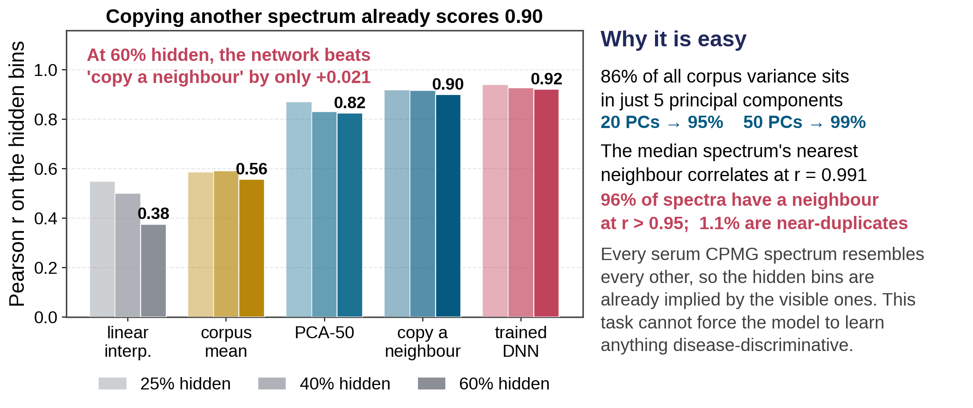
We now know WHY, not just that it failed
Masked reconstruction is nearly free on this corpus — so the objective cannot bite
No learning needed. Finding the most similar other spectrum and copying its hidden bins scores 0.900 at 60% masking. The trained network gets 0.921.
The corpus is narrow, not small. 86% of variance in 5 components; the median spectrum’s nearest neighbour correlates at 0.991. And it does not cover our evaluation cohorts (r = 0.37–0.78).
2
Notes:
This is the most useful thing we have produced since August, because it converts a negative result into a mechanism. Every reconstruction claim in the project had been reported WITHOUT a baseline — the same error as quoting classifier accuracy with no majority-class rate. With masks matched, copy-a-neighbour reaches 0.900 against the network's 0.921. Why: the corpus is close to low-rank and 55% of rows have a neighbour above r=0.99. The population prior already answers the pretext task, so masked modelling cannot be forced to learn anything disease-discriminative. Separately (#20) we checked the train/eval boundary: NO leakage — zero evaluation spectra have a near-duplicate in the corpus — but coverage is poor, r = 0.37-0.78 against 0.99 within-corpus. One prediction of ours failed and it is worth admitting: we expected r to be inflated by predicting empty baseline. It is not — peak bins 0.879 vs baseline bins 0.855.

Slide 3
Your outline: “is data limiting?”
Answered — but the answer splits in two, and only one half was ever measured
Marginal distributions: NOT limiting
1
Re-ran the 60-peak KS saturation on the v4 corpus under unit-area normalisation. Median N* = 363 spectra; 9,670 is roughly 10× more than needed. For any single peak’s intensity distribution, we have ample data.
The JOINT distribution: this is the constraint
2
Across-spectra correlation never decays — |r| is 0.95 at 32 points, 0.73 at 1024, and still 0.45 at 6 ppm separation. Removing the top 5 principal components barely dents it, so it is real composition covariance, not one global scale factor.
A trap worth recording
3
Re-picking the peak panel per normaliser changes which peaks are analysed (only 9 of 60 shared), and would have reversed the conclusion. The panel must be held fixed across conditions — now enforced by a --peaks-from flag.
3
Notes:
This maps directly onto the whiteboard tree. The marginal half of the question was already partly answered by the peak-saturation work; I re-ran it on v4 under unit-area (min-max is the wrong unit for an intensity distribution, because its unit is 'this spectrum's tallest peak', which turns out to be 21 different chemical positions across 400 spectra). The conclusion replicates: ~360 spectra suffice. The joint half had never been measured and it is where the difficulty lies. Note the contrast with the WITHIN-spectrum autocorrelation, which dies by ~1000 points — that is lineshape width. Conflating the two would have suggested a 1000-point window is enough. Consequence: no overlap setting makes window-stitching lossless. That is a hard constraint on route (b), and it is measured rather than assumed.

Slide 4
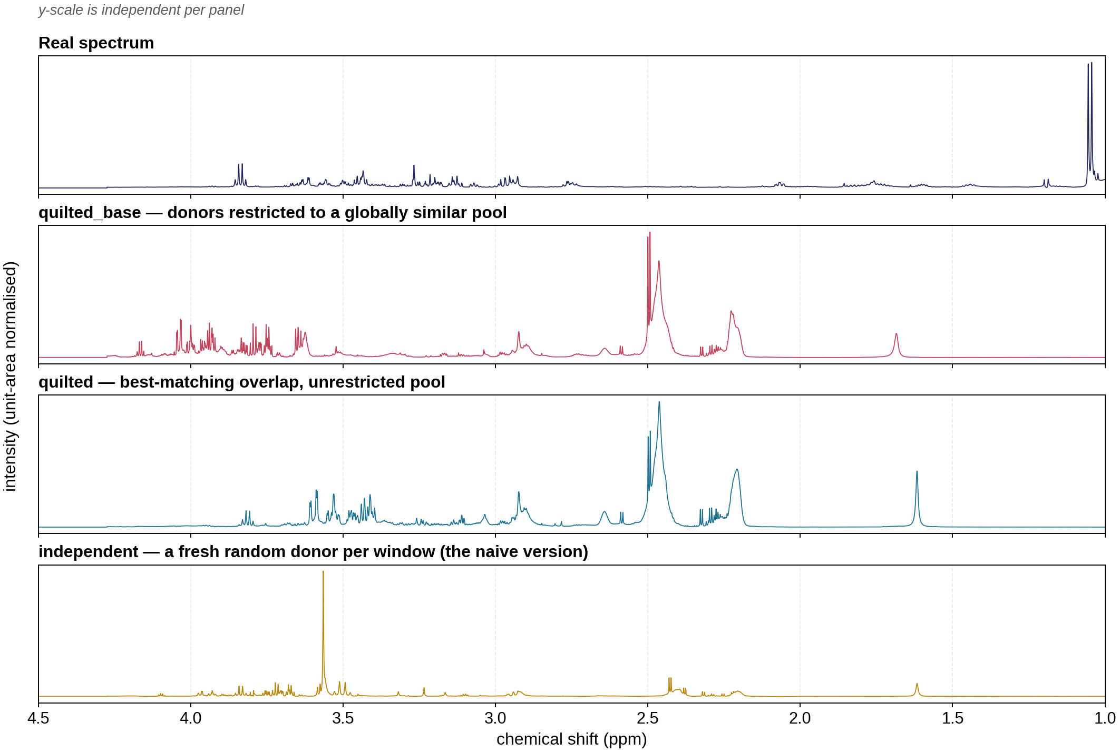
Synthetic data, route (b): overlapping windows
Built and validated. The trade-off it exposes is the result.
Three variants, 100 spectra each
independent
destroys correlation at every scale — 0.198 vs 0.717 even at 0.09 ppm
quilted
local structure recovered; long-range collapses to 0.051
quilted_base
long-range preserved (0.401 vs 0.453) — but nn r = 0.982, i.e. copying
Novelty and long-range fidelity pull against each other. If correlation never decays, anything novel at long range is also wrong at long range.
4
Notes:
Worth pausing on the figure: all three variants LOOK like plausible NMR spectra, including the one whose statistics are destroyed, because a 50% Hann crossfade hides every join. Visual inspection cannot validate a generator here. That is why we scored them against the measured correlation profile instead. The trade-off follows directly from the joint-distribution measurement on the previous slide, so it is not a tuning failure — it is structural to window sampling. Practical read: route (b) is usable as LOCAL augmentation on top of a coherent base spectrum, not as a stand-alone generator. That is what pushed us to build route (c).

Slide 5
Synthetic data, route (c): the LC generator
GISSMO basis built and validated at 600 MHz — but the fit gate does not pass yet
Library
The gate: does the model explain real spectra?
GISSMO is already installed on NMRbox — 661 compounds with spin-system parameters AND spectra pre-simulated at 19 field strengths. No download, no spin simulation needed.
46%
Basis
of a real serum spectrum’s variance is explained
(target: 90%)
43-metabolite serum panel, each pinned to an explicit compound ID with formula re-verification. 19 of 21 peak positions match literature within 0.03 ppm. Condition number 6.9.
Adding the lipid basis fixed the solver (constrained fit 0.11 → 0.45) but did NOT raise the ceiling (0.47 → 0.51). By elimination, the remaining bottleneck is peak ALIGNMENT.
Lipids
GISSMO holds small molecules only, so the lipoprotein envelope was extracted from our own corpus. It accounts for 37.5% of the signal.
Root cause, and it is fixable: our corpus has no 0 ppm reference resonance and was aligned to its own rightmost peak, so its ppm axis carries an arbitrary absolute offset of 0.15–0.3 ppm. That is invisible within the corpus but blocks any comparison against an external library.
5
Notes:
Be clear that Stage 0 is a genuine partial result, not a failure. What is solid: the library is local, the basis is built, and it is chemically validated — 19 of 21 metabolites match literature shifts within 0.03 ppm, and the two apparent misses were my reference values quoting a different peak of the same multiplet. What is not: the forward model explains ~46-51% of a real spectrum against a 90% bar. The diagnosis is the useful part. Adding the empirical lipid basis raised the CONSTRAINED fit from 0.11 to 0.45 and made the solver well behaved, but the unconstrained CEILING only moved 0.47 to 0.51. So the missing variance is not missing components — it is that misplaced peaks cannot be fitted by adding basis vectors. The ppm-offset finding is of independent value. Every within-corpus result we have remains internally consistent; it only bites when comparing to an external reference.

Slide 6
What I need, and what is next
One input from the instrument archive unblocks four separate open questions
Ask 1 — the Bruker parameter export
The raw archive is tens of GB, but we only need the parameter files: an acqus is 9 kB against ~1 MB for a single FID. A standard-library script extracts them on the machine holding the disk and produces a few-MB CSV. It unblocks:
SF / SR
true chemical-shift referencing — the fix for the ceiling above
SFO1 / BF1
field strength per experiment — is the corpus mixed-field?
DATE
real acquisition timestamps — upgrades the batch audit
NS / RG
scans and gain — tests the normalisation-leak question directly
Lipid basis — done, as you suggested
2
Extracted empirically from the corpus rather than from a library. Already folded into the fit.
Decision: how far to push route (c)?
3
Per-peak shift fitting is the clear next step and does not need the archive — it can start now, in parallel.
Proposed: start per-peak shift fitting now; run the parameter export in parallel.
6
Notes:
Close on the ask, not on the status. The single highest-value thing is the parameter export, because one small CSV resolves four questions that are currently each blocked separately. Emphasise that it does NOT mean moving the archive — the script reads a few kB per experiment and never opens a FID. If asked what happens if the corpus turns out to be mixed-field: then one 600 MHz basis is wrong for part of it, and that alone could account for a chunk of the missing variance in the fit gate. Either way we learn something that matters. Per-peak shift fitting can begin immediately without the archive — fitting each spectrum's offset as a free parameter would tell us how much of the ~50% ceiling is alignment, before the CSV arrives.

