Slide 1
Every whiteboard question now has an answer
Four questions, each tested with real experiments rather than argued
Question | What we found | Answer
1. Can a pretrained model beat standard ML on our patient cohorts? | Standard ML wins in all 24 comparisons, even after fine-tuning | No
2. Is the amount of data holding us back? | More spectra stop helping at ~2,000. More studies keep helping | Not the amount - the variety
3. Can synthetic spectra fill the gap? | Neither method produces spectra realistic enough to train on | Not yet
4. Would a bigger model help? | Slightly, then it levels off - still behind standard ML | Not enough
Bottom line: with the public data available today, standard ML is the better tool for these small clinical cohorts. What would change that is data from many more independent studies - not more spectra from the studies we already have.
1
Notes:
Accuracy throughout is balanced accuracy, so an uneven split between patient groups does not flatter the score. 'Standard ML' is the best of eight classical models (regularised logistic regression, SVMs, random forest, boosting, PLS-DA, LDA) on binned spectra.

Slide 2
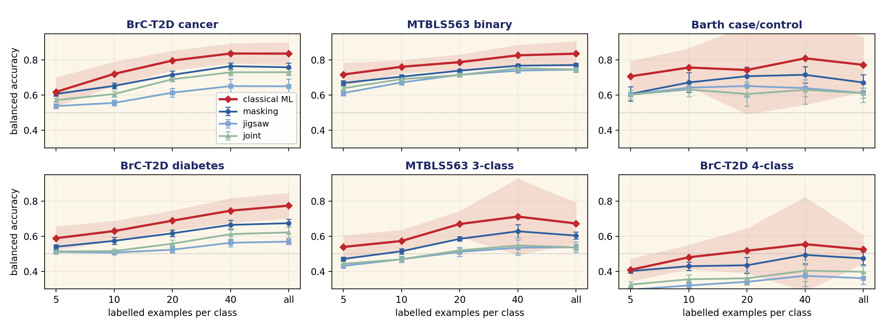
1. Standard ML beats the pretrained model on every cohort
Six patient comparisons, from 5 labelled patients per group up to all of them
Does retraining the model help?
How much we retrain | vs frozen
Nothing (frozen) | -
Last layer only | -0.009
Whole model | -0.010
Retraining on so few patients makes it slightly worse - it memorises rather than learns.
Red = standard ML. Blues = our pretrained model, three ways of pretraining it. Error bars: spread across 5 runs.
Standard ML wins 24 of 24. Average margin 0.055 in accuracy, at every number of labelled patients - including the smallest, where pretraining was supposed to help most.
But pretraining is not useless. The same model started from scratch does 0.057 worse. It learns something real from the spectra - just less than standard ML extracts directly.
2

Slide 3
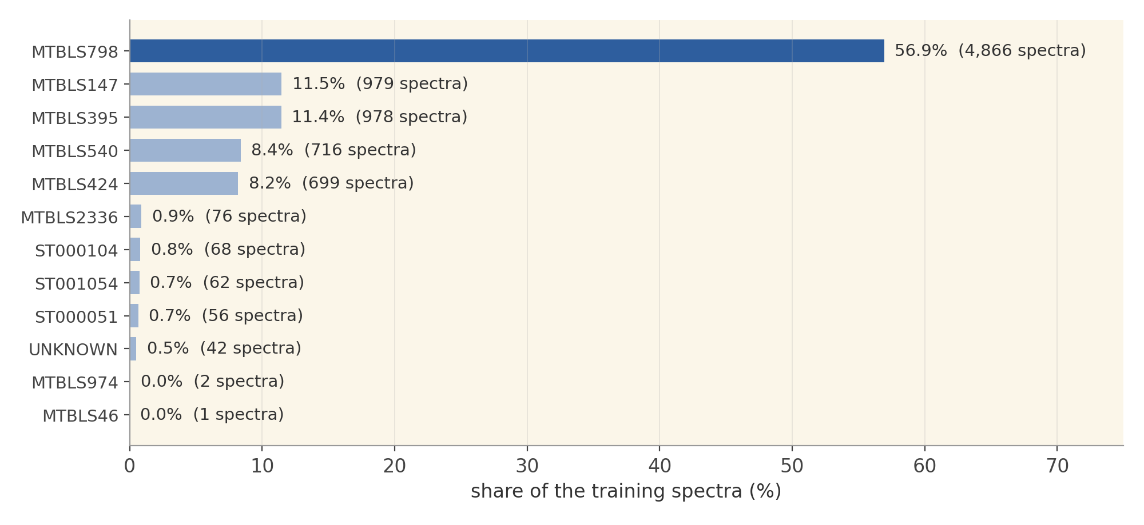
2. Our '12 studies' behave like about 4
One study supplies more than half of all the spectra
Why this matters. A model learns the variety it sees. Spectra from the same study are very alike, so 5,000 spectra from one study teach it much less than 5,000 spread across many.
Effective number of studies. Counts studies by how much they actually contribute. Twelve equal studies score 12. Ours - one giant study plus a long tail of tiny ones - scores 4.1. This is the number that matters on the next slide.
3

Slide 4
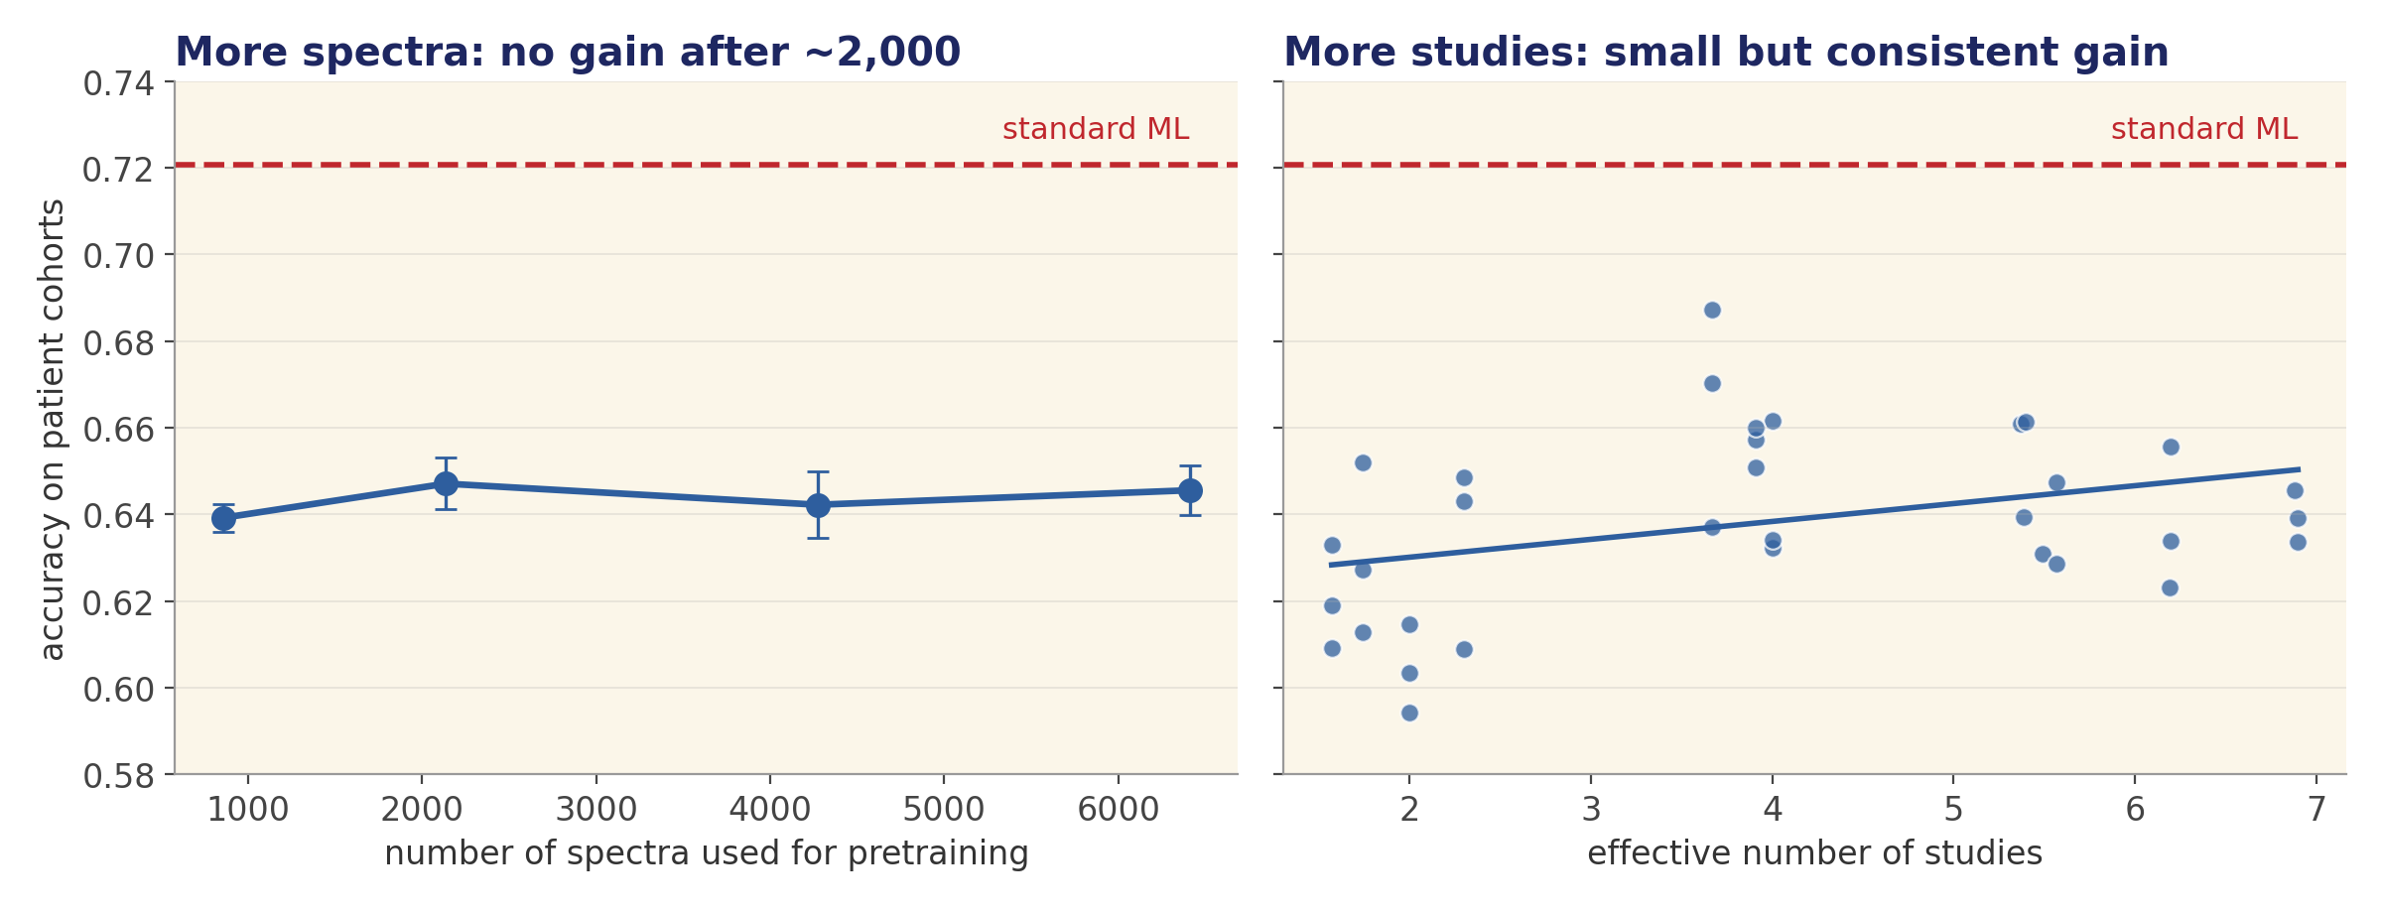
2. More studies help a little. More spectra don't
45 pretraining runs, varying one thing at a time
So the limit is variety, not volume. 7x more spectra from the same studies gave no gain. Our corpus can't go beyond about 7 effective studies, and even there the model is still below standard ML (dashed line).
4

Slide 5
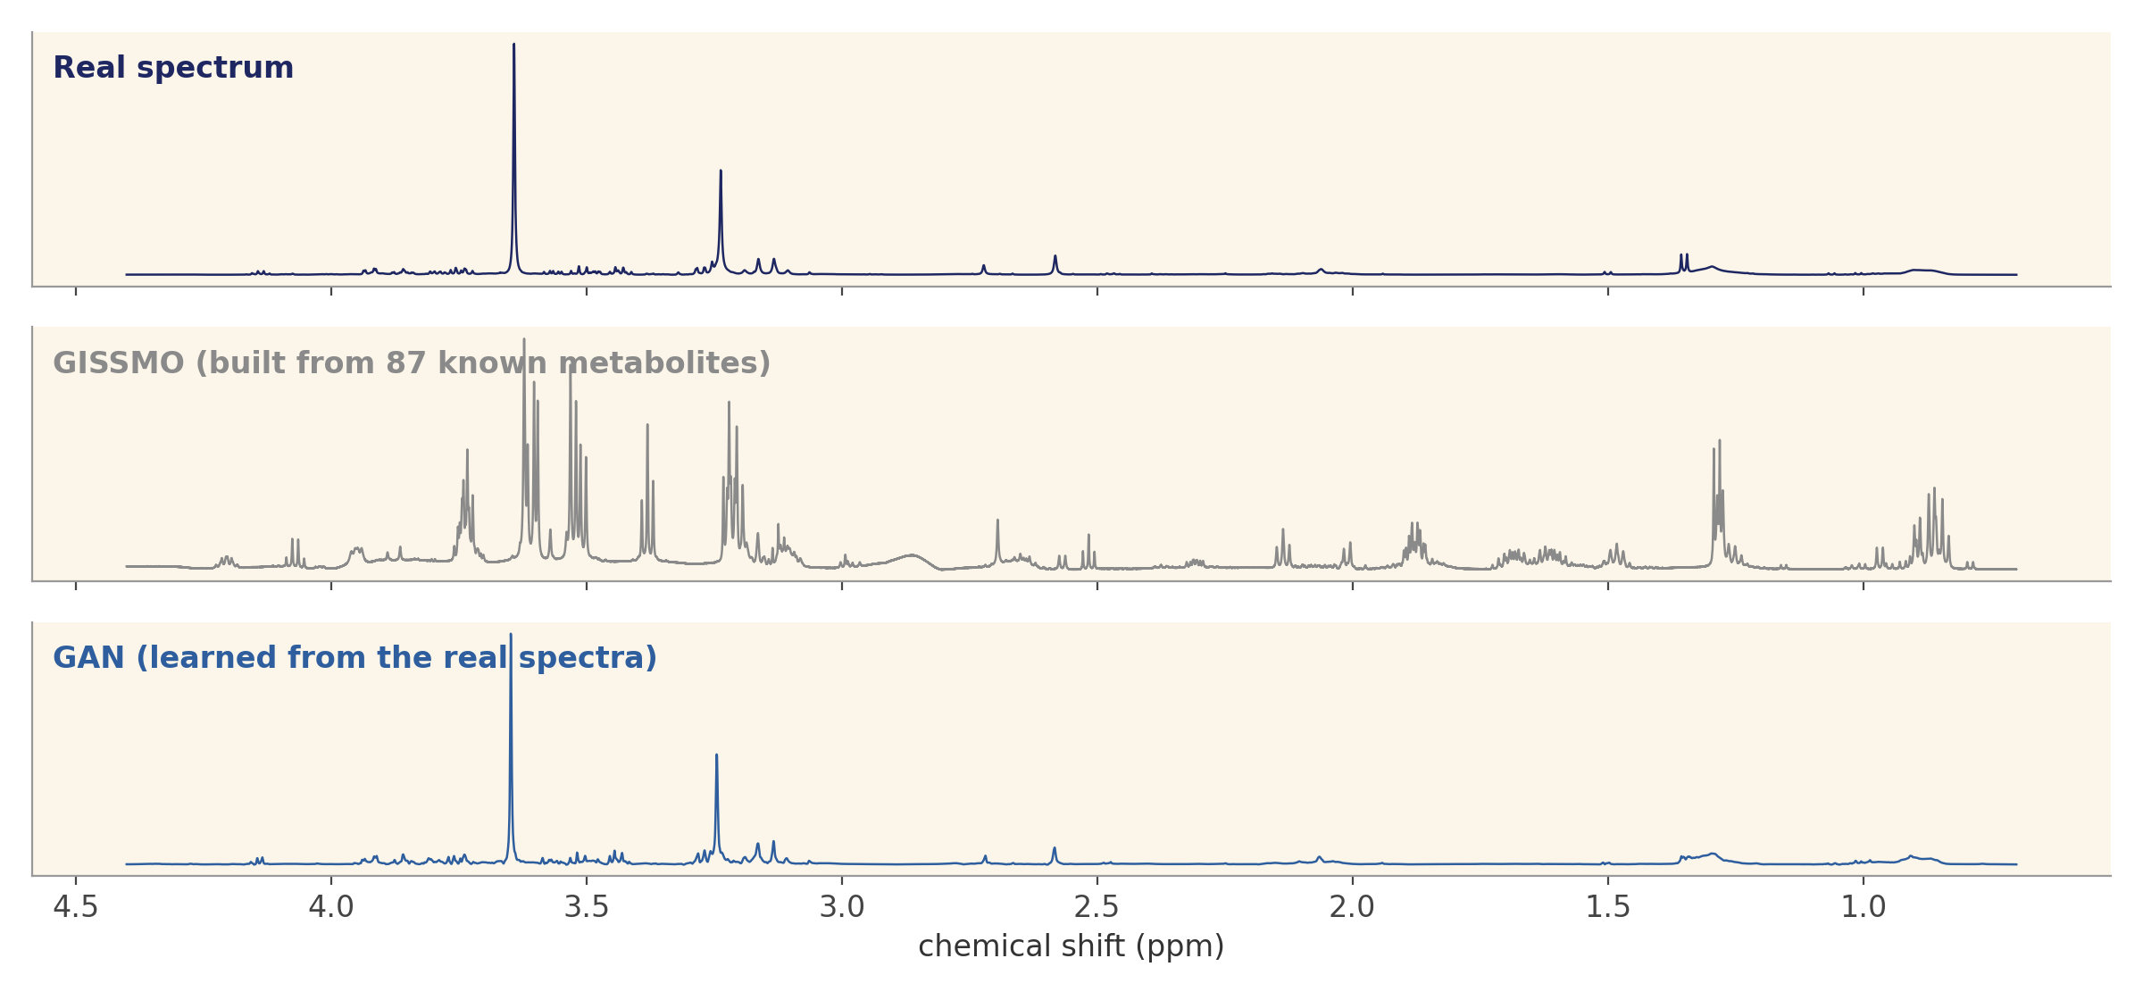
3. Synthetic spectra: not realistic enough to use yet
We tested both routes the whiteboard names
 | GISSMO | GAN
Can a simple test tell it's fake? | Always (1.00) | Usually (0.95)
Distance from real (lower = better) | 4.3 | 1.2
Peaks in the right places? | No | Yes
0.50 on the first row would mean indistinguishable from real.
GISSMO builds spectra from 87 known metabolites. But those explain only a quarter of a real serum spectrum, so the rest is missing.
The GAN learns from real spectra and looks far more realistic - but mostly copies the studies it was trained on, so it adds volume, not variety.
5

Slide 6
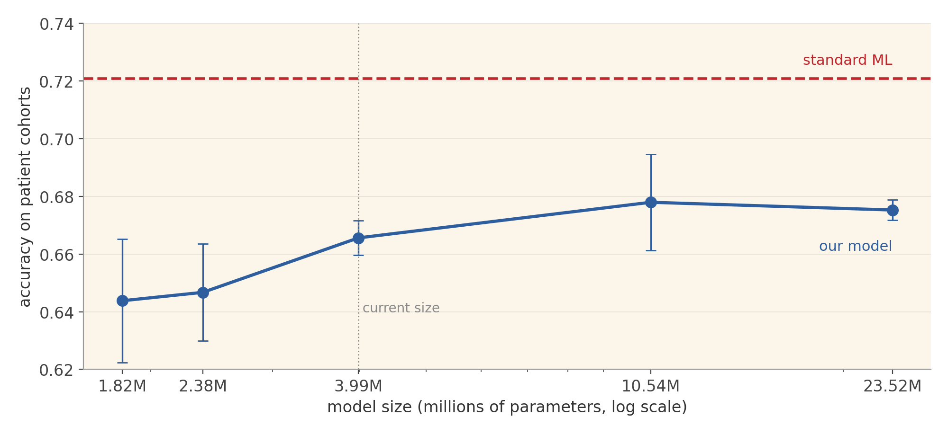
4. A bigger model helps a little, then levels off
Five model sizes from 1.8 to 23.5 million parameters, 3 runs each
Model size | Accuracy
1.8 M | 0.644
4.0 M (current) | 0.666
10.5 M | 0.678
23.5 M | 0.675
Standard ML | 0.721
Gain of about 0.01 per doubling, flat after 10 M. Closing the gap would take a model hundreds of times larger, and we don't have the data to train one. We reach the whiteboard's final box: a ceiling at this data scale.
6

Slide 7
Corrections to last week, and what we caught this week
Each of these produced believable numbers rather than an obvious error
Last week, slide 6: 'diversity beats quantity'
Right direction, wrong reasoning. We counted studies by name (12) rather than by contribution (about 4). The corrected analysis is slide 4 today.
Last week: study-count results were missing
A file-naming mismatch silently dropped them from the analysis. Now included.
This week: our prediction on model size was wrong
We expected smaller models to do better. They do worse. The conclusion still holds - but it now rests on the experiment, not a guess.
This week: the first GISSMO spectra were pure noise
A software function silently mishandled our ppm axis direction. Fixed and re-run; the verdict didn't change, the numbers did.
7

Slide 8
Where this leaves us, and next steps
We have a complete, defensible result
The result. Standard ML is the better tool for small clinical NMR cohorts with today's public data. The limit is the number of independent studies. That is a clear, useful message for the field about what data to collect.
What would change it. Data from many more independent studies. A metabolite library covering far more of the serum spectrum. Cohorts in the hundreds, where retraining has enough patients to learn from.
Next steps
Step | Status
Improved GAN - more stable, keeps its best version, plus a version that mixes studies | Running, results in ~12 h
Paper draft from the consolidated results | Structure and tables ready
Your feedback: is this the framing you want for the paper? | Needed
8

