Slide 1

Sanskrit WordNet
Malhar Kulkarni,
Department of Humanities & Social Sciences, IIT, Powai,
Mumbai-400076.

Slide 2
WordNet
Wordnet - A lexical database
Inspired by the English WordNet
Built conceptually
Synset (synonym set) is the basic building block.

Slide 3
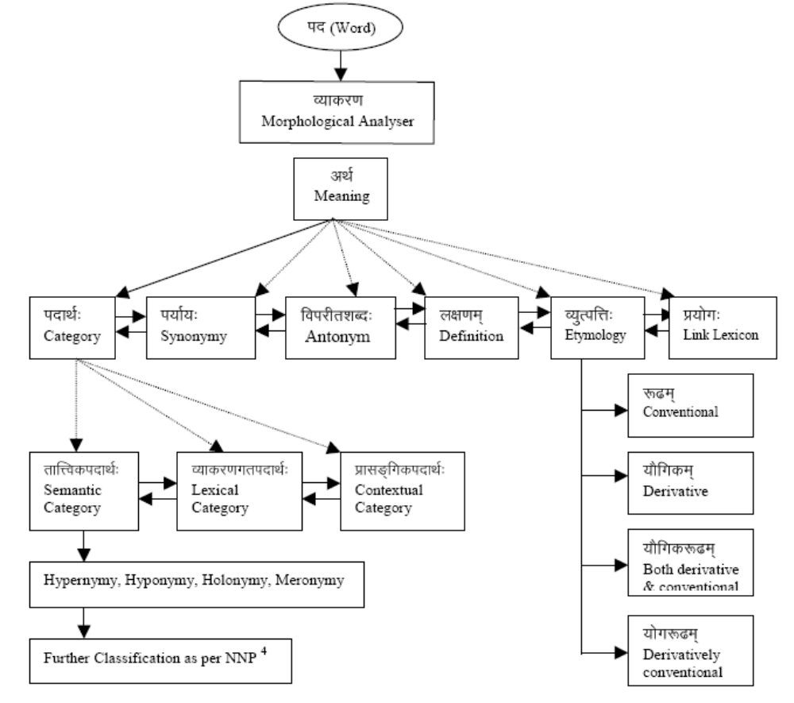
Proposed model of Sanskrit Word-net in Concept capability of Sanskrit word-net: for convergence of Knowledge-
Base by S. Mohanty. K.P. Das Adhikary, P.K. Santi, G.P. Rout (Convergence 2003)

Slide 4
Entry in Hindi Wordnet
Synset
{gae xenu g&òI xenu vza veht! b:ky[I}
{go dhenu gåñöé dhenu vaçä vehat bañkayaëé}, Cow
Gloss
  Text definition
saõa-la¼ƒl-kk…d-œour-iv;ai[nae ctu:padae pzu>,
(säsnäläìgülakakudkhuraviñäëino catuñpädo paçuù)
(a four-legged animal having dewlap, hairy tail, hump, hoof, horn )
  Example sentence
????????????????????????????????????

Slide 5
Methodology
Word is chosen from a Hindi dictionary
The particular concept is made explicit with the help of gloss and example(s)
Other synonyms according to that concept are taken
Definition, example and ontology are given
Parts of speech are given
Based on part of speech the relations are given

Slide 6
Principles for Creating a Synset
Minimaility
  The minimal set of words to make the concept unique.
Coverage
  The maximal set of words ordered by frequency in the corpus to include all possible words standing for the sense.
Replaceability
  The example sentence should be such that the most frequent words in the synset can replace one another in the sentence without altering the sense.
  ?????????????????????????????????????????????????????
  गृह, मकान, सदन, शाला, आलय, धाम, निकेतन, वास्तु, पण-मनुष्यों का छाया हुआ वह स्थान,जो दीवारों से घेरकर बनाया जाता है "इस घर में पाँच कमरे हैं "

Slide 7
Major Relations
Hypernymy / Hyponymy
Antonymy
Meronymy / Holonymy
Gradation
Entailment
Troponymy

Slide 8
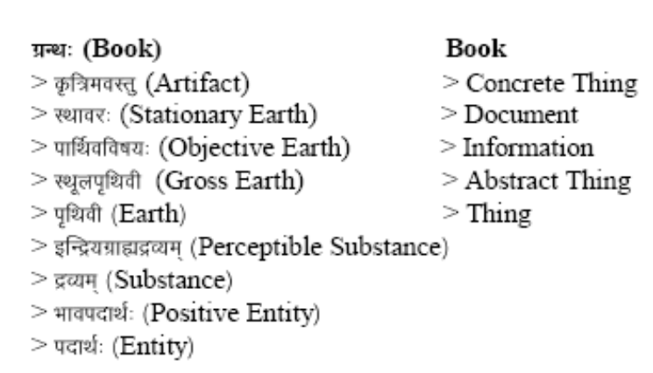
Subgraph of noun
From Concept capability of Sanskrit word-net: for convergence of Knowledge-Base by S. Mohanty. K.P. Das Adhikary, P.K. Santi, G.P. Rout (Convergence 2003)
ctu:pad-pzu
zakÉ] pUjnIy y}Iy
Hypernym
Attribute
saõa-la¼ƒl-kk…d-œour-iv;a[I
ctu:padae pzu>,
saõa
la¼ƒl
Meronym
Gloss
kk…dœ
“go” gae
Ability Verb
raemNway-
ruminate ,
chew
our
iv;a[
Antonym
H y p o n y m
Agae
g&òI xenu vza veht! b:ky[I
Marathi, Hindi Wordnet based subgraph of noun

Slide 9
Applications of Wordnet
Word Sense Disambiguation
Text classification
Information Retrieval: high precision and recall
Document similarity

Slide 10
Problems
Corpus: tagged and segmented corpus is not available
  Various e-texts are available: some without segmentation some with segmentation
  Font and encoding problem: no uniformity but font and encoding conversion utilities are available [John Smith conversion programs and Diacrunch on line utility ]

Slide 11
Wordnet does not include particles, indeclinables etc. Can we avoid them in Sanskrit Wordnet too?

Slide 12
POS tagging
Whether one needs to develop a different tagset which can include upsarga, nipaata, gati etc. or we can use the tagsets used in hindi and marathi word-net?

Slide 13
Resources
Sanskrit Koshas:
Ekärthanämamälä-dvyakñaranämamälä of Saubhari Edited by Ekanath D. Kulkarni, Deccan College Postgraduate and Research Institute, Poona, 1955.
Koçakalpataru (Fascicule I & II) Edited by Madhikar M. Patkar and K. V. Krishnamoorthy Sarma, Deccan College Postgraduate and Research Institute, Poona, 1966.
Dharaëékoça of Dharanidasa Edited by Ekanath D. Kulkarni, Deccan College Postgraduate and Research Institute, Poona, 1968.
Nänärtharatnamälä of Irugapa Dandadhinatha Edited by Bellikoth Ramachandra Sharma, Deccan College Postgraduate and Research Institute, Poona, 1954.
Nänärthamaïjaré of Raghava Edited by K. V. K. V. Krishnamoorthy Sarma, Deccan College Postgraduate and Research Institute, Poona, 1954.
Nämamälikä of Bhoja Edited by Ekanath D. Kulkarni and Vasudeo Damodar Gokhale, Deccan College Postgraduate and Research Institute, Poona, 1955.
Paryäyaçabdaratna of Dhananjayabhatta Edited by Ekanatha D. Kulkarni and M. C. Dixit, Deccan College Postgraduate and Research Institute, Poona, 1971.
Pramanadiya-namamala of Makarandadasa (Part I) Edited by Ekanath D. Kulkarni, Deccan College Postgraduate and Research Institute, Poona, 1968.
Paramänandéyanämamälä of Makarandadasa (Part II) Edited by Ekanath D. Kulkarni, Deccan College Postgraduate and Research Institute, Poona, 1971.
çivakoça of Shivadatta Mishra Edited by R. G. Harshe, Deccan College Postgraduate and Research Institute, Poona, 1952.
çäradéyäkhyanämamälä of Harsakirti Edited by Madhukar M. Patkar, Deccan College Postgraduate and Research Institute, Poona, 1951.
Siddhaçabdärëava of Sahajakirti Edited by M. G. Panase, Deccan College Postgraduate and Research Institute, Poona, 1965.
Bhautikaçästra Paribhäñä Koça, Directorate of Languages, Government of Maharashtra, 1988.
Bhäñävijïäna va Väìmayavidyä paribhäñä koça, Directorate of Languages, Government of Maharashtra, 2001.

Slide 14
Resources
Printed dictionary
    sanskrita-hindii kosha
    Monier Williams Sanskrit-English and English-Sanskrit Dictionary
    Apte, V. S. 1890: The Practical Sanskrit-English Dictionary. Poona.
    Böhtlingk, Otto 1879-1889: Sanskrit-Wörterbuch in kürzerer Fassung. St. Petersburg.
    Böhtlingk, Otto and Rudolph Roth 1855-1875: Sanskrit-Wörterbuch. St. Petersburg.
    Cappeller, Carl 1891: A Sanskrit-English Dictionary. Strassburg.
    Ghatage, A.M. 1976-: An Encyclopaedic Dictionary of Sanskrit on Historic Principles. Poona.
    Ingalls, Daniel H.H. and Daniel H.H. Ingalls 1985: The MahAbhArata: Stylistic study, computer
    analysis and concordance. In: Journal of South Asian Literature 20:17-46.
    Jachertz, Thomas 1983: Beiträge zu einer bibliographischen Übersicht über die textliche Basis unserer europäischen Sanskritwörterbücher, vorzüglich des grossen Petersburger Wörterbuches (PW) und des kleinen Pete rsburger Wörterbuches (pw). Unpublished MA thesis, Cologne University.
    Monier-Williams, Monier 1899: Sanskrit-English Dictionary, Oxford.
    Mylius, Klaus 1992: Wörterbuch Sanskrit-Deutsch. Leipzig.
    Schmidt, Richard 1928: Nachträge zum Sanskrit-Wörterbuch in kürzerer Fassung von Otto Böhtlingk. Leipzig.
    Schreiner, Peter 1995: Arbeitsbericht zum Skannen des Sanskrit-Deutsch-Wörterbuchs von Klaus Mylius. Unpublished MS.
    Schreiner, Peter 1996: Prefatory matter to {Peschmyl} (the electronic version of the Sanskrit-German Dictionary by Klaus Mylius), Zürich.

Slide 15
Electronic Dictionaries and Koshas
    Wordnet 2.1
    Amara-kosha <http://sanskrit.jnu.ac.in/amara/index.jsp>
    Monier Williams Sanskrit-English and English-Sanskrit Dictionary (2006 revision)
    <http://www.sanskrit-lexicon.uni-koeln.de/monier/>
    Monier Williams Sanskrit-English Dictionary by Mohanty (Downloadable)
    Sanskrit Dictionary for Spoken Sanskrit <spokensanskrit.de/ >
    Sanskrit dictionary www.sacred-texts.com/hin/sktdict.txt
    Apte Sanskrit Dictionary Search <www3.aa.tufs.ac.jp/~tjun/sktdic/ >
    Sanskrit dictionary with grammatical tools <sanskrit.inria.fr/ >
    Nämaliìgänuçäsana [=Amarakosa], Kanda 1 Input by Avinash Sathaye, Pramod SV Ganesan
    http://www.sub.uni-goettingen.de/ebene_1/fiindolo/gretil/1_sanskr/6_sastra/2_lex/amark3_u.htm
    Amarakosha (Sanskrit Thesaurus) http://sanskritdocuments.org/doc_z_misc_amarakosha.html
    Master Glossary for these Rigvedic Sanskrit texts <http://www.utexas.edu/cola/centers/lrc/eieol/vedol-MG-X.html>
    Base Form Dictionary for these Rigvedic Sanskrit texts <http://www.utexas.edu/cola/centers/lrc/eieol/vedol-BF-X.html>
    English Meaning Index for these Rigvedic Sanskrit texts http://www.utexas.edu/cola/centers/lrc/eieol/vedol-EI-X.html
    Whitney’s Roots, Verb-Forms, and Primary Derivatives of the Sanskrit Language <http://www.sanskritlibrary.org/>

Slide 16
Corpus:
  Sampurnananda Sanskrit University, Varanasi, Uttar Pradesh
  JNU (announced but not available yet)
Concordancer
    Panduns Project of E-texts & concoradane (literature): http://iu.ff.cuni.cz/pandanus/electronictexts/
    Bloomfield’s Vedic Concordance <http://www.people.fas.harvard.edu/~witzel/VedicConcordance/ReadmeEng.html>
Encyclopedia
    Wikipedia
Morpholyzer:
    Gshell: an interactive utility for testing morphological rules. The gshell interpreter and GFramework library are implemented in Perl. http://www.sanskritlibrary.org/
    Morphological analyzer (beta) by Sanskrit Library http://archimedes.fas.harvard.edu/cgi-bin/analyze
    Sanskrit Subanta Recognizer and Analyzer [JNU-Girish Jha] http://sanskrit.jnu.ac.in/subanta/rsubanta.jsp
    POS Tagger for Sanskrit [JNU-Girish Jha] http://sanskrit.jnu.ac.in/post/post.jsp
    Sanskrit verb analyzer [JNU-Muktanand agraval & Girish Jha] http://sanskrit.jnu.ac.in/tanalyzer/tanalyze.jsp
    The Sanskrit sandhi splitter (VOWEL SANDHI) is an ongoing R&D by Sachin Kumar (M.Phil. 2005-2007) under the supervision of Dr. Girish Nath Jha. http://sanskrit.jnu.ac.in/sandhi/viccheda.jsp

Slide 17
Coming up tools…
Thesaurus-Sanskrit Authoring System [C-DAC, B] Coming up http://www.cdacindia.com/html/connect/3q2000/art10a.htm (product info. only)
Morphological analyser [C-DAC, B] Coming up
Morphological analysis and generator [Academy of Sanskrit Research, Melkote] Coming up
Parsing: generation and analysis (parsing) [C-DAC, B] Coming up
Shabdabodha: Semantics and syntax analyser [Academy of Sanskrit Research, Melkote] Coming up http://tdil.mit.gov.in/download/menu1.html
Syntactic and Semantic Analyser [C-DAC, B]
Syntactic and Semantic Analyser [Academy of Sanskrit Research, Melkote]
Tagger, lemmatiser [C-DAC, B]
Karaka analyser [JNU, Delhi]
Medinii kosha [JNU, Delhi]
Tagged Corpus [JNU, Delhi]
Mahabharata indexer [JNU, Delhi]
Asthadhyayi indexer[JNU, Delhi]

Slide 18
Semantic Tree
गमन
त्याग
खादन
व्यापार
संयोग
व्यापार
विभाग
व्यापार
गल-
बिलाधः
संयोगः

Slide 19
Verbal Senses
Troponymy
Entailment

Slide 20
Troponymy
Verb Sense
"गति"
L
I
S
T
O
F
V
E
R
B
S
ईर् | "गतौ नुदि "
क्रुञ्च् | "गत्याम् वक्रणे तौच्छ्ये"
क्रुञ्च् | "गति-कौटिल्ये"
तूर् | "गति-त्वरणे"
ध्रुव् | "गति-स्थैर्ये"
स्था | "गति-निवृत्तौ"
श्वि | "गति-वृद्धौ"
शठ् | "गत्यसंस्कृत-संस्कृते"
श्वठ् | "गत्यसंस्कृत-संस्कृते"
श्वण्ठ् | "गत्यसंस्कृत-संस्कृते"
सठ् | "गत्यसंस्कृत-संस्कृते"
स्वठ् | "गत्यसंस्कृत-संस्कृते"
व्यय | "गतौ त्यागे"

Slide 21
Entailment
Verbs &
Verbal Senses
अस् / भू
"सत्तायाम् "
कृ
"करणे"
खादन
गति
त्याग
पाक
कर्मस्थ-
क्रियक
कर्मर्थ-
भावक
कर्तृ-
क्रियक
कर्तृ-
भावक

Slide 22
Verbal Synset
Nominal Synset
गम्
गमन
गति
गत
सृ
सरण
सर
सर्ता

Slide 23
Verbs and Upasargas
गति
अव
अधि
ज्ञा
बुध्
गम्
ज्ञान
हृ
प्र
आ
हन्
हिंस्
हनन

Slide 24
पद
गण-विकरण
धातु
गम्
सेट्
or
वेट्
स्वर
सकर्मक / अकर्मक
Link to
Morphological
Analyzer

