Slide 1
Sanskrit WordNet
(Expansion Approach)
IIT Bombay
LDC-IL PAC Meeting on August 10, 2010

Slide 2
Roadmap of Presentation
Team Introduction
Features of Sanskrit Language
Relation of Sanskrit with Modern Indian Languages
Dravidian & Sanskrit
तत्सम and तद्भव Concepts in modern Indo-Aryan languages
Introducing Sanskrit Wordnet
Features of Sanskrit Wordnet
Tool Interface
Sanskrit-Hindi Linkage
Peculiarities
Examples & Future Work
Financial & Technical Details

Slide 3
IITB’s Team
Principle Investigatior
Prof. Pushpak Bhattacharya
Prof. Malhar Kulkarni
Lexicographers-
Dr.Irawati Kulkarni
Dr.Chaitali Dangarikar
Engineers
Abhishek Nanda
Salil Joshi
Shaukat Shahi

Slide 4
Features of Sanskrit Language
Historical Indo-Aryan language
One of the 22 official languages of India
Liturgical languages of Hinduism and Buddhism
3 main periods in the development of Sanskrit language-
Vedic Sanskrit –
  oldest attested language of the Indo-Iranian branch of the Indo-European family
  oldest core dating back to as early as 1500 BCE
  evolved into Classical Sanskrit by the sixth century BC
Classical Sanskrit –
  For nearly 2,000 years
  A significant form of post-Vedic Sanskrit
Modern Sanskrit

Slide 5
Relation of Skt. with Modern Indian Languages
Modern Indo-Aryan languages began to develop around the end of first millennium A.D.
According to Chatterji, roughly 50% words of a modern Indo-Aryan languages are borrowed from Sanskrit either as तत्सम or Semi-तत्सम.
Yet Sanskrit remained an important language of literate tradition and this is evident from the 3 types of word which every modern Indo-Aryan language possesses-
  तद्भव- words which have developed from Sanskrit from middle Indo-Aryan to modern Indo-Aryan. e.g. Hindi हाथ from Sanskrit हस्त “hand”.
  तत्सम- words which are directly borrowed from Sanskrit, e.g., Hindi हस्त denoting “hand, autograph”
    Semi-तत्सम- A तत्सम word which was introduced at an early stage and underwent a similar change as तद्भव, .., Bengali sroddhā, a semi-तत्सम word cheddhā and a तद्भव word sādh. (Chatterji )
  देशी – Words of Indian but non- Indo-Aryan origin (Sometimes od Dravidian or Munda origin).

Slide 6
Dravidian & Sanskrit
Although Dravidian languages are not Indo-European, the terms तत्सम, semi-तत्सम and तद्भव are used to denote respectively unmodified and modifed Sanskrit words introduced into the Dravidian
Tamil is the least Sanskritaized language.
  According S.A. Pillai there are 54 Sanskrit Words in the Tolkappiyam.
The other main languages; Telugu, Kannada and Malyayam, contain exceedingly large percentage of Sanskrit words or words of Sanskrit origin, possibly well over 50%.
Apart from that, there is a considerable Dravidian influence on Sanskrit and therefore, a Sanskrit word of Dravidian origin to be adopted into Dravidian again. According to Collins, the word पूजा provides an example of this kind of migration

Slide 7
तत्सम and तद्भव Concepts in modern Indo-Aryan languages
Apart from linguistic in terms of borrowed Sanskrit words in modern Indo-Aryan languages, we also notice the similar process in the Indian cultural history.
Linguistic तत्सम-तद्भव distinction is easy to analyze but it is difficult to show the same in the cultural and conceptual history of India.
One obvious example is- extension of Sanskritic deities and ritual forms to an outlaying group – Sanskritic deities assume different forms in their travels all over India and local deities assuming Sanskritc labels and forms.
  For example- Vedic Deity क्षेत्रपाल becomes Kētrappa in Coorg, whereas the local cobra-deity becomes identified with सुब्रमण्य, the warrior son of शिवा.

Slide 8
Three Basic Principles of WN
Introducing Sanskrit Wordnet
Minimaility
  The minimal set of words to make the concept unique.
Example- गृहम्, सदनम्
Coverage
  The maximal set of words ordered by frequency in the corpus to include all possible words standing for the sense
  गृहम्, गेहम्, उद्वसितम्, वेश्म, सद्म, निकेतनम्, निशान्तम्, नत्स्यम्, सदनम्, भवनम्, अगारम्, सन्दिरम्, गृहः, निकायः, निलयः, आलयः, वासः, कुटः, शाला, सभा, पस्त्यम्, सादनम्, आगारम्, कुटिः, कुटी, गेबः, निकेतः, साला, मन्दिरा, ओकः, निवासः, संवासः, आवासः, अधिवासः, निवसति, वसति, केतनम्, गयः, कृदरः, गर्तः, हर्म्यम्, अस्तम्, दुरोणे, नीलम्, दुर्याः, स्वसराणि, अमा, दमे, कृत्तिः, योनिः, शरणम्, वरूथम्, छर्दिछदि, छाया, शर्म, अजम्
Replaceability
  The example sentence should be such that the most frequent words in the synset can replace one another in the sentence without altering the sense.
सः गृहं प्रविशति।
सः सदनं प्रविशति।

Slide 9
SWN: Lexical resources
Features of Sanskrit Wordnet
शब्दकल्पद्रुम
वाचस्पत्यम्
Monier Williams
Apte’s Sanskrit-Hindi Dictionary
Naravane’s भारतीय व्यवहार कोश
Apte’s Sanskrit-Hindi Kosh

Slide 10
Structure of the lexical entries in Sources:
शब्दकल्पद्रुमः and वाचस्पत्यम्
Lexical entry;
Gender; (omitted because the words are inserted in the first case-ending, so it is easy to recognize the gender of a word from that. Words that are used in all the three genders are inserted as 3 different words. )
Etymology (sometimes with Panini’s rules)
Concept
Synonyms
Examples

Slide 11
Monier Williams:
Useful in cross-checking Hindi-English synset mapping.
Useful in distinguishing tree/plant names from the names of grains.

Slide 12
High frequency words and most common words in first phase
A list of high frequency words
Amba Kulkarni (UoH) has provided the list of high frequency words in Sanskrit.
List contains 8338 words
A list of most common words in Indian languages
Naravane’s भारतीय व्यवहार कोश
Word list based on रामायण and महाभारत (http://indology.info/ )

Slide 13
Synset creation in the first phase
Initial word list based approach-
List of total words in the Hindi wordnet
105157
Listmmm 1-|Most frequent words of Sanskrit| 8338
Problems faced:
List 2-| Unique words of the Sanskrit epics| 127796
Domain based approach (which later extended to all Indian language wordnets): Based on Naravane’s भारतीय व्यवहार कोश most common words of Indian languages from following domains are selected.
Part of Speech distribution: 1512 Nouns, 225 Verbs, 180 Adjectives and 52 adverbs
1) Grains and Cereals | 2) Limbs of Humans | 3) Medical treatment | 4) Tools & implements | 5) Worms & Insects
6) Minerals | 7) Food and Drinks | 8)Games & sports | 9) Ornaments & Trinkets | 10) Household articles
11) Limbs of animals | 12) Post office | 13) Vegetables | 14) Directions | 15) Country
16) Religion | 17) Court | 18) Birds | 19) Trees & plants | 20) Dress
21) Nature | 22) Animals | 23) Fruits | 24) Flowers | 25) Young-ones of animals
26) Amusement | 27) Spices | 28) Weights & measures | 29) Colours | 30) Relatives
31) Diseases | 32) Reptiles | 33) Conveyances | 34) Occupations | 35) Education
36) Time | 37) Government | 38) Verbs | 39) Adverbs | 40) Abstract nouns
41) Adjectives | 42) Prepositions | 43) Numerals | 44) Conjunctions | 45) Collective words
46) Pronouns | 47) Ordinals | 48) Feminines | 49) Interjections | 50) War
51) House | 52) Miscellaneous

Slide 14
SWN Work report
Number of completed synsets 4576
Number of unique words 20022
Number of entries with Etymology field 100
Normal range of number of words in any synset is 1-20
    वृद्धः (20), लीला (20), भक्षणम् (20)
One word synset are common in the cases of-
    Coined words
    Words for instruments
    relations
Synsets having high number of words
  Names of Gods – विष्णुः (127), सोमः(120), युद्ध (99), सूर्यः (85), समुद्र (70), द्युतिमत् ADJ (246)

Slide 15
Additional features of SWN
Etymology.
Storing additional information for morph analyzer.
Reference.

Slide 16
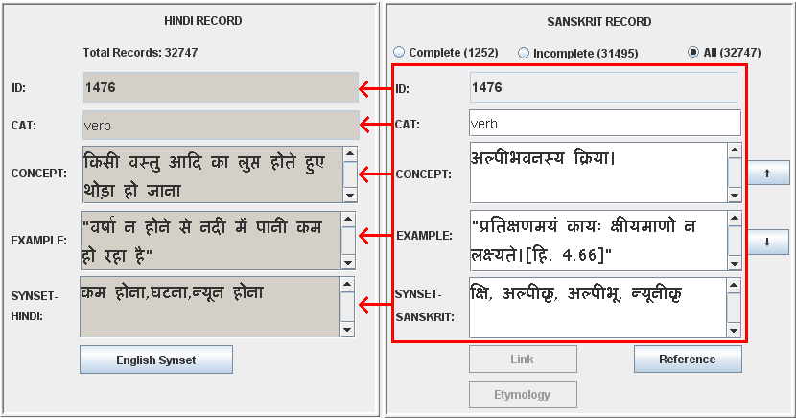
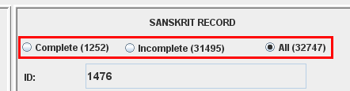
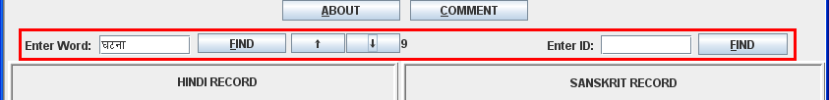
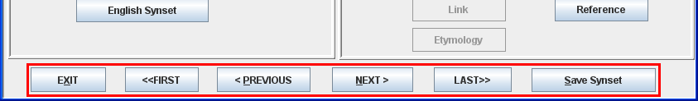
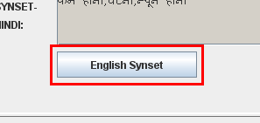
Lexicographers interface
Synset creation in expansion approach
Records of source and target synsets
ID search and word search
Browsing synsets
View English synset in a pop-up window

Slide 17
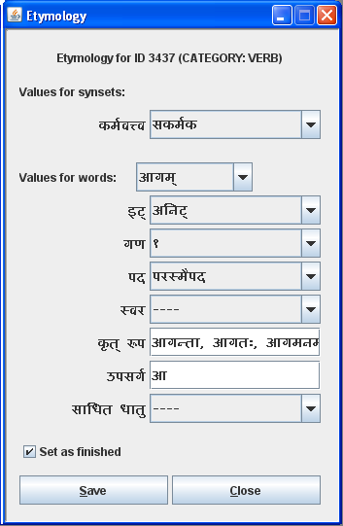

Etymology
Transitivity- Value for entire synset
Values for individual words in the synset
Noun forms derived from the same root
उपसर्ग (prefix) added to the root to modify its sense

Slide 18

Reference
  Reference is added for citing references in concept and example field.
  Example:
"प्रतिक्षणमयं कायः क्षीयमाणो न लक्ष्यते।”
[हि. 4.66]
Text cited from the text हितोपदेश and the reference of the text is 4.66

Slide 19
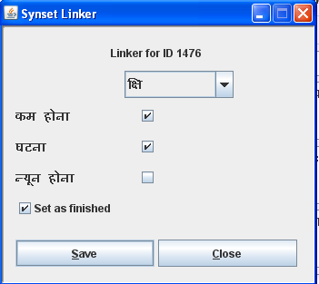
Sanskrit-Hindi Linkage

Slide 20
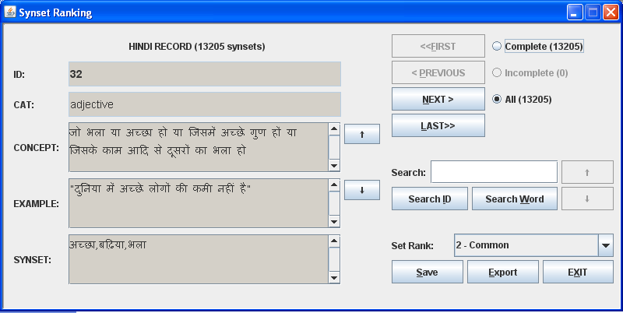
Synset creation in the second phase
Common concepts used in Indian languages are selected from the total Hindi wordnet synsets.
  Selection procedure-
    Stage I- All Hindi wordnet synsets were ranked by 6 language resource persons of Hindi, Marathi, Sanskrit and Kannada.
      >>> 13205 concepts are selected.
    Stage 2
      Group voting
      Online voting
        >>> 10312 concepts are selected.
Synset Ranking tool

Slide 21
तत्सम शब्दs in the synset of बैंगन
  एक फल जिसकी तरकारी बनती है
  “माँ सब्जी बनाने के लिए बैंगन चीर रही है”
  {बैंगन, बैगन, भंटा, भाँटा, शाकबिल्व, शाकबिल्वक, वृंताक, वृन्ताक, नीलवृषा, शाकश्रेष्ठा, वृंताकी, वागुण, वरा, चित्रफला, रक्तकंठ, रक्तकण्ठ, निद्रालु, नीलफला, नटपत्रिका}
  फलविशेषः यः शाकार्थे उपयुज्यते।
  “माता शाकार्थे वार्ताकी उत्कृन्तति।’’
  {वार्ताकी, वङ्गनम्, हिङ्गुली, सिंही, भण्टाकी, दुष्प्रधर्षिणी, वार्ता, वातीङ्गणः, वार्ताकः, शाकबिल्वः, राजकुष्माण्डः, वृन्ताकः, वङ्गणः, अङ्गणः, कण्टवृन्ताकी, कण्टालुः, कण्टपत्रिका, निद्रालुः, मांसफलकः, महोटिका, चित्रफला, कण्चकिनी, महती, कट्फला, मिश्रवर्णफला, नीलफला, रक्तफला, शाकश्रेष्ठा, वृत्तफला, नृपप्रियफलम्}

Slide 22
What is it good for?
  While linking WordNets into the “Indo-WordNet”- a massive semantic structure of Indian language WordNets.
  While linking the Indo WordNet to English and Euro-WordNets.

Slide 23
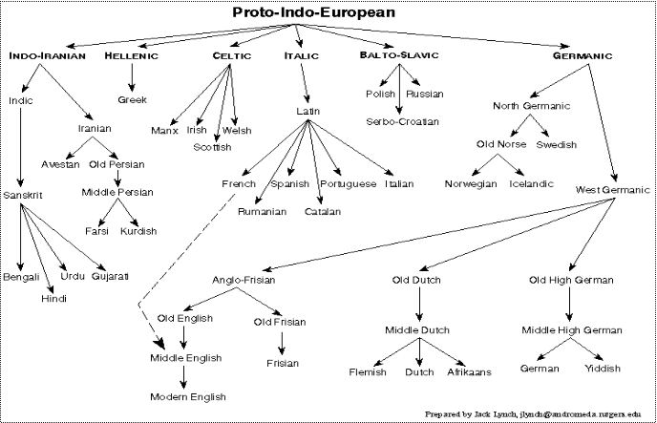

Indo-European

Slide 24
Why Sanskrit Wordnet?
  as one of the oldest Indo-European language can provide basis for the linguistic analysis of modern Indo-European languages.
  as a heritage language needs to preserve the rich lexicon of this language.
  To preserve the traditional culture and knowledge translation of Sanskrit texts is needed
  Sanskrit Wordnet can be of great help in developing Machine aided translations (MAT) system for Sanksrit.
  Text Search facility can be developed using the wordlist of Sanskrit Wordnet.
  Sanskrit has a rich lexical tradition but there is no single reference containing all these lexicas.

Slide 25
Peculiarities
Some times Sanskrit words may not be available for the given concept in the Hindi wordent. For example-
{पूरी,पूड़ी,सोहारी} - खौलते हुए घी,तेल आदि में छानकर बनाया हुआ रोटी की तरह का एक पकवान| "वह पीढ़े पर बैठकर खीर पूरी खा रहा है"
{पाना, रिंच, स्पैनर,स्पेनर} - एक हस्तोपकरण जिससे नट,बोल्ट आदि कसते या खोलते हैं। "श्याम रिंच से नट को कस रहा है”

Slide 26
Issues (2)
But still we do not find any solution for the concepts like –
“महिलामित्र” (girlfriend).
There are modern developments, like modern games which are obviously not captured by Sanskrit vocabulary, like, “चौपड़”, “ताश”, “बादशहा (in the game of cards)”, “बेगम (in the game of cards)” etc.

Slide 27
Issues 2 contd.
In case of चौपड़, we have find follwing description in HWN-
{चौपड़,चौसर,पासा,पाँसा,आकर्ष} एक खेल जो बिसात पर गोटियों से खेला जाता है
This concept is very close to the concept of द्यूत. So we can explain it using this idea like- पणपूर्विका क्रीडा यत्र जयपराजयार्थे जनाः पटे अक्षान् दीव्यन्ति। and can use words (द्यूतः, अक्षः, पाशः)
Similarly we can use “राजा” for बादशहा (in the game of cards), “राज्ञी” for बेगम (in the game of cards)
But some words are neither तत्सम nor तद्भव, i.e. they are borrowed from another language which is historically later than Sanskrit, like “गुलाम”, and “welding”

Slide 28
Meaning Expansion
In the तत्सम words, we see meaning getting expanded historically. Thus the word “सन्धि” which means treaty in Sanskrit is extended to gathering, planetary positions, truce etc. These meanings seem associated with the earlier meaning in Sanskrit but later on extended in Hindi.

Slide 29
Concept divergence
There are some concepts available in Sanskrit which have got an entirely different connotation in Hindi. Thus the concept, “स्त्रीधन” in Sanskrit which connotes the sense, namely, “the wealth of/for a woman” gets diverted in Hindi through the concept of “दहेज” which connotes to the sense namely, “something given by the bride’s parents to the groom” [to make up for deficiency-Dictionary]

Slide 30
Synset of बंदर (monkey)
  Synset: {बंदर:1, बन्दर,बानर,वानर,कीश,कपि,मर्कट,शाखामृग, तरुमृग,हरि,विटपीमृग,माठू,लांगुली,मर्कटक, पारावत,शालावृक,शाला-वृक}
  Concept: वृक्षों पर रहनेवाला एक चंचल स्तनपायी चौपाया
  Example: "भारत में बंदर की कई जातियाँ पाई जाती हैं"
  Synset: {वानरः, कपिः, मर्कटः, प्लवङ्गः, हरिः, शालावृकः, प्लवगः, शाखामृगः, वलीमुखः,, कीशः, वनौकाः,मर्कः, प्लवः, प्रवङ्गः, प्रवगः, प्लवङ्गमः, प्रवङ्गमः, गोलाङ्गुलः, कपित्थास्य, दधिक्षोणः, तरुमृगः, नगाटनः, झम्पी, झम्पारुकलिप्रियः, किखिः}
  स्तनपायी वन्यपशुः यः वृक्षे वसति भ्रमति च।
  "वाली नाम वानरः रामेण हतः।"

Slide 31
Synset of Sun
  Synset: {सूर्य,सूरज, भानु,दिवाकर,भास्कर,प्रभाकर,दिनकर,रवि:1,आदित्य:1,दिनेश,सविता,पुष्कर,मिहिर,अंशुमान,अंशुमाली,अग,अदित,अवि,अनड्वान्,आफ़ताब,आफताब,अफ़ताब,अफताब,अब्जबाँधव,अब्जहस्त,खगपति…………………}
  Concept: हमारे सौर जगत का वह सबसे बड़ा और ज्वलंत पिंड जिससे सब ग्रहों को गरमी और प्रकाश मिलता है
  Example: "सूर्य सौर ऊर्जा का एक बहुत बड़ा स्रोत है/ पूरब से सूर्य को आते देख तिमिर दुम दबाकर भागने लगा"
  {सूर्यः, सविता, आदित्यः, मित्रः, अरुणः, भानुः, पूषा, अर्कः, हिरण्यगर्भः, पतङ्गः, खगः, सहस्रांशुः, दिनमणिः, मरीचि, मार्तण्ड, दिवाकरः, भास्करः, प्रभाकरः, विभाकरः, विवस्वान्, सप्ताश्वः, हरिदश्वः, चित्ररथः, सप्तसप्तिः, दिनमणि, द्युमणिः, दिवामणिः, खमणिः, खद्योतः, प्रद्योतनः, ……………..}
  पृथ्वेः निकटतमः अतितेजस्वी खगोलीयः पिण्डः यस्मिन् परितः पृथ्व्यादिग्रहाः परिभ्रमति तथा च यः आकाशे सुवति लोकम् कर्मणि प्रेरयति च।
  "सूर्ये तपत्यावरणाय दृष्टैः कल्पेत लोकस्य कथं तमित्स्रा"[रघु 5.13]“

Slide 32
Words for SUN in Indian language
  Hindi सूर्य
  Punjabi सूरज
  Urdu आफताब, खुरशीद, मेहर, सूरज
  Kasmiri सिर्यि
  Sindhi सिजु
  Marathi सूर्य
  Gujarati सूर्य
  Bengali सूर्य
  Asameese बेलि, सूर्य
  Oriya सूर्य
  Telugu सूर्युडु
  Tamil सूरियन्
  Malyalam सूर्यन्
  Knnad सूर्य
  Sanskrit सूर्य

Slide 33
Inserting Concepts or glosses in the Sanskrit Wordnet
A combination of the glosses given in dictionaries like Shabdakalpadruma and the translation of the gloss of the Hindi wordnet synset is used to create the Sanskrit synset glosses.
While writing the gloss, complicated सन्धिs sandhis^{[1]} and समासs samAsas (compounds) are avoided.
Whenever lengthy compounds (having 5-6 members) became necessary, the members of the compounds were invariably joined with the hyphen symbol (-) as in: “अन्य-स्थान-संयोगानुकूल-व्यापार meaning the activity that is helpful in reaching a place”
the gloss of a verb in Sanskrit is generally created using technical terms like व्यापार vyApAra ‘action’, जन्य janya ‘produced,’ अनुकूल anukUla ‘helpful,’ etc
[1] Phonological conjoining

Slide 34
Future work
Use of ontology of नव्य-न्याय (Navya-NyAya)
  The traditional Sanskrit Texts on Philosophy as well as Medicine contain various discussions on ontological categories and hierarchies.
  These texts are closely related to the grammar of the Sanskrit Language.
  The comparison of these ontological structures and hierarchies to the existing one coming from the Hindi wordnet may shed light on new Indowordnet specific issues.
धातु (dhAtu) based WN
  There are theories in Sanksrit texts which adhere to the view that all nouns are derived from verbal roots.
  There is a need to test this theory and build a lexical structure where all the verbal roots will be at the nodal level with connected nouns at the leaf level.
    [A brief introduction of this is available in (Vrbal roots in the Sanskrit Wordnet Kulkarni and Bhattacharyya, 2009). ]

Slide 35
Financial & Technical Details

Slide 36
Financial Details upto 30.6.2010
Expense Head | Amount Received | Amount Spent | Projected Amount for next year
Pay & Allownces | 480000 | 692100 | 1000000
TADA | 115000 | 117555 | 200000
Equipment | 100000 | 110300 | 200000
Contingency | 100000 | 98069 | 150000
Consumable | 25000 | 17451 | 50000
Books | 50000 | 32316 | 100000
Overheads | 130000 | 130000 | 255000
Total | 1000000 | 1197791 | 1955000
Balance Avaliable as on 30th June 2010 (-1,97,791)

Slide 37
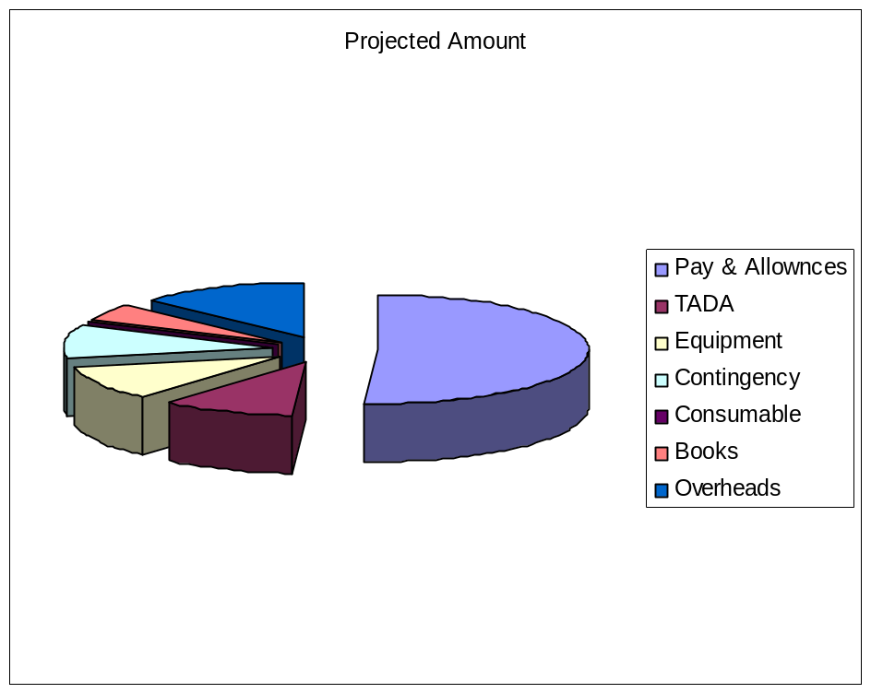
Plan for next one year
Month/Progress | 3 | 6 | 9 | 12
No. of Synset | 7000 | 9400 | 11800 | 14200
Evaluation Method | Internal | Internal | Internal | External
Manpower Required | 4 | 4 | 4 | 4

Slide 38
Research Component
‘Introduction to Sanskrit WordNet’ in the GWC, IITB, 2010.
‘Gloss in Sanskrit WordNet’- Paper to be presented at 4th Sanskrit Computational Linguistics Symposium, JNU, Dec.2010.

Slide 39
Internal Evaluations
In October 2009- by lexicographers
In April 2010- again by lexicographers
Ph.D. Students of Sanskrit at IITB doing constant evaluation.
In the process of Synset ranking, evaluation is done in contact with other language groups.

Slide 40
Extension Activities
Synset Ranking- according to the newly developed 6 fold synset category system
Two Workshops- Koimbatore(2009), Shillong(2010)
Lectures delivered- at University of Tempere (Finland), University of Lausanne(Switzerland), Uni. Of Hyd etc.

Slide 41
अनुगृहीताः स्मः।

