Slide 1


Sanskrit WordNet
Dr. Malhar Kulkarni,
Sanskrit WordNet Group, IITB.

Slide 2
Yogyataa
Compatibility/ adaptability
hariH shashaM bhakshayati/ (Hari eats a rabbit)
Who is Hari?
A lion or a monkey or Lord Vishnu?
The yogyataa principle tells that he is lion and not any other option.

Slide 3
What is WordNet?
WordNet is a system for bringing together different lexical and semantic relations between the words in a particular language.
It organizes the lexical information in terms of word meanings and can be termed as a lexicon based on psycholinguistic principles.
Words are grouped together according to their similarity of meanings.
Two words that can be interchanged in a context are synonymous in that context. For each word there is a synonym set, or synset representing one lexical concept .
This is done to remove ambiguity in cases where a single word has multiple meanings.

Slide 4
Wordnet database
Synsets- Synsets are the basic building blocks of WordNet. It is a set of synonymous words. For example, “विद्यालय, पाठशाला, स्कूल” (vidyaalay, paaThshaalaa, skuul) represents the concept of school as an educational institution. The words in the synset are arranged according to the frequency of usage.
  Fields:
    Gloss:
      Concept: It describes the lexical concept. It explains the concept denoted by the synset.
      Example: It gives the usage of the words in the sentence. Generally, the words in a synset are replaceable in the sentence.
    ID: For computer implementation of all the synsets by creating one-to-one relationship between the ID numbers and the lexical concept to disambiguate the senses of any given word.

Slide 5
Initial Wordnet- A semantic database of English In the middle of 1980s at Princeton University (prof.G.A.Miller, dr. Ch.Fellbaum)
  http://www.cogsci.princeton.edu/~wn/
Multilingual database EuroWordNet for 8 languages was created in 1996 – 1999
  Dutch, Spanish, Italian, English, Czech, German, French and Estonian
  http://www.illc.uva.nl/EuroWordNet/
Global WordNet Association
  http://www.globalwordnet.org/

Slide 6
Indian Languages
Hindi Wordnet – CFILT, IIT Bombay
Marathi Wordnet – CFILT, IIT Bombay
Tamil WordNets - AU-KBC and Tanjavur University
Telugu Wordnet-
North-East Wordnet

Slide 7
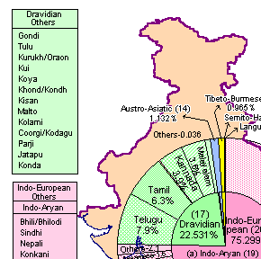
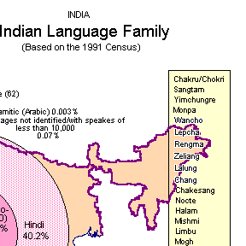
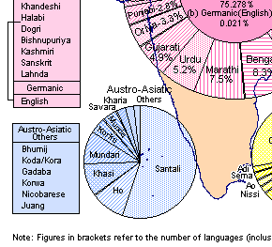
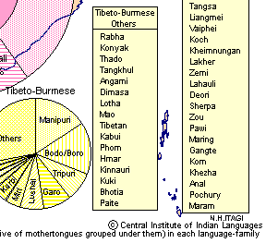

Slide 8
Population of Language Speakers (2001 census)
Sanskrit: 6,106
Hindi: 422,048,642 [41.03%]
Marathi: 71,936,894 [6.99%]
Telugu: 74,002,856 [7.37%]
Tamil: 60,793,814 [5.91%]
Malayalam: 33,066,392 [4.21%]
Kashmiri: 5,527,698
Nepali: 13,168,484 [1.28%]
Konkani: 2,489,015 [0.24%]
Meitei (Manipuri): 1,466,705 [0.14%]
Assamese : 13,168,484 [1.28%]
Bodo: 1,350,478 [0.13%]

Slide 9
Sanskrit Language
Historical Indo-Aryan language
One of the 22 official languages of India
Liturgical languages of Hinduism and Buddhism
3 main periods in the development of Sanskrit language-
  Vedic Sanskrit –
    oldest attested language of the Indo-Iranian branch of the Indo-European family
    oldest core dating back to as early as 1500 BCE
    evolved into Classical Sanskrit by the sixth century BC
  Classical Sanskrit –
    For nearly 2,000 years
    A significant form of post-Vedic Sanskrit
  Modern Sanskrit

Slide 10
Modern Indo-Aryan languages began to develop around the end of first millennium A.D.
According to Chatterji, roughly 50% words of a modern Indo-Aryan languages are borrowed from Sanskrit either as तत्सम दी Semi-तत्सम.
Yet Sanskrit remained an important language of literate tradition and this is evident from the 3 types of word which every modern Indo-Aryan language possesses-
  तद्भव- words which have developed from Sanskrit from middle Indo-Aryan to modern Indo-Aryan. e.g. Hindi हाथ from Sanskrit हस्त “hand”.
  तत्सम- words which are directly borrowed from Sanskrit, e.g., Hindi हस्त denoting “hand, autograph”
    Semi-तत्सम- A तत्सम word which was introduced at an early stage and underwent a similar change as तद्भव, .., Bengali sroddhā, a semi-तत्सम word cheddhā and a तद्भव word sādh. (Chatterji )
  देशी – Words of Indian but non- Indo-Aryan origin (Sometimes od Dravidian or Munda origin).

Slide 11
Dravidian Languages
Although Dravidian languages are not Indo-European, the terms तत्सम, semi-तत्सम and तद्भव are used to denote respectively unmodified and modifed Sanskrit words introduced into the Dravidian
  Tamil-least Sanskritaized but According S.A. Pillai there are 54 Sanskrit Words in the Tolkappiyam.
  The other main languages, Telugu, Kannada and Malyayam, contain exceedingly large percentage of Sanskrit words or words of Sanskrit origin, possibly well over 50%.
  Apart from that, there is a considerable Dravidian influence on Sanskrit and therefore, a Sanskrit word of Dravidian origin to be adopted into Dravidian again. According to Collins, the word पूजा provides an example of this kind of migration

Slide 12
तत्सम and तद्भव Concepts in modern Indo-Aryan languages
Apart from linguistic in terms of borro Sanskrit words in modern Ind-Aryan languages, we also notice the similar process in the Indian cultural history.
Linguistic तत्सम-तद्भव distinction is easy to analyze but it is difficult to show the same in the cultural and conceptual history of India.
  One obvious example is- extension of Sanskritic deities and ritual forms to an outlaying group – Sanskritic deities assume different forms in their travels all over India and local deities assuming Sanskritc labels and forms.
    For example- Vedic Deity क्षेत्रपाल becomes Kētrappa in Coorg, whereas the local cobra-deity becomes identified with सुब्रमण्य, the warrior son of शिवा.

Slide 13
Sanskrit Wordnet

Slide 14
Expansion Approach
Take synsets of Hindi Wordnet and prepare Sanskrit synset for that lexical concept.
No separate ID creation at initial stage.
No change in Ontology nodes.
No change in Part of Speech.

Slide 15
Benefits of Expansion Approach
Ontology nodes will be captured automatically.
Saves time and man-power.
Synset-linkage is fast.
Concepts common to only Sanskrit Language will have high range.

Slide 16
SWN: Lexical resources
शब्दकल्पद्रुम
वाचस्पत्यम्
Monier Williams
Apte’s Sanskrit-Hindi Dictionary
Naravane’s भारतीय व्यवहार कोश
Apte’s Sanskrit-Hindi Kosh

Slide 17
Structure of the lexical entries in Sources:
शब्दकल्पद्रुम and वाचस्पत्यम्:
  Lexical entry;
  Gender; (omitted because the words are inserted in the first case-ending, so it is easy to recognize the gender of a word from that. Words that are used in all the three genders are inserted as 3 different words. )
  Etymology (sometimes with Panini’s rules)
  Concept
  Synonyms
  Examples

Slide 18
Information used in SWN from शब्दकल्पद्रुम and वाचस्पत्यम्
Synonyms
Concepts (mostly with some modifications to make it clear and additional information is included from Wikipedia etc online sources),
Examples---
  If sentence is complete
  if the sentence is simple
  if it can be understood without mentioning the context
  if the subject of the example is well-suited (Avoiding sensuous examples)
Etymology

Slide 19
Monier Williams:
  Useful in cross-checking Hindi-English synset mapping.
  Useful in distinguishing tree/plant names from the names of grains.

Slide 20
High frequency words and most common words
A list of high frequency words
  Amba Kulkarni (UoH) has provided the list of high frequency words in Sanskrit.
  List contains 8338 words
A list of most common words in Indian languages
  Naravane’s भारतीय व्यवहार कोश
Word list based on रामायण and महाभारत (http://indology.info/ )

Slide 21
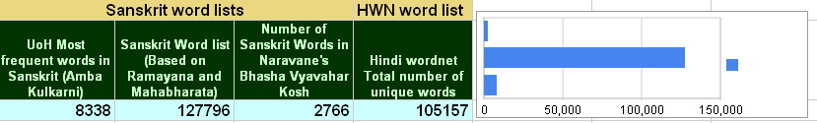

Slide 22
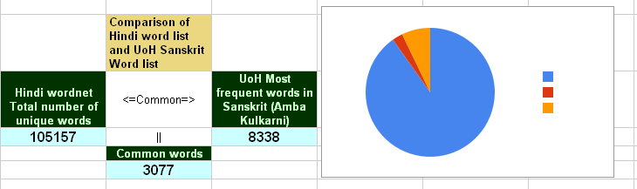
Comaprison of HWN wordlist and Sanskrit wordlist

Slide 23
SWN Work report
Number of completed synsets 1700+
Number of unique words 6977
Number of entries with Etymology field 100
Normal range of number of words in any synset is 1-20
    वृद्धः (20), लीला (20), भक्षणम् (20)
One word synset are common in the cases of-
      Coined words
      Words for instruments
      relations
Synsets having high number of words
    Names of Gods – विष्णुः (127), सोमः(120), युद्ध (99), सूर्यः (85), समुद्र (70), द्युतिमत् ADJ (246)

Slide 24
Additional features of SWN
Etymology.
Storing additional information for morph analyzer.
Reference.

Slide 25
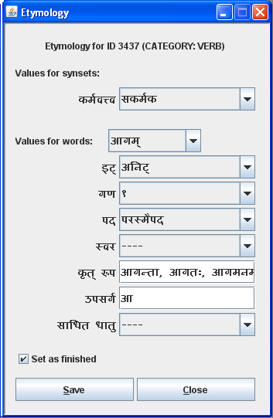
Etymology
Transitivity- Value for entire synset
Values for individual words in the synset
Noun forms derived from the same root
उपसर्ग (prefix) added to the root to modify its sense

Slide 26
Reference
Reference is added for citing references in concept and example field.
Example:
"प्रतिक्षणमयं कायः क्षीयमाणो न लक्ष्यते।”
[हि. 4.66]
Text cited from the text हितोपदेश and the reference of the text is 4.66

Slide 27
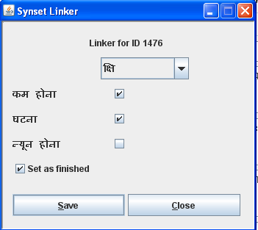
Sanskrit-Hindi Linkage

Slide 28
What is it good for?
While linking WordNets into the “Indo-WordNet”- a massive semantic structure of Indian language WordNets.
While linking the Indo WordNet to English and Euro-WordNets.

Slide 29
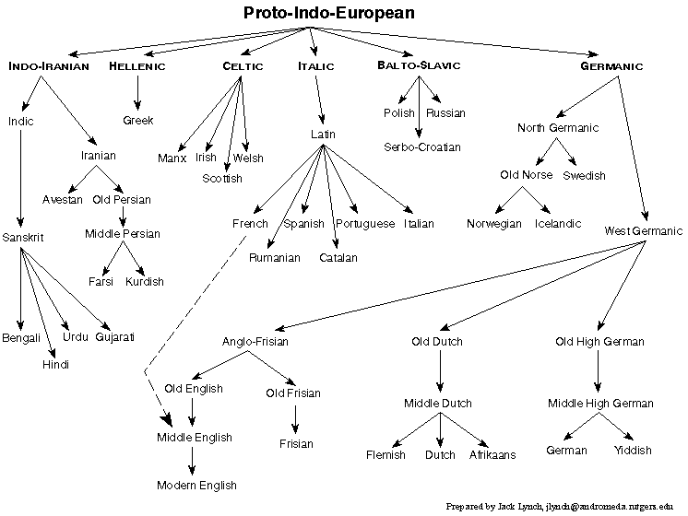
Indo-European

Slide 30
Issues arising (1)
Some times Sanskrit words may not be available for the given concept in the Hindi wordent. For example-
  {पूरी,पूड़ी,सोहारी} - खौलते हुए घी,तेल आदि में छानकर बनाया हुआ रोटी की तरह का एक पकवान| "वह पीढ़े पर बैठकर खीर पूरी खा रहा है"
  {पाना, रिंच, स्पैनर,स्पेनर} - एक हस्तोपकरण जिससे नट,बोल्ट आदि कसते या खोलते हैं। "श्याम रिंच से नट को कस रहा है”

Slide 31
Our strategy to handle issue 1
Similar concept which was already there in Sanskrit and which can be used for “पूरी” in extended. For example-
  {अपूपः, पिष्टकः} - तैलघृतादिषु भर्जितः पिष्टस्य मिष्टान्नविशेषः यः न पूयते विशीर्य्यति वा। "मालायै अपूपाः बहू रोचन्ते।”
In case of पाना, as it was invented in the modern times, the words are not readily available. In such cases we follow following strategy-
  Search for a word in the Dictionaries for technical terminology prepared by either Maharashtra Govt. or Indian Government.
  If the word is not available the we search in the Spoken Sanskrit Dictionary which includes newly coined words by the Sanskrit speaking people.
  If we do not find a word in the Spoken Sanskrit dictionary then we search for a verb which is close the describe the concept and use a suffix in the sense of करण as पाना is instruement.
  For example- परिमा means “to span to” and तीव्राकुञ्चनं कृत्वा आकर्ष् means “to wrench”. So in this way we can describe the concept of पाना in Sanskrit using these two verbs like तद् उपकरणं येन कीलः परिमाय तीव्राकुञ्चनेन आकृष्यते। and as the action of wrenching is more prominent, we can form a word आकर्षः for Hindi concept of पाना.

Slide 32
Issues (2)
But still we do not find any solution for the concepts like –
“महिलामित्र” (girlfriend).
There are modern developments, like modern games which are obviously not captured by Sanskrit vocabulary, like, “चौपड़”, “ताश”, “बादशहा (in the game of cards)”, “बेगम (in the game of cards)” etc.

Slide 33
In case of चौपड़, we have find follwing description in HWN-
  {चौपड़,चौसर,पासा,पाँसा,आकर्ष} एक खेल जो बिसात पर गोटियों से खेला जाता है
  This concept is very close to the concept of द्यूत. So we can explain it using this idea like- पणपूर्विका क्रीडा यत्र जयपराजयार्थे जनाः पटे अक्षान् दीव्यन्ति। and can use words (द्यूतः, अक्षः, पाशः)
  Similarly we can use “राजा” for बादशहा (in the game of cards), “राज्ञी” for बेगम (in the game of cards)

Slide 34
Contd.
But some words are neither तत्सम nor तद्भव, i.e. they are borrowed from another language which is historically later than Sanskrit, like “गुलाम”, and “welding”

Slide 35
Meaning Expansion
In the तत्सम words, we see meaning getting expanded historically. Thus the word “सन्धि” which means treaty in Sanskrit is extended to gathering, planetary positions, truce etc. These meanings seem associated with the earlier meaning in Sanskrit but later on extended in Hindi.

Slide 36
Meaning contraction
The meaning of the तत्सम word gets contracted in Hindi. Thus the word “वशीकृत” which means in Sanskrit, “to have control over something which was not under control” gets limited scope in Hindi and a negative one at that. It is recorded to mean “to control someone with the help of मन्त्र and तन्त्र”

Slide 37
Concept divergence
There are some concepts available in Sanskrit which have got an entirely different connotation in Hindi. Thus the concept, “स्त्रीधन” in Sanskrit which connotes the sense, namely, “the wealth of/for a woman” gets diverted in Hindi through the concept of “दहेज” which connotes to the sense namely, “something given by the bride’s parents to the groom”[to make up for deficiency-Dictionary]

Slide 38
Synset of बंदर (monkey)
Synset: {बंदर:1, बन्दर,बानर,वानर,कीश,कपि,मर्कट,शाखामृग,तरुमृग,हरि,विटपीमृग,माठू,लांगुली,मर्कटक,पारावत,शालावृक,शाला-वृक}
Concept: वृक्षों पर रहनेवाला एक चंचल स्तनपायी चौपाया
Example: "भारत में बंदर की कई जातियाँ पाई जाती हैं"
{वानरः, कपिः, मर्कटः, प्लवङ्गः, हरिः, शालावृकः, प्लवगः, शाखामृगः, वलीमुखः,, कीशः, वनौकाः,मर्कः, प्लवः, प्रवङ्गः, प्रवगः, प्लवङ्गमः, प्रवङ्गमः, गोलाङ्गुलः, कपित्थास्य, दधिक्षोणः, तरुमृगः, नगाटनः, झम्पी, झम्पारुकलिप्रियः, किखिः}
स्तनपायी वन्यपशुः यः वृक्षे वसति भ्रमति च।
"वाली नाम वानरः रामेण हतः।"

Slide 39
Synset of Sun
Synset: {सूर्य,सूरज, भानु,दिवाकर,भास्कर,प्रभाकर,दिनकर,रवि:1,आदित्य:1,दिनेश,सविता,पुष्कर,मिहिर,अंशुमान,अंशुमाली,अग,अदित,अवि,अनड्वान्,आफ़ताब,आफताब,अफ़ताब,अफताब,अब्जबाँधव,अब्जहस्त,खगपति…………………}
Concept: हमारे सौर जगत का वह सबसे बड़ा और ज्वलंत पिंड जिससे सब ग्रहों को गरमी और प्रकाश मिलता है
Example: "सूर्य सौर ऊर्जा का एक बहुत बड़ा स्रोत है/ पूरब से सूर्य को आते देख तिमिर दुम दबाकर भागने लगा"
{सूर्यः, सविता, आदित्यः, मित्रः, अरुणः, भानुः, पूषा, अर्कः, हिरण्यगर्भः, पतङ्गः, खगः, सहस्रांशुः, दिनमणिः, मरीचि, मार्तण्ड, दिवाकरः, भास्करः, प्रभाकरः, विभाकरः, विवस्वान्, सप्ताश्वः, हरिदश्वः, चित्ररथः, सप्तसप्तिः, दिनमणि, द्युमणिः, दिवामणिः, खमणिः, खद्योतः, प्रद्योतनः, ……………..}
पृथ्वेः निकटतमः अतितेजस्वी खगोलीयः पिण्डः यस्मिन् परितः पृथ्व्यादिग्रहाः परिभ्रमति तथा च यः आकाशे सुवति लोकम् कर्मणि प्रेरयति च।
"सूर्ये तपत्यावरणाय दृष्टैः कल्पेत लोकस्य कथं तमित्स्रा"[रघु 5.13]“

Slide 40
Words for SUN in Indian language
Hindi सूर्य
Punjabi सूरज
Urdu आफताब, खुरशीद, मेहर, सूरज
Kasmiri सिर्यि
Sindhi सिजु
Marathi सूर्य
Gujarati सूर्य
Bengali सूर्य
Asameese बेलि, सूर्य
Oriya सूर्य
Telugu सूर्युडु
Tamil सूरियन्
Malyalam सूर्यन्
Knnad सूर्य
Sanskrit सूर्य

Slide 41
Example Synset of Verb
Synset: {आना:1, पहुँचना,पहुंचना,पधारना,अवना,आगमना}
Concept: एक स्थान से आकर दूसरे स्थान पर उपस्थित होना
Example: "श्याम आज आएगा / वह आज ही दिल्ली पहुँचा"
{आगम्, अभ्यागम्, उपागम्, समुपागम्, अभिगम्, उपगम्, अनुपद्, प्रेष्, लिश्, आया, समाया, उपाया, अभिया, उपस्था, समुपस्था, ए, आव्रज्, अभिपद्, अभिऋ, उपक्रम्, अभिवृत्, विसृ,}
अन्य-स्थान-वियोग-पूर्वकः अन्य-स्थान-संयोगानुकूल-व्यापारः।
पञ्चवादने बालकः पाठशालातः गृहम् आगच्छति।

Slide 42
Thank You.

