Slide 1
Python Installation

Slide 2
Topics
Install Python
Python Documentation

Slide 3
Install Python

Slide 4
Open a Web browser and go to https://www.python.org/downloads/ to download the latest release of Python for different Operating Systems. Such as
Windows
Unix/Linux
macOS
Other Platforms
Windows Installation:
Here are the steps to install Python on Windows machine.
Visit the link https://www.python.org/downloads/windows/ to download the latest release of Python for Windows.
In this process, we will download and install Python 3.9.6 on our Windows operating system. Download Python for 32- or 64-bit OS.
Download Python 3.9.6 Windows installer (64-bit).
Download Python 3.9.6 Windows installer (32-bit).
After downloading Python Windows installer file, follow the steps to complete installation.

Slide 5
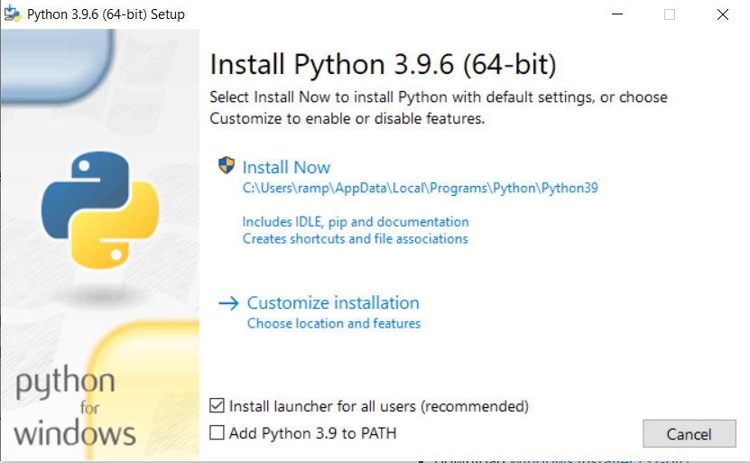
Step 1: Run the downloaded windows installer(python-3.9.6-amd64.exe) file. This brings up the Python install wizard as shown below.

Slide 6
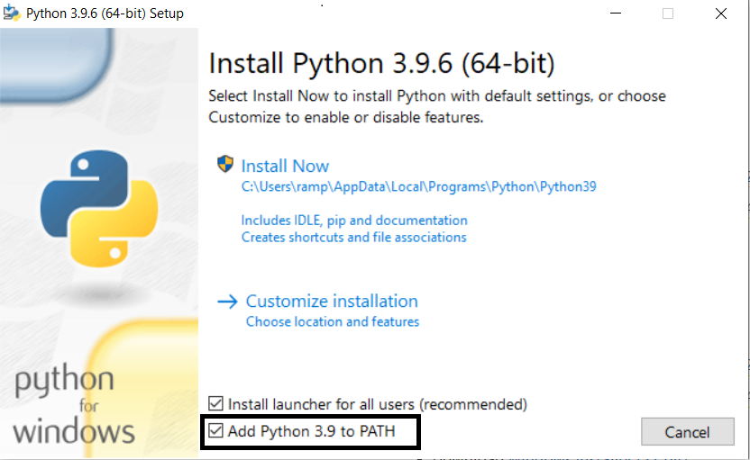
Step 2: Click on Add Python 3.9 to PATH check box, it will set the Python path automatically.

Slide 7
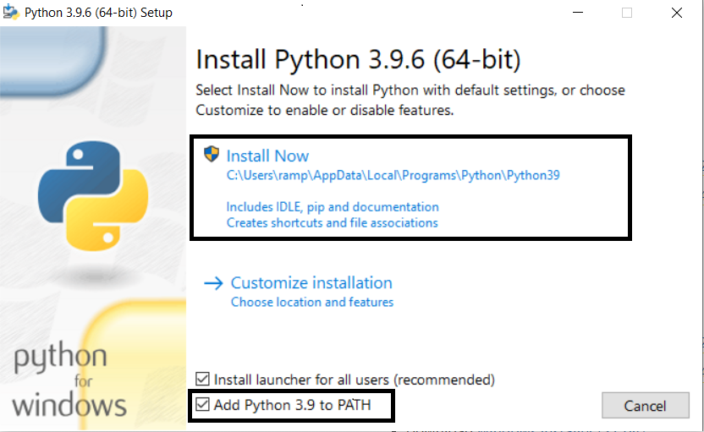
Step 3: Click on Install Now option.

Slide 8
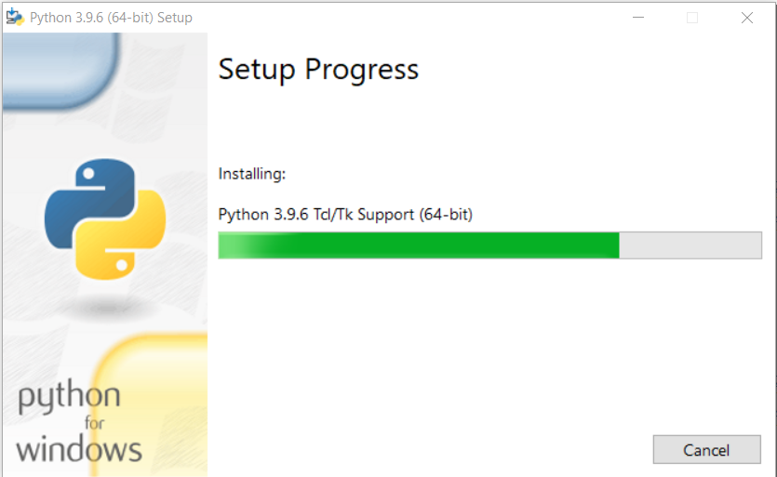
Step 4: Now the installation is in progress, wait until the installation is finished

Slide 9
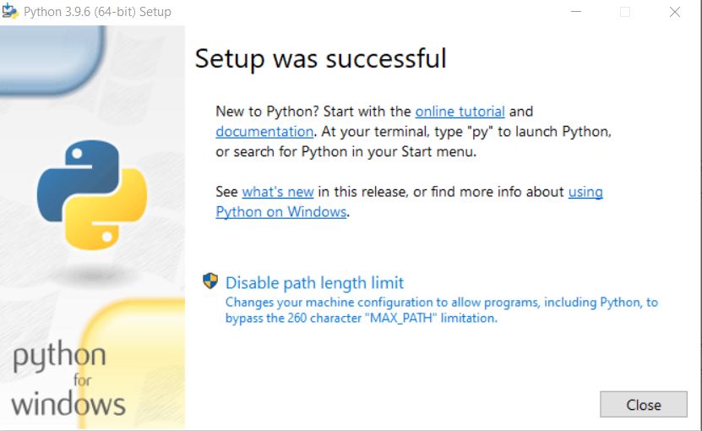
Step 5: Installation is finished and close the install wizard.

Slide 10
Running Python

Slide 11
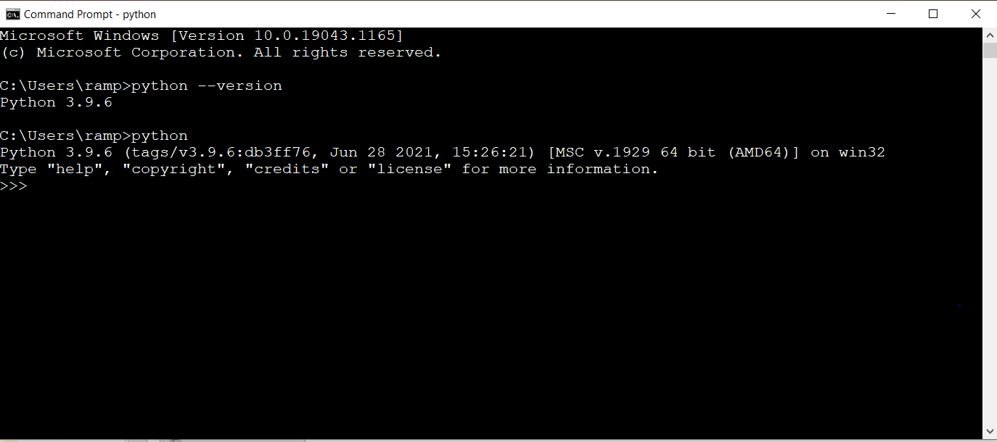
In order to run Python, we need to verify if Python is successfully installed or not.
Step 1: Open the Command Prompt and type “python --version” or “python”.

Slide 12
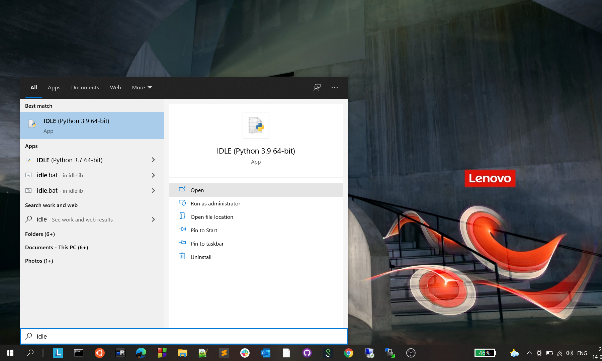
Step 2: Click on the start menu and search for IDLE as shown below.

Slide 13
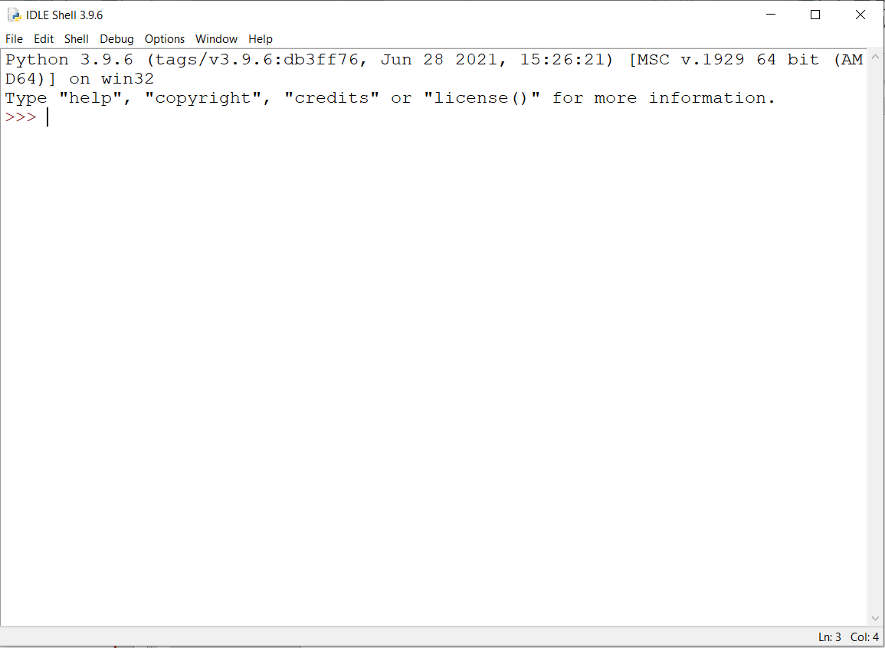
Step 3: when you open IDLE, a window will be opened which is known as Python Shell or Interpreter as shown below.

Slide 14
Python Documentation

Slide 15
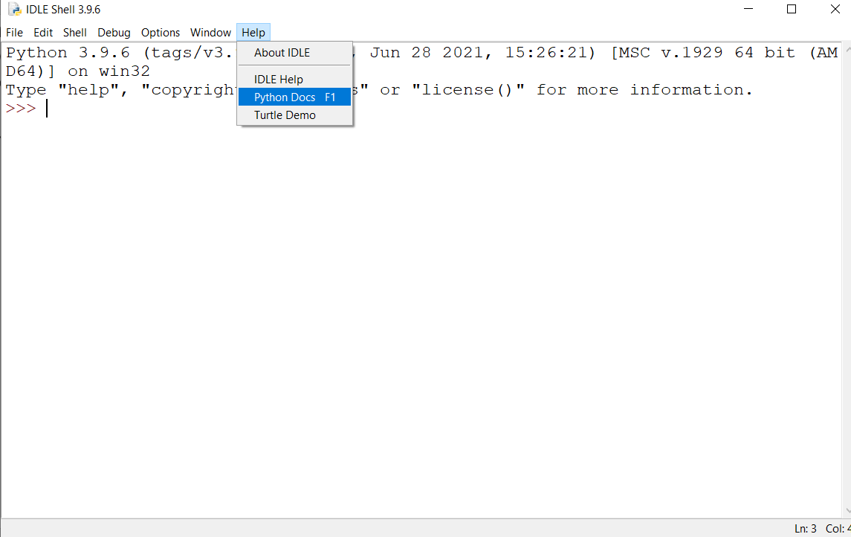
Open a Web browser and go to https://www.python.org/doc/ to browse or download the latest Python documentation.
To browse the documentation visit https://docs.python.org/3/
To download the documentation visit https://docs.python.org/3/download.html
You can also browse documentation from Python Shell as shown below.

