Slide 1
Accelerated and Accurate Alignment of Short Reads in High Throughput Next Generation Sequencing [NGS] Platforms
Santhi Natarajan (Research Scholar, CeNSE)
Advisors : Prof. Debnath Pal (CDS), Prof. S. K. Nandy (CDS)
Indian Institute of Science, Bangalore

Slide 2
Contents
Genome: The Secret Code of Life
Short Read Mapping: What we have?
Short Read Mapping: What we need?
Our Architecture
Our Prototypes: Results and Scalability Analysis
Putting it Altogether………..
“It is far more important to know what person the disease has than what disease the person has.” – Hippocrates

Slide 3
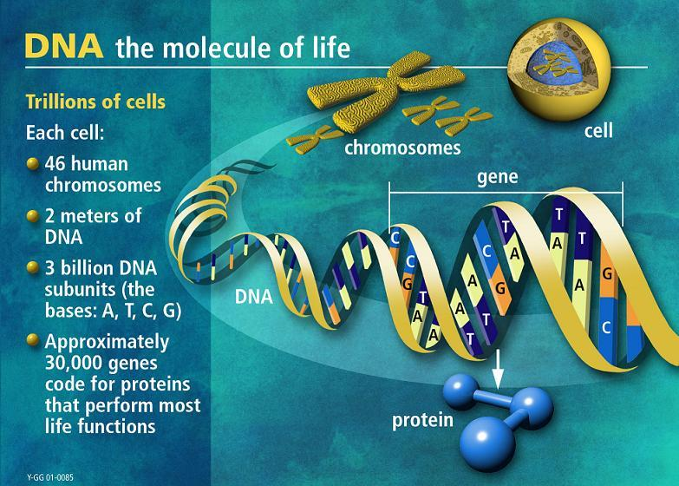
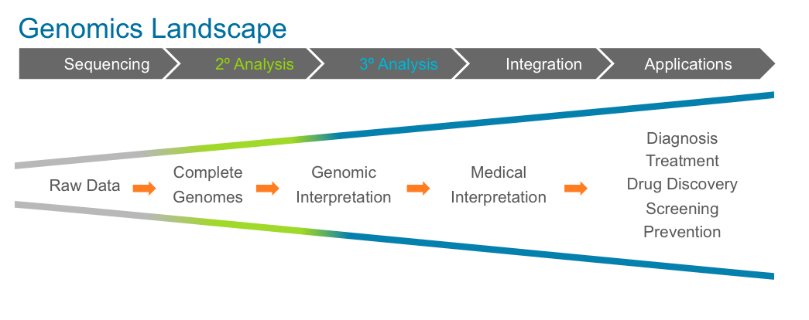
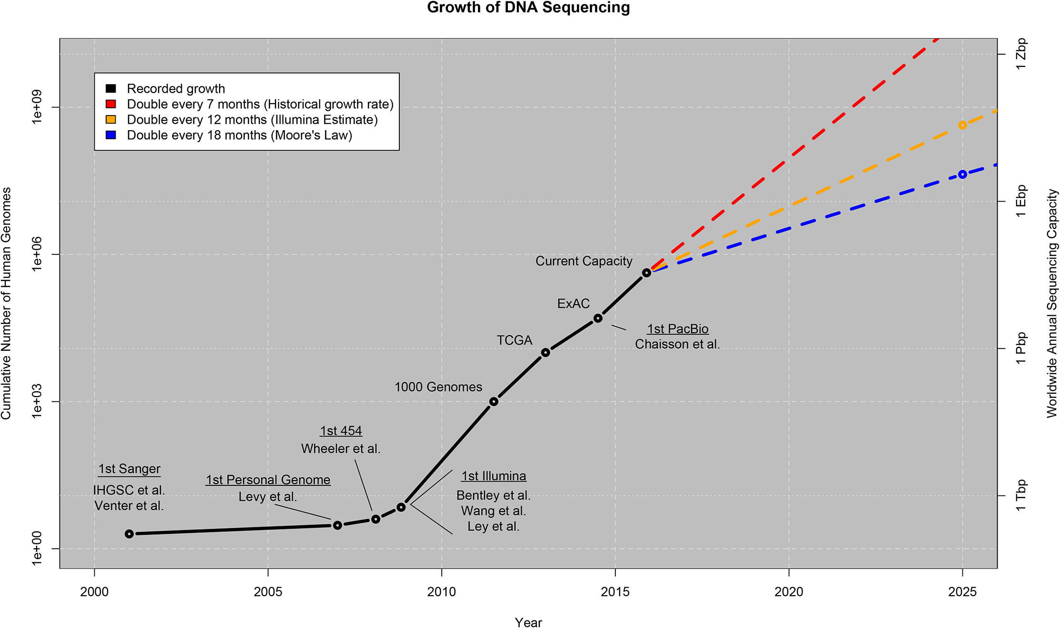
Genome: The Secret Code of Life
Genome Big Data Engineering
Scalability
Data Storage
performance
Data Transfer
Data Security
Ethical Values
Notes:
Snippet 1: short read mapping, massiveness of the problem, address time, performance and accuracy
Snippet 2: existing solutions, lack of standardization due to heuristics
Snippet 3: portability of the SRM model being offered, in all stages of NGS data flow

Slide 4
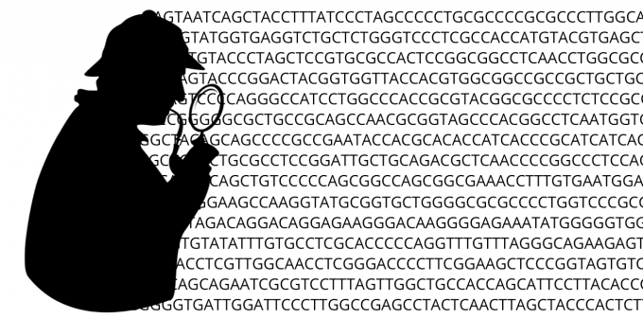


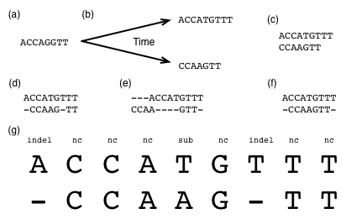
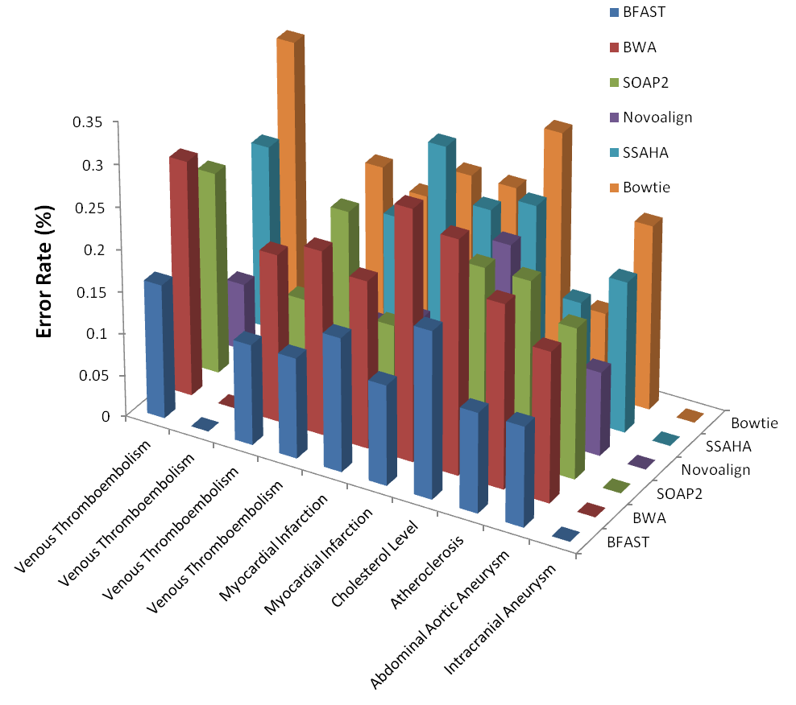
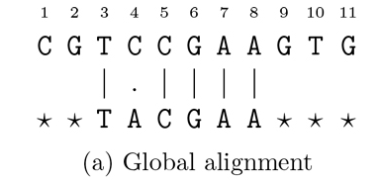
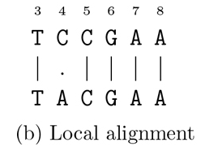
Short Read Mapping (SRM): What we have ?
Approximate String Matching
Error rate = Error in X positions per 100 aligned bases
Popular Heuristic Aligners
Genomic Data from Diseases
Notes:
Snippet 1: short read mapping, massiveness of the problem, address time, performance and accuracy
Snippet 2: existing solutions, lack of standardization due to heuristics
Snippet 3: portability of the SRM model being offered, in all stages of NGS data flow

Slide 5



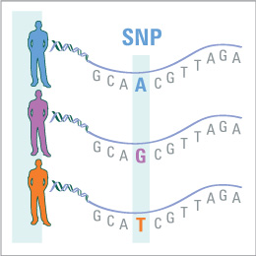




SRM: What we need?
Accuracy with Precision
Problem Statement:
If the reference genome is very large, and if there are billions of short reads, how accurately can we align the reads to the genome, guaranteeing precision and performance?
Resolution

Slide 6
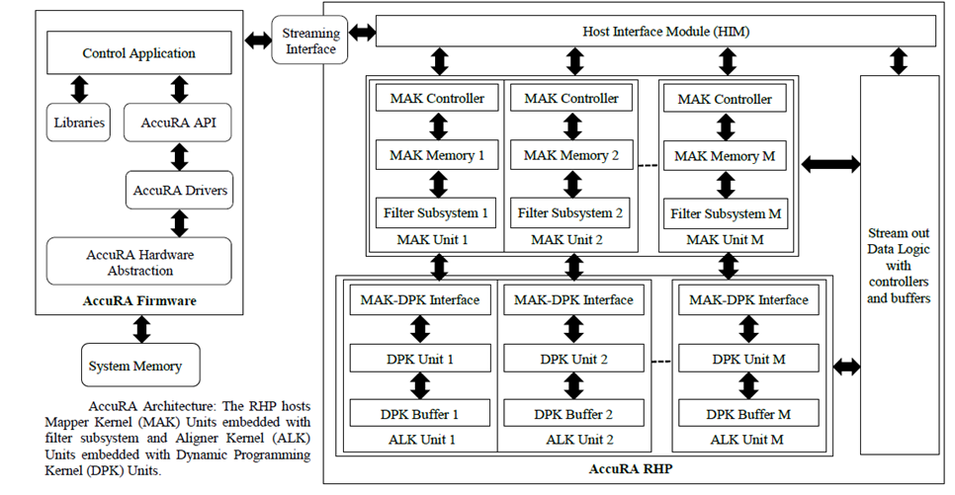
AccuRA: Accurate Alignment of Short Reads on Scalable Reconfigurable Accelerators

Slide 7
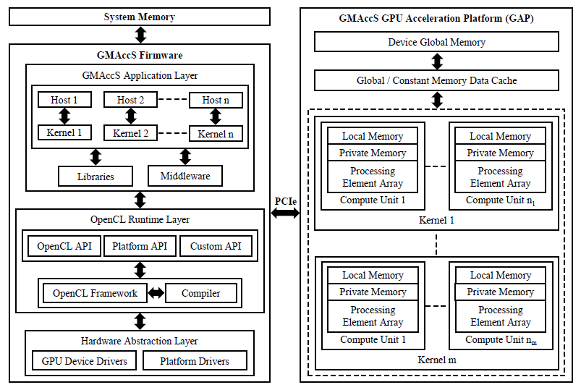
GMAccS: A Scalable GPGPU Model for
Accurate Alignment of Short Reads

Slide 8
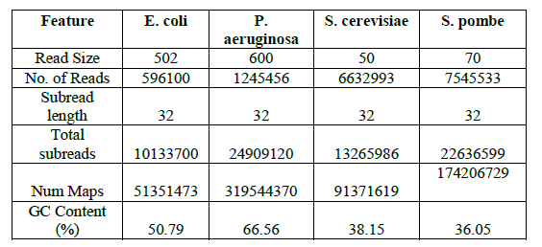
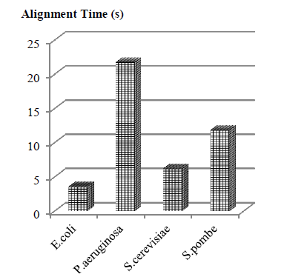
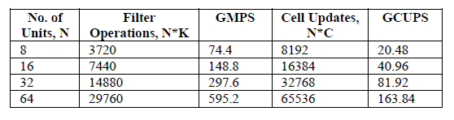
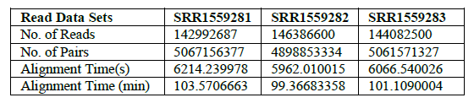
AccuRA Prototype: Performance and Scalability Analysis

Slide 9
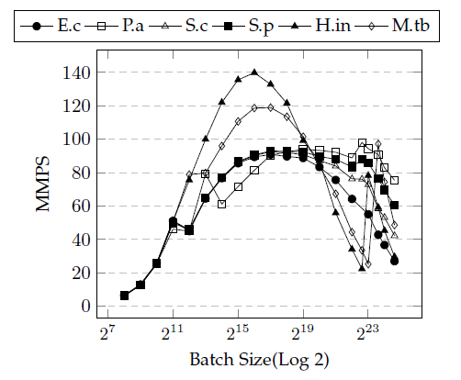
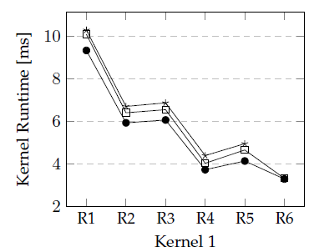
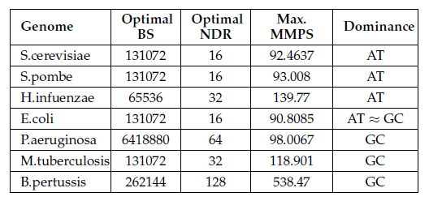
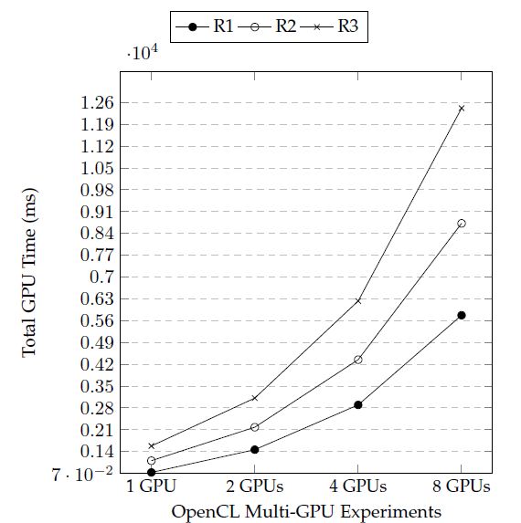
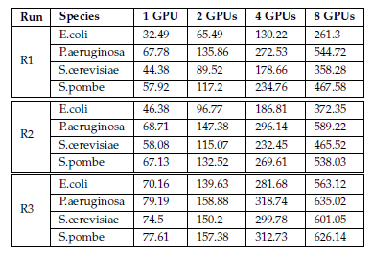
GMAccS Prototype: Performance for Small Genome Benchmarks

Slide 10
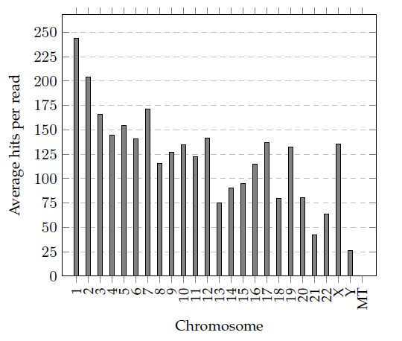
GMAccS Prototype: Performance and Scalability Analysis for Human Genome Benchmarks

Slide 11
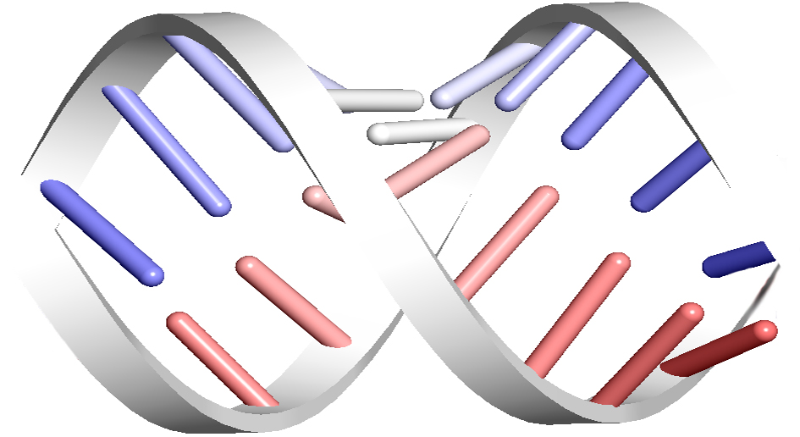

Putting it Altogether……..
SRM Value Propositions
Handling repeats and multi-read alignments
Calculating the Delta: How insufficient are our reference genomes?
Can SRM model be more domain aware?
The big picture
A peep beyond genomics
The Road Ahead
HARDWARE ACCELERATOR FOR ALIGNMENT OF SHORT READS IN SEQUENCING PLATFORMS
MAPPING OF SHORT READS IN SEQUENCING PLATFORMS
DATA STREAMING IN HARDWARE ACCELERATOR FOR ALIGNMENT OF SHORT READS
Endless Life: Commercial Venture

Slide 12
Thank You

